Slide 1
Artificial Neural Networks
鮑興國 Ph.D.
National Taiwan University of
Science and Technology

Slide 2
Outline
Perceptrons
Gradient descent
Multilayer Feedforward networks
Backpropagation
Hidden layer representations
Examples
Advanced topics

Slide 3
What is an Artificial Neural Network?
It is a formalism for representing functions inspired from biological learning systems
The network is composed of parallel computing units which each computes a simple function
Some useful computations taking place in Feedforward Multilayer Neural Networks are
  Summation
  Multiplication
  Threshold (e.g., 1/(1 + e^{-x}), the sigmoidal threshold function). Other functions are also possible

Slide 4
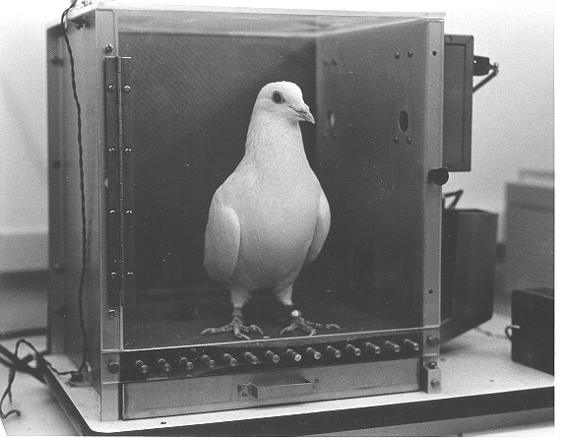
Pigeons as art experts
Pigeons as art experts (Watanabe et al. 1995)
Experiment:
Pigeon in Skinner box
Present paintings of two different artists (e.g. Chagall / Van Gogh)
Reward for pecking when presented a particular artist (e.g. Van Gogh)

Slide 5
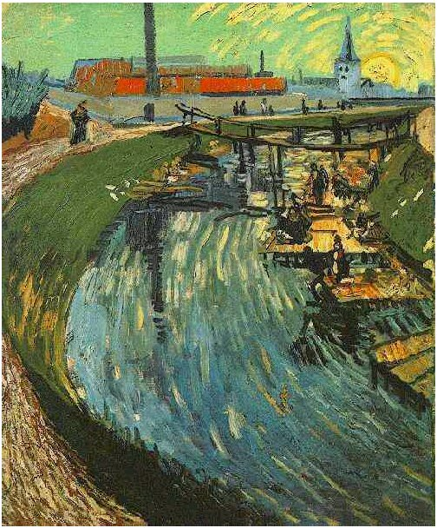
Notes:
Canal with Women Washing, 1888

Slide 6
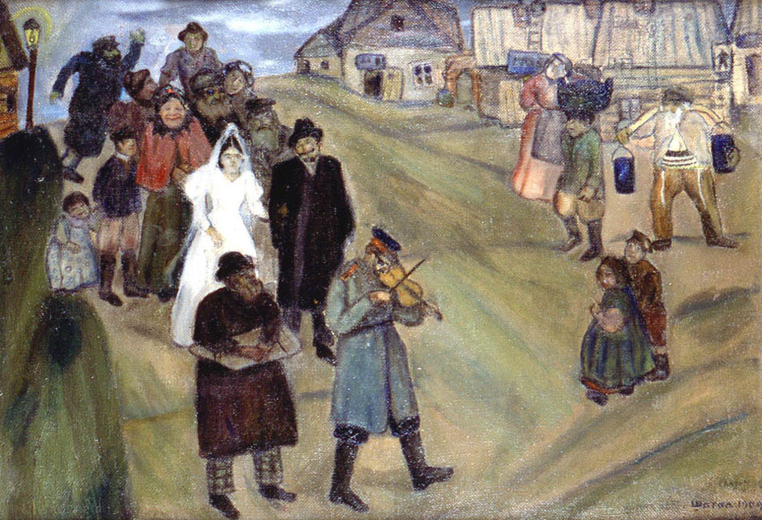

Slide 7
Pigeons as art experts (cont.)
Pigeons were able to discriminate between Van Gogh and Chagall with 95% accuracy (when presented with pictures they had been trained on)
Discrimination still 85% successful for previously unseen paintings of the artists
Pigeons do not simply memorise the pictures
They generalize from the already seen to make predictions

Slide 8
Biological Motivation
dendrites
cell
axon
synapse
dendrites
Biological Learning Systems are built of very complex webs of interconnected neurons
Information-processing abilities of biological neural systems must follow from highly parallel processes operating on representations that are distributed over many neurons
ANNs attempt to capture this mode of computation

Slide 9
Biological Neural Systems
Neuron switching time : > 10⁻³ secs
  Computer takes 10⁻¹⁰ secs
Number of neurons in the human brain: ~10¹¹
Connections (synapses) per neuron: ~10⁴-10⁵
Face recognition : ~0.1 secs
  100 inference steps? Brain must be parallel!
High degree of parallel computation
Distributed representations

Slide 10
Properties of Artificial Neural Nets (ANNs)
Many simple neuron-like threshold switching units
Many weighted interconnections among units
Highly parallel, distributed processing
Learning by tuning the connection weights
ANNs are motivated by biological neural systems; but not as complex as biological systems
  For instance, individual units in ANN output a single constant value instead of a complex time series of spikes

Slide 11
A Brief History of Neural Networks (Pomerleau)
1943: McCulloch and Pitts proposed a model of a neuron → Perceptron (Mitchell, section 4.4)
1960s: Widrow and Hoff explored Perceptron networks (which they called “Adelines”) and the delta rule.
1962: Rosenblatt proved the convergence of the perceptron training rule.
1969: Minsky and Papert showed that the Perceptron cannot deal with nonlinearly-separable data sets --- even those that represent simple function such as X-OR.
1975: Werbos’ ph.D. thesis at Harvard (beyond regression) defines backpropagation.
1985: PDP book published that ushers in modern era of neural networks.
1990’s: Neural networks enter mainstream applications.

Slide 12
Appropriate Problem Domains for Neural Network Learning
Input is high-dimensional discrete or real-valued (e.g. raw sensor input)
Output is discrete or real valued
Output is a vector of values
Form of target function is unknown
Humans do not need to interpret the results (black box model)
Training examples may contain errors (ANN are robust to errors)
Long training times acceptable

Slide 13
Prototypical ANN Approach
Mostly, network structure is fixed. Therefore, learning = weight adjustment
  deciding the structure is an art!
Units interconnected in layers
  directed, acyclic graph (DAG)
  skip-layer connection is possible
  the network can be sparse, with not all possible connections within a layer being present (convolutional networks)
input layer
hidden layer
output layer

Slide 14
Types of ANNs
Feedforward: Links are unidirectional, and there are no cycles, i.e., the network is a directed acyclic graph (DAG). Units are arranged in layers, and each unit is linked only to units in the next layer. There is no internal state other than the weights
Recurrent: Links can form arbitrary topologies. Cycles can implement memory. Behavior can become unstable, oscillatory, or chaotic

Slide 15
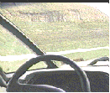



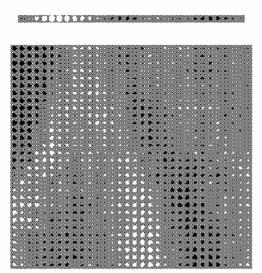
ALVINN: training and performance
Drives 70 mph on a public highway, by ~ 5 mins training
Camera
image
The weights from a hidden unit to 30 output units
30 outputs
for steering
30x32 weights
into one out of
four hidden
unit. A white box indicates a positive weight and a black box a negative weight
4 hidden
units
30x32 pixels
as inputs

Slide 16
ALVINN: training and performance
Trained with computer-generated road images
Involved 1200 different combinations of scenes, curvatures, lighting conditions and distortion levels
Entire driver implemented on an on-board computer and a modified Chevy van!
Performed comparably to the best traditional vision-based navigation systems evaluated under similar conditions
Training was done in half-an-hour!
  Was training done on board?
For comparison -- Algorithm-based drivers take months for algorithm development

Slide 17
Perceptrons
Structure & function
  inputs, weights, threshold
  hypotheses in weight vector space
Representational power
  defines a hyperplane decision surface
  linearly separable problems
  most boolean functions
  m of n functions
    Output “1” if m of n inputs are “1”s

Slide 18
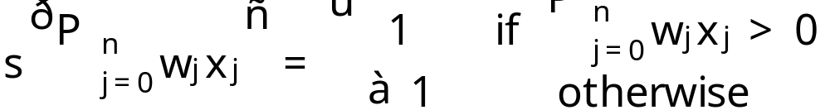
Perceptron
Linear threshold unit (LTU)
x₀=1
x₁
w₀
w₁
w₂
x₂
Σ
.
.
.
w_{n}
P
n
s
j
0
w
j
x
j
=
x_{n}

Slide 19
Purpose of the
Activation Function s
We want the unit to be “active” (near +1) when the “right” inputs are given
We want the unit to be “inactive” (near -1) when the “wrong” inputs are given.
It’s preferable for s to be nonlinear. Otherwise, the entire neural network collapses into a simple linear function.

Slide 20
Possibilities for function s
Sign function
Step function
Sigmoid (logistic) function
sign(x) = +1, if x > 0
-1, if x ≤ 0
step(x) = 1, if x > threshold
0, if x ≤ threshold
(in picture above, threshold = 0)
sigmoid(x) = 1/(1+e^{-x})
Adding an extra input with activation x₀ = 1 and weight
w₀ = -T (called the bias weight) is equivalent to having a
threshold at T. This way we can always assume a 0 threshold.

Slide 21
Using a Bias Weight to
Standardize the Threshold
1
-T
w₁
x₁
w₂
x₂
w₁x₁+ w₂x₂ < T
w₁x₁+ w₂x₂ – T < 0

Slide 22
Decision Surface of a Perceptron
x₂
x₂
+
+
+
–
+
–
–
x₁
x₁
+
–
+
–
–
Perceptron is able to represent some useful functions and (x₁, x₂): choose weights w₀ = –1.5, w₁=1, w₂=1
But functions that are not linearly separable (e.g. XOR) are not representable

Slide 23

Implementing AND
Assume Boolean (0/1) input values…
1
x₁
1
w = -1.5
h(x₁, x₂)
x₂
1
h(x₁, x₂) = 1 if –1.5 + x₁ + x₂ > 0
= 0 otherwise

Slide 24
Implementing OR
Assume Boolean (0/1) input values…
1
x₁
1
w = -0.5
h(x₁, x₂)
x₂
1
h(x₁,x₂) = 1 if –0.5 + x₁ + x₂ > 0
= 0 otherwise

Slide 25
Implementing NOT
1
w = 0.5
-1
x₁
h(x₁, x₂)
h(x₁) = 1 if 0.5 - x₁ > 0
= 0 otherwise

Slide 26

Implementing more complex Boolean functions
1
x₁
1
-0.5
x₁ or x₂
1
1
x₂
1
-1.5
1
x₃
(x₁ or x₂) and x₃

Slide 27
Perceptron Learning Rule
w_{j} ← w_{j} + Δw_{j}
Δw_{j} = η (y – h(x)) x_{j}
y is the target output for the current training example
h(x) is the perceptron output
η is a small constant (e.g. 0.1) called learning rate
Start with some random weights (usually small values)
If the output is correct (y = h(x)) the weights w_{j} are not changed
If the output is incorrect (y ≠ h(x)) the weights w_{j} are changed
such that the output of the perceptron for the new weights
is closer to y.
The algorithm converges to the correct classification
  if the training data is linearly separable
  and η is sufficiently small

Slide 28
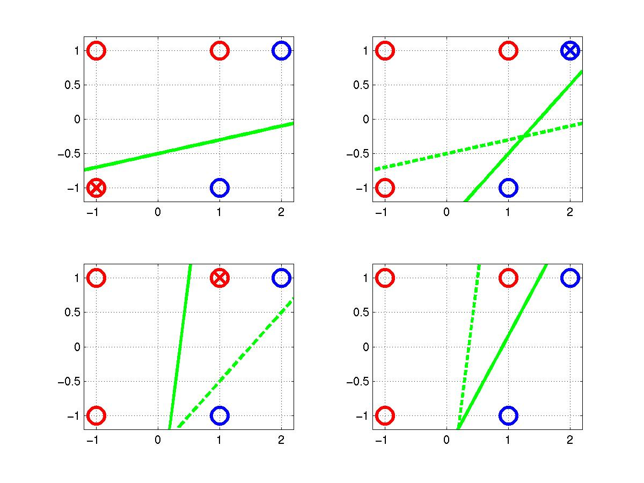
Perceptron Learning Rule
t = -1
t = 1
o=1
w = [0.25 –0.1 0.5]
x₂ = 0.2 x₁ – 0.5
x₂
x₂
o=-1
(x, y)=([-1,-1], 1)
h = sgn(0.25+0.1-0.5)
=1
x₁
x₁
(x, y)=([2,1], 1)
h =sgn(0.45-0.6+0.3)
=1
(x, y)=([1,1], 1)
h = sgn(0.250.7+0.1)
= 1
Δw = [0.2 –0.2 –0.2]
x₂
x₂
Δw = [0.2 –0.4 –0.2]
Δw = [0.2 0.2 0.2]
x₁
x₁
-0.5x₁+0.3x₂+0.45>0 ⇨ h = 1

Slide 29
Perceptron Convergence Theorem
If the training data are linear separable, the perceptron learning algorithm is guaranteed to find an exact solution in a finite number of steps (by many – Rosenblatt (1962), Block, Nilsson, Minsky and Pappert, Duda and Hart, etc.)
Proof:
Many different solutions can be found with the different initialization of the parameters or the order of presentation of data points

Slide 30
Gradient Descent Learning Rule
Perceptron learning rule fails to converge if examples are not linearly separable
Consider linear unit without threshold and continuous output h (not just –1, 1)
  h = w₀ + w₁ x₁ + … + w_{n} x_{n}
Train the w_{j}’s such that they minimize the squared error
  E[w₁, …, w_{n}] = ½ Σ_{i∈D} (y_{i} − h(x_{i}))²
  where D is the set of training examples

Slide 31
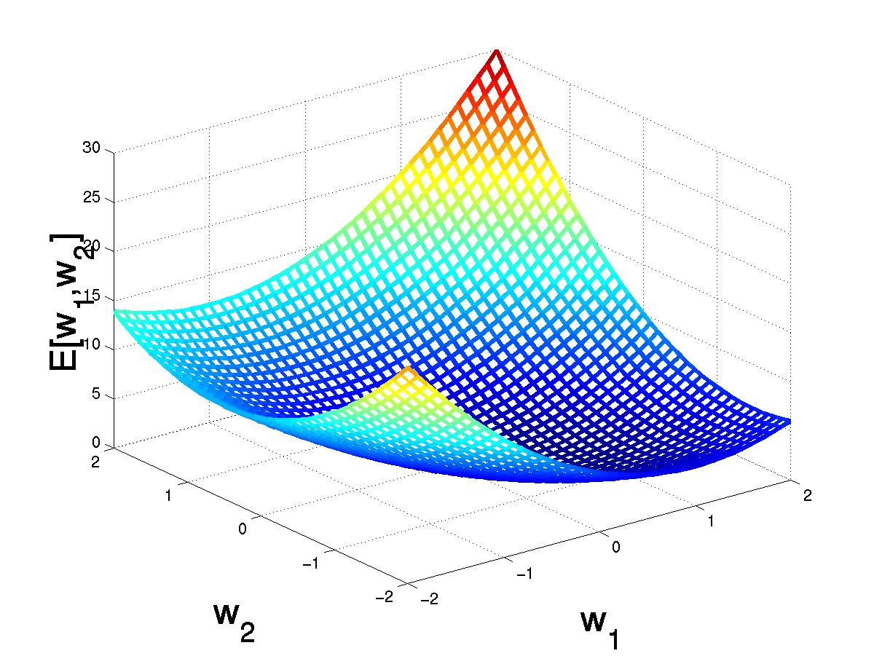
Gradient Descent
D = {⟨(1,1), 1⟩, ⟨(-1,-1), 1⟩,
⟨(1,-1), -1⟩, ⟨(-1,1), -1⟩}
(w₁, w₂)
Gradient:
∇E[w]=[∂E/∂w₀,… ∂E/∂w_{n}]
(w₁+Δw₁, w₂ +Δw₂)
Δw = −η ∇E[w]
E[w₁, w₂]
Δw_{j} = −η ∂E/∂w_{j}
= −η ∂/∂w_{j} ½Σ_{i}(y_{i} − h(x_{i}))²
= −η ∂/∂w_{j} ½ Σ_{i}(y_{i} − Σ_{j} w_{j} x_{ij})²
= η Σ_{i}(y_{i} − h(x_{i})) x_{ij}
w₂
w₁

Slide 32
Gradient Descent
Train the w_{j}’s such that they minimize the squared error
  E[w₁,…, w_{n}] = ½ Σ_{i∈D} (y_{i}  h(x_{i}))²
Gradient:
∇E[w]=[∂E/∂w₀,…, ∂E/∂w_{n}]
Δw = η ∇E[w]
Δw_{j} = η ∂E/∂w_{j}
= η ∂/∂w_{j} ½Σ_{i}(y_{i}  h(x_{i}))²
= η ∂/∂w_{j} ½Σ_{i}(y_{i}  Σ_{j} w_{j} x_{ij})²
= η Σ_{i}(y_{i}  h(x_{i}))(x_{ij})

Slide 33
Gradient Descent
Gradient-Descent(training_examples, η)
Each training example is a pair of the form ⟨(x₁, …, x_{n}), y⟩ where (x₁,…, x_{n}) is the vector of input values, and y is the target output value, η is the learning rate (e.g. 0.1)
Initialize each w_{j} to some small random value
Until the termination condition is met, Do
  Initialize each Δw_{j} to zero
  For each ⟨(x₁, …, x_{n}), y⟩ in training_examples Do
    Input the instance (x₁, …, x_{n}) to the linear unit and compute the output h
    For each linear unit weight w_{j} Do
      Δw_{j}= Δw_{j} + η (y − h(x)) x_{j}
  For each linear unit weight w_{j} Do
    w_{j} = w_{j} + Δw_{j}
Termination condition – error falls under a given threshold

Slide 34


Perceptron Learning (Thresholded Version)
Initialize weights and threshold: Set weights w_{j} to small random values
Present Input and Desired Output: Set the inputs to the example values x_{j} and let the desired output be y
Calculate Actual Output
Adapt Weights: If actual output is different from desired output, then
where 0 < η < 1 is the learning rate
Repeat from Step 2 until done

Slide 35

Gradient Descent Learning (Unthresholded Version)
Initialize weights and threshold: Set weights w_{j} to small random values
Present Input and Desired Output: Set the inputs to the example values x_{j} and let the desired output be y
Calculate Unthresholded Output
Adapt Weights: If actual output is different from desired output, then
where 0 < η < 1 is the learning rate
Repeat from Step 2 until done

Slide 36
Incremental Stochastic Gradient Descent
Batch mode : gradient descent
w = w − η ∇E_{D}[w] over the entire data D
E_{D}[w] = ½ Σ_{i}(y_{i} − h(x_{i}))²
Incremental mode: gradient descent
w=w − η ∇E_{i}[w] over individual training examples i
E_{i}[w] = ½ (y_{i} − h(x_{i}))²
Incremental Gradient Descent can approximate Batch Gradient Descent arbitrarily closely if η is small enough

Slide 37
Comparison Perceptron and Gradient Descent Rule
Perceptron learning rule guaranteed to succeed (converge in finite steps) if
Training examples are linearly separable
Sufficiently small learning rate η
Gradient descent learning rules uses gradient descent
Guaranteed to converge to hypothesis with minimum squared error asymptotically
Given sufficiently small learning rate η
Even when training data contains noise
Even when training data not linearly separable

Slide 38
XOR
h
(
~
)
~
¢
~
x
=
w
x
E
(
~
)
1
X
(
h
(
)
)
2
w
=
2
y
i
¡
x
i
i
2
D
1
h
(
)
2
(
)
2
=
¡
1
¡
w
0
¡
w
1
¡
w
2
+
1
¡
w
0
+
w
1
¡
w
2
2
+
(
¡
1
¡
+
+
)
2
+
(
1
¡
¡
+
)
2
i
w
0
w
1
x
2
w
0
w
1
w
2
=
2
(
1
+
w
2
+
w
2
+
w
2
)
0
1
2
The error will reach
the minimum 2 when w₀ = w₁ = w₂ = 0
For perceptron learning, the iteration will not stop!
For gradient descent learning, process will converge to the minimum even the dataset is not linearly-separable!
(-1, 1; 1)
x₂
(1, 1; -1)
+
–
x₁
–
+
(x₁, x₂, t) = (-1, -1; -1)
(1, -1; 1)

Slide 39
Limitations of Threshold and Perceptron Units
Limitations of Threshold and Perceptron Units
Perceptrons can only learn linearly separable classes
Perceptrons cycle if classes are not linearly separable
Threshold units converge always to MSE hypothesis
Network of perceptrons – how to train?
Network of threshold units – not necessary! (why?)

Slide 40
Multilayer Networks
Single perceptrons can only express linear decision surfaces
On the other hand, multilayer networks are capable of expressing a rich variety of nonlinear decision surfaces
k
output layer
w_{kj} ⋅ x_{kj}
conventionally, it’s called
a two-layer network
j
hidden layer
input layer

Slide 41
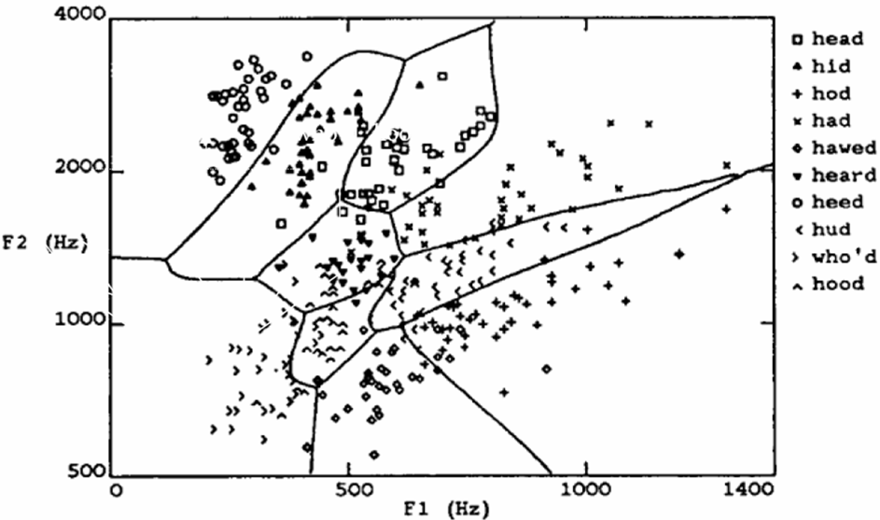
A Speech Recognition Task

Slide 42
Sigmoid Threshold Unit
x₀=1
x₁
w₁
w₀
o = σ (net) = 1/(1 + e^{-net})
w₂
n
e
t
=
P
n
w
x
x₂
Σ
j
=
0
j
j
o
.
.
.
w_{n}
σ(x) is the sigmoid function: 1/(1+e^{-x})
dσ(x)/dx = σ(x) (1− σ(x))
x_{n}
Derive gradient decent rules to train:
one sigmoid function
∂E/∂w_{j} = −Σ_{i}(y_{i} − h(x_{i})) h(x_{i}) (1− h(x_{i})) x_{ij}
Multilayer networks of sigmoid units
backpropagation:

Slide 43
Designation of Output Units
Regression: identity function
Binary classification: e.g., sigmoid function
Multiclass classfication: softmax function
K binary classification problem: K sigmoid function for each problem
e
x
p
(
n
e
t
k
)
h
(
x
w
)
=
;
P
e
x
p
(
n
e
t
)
`
`
input layer
hidden layer
output layer

Slide 44
BACKPROPAGATION Algorithm
Initialize each w_{j} to some small random value
Until the termination condition is met, Do
  For each training example ⟨(x₁,…, x_{n}), y⟩ Do
    Input the instance (x₁,…, x_{n}) to the network and compute the network outputs h_{k} for every output unit k
    For each output unit k
      δ_{k} = h_{k}(1−h_{k})(y_{k}−h_{k})
    For each hidden unit j
      δ_{j} = h_{j}(1−h_{j}) Σ_{k} w_{kj} δ_{k}
    For each network weight w_{kj} Do
      w_{kj} = w_{kj} + Δw_{kj} where
      Δw_{kj} = η δ_{k} x_{kj}

Slide 45
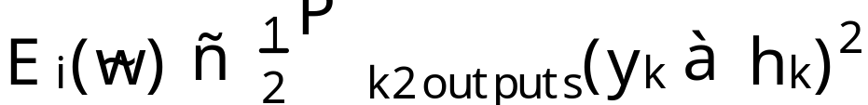
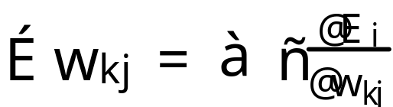
Derivation of the BACKPROPAGATION Rule I
x_{kj}: the jth input to unit k
w_{kj}: the weight associated with the jth input to unit k
net_{k} = Σ_{j} w_{kj} x_{kj} (the weighted sum of inputs for unit k)
h_{k}: the output computed by unit k
y_{k}: the target output for unit k
σ: the sigmoid function
outputs: the set of units in the final layer of the network
Downstream(k): the set of units whose immediate inputs include the output of unit k

Slide 46
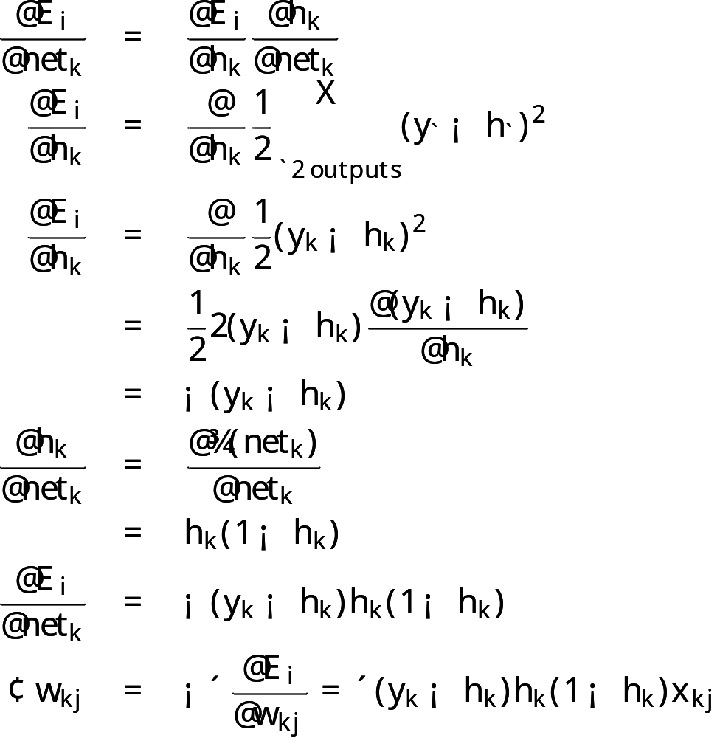
Derivation of the BACKPROPAGATION Rule II
@
E
i
@
E
i
@
n
e
t
k
@
=
@
t
@
w
k
j
n
e
k
w
k
j
@
E
i
=
@
t
x
k
j
n
e
k
Training rule for output unit weights:

Slide 47
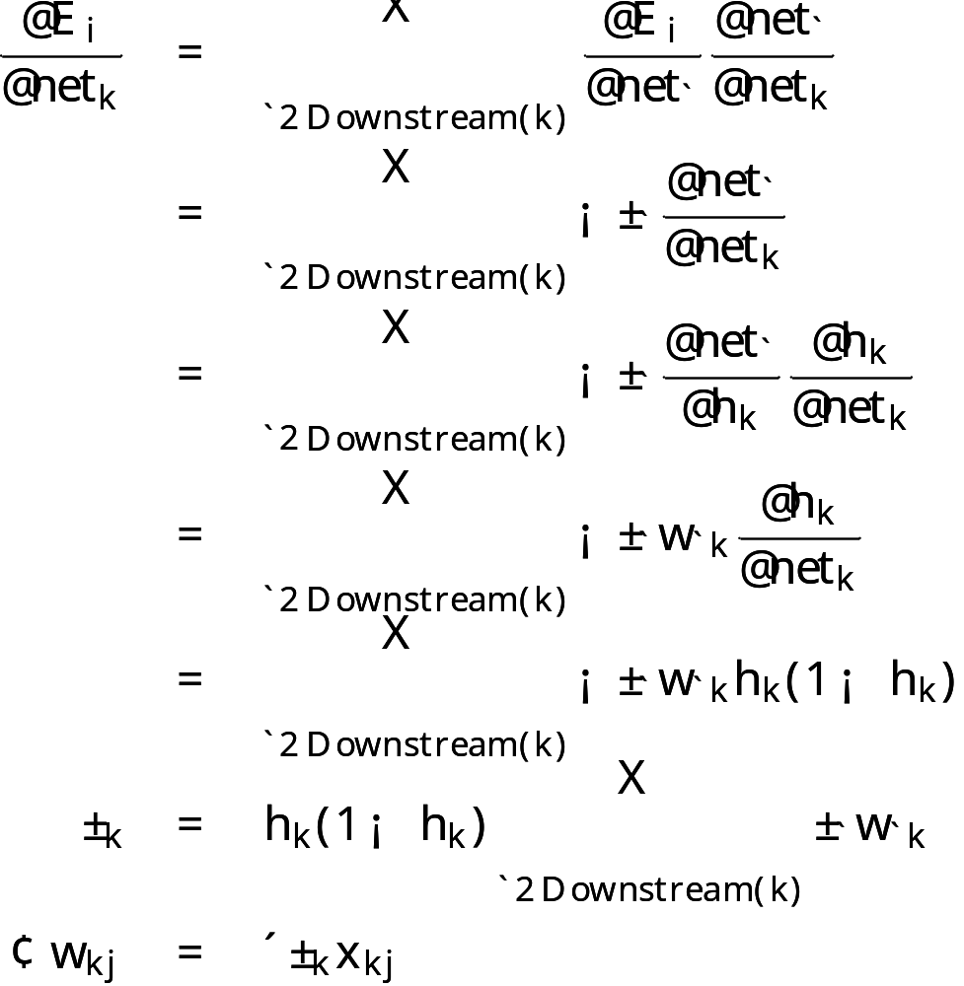
Derivation of the BACKPROPAGATION Rule III
Training rule for hidden unit weights

Slide 48
Backpropagation
Gradient descent over entire network weight vector
Easily generalized to arbitrary directed graphs
Will find a local, not necessarily global error minimum
  in practice often works well (can be invoked multiple times with different initial weights)
Often include weight momentum term
      Δw_{kj}(n) = η δ_{k} x_{kj} + α Δw_{kj} (n1)
Minimizes error training examples
  Will it generalize well to unseen instances (over-fitting)?
Training can be slow typical 1000-10000 iterations
(use Levenberg-Marquardt instead of gradient descent)
Using network after training is fast

Slide 49
Learning in Arbitrary Acyclic Networks
For networks of more than two layers
  The δ_{r} value for a unit r in layer m is computed from the d values at the next deeper layer m+1 according to
For networks where nodes are not arranged in uniform layers
  The δ_{r} value for any internal unit

Slide 50
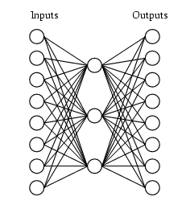
Learning Hidden Layer Representations
A target function:
Input |  | Output
10000000 | → | 10000000
01000000 | → | 01000000
00100000 | → | 00100000
00010000 | → | 00010000
00001000 | → | 00001000
00000100 | → | 00000100
00000010 | → | 00000010
00000001 | → | 00000001
Can this be learned??

Slide 51
Learning Hidden Layer Representations
A network:
Learned hidden layer representation:
Input |  | Hidden Values |  |  | Output
10000000 | → | .89 .04 .08 | → | 10000000
01000000 | → | .15 .99 .99 | → | 01000000
00100000 | → | .01 .97 .27 | → | 00100000
00010000 | → | .99 .97 .71 | → | 00010000
00001000 | → | .03 .05 .02 | → | 00001000
00000100 | → | .01 .11 .88 | → | 00000100
00000010 | → | .80 .01 .98 | → | 00000010
00000001 | → | .60 .94 .01 | → | 00000001

Slide 52
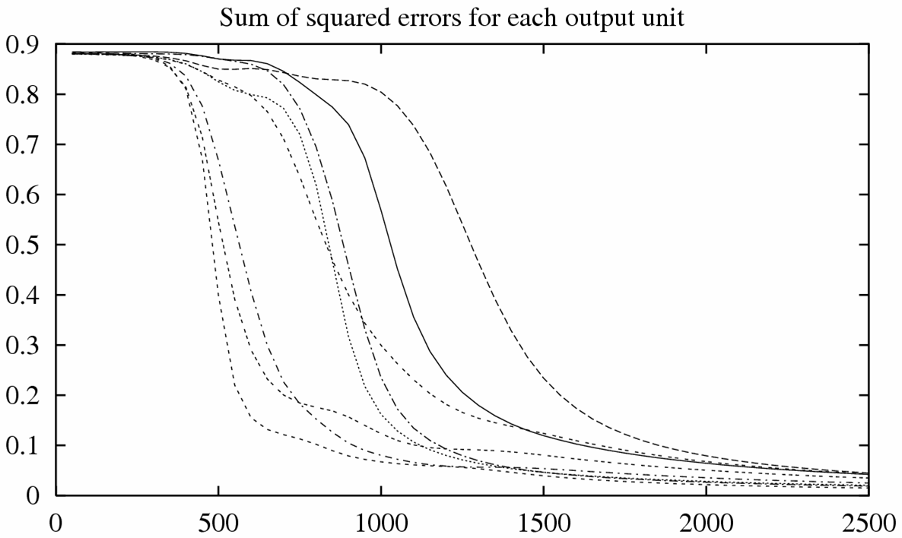
Training

Slide 53
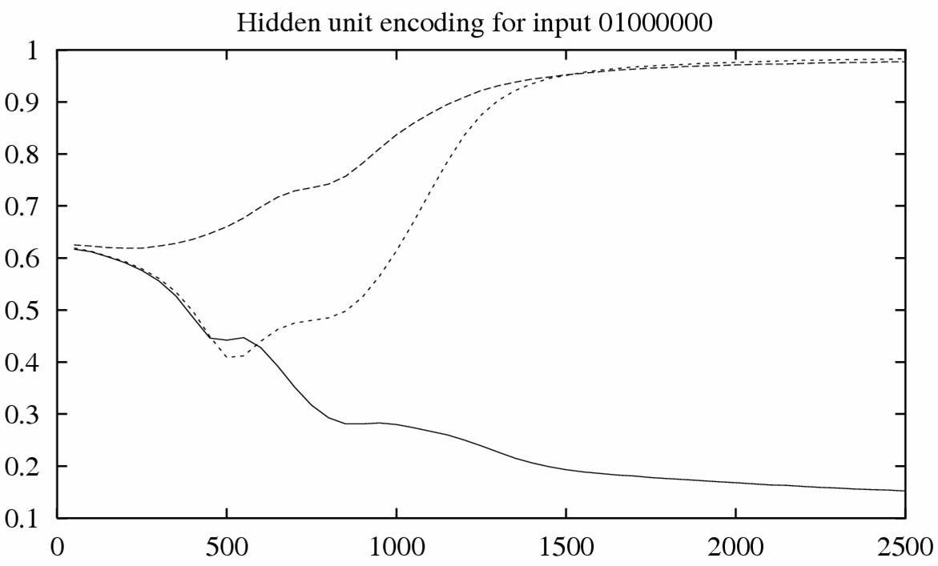
Training

Slide 54
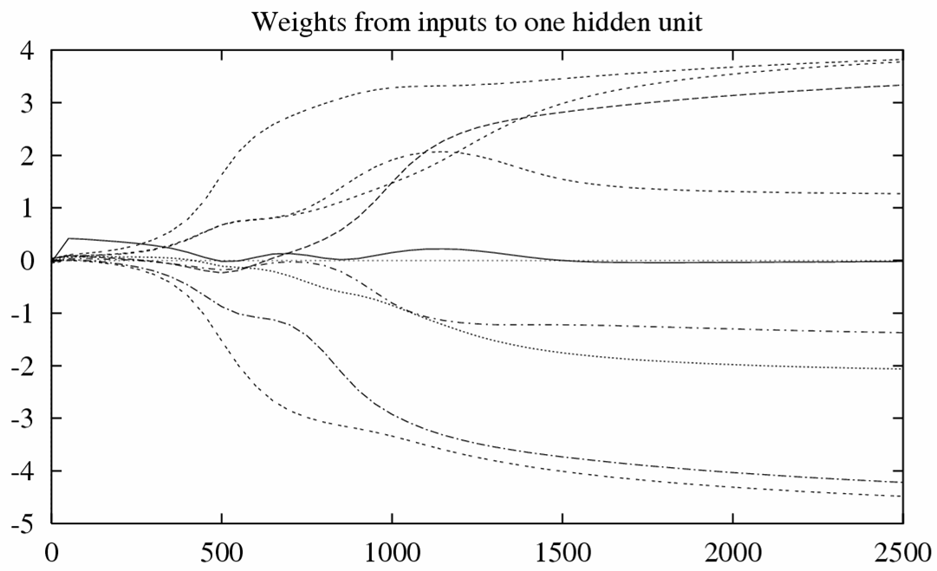
Training

Slide 55
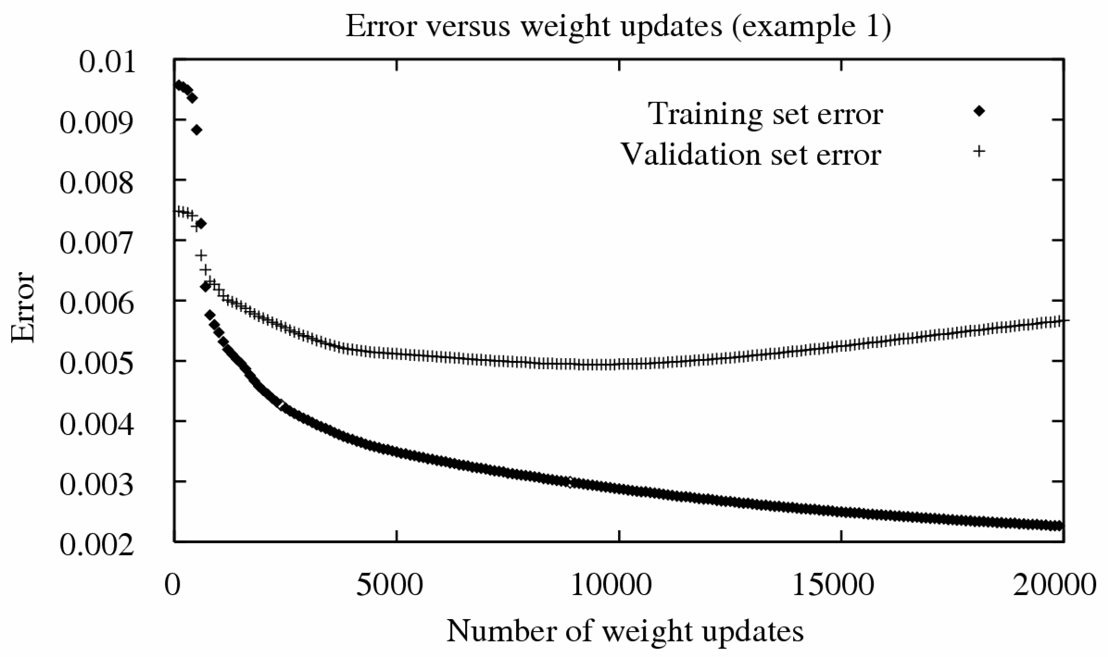
Overfitting: case I

Slide 56
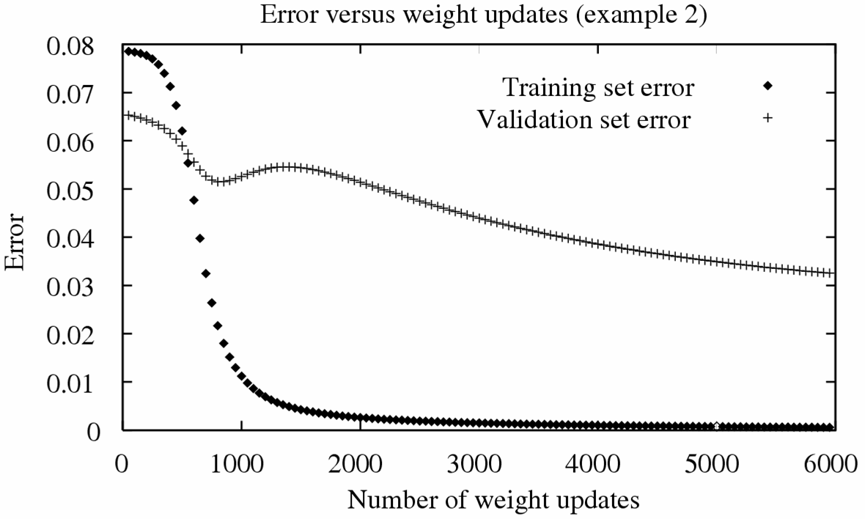
Overfitting: case II

Slide 57
Convergence of Backprop
Gradient descent to some local minimum
Perhaps not global minimum (because the function is nonlinear!)
Nature of convergence
Initialize weights near zero
Therefore, initial networks near-linear
Increasingly nonlinear functions possible as training progresses
Close enough to the global min. if only a local minimum

Slide 58
Avoid the Local Minimum
Add momentum (through smooth area)
Stochastic gradient descent
Train multiple nets with different initial weights
  Choose the best one by validation
  Using the result from “committee”

Slide 59
Avoid ANN Overfitting
1. Weight decay
Decrease each weight by a small factor during each iteration
Plays the role of a penalty term
[Keep weight values small]
2. Use a different validation set
Use the number of iterations that leads to the lowest error on the validation set

Slide 60
Expressive Capabilities of ANN
Boolean functions
Every boolean function can be represented by network with single hidden layer
But might require exponential (in number of inputs) hidden units
Continuous functions
Every bounded continuous function can be approximated with arbitrarily small error, by network with one hidden layer [Cybenko 1989, Hornik 1989]
Any function can be approximated to arbitrary accuracy by a network with two hidden layers [Cybenko 1988]

Slide 61
Literature & Resources
Textbook:
  “Neural Networks for Pattern Recognition”, Ch. 5, C. M. Bishop, 1996
  “Machine Learning”, Ch. 4, T. M. Mitchell, 1997
Software:
  Neural Networks for Face Recognition
  http://www.cs.cmu.edu/afs/cs.cmu.edu/user/mitchell/ftp/faces.html
  SNNS Stuttgart Neural Networks Simulator
  http://www-ra.informatik.uni-tuebingen.de/SNNS
  Neural Networks at your fingertips
  http://www.stats.gla.ac.uk/~ernest/files/NeuralAppl.html

