Slide 1
RHYTHMGAME

Slide 2
APPROACH
Get principle
Find physical components
Make circuit
Write code
Assign code to the hardware
Make 3d model
(Build irl)

Slide 3
COMPONENTS OF A RHYTHM GAME Software-ddd
(Adjusting Margin: -+80ms)
Player Input: buttonpressed 4 buttons
ONLY ONCE PER MARGIN: IS HIT?
0:none
1: 1 button- 1 time randomly select
… 4: 4 buttons- 4 time randomly select
Music Player: plays tracks, switches tracks, dynamics of music, layers music/sfx
Indicates timeposition!==bpm
Wwise, fmod
Metronome: Input bpbeat %4, bar%16, part depends STEADYCLOCK
Where are we?
m, make beatDurationSec=60/bpm (1/8 note), beatDurationMs= 60/bpm *1000, lastBeat equals 0
Import timepostion from the Music Player and compare it to beatDurationMs: if timepostion>=beatDurationMs
lastBeat++
Emit(„beat“, lastBeat)
Timeposition +=beatDurationMs
Error Margin (door)
activeBeat start/end = beatDurationMs +- margin

Slide 4
COMPONENTS OF A RHYTHM GAME Software-ddd 2
Composer
Writes chart based off of MIDI/bpm and set/randomized
Next required input: button+beat ex: A3 or K4
Beatx4 randomized 0(none),1(L),2(R),3(both)
array
Judge HIGHRESCLOCK
Composer: required input?
Player Input: Button right?
Metronome: Error Margin open? Beat correct?
Output: yes or no
Perfect 20 3, great 30 2, good 50 1, miss 100ms 0
Using 3 vectors NOT lists: each´beatposition 3 (4)values:
(Beatposition), required keys, pressed keys, accuracy
Referee (Manager) Start: Musicplayerstart, givebpmtometronome, givelvldatacomposer, EVERYONEGAMESTART
score
DisplayGame: Score according to judge
End: Music Player-MusicEnd,EVERYONEGAMESTOP,give final
Read chart of everyone – give visual feedback

Slide 5
DISPLAY HW
LED Matrix
64x32 RGB LED Matrix - 3mm pitch: https://www.adafruit.com/product/2279
Dimensions: 191mm x 96mm x 15mm / 7.5” x 3.8” x 0.6”
Panel weight with IDC cables and power cables: 189g
Compatible with M3 mounting screws
5V regulated power input @ ~4A (with all LEDs on)
2000 mcd LEDs on 3mm pitch
1/16 scan rate
Indoor display, wide visibility
Displays are 'chainable
Adafruit RGB Matrix Bonnet for Raspberry Pi: https://www.adafruit.com/product/3211
Power
5V 4A (4000mA) switching power supply - UL Listed: https://www.adafruit.com/product/1466
Female DC Power adapter - 2.1mm jack to screw terminal block: https://www.adafruit.com/product/368
Connection
Adafruit RGB Matrix Bonnet for Raspberry Pi: https://www.adafruit.com/product/3211
to calculate the power, multiply the width of all the chained matrices * 0.12 Amps : A 32 pixel wide matrix can end up drawing 32*0.12 = 3.85A

Slide 6
PROCESSOR HW
Raspberry Pi:Model A, B, 2345 https://www.adafruit.com/categories/176
Depending on Code GB
C++ setup: https://www.raspberrypi.com/documentation/microcontrollers/c_sdk.html

Slide 7
Raspberry Pi

Slide 8
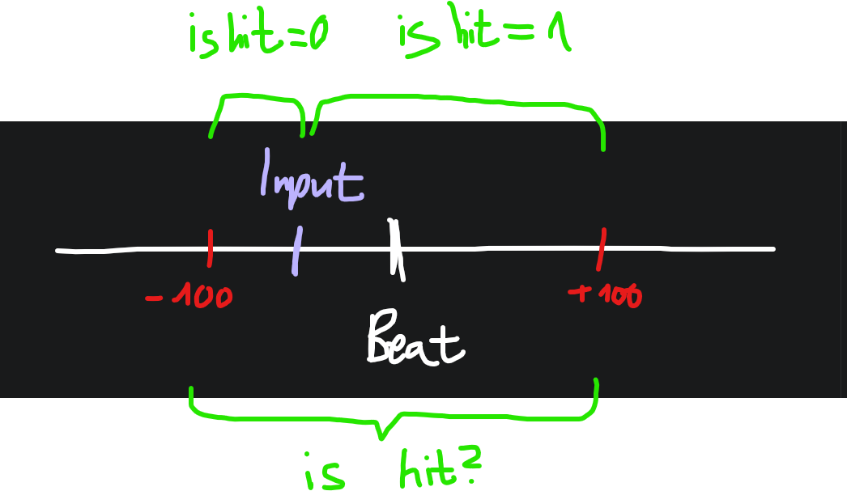
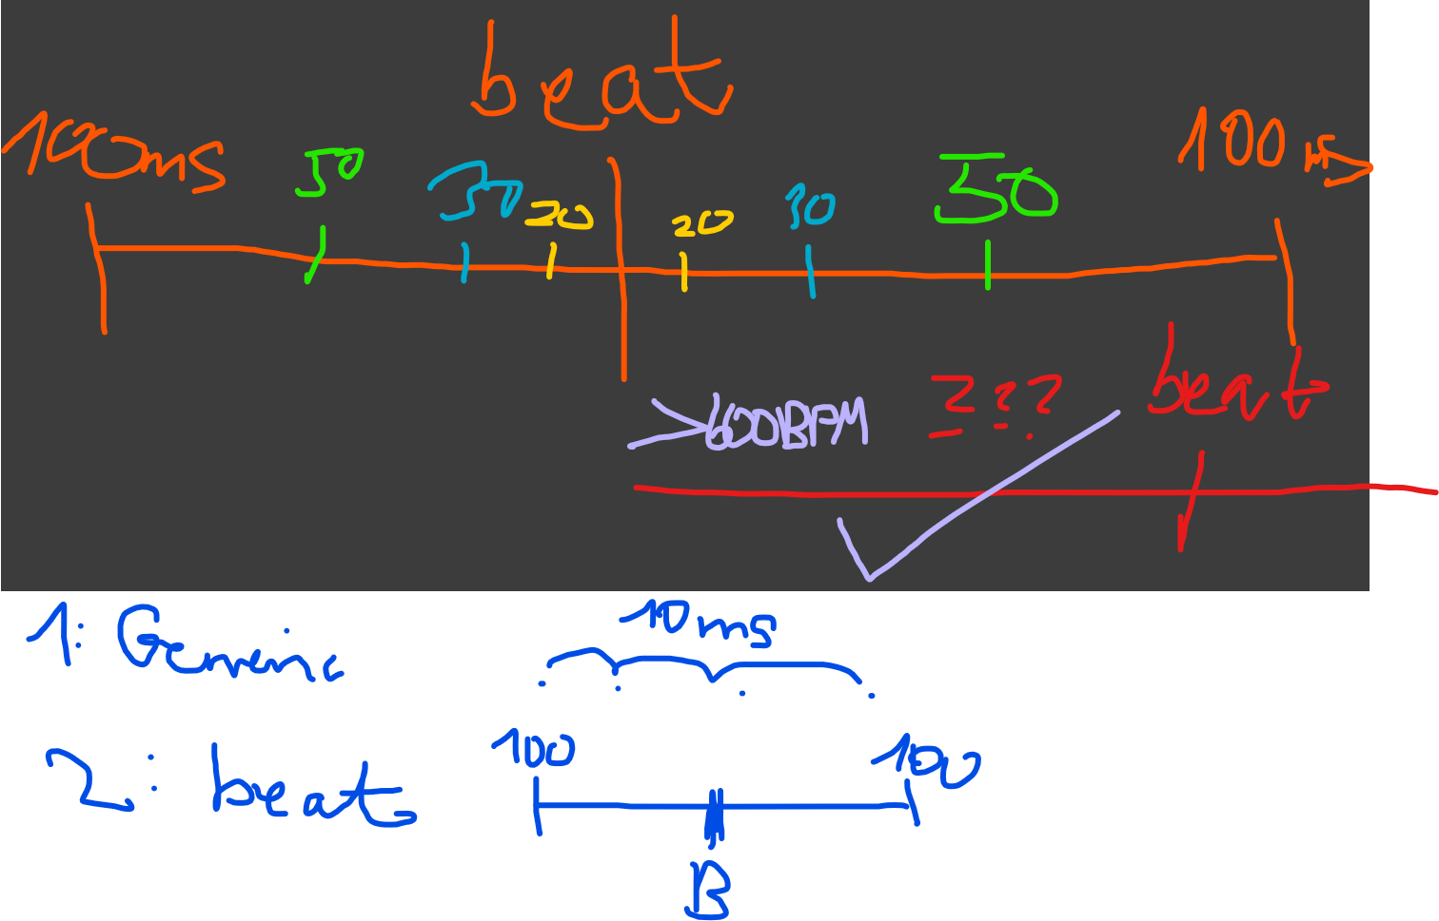
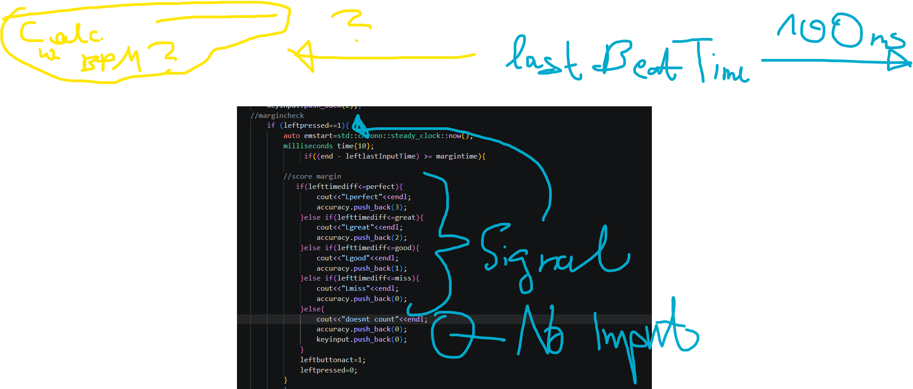
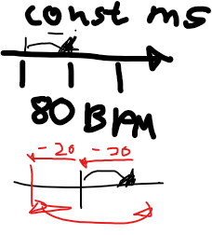
Error margin

Slide 9
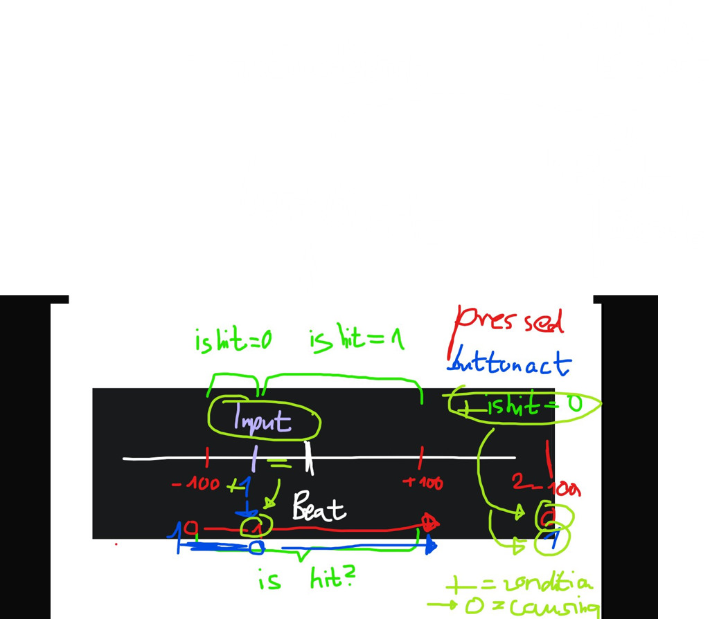
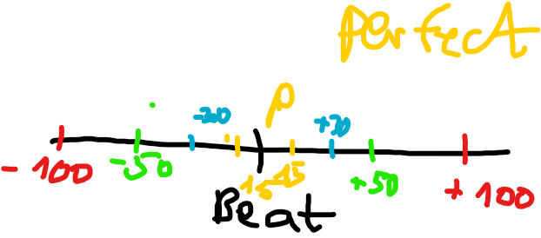
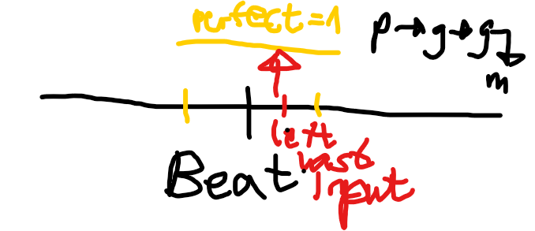
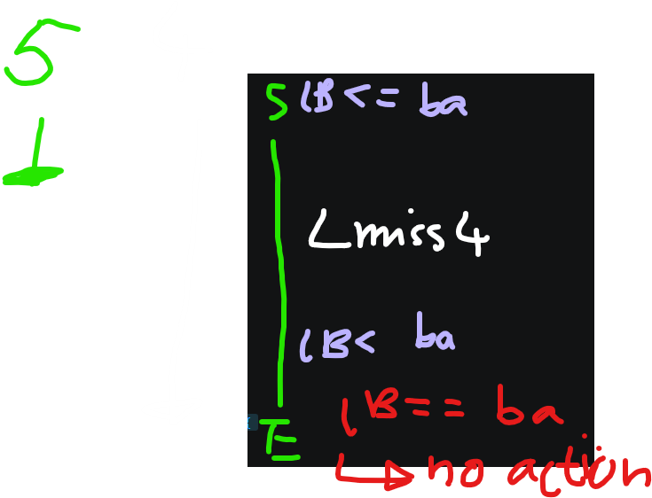

Slide 10
First ideas
Rhythm game: (Multiplayer) EXERCISE TOGETHER WHILE HAVING FUN!
FNF type game on device with STOMPERS L and R
Arcade gamed Model
FNF game:
Input a BPM & Difficulty
LED matrix
Microcontroller
Gives SCORE
Display https://www.adafruit.com/product/4311
Animal slippers you have to sit down
Senses the FNF
sensors
Stompers: light up lol
LED stripes
Hand controller:
Senses the FNF
Sensors
ESP 32 MODEL: ??

