Slide 1
1/10
Model Risk Factory
The Agent does the reading, porting and number-crunching of a model review. Reviewers keep every decision, and every number traces to evidence.
Challenge 04 · EXL × UCD Data & AI Hackathon 2026 · competition prototype
• Document: three legacy R models inventoried from code and stale notes. Conflicts and Unknowns are kept, each with path, line and SHA-256.
• Migrate: MDL_CREDIT_V1 ported to Python by a real gateway Agent. Max |Δp| 2.220e-16 against R on 12,000 records (HIST-UCI).
• Validate: performance, calibration, drift and fairness computed by Python. 191 report values each resolve to a JSON path (HIST-UCI).
• Control: three hash-bound review gates. Any change to code, config or candidate invalidates earlier approvals.
results come only from runs recorded in the repository. HIST-UCI = v2-20261109T210903Z-3dcfab73 (UCI, seed 46, historical); SYN-SEED47 = dev_runs/v2-20261110T182506Z-9acb1487 (synthetic). Release state: slide 9.

Slide 2
2/10
The client problem
CLIENT-CONTEXT (from the challenge brief, not measured here): a bank runs ~250 models; documentation drifts away from code; a model review takes 8–12 weeks; PRA SS1/23 sets the expectation that models are documented, validated, monitored and independently reviewed.
What that costs in practice, and what this prototype addresses:
• The document and the code disagree, and nobody can say which one is right without reading both.
• Re-implementation is checked by eye, sampled, or "the AUC looks fine".
• Validation evidence is rebuilt per review instead of being produced by the pipeline.
• Drift is found by a spreadsheet refresh, not by a metric with a recorded threshold.
docs/01_比赛背景与官方要求.md and the official PDF. The 250-model / 8–12-week figures are client backdrop only and are never presented as this project's results.

Slide 3
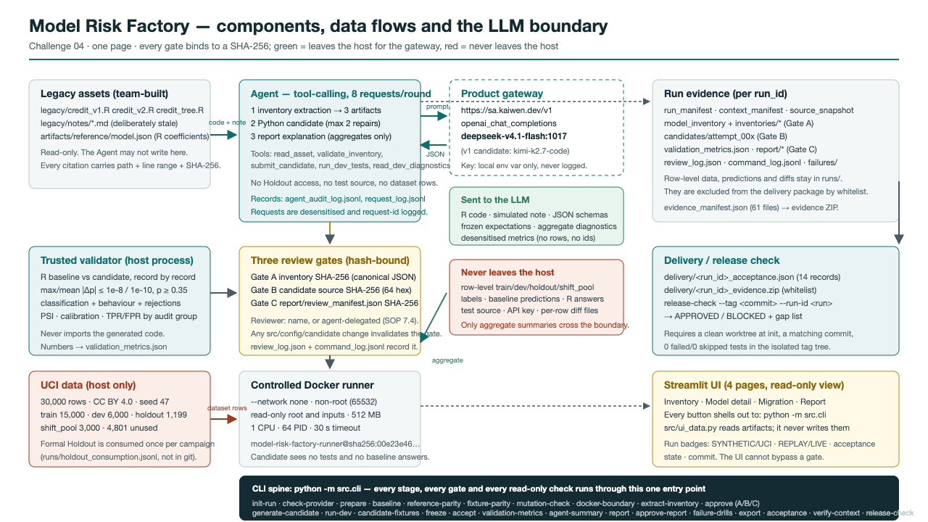
3/10
Method and architecture
The Agent proposes artifacts, deterministic checks validate them, and reviewers record decisions at three gates.
• Document → Agent returns a schema-validated inventory; Gate A approves its hash. Redevelop → Agent writes the Python candidate; Gate B approves the 64-hex source hash before anything runs.
• Validate → candidate runs in a no-network, read-only container; a trusted validator compares it with the R baseline. Monitor → drift, calibration and fairness; Gate C approves the rendered report.
• Hard boundary: Holdout inputs and answers never enter the Agent context; only aggregate, desensitised metrics do.
architecture detail in materials/architecture.md. Gate definitions: docs/02_项目SOP.md §7.4.

Slide 4
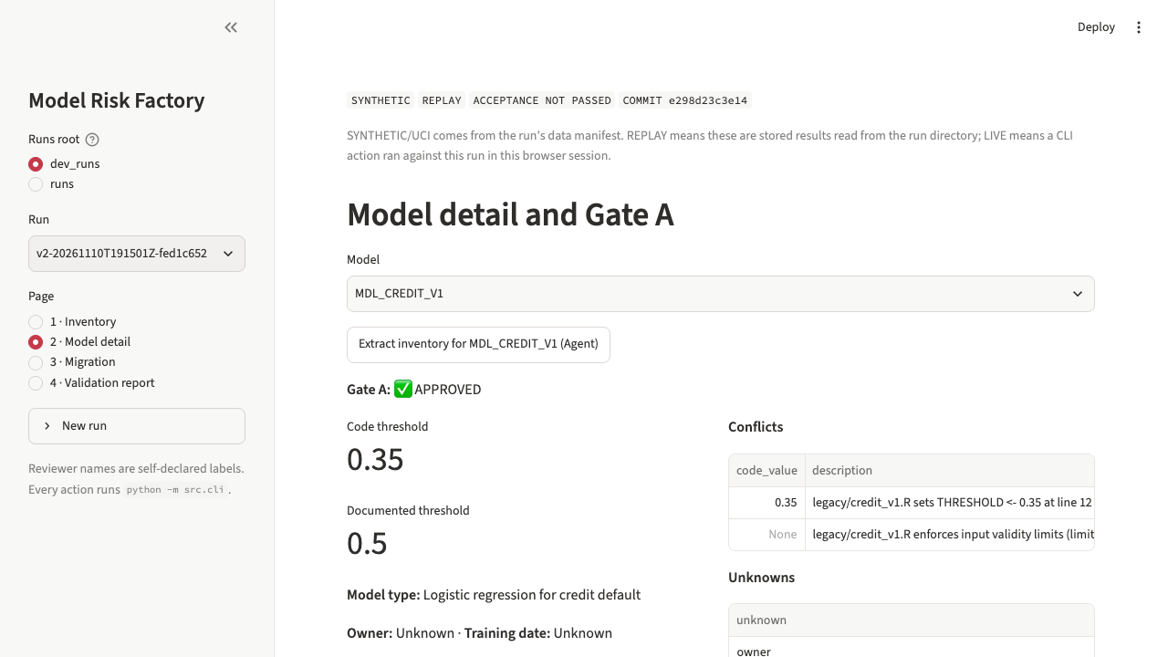
4/10
Inventory and documented gaps
Three models documented from their real code and their real (deliberately stale) notes.
• MDL_CREDIT_V1: code threshold 0.35 vs documented 0.50 — kept as a conflict, never auto-normalised; 14 verified sources.
• MDL_CREDIT_V2 and MDL_CREDIT_TREE: undocumented input limits, transformations and hyperparameters recorded as conflicts; owner and training date stay Unknown.
• Each confirmed conflict carries file path, line, excerpt and SHA-256. Equal code and document thresholds cannot be recorded as a conflict.
• HIST-UCI: 3 inventories, 3 Gate A approvals, 4 Unknown fields each.
HIST-UCI model_inventory.json, inventories/*.json, inventory_validation.json; rule set src/inventory.py + config/inventory_expectations.json; regression tests/test_v3_gap_inventory_conflicts.py.

Slide 5
5/10
R to Python parity
The candidate reuses the exported R coefficients, medians, feature order and the 0.35 threshold. Nothing is retrained.
• HIST-UCI: 6,000 development records and 6,000 Holdout records compared one by one — max |Δp| 2.220e-16, mean |Δp| 2.707e-17, 0 classification mismatches, 0 behaviour mismatches (tolerance 1e-8 / 1e-10).
• Behaviour is tested too: missing values, imputation flags, invalid rows and rejection codes match record by record, plus row-order, column-order and structural-refusal fixtures.
• A deliberately altered coefficient (+0.001 on delay_1) is caught by the fixed validator; the original baseline and test hashes stay unchanged.
• The Agent never sees the Holdout: it only gets development parity summaries and aggregate diagnostics.
HIST-UCI parity/*/parity_summary.json, mutation/mutation_summary.json, dev/attempt_000/fixtures/; thresholds config/model_config.json.

Slide 6
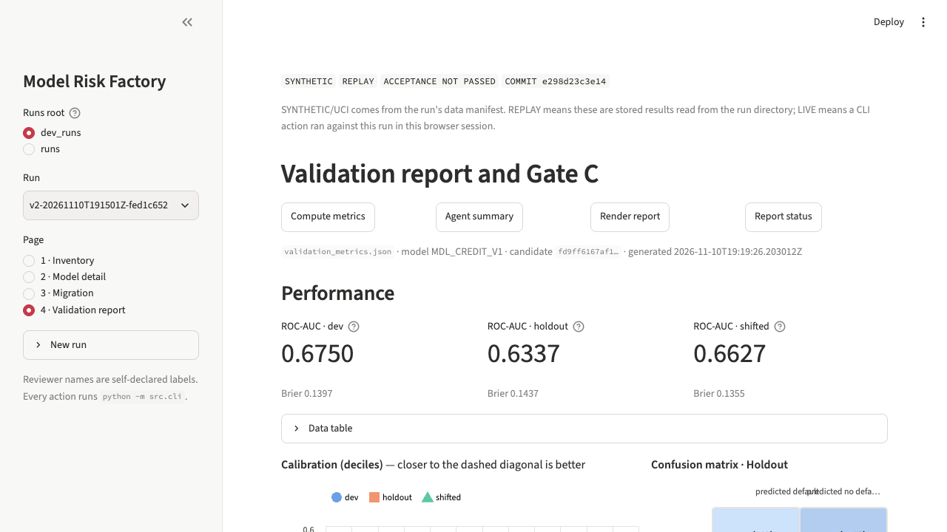
6/10
Validation and monitoring
Python computes the metrics and renders the conclusions. The Agent selects a review focus and its structured facts are checked against the metrics.
• Performance (HIST-UCI Holdout, 6,000 rows): ROC-AUC 0.7529, Brier 0.1422, decile calibration table, confusion matrix at p ≥ 0.35 (TP 621 / FP 501 / FN 701 / TN 4177).
• Stability: weighted drift batch vs dev reference — prediction PSI 0.0170, worst feature PSI 0.0799 (util_1); attention 0.10 / review 0.25 are project demo rules, not a regulatory standard.
• Fairness audit: age_band 21–25 TPR 0.5477 vs reference 0.4392 (+0.1086), sex=1 TPR difference −0.0387; small groups are marked LOW_SAMPLE and rates are not assessable.
• Limits sit next to the numbers: same-period hold-out (not a back-test), drift is a sensitivity analysis, no cross-time back-test. Gate C re-renders and compares every cell (SYN-SEED47: 196 values, 0 unresolved).
HIST-UCI validation_metrics.json, report/validation_report.md; SYN-SEED47 report/values_index.csv, report/review_manifest.json.

Slide 7
7/10
What the reviewer no longer does by hand
Each line is a task a validator normally does by hand, with the measured automated time (SYN-SEED47, gateway deepseek-v4.1-flash:1017).
• Read code and notes, write the inventory and list the conflicts: 12.7 s / 31.6 s / 40.3 s per model. A deterministic rule rejected one incomplete answer automatically.
• Re-implement the model in Python: 66.1 s for the candidate. Prove it matches R record by record: run by the pipeline, with no sampling or checking by eye.
• Recompute every report number and check every table cell: done at Gate C. Draft the review summary: 9.8 s.
• End to end: 29 commands and 3.49 min of automated work for 3 inventories, a migration, validation, report and export. Reviewer time is spent on the decisions at the gates.
• Not claimed yet: a speed-up percentage. The paired manual-vs-Agent study (protocol in materials/impact_measurements_README.md) has 0 completed pairs.
SYN-SEED47 command_log.jsonl timings, agent_audit_log.jsonl, provider/request_log.jsonl; materials/impact_measurements.csv + its README.

Slide 8
8/10
Responsible AI
• Data: UCI Default of Credit Card Clients (CC BY 4.0), a 2005 Taiwan sample; no direct identifiers but demographic attributes exist. Competition use permission is still recorded as unconfirmed (uci_competition_use_approved=false).
• Privacy: demographics are audit-only and never model inputs; no raw rows, labels or Holdout content are sent to the LLM — only R code, the simulated note, schemas and aggregate diagnostics; API keys live in local environment variables only.
• Bias: TPR/FPR by age_band and sex are audit signals, not a fairness verdict; small groups are marked not assessable; the model is not claimed to be fair.
• Limitations: not production-ready, not independently validated, not a regulatory certification; no cross-time back-test; report conclusions come from computed metrics and are checked again at Gate C.
• Safeguards: generated code runs only in a no-network, read-only, non-root container with memory/CPU/PID/time limits; gates A/B/C bind to hashes and invalidate on any source, config or candidate change.
HIST-UCI boundary/boundary_report.json, review_log.json, report/validation_report.md; materials/responsible_ai_note.md.

Slide 9
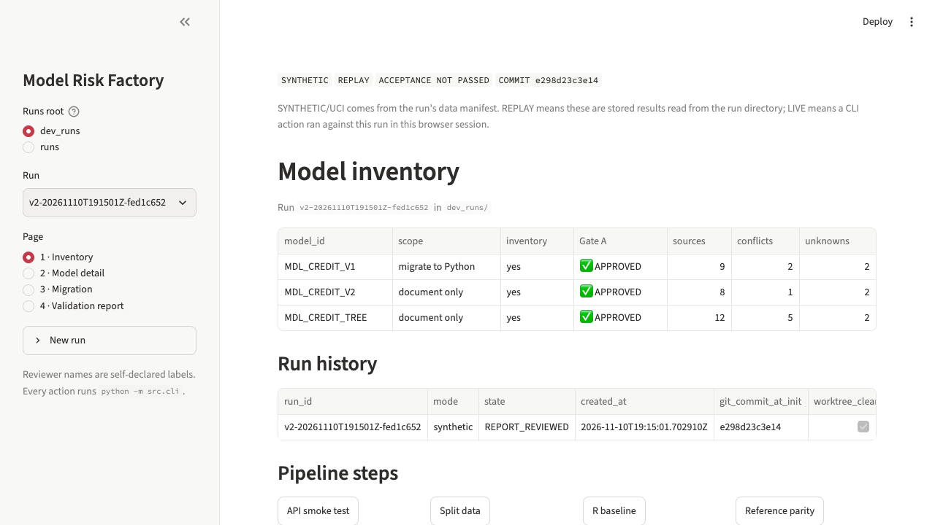
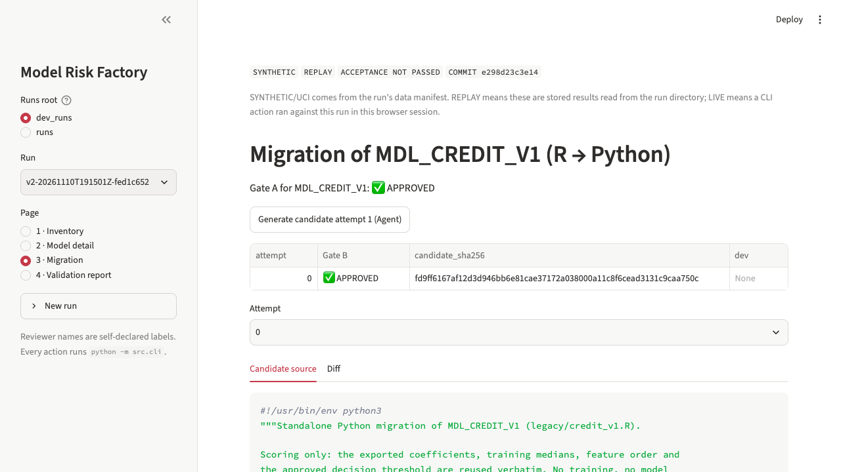
9/10
Prototype walkthrough and release state
Four Streamlit pages over the same CLI the pipeline uses — every button runs python -m src.cli, so the UI cannot bypass a gate.
• Inventory, Model detail (Gate A), Migration (Gate B + Docker), Validation report (Gate C + downloads).
• The 1:51 demo replays a synthetic run. The current drill pauses at every gate for a reviewer decision.
• Release state, stated plainly: v1 accepted locally (tag v1 → 70858cd, 7/7 PASS, not pushed). v2 BLOCKED, because its evidence matches no commit (17 gaps). The single v3 formal run (seed 47) is scripted and preflight-checked, and waits on the organiser's UCI permission, ledger confirmation and named reviewers.
docs/v3/00_baseline_status.md, docs/v3/03_release_readiness.md, docs/v3/02_new_environment.md; screenshots in docs/v3/ui_screens/.

Slide 10
10/10
Roadmap and disclosure
Why this is different: approvals bind exact hashes and expire on any change; every report number resolves to a JSON path; parity is proven record by record and mutation-tested.
• Short term: one authorised formal seed-47 run on the frozen commit, human Gate A/B/C sign-off, recorded demo of the same chain.
• Then: SAS/other formats behind the same inventory contract; batch queue across ~250 models; MLflow/Azure ML as an evidence sink, not a replacement for the gates; genuine out-of-time data for back-testing.
• AI tools used: Claude Code / Kimi Code CLI (implementation, tests, docs) and this delivery Agent; in-product gateway sa.kaiwen.dev with deepseek-v4.1-flash:1017 for inventory extraction, candidate generation and report explanation (v1 candidate used kimi-k2.7-code).
• Existing code and data: R glm/rpart/jsonlite, Python NumPy/pandas/Pydantic/pytest/Docker/Streamlit, the UCI dataset, and the three team-built R models plus their simulated notes.
• What is human-written: the trusted Python reference predictor and the fixed tests. What is Agent-written: the migration candidate, the inventories and the report narrative.
README.md (AI tool and existing-code disclosure), HIST-UCI provider/request_log.jsonl, agent_audit_log.jsonl, V1-UCI candidate.json.

