Slide 1
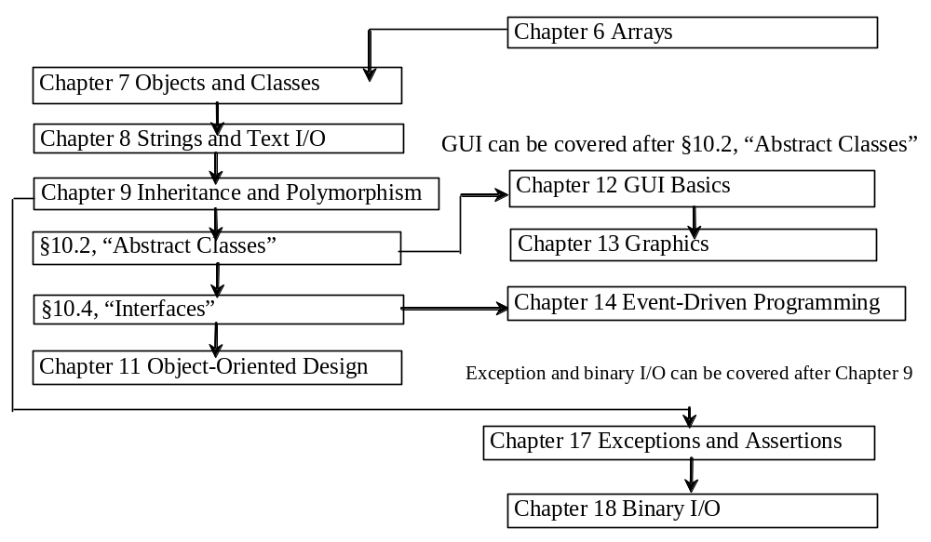
Chapter 8 Strings and Text I/O

Slide 2
Objectives
To use the String class to process fixed strings (§8.2).
To use the Character class to process a single character (§8.3).
To use the StringBuilder/StringBuffer class to process flexible strings (§8.4).
To know the differences between the String, StringBuilder, and StringBuffer classes (§8.2-8.4).
To learn how to pass strings to the main method from the command line (§8.5).
(Optional) To use the regular expressions to represent patterns for matching, replacing, and splitting strings (§8.6).
To discover file properties, delete and rename files using the File class (§8.7).
To write data to a file using the PrintWriter class (§8.8.1).
To read data from a file using the Scanner class (§8.8.2).
(Optional GUI) To add components to a frame (§8.9).

Slide 3
8.2 The String Class
Constructing a String:
  String message = "Welcome to Java“;
  String s = new String();
Obtaining String length and Retrieving Individual Characters in a string
String Concatenation (concat)
Substrings (substring(index), substring(start, end))
Comparisons (equals, compareTo)
String Conversions
Finding a Character or a Substring in a String
Conversions between Strings and Arrays
Converting Characters and Numeric Values to Strings

Slide 4
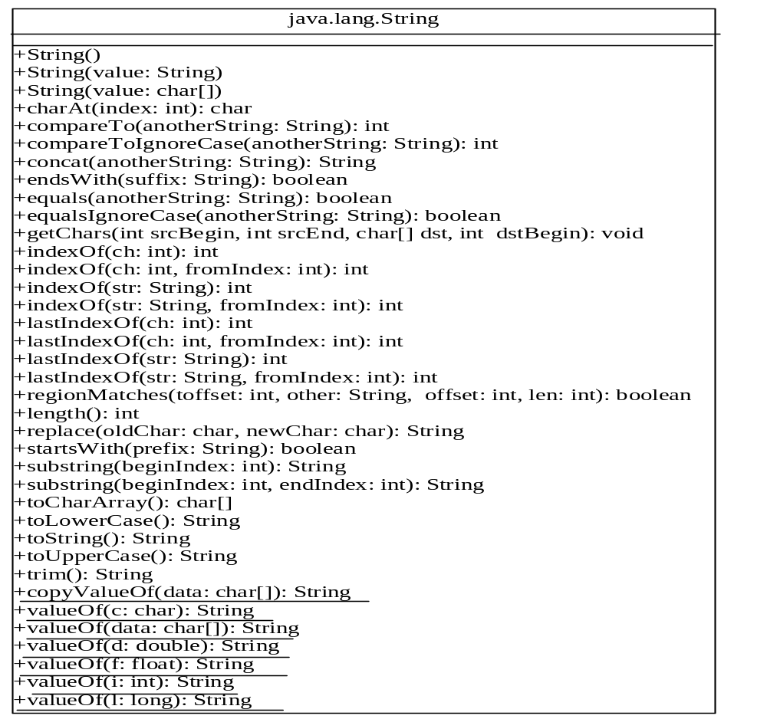

Slide 5
8.2.1 Constructing Strings
String newString = new String(stringLiteral);
  String message = new String("Welcome to Java");
Since strings are used frequently, Java provides a shorthand initializer for creating a string:
  String message = "Welcome to Java";

Slide 6
8.2.2 Strings Are Immutable
Does the following code change the contents of the string?
String s = "Java";
s = "HTML";
Notes:
A String object is immutable; its contents cannot be changed.

Slide 7
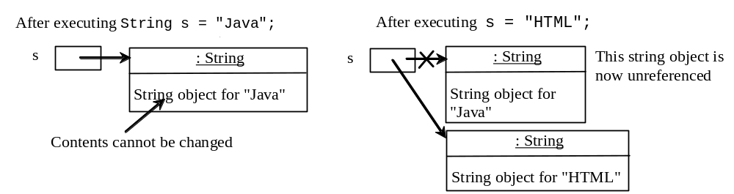
Trace Code
animation
String s = "Java";
s = "HTML";

Slide 8
Trace Code
animation
String s = "Java";
s = "HTML";

Slide 9
Interned Strings（限定字符串）
Since strings are immutable and are frequently used, to improve efficiency and save memory, the JVM uses a unique instance for string literals with the same character sequence.
Such an instance is called interned(限定的).
You can also use a String object’s intern method to return an interned string.

Slide 10
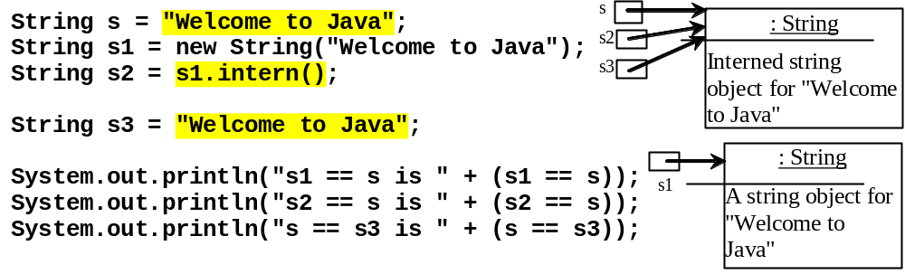
Examples
display
s1 == s is false
s2 == s is true
s == s3 is true
A new object is created if you use the new operator.
If you use the string initializer, no new object is created if the interned object is already created.
Notes:
String s = "Welcome to Java";
String s1 = new String("Welcome to Java");
String s2 = s1.intern();
String s3 = "Welcome to Java";
String s4=s1;
System.out.println("s1 == s is " + (s1 == s));
System.out.println("s2 == s is " + (s2 == s));
System.out.println("s == s3 is " + (s == s3));
System.out.println(“s == s4 is ” + (s == s4)); (false)
System.out.println("s1 == s4 is " + (s1 == s4)); (true)

Slide 11
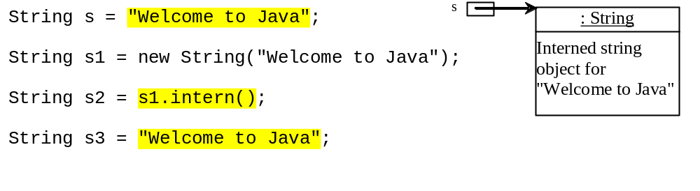
Trace Code
animation

Slide 12
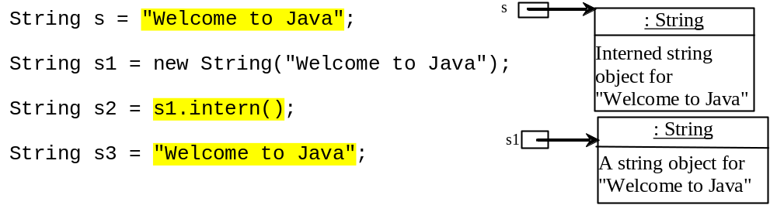
Trace Code

Slide 13
Trace Code
s2

Slide 14
Trace Code
s2
s3

Slide 15
8.2.3 String Comparisons
equals
String s1 = new String("Welcome“);
String s2 = "welcome";
if (s1.equals(s2)){
// s1 and s2 have the same contents
}
if (s1 == s2) {
// s1 and s2 have the same reference
}

Slide 16
String Comparisons, cont.
compareTo(Object object)
String s1 = new String("Welcome“);
String s2 = "welcome";
if (s1.compareTo(s2) > 0) {
// s1 is greater than s2
}
else if (s1.compareTo(s2) == 0) {
// s1 and s2 have the same contents
}
else
// s1 is less than s2

Slide 17
8.2.4 字符串长度及提取单个字符串
Finding String Length
Finding string length using the length() method:
message = "Welcome";
message.length() (returns 7)

Slide 18
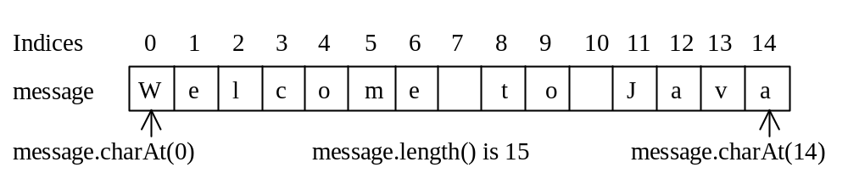
Retrieving Individual Characters in a String
Do not use message[0]
Use message.charAt(index)
Index starts from 0

Slide 19
8.2.5 String Concatenation
String s3 = s1.concat(s2);
String s3 = s1 + s2;
s1 + s2 + s3 + s4 + s5 same as
(((s1.concat(s2)).concat(s3)).concat(s4)).concat(s5);

Slide 20
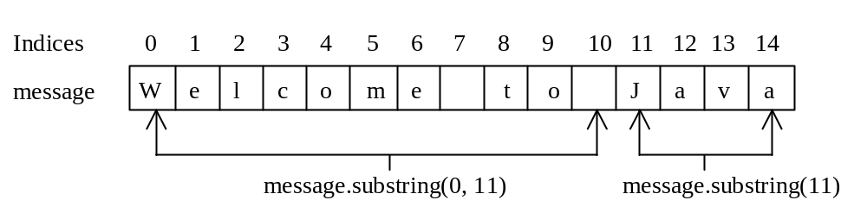
8.2.6 Extracting Substrings
You can extract a single character from a string using the charAt method. You can also extract a substring from a string using the substring method in the String class.
String s1 = "Welcome to Java";
String s2 = s1.substring(0, 11) + "HTML";
Notes:
substring()函数名全小写

Slide 21
8.2.7 String Conversions
The contents of a string cannot be changed once the string is created. But you can convert a string to a new string using the following methods:
toLowerCase
toUpperCase
trim
replace(oldChar, newChar)

Slide 22
8.2.8 Finding a Character or a Substring in a String
"Welcome to Java".indexOf('W') returns 0.
"Welcome to Java".indexOf('x') returns -1.
"Welcome to Java".indexOf('o', 5) returns 9.
"Welcome to Java".indexOf("come") returns 3.
"Welcome to Java".indexOf("Java", 5) returns 11.
"Welcome to Java".indexOf("java", 5) returns -1.
"Welcome to Java".lastIndexOf('a') returns 14.

Slide 23
8.2.9 字符串与数组之间的转换
char[] chars=“Java”.toCharArray();
char[] dst={‘j’,’a’,’v’,’a’,’1’,’3’,’0’,’1’};
“cs3720”.getChars(2,6,dst,4);
String str=new String(new char[] ={‘j’,’a’,’v’,’a’});
String str=String.valueOf(new char[] ={‘j’,’a’,’v’,’a’});
Notes:
getChars(int srcBegin, int srcEnd, char[] dst, int dstBegin)
“cs3720”.getChars(2,6,dst,4);使dst变成了“java3720”

Slide 24
8.2.10 Convert Character and Numbers to Strings
The String class provides several static valueOf methods for converting a character, an array of characters, and numeric values to strings.
These methods have the same name valueOf with different argument types char, char[], double, long, int, and float.
For example, to convert a double value to a string, use String.valueOf(5.44). The return value is string consists of characters ‘5’, ‘.’, ‘4’, and ‘4’.

Slide 25
8.2.11 Example:
Finding Palindromes（检测回文串）
Objective: Checking whether a string is a palindrome: a string that reads the same forward and backward.(P.212)
CheckPalindrome
Run

Slide 26
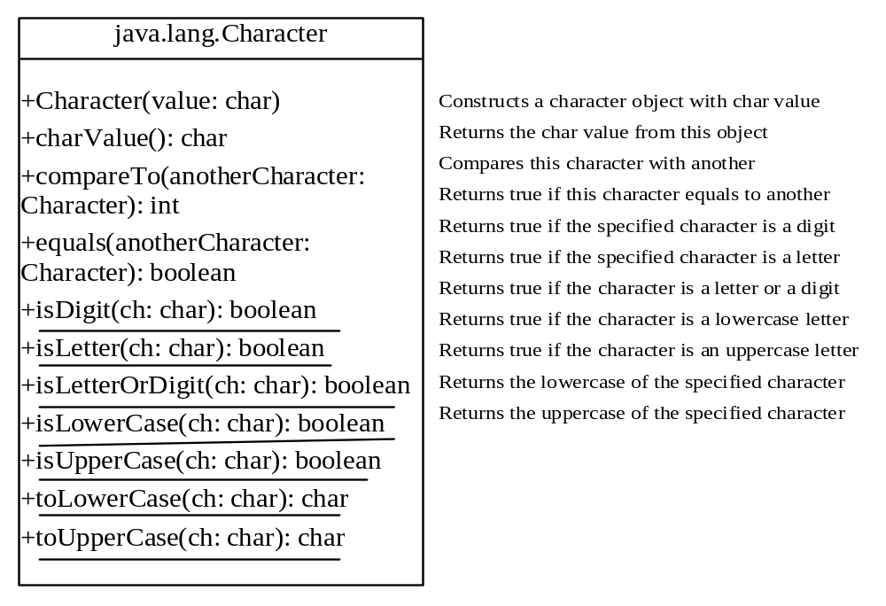
8.3 The Character Class
Notes:
方法中带下划线的是静态方法

Slide 27
Examples
Character charObject = new Character('b');
charObject.compareTo(new Character('a')) returns 1
charObject.compareTo(new Character('b')) returns 0
charObject.compareTo(new Character('c')) returns -1
charObject.compareTo(new Character('d') returns –2
charObject.equals(new Character('b')) returns true
charObject.equals(new Character('d')) returns false

Slide 28
Example: Counting Each Letter in a String
This example gives a program that counts the number of occurrence of each letter in a string. Assume the letters are not case-sensitive.
CountEachLetter
Run

Slide 29
8.4 StringBuilder/ StringBuffer
The StringBuilder/StringBuffer class is an alternative to the String class.
In general, a StringBuilder/StringBuffer can be used wherever a string is used.
StringBuilder/StringBuffer is more flexible than String.
  You can add, insert, or append new contents into a string buffer, whereas the value of a String object is fixed once the string is created.

Slide 30
StringBuilder vs. StringBuffer
The StringBuilder class, introduced in JDK 1.5, is similar to StringBuffer except that the update methods in StringBuffer are synchronized.
  Use StringBuffer if it may be accessed by multiple tasks concurrently.
  Using StringBuilder is more efficient if it is accessed by a single task.
  The constructors and methods in StringBuffer and StringBuilder are almost the same.
This book covers StringBuffer. You may replace StringBuffer by StringBuilder. The program can compile and run without any other changes.

Slide 31
8.4.1 修改缓冲区中的字符串
The StringBuffer class is an alternative to the String class. In general, a string buffer can be used wherever a string is used.
StringBuffer is more flexible than String. You can add, insert, or append new contents
into a string buffer. However, the value of
a String object is fixed once the string is created.

Slide 32
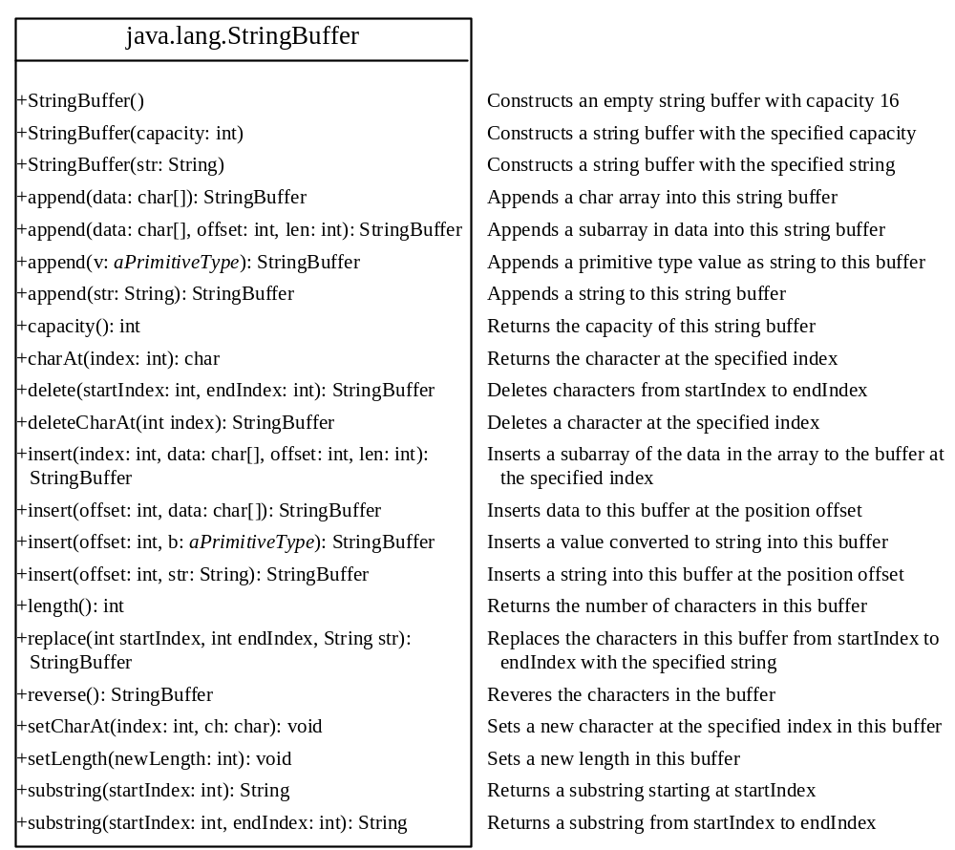

Slide 33
StringBuffer Constructors
public StringBuffer()
容量为16的空字符串缓冲区
public StringBuffer(int length)
No characters, initial capacity specified by the length argument.
public StringBuffer(String str)
Represents the same sequence of characters
as the string argument. Initial capacity 16
plus the length of the string argument.

Slide 34
Appending New Contents into a String Buffer
StringBuffer strBuf = new StringBuffer();
strBuf.append("Welcome");
strBuf.append(' ');
strBuf.append("to");
strBuf.append(' ');
strBuf.append("Java");

Slide 35
8.4.2 toString, capacity, length, setLength和charAt方法
toSting()：返回字符串
capacity()：返回容量
length()：返回长度
setLength()：设置缓冲区长度
charAt()：返回指定的字符

Slide 36
8.4.3 Example:
Checking Palindromes Ignoring Non-alphanumeric Characters
This example gives a program that counts the number of occurrence of each letter in a string. Assume the letters are not case-sensitive. (P.217)
  删除非字母和非数字字符
  倒置过滤后的字符，并进行比较
PalindromeIgnoreNonAlphanumeric
Run

Slide 37
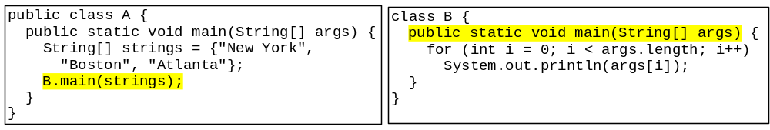
8.5 命令行参数
You can call a regular method by passing actual parameters. Can you pass arguments to main? Of course, yes. For example, the main method in class B is invoked by a method in A, as shown below:

Slide 38
8.5.1 向main方法传递字符串
class TestMain {
public static void main(String[] args){
...
}
}
java TestMain arg0 arg1 arg2 ... argn
问题：Eclipse中如何向程序的主函数传递参数？

Slide 39
Processing
Command-Line Parameters
In the main method, get the arguments from args[0], args[1], ..., args[n], which corresponds to arg0, arg1, ..., argn in the command line.
Notes:
Example 12.4

Slide 40
8.5.2 Example: Using Command-Line Parameters
Objective: Write a program that will perform binary operations on integers. The program receives three parameters: an operator and two integers.
java Calculator 2 + 3
Calculator
“*” ？？
java Calculator 2 - 3
Run
java Calculator 2 / 3
java Calculator 2 “*” 3
Notes:
符号“*”用于命令行时，表示当前目录下的所有文件

Slide 41
8.6 Regular Expressions(正则表达式)
Optional
A regular expression (abbreviated regex) is a string that describes a pattern for matching a set of strings.
Regular expression is a powerful tool for string manipulations. You can use regular expressions for matching, replacing, and splitting strings.

Slide 42
8.6.1 Matching Strings
Optional
"Java".matches("Java");
"Java".equals("Java");
"Java is fun".matches("Java.*")
"Java is cool".matches("Java.*")
"Java is powerful".matches("Java.*")

Slide 43
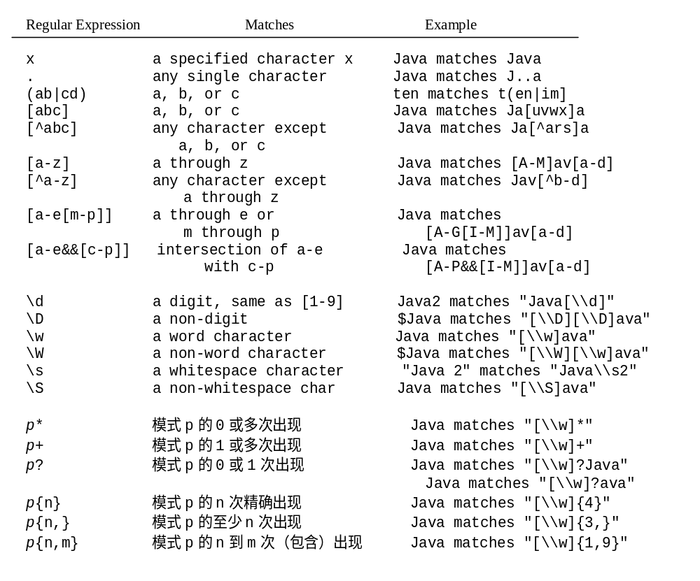
8.6.2 Regular Expression Syntax
Optional
Notes:
一个词字符（word character）是任何字母、数字与下划线字符。

Slide 44
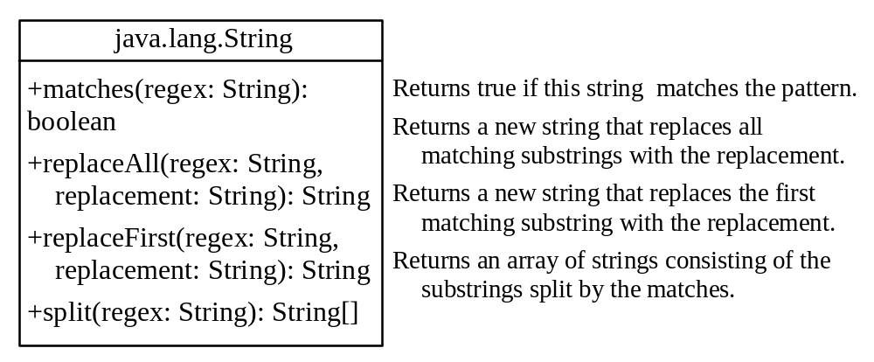
8.6.3 Replacing and Splitting Strings
Optional

Slide 45
Examples
Optional
String s = "Java Java Java".replaceAll("v\\w", "wi") ;
String s = "Java Java Java".replaceFirst("v\\w", "wi") ;
String[] s = "Java1HTML2Perl".split("\\d");

Slide 46
8.7 The File Class
The File class is intended to provide an abstraction that deals with most of the machine-dependent complexities of files and path names in a machine-independent fashion.
The filename is a string. The File class is a wrapper class for the file name and its directory path.

Slide 47
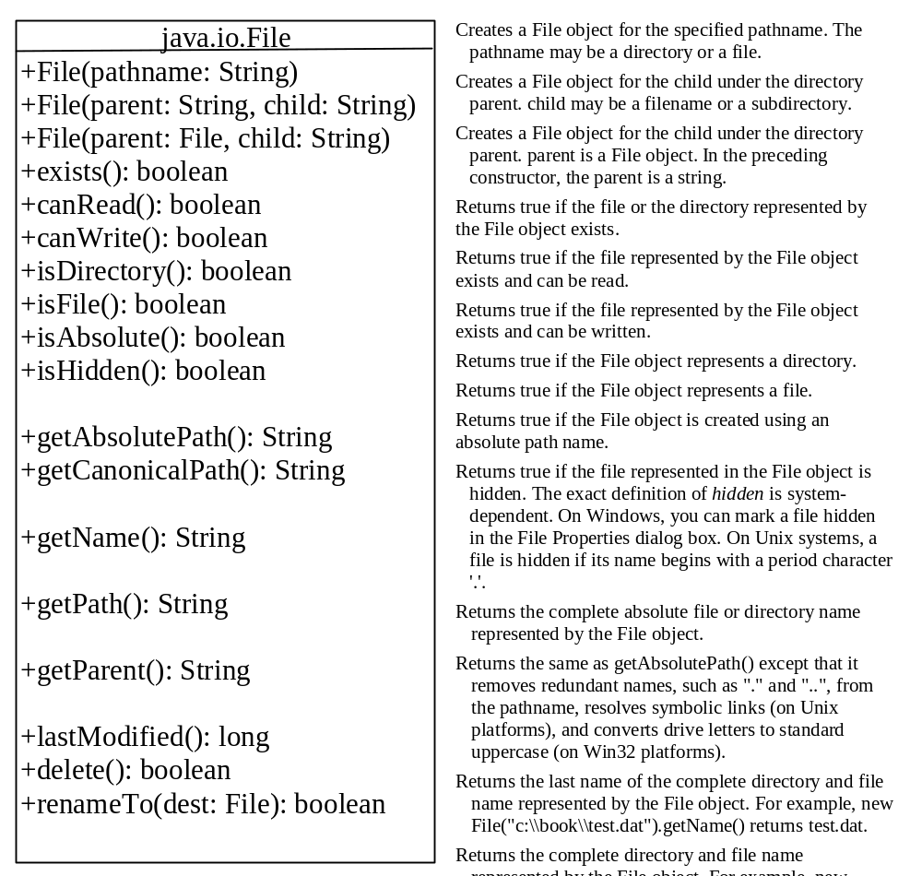
Obtaining file properties and manipulating file

Slide 48


Example: Using the File Class
Objective: Write a program that demonstrates how to create files in a platform-independent way and use the methods in the File class to obtain their properties. Figure 16.1 shows a sample run of the program on Windows, and Figure 16.2 a sample run on Unix.
TestFileClass
Run

Slide 49
8.8 Text I/O（文本I/O）
A File object encapsulates the properties of a file or a path, but does not contain the methods for reading/writing data from/to a file.
In order to perform I/O, you need to create objects using appropriate Java I/O classes. The objects contain the methods for reading/writing data from/to a file.
This section introduces how to read/write strings and numeric values from/to a text file using the Scanner and PrintWriter classes.

Slide 50
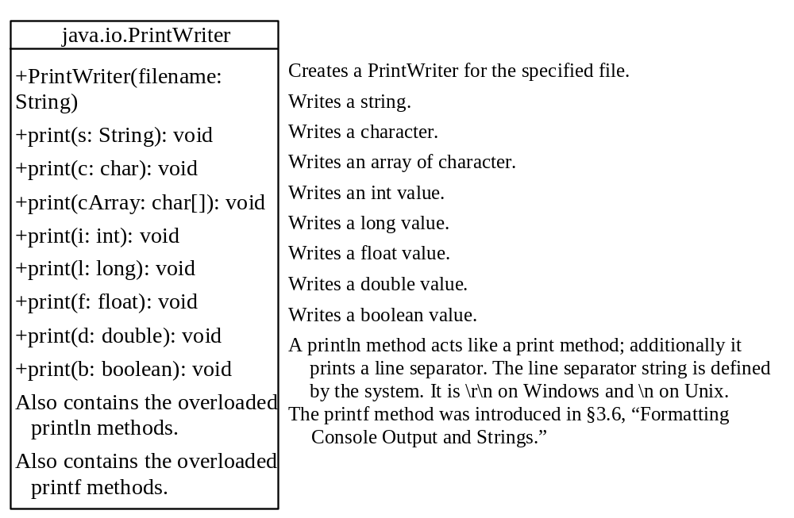
8.8.1 Writing Data Using PrintWriter
WriteData
Run

Slide 51
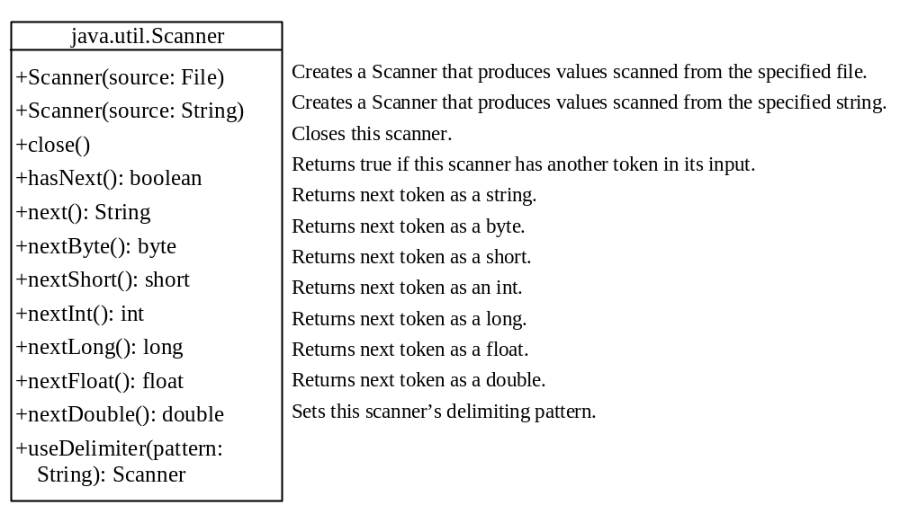
8.8.2 Reading Data Using Scanner
ReadData
Run

Slide 52
8.8.3 Example: Replacing Text
Write a class named ReplaceText that replaces a string in a text file with a new string. The filename and strings are passed as command-line arguments as follows:
  java ReplaceText sourceFile targetFile oldString newString
For example, invoking
  java ReplaceText FormatString.java t.txt StringBuilder StringBuffer
  replaces all the occurrences of StringBuilder by StringBuffer in FormatString.java and saves the new file in t.txt.
ReplaceText
Run

Slide 53
8.9 Containers and Layout Managers
Optional
GUI
Objective: Add a button to the frame.
HoldComponents
Run

Slide 54
Using FlowLayout Manager
Optional
GUI
Objective: Add a button to the frame of FlowLayout.
UseFlowLayout
Run

Slide 55
Adding Multiple Components
Optional
GUI
Objective: Add two buttons to the frame of FlowLayout.
TwoButtons
Run

Slide 56
本章作业
一般：8.4、8.14
较难：8.5、8.12、8.23

Slide 57
第9章作业
一般：9.1、9.2 、9.6

Slide 58
第10章作业
一般：10.2、10.6、10.7、10.9
较难：10.10

Slide 59
第11章作业
一般：11.3
较难：11.4

