Slide 1
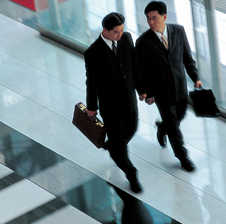
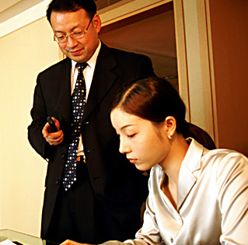
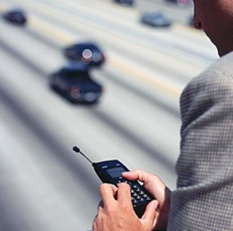


Unit 4
Verbal Communication

Slide 2
Objectives
Learn the culturally loaded words
Learn the cultural reflections on proverbs
Learn taboos
Learn the differences in cultural thought patterns

Slide 3
CONTENTS
I. Warm-up cases
II. Detailed Study:
culturally loaded words
cultural reflections on proverbs
taboos
differences in cultural thought patterns
III. Summary
IV. Assignments

Slide 4
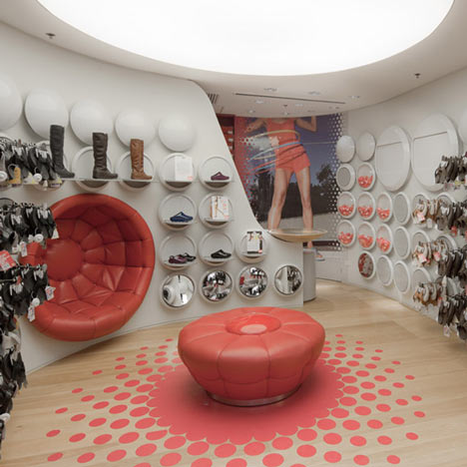
I. Warm-up cases
Case 1. Shoes for Street Walking
Question : Why did the Italian shop owner
make such a blunder?
Shoes for street walking.
Come in and have a fit.

Slide 5
Interpretation
a street walker----- a prostitute
to have a fit--------to become suddenly and violently angry or upset

Slide 6
Case 2. A Misunderstanding Caused by a Joke
Roger, the Personnel Executive of a large American multinational firm, worked in Brazil to help promote business.
Rosalita, a Brazilian woman Roger had known for some time. Roger generally had a very good impression of her and always felt at ease with her.
One evening, they met at a party, attended by both Roger’s employees from the United States and many Brazilian business people.

Slide 7
Case 2. A Misunderstanding Caused by a Joke
Rosalita said to Roger, “I’d like to introduce you to one of my good friends. She is a very capable woman and is presently thinking of working in a joint venture so she can provide a better living for her large family. She is very much interested in your company.”
Hearing that, Roger smiled and replied, “OK, but I just hope I don’t get hustled.”
Very soon, Rosalita excused herself as politely as she could, and did not speak with Roger for the rest of the evening. Roger was confused by Rosalita’s behavior.

Slide 8
Case 2. A Misunderstanding Caused by a Joke
Question: Could you give Roger an
explanation?
Hustle---- to force sb to make a decision
before they are ready or sure
(强迫、打扰)
-----to work as a prostitute /
romance or sex is hinted
(欺骗、卖淫、勾搭)
Comment:

Slide 9
Case 2. A Misunderstanding Caused by a Joke
As a Personnel Executive of a large American multinational firm, Roger must have attended many parties. At these parties, he will always encounter people eager to get a job from him in his company, so he often gets hustled. This is just what Roger was implying to Rosalita regarding her friend.
However, the word “hustle” has another meaning in which romance or sex is hinted. Rosalita must have thought Roger was referring to this and considered it as an insult to her friend.

Slide 10
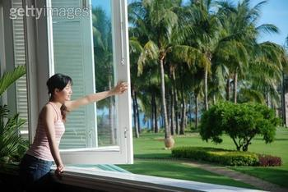
Case 3 Look out
A foreign student in the U.S.
was sitting by a window
reading a book.
She heard someone yelling
“Look out!”, so she stuck her
head out of the window.
Just then a board hurtled down from above, narrowly missing her. She looked up, half in anger and half in fright.
There was a man on the roof doing repairs. “Didn’t you hear me call ‘Look out’?” he demanded. “Yes, and that’s what I did,” she replied.

Slide 11
Case 3 Look out
Look out---- to stick your head outside of
sth. (window/door) ; to take a look
(向外看)
----to be careful, especially when there is
danger (小心、当心)
类似look out一样容易被误解的表达：
Watch out 小心 Look after 照看
Look up 查找
Questions for discussion:
In this case, what does “look out” mean? Could you give a similar case like this?

Slide 12
II. Detailed Study
1.Culturally Loaded Words
What is loaded words?
Loaded words and phrases are those which have strong emotional overtones (n. 暗示，弦外音，寓意) or connotations (n. 涵义，言外之意), and which evoke strongly positive or negative reactions beyond their literal meaning.

Slide 13
Animals in English and Chinese
Dragon--- in Chinese culture, it is a totem with many royal associations, such as 龙颜，龙床，龙袍， 龙体，龙榻，龙心大喜, 龙颜大怒。And all the Chinese people call themselves to be the offspring of the dragon。
In the English culture, dragon refers to a giant horrible animal like the lizard, meaning being terrible or disgusting. Therefore, in the west a person like a dragon usually implies that he is horrible, vicious and disgusting.

Slide 14
Animals in English and Chinese
Phoenix--- In China, it refer to an auspicious bird, implying that peace reign in the world. Also it refers to the queen or the holy person, such as 凤冠， 风辇。In English it refer to a kind of bird which has been burnt to death, regenerating from the ashes. Therefore, phoenix means reviving or regenerating in the western country.

Slide 15
Animals in English and Chinese
Dogs– In the west, dogs are the faithful friends for the mankind and the lovable pets in the family. Therefore the idiom related to dogs usually have the positive meaning, such as a lucky dog 幸运儿；an old dog 老手； Every dog has its day. 凡人皆有得意日。He works like a dog. 他工作很努力。Love me, love my dog. 爱屋及乌。
In China, dogs are insulting languages, meaning being despicable and hateful, so the idioms related to dogs usually has negative meanings, such as 走狗，丧家犬，看门狗，狗急跳墙，狗仗人势，狼心狗肺，鸡鸣狗盗，蝇营狗苟。

Slide 16
Animals in English and Chinese
Owl– In China it has something to do with death, implying being unlucky; in the west, owl relates to cleverness, wiseness, in English a person like an owl suggests that he is as clever as an owl.
Peacock– In Chinese it is an auspicious bird, so when the peacock spreads it tail, it represents auspiciousness, prosperity and peace. However, in English, peacock usually means being pleased with oneself or showing off oneself, therefore, a person like a peacock suggests that he is as proud as a peacock

Slide 17
Owl
In English: as wise as an owl 象猫头鹰一样聪明
In Chinese: 猫头鹰进宅, 好事不来
bear
In English: He is a bear at maths (他是个数学天才)
In Chinese: “瞧他那个熊样儿”、“真熊”

Slide 18
。
fish
In Chinese:
年年有余(鱼)
In English:
a poor fish
a loose fish
fish in the air
可怜虫
生活放荡的女人
水中捞月

Slide 19
Please choose the proper animal words for each phrase.
hare horse snail mouse bee mule
bee
as busy as a ______
as slow as a ______
snail
as stubborn as a ______
mule
as timid as a _____
hare
horse
as strong as a _____
mouse
as poor as a church _____

Slide 20
A dog’s life
  争吵不休，过着不安宁的日子
Go to the dogs
  每况愈下
Dog-eat-dog
  狗咬狗的，损人利己的
Dog in the manger
  站着茅坑不拉屎
Dog days
  大热天
Doggy bag
  餐馆里的打包袋

Slide 21
Better be the head of a dog than the tail of a lion.
drink like a fish
tread upon eggs
宁为鸡头，不为凤尾。
牛饮
如履薄冰

Slide 22
Chinese:
胆小如鼠
狐假虎威
瓮中之鳖
English:
as timid as a rabbit/chicken-hearted
an ass in a lion’s skin
like a rat in a hole

Slide 23
Chinese:
落汤鸡
母老虎（比丈夫强的妻子）
English:
like a drenched chicken; like a drowned rat
grey mare

Slide 24
Can you find the equivalent words in English
for these Chinese words?
干部----cadre
母马----female horse?/mare?
扁担---a carrying pole; a shoulder pole
一本书--- a book
知识分子----intellectual
社会科学-social science?/the humanities?

Slide 25
知识分子
In CC, it refers to people including college teachers, college students, middle school teachers, and such people as medical doctors, engineers, interpreters.
In EC, it refers to people of high academic status (college professors) –much smaller range of people.
not always a complimentary term, sometimes used in derogatory sense.

Slide 26
干部
----a small group of people who are specially chosen and trained for a particular purpose.骨干队伍
----a member of this kind of group.干部
In EC, many people don’t know what it
means. (not a common word)
Some other substitutes:
official, functionary, administrator, etc.
But none of these gets exact same meaning as Chinese word “干部”.

Slide 27
社会科学
Social Sciences in Chinese covers all the fields except the ones in the natural science and applied sciences. Same as “the humanities” in English.
While in English, “social sciences” cover a smaller area of learning. It includes political science, economics, history (often classified under the humanities) and sociology. ----the branches of learning that study human society, especially its organization and relationship of individual members to it.

Slide 28
Birds and animals/ male or female
Generic term male female the young
chicken cock/rooster hen chick
duck drake duck duckling
goose gander goose gosling
horse stallion mare foal
cattle/cow bull cow calf
dog dog bitch puppy
sheep ram ewe lamb
deer stag doe fawn
pig boar sow shoat

Slide 29
bull, cow, cock or hen, male, female, she
Not all animals or birds have specific names that denote different sex.
a. bull, cow, cock or hen are frequently used to distinguish sex.
e.g. bull seal/cow seal; bull elephant/cow elephant;
cock pheasant/ hen pheasant; cock sparrow/hen sparrow
b. male, female , she also acceptable
e.g.male leopard, female panda, she wolf

Slide 30
副
副主席 vice-chairman
副教授 associate professor
副主任 deputy director
副秘书长 assistant secretary
副州长 lieutenant governor
副国务卿 undersecretary

Slide 31
Colors in Chinese and English
Red--In Chinese, red usually has something to do with happiness, fortunes, fervency, auspiciousness. Such as, 红喜字，红盖头，红地毯，红灯笼，红包，红利，满堂红。Also, red denotes the revolution. Such as 红旗，红领巾，红军，红色根据地。
In English red has something to do with blood or infelicity, implying bleeding, danger or violence. For example, red in tooth and claw 血淋淋；a red tag to the bull 令人生气的事情, be in the red 负债亏空；see red 大发脾气，red revenge 血腥复仇

Slide 32
Colors in Chinese and English
Yellow– In Chinese, yellow has something with sovereign, harvest, and wealth. For example, 黄袍，黄榜，黄道吉日。 Also it is related to something pornographic and scurrilous, such as 黄色电影，黄色小说，黄碟。
In English, yellow just refers to a color existing in our life, such as, yellow card 黄牌， a yellow alarm 黄色警报， yellow line 黄线，yellow light 黄灯， yellow page 黄页。

Slide 33
Colors in Chinese and English
green– In Chinese, green is relevant to peace, safety, hope, environmental protection, such as 绿色食品，green food; 绿色产业 green industry; 绿色能源，green power，绿色产品，green products. Sometimes, it has something to do with the adultery between men and women, such as 绿帽子， 绿头巾.
In English, green is the most valuable color in the nature, also, it means immature, such as green tomatoes 不成熟的人. As well green implies being envy with somebody such as green with envy.

Slide 34
green
a green hand(生手，易上当受骗的人)，
green goods(新鲜货)，
a green man(新来水手)，
a green old age(老当益壮)等等。
green-eyed“嫉妒”、“眼红”
You are expecting too much of him. He is still green, you know.
（你对他要求过高，他还没经验嘛。）
green back “美钞”
green power “金钱的力量”或“财团”

Slide 35
White: the color of snow
Western country
Fair,pure(in the wedding)
Lucky (eg. a white day)
Conservative
Modern meaning:equal, from the film “white”
China
Unlucky(葬礼，白事）
Crafty(奸诈的，eg.白脸的曹操）
Vain (eg.没效果，白费力气）
不付出代价而享受（eg.吃白食，小白脸）

Slide 36
White
Snow White, white Christmas, a white soul
the White House
He has white hands.
white hand有“pure”(纯洁)、或“unstained”(清白)之意。

Slide 37
white war指没有硝烟的战争，常指“经济竞争”。
white elephant（昂贵却派不上用场的物体或物主不需要但又无法处置之物） white goods
表示纯洁、美好、善意、合法、公平、幸福、轻轻的、政治上反动等
a white flag

Slide 38
白色
“白手” “白手起家”
start from scratch; build up from nothing
白眼
the tired look
白丁
very common people
表示清楚、明白、陈述、纯净、无代价的、无效的、政治上反动的等

Slide 39
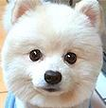
“White” in Chinese
白班day shift
白鹭egret
白内障cataract
白痴 idiot
白开水plain boiled water
白血病 leukemia
白眼 supercilious
白手起家to start from scratch

Slide 40
Black: the color of night or coal
Western country
Evil(e.g..black mail)
Unlucky VS.white meaning unluckiness in Chinese
Hopeless (e.g..thing was beginning to look pretty black for us)
China
Righteous(e.g..黑脸的包公铁面无私）
The same as western country – evil(黑社会）
Secret (e.g..黑话）

Slide 41
black
black money（黑钱）
black market（黑市交易或黑市）
a black letter day 不吉祥的日子，倒霉的一天
black ox 不幸
black figure，in the black都表示“盈利”、“赚钱”
表示 “严重的，不受欢迎的，不吉利的、罪恶的、不合适的、不合法的、愤怒的”等

Slide 42
“黑色”
黑心人
the very cruel people
黑帮
the reactionary organizations gathered secretly
多表示贬意如“阴暗的、非法的、秘密的、坏的、狠毒的等

Slide 43
Black in Chinese
黑眼镜sun glasses
黑货smuggled goods
黑心肠evil mind
黑话cant
黑体字boldface type
黑咕隆咚pitch-dark
黑死病the plague
黑更半夜in the dead of night

Slide 44
Translation of black
1.black tea
红茶(而不译为黑茶)
汉语中的“红茶”译成英语是“black tea”，字面上意为“黑茶”，这是因为汉语针对茶水的颜色而言，故称其为“红”，而英语的着眼点则放在茶叶的颜色上，故称其为“黑”。
2.black and blue
青一块紫一块(而不是青一块黑一块)

Slide 45
Blue: the color of sky
China
表示天空和大海的颜色。
京剧中的蓝脸表示人物刚直勇猛、坚毅勇敢、桀骜不驯，有心计等 如窦尔敦，单雄信，马武等。
Western country
Sad (eg. get the blues; blues—a slow sad style of music that came from the southern US)
Obscene(mentioned above, blue book)
Noble, highly privileged(e.g.blue-blooded=belonging to a royal or noble)
Modern meaning: freedom(from the film “blue”)

Slide 46
blue
he is a real blue blood.（他是真正的贵族。）
blue-eyed boys “受到管理当局宠爱和特别照顾的职工”
blue book （蓝皮书）
blue-sky market（露天市场），
blue-collar workers（从事体力劳动的工人）

Slide 47
blue
You look blue today. What‘s wrong with you?
你今天看起来闷闷不乐，出了什么事？
“忧郁，伤感，沮丧”
a blue Monday
(倒霉的星期一)
in a blue mood
(情绪低沉)
blue moon; once in a blue moon
“罕见之至，极不可能”"千载难逢

Slide 48
Grey: the mixed color of black and white
Western country
Experienced( e.g. grey hand老手）
Boring (e.g. a grey book)
Gloomy(e.g. grey prospects)
Reliable,expensive(灰色是西方消费者联想到贵重的，质量可靠的商品）
China
also the meaning –gloomy,depressed (e.g. 灰心丧气，心灰意懒）
Cheap,unqualified(灰色使消费者联想到廉价货，水货）

Slide 49
Purple: the mixed color of red and blue
Western country
Royal(e.g..born to the purple=born into a high social class)
Flashy and without substance(华而不实的，e.g..a purple passage)
China
Propitious(祥瑞，e.g..紫气冲天，紫气东来）

Slide 50
Pink: pale red
Western country
Healthy(e.g.. In the pink=in good shape)
Mostly referred to female(e.g.. Pink jobs:女性的职业）
China
Related with the color of peach
Romantic (e.g.桃花运）
The vague relationship between men and women (桃色新闻）

Slide 51
Numbers in English and Chinese
In china, Three, six eight and nine are usually regarded the auspicious numbers, and these numbers or dates are usually used in our daily life. Also, nine is the largest one in the ten Arabic numbers with the partial tone with the Chinese character “久” meaning forever. Therefore, most emperors in China admired this number which can be reflected in the architecture of the Palace Museum. Also there are some other idioms related nine in Chinese

Slide 52
Numbers in English and Chinese
such as “九流， 九泉，九族，九品，九连环，九牛二虎，九九重阳，九九艳阳天.
However, four and five have the partial tone with the Chinese character “死”
“无” . Therefore, these numbers are regarded unlucky. In the west, thirteen is regarded as the unlucky number which is related with the story of the Jesus death. If it is 13th on Friday, it is called the Black Friday, meaning the most unfortunate day.

Slide 53
Summary
A term in one language does not necessarily have a counterpart in the other language;（扁担）
Words or terms in both language appear to refer to the same object or concept only on the surface, but actually refer to quite different things;（龙）

Slide 54
Things or concepts are represented by one or perhaps two terms in one language, but by many more terms in the other language, ie, finer distinctions exist in the other language;（社会科学）
Terms have more or less the same primary meaning, but have secondary or additional meanings that may differ considerably from each other.（龙）

Slide 55
2. Cultural Reflections on Proverbs
Proverbs may provide interesting glimpses or
clues to a people’s geography, history,
social organization, social views, etc.
A new broom sweeps clean.
新官上任三把火
Many hands make light work.
众人拾柴火焰高。
Don’t put off until tomorrow what you can do today. 今日事今日毕。
Kill two birds with one stone. 一箭双雕。
Haste makes waste. 欲速则不达。

Slide 56
Where there’s smoke there’s fire.
无风不起浪。
The grass is always greener on the other side of the fence.
这山望着那山高。
Beauty is only skin deep.
好花不常开，好景不常在。
Spare the rod and spoil the child.
玉不琢不成器
Give a person a dose of his own medicine.
以其人之道还治其人之身。

Slide 57
Man proposes, God disposes.
  尽人事，听天命。/ 谋事在人，成事在天。
It is a sin to steal a pin.
  勿以恶小而为之，勿以善小而不为。
Revenge is a dish that could be eaten cold.
  君子报仇，十年不晚。
Every dog has its day.
  人人皆有得意日 。/十年风水轮流转 。

Slide 58
The above expressions get similar /same meanings both in English and Chinese. But some others get dissimilarities:
良药苦口利于病，忠言逆耳利于行。
Frank advice is like good herbal medicine, had to take but ultimately beneficial.
瓜田不纳履，李下不整冠。
Neither adjust your shoes in the melon patch; nor your hat under a plum tree.
一人得道，鸡犬升天。
Even the dogs swaggers when its master wins favor.

Slide 59
Hard to find equivalents
Absence makes the heart grow fonder.
越是不见越想见。
An apple a day keeps the doctor away.
一天一苹果，医生远离我。
Let sleeping dogs lie.
莫惹是非。
You can’t teach an old dog new tricks.
年逾花甲不堪教。
You can’t have your cake and eat it too.
鱼与熊掌不可兼得。

Slide 60
Lightening never strikes the same place twice.
福无双至，祸不单行。
坏事不过二 。
祸无双至。同一灾害不会在同一场所重复发生。
One swallow does not make a summer.
一叶知秋。
一燕不成夏。一花独放不是春。

Slide 61
Surface similarities, but differences
It takes two to make a quarrel.
一个巴掌拍不响。
A miss is as good as a mile.
差之毫厘失之千里。
Gilding the lily.
锦上添花。
Life begins at forty.
三十如狼，四十如虎。
If you lie down with dogs, you will get up with fleas.
近朱者赤，近墨者黑。

Slide 62
The Proverbs in English and Chinese Culture
趁热打铁。 Strike while the iron is hot.
不入虎穴焉得虎子。
Nothing ventured, nothing gained.
打铁还得自身硬。
Forging the iron needs a strong body.
行行出状元。
Every profession produces its own best.
亡羊补牢未为晚已。It’s never too late to mend.
眼不见心不烦。Out of sight, out of mind.
物以类聚人以群分。
Birds of a feather flock together.
三思而后行. Look before your leap.

Slide 63
The Proverbs in English and Chinese Culture
Where there is a will, there is a way.
有志者事竟成。
Works make the workman. 勤工出巧匠。
Constant dropping wears the stone. 水滴石穿。
Like Father, like son. 有其父必有其子。
Great mind think alike. 英雄所见略同。
Rome wasn’t built in a day. 冰冻三尺非一日之寒。
Where there is a life, there is a hope.
留得青山在不愁没柴烧。
Spare the rod, spoil the child.
棒打出孝子，惯养忤逆儿。

Slide 64
The Mottos in the Chinese and English Culture.
It takes ten years to grow trees, but a hundred to rear people.
十年树木百年树人。
Eat to live, but not live to eat.
吃饭为了活着，活着不是为了吃饭。
A friend in need is a friend in deed.
路遥知马力，日久见人心。
Speech is silver, but silence is gold.
言语是银，沉默是金。
Two dogs strive for a bone a third runs away with it．
鹬蚌相争，渔翁得利。

Slide 65
The Mottos in the Chinese and English Culture.
山重水复疑无路，柳暗花明又一村。
Sometimes, things may seem to be pretty bad, but if you work hard, there will be a light at the end of the tunnel.
亦余心之所向兮，虽九死其犹未悔。
For the ideal that I hold dear to my heart, I’d not regret a thousands times to die.
苟利国家生死以，岂因祸福避趋之。
I shall dedicate myself to the interests of the country in life and death irrespective of personal weal and woe.

Slide 66
The Mottos in the Chinese and English Culture.
华山再高，顶有过路。
No matter how high the mountain is , one can always ascend to its top.
人或加讪，心无疵兮
My conscience stays untainted in spite of rumors and slanders from outside.
兄弟虽有小忿，不废懿亲。
Difference between brothers can not serve their ties.
不畏浮云遮望眼，只因身在最高层。
We have no fear of the clouds that may block our sight as we are already at the top of the height.

Slide 67
The Idioms Related to the Chinese Culture
吃豆腐—— to eat the bean curd
放鸽子—— to stand sb up
泼冷水—— to throw the cold water on
敲竹杠—— to rob by a trick
走过场—— to do sth as a formality
打酱油—— to walk by or be not involved in
炒鱿鱼—— to be dismissed from the office
唱高调—— to have an empty talk
拉大旗作虎皮——deck oneself and frighten
挂羊头卖狗肉—— sail under the false color

Slide 68
The Idioms Related to the Chinese Culture
丧家犬—— a person out of favor
冷板凳—— a cold reception
闭门羹—— refusal of entrance
笑面虎—— a friendly-looking villain
替罪羊—— a whipping guy
敲门砖—— a stepping stone to success
撒手锏—— the trump card or specialty
醋坛子—— a person to be jealous
此地无银三百两—— a very poor lie releasing the truth
不见兔子不撒鹰—— to take the action at the appropriate moment

Slide 69
The Two-part Allegorical Saying in Chinese
狗撵鸭子-呱呱叫—— to do sth very well
吃了秤砣-铁了心—— to be determined to do sth.
茶壶倒饺子— 有口道不出 be not good at expressing oneself
老鼠跑进风箱里-两头受气 - suffer from both sides
瞎子点灯—白费蜡——to do sth useless
十五只水桶打水—七上八下---- to be upset
擀面杖吹火— 一窍不通--- to know nothing about
王婆卖瓜—自卖自夸— to boast oneself
老牛拉破车— 慢慢吞吞—to make slow progress
猪鼻子插根葱—冒充大象— to do sth pretendedly

Slide 70
The Two-part Allegorical Saying in Chinese
徐庶进曹营—一言不发—— Hold the tongue.
骑驴看唱本—走着瞧— Reading while riding.
孔夫子搬家— 净是输— Keep losing all the time.
三九的萝卜— 动了心。
A mid-winter turnip — the heart is frozen (moved).
阎王爷出告示— 鬼话连篇。
The king of the hell’s announcement– a series of lies.
猫哭老鼠—假慈悲。
A cat crying the mouse’s misfortune– sham mercy.
牛角抹油—又尖又滑— be cunning and treacherous
正月十五贴门神— 晚了半个月— It’s too late to do…

Slide 71
Some Expressions in the Internet culture
hold得住— be able to control a situation
卖萌— to pretend to be lovable
坑爹— to be cheated; 悲催— miserable or failing
打酱油—— to walk on or look on
杯具—— sad or unhappy
给力— to make sb cheer up
正能量— the positive factors
纠结— to be annoyed; 拍砖— to criticize on the net
潜水— to conceal oneself on the internet.
灌水— to make the meaningless comment

Slide 72
Some Expressions in the Internet Culture
GF— girl friend ; CY— see you
Y—— why; PS ——Photoshop
俯卧撑— to be not one’s own business
元芳，你怎么看？—— have no one’s own opinion
躲猫猫— to remove oneself from the responsibility
至于你信不信，反正我信了—to show the doubtful attitude toward the truth of an incident
贾君鹏，你妈喊你吃饭呢！— to persuade the young men not to lose themselves into the net
LJ— rubbish; FQ— the cynical young men
BC— the idiot; 94— you are right
8147— Don’t get angry; 555— feel sad and cry

Slide 73
3.Taboos
---a cultural or religious custom that does not allow people to do, use or talk about a particular thing as people find it offensive or embarrassing
Excreta and acts of human excretion
Sexual intercourse/certain parts of the body
(four letters)
Swear words (age, sex, occupation)

Slide 74
Human Excretion
go to the can/ go to the John
go and see one’s aunt
I’m going to pick some flowers.
Can I add some powder?
I would like to powder my nose.
I wonder if I could go somewhere.
heed /answer the call of nature
May I be excused? Nature calls me.

Slide 75
Sex/Body parts
pee pee (penis)
wee wee (urinate)
down there (vagina)
she is expecting a baby.
she is in a family way.
She is expecting. She is in a delicate condition.
She is well-along.
She is about to have a blessed event.

Slide 76
Talking about sexual intercourse and certain parts of the body is taboo in English culture.
Eg. make love
To have sex with

Slide 77
Four- letter words are still considered improper in most conversation, especially in mixed company.
e.g. Fuck tits, shit
Jesus Christ Holy Mary
Son of a bitch bitch
Damn! Damn it! Hell!

Slide 78
委婉语的类别
1) 传统委婉语
生,老,病,死 性 裸 拉 撒
decease, expire, breathe one’s last, fall asleep
elderly, golden ager, mature in one’s birthday suit

Slide 79
die
Go
depart
depart from this world
go to a better world
go the ways of all flesh
pass away
late
In Chinese, we also can find similar euphemisms: “去了”, “离开了我们”, “辞世”, “去见马克思了”, “归西”,“升天”, “上路”

Slide 80
disease
Abbreviations:
SARS (Severe Acute Respiratory
Syndromes)
AIDS (Acquired Immure Deficiency
Syndrome)
V.D (venereal disease) 性病
big C/ long disease/ terminal illness (cancer)

Slide 81
Old Age
senior citizens
advanced in age
golden years

Slide 82
Swear words
1. some words are more offensive some are less
2.age, sex, occupation
3. setting or environment

Slide 83
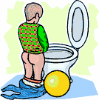
apple and pip
number one
See a man about a dog (horse )
Plant a sweet pea
pick a daisy
Pluck a rose
to spend a penny
Wee-wee cis-cis cissy sis-sis sissy

Slide 84
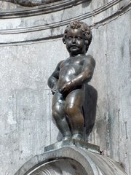
Get some fresh air
May I please be excused? (American)
Powder one’s nose
Wash one’s hands
What is the geography of the house?

Slide 85
2.职业委婉语
e.g.
home help
houseman
meat technologist
recycler
beautician
cosmetologist
hairstylist
vision engineer
wardrobe engineer
mixologist 酒吧调酒员

Slide 86
sanitation engineer
环卫师（婉指垃圾工人）
vision engineer
视力工程师（婉指眼镜商）
sleep engineer 睡眠工程师（婉指床具制造商）

Slide 87
The Taboos in the Chinese Culture
入赘—— marry into and live with the bride family.
怀春—— to fall in love with
有喜—— to be pregnant
临盆—— to have a birth
续弦—— to remarry after the wife died
失聪—— lose the hearing
发福—— become fat
苗条—— to be thin
不适—— to be ill
保洁员—— the cleaner

Slide 88
The Taboos in the Western Culture
to wash hand—— 方便
to go to bed with —— 同房，上床
To have a sex with—— 云雨，风月
The long illness—— 不治之症
To be unemployed —— 下岗，待业
To pass away ——过世，作古，归西
In the family way —— 行动不便
Physically challenged— 腿脚不灵，要做妈妈了
Unmarried women——单身女士
Mental problems—— 精神疾病
The senior citizen—— 银发族

Slide 89
A Joke about “方便”
两个字把老外搞疯：
吃饭时，一人说去方便一下，老外不解，旁人告诉他＂方便＂就是：上厕所；
敬酒时，另一人对老外说，希望下次出国时能给予方便，老外纳闷不敢问；
酒席上，电视台美女主持人提出，在她方便的时候会安排老外做专访。老外愕然：怎么能在你方便的时候？
美女主持人说，那在你方便时，我请你吃饭。老外晕倒！
醒来后，美女主持人又对他说，要不你我都方便时，一起坐坐？老外
又一次晕倒，再没有醒来。
大家方便的时候笑一笑吧！

Slide 90
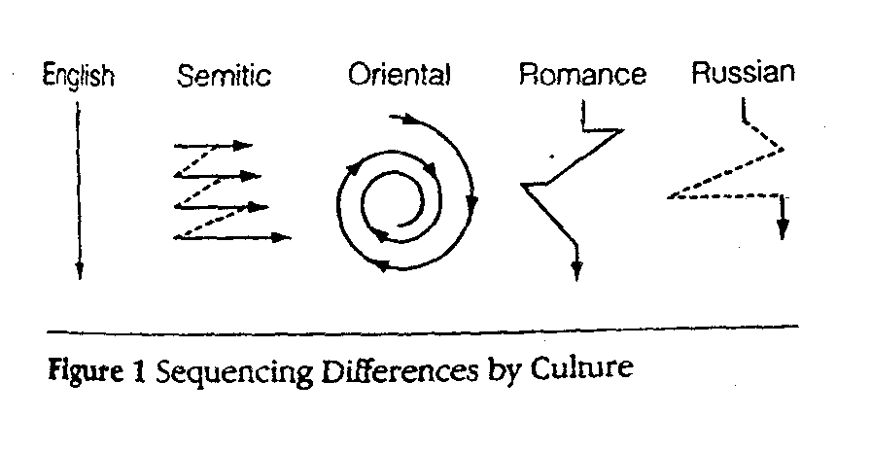
Differences in Cultural thought patterns

Slide 91
Differences in Cultural Thought Patterns
  English-speakers---linear and direct
  Semitic---combination of tangential
  and semi-direct
  Asian--- circular
  Romance---more consistently
  circuitous
  Russian---direct and circuitous

Slide 92
英国人：直接的、线性的
闪族人：间接相关与半直接相结合
东方人：循环、迂回论证
罗曼人：固守的迂回
俄罗斯人：直接中又带着隐晦和迂回
西方文化多是推论演绎的论证方式
东方文化更多倾向于把情感带入论证中
差异体现在，理胜于情 还是 情胜于理。

Slide 93
  American---factual-inductive (ascertain facts, find similarities, and formulate conclusions)
  Russian--- combination of direct and circuitous approaches/axiomatic-deductive (move from general principle to particulars which can be easily deduced)
  Arab---intuitive-affective (facts are secondary to emotions)

Slide 94
  Understanding and appreciation of differences among cultures in cognitive processing and problem solving is a major step toward successful intercultural communication.

Slide 95
III. Summary
■ Culturally loaded words
■ Cultural reflections on proverbs
■ Taboos
■ Differences in cultural thought patterns

Slide 96
IV. Assignments
1.Research Topic
Different colors have different associations in different languages. Please make a close study of the “color” languages in Chinese and English.
2. Watch the video “A Journey to India”

Slide 97
1.Justice has long arms.
2.Tread upon eggs.
3.sanitation engineer
4.Industrial climate
5.To take things without permission
6.A man of doubtful taste
7.Gilding the lily
8.You can’t have the cake and eat it too.
9.Associate professor
10.ethnocentrism

Slide 98
Thank You!

