Slide 1
Solr Cloud
Wu Guoli, Gloria
2023.03.29

Slide 2
01
Introduction to SolrCloud
目录
02
Architecture of Solr Cloud
03
Shards and Indexing Data
04
Recoveries and Write Tolerance
05
Conclusions
contents
Notes:
http://www.taodudu.cc/news/show-403450.html

Slide 3
01
Introduction

Slide 4
Introduction to SolrCloud
SolrCloud is designed to provide a highly available, fault tolerant environment for distributing your indexed content and query requests across multiple servers.
It’s a system in which data is organized into multiple pieces, or shards, that can be hosted on multiple machines, with replicas providing redundancy for both scalability and fault tolerance, and a ZooKeeper server that helps manage the overall structure so that both indexing and search requests can be routed properly.
Notes:
SolrCloud 旨在提供一个高度可用的容错环境，用于跨多个服务器分发索引内容和查询请求。
它是一个系统，其中数据被组织成多个片段或碎片，可以托管在多台机器上，副本为可伸缩性和容错提供冗余，ZooKeeper 服务器帮助管理整体结构，以便索引和搜索可以正确路由请求。
SolrCloud(solr 云)是Solr提供的分布式搜索方案，当你需要大规模，容错，分布式索引和检索能力时使用SolrCloud。当一个系统的索引数据量少的时候是不需要使用SolrCloud的，当索引量很大，搜索请求并发很高，这时需要使用SolrCloud来满足这些需求。
SolrCloud是基于Solr和Zookeeper的分布式搜索方案，它的主要思想是使用Zookeeper作为集群的配置信息中心。

Slide 5
02
Architecture of Solr Cloud
Notes:
4mins
6mins

Slide 6
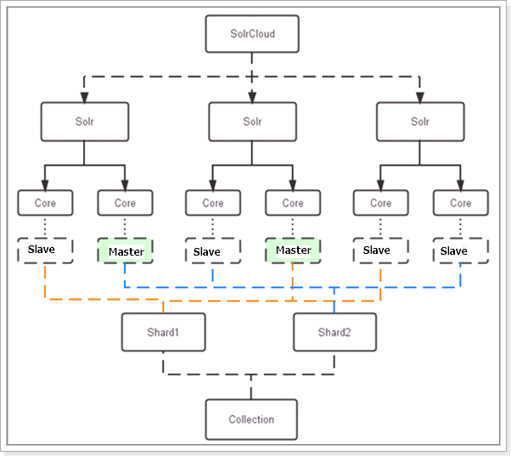
Architecture of Solr Cloud
Physical Concepts
A Cluster is made up of one or more Solr Nodes, which are running instances of the Solr server process.
Each Node can host multiple Cores.
Each Core in a Cluster is a physical Replica for a logical Shard.
Every Replica uses the same configuration specified for the Collection that it is a part of.
The number of Replicas that each Shard has determines:
The level of redundancy built into the Collection and how fault tolerant the Cluster can be in the event that some Nodes become unavailable.
The theoretical limit in the number concurrent search requests that can be processed under heavy load.
Notes:
SolrCloud 集群由一些位于某些“物理”概念之上的“逻辑”概念组成。
物理概念
一个集群由一个或多个 Solr 节点组成，这些节点运行着 Solr 服务器进程的实例。
每个节点可以托管多个核心。
集群中的每个核心都是逻辑分片的物理副本。
每个副本都使用为其所属的集合指定的相同配置。
每个Shard拥有的Replica数量决定了：
集合中内置的冗余级别以及集群在某些节点变得不可用时的容错能力。
在重负载下可以处理的并发搜索请求数的理论限制。

Slide 7
Architecture of Solr Cloud
Logical Concepts
A Cluster can host multiple Collections of Solr Documents.
A collection can be partitioned into multiple Shards, which contain a subset of the Documents in the Collection.
The number of Shards that a Collection has determines:
The theoretical limit to the number of Documents that Collection can reasonably contain.
The amount of parallelization that is possible for an individual search request.
Notes:
SolrCloud 集群由一些位于某些“物理”概念之上的“逻辑”概念组成。
逻辑概念
一个集群可以托管多个 Solr Documents的collections。
一个集合可以被划分成多个分片，其中包含集合中document的一个子集。
Collection 拥有的 Shards 数量决定了：
Collection 可以合理包含的文档数量的理论限制。
单个搜索请求可能的并行化量。

Slide 8
03
Shards and Indexing Data
Notes:
2mins
5mins

Slide 9
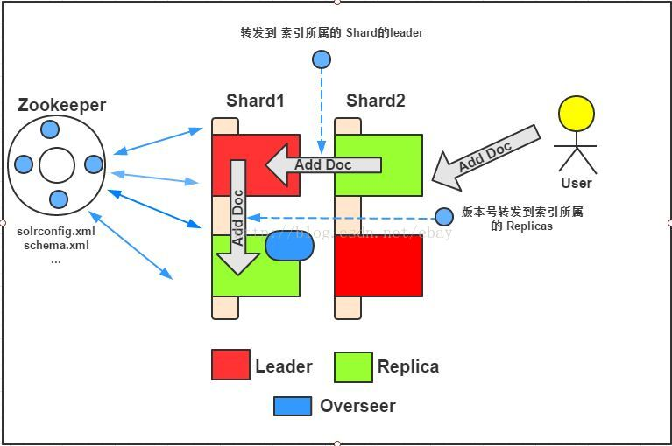
Shards and Indexing Data
When a document is sent to a Solr node for indexing, the system first determines which Shard that document belongs to, and then which node is currently hosting the leader for that shard. The document is then forwarded to the current leader for indexing, and the leader forwards the update to all of the other replicas.
POST http://<solr-cloud-host>:<solr-cloud-port>/<collection>/update/json/docs
Notes:
Solr 客户端可以向 Solr Cloud 发送创建索引的请求，Solr Cloud 会将请求路由到正确的分片，并在集群中创建新的索引文档。以下是客户端向 Solr Cloud 发送创建索引请求的处理过程：

Slide 10
Shards and Indexing Data
1. The client sends a create index document request to Solr Cloud. The request typically includes the data for the document to be created and the URL address of a Solr instance.
2. The request is received by the load balancer in Solr Cloud, which routes it to the correct shard based on Solr's routing strategy. The routing strategy can be hash, range, implicit, or composite.
3. The shard receives the request and sends it to the local Solr instance. If the local Solr instance is not the shard's leader, it forwards the request to the leader to be processed.
POST http://<solr-cloud-host>:<solr-cloud-port>/<collection>/update/json/docs
Notes:
客户端向 Solr Cloud 发送创建索引请求。请求通常包括要创建的文档数据，以及 Solr 实例的 URL 地址。
请求被 Solr Cloud 的负载均衡器接收，并将其路由到正确的分片上。路由的过程基于 Solr 的路由策略，可以是 hash、range、implicit 或 composite 策略。
分片收到请求并将其发送给本地的 Solr 实例。如果本地的 Solr 实例不是分片的 Leader，它会将请求转发给 Leader 进行处理。

Slide 11
Shards and Indexing Data
4. The leader receives the request and adds the document to the local Lucene index. The leader also maintains a record in memory so that the document can be written to disk during a commit operation. The leader also adds the document to the Lucene indexes of other replicas to ensure data reliability and consistency.
5. The leader sends the response to the Solr instance, which in turn sends the response back to the client.
6. The client receives the response and can determine if the request was successful based on the response status code.
POST http://<solr-cloud-host>:<solr-cloud-port>/<collection>/update/json/docs
Notes:
Leader 接收到请求后，会将文档添加到本地的 Lucene 索引中，并在内存中维护一个记录，以便在进行提交操作时将其写入磁盘。Leader 还会将文档添加到其它副本的 Lucene 索引中，以确保数据的可靠性和一致性。
Leader 将响应返回给 Solr 实例，Solr 实例再将响应返回给客户端。
客户端接收到响应后，可以根据响应中的状态码来判断请求是否成功执行。

Slide 12
04
Recoveries and
Write Tolerance

Slide 13
Recoveries and Write Tolerance
Write Side Fault Tolerance
Data redundancy
Send update requests to any node in the cluster
node will forward the request to the leader(if it is not the leader)
After updating, leader will then forward it to all existing replicas
using versioning to make sure every replica has the most up-to-date version
If the leader goes down, another replica can take its place
This architecture enables you to be certain that your data can be recovered in the event of a disaster, even if you are using Near Real Time Searching
Notes:
提供了一些写端容错的机制
第一个是。。
SolrCloud 旨在复制文档以确保数据冗余，
并使您能够向集群中的任何节点发送更新请求。
该节点将确定它是否托管适当分片的领导者，如果不是，它将把请求转发给领导者，然后领导者将它转发给所有现有的副本，
使用版本控制来确保每个副本都有最新的日期版本。
如果领导者宕机，另一个副本可以取代它。
这种架构使您能够确保在发生灾难时可以恢复您的数据，即使您使用的是近实时搜索。

Slide 14
Recoveries and Write Tolerance
Recovery
A Transaction Log is created for each node so that every change to content or organization is noted.
When a new replica is created, it refers to the Leader and the Transaction Log to know which content to include. If it fails, it retries.
If a leader goes down, it may have sent requests to some replicas and not others. So when a new potential leader is identified, it runs a synch process against the other replicas. If this is successful, everything should be consistent, the leader registers as active, and normal actions proceed. If a replica is too far out of sync, the system asks for a full replication/replay-based recovery.
If an update fails because cores are reloading schemas and some have finished but others have not, the leader tells the nodes that the update failed and starts the recovery procedure.
Notes:
恢复
为每个节点创建一个事务日志，以便记录内容或组织的每个更改。该日志用于确定节点中的哪些内容应包含在副本中。创建新副本时，它会参考 Leader 和 Transaction Log 以了解要包含哪些内容。如果失败，它会重试。
由于事务日志由更新记录组成，它允许更健壮的索引，因为它包括在索引中断时重做未提交的更新。
如果领导者宕机，它可能向某些副本发送了请求，而没有向其他副本发送请求。因此，当识别出新的潜在领导者时，它会针对其他副本运行同步过程。如果成功，一切都应该是一致的，领导者注册为活跃的，并且正常的动作继续进行。如果副本太不同步，系统会要求进行完全复制/基于重放的恢复。
如果由于core正在
如果更新失败是因为核心正在重新加载模式并且一些已经完成但其他尚未完成，则领导者告诉节点更新失败并启动恢复过程。

Slide 15
Recoveries and Write Tolerance
Achieved Replication Factor
The achieved replication factor is the number of replicas of the shard that actually received the update request (including the leader).
The replication factor is the replicas nums. For instance, consider a collection with one shard and a replication factor of three. In this case, you have a shard leader and two additional replicas.
Behind the scenes, this means that Solr has accepted updates that are only on one of the nodes (the current leader). To make the client aware of this, Solr includes in the response header the "Achieved Replication Factor" (rf).
On the client side, if the achieved replication factor is less than the acceptable level, then the client application can take additional measures to handle the degraded state.
Notes:
达到的复制因子
当使用大于 1 的复制因子时，更新请求可能在分片领导者上成功，但在一个或多个副本上失败。例如，考虑一个具有一个分片和三个复制因子的集合。在这种情况下，您有一个分片领导者和两个额外的副本。如果更新请求在领导者上成功但在两个副本上都失败，无论出于何种原因，从客户端的角度来看，更新请求仍然被认为是成功的。错过更新的副本将在恢复时与领导者同步。
在幕后，这意味着 Solr 已接受仅在其中一个节点（当前领导者）上的更新。为了让客户端意识到这一点，Solr 在响应标头中包含“Achieved Replication Factor”( rf)。achieved replication factor是实际收到更新请求的shard的副本数（包括leader），在上面的例子中，1。在多shard更新请求的情况下，achievement replication factor是最小的replicament所有分片的因素。
在客户端，如果实现的复制因子低于可接受的水平，则客户端应用程序可以采取额外的措施来处理降级状态。例如，客户端应用程序可能希望记录在集合状态降级时发送了哪些更新请求，然后在问题解决后重新发送更新。
在SolrCloud中，Achieved Replication Factor是指实际的副本数量，即已经被成功复制的副本数。它表示了在SolrCloud集群中，每个副本所需的最小可用副本数量是否已经被满足。如果Achieved Replication Factor小于所需的Replication Factor，则表明某些副本无法正常工作，可能会影响搜索结果的准确性和可用性。
以下是几个例子：
如果您的SolrCloud集群中有10个副本，并且您将Replication Factor设置为3，则每个文档将在3个副本之间进行复制。如果Achieved Replication Factor小于3，那么当其中一个副本出现故障时，将可能导致数据丢失或搜索结果不准确。
如果您的SolrCloud集群中有5个副本，并且您将Replication Factor设置为2，则每个文档将在2个副本之间进行复制。如果Achieved Replication Factor小于2，那么当其中一个副本出现故障时，将可能导致数据丢失或搜索结果不准确。
如果您的SolrCloud集群中有8个副本，并且您将Replication Factor设置为4，则每个文档将在4个副本之间进行复制。如果Achieved Replication Factor小于4，那么当其中一个副本出现故障时，将可能导致数据丢失或搜索结果不准确。
总之，Achieved Replication Factor是用于确保SolrCloud集群中每个副本的可用性和搜索结果的准确性的重要指标。

Slide 16
05
Conclusions

Slide 17
Conclusions
Distributed Architecture: Solr Cloud is a distributed system that can distribute indexes and search requests across multiple nodes for processing.
High Availability: Solr Cloud supports automatic failover and replication, ensuring that the system can continue to provide search services even if a node fails.
Horizontal Scalability: Solr Cloud can be horizontally scaled by adding nodes to support larger data volumes and higher concurrency search requests.
Load Balancing: Solr Cloud supports automatic load balancing, automatically allocating search requests to available nodes to ensure load balancing of each node.
Real-time Updates: Solr Cloud supports real-time updates, allowing documents to be added, updated, or deleted without affecting search performance.
Data Security: Solr Cloud supports data backup and recovery, ensuring data security and integrity.
Query Performance: Solr Cloud uses efficient inverted index and query optimization techniques to perform search requests quickly and accurately on large datasets.
Notes:
总之，Solr Cloud是一个强大的搜索引擎，具有高可用性、可扩展性、实时更新和安全性等优点，适用于需要处理大量数据和高并发搜索请求的企业应用场景。

Slide 18
References
https://solr.apache.org/guide/8_11/index.html
http://www.taodudu.cc/news/show-403450.html
Notes:
总之，Solr Cloud是一个强大的搜索引擎，具有高可用性、可扩展性、实时更新和安全性等优点，适用于需要处理大量数据和高并发搜索请求的企业应用场景。

Slide 19
Thanks
Notes:
我的汇报到此结束，谢谢观看，请各位老师批评指正。

Slide 20
Shards and Indexing Data
When a document is sent to a Solr node for indexing, the system first determines which Shard that document belongs to, and then which node is currently hosting the leader for that shard. The document is then forwarded to the current leader for indexing, and the leader forwards the update to all of the other replicas.
POST http://<solr-cloud-host>:<solr-cloud-port>/<collection>/update/json/docs

