Slide 1
LUNARCH
AI-Driven Chip Design Leveraging Open-Source Toolchains
Han Wu
RISC-V RV32I core · sky130HD · RTL-to-GDS · verification, timing & power studies
Disclaimer: this material reflects the author’s personal research interest only. It is not related to, endorsed by, or affiliated with my current or former employers.

Slide 2
Agenda
• Introduction — RISC-V RV32I core and the open-source RTL→GDS motivation
• Design under test and the AI-driven open-source flow
• Verification and sign-off — simulation, LEC, DRC, LVS
• Results — baseline timing / power and the Pareto study
• Conclusions and next steps

Slide 3
Design Under Test — RISC-V RV32I Core
• Top module: riscv — a simple single-cycle RV32I core
• Origin: J. E. Stine, Oklahoma State University (Harris & Harris textbook processor); bundled with OpenROAD Flow Scripts (Apache-2.0)
• 24 RTL modules; 18 elaborated under the riscv top
• Sequential state: PC register (32 b) + register file 32×32 (1,024 FFs) + SEPC
• Instruction/data memories are external (instr / readdata in, memwrite / aluout / writedata out)
• Target platform: sky130HD (sky130_fd_sc_hd), high-density standard cells
• Baseline: 5,520 cells, 73,594 µm² core area, 376.6 µm die

Slide 4
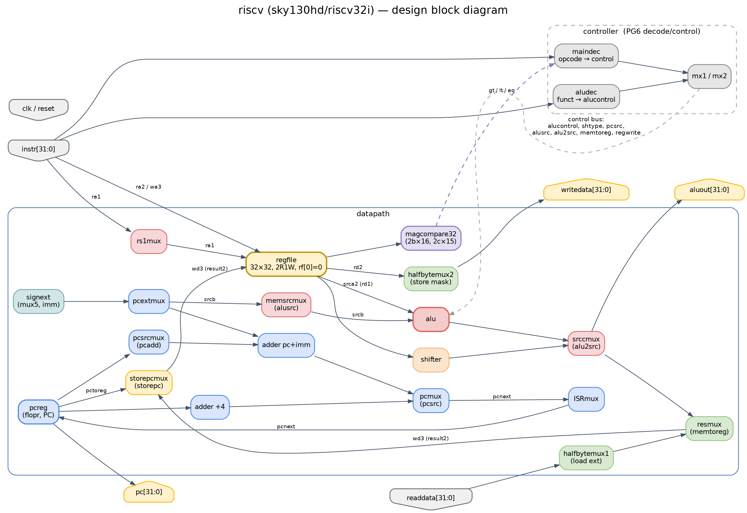
Block Diagram & Microarchitecture
controller + datapath, colour-coded by path group
• Single cycle: fetch → decode → execute → write-back in one clock
• controller (maindec + aludec) drives the datapath control bus
• datapath: regfile 32×32, ALU (add/sub/and/or/xor/slt), shifter (sll/srl/sra), magcompare32, adders, mux2/3/5, signext
• sequential: PC register + SEPC (saved exception PC on ecall/ebreak)
• Critical loop: regfile read → mux → ALU → mux → regfile write

Slide 5
Data Flow & Path Groups
critical path sits in PG2 (regfile → ALU → regfile)
ID | Group | Start → End | Dominant logic
PG1 | PC / Fetch | pcreg → pcreg | adder(+4/+imm), pcmux, flopr
PG2 | ALU write-back | regfile → regfile | rs1mux, memsrcmux, alu, srccmux, resmux
PG3 | Shift write-back | regfile → regfile | shifter, srccmux, resmux
PG4 | Memory (LSU) | readdata→rf / rf→writedata | halfbytemux1/2, resmux
PG5 | Branch compare | regfile → pcreg | magcompare32 → controller.pcsrc
PG6 | Decode / Control | instr → ctrl bus | controller (maindec, aludec)
PG7 | Immediate | instr → alu/pcreg | signext(mux5), pcextmux, adder
PG8 | Output / Exception | regfile → aluout; pcreg → SEPC | srccmux, flopenr
• Fetch: pcreg → adder(+4) / adder(+imm) → pcmux(pcsrc) → pcreg
• Decode & read: instr → controller (maindec, aludec); regfile rd1→srca2, rd2→writedata
• Immediate: instr → signext(mux5) → pcextmux → adders / ALU B-operand
• Execute & compare: alu / shifter → srccmux → aluout; magcompare32 → gt/lt/eq → pcsrc
• Write-back: resmux(ALU/load) → storepcmux(link PC) → rf.wd3

Slide 6
AI-Driven Open-Source Flow & Verification
100% open-source RTL→GDS, sign-off clean
• Synthesis — Yosys (≥ 0.69) → sky130_fd_sc_hd liberty
• Floorplan / place / CTS / route — OpenROAD + OpenROAD Flow Scripts (version-matched)
• GDS stream-out (OpenROAD / KLayout); DRC & LVS (KLayout); SPEF extraction for STA
• Logical equivalence — Kepler Formal (gate-level) + Yosys equiv_* (RTL vs synth)
• AI agents orchestrated: toolchain bring-up, version matching, debugging, report/dashboard generation, goal-directed optimization
Check | Tool / method | Result
RTL ≡ synthesised netlist | Yosys equiv_make / equiv_induct / equiv_status | Proven
Synth ≡ final routed netlist | Kepler Formal (gate-level LEC, LEC_CHECK=1) | Global output passed
DRC | KLayout sky130hd.lydrc | 0 violations
LVS | KLayout sky130hd.lylvs (+ Magic/netgen) | Netlists match
Timing sign-off | OpenROAD STA (report_checks), SDC 7.0 ns | WNS/TNS 0.00 ns, hold MET
Simulation / equivalence | Yosys formal + SAT (counter-example free) | Pass

Slide 7
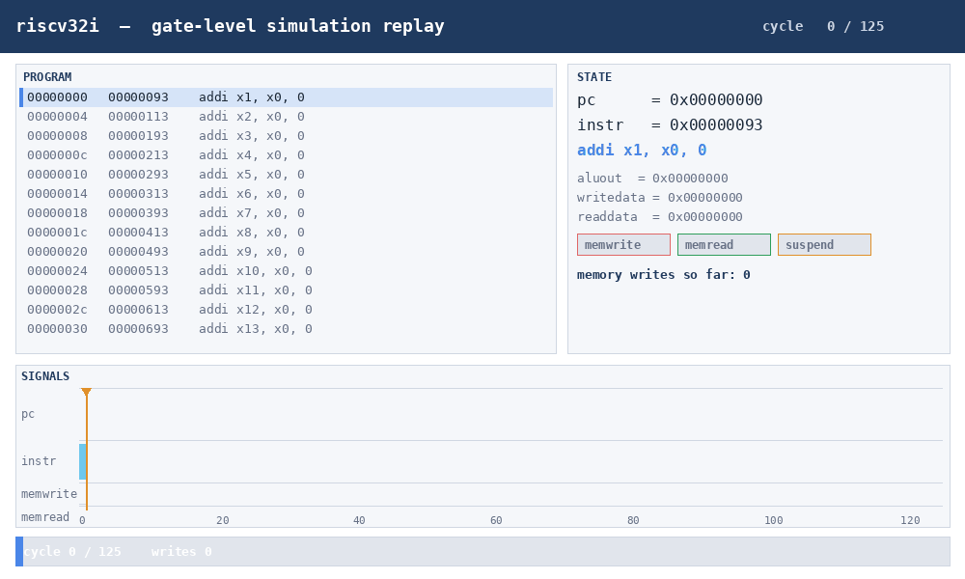
Simulation Replay — gate-level
pre-layout RTL trace — animates in slide-show mode (press F5)
Debugger-style replay of the 125-cycle directed test: program listing (left, current PC highlighted), architectural state + memory-write log (right), and a signal strip (pc / instr / memwrite / memread).

Slide 8
Physical-Design Flow
• 1_synth — Yosys synthesis to sky130 std cells (1_synth.odb / 1_2_yosys.v)
• 2_floorplan — die/core sizing, tapcells, PDN (power grid)
• 3_place — global place → resizer → detailed place (sizing for timing/area)
• 4_cts — clock-tree synthesis, clock buffers, skew balancing
• 5_route — global route (FastRoute) → detailed route → fill cells
• 6_finish — final GDSII, SPEF, netlist, reports (DRC/LVS run separately)
• Artifacts: 6_final.gds / .def / .v / .spef, 6_drc.lyrdb, 6_lvs.lvsdb

Slide 9
Baseline Results (7.0 ns, 142.9 MHz)
reference point for all optimization studies
Metric | Value
Setup WNS / TNS | 0.00 / 0.00 ns
Min reg→reg period | 6.76 ns (fmax 147.9 MHz)
Hold | MET (worst +0.58 ns)
Core area | 73,594 µm² (die 376.6 µm)
Cells | 5,520 (1,024 edfxtp + 32 dfrtp)
Power | 19.7 mW (seq 40% / comb 30% / clk 29%)
Signal wirelength | 274.2 mm (met1/met2 dominated)
DRC / LVS / LEC | 0 / match / proven

Slide 10
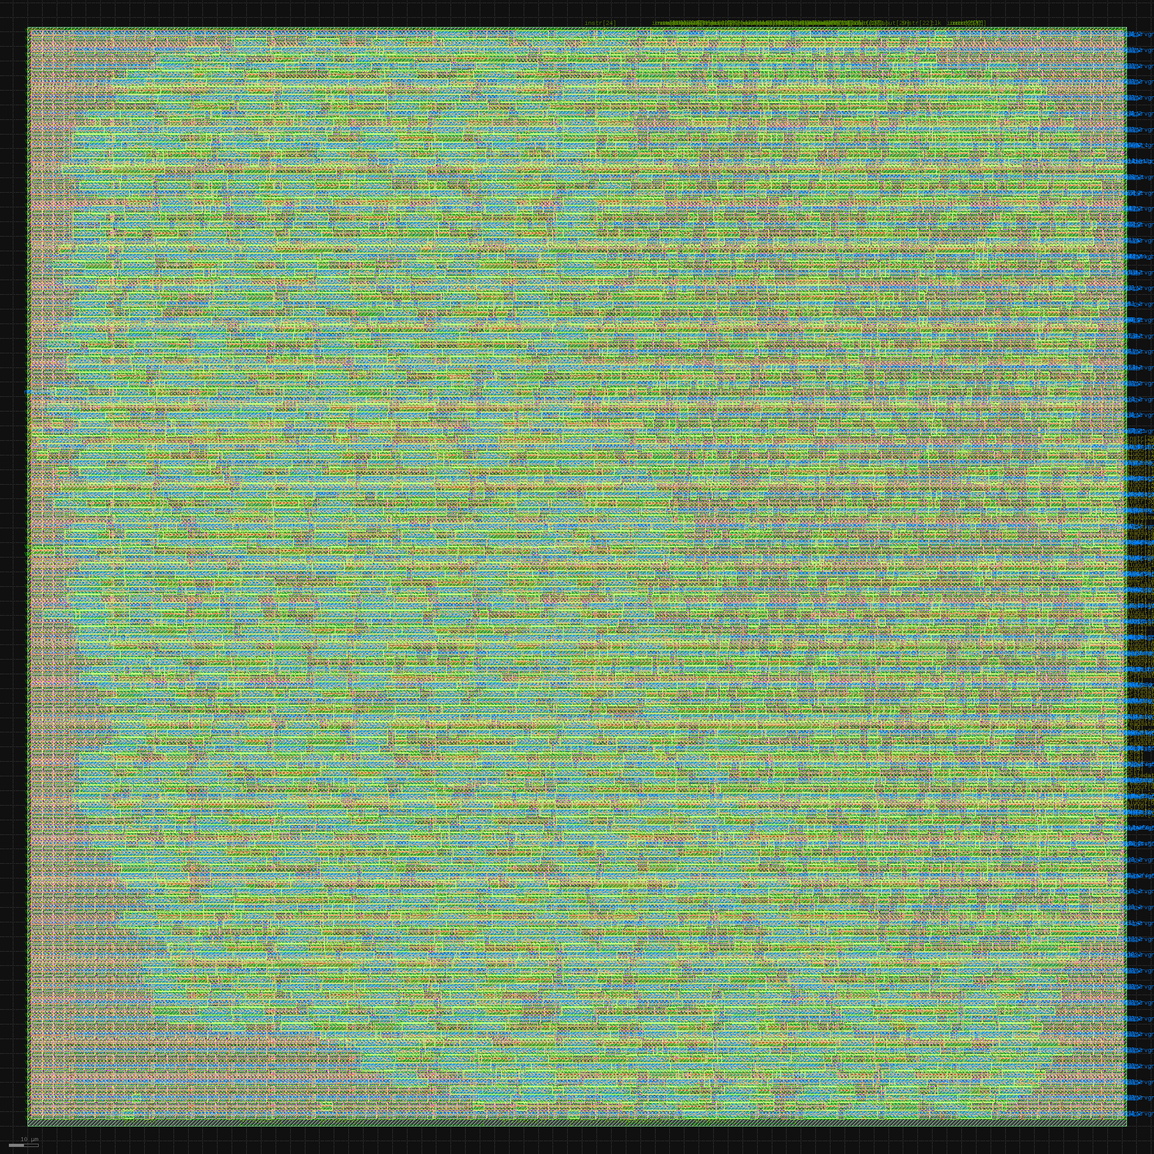
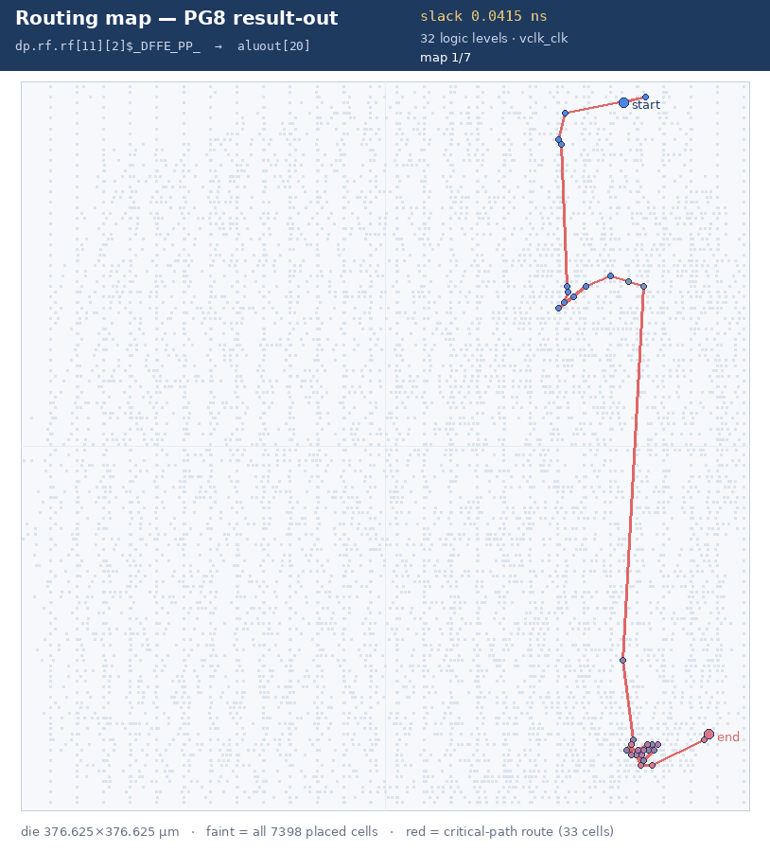
Final Layout — GDS photo + critical-path routing
timing-closed 7.0 ns, 376.6 µm die
GDS photo (left): final routed sky130 layout (poly / li / met1–met5). Routing map (right): critical-path route highlighted on the die — animates in slide-show mode.

Slide 11
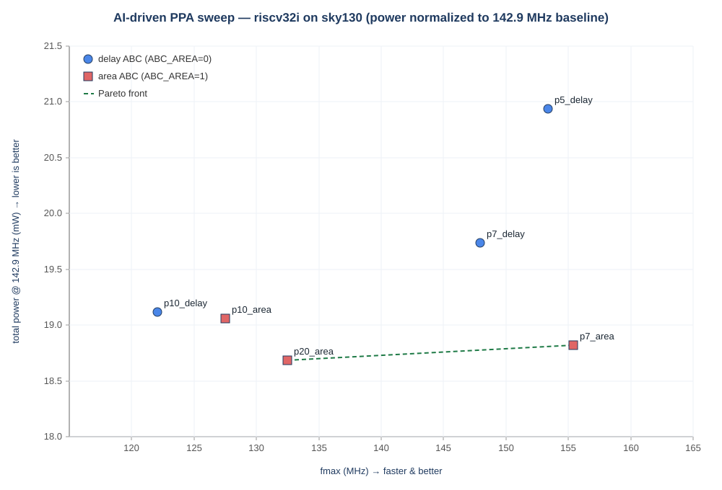
Timing vs Power — Pareto (same 376.6 µm die)
power normalized to the 142.9 MHz baseline clock
ABC mapper: “delay-oriented” vs “area-oriented”
delay-oriented (ABC_AREA=0): the mapper optimises the critical path — larger, faster cells, area spent to shorten logic depth. Fastest, but more capacitance → more dynamic power. (blue circles: p5/p7/p10_delay)
area-oriented (ABC_AREA=1): the mapper minimises gate area / transistor count — smaller cells, shared logic. Lower capacitance → less switching power, at some speed cost. (red squares: p7/p10/p20_area)
Reading the plot: X = achieved fmax; Y = total power @142.9 MHz (fair comparison). Dashed line = Pareto front.
Result: p7_area is lower power AND faster than the delay baseline at equal frequency → area-oriented mapping dominates.

Slide 12
Why p7_area beats p7_delay (same 7 ns clock)
cell-type analysis — area vs delay ABC mapping
Cell class | p7_delay | p7_area | Δ
Multi-input combinational | 3,458 | 6,404 | +2,946
Inverter | 123 | 843 | +720
Clock inverter | 68 | 63 | −5
Clock buffer | 135 | 148 | +13
Timing-repair buffer | 680 | 405 | −275
Sequential (FF) | 1,056 | 1,056 | 0
Antenna | 2 | 3 | +1
Tap | 1,876 | 1,876 | 0
Fill | 11,652 | 12,904 | +1,252
Total instances | 19,050 | 23,702 | +4,652
• Only the combinational mapping changed (the ABC_AREA knob).
• ~1.85× more combinational gates (3,458→6,404), each smaller — +85% gates for only +3% comb area.
• ~7× more inverters (123→843, +2.7k µm²): the area map leans on inversions / AOI-OAI structures.
• ~40% fewer timing-repair buffers (680→405, −2.3k µm²): smaller cells needed less resizer fixing.
• FFs (1,056), tap cells and clock buffers ~unchanged; fill grows (+1,252) as the extra small cells leave gaps.
• Net: a finer-grained, smaller-gate netlist the resizer + CTS could tune better → fmax 147.9→155.4 MHz AND power 19.7→18.8 mW at the same 7 ns clock.

Slide 13
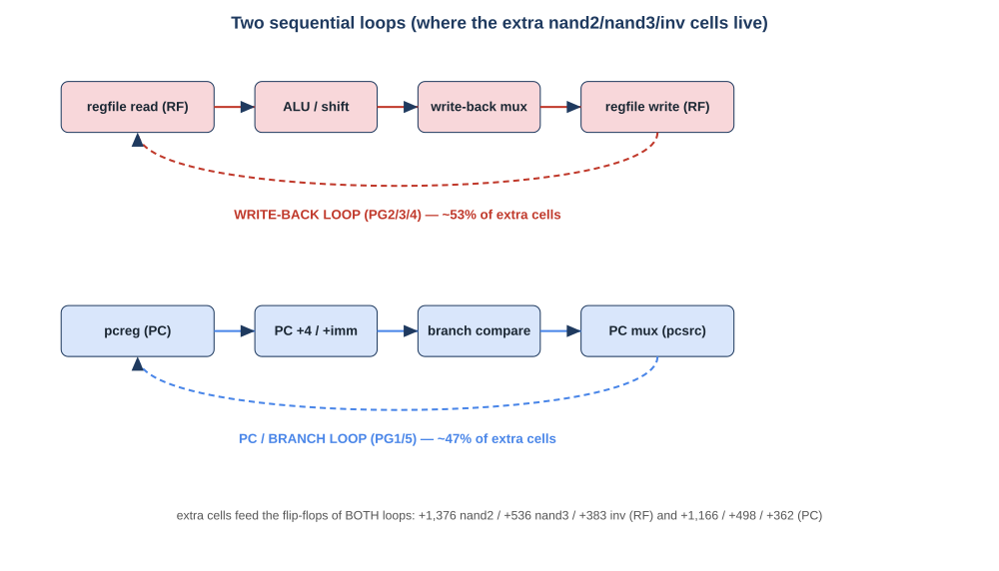
Where the extra cells go — two critical loops
p7_area vs p7_delay: extra nand2 / nand3 / inv by endpoint loop
Loop (endpoint FF) | Run | nand2 | nand3 | inv
write-back (rf/D) | p7_delay | 151 | 30 | 40
 | p7_area | 1,527 | 566 | 423
PC / branch (pcreg/D) | p7_delay | 175 | 40 | 33
 | p7_area | 1,341 | 538 | 395
Δ (area − delay) | total | +2,542 | +1,034 | +745
• Extra cells split ~53% / ~47% between the register-file write-back loop and the PC/branch loop — both sequential loops were re-expressed.
• Avg logic levels/path: p7_delay 21.5 vs p7_area 24.7 — more levels.
• Avg logical effort/stage: p7_delay 1.96 vs p7_area 1.68 — each stage is cheaper (Σg ≈ 42 both).

Slide 14
Why the critical loops prefer NAND2 / NAND3 / INVERTER cells
• Logical effort: inverter = 1.0, nand2 = 4/3, nor2 = 5/3 — the LOWEST of any gate; compound AOI/OAI (2–3) and 4:1 muxes are much higher.
• A 32-bit ALU / comparator / mux network re-decomposes into shallower stages of low-effort gates, so the whole path has less stage delay.
• Shallow series stacks: nand/nor stack only 2–3 devices in series, vs deep AOI/OAI stacks — less intrinsic delay per logical level.
• Drive-strength granularity: nand2/nand3/inv ship in X1…X8, so the resizer picks the exact drive to match each stage's fanout.
• The area map (map -B 0.9) emits this fine, uniform gate mix; resizer + CTS then tune it on the fixed 7 ns clock, whereas the delay map pre-sized with wide cells and left less room.
• Net effect at the same clock: fmax 147.9 → 155.4 MHz and power 19.7 → 18.8 mW — the extra nand/inv gates ARE the speedup, not a cost.

Slide 15
Hardware Requirements
• Host: x86-64 machine running WSL2 (Ubuntu 24.04)
• CPU: multi-core (≥ 4 cores; place/route are largely single-thread heavy)
• RAM: ≥ 16 GB (recommend 32 GB); peak route/STA ~ 1–2 GB for this design
• Disk: ≥ 50 GB free (PDK + tools + builds; ORFS submodules & sources are large)
• Optional: dedicated NVMe for the WSL VHD (this project used an external NVMe)
• No special accelerator required — a standard workstation/laptop suffices

Slide 16
Software Requirements (open-source)
100% open-source; no commercial EDA licenses
Layer | Tools / version
OS | WSL2 Ubuntu 24.04 LTS
Synthesis | Yosys ≥ 0.69 (built from source)
P&R + STA | OpenROAD (built from source, matched to ORFS)
Flow scripts | OpenROAD Flow Scripts (ORFS, master)
Layout / extract | Magic 8.3 (build), netgen 1.5 (apt)
DRC / LVS / view | KLayout 0.28
Formal LEC | Kepler Formal (built from source)
PDK | sky130A (open_pdks, sky130_fd_sc_hd)
AI / scripting | opencode AI agent, Python 3 + openpyxl / python-pptx

Slide 17
Conclusions
• A complete open-source RTL→GDS flow for an RV32I core was built and sign-off clean (DRC 0, LVS match, LEC proven)
• AI orchestration covered toolchain bring-up, version matching, debugging, dashboards and goal-directed studies
• Baseline closes timing at 7.0 ns (147.9 MHz, 19.7 mW)
• 200 MHz is unreachable without RTL pipelining — best is 153.4 MHz
• Area-oriented synthesis cuts per-cycle energy ~5% (18.7 mW @142.9 MHz equiv.) and raises fmax to 155 MHz
• The design is cell-delay dominated; wire delay < 0.02 ns per path — not wire-limited
• Next steps: pipelined microarchitecture to reach 200 MHz+; SRAM macro for the memories

Slide 18
Backup — logical-effort distribution (stages)
per-stage g over the worst 264 paths of each run
g | gate types | p7_delay | p7_area
1.00 | inv / buf | 1,623 | 719
1.33 | nand2 | 181 | 2,591
1.60–1.80 | a21o/a22o/o21a/o22a · nand3 | 694 | 885
2.00 | aoi21 / oai21 / mux2 / ha | 1,516 | 1,767
2.30–2.33 | aoi22 / oai22 / nor3 | 285 | 4
2.70 | aoi211/221/31 · oai211 | 381 | 332
3.00 | aoi311 / oai311 / mux4 | 388 | 1
3.30 | aoi41 | 295 | 0
4.00 | xor2 / xnor2 | 305 | 221

Slide 19
Acknowledgements
thanks to the open-source tool, PDK and research communities
• OpenROAD + OpenROAD Flow Scripts — the open-source RTL→GDS flow and STA.
• Yosys — open-source synthesis and formal equivalence (equiv_*).
• KLayout — GDS viewing, DRC and LVS. Magic + netgen — extraction and LVS.
• Kepler Formal — gate-level logical equivalence checking.
• SkyWater Technology, Google and open_pdks — the open sky130 PDK and standard-cell library.
• The RISC-V community, and J. E. Stine (Harris & Harris textbook reference core) whose RV32I design is the DUT.
• With thanks to all these tool, PDK and research teams for making an open silicon flow possible.

