Slide 1
BERT-Based Question Answering Task
Group 24
WU Hao 20711289
CHAN Chun Kit 20728737
YANG Siting 20714786
December 2020

Slide 2
Introduction

Slide 3
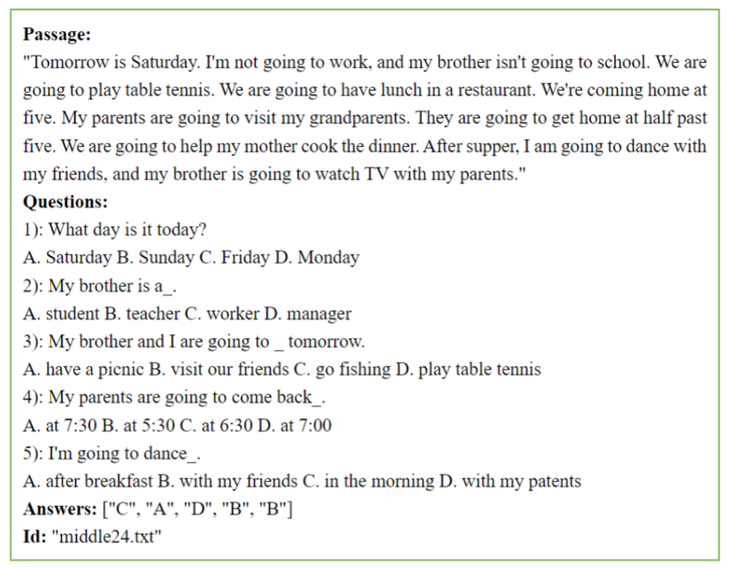
Introduction--Background
Question answering (QA) is a multidisciplinary task that includes natural language processing, information technology, artificial intelligence, and cognitive science. The QA system attempts to understand the question pose in natural language and then find out the correct answer given a set of documents or passages.
Include Question classification, Information retrieval, and Answer extraction.
Sources: Gupta, P. and Gupta, V., 2012. A Survey of Text Question Answering Techniques. International Journal of Computer Applications, 53(4), pp.1-8.

Slide 4
Introduction--Project Structure
Focus on :
Automated multiple-choice reading comprehension(RACE dataset)
BERT based models(BERT, Roberta, ALBERT)
Project Structure：
Review the background of Question answering task, dataset and the models
Demonstrate how we preprocess the data and train different models
Use Easy Data Augmentation and fine-tuning different parameter to obtain higher performance

Slide 5
2. Methodology

Slide 6
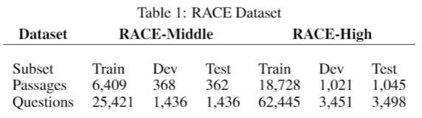
Dataset

Slide 7
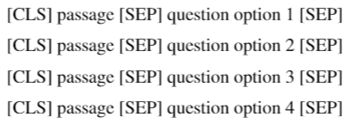
Data Preprocessing and Augmentation
Tokenize the text.
Add special tokens - [CLS] and [SEP].
Pad the sentences to a designed length.
Easy Data Augmentation
Word swap
Synonym replacement
Word insertion
Word deletion
Sources:
Jason Wei and Kai Zou. Eda: Easy data augmentation techniques for boosting performance on text classification tasks.arXiv preprint arXiv:1901.11196, 2019.

Slide 8
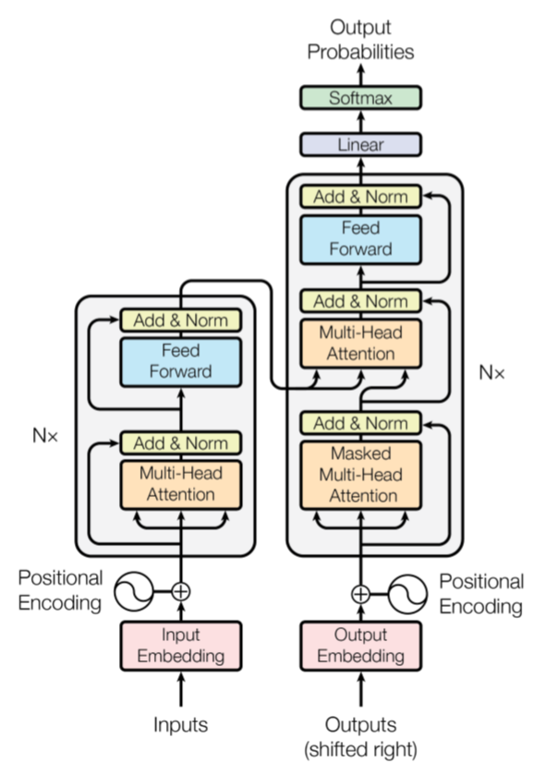
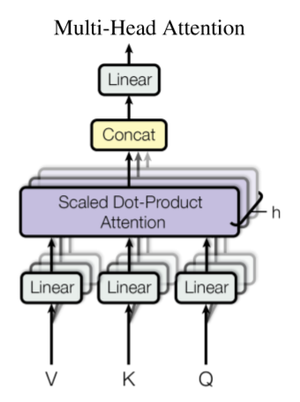
Model - BERT
Sources:
Ashish Vaswani, Noam Shazeer, Niki Parmar, Jakob Uszkoreit, Llion Jones, Aidan N Gomez, Lukasz Kaiser, and Illia Polosukhin. 2017. Attention is all you need. In Advances in Neural Information Processing Systems, pages 6000–6010.

Slide 9
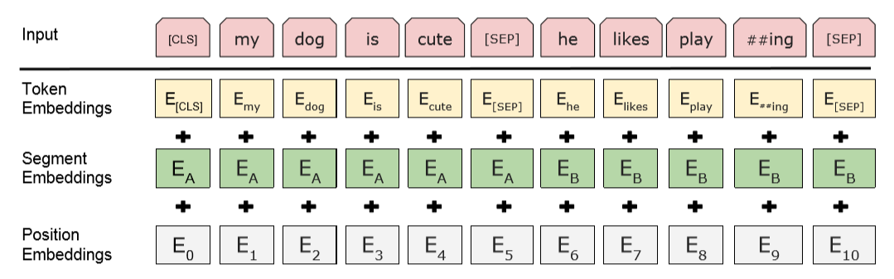
Model - BERT
Sources:
Jacob D., et al. BERT: Pre-training of Deep Bidirectional Transformers for Language Understanding. arXiv:1810.04805v2 [cs.CL]. 2019.

Slide 10
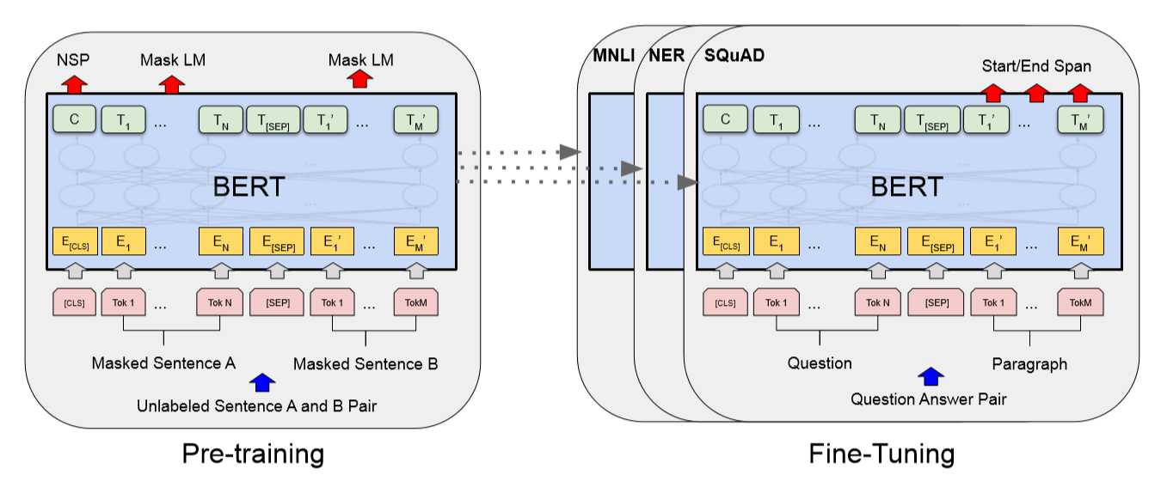
Model - BERT
Sources:
Jacob D., et al. BERT: Pre-training of Deep Bidirectional Transformers for Language Understanding. arXiv:1810.04805v2 [cs.CL]. 2019.

Slide 11
Model - RoBERTa
Increases the size of mini-batches over more data.
Removes Next Sentence Prediction.
Trains in longer sequences.
Dynamically generates [MASK] patterns.
Bytes-level encoding instead of the char-level.
Sources:
Yinhan, Liu, et al. RoBERTa: A Robustly Optimized BERT Pretraining Approach. arXiv:1907.11692v1 [cs.CL]. 2019.

Slide 12
Model - ALBERT
A factorized embedding parameterization.
Cross-layer parameter sharing.
A self-supervised loss for Sentence-Order Prediction (SOP) instead of the original NSP loss.
Sources:
Zhengzhong Lan, et al. ALBERT: A Lite BERT for self-supervised learning of language representations. ICLR. 2020.

Slide 13
3. Experiment & Discussion

Slide 14
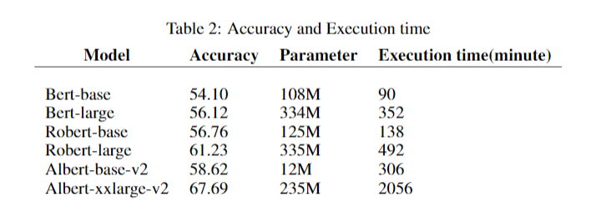
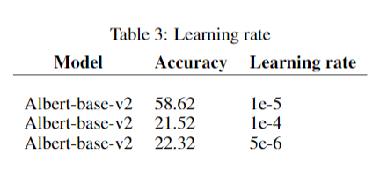
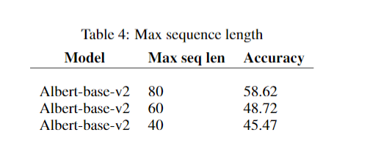
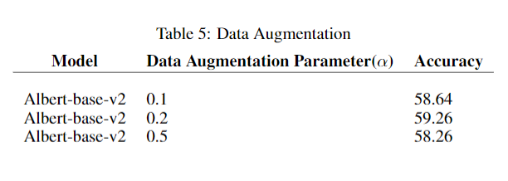
Experiment and Discussion

Slide 15
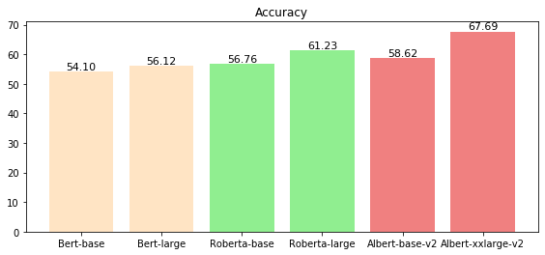
Model Performance
Albert>Roberta>Bert

Slide 16
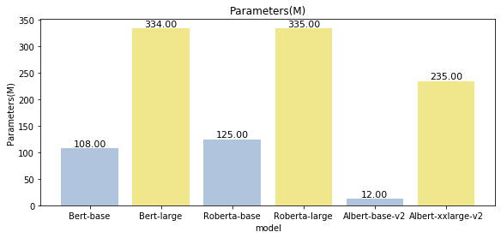
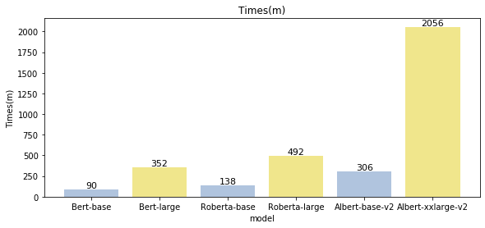
Model Performance
The size of the model:
Roberta>Bert>Albert
The training time of the model:
Albert>>Roberta>Bert

Slide 17
Analysis in model Performance
Origin sentence: A + B
Model | Sentence-level Task in pre-training | Positive Sample | Negative Sample
Bert | Next sentence prediction(NSP) | A->B | A->C
Roberta | None(Delete the NSP task) | None | None
Albert | Sentence Order Prediction（SOP） | A->B | B->A

Slide 18
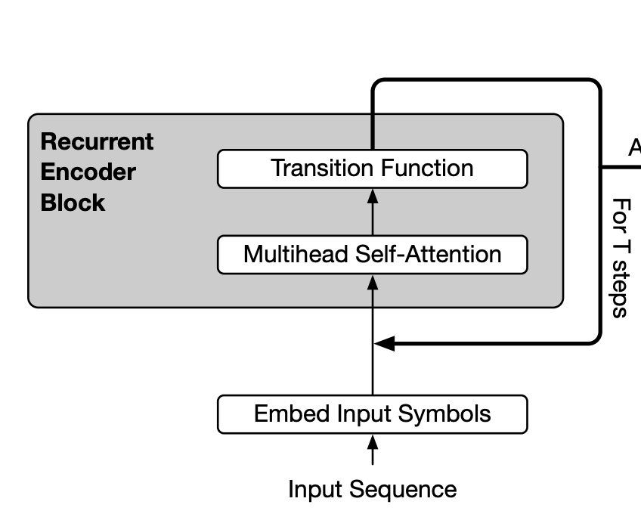
Analysis in model performance
Why is it running many times longer with the fewest parameters?
Two ways to reduce the parameters:
Factorized Embedding Parameterization
Cross-layer Parameter Sharing
Reason:
1. Less parameters but same network structure
2. With similar results, the width of the Albert model would be even larger than bert

Slide 19
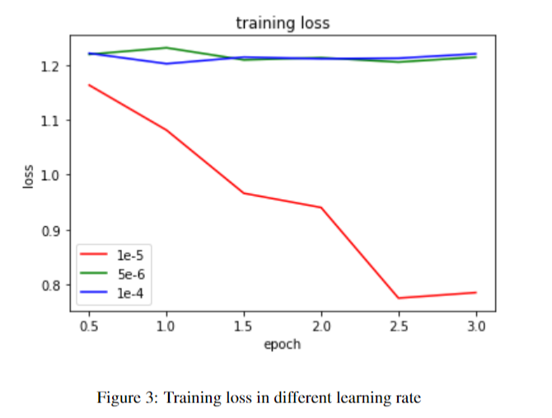
Learning Rate

Slide 20
Max Sequence Length
Due to the lack of hardware resources and, we only set 40,60,80.
It causes the reduction of some information in the data (not conducive to model fitting)
The best model is the Albert-base-v2 with 80 max sequence length and obtain 58.62% accuracy.
With increase the max sequence length, the performance also increases based on the experiment result of this project.

Slide 21
Data Augmentation (ALBERT-Base)
Easy Data Augmentation(EDA) used to construct the augmented passages/question/options to improve the performance of ALBERT- base models → prevent overfitting and build a robust model
4 Operations of Easy Data Augmentation:
Word swap
Synonym replacement
Word insertion
Word deletion
This Project will focus on the data augmentation techniques in NLP
This Project will focus on the augmentation data method in NLP
This Project will focus on the augmentation data techniques in NLP
This Project will focus on write-up the augmentation data techniques in NLP
This Project will focus on the augmentation data in NLP
Source: Wei, J., & Zou, K. (2019). Eda: Easy data augmentation techniques for boosting performance on text classification tasks. arXiv preprint arXiv:1901.11196.

Slide 22
Data Augmentation (ALBERT-BASE)
Performing the Easy Data Augmentation with 10% of overall training set
α = 0.2 obtain best highest accuracy(59.26%)
EDA not improve much in the project:
Easy Data Augmentation prefers to work well on a small dataset
Synonym replacement(Synonyms and original words often have similar word vectors)
Word swap & word insertion may affect the sentence structure and semantic structure

Slide 23
6. Conclusion
and
Future work

Slide 24
Conclusion
Best models (Albert-xxlarge-v2) obtained 67.69% test accuracy on the RACE dataset
Fine-tune different parameters which include learning rate, L2 regulation, and max sequence length.
Implement the Data augmentation on the ALBERT-base to obtain the 0.6 gain in accuracy.

Slide 25
Future Work
Try more different deep learning such as the XLNet and other ensemble deep learning models
Try to add more features (such as named entity recognition on Question and passage) to the models.
Try other Data Augmentation Method (Mixmatch,UDA)
Try more higher max sequence length(e.g. 300)

Slide 26
Contribution
Groupmates | Contribution
WU Hao (20711289) | Data Preprocessing, Model Setup/Coding, Experiment and Results, Discussion
CHAN Chun Kit (20728737) | Literature Review,Methodology, Model Setup/Coding,Experiment and Results, Discussion
YANG Siting (20714786) | Literature Review, Methodology, Model Setup/Coding

Slide 27
Reference
[1] Gupta, P. and Gupta, V., 2012. A Survey of Text Question Answering Techniques. International Journal of Computer Applications, 53(4), pp.1-8.
[2] Kolomiyets, O. and Moens, M., 2011. A survey on question answering technology from an information retrieval perspective. Information Sciences, 181(24), pp.5412-5434.
[3] Guda, V., Sanampudi, S. K., & Manikyamba, I. L. (2011). c(IJEST), 3(2), 990-995.
[4] Lai, G., Xie, Q., Liu, H., Yang, Y., & Hovy, E. (2017). Race: Large-scale reading comprehension dataset from examinations. arXiv preprint arXiv:1704.04683.
[5] Rajpurkar, P., Zhang, J., Lopyrev, K., & Liang, P. (2016). Squad: 100,000+ questions for machine comprehension of text. arXiv preprint arXiv:1606.05250.
[6] Zhu, H., Wei, F., Qin, B., & Liu, T. (2018, April). Hierarchical attention flow for multiple-choice reading comprehension. In Thirty-Second AAAI Conference on Artificial Intelligence.
[7] Wei, J., & Zou, K. (2019). Eda: Easy data augmentation techniques for boosting performance on text classification tasks. arXiv preprint arXiv:1901.11196.

