Slide 1

ChaosArena: Multi-Agent Concurrency Testing of REST APIs from Natural-Language Specifications
Hao Wu · Master's Project · Advised by Yvonne Coady

Slide 2
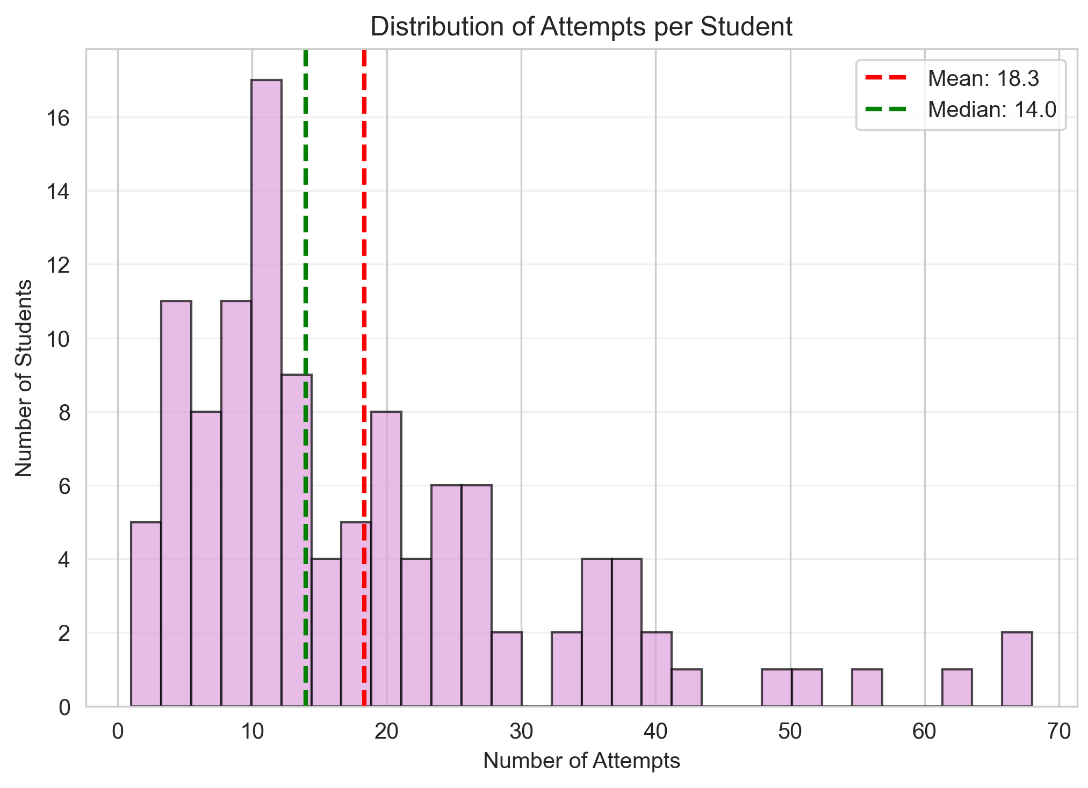
Where this comes from?
AI-coauthored code does NOT just work
Origin: CS 6650 Building Scalable Distributed Systems
Patterns we observed:
Many paste assignment into Claude, generate, submit
Systems failed silently. Didn’t know what happen.
To push back, we built ChaosArena v1:
Black-box probe
Tests reliability + race conditions on a deployed service
Simple target: an Album Store (get/add/delete photo)
Results over the semester:
~120 students
Average 18 evaluation runs per student
ZERO passed on first submission
Notes:
Some context. Last semester, in CS 6650 Distributed Systems, the pattern was unmistakable. Students used AI to generate code, many didn't read the spec carefully, demos looked fine, systems failed under any real probing.
We built ChaosArena v1 to push back. Black-box probe, simple target — an Album Store. Add a photo, delete a photo. That's it.
Over the semester: 60 students, average 18 runs each, zero passed on first submission. The takeaway: AI-coauthored code does not just work. That's the problem this project addresses.

Slide 3
Recap: OLD ChaosArena
In the course: ‘Building Scalable Distributed Systems’, the ultimate boss doesn’t scale!
Worker
Students’ Server
ALB/Rate Limiter
ECS/ECR API Handler
Queue
…..
Worker
DynamoDB
Requires Manual Coding! (or co-authored with AI ☺)
Contract (15 Test Scenarios)
Launcher (Launch tests)
Report
What Works:
Black-box
Stateless workers
Forensic event log
What Hurts:
Contract layer is hardcoded
Every spec need new contract (~2000 LOC)

Slide 4
Overview: Overlapping requests create failures sequential tests cannot see
Concurrency defects live in the interleaving, not in either request alone.
LOST UPDATE
DUPLICATE REGISTRATION
STALE STATE
Two add-to-cart requests read quantity 0 and both write 1.
Expected: quantity = 2
Observed: quantity = 1
Delete/update or pay/add paths overlap while mutating shared state.
Observed: stale cart, stale update, or internal exception leakage
Two independent sessions submit the same registration concurrently.
Expected: one success + 409
Observed: HTTP 500 + stack trace
ChaosArena

Slide 5
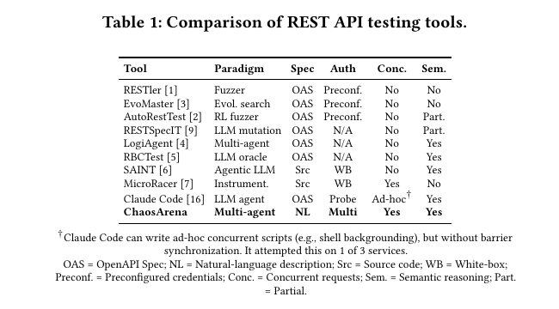
Overview: No existing workflow combines all three required capabilities
Broad fuzzing, semantic reasoning, and concurrency support exist, but remain disconnected.
Black-box tools usually do not combine:
semantic reasoning
multiple authenticated sessions
synchronized request release
Concurrency must be a first-class testing capability, not an optional script.
ChaosArena
Notes:
- Fuzzers provide broad request coverage, but generally execute sequentially
- Tool-equipped LLM agents can reason about semantics, but concurrency is ad hoc
- Black-box tools usually do not combine:
- semantic reasoning
- multiple authenticated sessions
- synchronized request release
- Thesis: concurrency needs to be a first-class testing capability, not an optional script

Slide 6
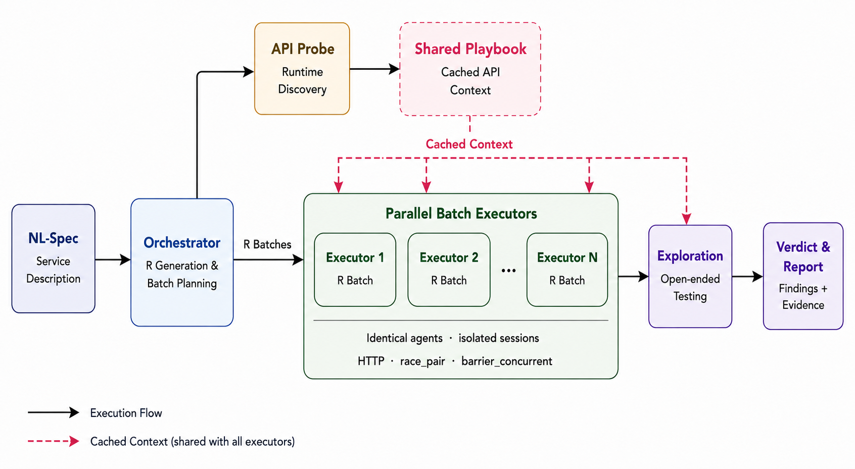
Design: Architecture from the paper
One shared probe feeds isolated executors and a final evidence pipeline
ChaosArena
Notes:
Input: natural-language service description derived from API documentation
Required phase: orchestrator generates required scenarios (Rs)
Shared probe: API playbook collected once, reused across executors
Parallel execution: batches run concurrently with isolated sessions
Exploration phase: one executor performs open-ended testing after required coverage
Verdict drafter aggregates findings into the final report

Slide 7
Design: Required scenarios create a deterministic coverage contract
The scenario set is fixed before any executor starts.
Concurrency
Auth / Authorization
IDOR(Insecure Direct Object Reference)
Overlapping shared-state mutations
Role and session boundaries
Cross-user resource access
Input Validation
HTTP Semantics
Business Logic
Malformed and boundary inputs
Status, method, schema behavior
Multi-step invariants
Multi-stage decomposition → mandatory category injection → structured reasoning → self-review
ChaosArena
Notes:
- Six required categories:
- concurrency
- authentication/authorization
- IDOR
- input validation
- HTTP semantics
- business logic
- Design principles:
- multi-stage decomposition
- mandatory category injection
- structured reasoning before emitting Rs
- self-review for coverage completeness
- Outcome: a deterministic coverage contract before execution starts

Slide 8
Design: Cache what is common, isolate what can interfere
Shared discovery reduces setup; isolated batches preserve independence
API PROBE
CACHED PLAYBOOK
PARALLEL BATCHES
Discovers once:
• auth flows and credentials
• working endpoints
• response shapes
• useful IDs and constraints
Injected as a shared prompt prefix across executors.
Avoids repeated API discovery and enables prompt-cache reuse.
Each executor receives the same playbook but maintains:
• its own session pool
• its own turn budget
• its own evidence log
ChaosArena

Slide 9
Design: The model chooses the race; the tool guarantees the overlap
Concurrency is exposed as a first-class agent capability.
race_pair
barrier_concurrent
Two prepared HTTP actions are released together with configurable microsecond-level skew.
Best for:
• add + add
• pay + add-item
• delete + update
Every action names an explicit session ID.
N prepared requests wait at a shared barrier, then release simultaneously.
Best for:
• duplicate registrations
• role/permission races
• multi-user contention
Returns all responses and timing together.
Sequential agent loop
OS-level synchronized execution
ChaosArena
Notes:
- `race_pair`: two synchronized HTTP actions with microsecond-level release skew
- `barrier_concurrent`: generalized N-way synchronized requests
- Each action is tied to an explicit session ID
- Important split:
- the model decides what to race
- the tool ensures the overlap actually happens
- This is the core difference from ordinary sequential LLM agent loops

Slide 10
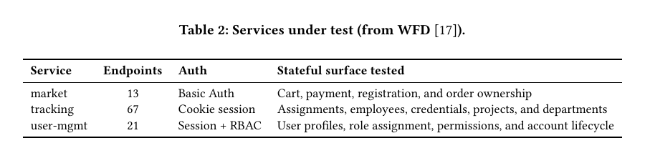
Design: Evaluation design isolates architecture effects
Three auth-diverse services, clean resets, concrete HTTP evidence, and matched-model comparison.
CLAUDE CODE
AUTORESTTEST
Same service information
Same Sonnet 4.6 model family
Isolates architecture effects
OpenAPI-based fuzzer baseline
Compared for raw failures and operation coverage
Excluded from semantic category/severity counts
WFD (Web Fuzzing Commons) is a collection of 36 open-source APIs with all necessary scaffolding to easily run experiments with fuzzers.
Services are reset before every run. A bug counts only with exact HTTP request/response evidence.
ChaosArena
Notes:
- Three Java Spring Boot services from WFD
- `market`: 13 endpoints, Basic Auth
- `tracking`: 67 endpoints, cookie session
- `user-mgmt`: 21 endpoints, session + RBAC
- Services reset to a clean state before each run
- ChaosArena input is a natural-language service description derived from OpenAPI
- Bug counted only if supported by concrete HTTP request/response evidence

Slide 11
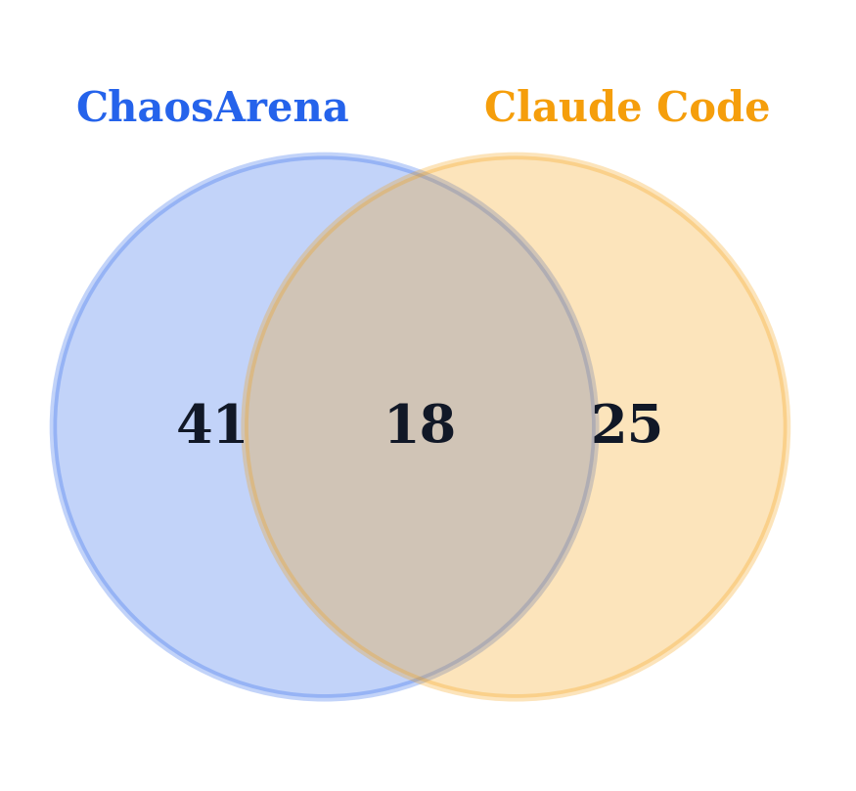
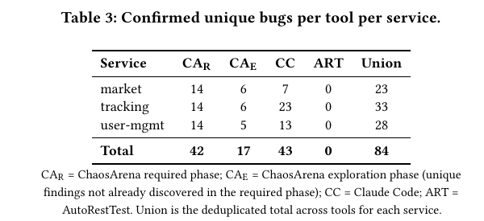
Evaluation: The tools find complementary failures—not the same bug set
Only 18 of 84 confirmed findings overlap.
What happens to ART?
It's a fuzzer, not a reasoner.
No semantic classification.
No multi-session or concurrency capability.
High noise drowns signal.
ChaosArena
Notes:
- Table/visual from paper:
- ChaosArena required phase: 42
- ChaosArena exploration phase: 17 additional unique findings
- ChaosArena total: 59
- Claude Code: 43
- Union across tools: 84
- Overlap between ChaosArena and Claude Code:
- 41 only by ChaosArena
- 18 shared
- 25 only by Claude Code
- Message: the tools are not finding the same things

Slide 12
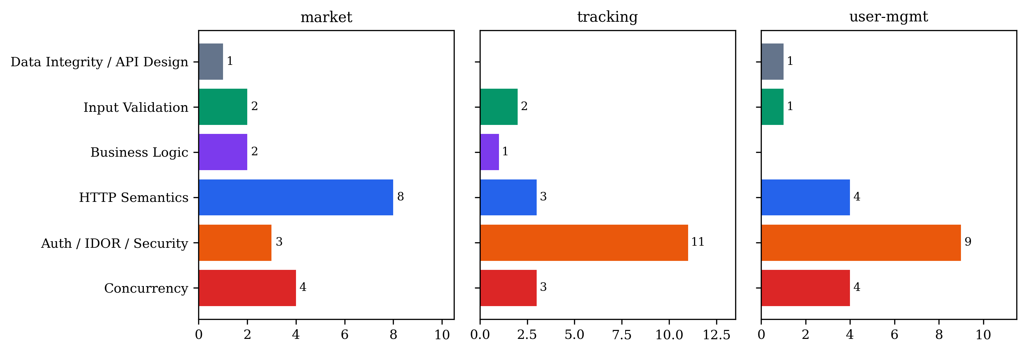
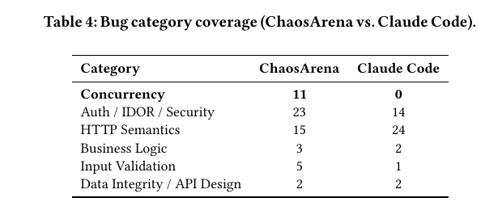
Evaluation: ChaosArena shifts coverage toward concurrency and authorization
Claude Code remains stronger on open-ended HTTP semantics.
ChaosArena is stronger on multi-session and concurrency-driven issues
Claude Code is stronger on open-ended HTTP-semantics exploration
ChaosArena

Slide 13
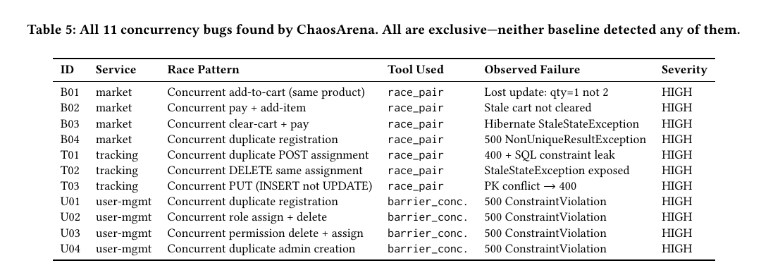
Evaluation: All 11 concurrency findings were exclusive to ChaosArena
Seven expose internal constraint failures; four corrupt or retain stale state.
Failure modes: silent data corruption and unhandled internal exceptions.
ChaosArena
Notes:
- ChaosArena reported all 11 concurrency findings; Claude Code reported none
- Two observed failure modes:
- silent data corruption
- unhandled internal exceptions / constraint violations
- Representative examples:
- lost update in `market`
- stale cart after concurrent pay + add-item
- concurrent role/permission races in `user-mgmt`

Slide 14
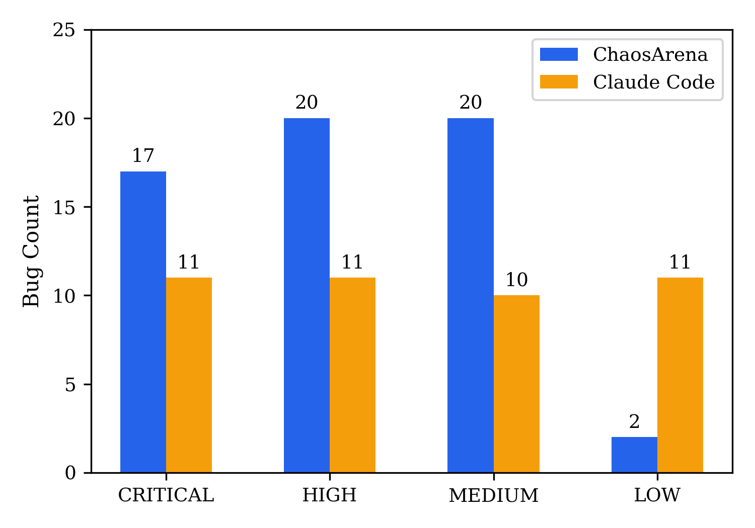
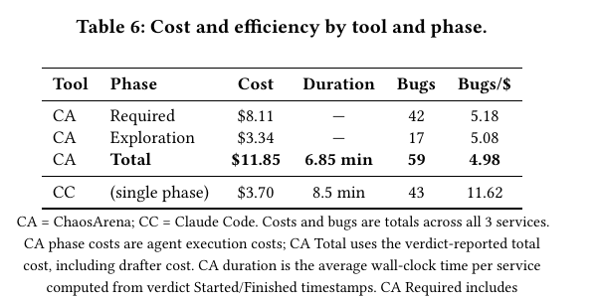
Evaluation: ChaosArena finds higher-impact failures faster—but costs more
Required coverage nearly matches Claude Code's total count before exploration.
HIGH for data corruption, internal exceptions, and serious state inconsistency;
MEDIUM/LOW for status-code or validation deviations with limited security impact.
ChaosArena is more expensive per dollar
Required phase alone nearly matches Claude Code's total bug count
Parallel batches reduce wall-clock time
Duplication in exploration is the main inefficiency
ChaosArena
Notes:
Severity:
Severity was reclassified based on impact-based criteria.
- ChaosArena: 17 critical, 20 high, 20 medium, 2 low
- Claude Code: 11 critical, 11 high, 10 medium, 11 low
- Cost/time:
- ChaosArena total: $11.85, 6.85 min average per service
- Claude Code: $3.70, 8.5 min average per service
- Interpretation:
- ChaosArena is more expensive per dollar
- required phase alone nearly matches Claude Code's total bug count
- parallel batches reduce wall-clock time
- duplication in exploration is the main inefficiency

Slide 15
Evaluation: Required coverage changes what the agent chooses to investigate
The different findings follow directly from the workflow design.
Coverage contract
Multiple sessions
Synchronized tools
Evidence verdicts
forces concurrency + auth scenarios
enables systematic cross-user checks
creates database-level overlap
preserves request/response proof
Result: stronger multi-session and concurrency coverage
Complement: Claude Code explores more HTTP-semantic side effects
ChaosArena

Slide 16
Evaluation: Can attempt concurrency is not the same as reliably exercising it
Claude Code tried one backgrounded shell loop; ChaosArena makes concurrency mandatory and synchronized.
AD-HOC SCRIPT
STRUCTURED CONCURRENCY
• attempted on 1 of 3 services
• one duplicate-creation pattern
• shell backgrounding, no barrier
• single user session
• depends on exploration choices
• required on every service
• 4–7 race scenarios per service
• microsecond-level release coordination
• explicit multi-user sessions
• evidence returned as one tool result
optional behavior
coverage guarantee
ChaosArena

Slide 17
Reflection: The current evidence is promising, not yet production-general
Several validity threats remain.
Evaluation scope
Authentication
Three demo-grade Java services
No OAuth 2.0 or MFA flows
Duplication
Deduplication
38–67% exploration restatements
Manual cross-tool matching
Reproducibility
System boundary
LLM outputs remain non-deterministic
No inter-service scheduling instrumentation
ChaosArena

Slide 18
Real Limitation: This is (possibly) a nice tool, but……
Lacking Novelty
Current:
ChaosArena is best described as an LLM-orchestrated, multi-turn black-box REST API testing workflow with explicit support for concurrency testing.
Ideal:
A novel ChaosArena would infer shared state and identity constraints from black-box interactions, generate cross-endpoint race tests, and verify whether concurrent outcomes are serializable.
well-engineered multi-agent, multi-turn testing agent
!=
fundamentally new concurrency-testing method
ChaosArena

Slide 19
How it evolves?
Some trade-offs
NL Description
Spec Drafter (1 LLM call)
Drafter_prompt
Structured spec.md
Agent Runner (multi-turn loop)
Tool.py (in-process)
Tool Schema
System Prompt
Previous Conversations
Outputs: Report

Slide 20
ULTIMATE GOAL: CUT THE COST!!!
I introduced a solution, and brought in several new problems
NL Description
Too costly since every log is saved in memory which becomes the new prompt for next turn, resulted in exponentially exploding context and cost! 91% of the total cost was just re-sending old conversation history.
Solution:
Once an R is verified, trim its conversation from the context.
New Problem:
Breaking coherence: the model may reference earlier findings ("as I saw in R3...") and pruning those messages causes hallucination or confusion
Losing cross-R context: some findings from R1 (e.g., discovered IDs, auth patterns) are needed to test R5. You can't know in advance which results are reusable vs. disposable
Spec Drafter (1 LLM call)
Drafter_prompt
Structured spec.md
Agent Runner (multi-turn loop)
Tool.py (in-process)
Tool Schema
System Prompt
Previous Conversations
Trim
Outputs: Report

Slide 21
ULTIMATE GOAL: CUT THE COST!!!
I introduced a solution, and brought in several new problems
NL Description
Problem:
Cannot trim perfectly which would affect testing outcome.
Solution:
Batch the execution: the orchestrator generates all Rs upfront, groups them into independent batches, and dispatches each batch to a separate short-lived executor. Each executor runs its own isolated conversation (~6–12 turns) instead of one monolithic conversation that grows to 40+ turns.
New Problem:
Every executor must independently discover the API (auth flows, endpoints, working IDs) before it can start testing. This redundant probing multiplies setup cost by N batches — the same discovery work repeated N times.
Spec Drafter (1 LLM call)
Drafter_prompt
Structured spec.md
Orchestrator
Batch executor 1
…
Batch executor N
Outputs: Report

Slide 22
ULTIMATE GOAL: CUT THE COST!!!
I introduced a solution, and brought in several new problems
NL Description
Problem:
Every executor must independently discover the API, which COSTS!
Solution:
Add the API Probe agent, share the API Playbook!
New Problem:
Each executor has its own turn budget but no external guidance on pacing. Agents tend to over-explore early Rs and run out of budget before covering later ones, or keep probing after all assigned Rs are already verified.
Spec Drafter (1 LLM call)
Drafter_prompt
Structured spec.md
Orchestrator
API Probe
Playbook
Batch executor 1
…
Batch executor N
Outputs: Report

Slide 23
ULTIMATE GOAL: CUT THE COST!!!
I introduced a solution, and brought in several new problems
Problem:
Batch cannot be done!
Solution:
Add remaining turn counts in each turn.
New Problem:
Duplicated tests!
Proposed Solution?
Share state across each Batch?
ChaosArena

