Slide 1
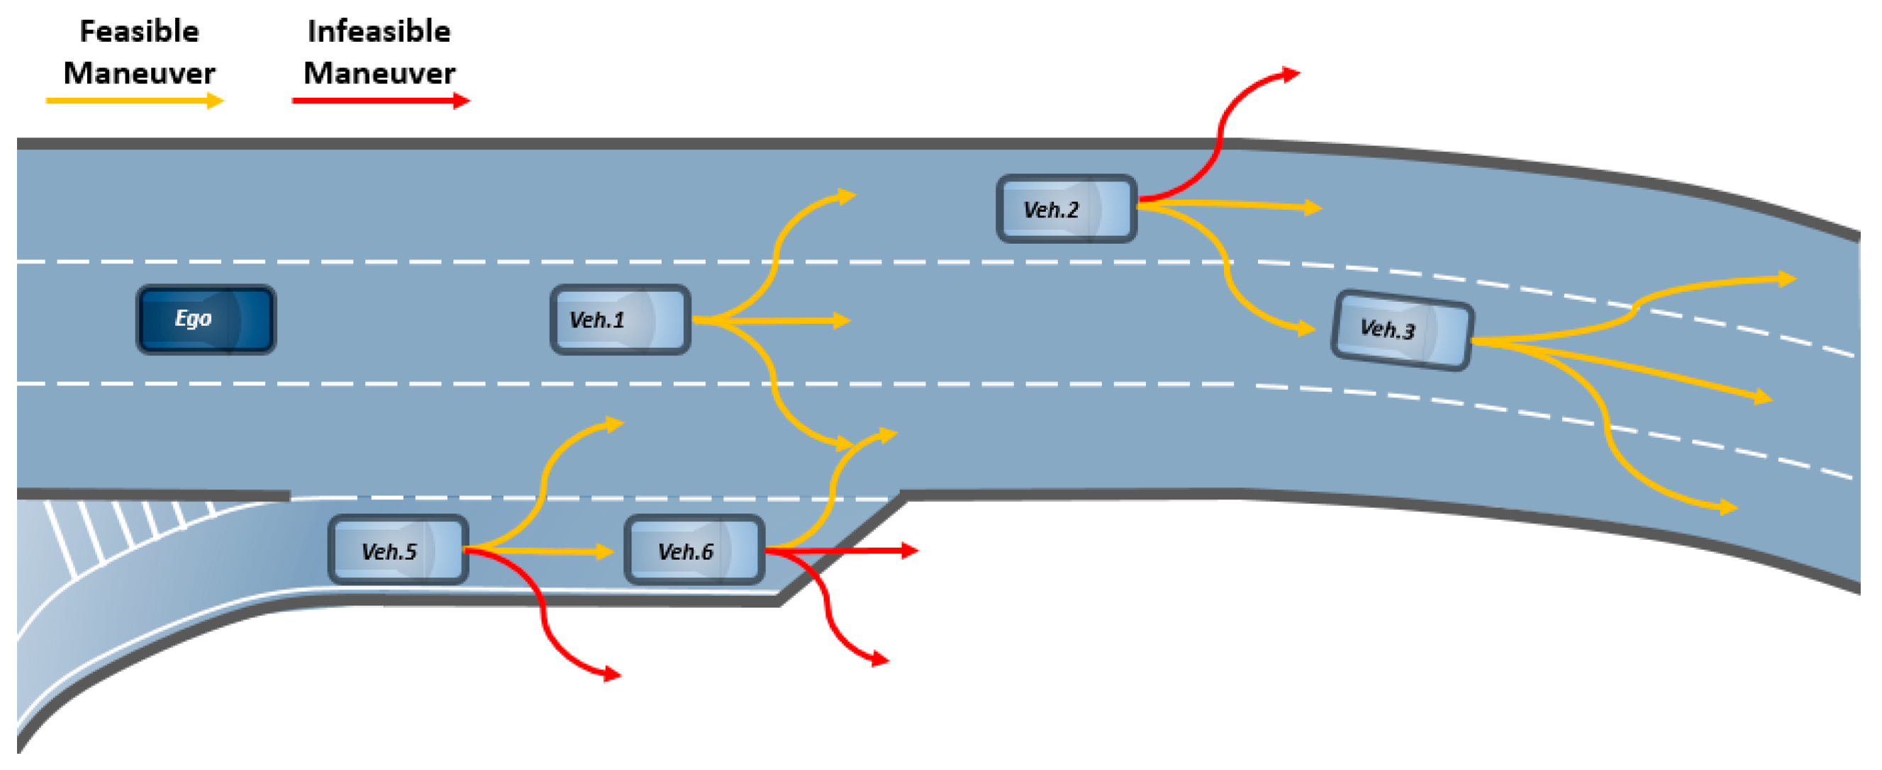
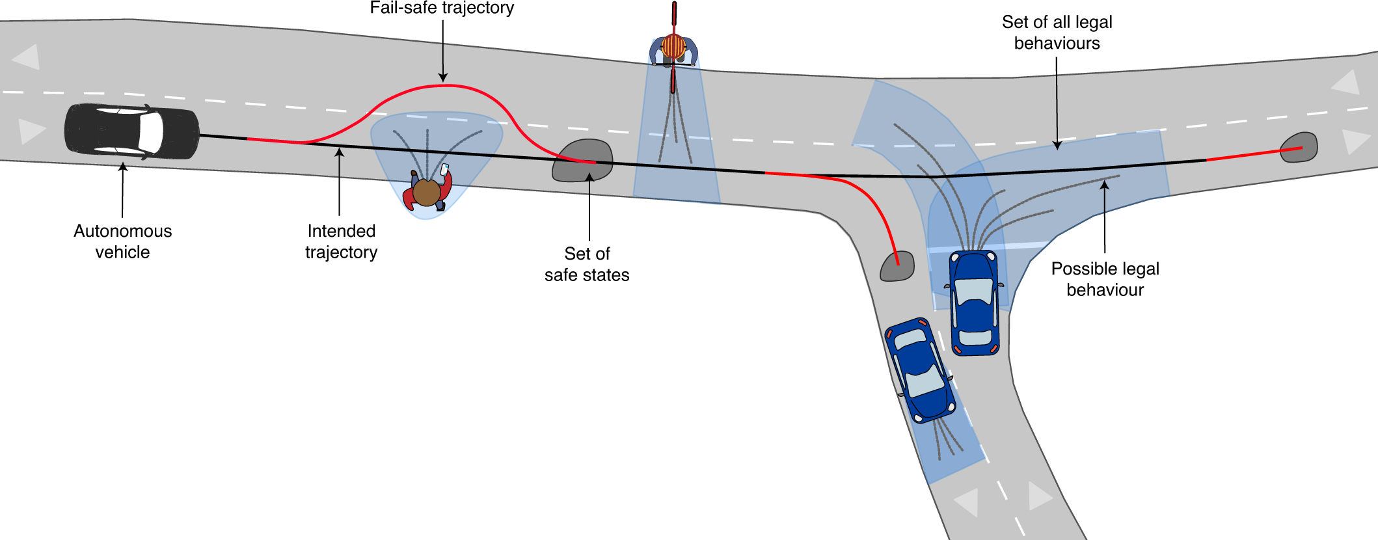
Research Projects
1) Interactive State Prediction
2) State Prediction Evaluation for Downstream Tasks
Vehicle State Prediction during Lane Changes
Pedestrian Intention Recognition & Trajectory Prediction
Urban Road Mixed Prediction

Slide 2
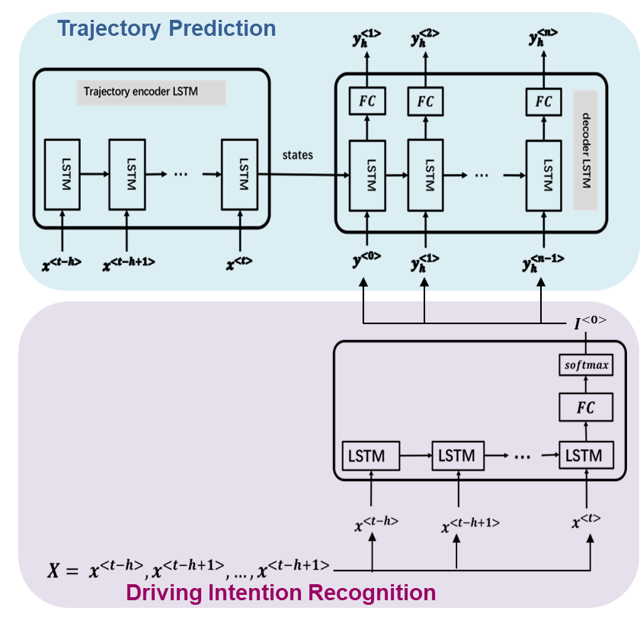
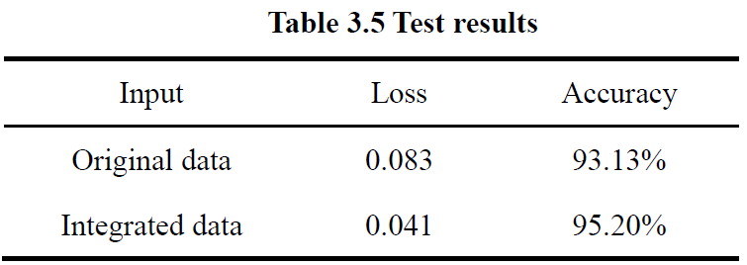
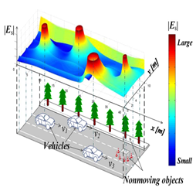
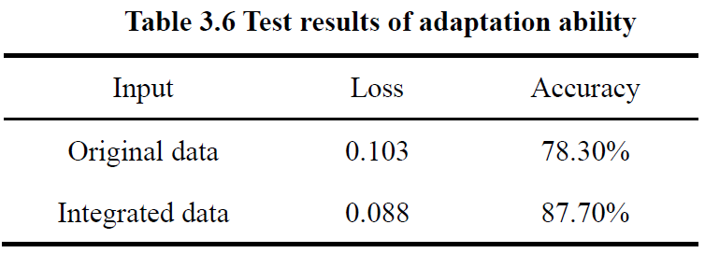
Vehicle State Prediction during Lane Changes
Encoder-Decoder Structure
Safety Field for information Integration
Strong Adaptability
Same num.
of Lanes
Diff. num.
of Lanes

Slide 3
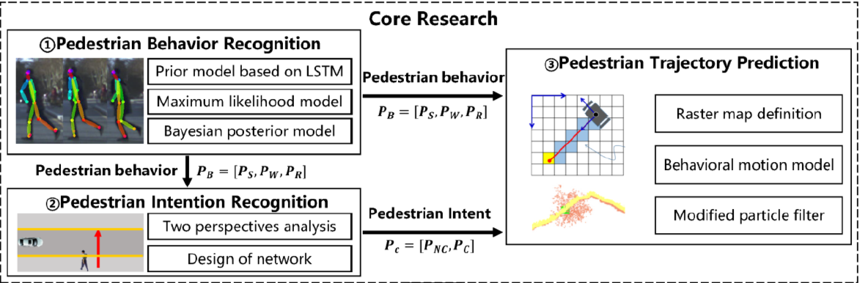
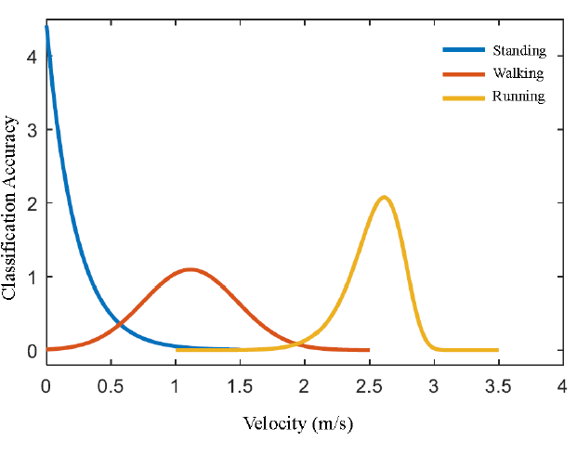
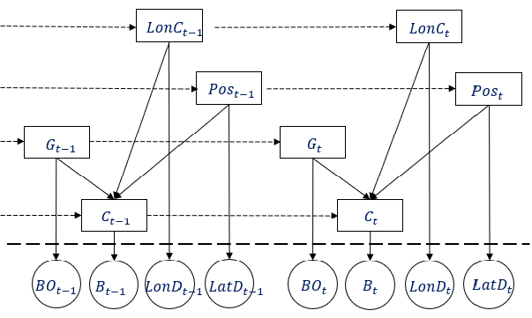
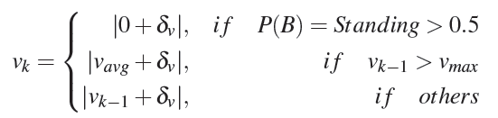
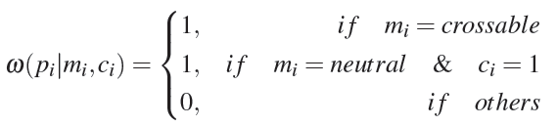
Pedestrian Intention Recognition & Trajectory Prediction
Machine Learning
Comprehensive System
Behavior & Intention based Particle Filter
[1] Crossing-Road Pedestrian Trajectory Prediction Based on Intention and Behavior Identification, IEEE ITSC, 2020.
[2] Roadside pedestrian motion prediction using Bayesian methods and particle filter, IET ITS, 2021.

Slide 4
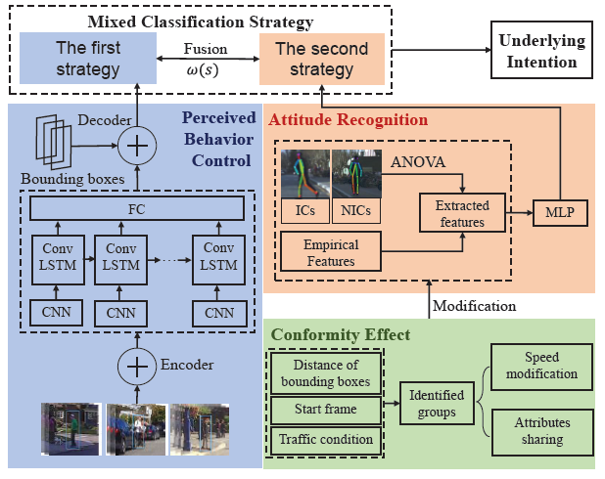
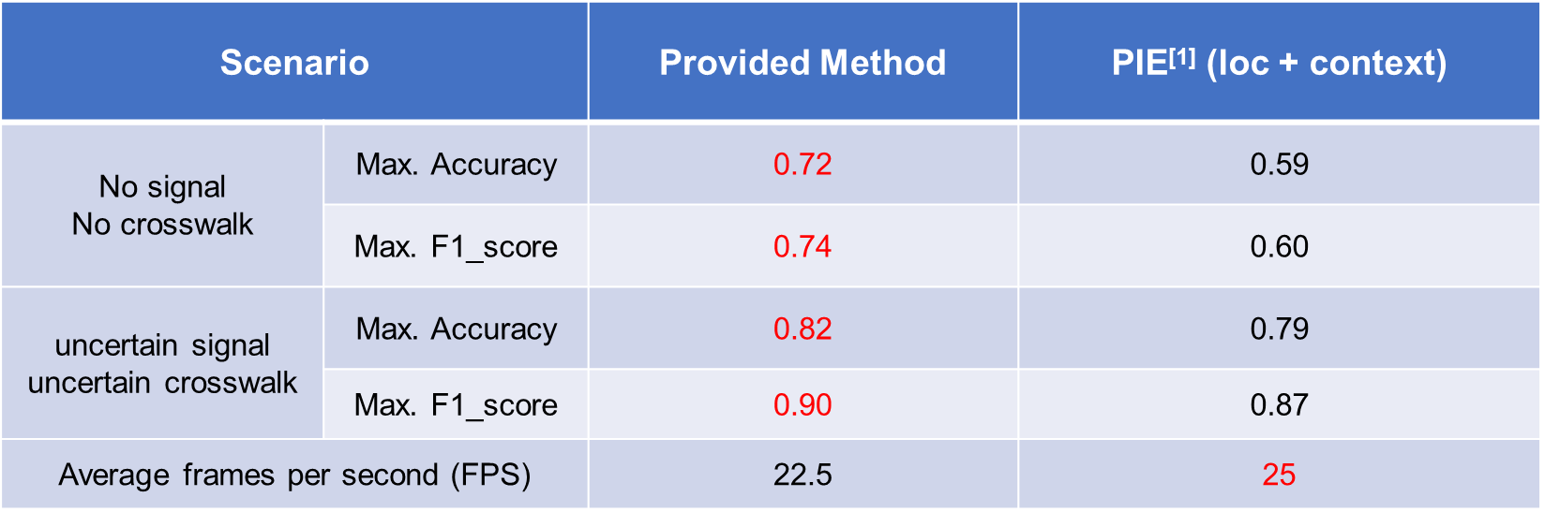
Pedestrian Intention Recognition & Trajectory Prediction
Theory of planned behavior
Attitude
Subjective Norms
Perceived Behavioral Control
Interpretability
Results
[3] Applying the Extended Theory of Planned Behavior to Pedestrian Intention Estimation, IEEE IV, 2021.

Slide 5
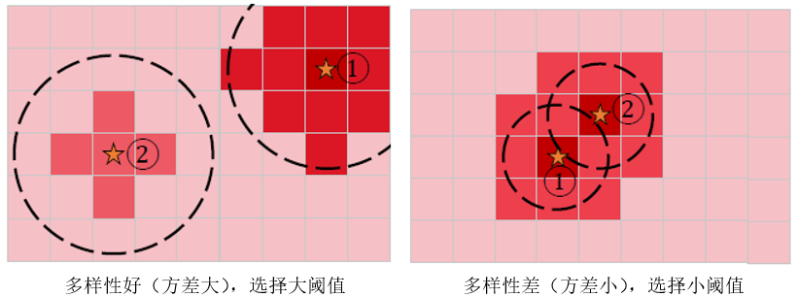
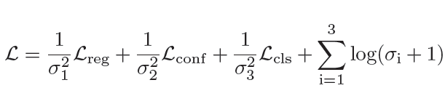

Urban Road Mixed Prediction
AS-NMS
Diversity Loss
$$L_{div}=max(μ−{\left\|{fp}_{i}−{fp}_{j}\right\|}_{2}, 0)$$
Road to Road
Multi-Task Learning
Rank 7th in Argoverse Competition

Slide 6
Research Projects
1) Interactive State Prediction
2) State Prediction Evaluation for Downstream Tasks
Rethinking State Prediction Evaluation
State Prediction for Sequential Decision Making

Slide 7
Rethinking State Prediction Evaluation
AV Architecture
Evaluation
Evaluation
Perception
Prediction
Planning
Control
Average Displacement Error (ADE)
Final Displacement Error (ADE)
Safety
Efficiency
Comfort
Planning-aware Evaluation

Slide 8
Rethinking State Prediction Evaluation
*Results obtained using SUMMIT simulator, GAMMA dynamic model and RVO Planner, 5 different world maps.
[4] What Truly Matters in Trajectory Prediction for Autonomous Driving, Preprint, 2023.
Notes:
Therefore, we use the the most simple planner called RVO planner, with the most commonly used simulator to see whether there is such a gap and how big is this gap.
We evaluated 8 different prediction models using Carla based simulator including both data driven and rule based predictor on 5 real world adapted maps from London india, and china. We measure the driving performance using there major criteria.
First, safety, which corresponds to collision rate. Efficiency, the average of speed of the agent, comfort, the change of the acceleration of the agent.
The black line indicates the expectation, we assume the better the prediction results and the better the driving performance. However, this is not entirely true.

Slide 9
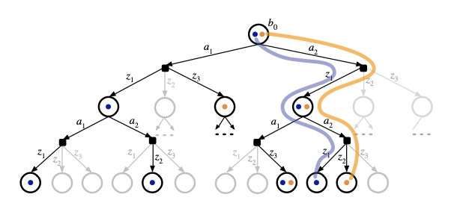
Rethinking State Prediction Evaluation
Dynamics Gap.
Computational Efficiency.
DESPOT Planner
[4] What Truly Matters in Trajectory Prediction for Autonomous Driving, Preprint, 2023.
Notes:
The dynamics gap arises from the fact that the behavior of the autonomous vehicle, also known as the ego-agent, changes with different trajectory predictors. In real-world scenarios, the ego-agent utilizes trajectory predictions to determine its actions. However, different trajectory predictions result in varied behaviors of the ego-agent, which, in turn, influence the future behaviors of other road users, leading to different dynamics within the environment. This directly affects the prediction results as other agents behave differently. Consequently, there exists a disparity between the dynamics represented in the dataset and the actual driving scenario when assessing a specific trajectory predictor.
In addition, different from our notion of computational efficiency of the predictor. There is no clear threshold to say whether a predictor is fast enough, instead, the trade-off between the speed and accuracy of the planner is crucial. For an anytime sampling based planner, which is relatively slow, constant velocity tends to be the optimal considering trade-off.
Given these results, we definitely want a interactive realistic platform to evaluate our prediction models. However, first, we can’t afford run the simulator to evaluate the predictor everytime. Second, the dynamics in the simulator still have a gap with the real world dynamics. Thus, we want a more general solution, affordable solution to the problem .

Slide 10






State Prediction for Sequential Decision Making
An MDP Formulation:
$$M = (S, A, T, R)$$
$s=\{s_{ego}, s_{exo}\}∈S$ : states of all agents including historical information
$a∈A$: Prediction of exo-agents
$π$: The predictor predict all exo-agents future trajectory.
$R$: The reward function, the average prediction accuracy
$$T_{2}$$
$$T_{1}$$
$T\left(s_{t+1}\right| s_{t}, a_{t})=T_{2}\left({s_{exo} | s}_{t}\right){ T}_{1}\left(s_{ego} | s_{t}, a_{t}\right)$: Transition Function.
[5] On the Evaluation of State Prediction for Sequential Decision Making, Ongoing

Slide 11
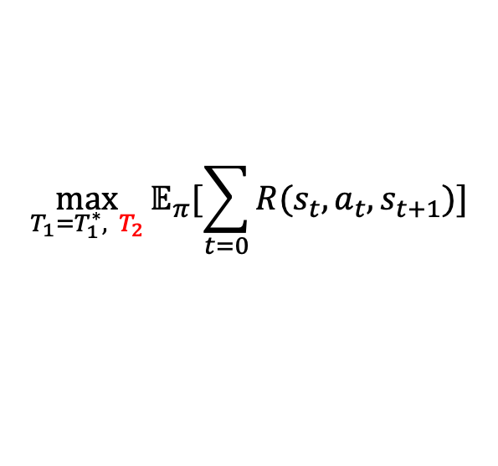
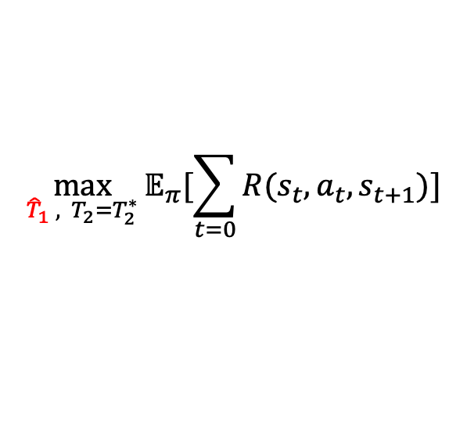
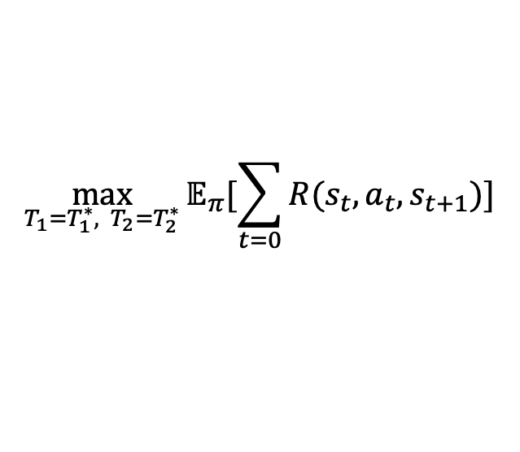


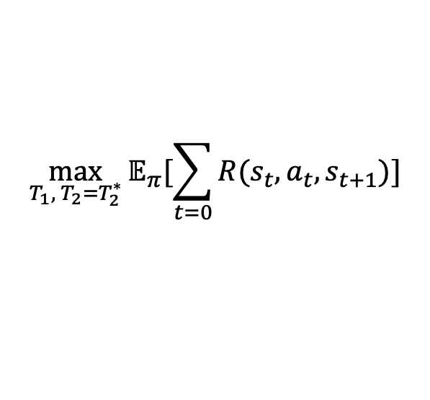
State Prediction for Sequential Decision Making
$$\max_{T_{1}=T_{1}^{∗}, T_{2}=T_{2}^{∗}}{𝔼_{π}[\sum_{t=0}{R(s_{t}, a_{t}, s_{t+1})}]}$$
Objective:
Solution 1: Evaluation on dataset
Solution 2: Evaluation on Simulation
$$\max_{{\hat{T}}_{1} , T_{2}=T_{2}^{∗}}{𝔼_{π}[\sum_{t=0}{R(s_{t}, a_{t}, s_{t+1})}]}$$
$$\max_{T_{1}=T_{1}^{∗}, T_{2}}{𝔼_{π}[\sum_{t=0}{R(s_{t}, a_{t}, s_{t+1})}]}$$
Evaluation by Scenario Replication on Datasets
$$T_{2}$$
$$\max_{T_{1}, T_{2}=T_{2}^{∗}}{𝔼_{π}[\sum_{t=0}{R(s_{t}, a_{t}, s_{t+1})}]}$$
$$T_{1}$$
$$s.t. T_{1}\left(s_{t}, π(s_{t})\right)={\hat{T}}_{1}\left(s_{t}, \hat{π}(s_{t})\right)$$
[5] On the Evaluation of State Prediction for Sequential Decision Making, Ongoing

Slide 12
State Prediction for Sequential Decision Making
An MDP Formulation:
A*
RVO
POMDP Planner
Evaluation
Evaluation
Perception
Prediction
Planning
Control
[5] On the Evaluation of State Prediction for Sequential Decision Making, Ongoing

