Slide 1
PROJECT THESIS
Style-Aware Adaptation for Language-Conditioned Humanoid Motion Generation
A 5-minute report on MoConVQ style steering with LoRA distillation.
When direct HumanML3D-to-MoConVQ supervision was unavailable, the final system switched to pseudo-token distillation and still produced measurable style-direction changes.
format pivot
1.97M
18 / 22
No unsupported token labels
Trainable LoRA params
Proxy checks improved
HumanML3D parquet gives 263-D features, not MoConVQ tokens.
Only 1.005% of the wrapped generator is updated.
Pre-defined BVH style-direction comparisons.
Source: final_report.pdf, Abstract and Conclusion
1 / 6 - Initial 5-minute report
Notes:
Open with the pivot: the project did not force invalid supervision. It found a data-format mismatch, used teacher pseudo tokens, trained a small LoRA adapter, and evaluated style changes with BVH proxies.

Slide 2
ENGINEERING PIVOT
The key decision was to avoid invalid supervision.
ORIGINAL PLAN
DISCOVERED CONSTRAINT
FINAL ROUTE
Fine-tune style control
No direct token labels
LoRA distillation
Keep MoConVQ representation, decoder, and controller frozen.
Local HumanML3D export provides processed 263-D motion features.
Filter style captions from HumanML3D.
Adapt the language-conditioned generator for style prompts.
A reliable bridge to MoConVQ BVH/token labels is not available.
Use pretrained MoConVQ teacher outputs as pseudo-token targets.
Train only low-rank LoRA updates.
Decision rule: report only claims supported by available representations and measured artifacts.
Source: Data and Format Constraint; Method
2 / 6 - Initial 5-minute report
Notes:
This is the credibility slide. The original idea stayed intact at the level of frozen-backbone adaptation, but the supervision changed because the available HumanML3D files are not MoConVQ token labels.

Slide 3
FINAL METHOD
LoRA distillation adapts the language-to-token interface while motion execution stays frozen.
HumanML3D
style captions
MoConVQ teacher
pseudo tokens
Frozen student
+ LoRA adapter
BVH motion
outputs
Style proxy
metrics
distillation target
train low-rank updates
freeze decoder/controller
render and parse
kinematic motion files
Evaluation separates three signals: teacher-token learning, BVH kinematic proxy movement, and qualitative motion inspection.
Source: Fig. 2 and Method section
3 / 6 - Initial 5-minute report
Notes:
Walk left to right. The teacher supplies targets in MoConVQ's own token space, the student starts from the same pretrained generator, and only LoRA parameters move. The decoder and controller stay stable.

Slide 4
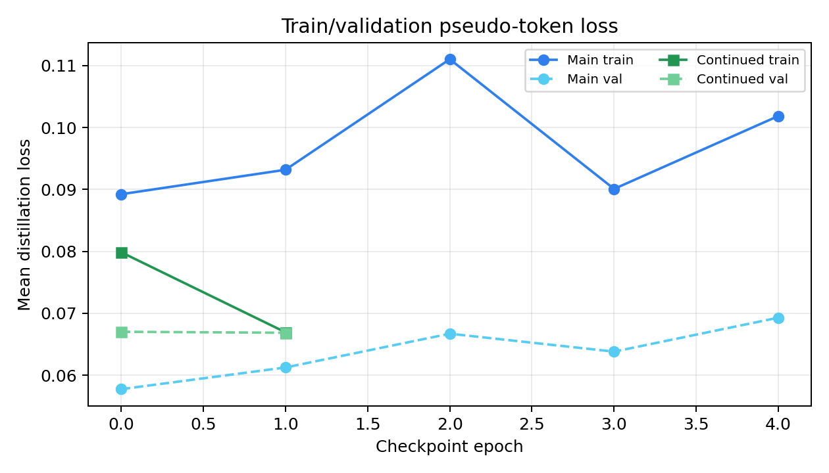
TRAINING EVIDENCE
A tiny adapter learns the teacher distribution while the motion stack stays frozen.
200
Distilled style captions
Small, reproducible teacher-token cache.
1.005%
Generator parameters updated
1.97M trainable out of 195.59M.
0.0669
Final train / val diagnostic
Continued checkpoint ends at matched pseudo-token loss.
This proves adapter learning against teacher tokens, not official HumanML3D motion fidelity.
Source: Experiments; Results; eval_distill_loss_comparison.png
4 / 6 - Initial 5-minute report
Notes:
Make the distinction clear: the adapter learns the teacher token distribution and uses only about one percent trainable parameters. This is evidence for controllable adaptation, not a claim of official benchmark improvement.

Slide 5
RESULTS
Proxy metrics show style steering on most tested prompts.
Expected-direction BVH proxy win rate
Slow deliberate
4/4
18 / 22
Graceful dance
3/4
pre-defined checks improved
Tai chi
2/4
Energetic jump
5/6
Strongest
Heavy tired
4/4
slow deliberate
heavy tired
Weakest case: tai chi needs coordinated slow rotation beyond these simple proxies.
Source: Table IV; evaluation_summary.csv
5 / 6 - Initial 5-minute report
Notes:
Explain the metric protocol. The direction was pre-defined before scoring. Slow and heavy should reduce speed-like measures, energetic jump should increase vertical motion and speed. The total is strong, but tai chi stays weak.

Slide 6
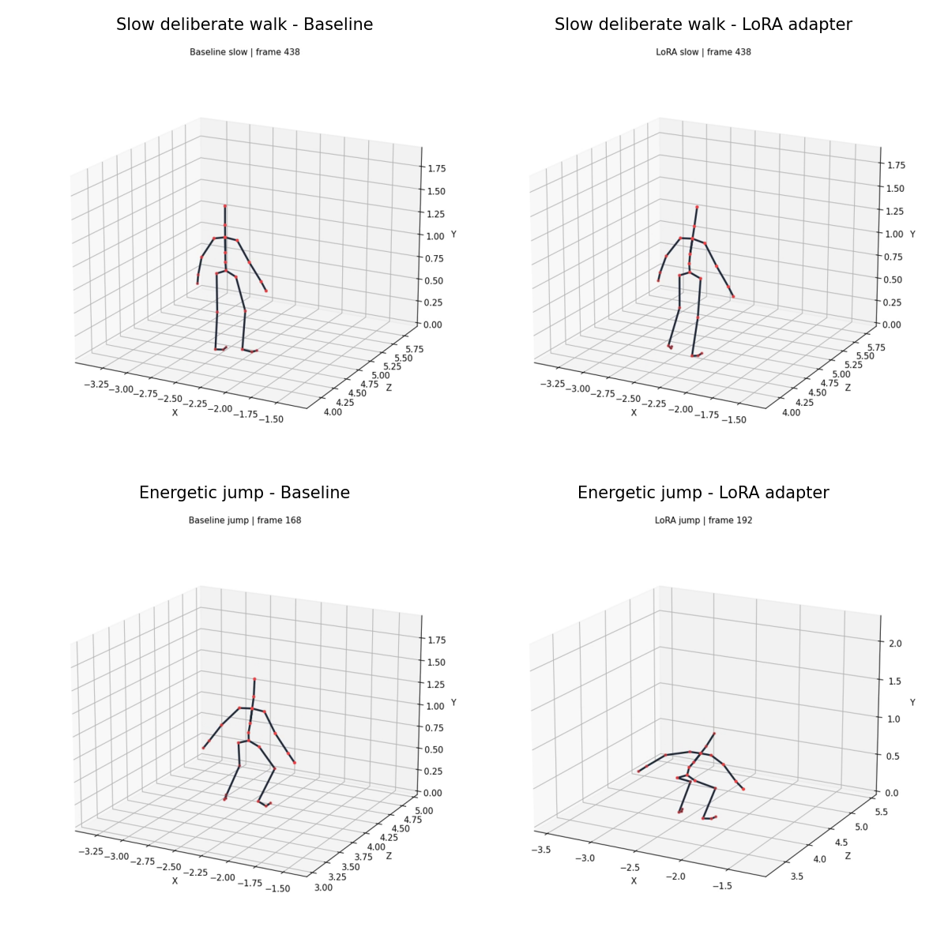
TAKEAWAY
The result is defensible style steering, not a full benchmark win.
What is solid
Best next step
MoConVQ inference path reproduced.
LoRA distillation pipeline is reproducible.
Build a verified representation or evaluator bridge so style control can be measured against true motion benchmarks, not only teacher tokens and proxies.
BVH proxy checks support most coarse style directions.
What remains limited
No official FID or R-Precision bridge.
Small prompt-level proxy evaluation.
Teacher distillation cannot add new motion knowledge.
Qualitative previews are inspection evidence, not benchmark scores.
Source: Limitations; Result Interpretation; Conclusion
6 / 6 - Initial 5-minute report
Notes:
Close by being precise. The project is successful as a reproducible, parameter-efficient style-steering experiment. The remaining scientific work is a verified representation or evaluator bridge for full benchmark evaluation.

