Slide 1
FINAL REPORT DEFENSE
HumanML3D-Guided
Teacher Selection
for MoConVQ LoRA Motion Distillation
Core claim: paired HumanML3D motion can guide teacher pseudo-token selection, but the final student still needs paired-motion evaluation.
Method
Evidence
Finding
multi-candidate teacher sampling + HumanML motion-distance selection
top-k makes 86/200 selections non-first candidates
teacher alignment improves; old style proxy drops
HumanML3D-Guided Teacher Selection | Paper-Synced Defense Deck
1 / 15
Notes:
这一页先讲整份报告的核心结论。我的工作不是重新训练一个全新的动作生成器，而是在 MoConVQ GPT 的 LoRA 蒸馏流程里，重新设计 teacher pseudo-token target 的选择方式。原来的流程更接近 caption-only distillation：HumanML3D 主要提供文本 caption，teacher 根据 caption 生成 token，学生去模仿这些 token。我的新版方法把 HumanML3D 里同一条样本的 paired motion 也用起来，先让 teacher 产生多个候选动作，再挑选和 HumanML3D 真实动作统计特征最接近的那个候选作为 LoRA 学生的训练目标。需要注意的是，最终结论不是“质量已经全面提升”，而是“teacher target selection 更数据化了，并且 top-k 让选择真正起作用了”。

Slide 2
ROADMAP
Presentation structure follows the final report
01
Data mismatch
HumanML3D motion is continuous features; MoConVQ GPT trains on discrete tokens
Message hierarchy
02
Baseline distillation
Every section answers one question: what changed, how it was measured, and what the result means.
Caption-only teacher pseudo-token imitation
03
Motion-guided target selection
Decode candidates and choose the one closest to paired HumanML3D motion
04
Training and metrics
Loss, style proxy, and HumanML teacher alignment are separate signals
05
Result and limitation
Top-k fixes candidate diversity, but old style proxy does not improve
HumanML3D-Guided Teacher Selection | Paper-Synced Defense Deck
2 / 15
Notes:
这一页给听众一个路线图。第一部分先说明数据格式问题：HumanML3D 有 motion，但这些 motion 不是 MoConVQ GPT 可以直接训练的离散 token。第二部分解释原始 baseline：teacher 生成 pseudo-token，学生用 LoRA 模仿。第三部分是这次论文和 PPT 的重点，也就是 HumanML3D motion-guided teacher selection。第四部分讲实验指标，尤其要区分 training loss、old style proxy 和 HumanML alignment。最后讲结果：top-k 解决了候选几乎不变的问题，也让 teacher target 更接近 HumanML3D，但 old style proxy 下降，所以最后的 claim 要保守。

Slide 3
DATA CONSTRAINT
HumanML3D motion exists, but it is not a MoConVQ token label
HumanML3D row
MoConVQ GPT target
Key mismatch
caption + motion_id + processed 263-D continuous motion features
finite codebook token IDs such as [34, 812, 91, ...]
Motion values are continuous floats; GPT loss expects discrete token labels.
Therefore, HumanML3D motion should not be treated as a direct token label. It can still guide which teacher-generated token sequence is selected.
HumanML3D-Guided Teacher Selection | Paper-Synced Defense Deck
3 / 15
Notes:
这一页回答一个容易混淆的问题：HumanML3D 和 MoConVQ token 到底是不是都离散。HumanML3D 的动作是按帧存储的，所以时间步是离散的，但每一帧里面的关节位置、旋转、速度等数值是连续浮点数。MoConVQ GPT 训练的目标则是 codebook 里的离散 token id。也就是说，HumanML3D motion 不能直接当成 GPT 的标签。我的方法没有伪装这个转换已经解决，而是采用更稳的方式：让 MoConVQ teacher 先生成合法 token，再用 HumanML3D motion 去选择哪个 teacher token 更适合。

Slide 4
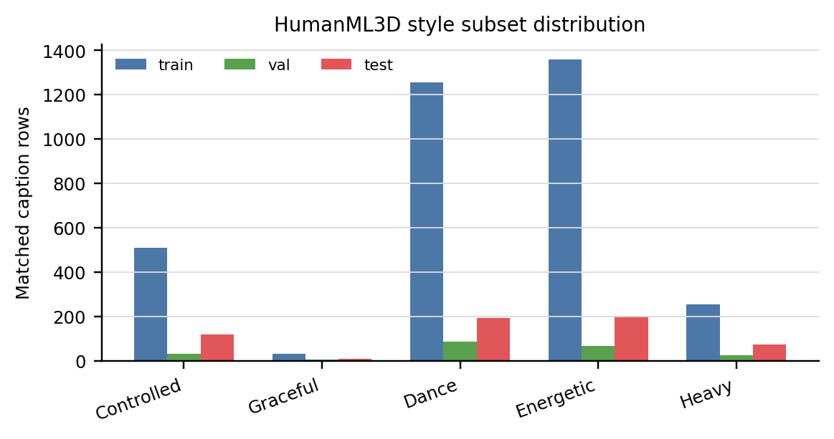
DATA
Style-caption subset used for the project
The subset is strongest for dance, energetic, and controlled styles; graceful style is sparse.
HumanML3D-Guided Teacher Selection | Paper-Synced Defense Deck
4 / 15
Notes:
这一页展示论文里的 style subset distribution。HumanML3D 是数据来源，但在最初的 LoRA distillation 里，主要用的是 caption，也就是文本条件。这个图说明我们的 style subset 是通过关键词过滤出来的，其中 dance、energetic、controlled 这些类别相对多一些，而 graceful 更少。这个分布会影响后面结果的解释：粗粒度、运动学特征明显的风格，比如 slow、heavy、energetic，更容易被当前 proxy 捕捉；更细腻的 graceful 或 tai chi 风格，则更难仅靠简单运动统计完整评价。

Slide 5
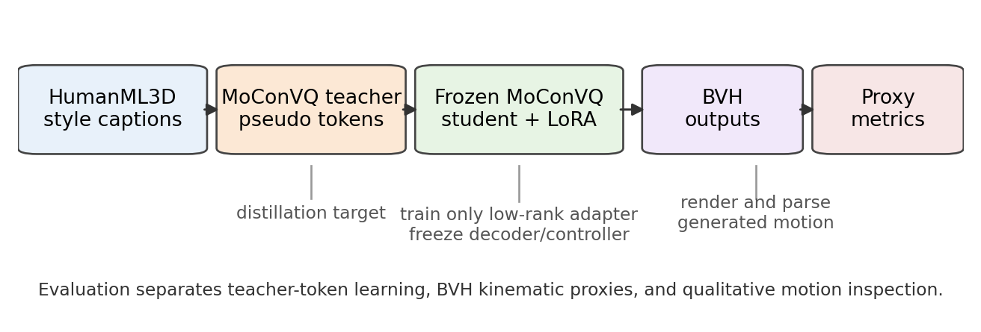
BASELINE PIPELINE
Original LoRA distillation learns teacher pseudo-tokens
Loss meaning
What it misses
Why preserve it
Low CE loss means the student copied selected teacher tokens.
It does not prove the teacher target matches HumanML3D motion.
It keeps the decoder, quantizer, and controller frozen.
HumanML3D-Guided Teacher Selection | Paper-Synced Defense Deck
5 / 15
Notes:
这一页讲 baseline pipeline。HumanML3D caption 进入 MoConVQ teacher，teacher 输出 pseudo-token，LoRA student 用 cross entropy 去拟合这些 token，最后 token 经过 decoder 和 controller 生成 BVH。这里的优点是训练目标和 MoConVQ GPT 完全兼容，不需要强行把 HumanML3D motion 转成 token。缺点也很清楚：如果 teacher 采样出来的动作虽然合理，但和当前 HumanML3D row 的真实 motion 不接近，学生仍然会模仿这个 teacher target。所以 training loss 只说明学生模仿 teacher 是否成功，不说明 teacher target 是否是最贴近数据的目标。

Slide 6
METHOD
Motion-aware pseudo-token cache selection
1 HumanML row
>
2 Teacher top-k
>
3 Decode BVHs
>
4 Select target
>
5 Train LoRA
caption + paired motion metrics
sample 4 stochastic candidates
measure each candidate motion
minimize distance to HumanML profile
CE loss on selected token IDs
selection distance = mean | log((candidate_metric + eps) / (HumanML_metric + eps)) |
This rewards closeness to the paired HumanML3D motion, not a one-way style direction such as always lower speed.
HumanML3D-Guided Teacher Selection | Paper-Synced Defense Deck
6 / 15
Notes:
这一页是新方法的核心流程。第一步，从 HumanML3D row 里拿到 caption 和 paired motion 的统计特征。第二步，teacher 不再只给一个几乎确定的输出，而是用 top-k stochastic sampling 生成多个候选 token。第三步，把每个候选 token 解码成 BVH，再计算 duration、root speed、path length、joint velocity、acceleration、jerk、vertical range 等统计。第四步，用 log-ratio distance 比较 candidate 和 HumanML3D motion 的接近程度，选距离最小的 candidate。第五步，LoRA 训练本身不变，仍然是对选中的 token ids 做 cross entropy。这样 HumanML3D motion 影响的是 pseudo-label selection，而不是被当成直接 token label。

Slide 7
IMPLEMENTATION FINDING
Deterministic teacher candidates made filtering meaningless
Selected teacher candidate counts on 200 samples
candidate 0
199
candidate 1
1
Interpretation
Multiple candidates existed in code, but they were almost identical in practice. The selector could not really choose.
HumanML3D-Guided Teacher Selection | Paper-Synced Defense Deck
7 / 15
Notes:
这一页解释为什么我后来一定要改 top-k。最初我以为只要生成多个 teacher candidate，再用 HumanML motion score 选择，就能利用 HumanML3D。但统计结果发现，在 200 个样本里，candidate 0 被选中 199 次，candidate 1 只被选中 1 次。这说明 teacher.sample 在原设置下几乎是确定性的。也就是说，表面上有多候选，实际却几乎没有多样性，筛选器没有真正的选择空间。所以问题不是评分器一定没用，而是 candidate generation 本身太确定。

Slide 8
TOP-K FIX
Top-k sampling gives the selector real alternatives
Top-k selected candidate counts
What changed
Before top-k: multi-candidate filtering was mostly decorative.
After top-k: HumanML motion-distance selection can actually influence which pseudo-token sequence is cached.
This is a method-level fix, not final proof of better student motion.
114
31
32
23
cand 0
cand 1
cand 2
cand 3
86 / 200 selections came from non-first candidates.
HumanML3D-Guided Teacher Selection | Paper-Synced Defense Deck
8 / 15
Notes:
这一页展示 top-k 的作用。改成 top-k stochastic sampling 后，候选选择分布变成 candidate 0 选中 114 次，candidate 1 选中 31 次，candidate 2 选中 32 次，candidate 3 选中 23 次。也就是说，有 86 个样本选择了不是第一个的 candidate。这说明候选真的多样了，HumanML motion-distance score 不再只是形式上的筛选，而是能改变最终 cached pseudo-token target。这里要强调：这证明的是“选择机制起作用了”，还不是证明“最终学生生成一定更好”。

Slide 9
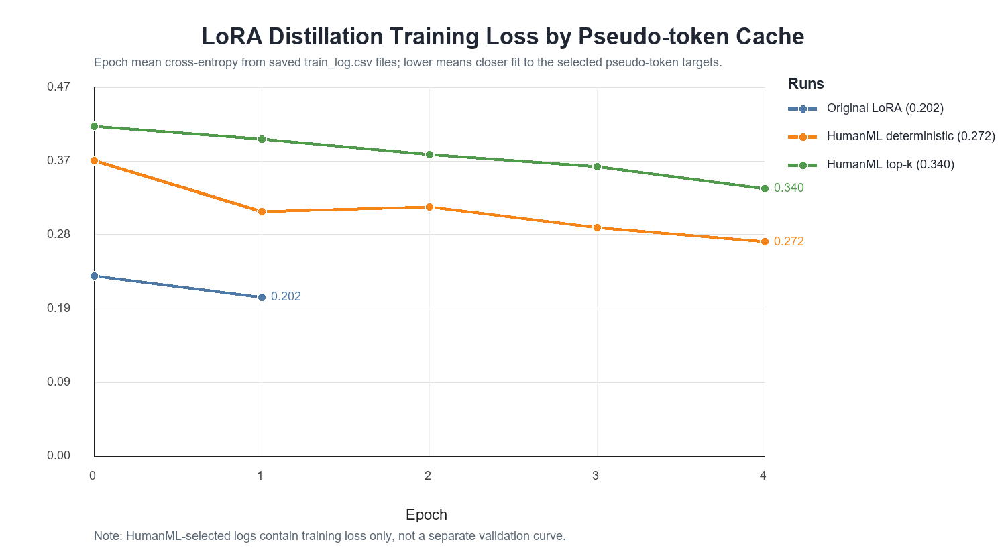
TRAINING LOSS
HumanML-selected top-k cache is learnable but harder to fit
Deterministic
0.3749 -> 0.2721
Top-k
0.4184 -> 0.3396
Meaning
higher loss = harder/diverse pseudo-targets
HumanML3D-Guided Teacher Selection | Paper-Synced Defense Deck
9 / 15
Notes:
这一页是根据论文更新后的新 loss 曲线。之前 PPT 里没有放新训练的 loss，这是不完整的。现在这张图比较三种 pseudo-token cache 下的 LoRA distillation training loss。Original LoRA continuation 从 0.2289 降到 0.2018。HumanML deterministic 从 0.3749 降到 0.2721。HumanML top-k 从 0.4184 降到 0.3396。top-k 的 loss 更高，不代表训练失败，而是说明 top-k cache 产生的目标更分散、更难拟合。这个现象和后面的结果一致：top-k 带来了更多样的 teacher candidates，但更多样不一定立刻让 old style proxy 更高。

Slide 10
EVALUATION
Separate token learning, style direction, and HumanML closeness
Training loss
Old style proxy
HumanML alignment
Does student imitate selected teacher tokens?
Does generated BVH move in hand-defined style directions?
Is selected teacher target close to paired HumanML motion?
Lower CE is better, but only for imitation.
Good for slow/heavy/energetic cues, not true HumanML closeness.
Better matches the new method objective.
The paper conclusion depends on keeping these metrics separate, not merging them into one vague score.
HumanML3D-Guided Teacher Selection | Paper-Synced Defense Deck
10 / 15
Notes:
这一页是理解结果的关键。training loss 回答的是：学生有没有学会模仿 selected teacher tokens。old style proxy 回答的是：生成出来的 BVH 是否按照手写风格方向变化，比如慢走是不是速度更低，跳跃是不是 vertical range 更大。HumanML alignment 回答的是：被选中的 teacher target 是否更接近对应 HumanML3D motion。三个指标不是同一个东西，所以不能混着说。我的论文现在的结论是：top-k 让 teacher selection 更真实，HumanML alignment 略有提升，但 old style proxy 下降，因此不能说最终动作质量全面提升。

Slide 11
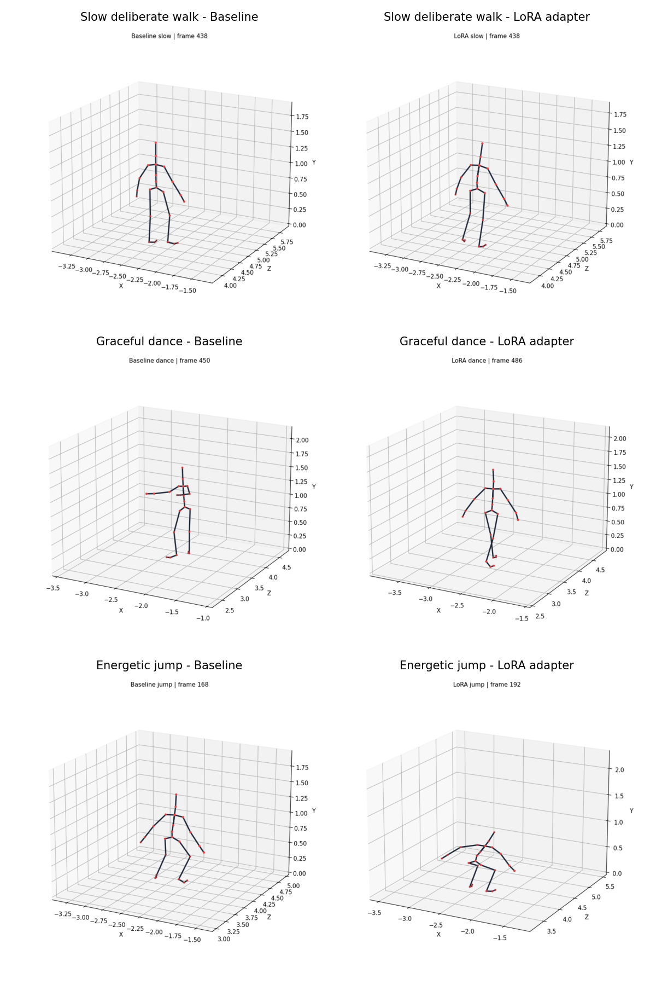
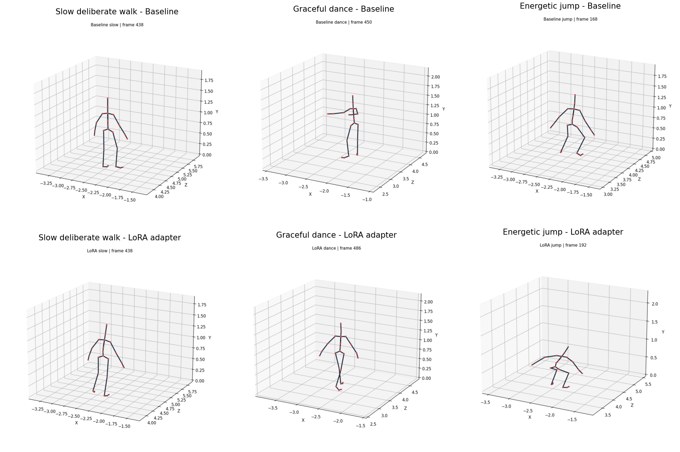
QUALITATIVE CHECK
Rendered BVH frames are visual evidence, not benchmark scores
HumanML3D-Guided Teacher Selection | Paper-Synced Defense Deck
11 / 15
Notes:
这一页放的是论文里的 qualitative frames。它展示了 baseline 和 LoRA adapter 在几个 style prompts 上的可视化对比，比如 slow deliberate、graceful dance 和 energetic jump。这个图的作用是帮助人直观看到动作差异，但我不会把它当成正式 benchmark。因为截图只能说明某几个时间点看起来如何，不能覆盖整个序列的自然性、稳定性和语义匹配。真正的量化还需要后面那些 BVH proxy metrics 和未来的 HumanML paired-motion evaluation。

Slide 12
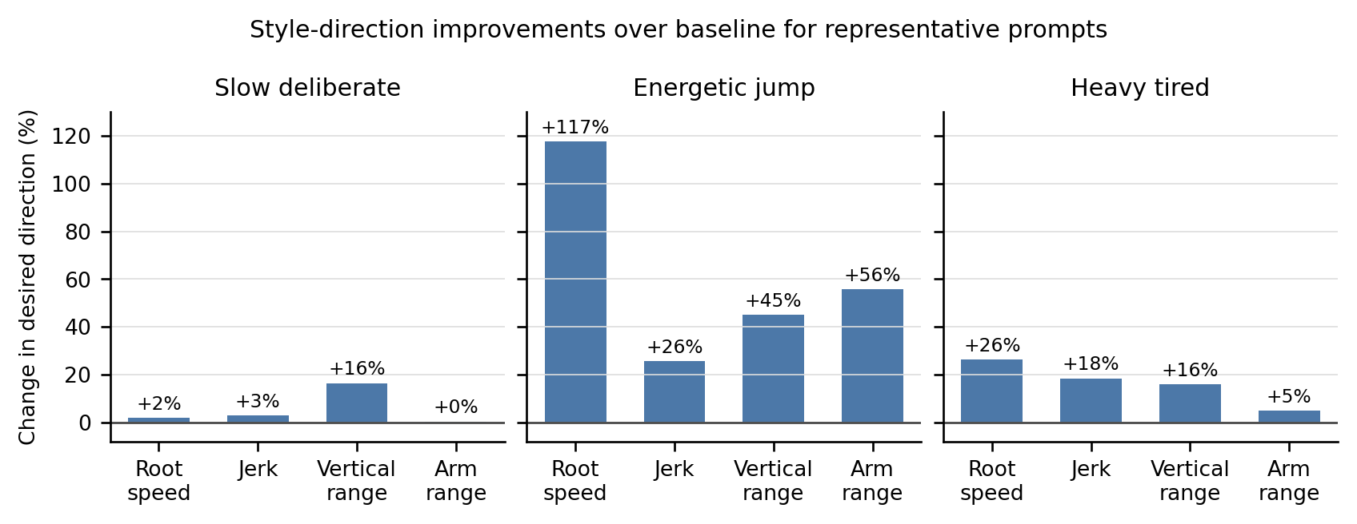
STYLE PROXY
Original LoRA improves most old style-direction checks
Old result: original LoRA reaches 18/22 predefined style-proxy wins. This is useful, but it measures hand-written directions rather than HumanML closeness.
HumanML3D-Guided Teacher Selection | Paper-Synced Defense Deck
12 / 15
Notes:
这一页展示 original LoRA 在旧 style proxy 上的效果。旧结果是 18 out of 22，也就是 22 个预定义 proxy checks 里有 18 个朝着预期风格方向移动。比如 slow deliberate 应该速度和 jerk 更低，energetic jump 应该 vertical range 更大。这个结果说明 LoRA 确实能在一些粗粒度运动学特征上改变生成动作。但要注意，这个分数是 hand-written style direction，不是 HumanML3D paired motion closeness。因此它和新方法的 HumanML alignment 不一定一致。

Slide 13
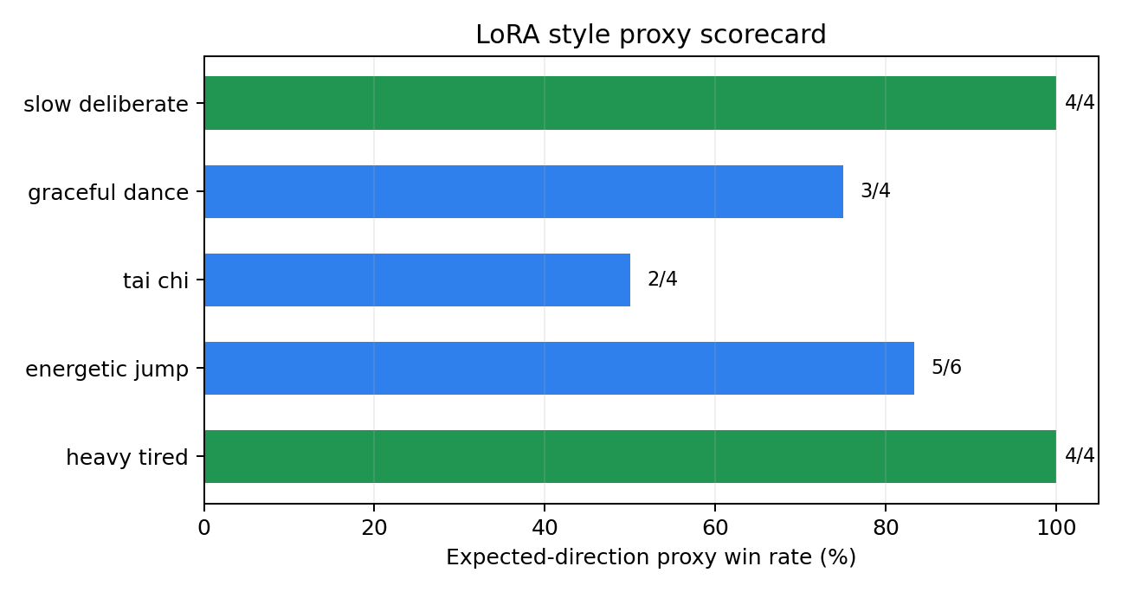
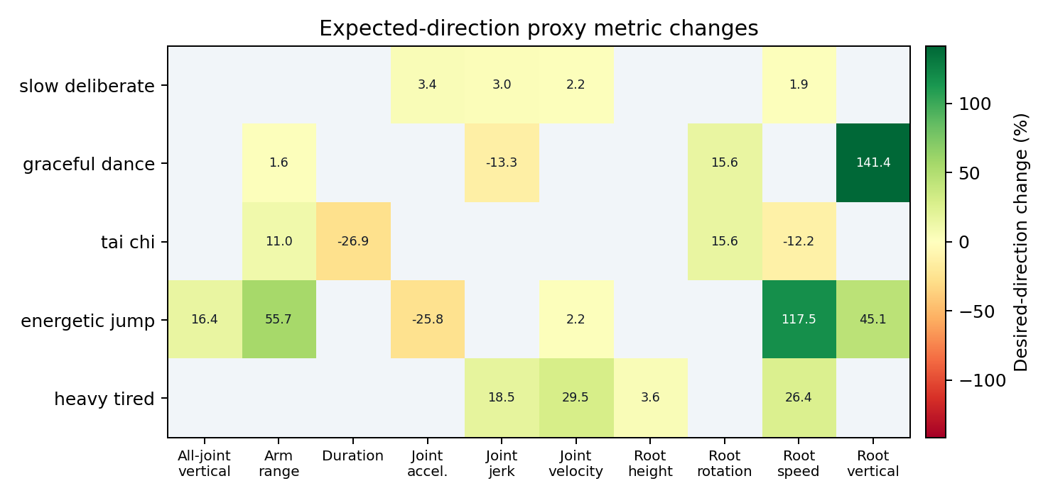
STYLE PROXY DETAILS
Scorecard and metric deltas show where proxy wins come from
Prompt-level win counts
Metric-level percentage changes
HumanML3D-Guided Teacher Selection | Paper-Synced Defense Deck
13 / 15
Notes:
这一页把旧 style proxy 拆开看。左边是 scorecard，显示每个 prompt 有多少指标朝预设方向移动。右边是 delta heatmap，显示具体每个指标变化了多少。这个分析有两个作用：第一，它避免我们只看一个总分而忽略每个风格的差异；第二，它提醒我们 proxy 的局限性。比如 tai chi 这种风格需要连续、平衡、协调的动作，而简单的速度、加速度、vertical range 不一定能完整衡量。所以这些图是 project-scale evidence，不是官方 HumanML3D benchmark。

Slide 14
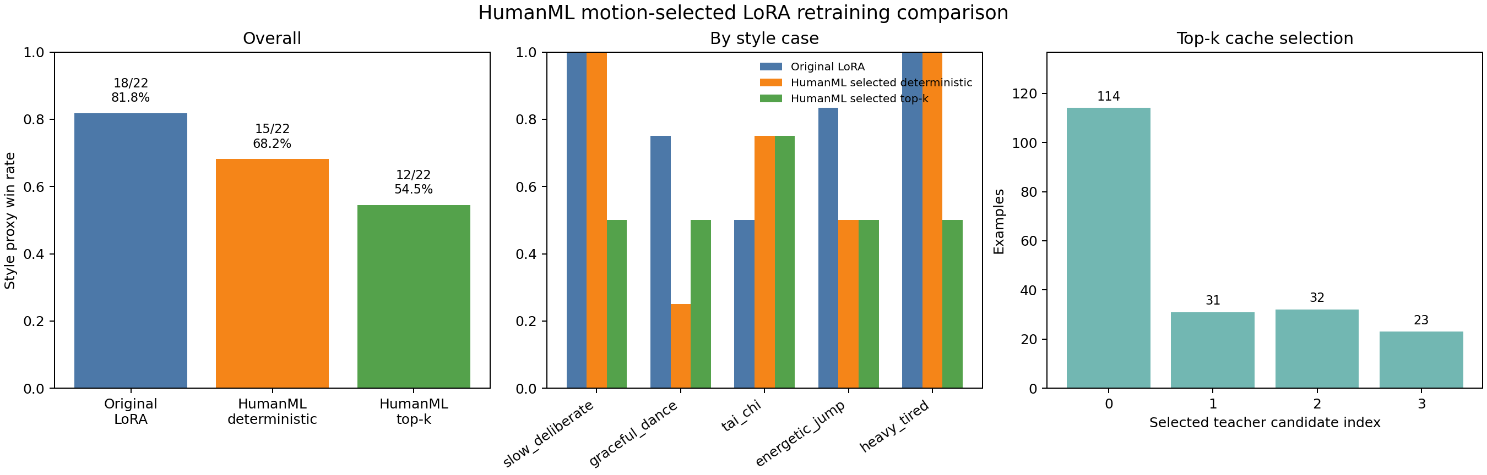
HUMANML-SELECTED RESULT
Teacher alignment improves slightly; old style proxy drops
Old proxy
18/22 -> 15/22 -> 12/22
Top-k diversity
candidate counts 114 / 31 / 32 / 23
Alignment
score 0.1443 -> 0.1477
HumanML3D-Guided Teacher Selection | Paper-Synced Defense Deck
14 / 15
Notes:
这一页是最终结果的核心。左边可以看到 old style proxy：original LoRA 是 18/22，HumanML deterministic 是 15/22，HumanML top-k 是 12/22。也就是说，按照旧的手写 style direction 分数，新方法没有更好，top-k 反而更低。中间和右边说明为什么这个结果不能简单理解成“方法失败”。top-k 后候选选择更分散，candidate 0、1、2、3 分别被选中 114、31、32、23 次，说明筛选机制真的起作用了。同时 HumanML teacher alignment 略有提升，score 从 0.1443 到 0.1477，distance 从 1.9666 到 1.9419。因此正确解释是：新方法让 teacher target selection 更接近 paired HumanML motion，但旧 style proxy 和新目标没有完全对齐。

Slide 15
CONCLUSION
A data-grounded bridge, not a finished evaluator
HumanML3D motion can guide teacher target selection; final student quality still needs paired HumanML BVH evaluation.
1
2
3
Solved
Not solved
Next step
HumanML motion is no longer unused; top-k makes candidate selection meaningful.
Selected teacher alignment gains are small and old style proxy drops to 12/22.
Generate baseline and LoRA BVHs from HumanML captions, then compare each output to its paired motion_id.
Final takeaway
The project moves from caption-only pseudo-token distillation toward data-grounded teacher selection. The next experiment should close the loop at the student-output level.
HumanML3D-Guided Teacher Selection | Paper-Synced Defense Deck
15 / 15
Notes:
最后一页总结。已经解决的是，HumanML3D 不再只是提供 caption，它的 paired motion 已经进入 teacher target selection；top-k 也解决了之前几乎全选第一个 candidate 的问题。没有解决的是，teacher target 更接近 HumanML3D，并不自动保证学生最终生成的 BVH 也更接近 HumanML3D。因为学生训练、采样和解码都会引入新的偏差，而且旧 style proxy 衡量的是手写方向，不是 paired motion closeness。所以下一步应该做闭环实验：用同一批 HumanML caption 让 baseline 和 LoRA 分别生成 BVH，再按 motion_id 和真实 HumanML3D motion 做配对比较。这样才能真正回答最终生成质量是否提升。

