Slide 1

Music-Mike
Husam Abdul-Kafi
System Architect
(hsa2126)
Harvey Wu
Language Guru
(hw2473)
Lakshmi Bodapati
Team Manager
(lmb2254)
Kaitlin Pet
Tester
(khp2106)

Slide 2

Motivation
Write a strongly-typed language for expressing musical concepts intuitively for musicians
Build music in terms of tunes, modes and rhythms independently
Looks good AND sounds good

Slide 3
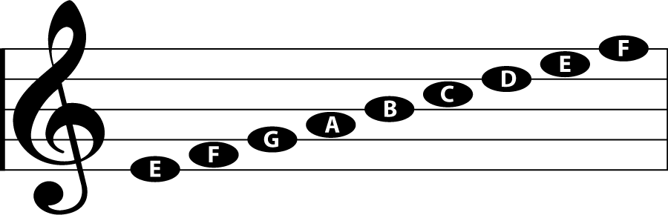
Introduction
Western music notated on a staff with notes given a duration based on the symbol and pitch based on location on the staff.
Most programming music libraries are unintuitive and complicated
music-mike – create music based on varied manipulations of patterns in a modal system

Slide 4
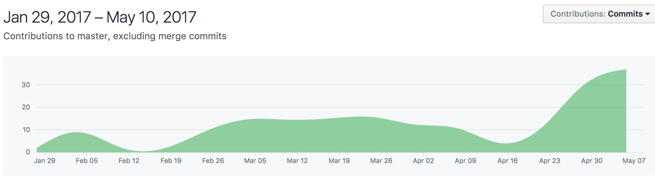
Project Planning
Agile Software Development using Github issues
Feature based rather than module based work distribution
Weekly deadlines

Slide 5
Overview and Features
Context-Sensitive Scanner
Type Inference
Immutable Data Types
Polymorphic Functions
Modal-based music manipulation and expression
Easy-to-use musical programming language
Output music to multiple channels with ease

Slide 6
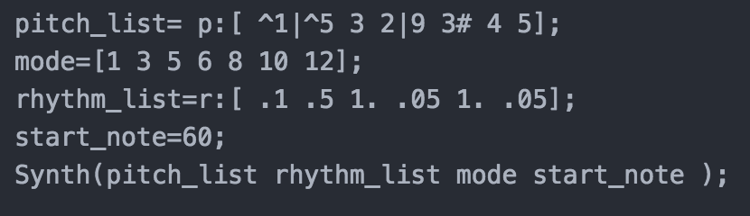
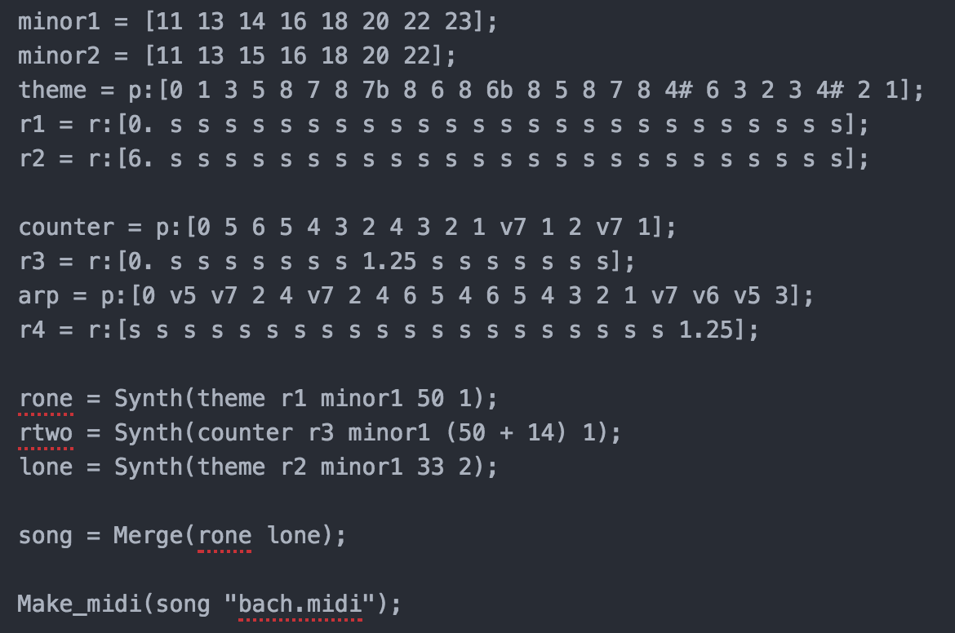
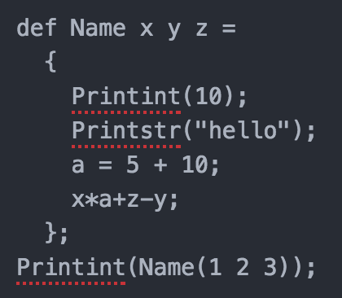
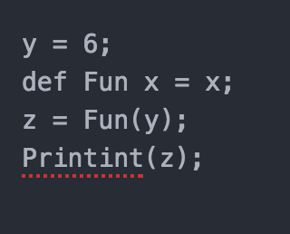
Syntax
Basic Functionality
Complex Example
Function Declaration & Type Inference

Slide 7
Compiler Architecture
AST
music-mike
program
Scanner
Parser
Inference
SAST
LLVM IR
Codegen
Semant
Music-mike
Standard
Library
Midi Music File
Executables
Object Files
External Music
Library Linking
CFugue

Slide 8
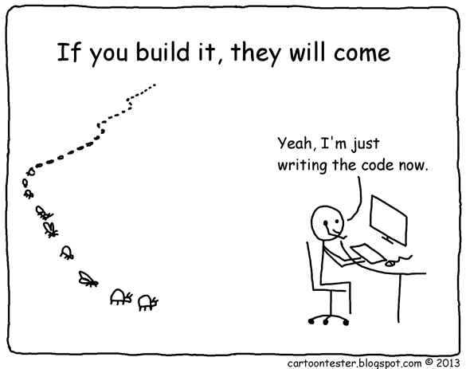
Testing
Fail Testing
Assignment
Blocks
Types
Control Flow
Printing
Functions

Slide 9
Demo

