Slide 1
Measuring Footprints
https://github.com/wuihee/Measuring_Footprints

Slide 2

Project Overview
Create an program to calculate the carbon footprint of a city.

Slide 3


Carbon Footprints
= CO₂e or Carbon Dioxide Equivalent
Different greenhouse gases are converted to CO₂e
using Global Warming Potentials

Slide 4

Greenhouse Gases
Carbon Footprint: The total amount of greenhouse gases produced to directly
and indirectly support human activities.
Radiative Forcing: The change in net vertical irradiance at the tropopause
due to an internal change or change in the external
forcing of the climate system.
Global Warming Potential: Ratios that compare the amount of infrared
energy absorbed by 1 ton of a given gas over
a period of time.
CO₂e expresses the RF of all GHGs as a common unit.

Slide 5
Greenhouse Gases

Slide 6


Slide 7




Measuring Methodologies
Process Analysis: Calculates all stages in life cycle
and totals carbon emissions.
Input-Output: Employs economic modelling to calculate
the carbon footprint.

Slide 8
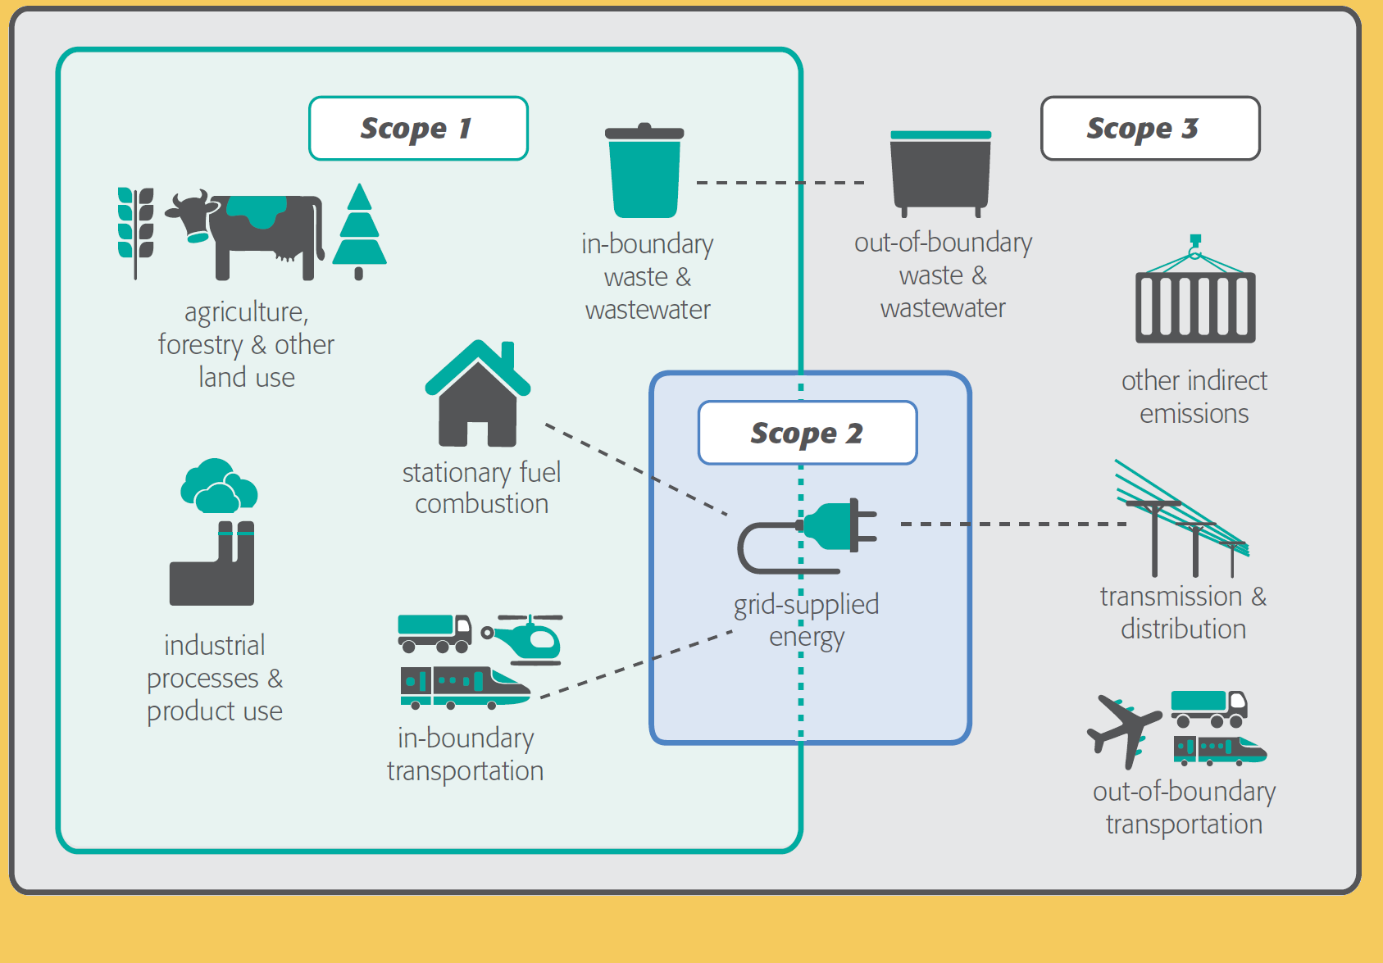
City Assessment
Sectors:
Stationary Energy
Transportation
Waste
Industrial Processes and Product Use (IPPC)
Agriculture, Forestry, and Other Land Use (AFOLU)

Slide 9
Conclusion:
It’s pretty hard.

