Slide 1
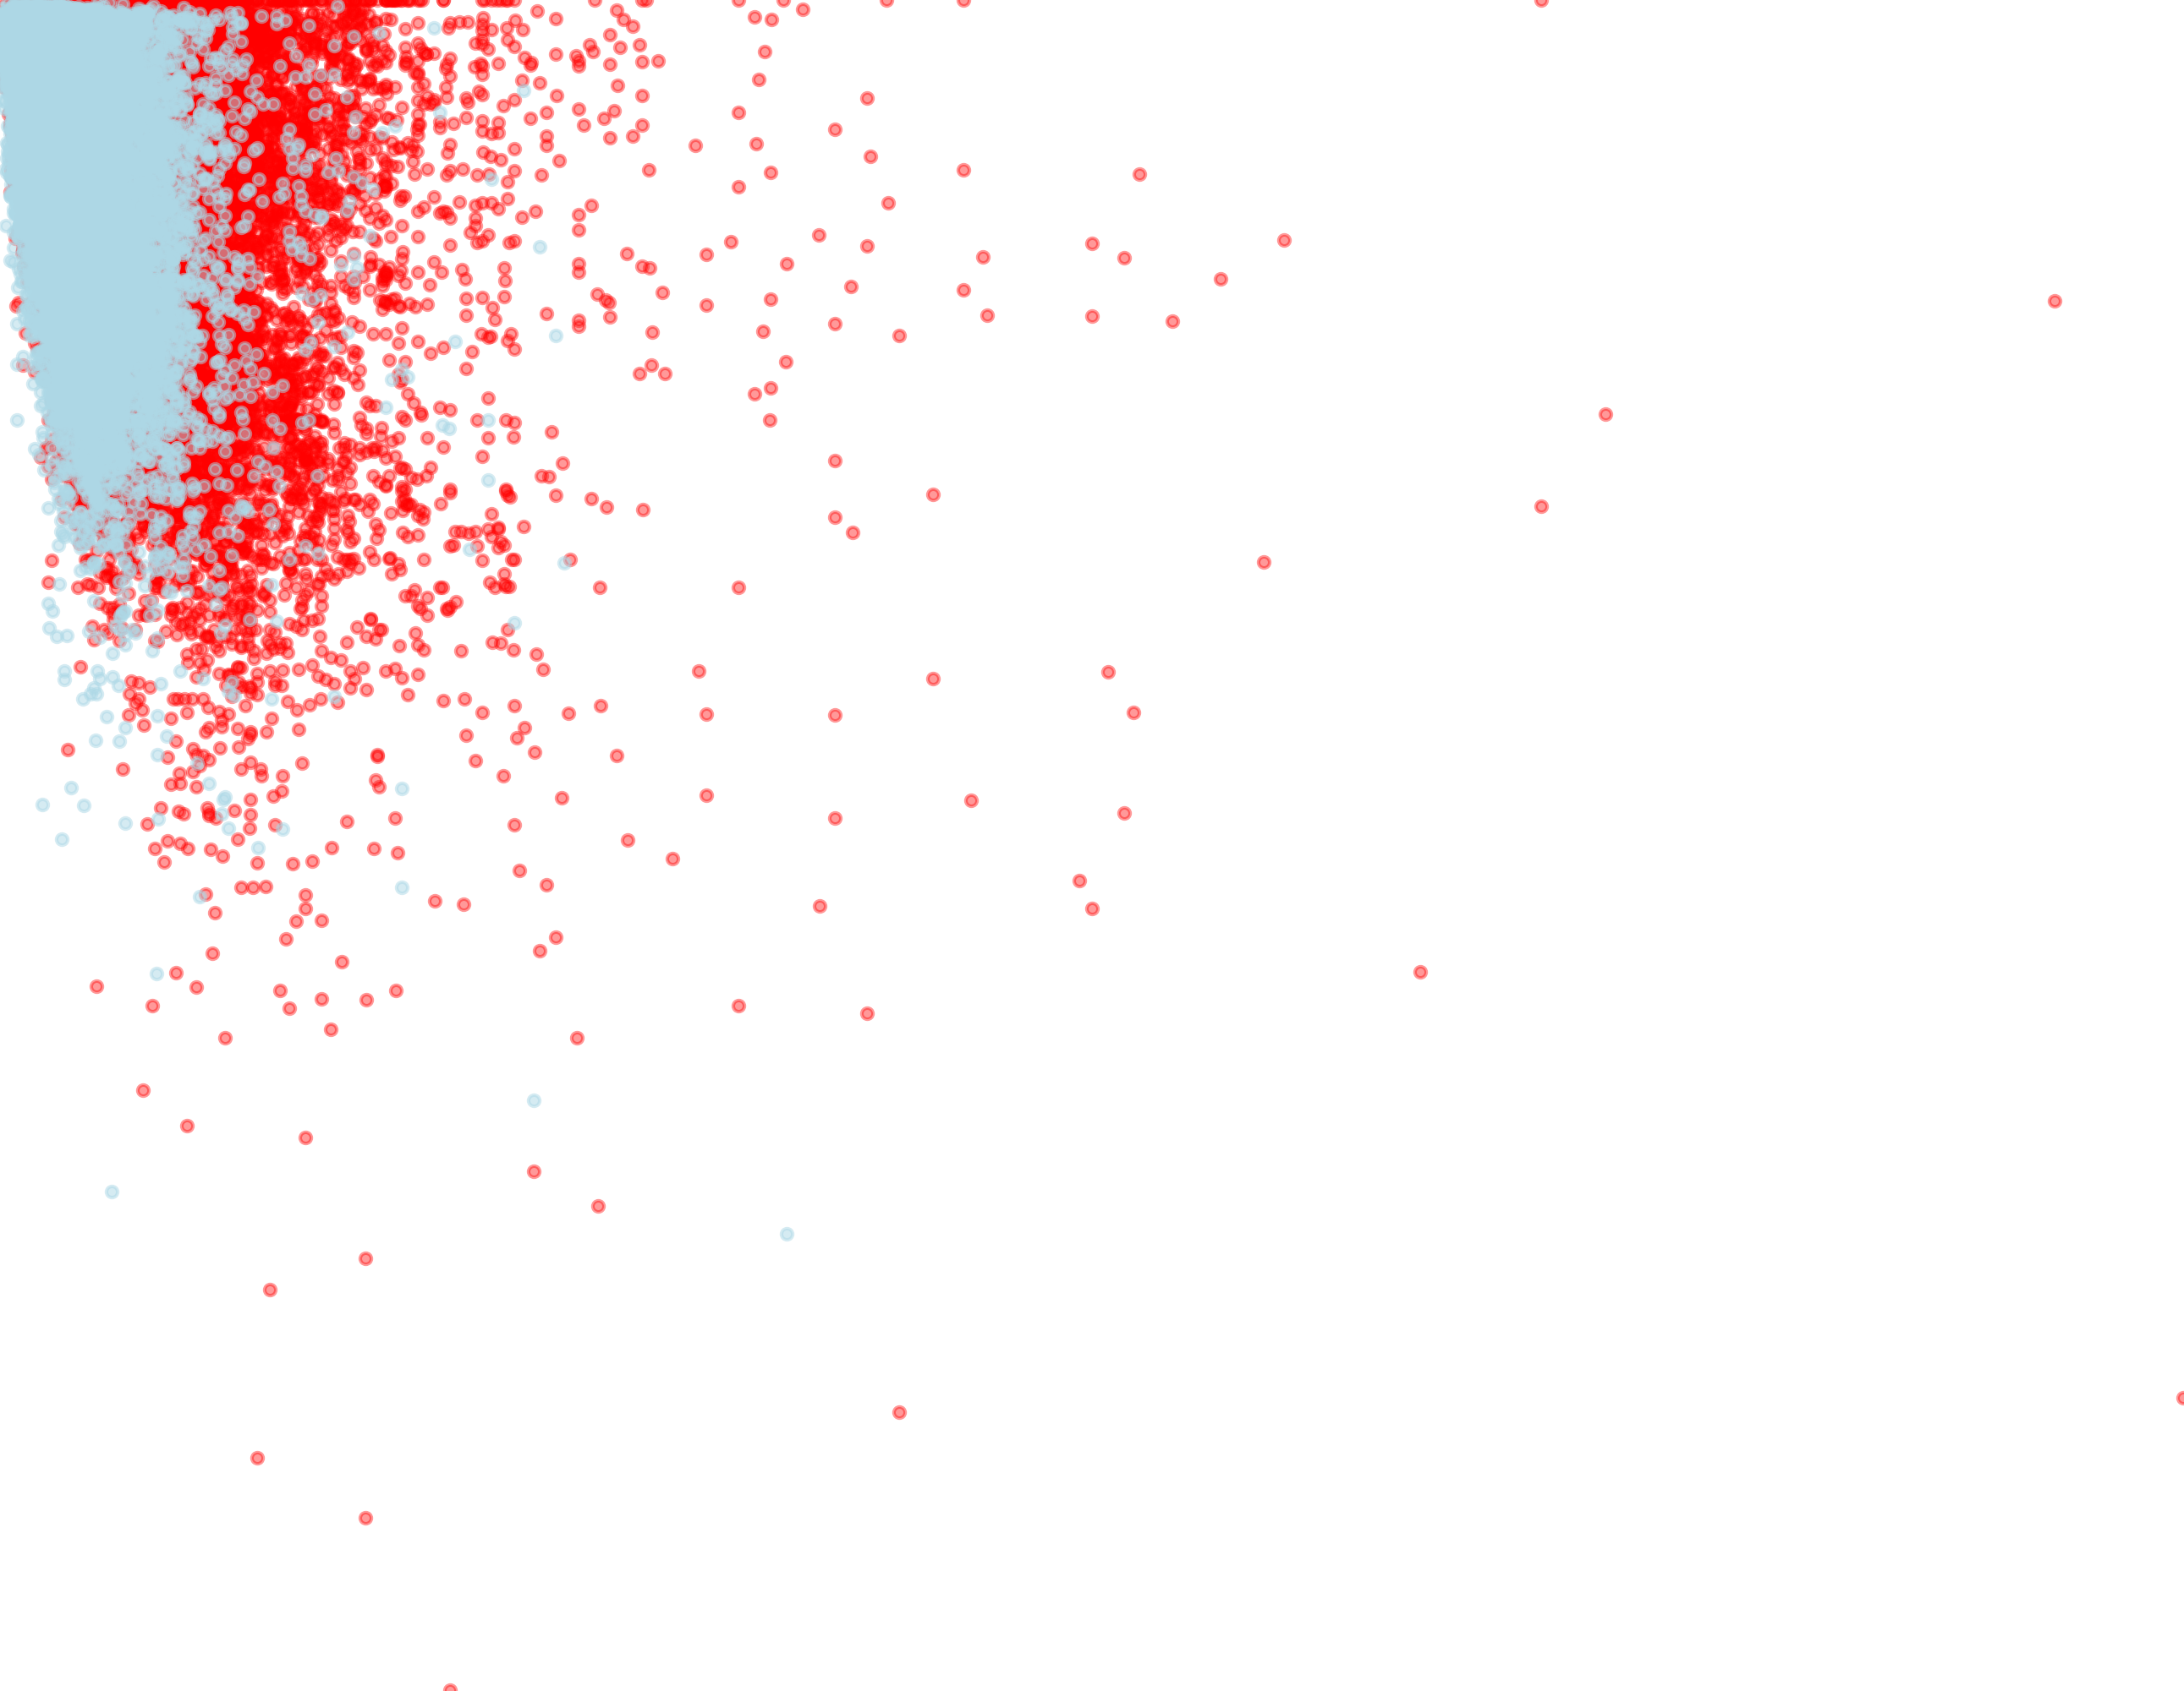
Damage Outpaced Property Value for Low-Income Residents Under the Road Home Program
Leading to Less Aid Distribution for Low-Income Households vice High-Income homeowners
Because Road Home grants were based on pre-storm property values rather than actual damage,
low-income homeowners—whose homes were worth less before the storm—received less funding to rebuild.
$1,600,000
$1,400,000
$1,200,000
$1,000,000
$800,000
Damage Assessment ($)
$600,000
$400,000
$200,000
$0
$0
$500,000
$1,000,000
$1,500,000
$2,000,000
$2,500,000
$3,000,000
Pre-Storm Value ($)

Slide 2
Low Income Households Inequitably Impacted by Road Home’s Property Value Based Grant Funding Calculations.
Proportion of Homes with Damage Greater Than Pre-Storm Value of Home
100%
82.5%
80%
60%
40%
37.9%
20%
0%
Low Income
High Income

