Slide 2
shooter

Slide 3
Action

Slide 4
shooter

Slide 11
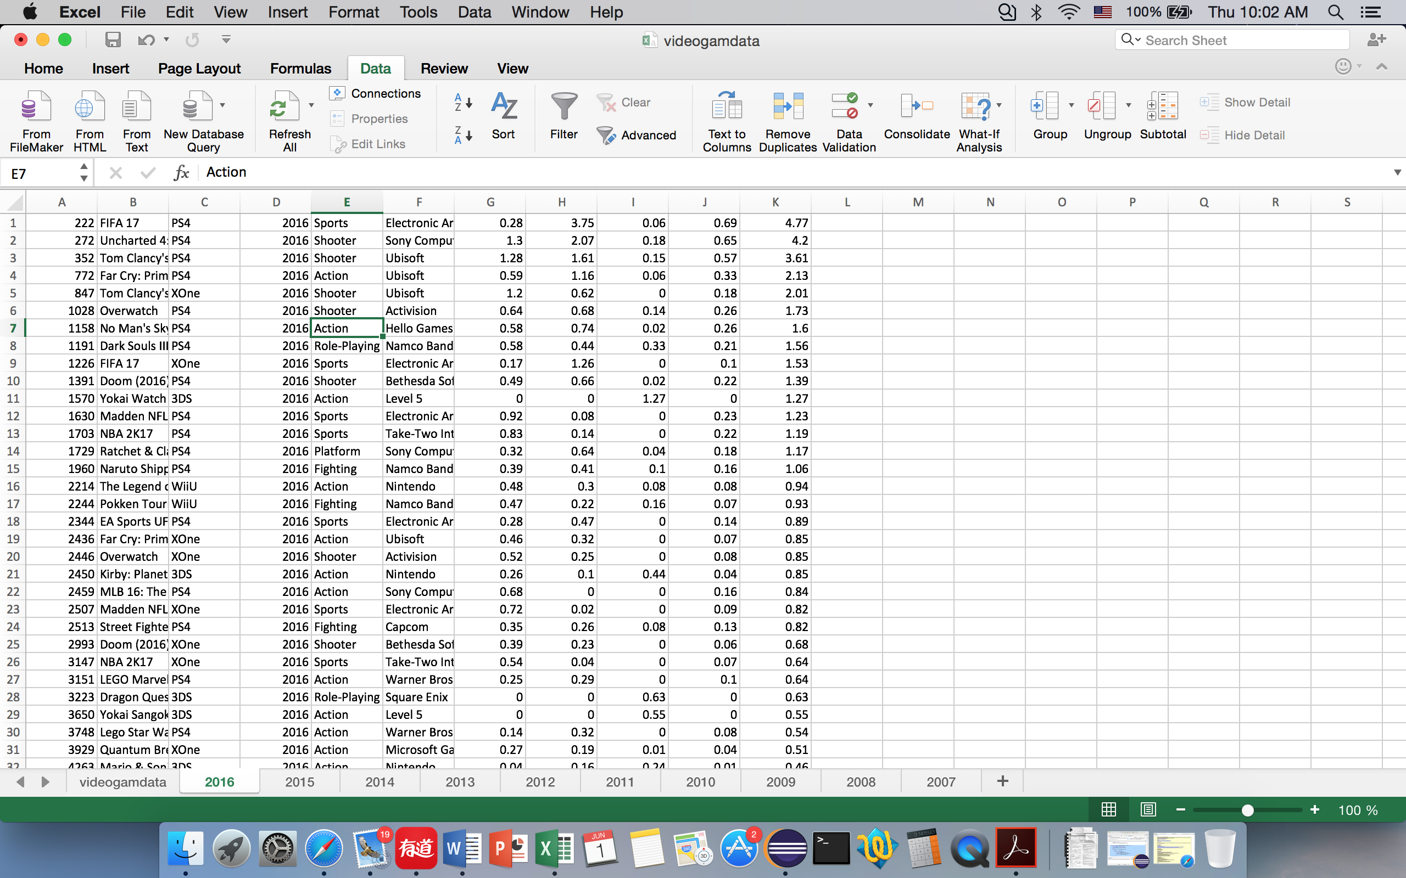

Slide 12
