Slide 1
similarity between Manhattan and Downtown Toronto
2019.06.29

Slide 2
INtrocution
In this project, the similarity between Manhattan (New York) and Downtown Toronto (Toronto) will be compared. Say that there will be an upcoming holiday and you have two options for visit: New York and Toronto. Which one would you like to go? Let's compare them from the counts of Coffee Shop, Hotel, Café, Restaurant, Gastropub.

Slide 3
Exploratory Data Analysis
Two typical borough data will be intorudced to analyze the top 10 venues which may give some clues on wether they have the same popular venues.

Slide 4
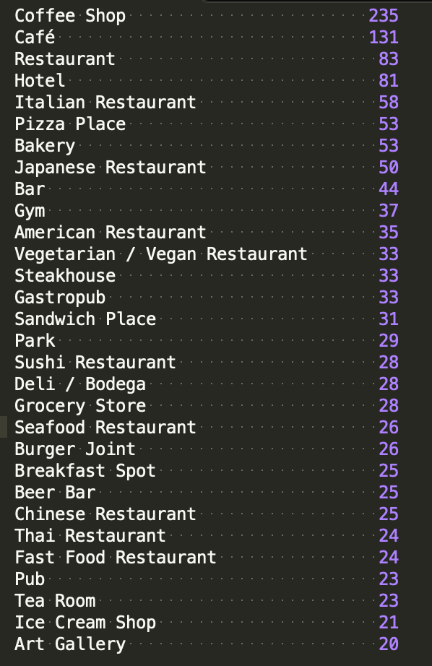
Tornto Downtown venues distribution (> 20):

Slide 5
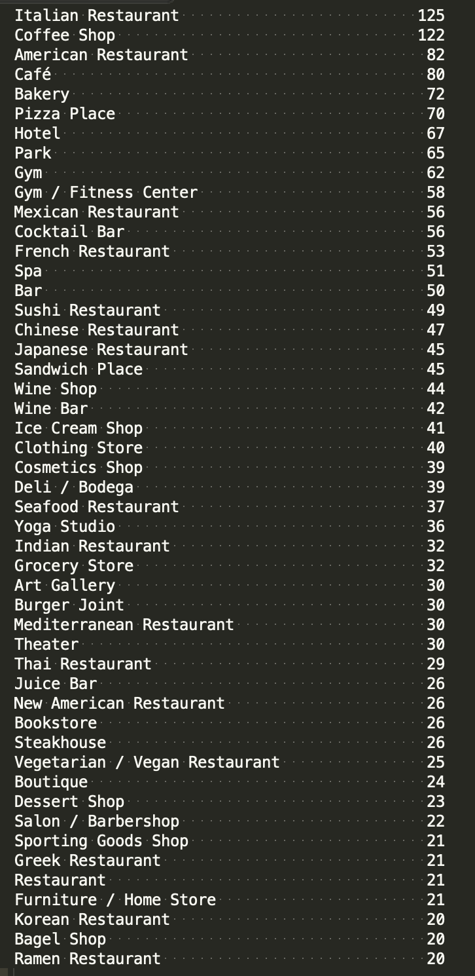
Manhattan venues distribution (> 20):

Slide 6
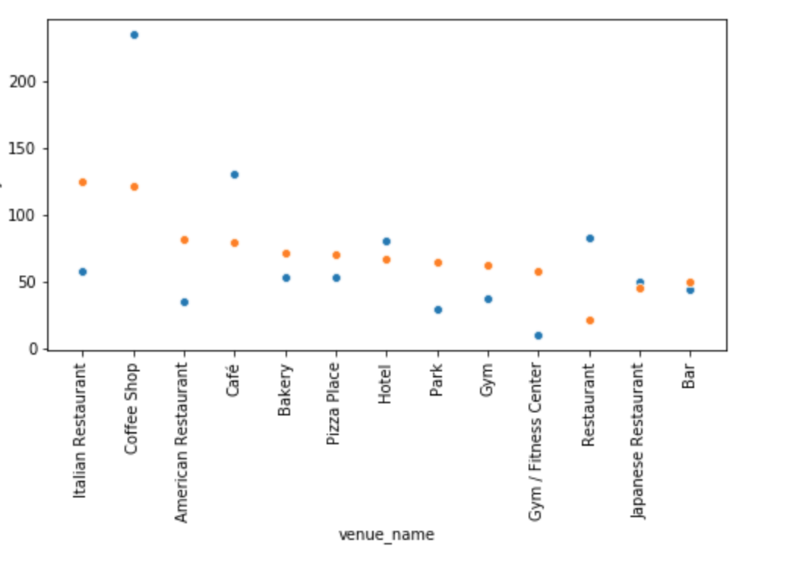
Top 10 venues in both areas

Slide 7
One-way anova analysis in the count of venues in two ares:

Slide 8
CONclusion
pvalue >> 0.05 which indicates that the top 10 venues in Toronto Downtown and Manhattan have no obvious difference. The count of Coffee Shop, Hotel, Café, Restaurant, Gastropub have similarity.
The types in top 20 venues in Manhattan is larger than Toronto Downtown which indicates that Manhattan enjoys more desity and diversity of venues

