Slide 1
AAAI 2022: Data-Centric Robust Learning on ML Models Rank 10
USTC-IAT-United
University of Science and Technology of China
2022/1/24

Slide 2
Contents
Challenge Introduction
Related Work
Method
Experiment Results
References

Slide 3

Challenge Introduction
Construct a dataset that is universal and effective for the training of robust models.
Accelerate the research on data-centric techniques of adversarial robustness in image classification.

Slide 4
Challenge Introduction: Rules
Stage I:
1. Models: ResNet50, DenseNet121.
2. Players can only adjust data.npy, label.npy, config.py(config.py contains the training settings of the model, including optimizer, weight decay, learning rate, and the number of training epochs.).
3. Epoch < = 200 and batchsize < = 256 in the hyperparameters to avoid too long training time or too large occupation of GPU memory.
Stage II:
1. Models: wideresnet, preactresnet18.
2. Other requirements as above.
Others:
1. In Stage II, the test data is changed.

Slide 5
Related Work
Enhance model generalization
Data augmentation
Enhance model robustness
Adversarial training
Adjust the strategy of AT
Evaluate model robustness
Corruptions
Adversarial attack

Slide 6
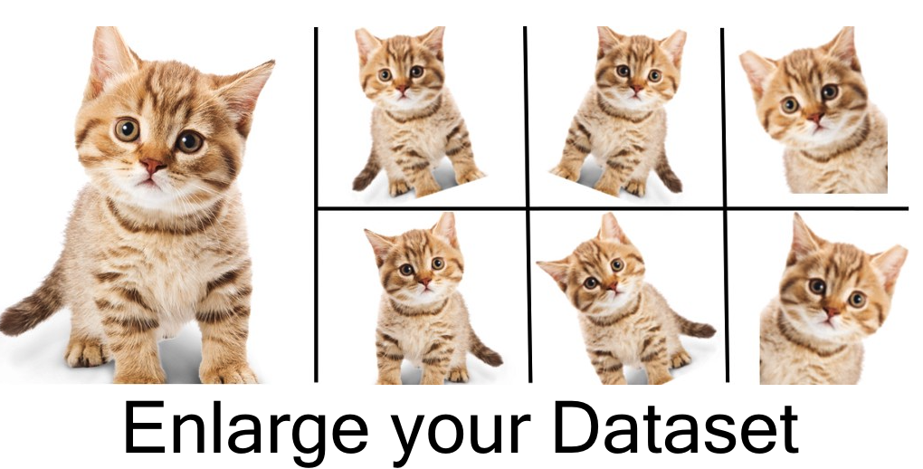
Related Work: Enhance model generalization
Data augmentation
Two settings
Online
Offline
Common operations
Filp, Rotation, Scale, Translation, etc.
Cutout, Cutmix, Mixup, etc.
Generate more data based on the limited data, enrich the distribution of training data, and enhance the model generalization.

Slide 7
Related Work: Enhance model robustness
Adversarial training
Tradeoff between robustness and generalization
Adversarial training is an important way to enhance the robustness of neural networks. In the process of adversarial training, the sample will be mixed with some small perturbations (the change is very small, but it is likely to cause misclassification), and then the neural network will adapt to this change, so as to be robust to the Adversarial example.
The robustness and generalization are negatively correlated. The possible reason is that if the Adversarial examples are trained into the model, the model will be underfit, so the accuracy of the original images will decrease while the robustness is improved.

Slide 8
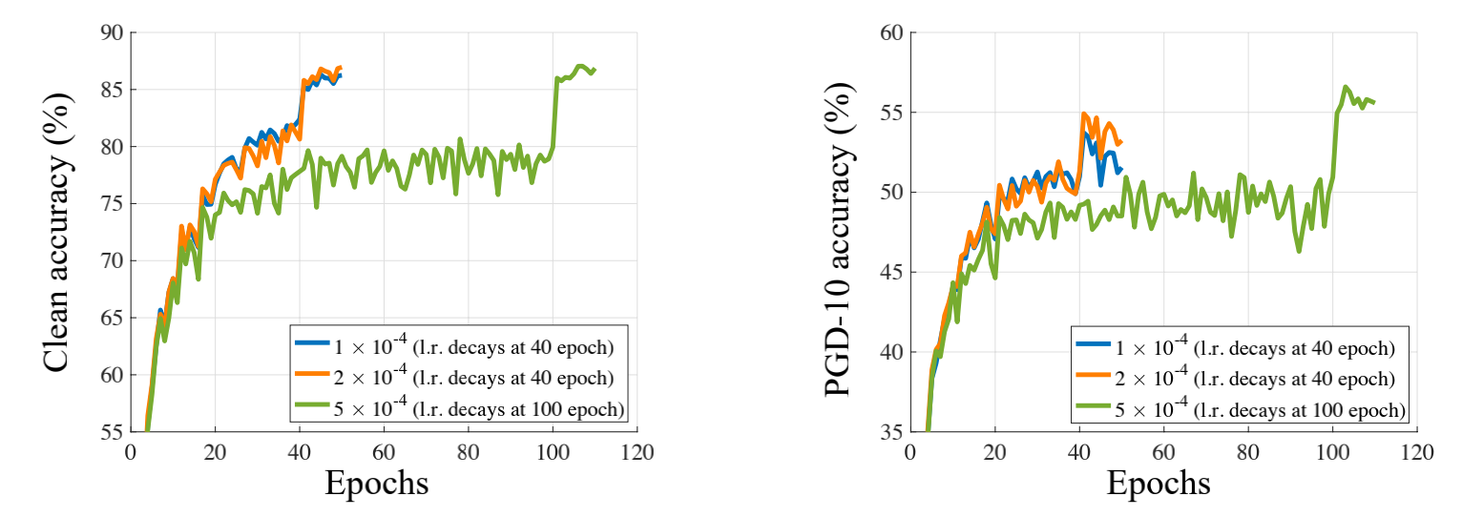
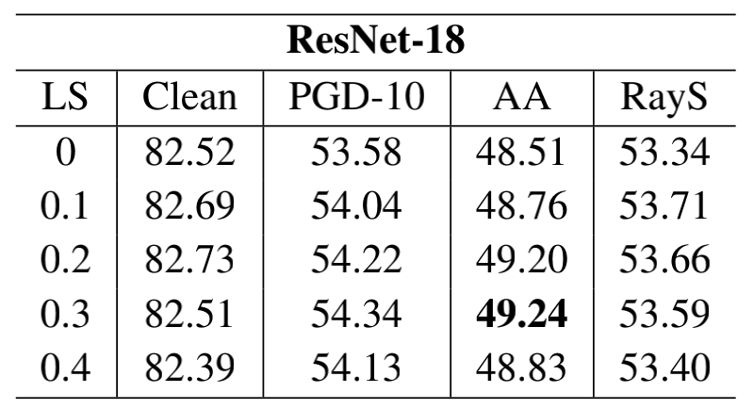
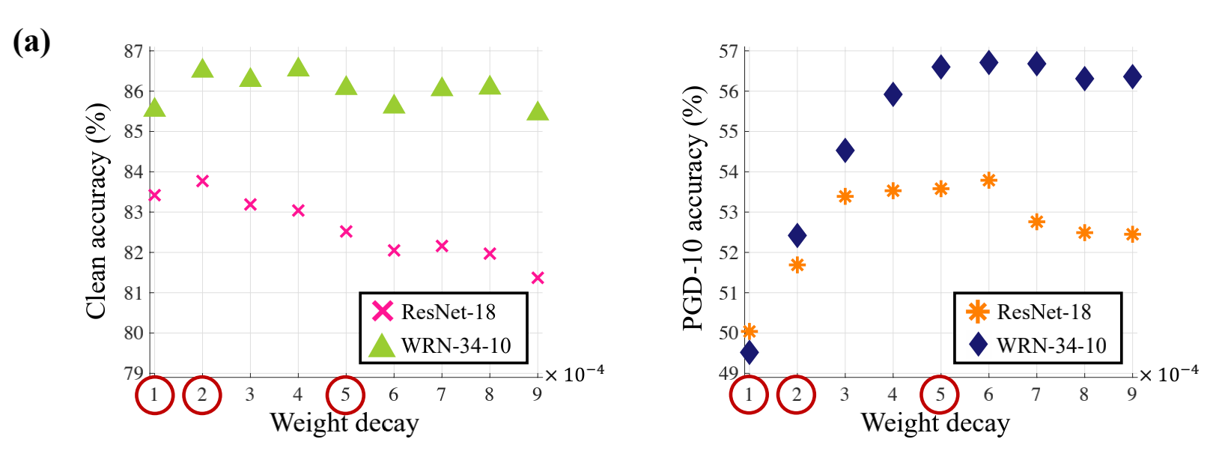
Related Work: Enhance model robustness
Adjust the strategy of Adversarial training
1. Early stopping w.r.t. training epochs
2. Label smoothing 3. Weight decay

Slide 9
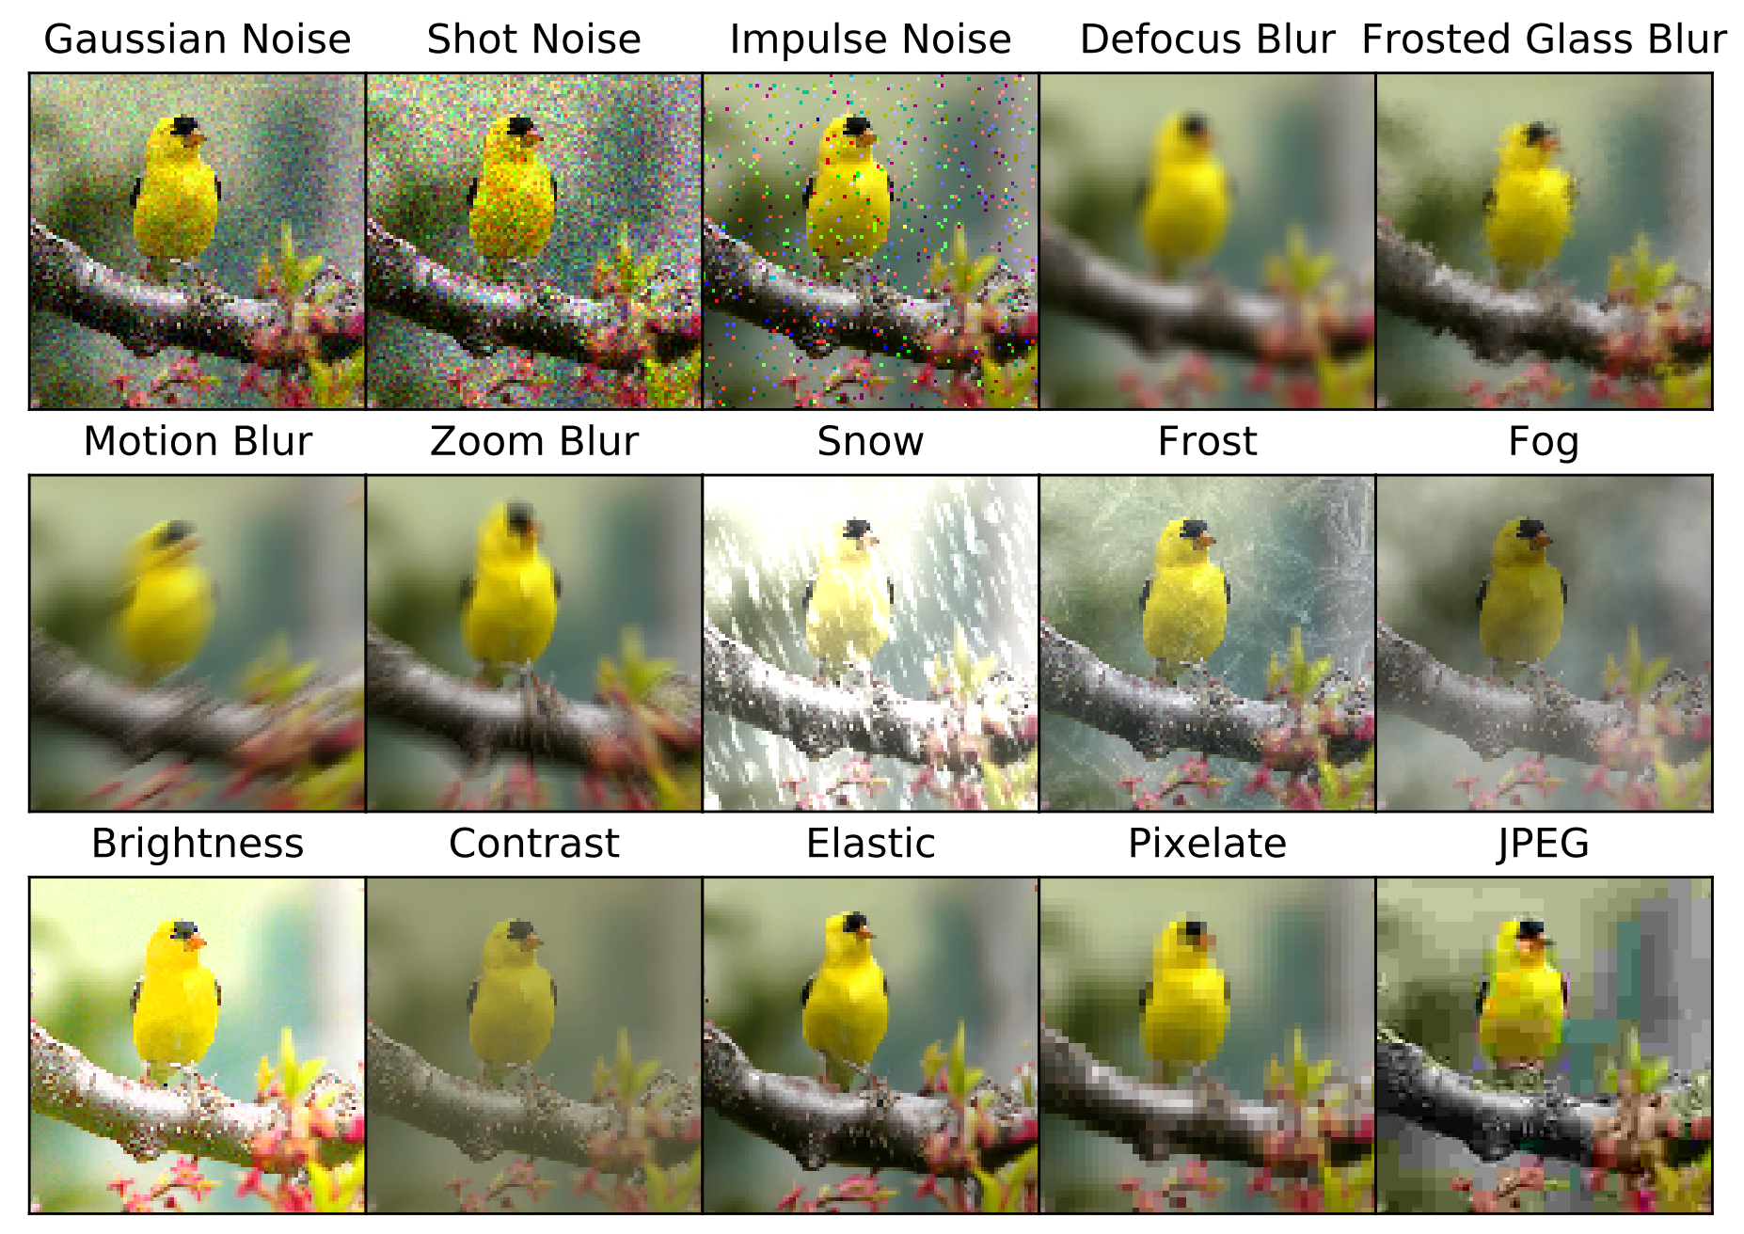
Related Work: Evaluate model robustness
Corruptions
Use common perturbations to evalueate model robustness.
Adversarial attack
Evaluate model robustness through the Adversarial examples.
I-FGSM(BIM)
PGD(Projected gradient descent)
Generate corruptions from noise, blur, weather, and digital categories as shown on the right.

Slide 10
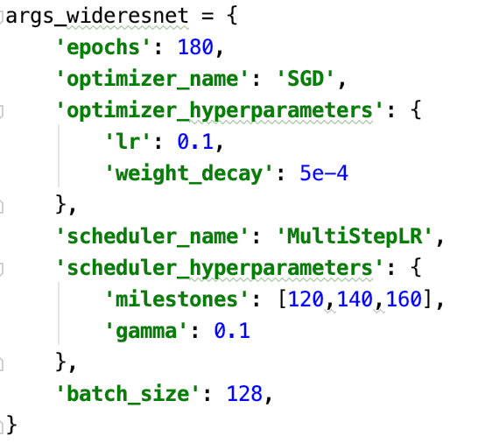
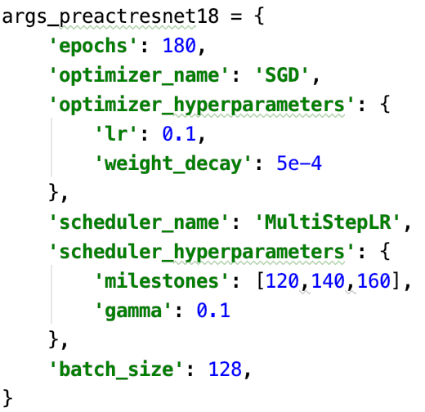
Method
Our method includes three aspects namely label, training strategy and data.
Label
Label smoothing, smoothing coefficient = 0.1
Strategy
1. Early stopping
2. Weight decay
Two points

Slide 11
Method
Data
Corruption agumentation(Ours)
Data augment was performed on 5W images from the CIFAR10 training set, randomly selecting one of 15 Corruptions.
Iterative search:
From top to bottom
Train a large and robust model using all the data sets generated by adversarial attack or corruption, and use it to filter 50,000 data sets to generate models with similar performance. (The disadvantage is that it consumes a lot of resources and time)
From the bottom up(Ours)
The first 10,000 data sets were used to train a model, and then the next 10,000 data sets were screened. Images unsuccessfully classificated were randomly selected (15 candidate sets generated after corruption) and add the former data to train the new model. The optimal data set was obtained through 5 iters.

Slide 12
Method
Theory
Why not choose adversarial examples?
When adversarial examples are added to the model, the model will be underfit, so the accuracy of the original picture will decrease while the robustness is improved.
How to continue optimization under limited conditions?
The data space is infinite. If resources and time allow, we could utilize various methods (such as adversarial attack, corruption, augmentation, etc.) as far as possible to generate enough data to represent this space, and then the large model generated by the data is robust enough.
Under the limit of this challenge, it’s particularly important to find the 50,000 data representing the large model. In order to enhance the generalization and robustness we need to add as many images as possible that are difficult to recognize.

Slide 13


Experiment Results
Hyperparameter of training strategy
A: 110 epochs with the learning rate decaying by a factor of 0.1 at 100 and 105 epochs and weight decay .
B: 165 epochs with the learning rate decaying by a factor of 0.1 at 120, 135 and 150 epochs and weight decay .
C: 165 epochs with the learning rate decaying by a factor of 0.1 at 120, 135 and 150 epochs and weight decay .
D: 180 epochs with the learning rate decaying by a factor of 0.1 at 120, 140 and 160 epochs and weight decay .

Slide 14
Experiment Results
Only Adjust data
We believe that there is still a large space for optimization in Iterative Search!

Slide 15
References
[1] Hendrycks D, Dietterich T. Benchmarking neural network robustness to common corruptions and perturbations[J]. arXiv preprint arXiv:1903.12261, 2019.
[2] Pang T, Yang X, Dong Y, et al. Bag of tricks for adversarial training[J]. arXiv preprint arXiv:2010.00467, 2020.
[3] Zhang H, Yu Y, Jiao J, et al. Theoretically principled trade-off between robustness and accuracy[C]//International Conference on Machine Learning. PMLR, 2019: 7472-7482.
[4] Madry A, Makelov A, Schmidt L, et al. Towards deep learning models resistant to adversarial attacks[J]. arXiv preprint arXiv:1706.06083, 2017.
[5] Goodfellow I J, Shlens J, Szegedy C. Explaining and harnessing adversarial examples[J]. arXiv preprint arXiv:1412.6572, 2014.
[6] Raghunathan A, Xie S M, Yang F, et al. Understanding and mitigating the tradeoff between robustness and accuracy[J]. arXiv preprint arXiv:2002.10716, 2020.
[7] Ilyas A, Santurkar S, Tsipras D, et al. Adversarial examples are not bugs, they are features[J]. arXiv preprint arXiv:1905.02175, 2019.
[8] Raghunathan A, Xie S M, Yang F, et al. Adversarial training can hurt generalization[J]. arXiv preprint arXiv:1906.06032, 2019.
[9] Schmidt L, Santurkar S, Tsipras D, et al. Adversarially robust generalization requires more data[J]. arXiv preprint arXiv:1804.11285, 2018.

Slide 16
Thank You!

