Slide 1
LOOM: Bypassing Races in Live Applications with Execution Filters
Jingyue Wu, Heming Cui, Junfeng Yang
Columbia University
Notes:
Use execution filters to filter out buggy executions in order to bypasses races.
Races include not only data races but also more complicated ones like atomicity errors.
Atomicity violations caused by violation of atomicity intentions. i.e. a code region is intended to be atomic, but not enforced by the code. Order violations are caused by violation of order intentions. i.e. one statement is supposed to happen before the other, but not enforced by the source code.

Slide 2
Mozilla Bug #133773
void js_DestroyContext(
JSContext *cx) {
JS_LOCK_GC(cx->runtime);
MarkAtomState(cx);
if (last) { // last thread?
...
FreeAtomState(cx);
...
}
JS_UNLOCK_GC(cx->runtime);
}
A buggy interleaving
Non-last Thread
Last Thread
if (last) // return true
FreeAtomState
bug
MarkAtomState
Notes:
show how complicated and time-consuming
highlight
can be
In firefox.. browser to crash
label: non-last thread and last thread
First, let’s use a real bug to show how complicated fixing a race can be. This bug is in the core of the JavaScript engine, and makes the program crash. The problematic function is called js_DestroyContext. If the current thread is the last thread entering the function, it will call FreeAtomState to free some data structure in memory. Otherwise, it will call MarkAtomState to do garbage collection.
The problem with this function is...
But, the developers didn’t fix the error this way for performance reasons. Because they think...

Slide 3
Complex Fix
void js_DestroyContext() {
if (last) {
state = LANDING;
if (requestDepth == 0)
js_BeginRequest();
while (gcLevel > 0)
JS_AWAIT_GC_DONE();
js_ForceGC(true);
while (gcPoke)
js_GC(true);
FreeAtomState();
} else {
gcPoke = true;
js_GC(false);
}
}
void js_BeginRequest() {
while (gcLevel > 0)
JS_AWAIT_GC_DONE();
}
void js_ForceGC(bool last) {
gcPoke = true;
js_GC(last);
}
void js_GC(bool last) {
if (state == LANDING && !last)
return;
gcLock.acquire();
if (!gcPoke) {
gcLock.release();
return;
}
if (gcLevel > 0) {
gcLevel++;
while (gcLevel > 0)
JS_AWAIT_GC_DONE();
gcLock.release();
return;
}
gcLevel = 1;
gcLock.release();
restart:
MarkAtomState();
gcLock.acquire();
if (gcLevel > 1) {
gcLevel = 1;
gcLock.release();
goto restart;
}
gcLevel = 0;
gcPoke = false;
gcLock.release();
}
4 functions; 3 integer flags
Nearly a month
Not the only example
Notes:
Involved with 4 functions. Using flags instead of a mutex. Still problematic.
*likely* for performance reasons
highlight the flags (integer flags)
don’t explain the flags
So you can see, fixing a race can be very complicated and time-consuming, and needs to involve with lots of testing.
transition: dangerous. would it be nice if we can...

Slide 4
LOOM: Live-workaround Races
Execution filters: temporarily filter out buggy thread interleavings
void js_DestroyContext(JSContext *cx) {
MarkAtomState(cx);
if (last thread) {
...
FreeAtomState(cx);
...
}
}
A mutual-exclusion execution filter to bypass the race on the left
js_DestroyContext <> self
Declarative, easy to write
Notes:
more language

Slide 5
LOOM: Live-workaround Races
Execution filters: temporarily filter out buggy thread interleavings
Installs execution filters to live applications
Improve server availability
STUMP [PLDI ‘09], Ginseng [PLDI ‘06], KSplice [EUROSYS ‘09]
Installs execution filters safely
Avoid introducing errors
Incurs little overhead during normal execution
Notes:
Low overhead encourage user adoption.

Slide 6
Summary of Results
We evaluated LOOM on nine real races.
Bypasses all the evaluated races safely
Applies execution filters immediately
Little performance overhead (< 5%)
Scales well with the number of application threads (< 10% with 32 threads)
Easy to use (< 5 lines)

Slide 7
Outline
Architecture
Combines static preparation and live update
Safely updating live applications
Reducing performance overhead
Evaluation
Conclusion

Slide 8
Architecture
Static Preparation
Live Update
Application Source
Execution Filter
js_DestroyContext
<> self
$ llvm-gcc
$ opt –load
$ llc
$ gcc
LLVM Compiler
LOOM Controller
$ loomctl add <pid>
<filter file>
LOOM Compiler Plugin
LOOM Update Engine
LOOM Update Engine
LOOM Update Engine
Application Binary
Buggy Application
Patched Application
Notes:
Challenges need to be handled in each component:
llvm-gcc + opt. explain
$ loomctl add: standalone utility program
show: lock unlock up and down
show animations
We must inject the LOOM update engine very carefully to reduce the overhead when running it along with the application binary. LOOM update engine also contains source code to help to ensure safety.
During the live update process, LOOM controller translates the execution filter into scalar operations. e.g. it translates mutual exclusion filters into mutexes, and translates order constraints into semaphores.
LOOM update engine is in charge of updating the program and ensuring safety. It monitors the program state, and proactively leads the running program into a safe state, and finally install the filter. LOOM update engine will be running in a separate thread from the application threads.

Slide 9
Outline
Architecture
Combines static preparation and live update
Safely updating live applications
Reducing performance overhead
Evaluation
Conclusion

Slide 10
Safety: Not Introducing New Errors
Mutual Exclusion
Order Constraints
PC
Lock
Up
PC
Up
PC
PC
Down
Down
Unlock
PC
Notes:
Transition: In the next a few sides, I’ll talk about two technical challenges of our system. Safety challenges and performance challenge. Explain.
What is the safety challenge?
As I said, the mutual exclusion will be translated into mutexes. The function-quiescence approach is not enough to solve the safety issue. For example, consider lock and unlock to be in some wrapper functions.
Introduce new errors or even make your program crash immediately.
Order constraints are translated into semaphores. We use “up” and “down” to ensure an order between two events.
Define safety. Not introduce new errors.
don’t say starvation.

Slide 11
Evacuation Algorithm
Identify the dangerous region using static analysis
Evacuate threads that are in the dangerous region
Install the execution filter
Notes:
We solve the safety challenge by using what we call the evacuation algorithm.
legend: say red region is the dangerous region
reachability
Cut: Conservatively. Put it in backup
There are two technical challenges here. One is how to pause and resume application threads. The other is how to pause threads at safe locations.
block and wait

Slide 12
Control Application Threads
1 : // database worker thread
2 : void handle_client(int fd) {
3 : for(;;) {
4 : struct client_req req;
5 : int ret = recv(fd, &req, ...);
6 : if(ret <= 0) break;
7 : open_table(req.table_id);
8 : ... // do real work
9 : close_table(req.table_id);
10: }
11: }

Slide 13
Control Application Threads (cont’d)
// not the final version
void cond_break() {
read_unlock(&update);
read_lock(&update);
}
// not the final version
void loom_update() {
write_lock(&update);
install_filter();
write_unlock(&update);
}
Notes:
Source code of the function.
conceptually conditional breakpoints. not hardware breakpoints. injected by compiler plugin
highlight the part i’m talking about
define backedge?
cycle_check => cond_break
We don’t pause a thread at arbitrary locations. We only pause it at a back-edge, an external function call, or the entry of a function inside a call loop. The reason is that if a piece of code...
This is not the final version yet.
Version 1, version 2: not the final version. Inlined assembly.

Slide 14
Pausing Threads at Safe Locations
cmpl 0x0, 0x845208c
je 0x804b56d
void cond_break() {
if (wait[backedge_id]) {
read_unlock(&update);
while (wait[backedge_id]);
read_lock(&update);
}
}
void loom_update() {
identify_safe_locations();
for each safe backedge E
wait[E] = true;
write_lock(&update);
install_filter();
for each safe backedge E
wait[E] = false;
write_unlock(&update);
}
Notes:
wait flag:
not pthread locks
backedge_id compile time constant
highlight the things i’m talking about
show instructions
wait flag is not only used to pause threads at safe locations, but also reduce the overhead. Because during normal execution, this wait flag is always zero. Skip the read_unlock and read_lock.
The array is always in the cache. backedge_id is fixed. Simply a compare and conditional jump.
If questions: Bug isolation paper also used.

Slide 15
Outline
Architecture
Combines static preparation and live update
Safely updating live applications
Reducing performance overhead
Evaluation
Conclusion

Slide 16
Hybrid Instrumentation
void slot(int stmt_id) {
op_list = operations[stmt_id];
foreach op in op_list
do op;
}
Notes:
We just talked about how we ensure safety. Now let’s look at how we improve performance. When people want to update a running program, the common technique they use is program instrumentation. Pin is such a tool. But we found they usually
Clone functions. Fast version and slow version.
Add slot functions in the slow version.
Slot functions iterate through a list of operations, and execute them one by one.
When updating, change the operation list.
Normally on the fast path.
Switch flags.

Slide 17
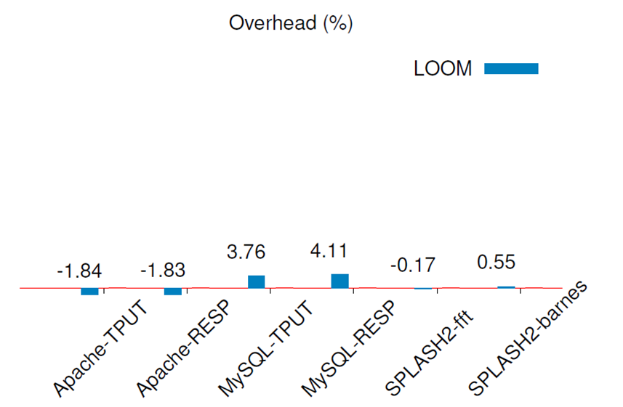
Bare Instrumentation Overhead
Performance overhead < 5%
Notes:
What’s overhead?
Conclusion at the bottom.
Applications. Metrics. Benchmarks. CPU-Bound.
(They are used by developers as well. )
Machine configuration. Threads.
I think the reason may be... avoid contentions in the
TPUT is short for throughput, and RESP is short...
Pin is a widely-used binary instrumentation tool.

Slide 18
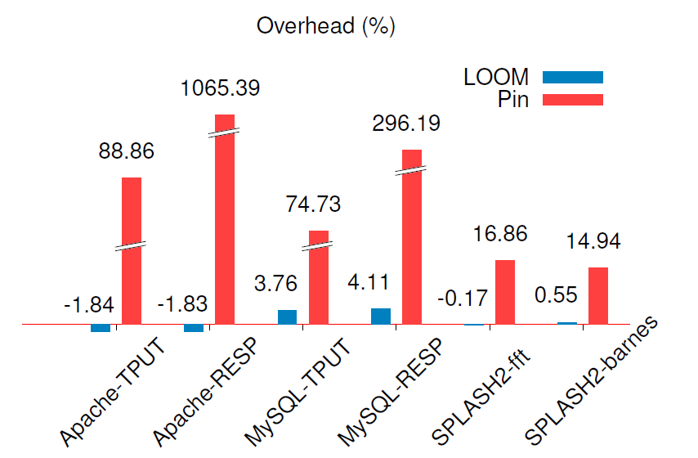
Bare Instrumentation Overhead
Performance overhead < 5%
Notes:
What’s overhead?
Conclusion at the bottom.
Applications. Metrics. Benchmarks. CPU-Bound.
(They are used by developers as well. )
Machine configuration. Threads.
I think the reason may be... avoid contentions in the
TPUT is short for throughput, and RESP is short...
Pin is a widely-used binary instrumentation tool.

Slide 19
Scalability
48-core machine with 4 CPUs; Each CPU has 12 cores.
Pin the server to CPU 0, 1, 2, and the client to CPU 3.
Performance overhead does not increase
Notes:
Setup for scalability.
Conclusion at the bottom.
Explain why speedup. Previous work shows the possibility of getting a speedup when changing the synchronization in the program.
Doesn’t increase.

Slide 20
Conclusion
LOOM: A live-workaround system designed to quickly and safely bypass races
Execution filters: easy to use and flexible (< 5 lines)
Evacuation algorithm: safe
Hybrid instrumentation: fast (overhead < 5%) and scalable (overhead < 10% with 32 threads)
Future work
Generic hybrid instrumentation framework
Extend the idea to other classes of errors
Notes:
maximum number of threads.
no # events
multiple fixes

Slide 21
Questions?

Slide 22
Related Work
Live update
most of them target general fixes
either do not ensure safety or need annotation
Error recovery
Not on races
Instrumentation

Slide 23
Language Summary
Constructs | Syntax
Event (short as e) | file:line file:line (expr) e{n}: n is # of occurences
Region (short as r) | {e₁, ..., e_{i}; e_{i + 1}, ..., e_{n}} func(args)
Mutual Exclusion | r₁ <> r₂ <> ... <> r_{n}
Unilateral Exclusion | r <> *
Execution Order | e₁ > e₂ > ... > e_{n}
Notes:
Formal format. BN Form. $n$ is not arbitrarily (or not mention it).
Order violation. Entries statements and exit statements. Boundaries.
Think about: Loom compile it down to scalar operations. Ensure safety by adding extra checks.

Slide 24
Current practice
Performance
Backward compatability
Safely live update

Slide 25
Reliability
Data races and atomicity violations
Race ID | Mutual Exclusion
 | TPUT | RESP
MySQL-169 | 0.14% | 0.15%
MySQL-644 | 0.22% | 0.20%
MySQL-791 | 0.23% | 0.32%
Apache-21287 | -0.02% | -0.03%
Apache-25520 | 0.52% | 0.55%
Order violations
Race ID | Overhead
PBZip2 | 1.26%
SPLASH2-fft | 0.08%
SPLASH2-lu | 1.68%
SPLASH2-barnes | 1.99%
Notes:
Explain TPUT and RESP. How to calculate overhead? Overhead is suprisingly small.

Slide 26
Reliability
Data races and atomicity violations
Race ID | Mutual Exclusion |  | Unilateral Exclusion
 | TPUT | RESP | TPUT | RESP
MySQL-169 | 0.14% | 0.15% | 3.28% | 3.37%
MySQL-644 | 0.22% | 0.20% | 32.58% | 48.34%
MySQL-791 | 0.23% | 0.32% | 0.33% | 0.48%
Apache-21287 | -0.02% | -0.03% | 54.03% | 118.16%
Apache-25520 | 0.52% | 0.55% | 86.04% | 637.03%
Order violations
Race ID | Overhead
PBZip2 | 1.26%
SPLASH2-fft | 0.08%
SPLASH2-lu | 1.68%
SPLASH2-barnes | 1.99%
Notes:
Explain TPUT and RESP. How to calculate overhead? Overhead is suprisingly small.

Slide 27
Backup

Slide 28
Execution Filter Examples
1: // log.cc. thread T1
2: void MYSQL_LOG::new_file(){
3: lock(&LOCK_log);
4: ...
5: close(); // log is closed
6: open(...);
7: ...
8: unlock(&LOCK_log);
9: }
1: // sql_insert.cc. thread T2
2: // [race] may return false
3: if (mysql_bin_log.is_open()){
4: lock(&LOCK_log);
5: if (mysql_bin_log.is_open()){
6: ... // write to log
7: }
8: unlock(&LOCK_log);
9: }
Bug: MySQL #791
// Execution filter 1: unilateral exclusion
{log.cc:5, log.cc:6} <> *
// Execution filter 2: mutual exclusion of code
{log.cc:5, log.cc:6} <> MYSQL_LOG::is_open
// Execution filter 3: mutual exclusion of code and data
{log.cc:5 (this), log.cc:6 (this)} <> MYSQL_LOG::is_open(this)
Notes:
TODO: make it prettier

Slide 29
Hybrid Instrumentation

Slide 30
Overview

Slide 31
Execution Filter Examples
1: // log.cc. thread T1
2: void MYSQL_LOG::new_file(){
3: ...
4: close(); // log is closed
5: open(...);
6: ...
7: }
1: // sql_insert.cc. thread T2
2:
3: if (mysql_bin_log.is_open()){
4: ... // write to log
5: }
Bug: MySQL #791
// Execution filter 1: unilateral exclusion
{log.cc:4, log.cc:5} <> *
// Execution filter 2: mutual exclusion of code
{log.cc:4, log.cc:5} <> MYSQL_LOG::is_open
// Execution filter 3: mutual exclusion of code and data
{log.cc:4 (this), log.cc:5 (this)} <> MYSQL_LOG::is_open(this)
Notes:
TODO: make it prettier.
Serious problem.
Star
Just serveral examples on mutual exclusion and unilateral exclusion.
What’s an event?

Slide 32
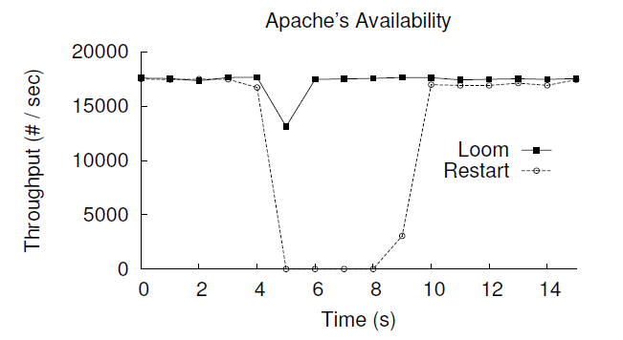
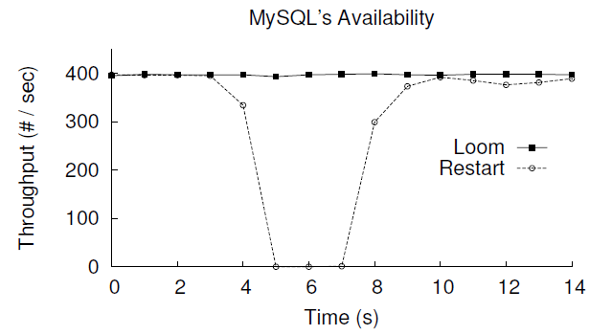
Timeliness

Slide 33
Safety Challenge
1 : // database worker thread
2 : void handle_client(int fd) {
3 : for(;;) {
4 : struct client_req req;
5 : int ret = recv(fd, &req, ...);
6 : if(ret <= 0) break;
7 : open_table(req.table_id);
8 : ... // do real work
9 : close_table(req.table_id);
10: }
11: }
12: void open_table(int table_id) {
13: // fix: acquire table lock
14: ... // actual code to open table
15: }
16: void close_table(int table_id) {
17: ... // actual code to close table
18: // fix: release table lock
19: }

Slide 34
Control Application Threads

Slide 35
Pause a Thread at Safe Locations
void before_blocking() {
atomic_inc(&counter[callsite_id]);
read_unlock(&update);
}
void after_blocking() {
read_lock(&update);
atomic_dec(&counter[callsite_id]);
}
void cycle_check() {
if (wait[stmt_id]) {
read_unlock(&update);
while (wait[stmt_id]);
read_lock(&update);
}
}

Slide 36
Evaluation
Race ID | Type
MySQL-791 | Atomicity
MySQL-169 | Atomicity
MySQL-644 | Atomicity
Apache-21287 | Atomicity
Apache-25520 | Atomicity
PBZip2 | Order
SPLASH2-fft | Order
SPLASH2-lu | Order
SPLASH2-barnes | Order

Slide 37
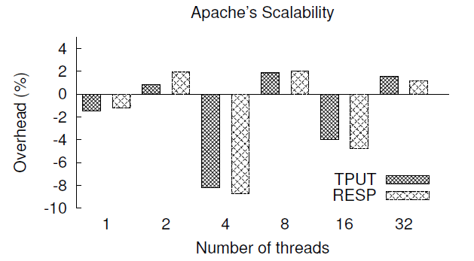
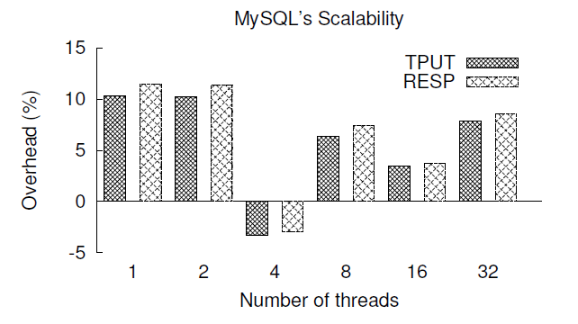
Scalability
48-core machine with 4 CPUs; Each CPU has 12 cores.
Pin the server to CPU 0, 1, 2, and the client to CPU 3.
Notes:
TODO: Redraw the figure with Excel.

Slide 38
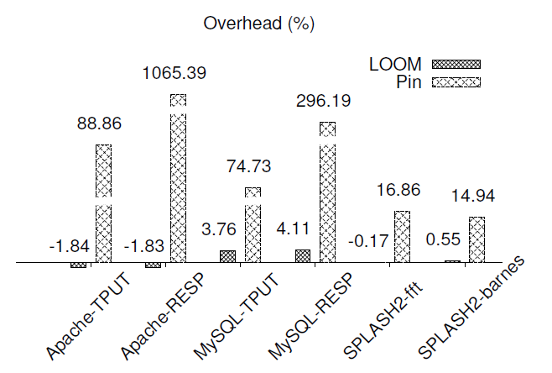
Overhead During Normal Executions
Notes:
Pin is a widely-used binary instrumentation tool.

Slide 39
Long Delay in Race Fixing
History
Reported on 2002-03-27
Considered to be fixed on 2002-04-11
Finally resolved on 2009-12-01
Hidden in the system for more than 7 years!
Totally 39 messages back and forth
Race ID | Report | Diagnosis | Fix | Release
Apache-25520 | 12/15/03 | 12/18/03 | 01/17/04 | 03/19/04
Apache-21287 | 07/02/03 | N/A | 12/18/03 | 03/19/04
MySQL-169 | 03/19/03 | N/A | 03/24/03 | 06/20/03
MySQL-644 | 06/12/03 | N/A | N/A | 05/30/04
MySQL-791 | 07/04/03 | 07/04/03 | 07/14/03 | 07/22/03
Mozilla-73761 | 03/28/01 | 03/28/01 | 04/09/01 | 05/07/01
Mozilla-201134 | 04/07/03 | 04/07/03 | 04/16/03 | 01/08/04
Mozilla-133773 | 03/27/02 | 03/27/02 | 12/01/09 | 01/21/10
Notes:
It’s interesting to look at the history of this bug. This is not the only example. We looked at 7 more bugs in our bug database, and find similar patterns. No need to show the table.

Slide 40
Hybrid Instrumentation
Function Entry
Function Entry
Fast Version
switch
Slow Version
cycle_check()
cycle_check()
Loop
Body
Loop
Body
switch
Loop
Body
Function Exit
Function Exit

Slide 41
An Example: Mozilla #133773
New thread
Non-last thread
Last thread
void js_DestroyContext() {
if (last) {
state = LANDING;
wait for gcLevel = 0;
gcPoke = true;
js_GC(true);
while (gcPoke)
js_GC(true);
FreeAtomState();
} else {
gcPoke = true;
js_GC(false);
}
}
void js_GC(bool last) {
...
MarkAtomState();
...
}
gcPoke = TRUE
state == LANDING? No
gcPoke? Yes
gcLevel > 0? No
1
state = LANDING
wait for gcLevel == 0
gcPoke = TRUE
2
3
gcPoke = FALSE
4
FreeAtomState()
5
MarkAtomState()
Hidden in the system for years!
Totally 39 messages back and forth
Notes:
Simplified. Show complication. All related functions. How complicated the fix is. Touches how many functions. Why complicated? performance. Still problematic. Time consuming. Involves with lots of testing.
Don’t say “hidden...”

Slide 42
Problems
Detect
Report
Diagnosis
Release
Restart
Want their code very efficient
Test the fixes thoroughly before release
...
Software update requires restarts.
Conventional live update is unsafe.
Notes:
Between this window, the server may get attacked. Security. Exploitable. test => detect. Define safety => introduce new bugs. Real data to back it up. Looked at real bugs. Show similar patterns.
Gap. Real study and found this gap. Importance the gap. Server programs => live update, although not shown by the JavaScript bug.
Define safety: introduce new errors.

Slide 43
Pause/Resume Application Threads
void cycle_check() {
read_unlock(&update);
read_lock(&update);
}
Function Entry
Function Entry
cycle_check()
Loop
Body
Loop
Body
void loom_update() {
write_lock(&update);
install_filter();
write_unlock(&update);
}
Function Exit
Function Exit
Notes:
We don’t pause a thread at arbitrary locations. We only pause it at a back-edge, an external function call, or the entry of a function inside a call loop.
Version 1, version 2: not the final version. Inlined assembly.

Slide 44
Pause Threads at Safe Locations
Function Entry
void cycle_check() {
if (wait[backedge_id]) {
read_unlock(&update);
while (wait[backedge_id]);
read_lock(&update);
}
}
cycle_check()
Loop
Body
void loom_update() {
identify_safe_locations();
for each safe backedge E
wait[E] = true;
write_lock(&update);
install_filter();
write_unlock(&update);
for each safe backedge E
wait[E] = false;
}
Function Exit
Notes:
wait flag: safe, and performance.

Slide 45
Evaluation (Benchmarks)
Race ID | Bug Type | Application
MySQL-169 | Atomicity | SQL Server
MySQL-644 | Atomicity
MySQL-791 | Atomicity
Apache-21287 | Atomicity | HTTP Server
Apache-25520 | Atomicity
PBZip2 | Order | Parallel BZip2
SPLASH2-fft | Order | Scientific computation programs
SPLASH2-lu | Order
SPLASH2-barnes | Order

Slide 46
Evaluation (Metrics)
Overhead
Does LOOM incur low overhead?
Scalability
Does LOOM scale well with the number of threads?
Reliability
Can LOOM fix all the races evaluated?
What are the trade-offs between reliability and performance?
Notes:
Does performance after fixing belong to the overhead part?

Slide 47
Scalability
48-core machine with 4 CPUs; Each CPU has 12 cores.
Pin the server to CPU 0, 1, 2, and the client to CPU 3.
Notes:
Explain why speedup. Previous work shows the possibility of getting a speedup when changing the synchronization in the program.

Slide 48
Problems
Gap
Gap
Detection
Diagnosis
Fix
Restart
Notes:
This is not the only example. We looked at 9 real bugs and found similar patterns. there is a huge gap between when... and when... It ranges from... to... to...
The life cycle of a bug has four stages: ...
Most previous work focuses on the first two stages: detection and debug. Before the fix is deployed, the application remains buggy and vulnerable. Security...
The bugs we looked at are not only in the client programs, but also in server programs. Most bugs crash the programs or have serious side effects, which means they are important. Especially for server programs, because attackers may exploit these long vulnerability windows to attack your machines.
Live update makes the deploy process easier by updating your programs without restarts. But they suffer from safety issues. specifically, programs may be running in an unsafe state when we update them. If we apply the fixes this time, it may introduce new errors or even crash your programs immediately.

Slide 49
Execution Filters
jscntxt.c
1 : void js_DestroyContext(JSContext *cx) {
2 : if (last thread) {
3 : ...
4 : FreeAtomState();
5 : ...
6 : } else {
7 : ...
8 : MarkAtomState();
9 : ...
10: }
11: }
// mutual exclusion of code
{jscntxt.c:2; jscntxt.c:10} <> self
// mutual exclusion of code and data
{jscntxt.c:2 (cx->runtime); jscntxt.c:10 (cx->runtime)} <> self
// unilateral exclusion
{jscntxt.c:2; jscntxt.c:10} <> *
Flexible
Declarative
Easy to write (< 5 lines)
// order constraint
jscntxt.c:8 (cx->runtime) > jscntxt.c:4 (cx->runtime)
Notes:
We’ve talked about execution filters for a while. What do execution filters look like?
Region, operator, * explain the syntax.
high bits: fix it in different ways. Small language and expressive. Declarative: declare users’ intent. do not need to start from locks and unlocks. mention the trade-off. Loom automatically convert.
Average 3.79. Easy to use.
add bulletin points
Flexible
Declarative
Easy to write
file name and line number
< > and >
self

Slide 50
Problems
Fixing races: complex
Performance pressure
Time-consuming testing
➔ Applications remain vulnerable
Deploying race fixes: needs restarts
Live update: unsafe
Notes:
Before races are fixed, applications still remain.
emphasize unsafe
did a study on 9 real races

Slide 51
Execution Filters: Temporarily Filter out Unwanted Interleavings
jscntxt.c
1 : void js_DestroyContext(JSContext *cx) {
2 : if (last thread) {
3 : ...
4 : FreeAtomState(cx);
5 : ...
6 : } else {
7 : ...
8 : MarkAtomState(cx);
9 : ...
10: }
11: }
// mutual exclusion of code
js_DestroyContext <> self
Declarative, easy to write
Notes:
We’ve talked about execution filters for a while. What do execution filters look like?
Region, operator, * explain the syntax.
highlight <> and self when explain
pointer to paper
low-level operations
high bits: fix it in different ways. Small language and expressive. Declarative: declare users’ intent. do not need to start from locks and unlocks. mention the trade-off. Loom automatically convert.
Average 3.79. Easy to use.
add bulletin points
Flexible
Declarative
Easy to write
file name and line number
< > and >
self

