Slide 1
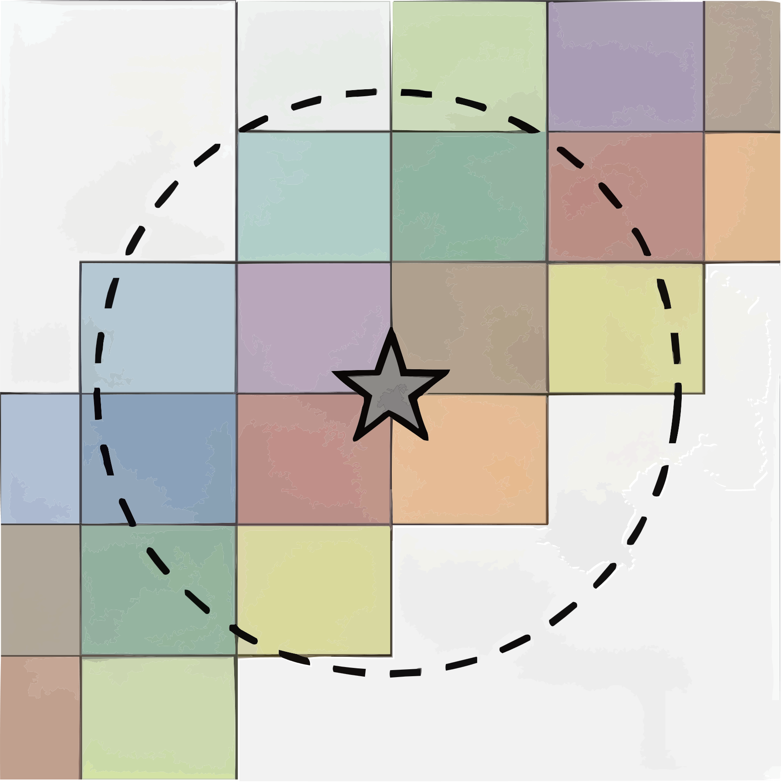
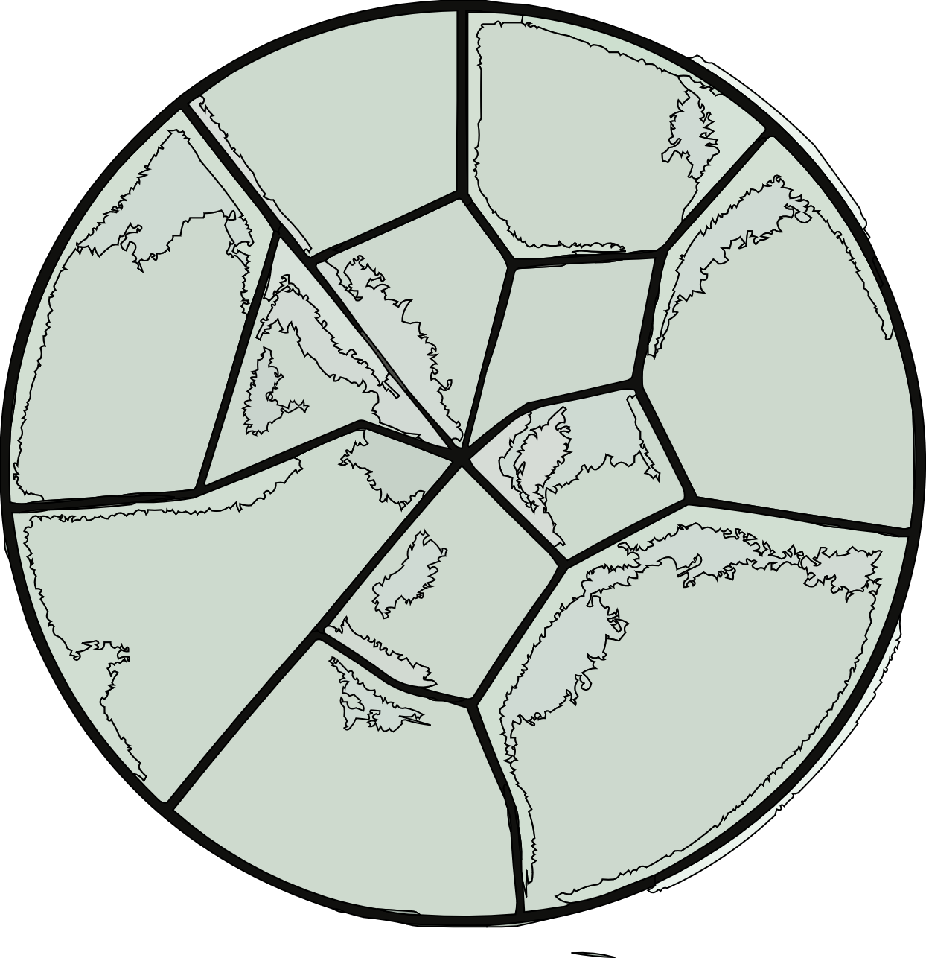
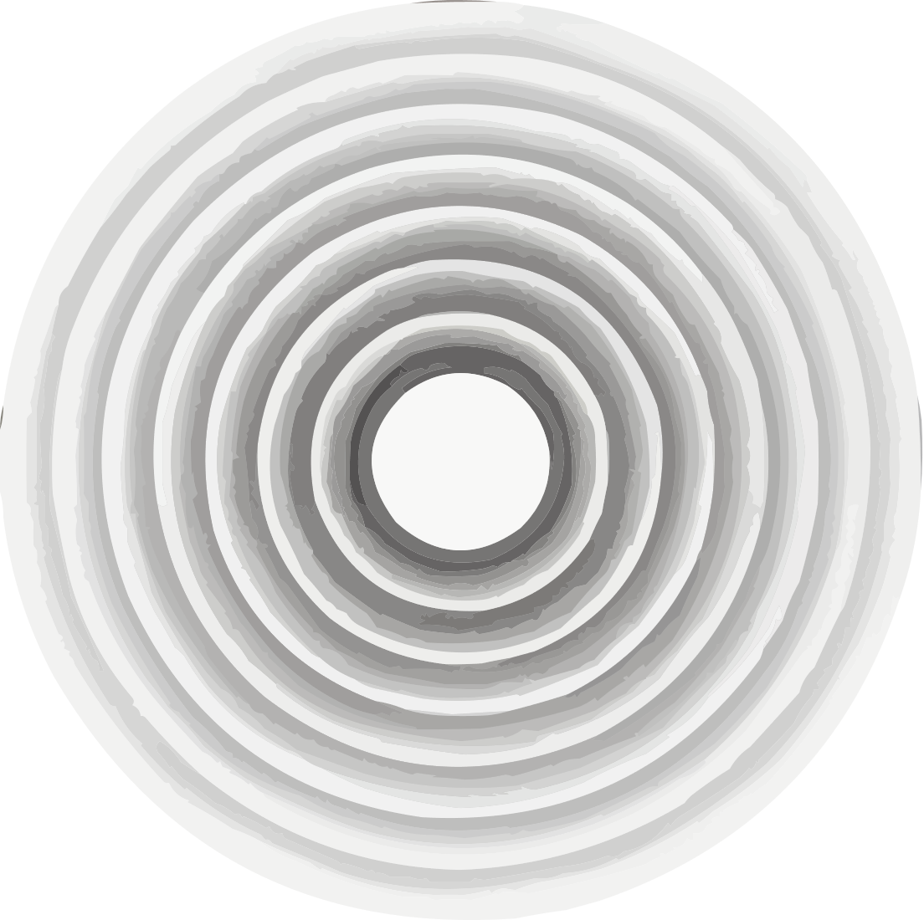










Data Pipeline
Radial Annuli
Displacement Trajecory
FBDM Tiles
$$D\left(t\right)$$
Radial Binning
Aggragated Displacement
$$t$$
Parameter
Extraction
Validation
Synthetic Experiment
Cross-scale Generalization
PDE Model
$$α_{pred}$$
$$\log{D}$$
$$−α$$
$$\log{t^{′}}$$
Counterfactual
Experiments
No Diffusion
Shuffle
$$\frac{D}{D_{peak}}$$
(i)
(iii)
$$δ$$
Flat Profile
$$r$$
(ii)
$$τ$$

