Slide 1

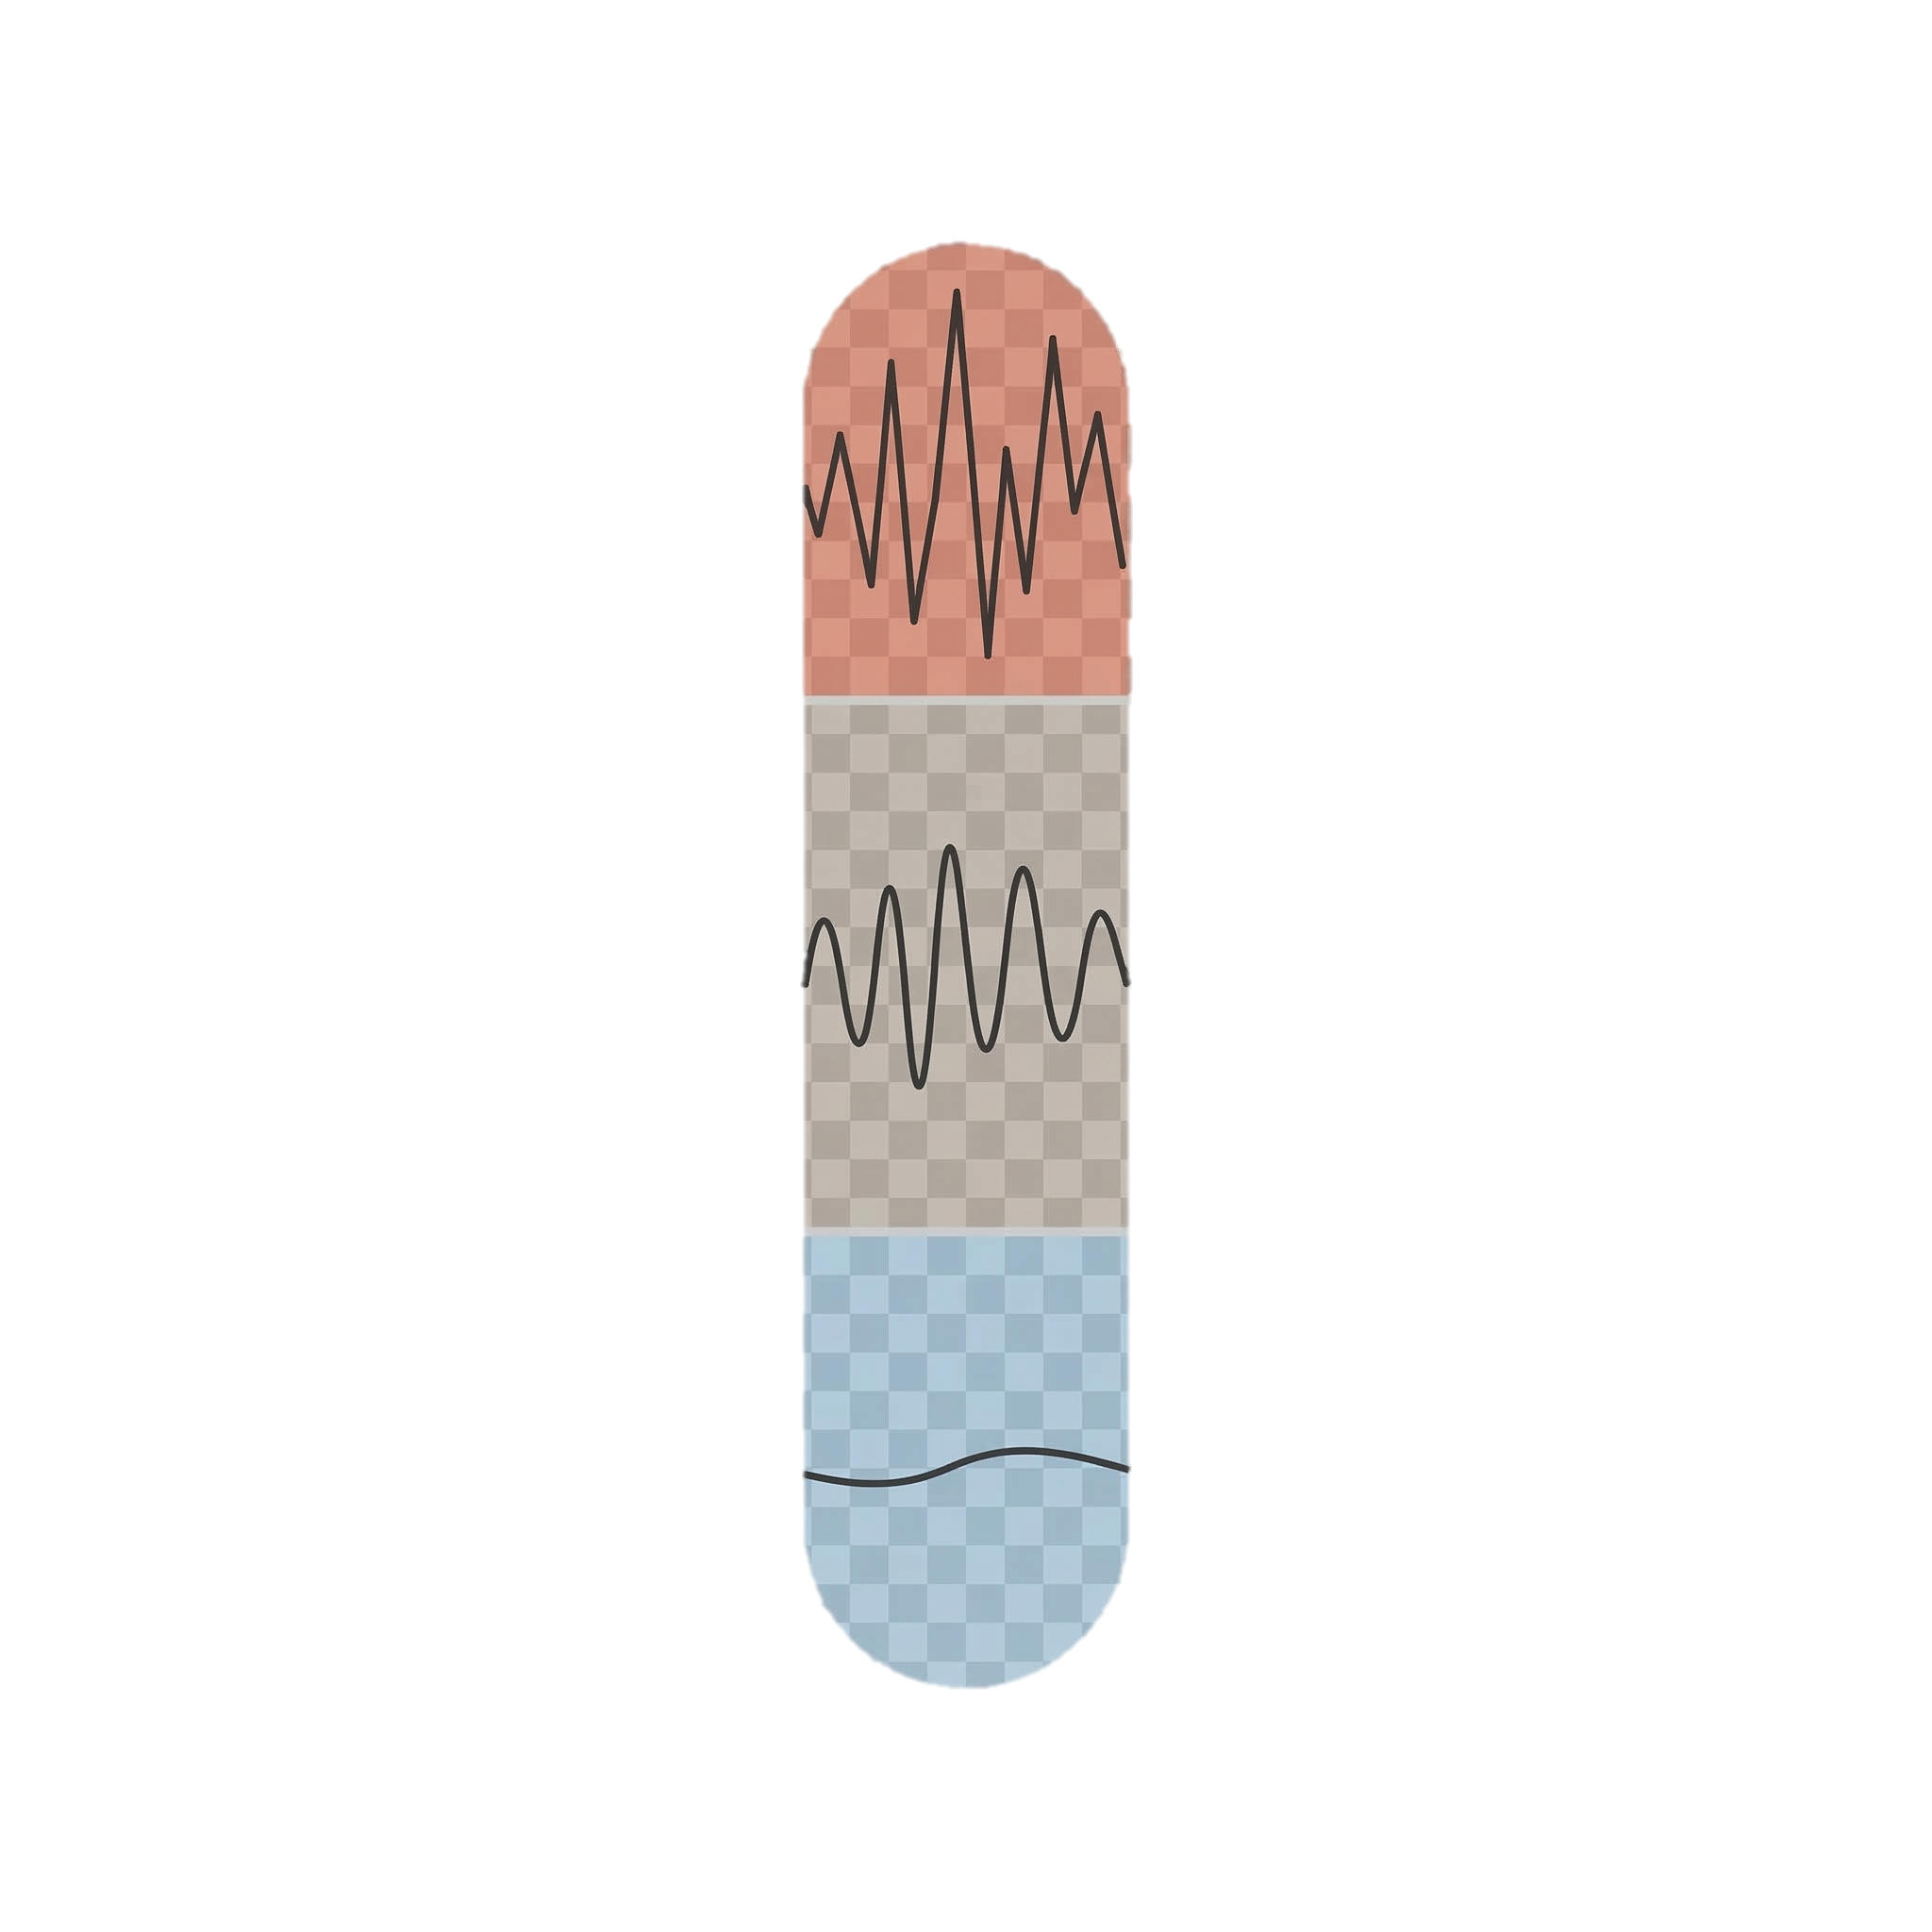
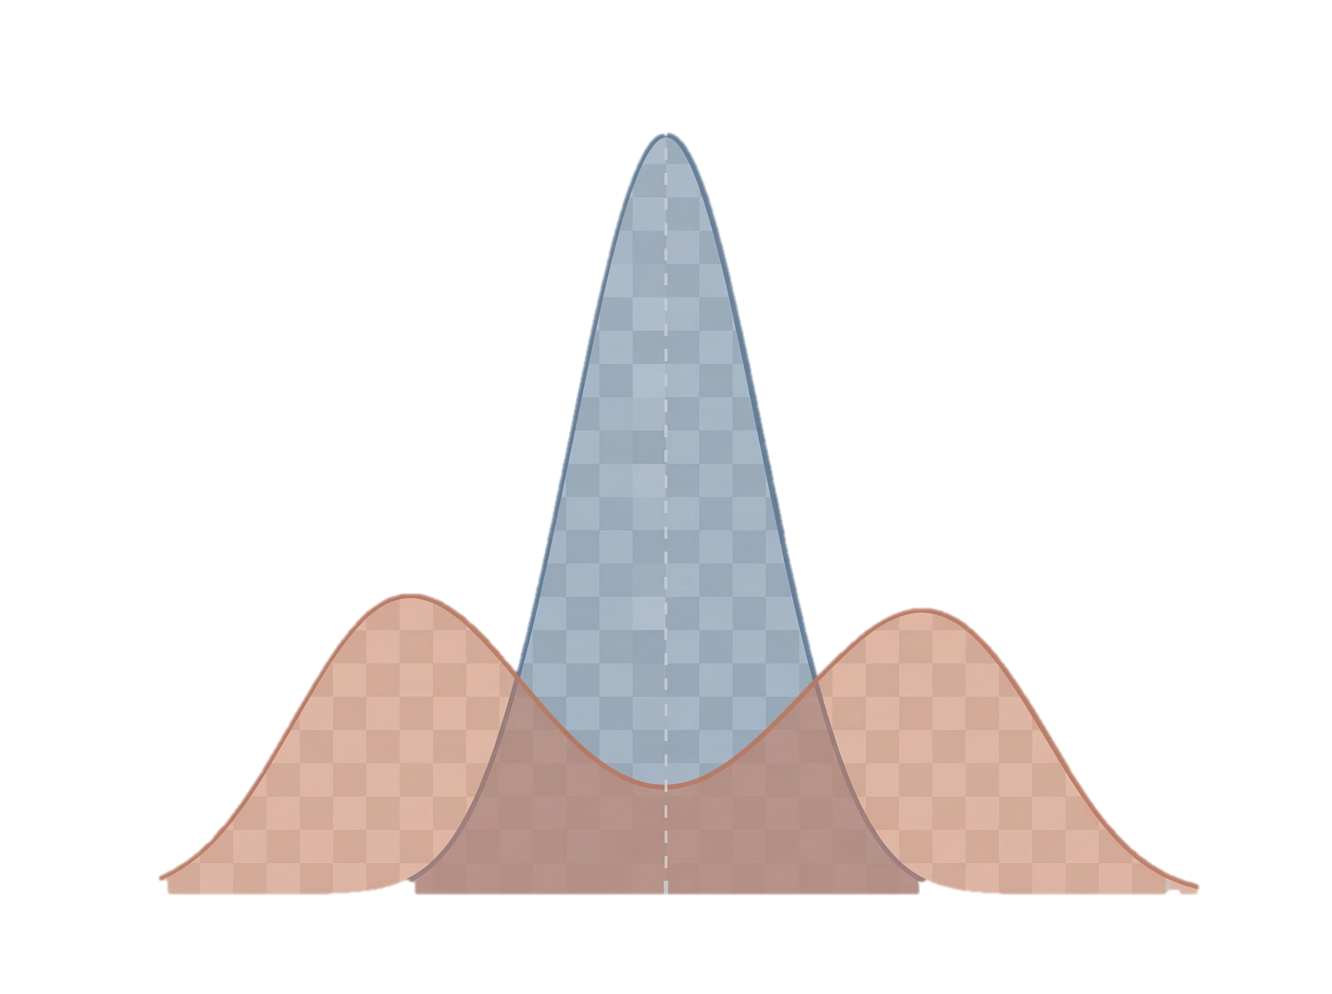
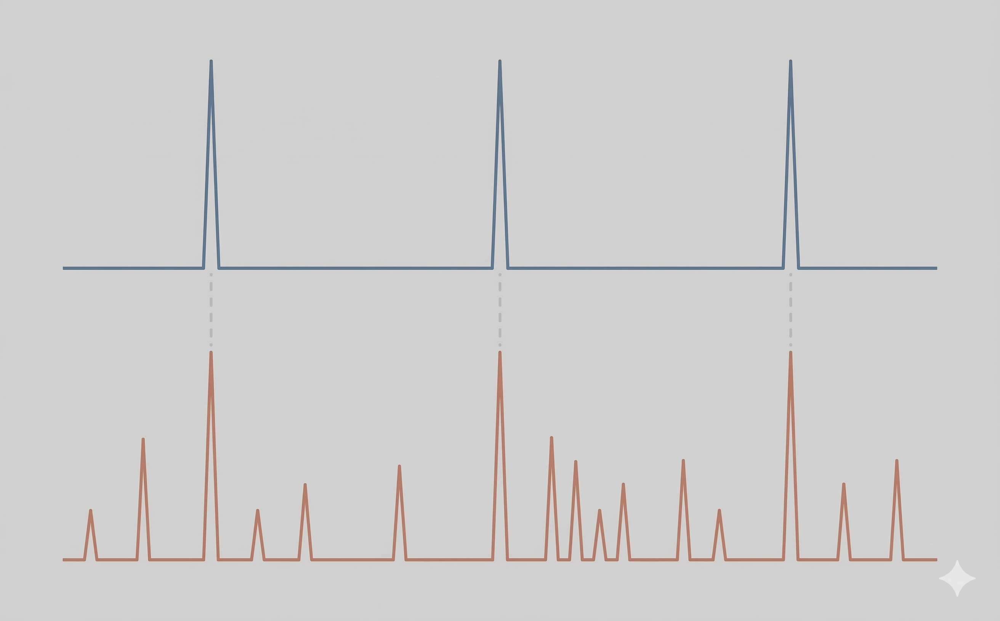
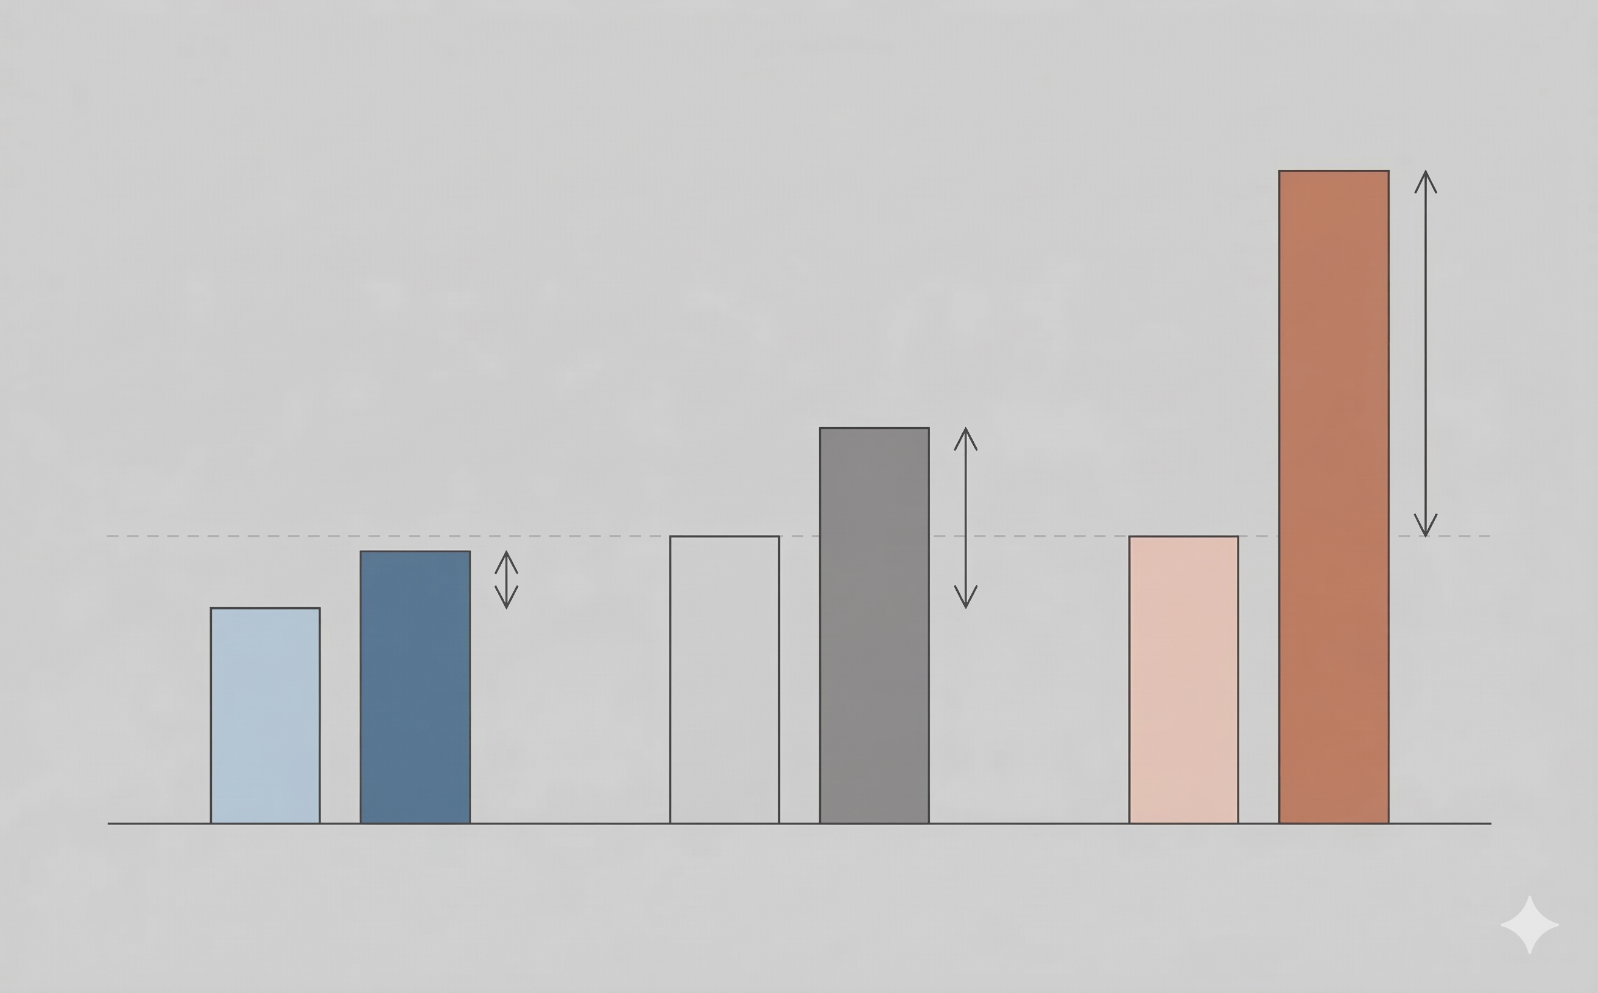
DATA INPUT
Wei Posts
Long-COVID, 2020.03-2024.02
LLM Annotation
Emotion Arousal
Layer 1: Content Framing
Layer 2: Temporal Synchrony
Layer 3: Individual Sensitivity
We-media frames risk more emotionally
Aligned peaks: shared major events
Light vs dark bars: non-risk vs risk
Orange spread: stronger emotional framing
Extra peaks: additional we-media coverage
Longer arrows: stronger response
We-media frames risk more emotionally
Shared major events, broader we-media coverage
We-media-only users react most strongly under risk
Compounded Mechanism
Distinct mechanisms
Reinforcement
Amplified dynamics

