Slide 1
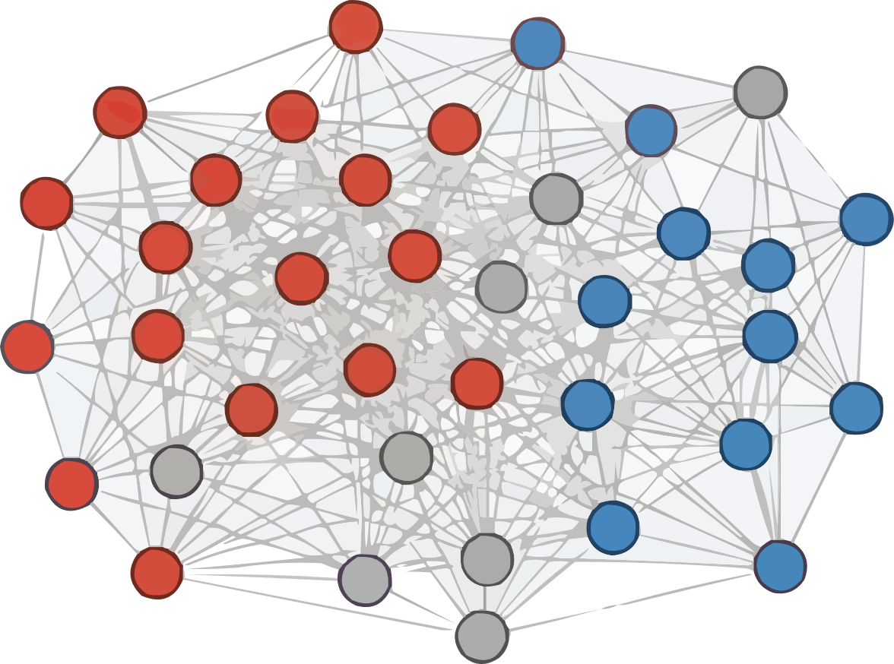






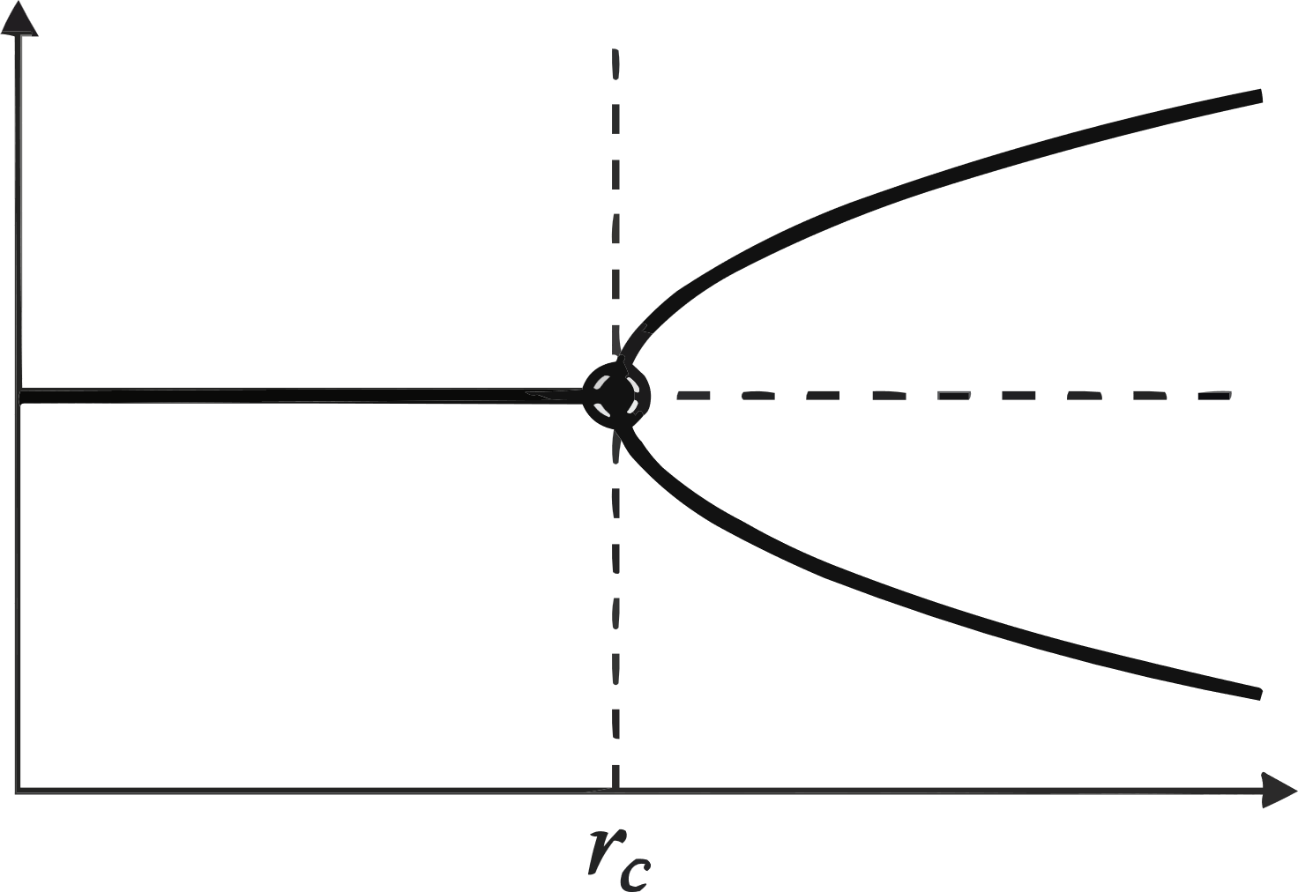
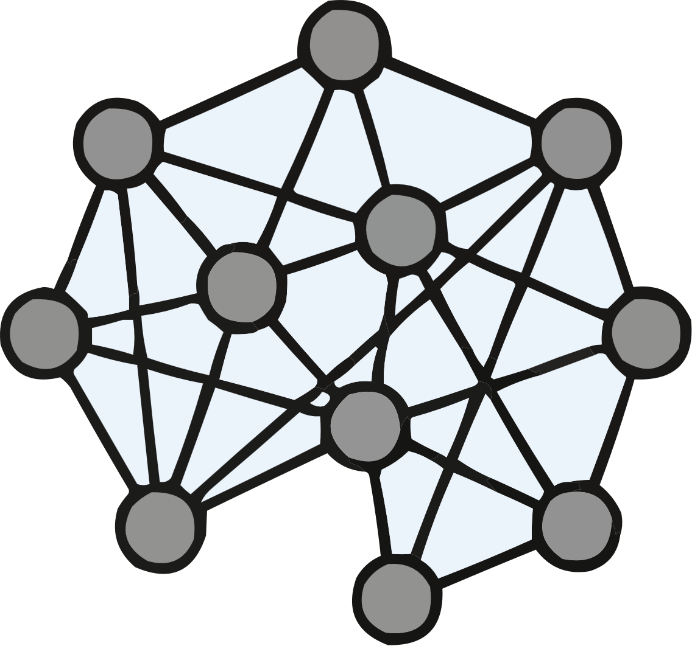
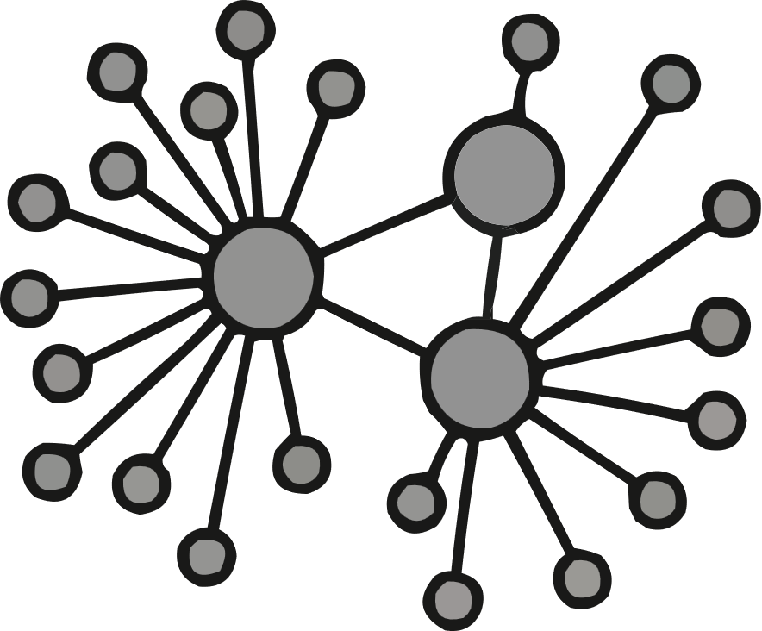


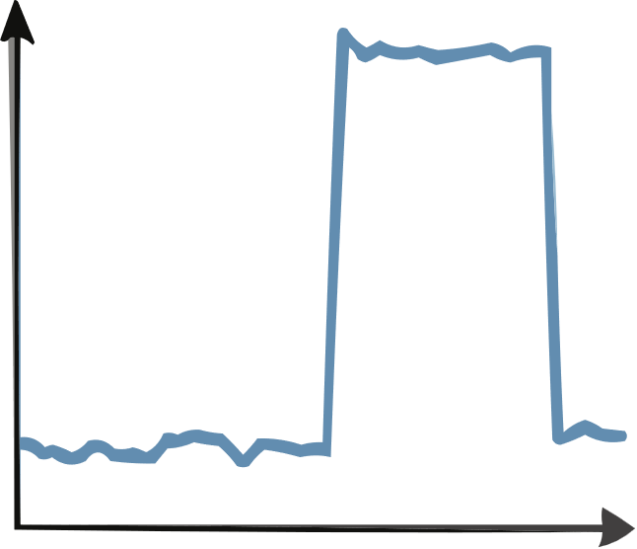
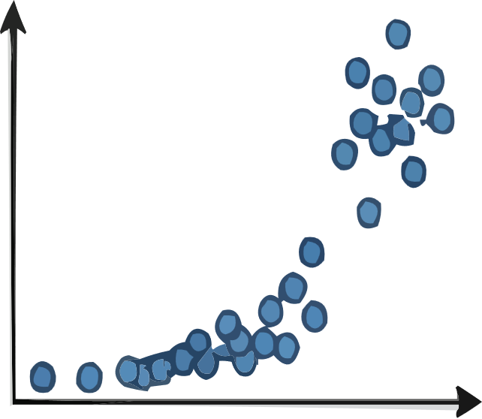




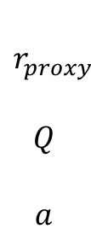

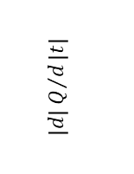



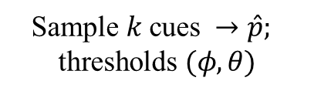
Theoretical Mechanism
Agent-Based Model
Empirical Validation
Amplifying
(We-media)
Stabilizing
(Mainstream)
Collective state
$(q,a)$
Posts
Processing
Time Series
$$r_{proxy}$$
$$Q$$
$$a$$
Media Ratio
Polarization
Activity
High
Arousal
Moderate
Low
Arousal
Pitchfork bifurcation at $r_{c}$
Polarization q
H1: $a$ $vs$ jump in $|Q|$
H2:${ r}_{proxy} vs$ $std(Q)$
$$\text{Sample} k \text{cues} →\hat{p};$$
$$\text{thresholds} (φ,θ)$$
$$\left|d\right|Q/d\left|t\right|$$
$$std(Q)$$
$$\text{Topology} \text{robustness}\text{ (}\text{ER}\text{/}\text{BA}\text{)}$$
$$a$$
$$r_{proxy}$$
Posts

