Slide 1

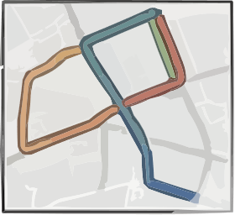
Input
Preprocessing
Consecutive Setup on Way_id Token Route
Topological
WorldTrace
Urban Semantics
OpenStreetMap Road Network

