Slide 1
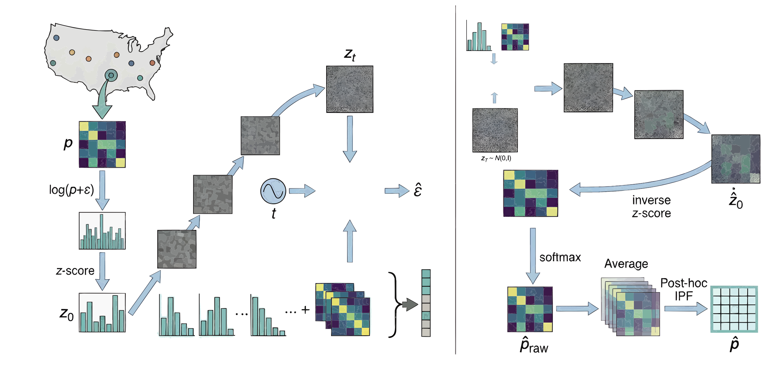



Training
Inference
Denoiser
$$X_{0}$$
Denoiser
Age$×$Income
Age
Income
Education
Income$×$Education

Slide 2
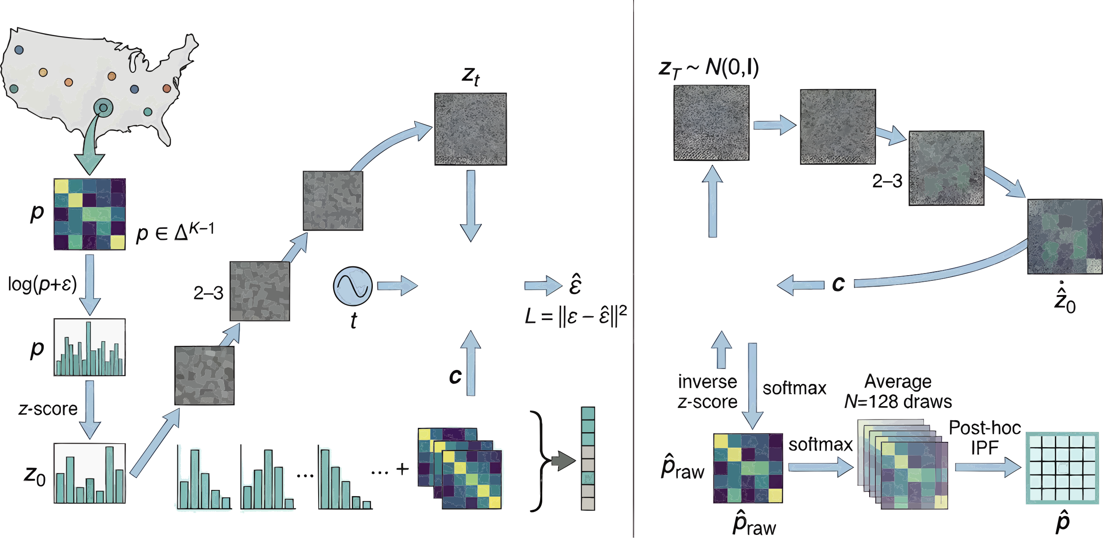


训练
推理
去噪器
去噪器
年龄$×$收入
年龄
收入
教育
收入$×$教育

Slide 3

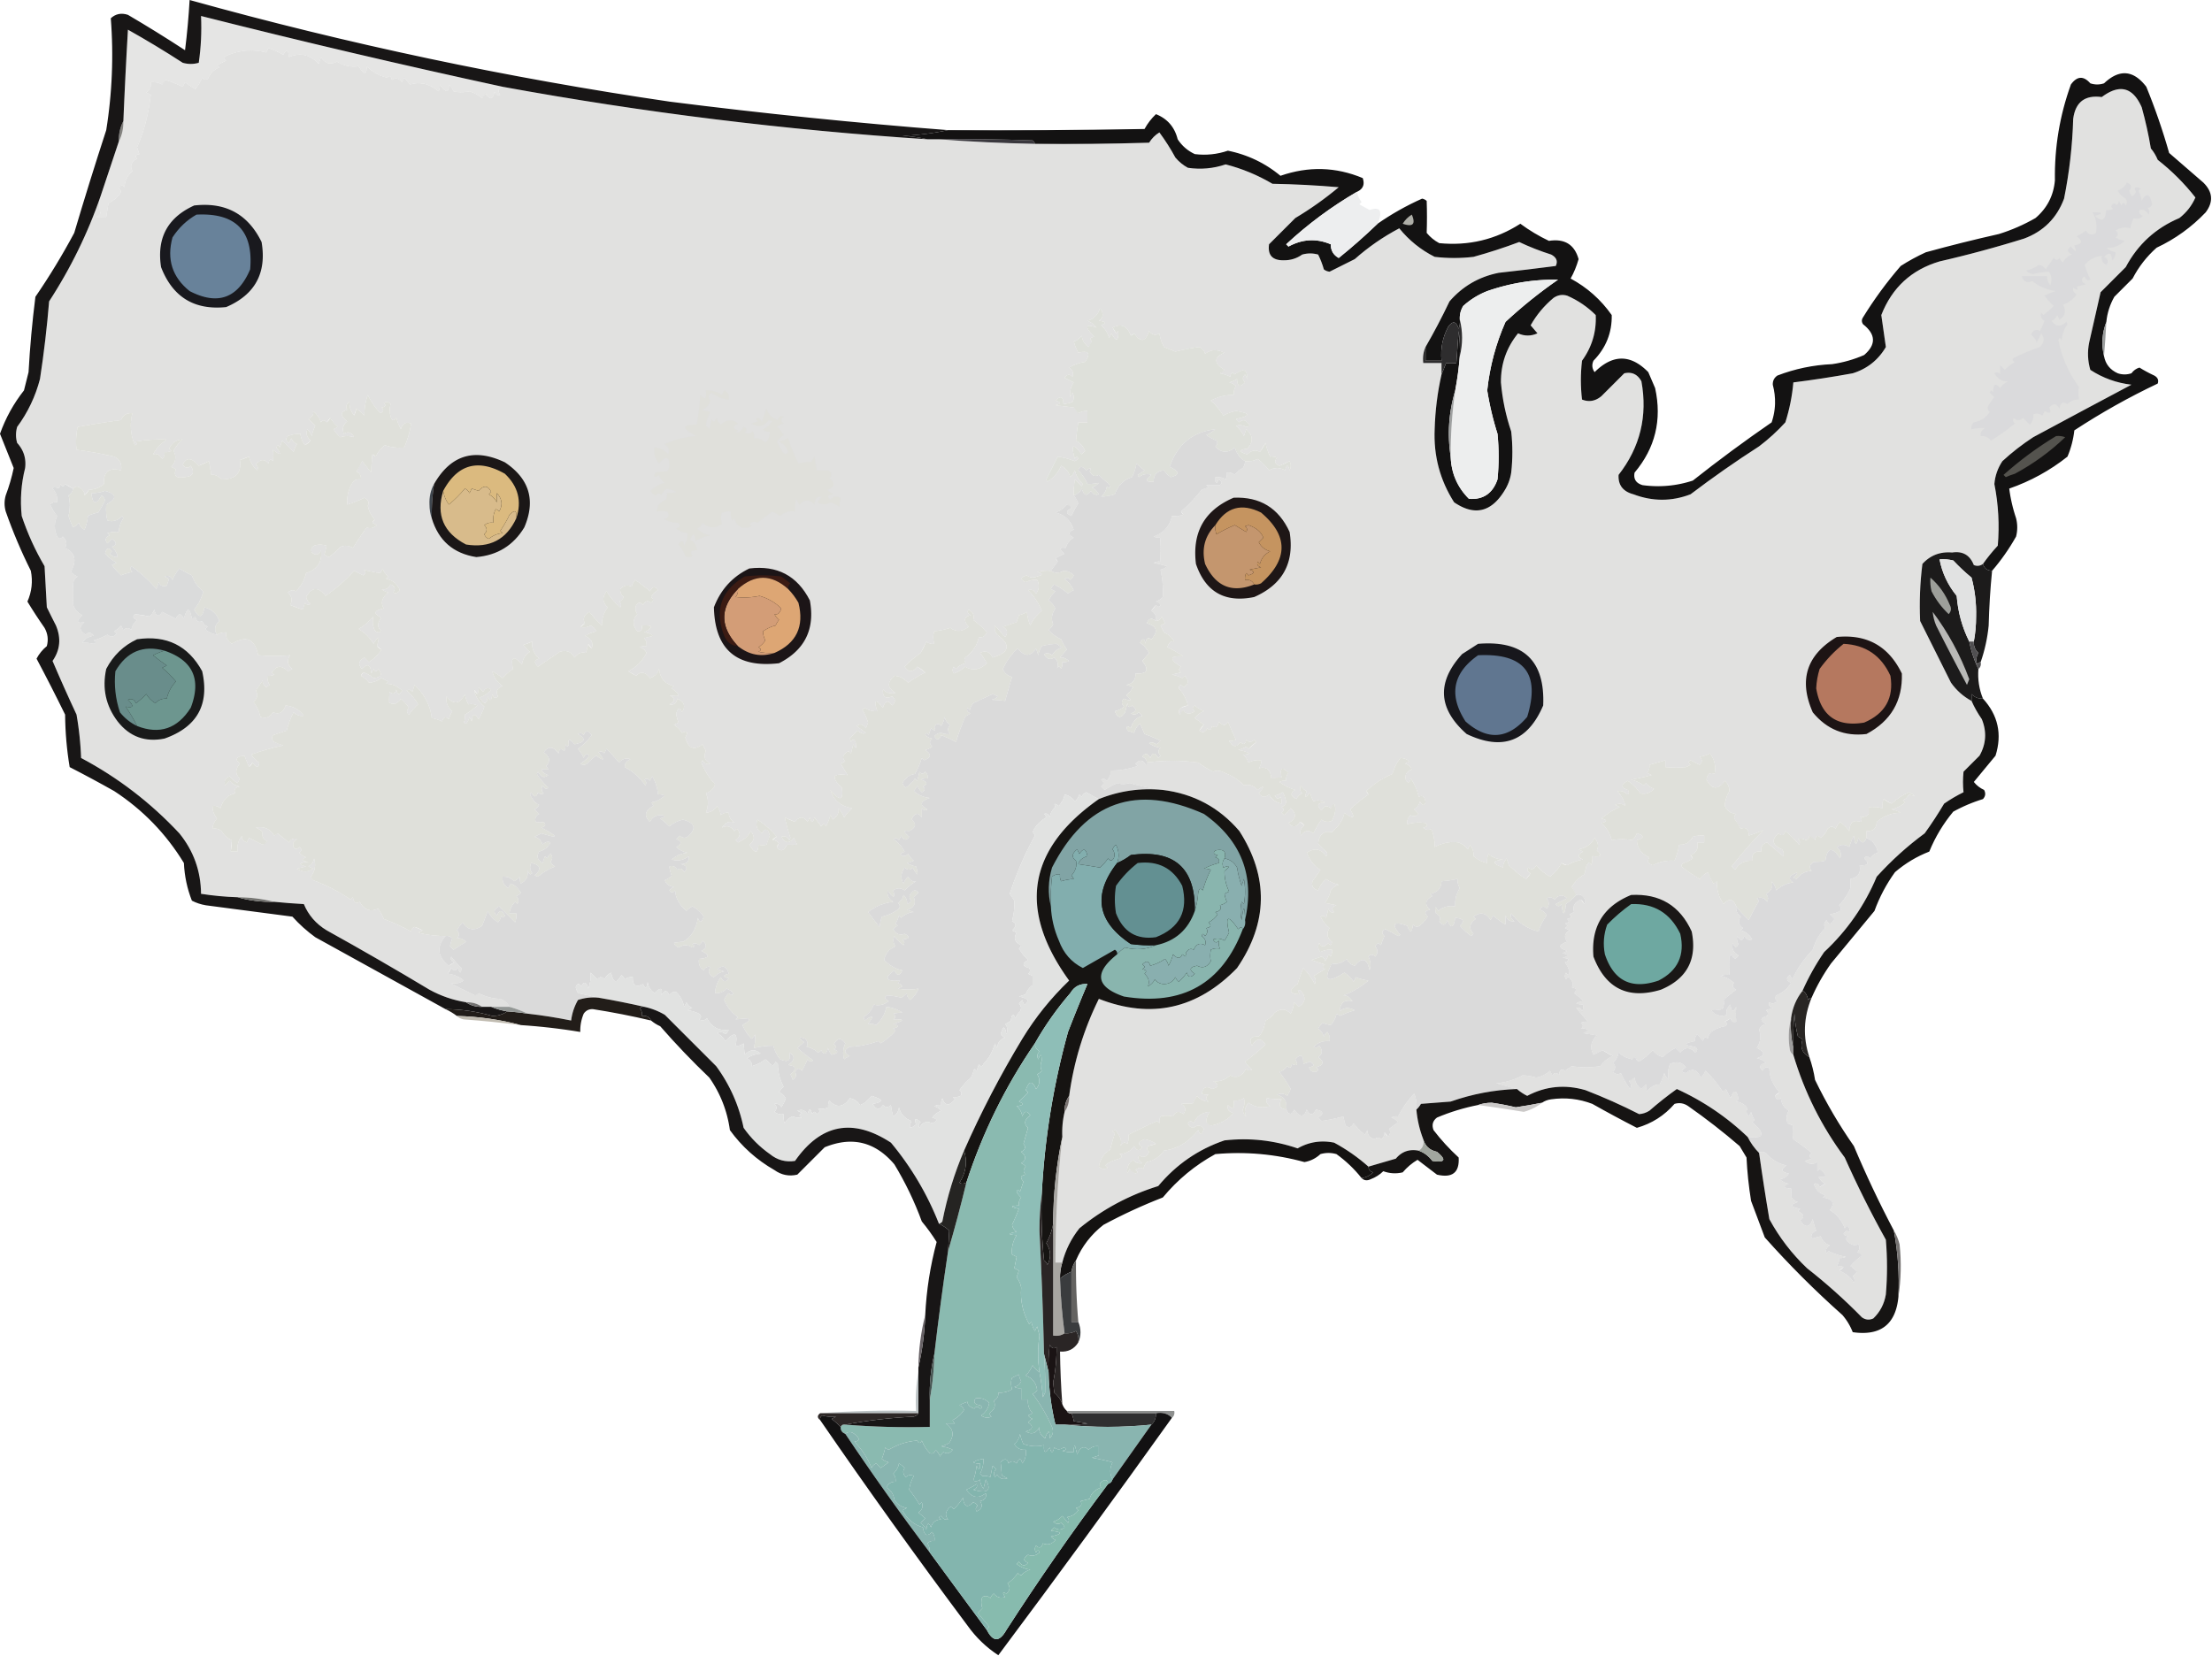






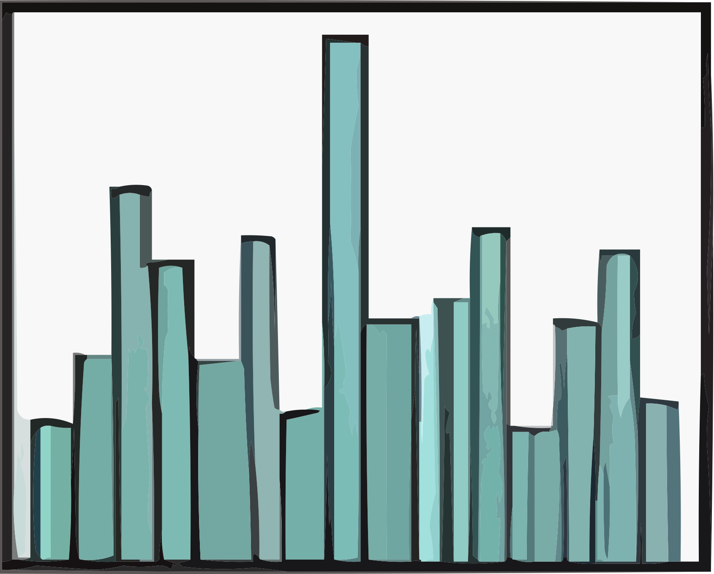
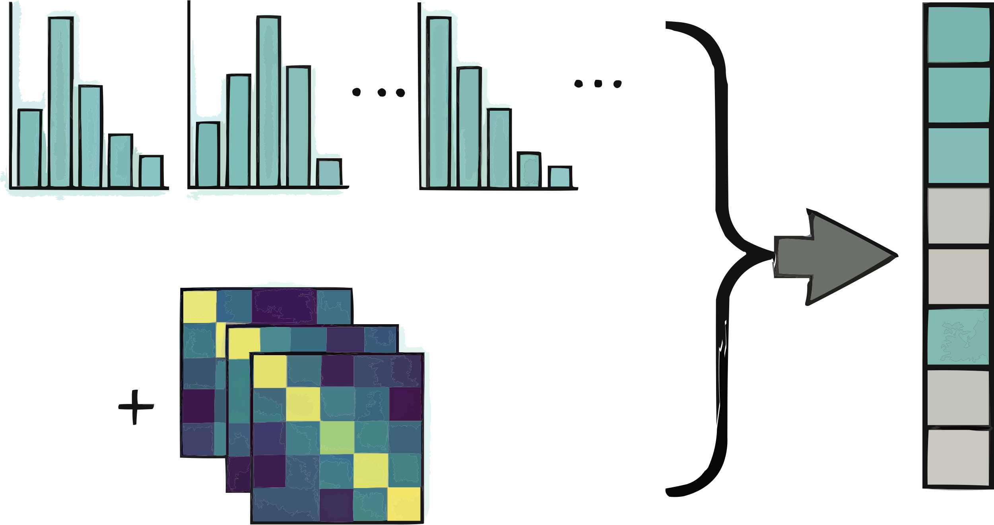
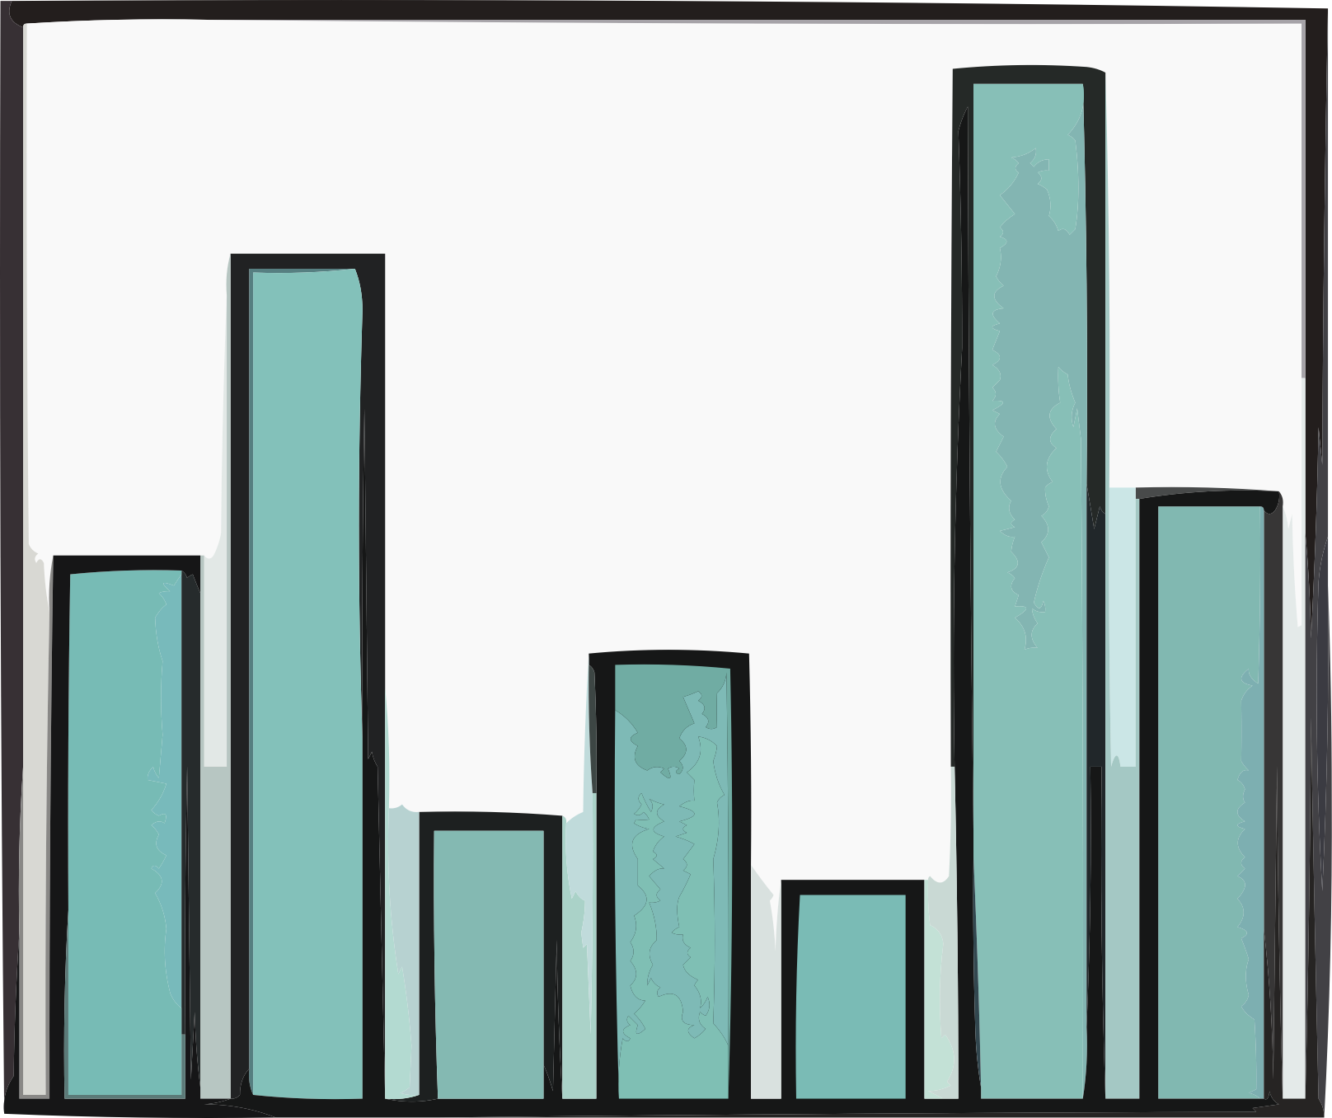





Step1: Demographic Characteristic Extraction
Step2: Conditional Diffusion
Generative Inference
Denoiser
Noising
Denoising
$$Z_{t}$$
$$P_{0}$$
t
Inverse z-score &
Softmax
$$log (p+φ)$$
Denoiser
Z-score
Average
$$Z_{0}$$
Condition

Slide 4


Step1: Demographic Characteristic Extraction
PUMS Data
z-score
Normalization
$$P_{0}$$
$$log (p+φ)$$

