Slide 1
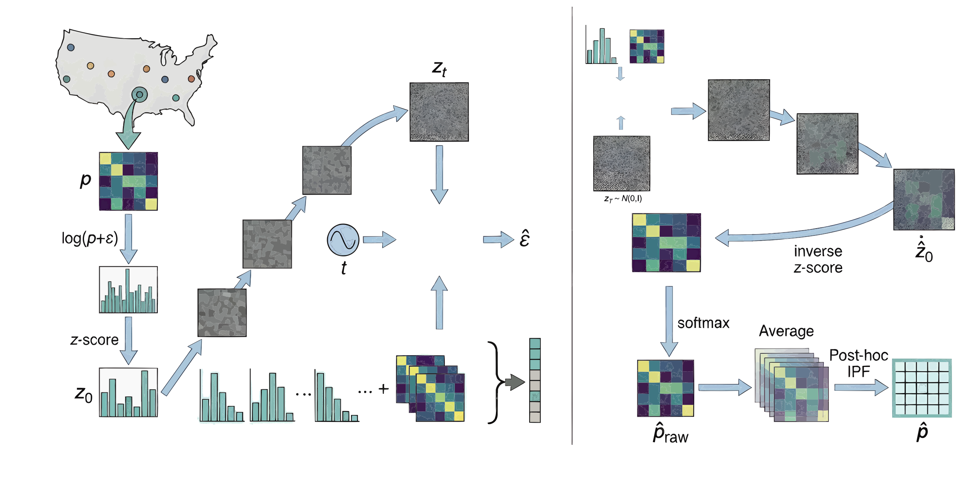



Training
Inference
Denoiser
$$X_{0}$$
Denoiser
Age$×$Income
Age
Income
Education
Income$×$Education

Slide 2
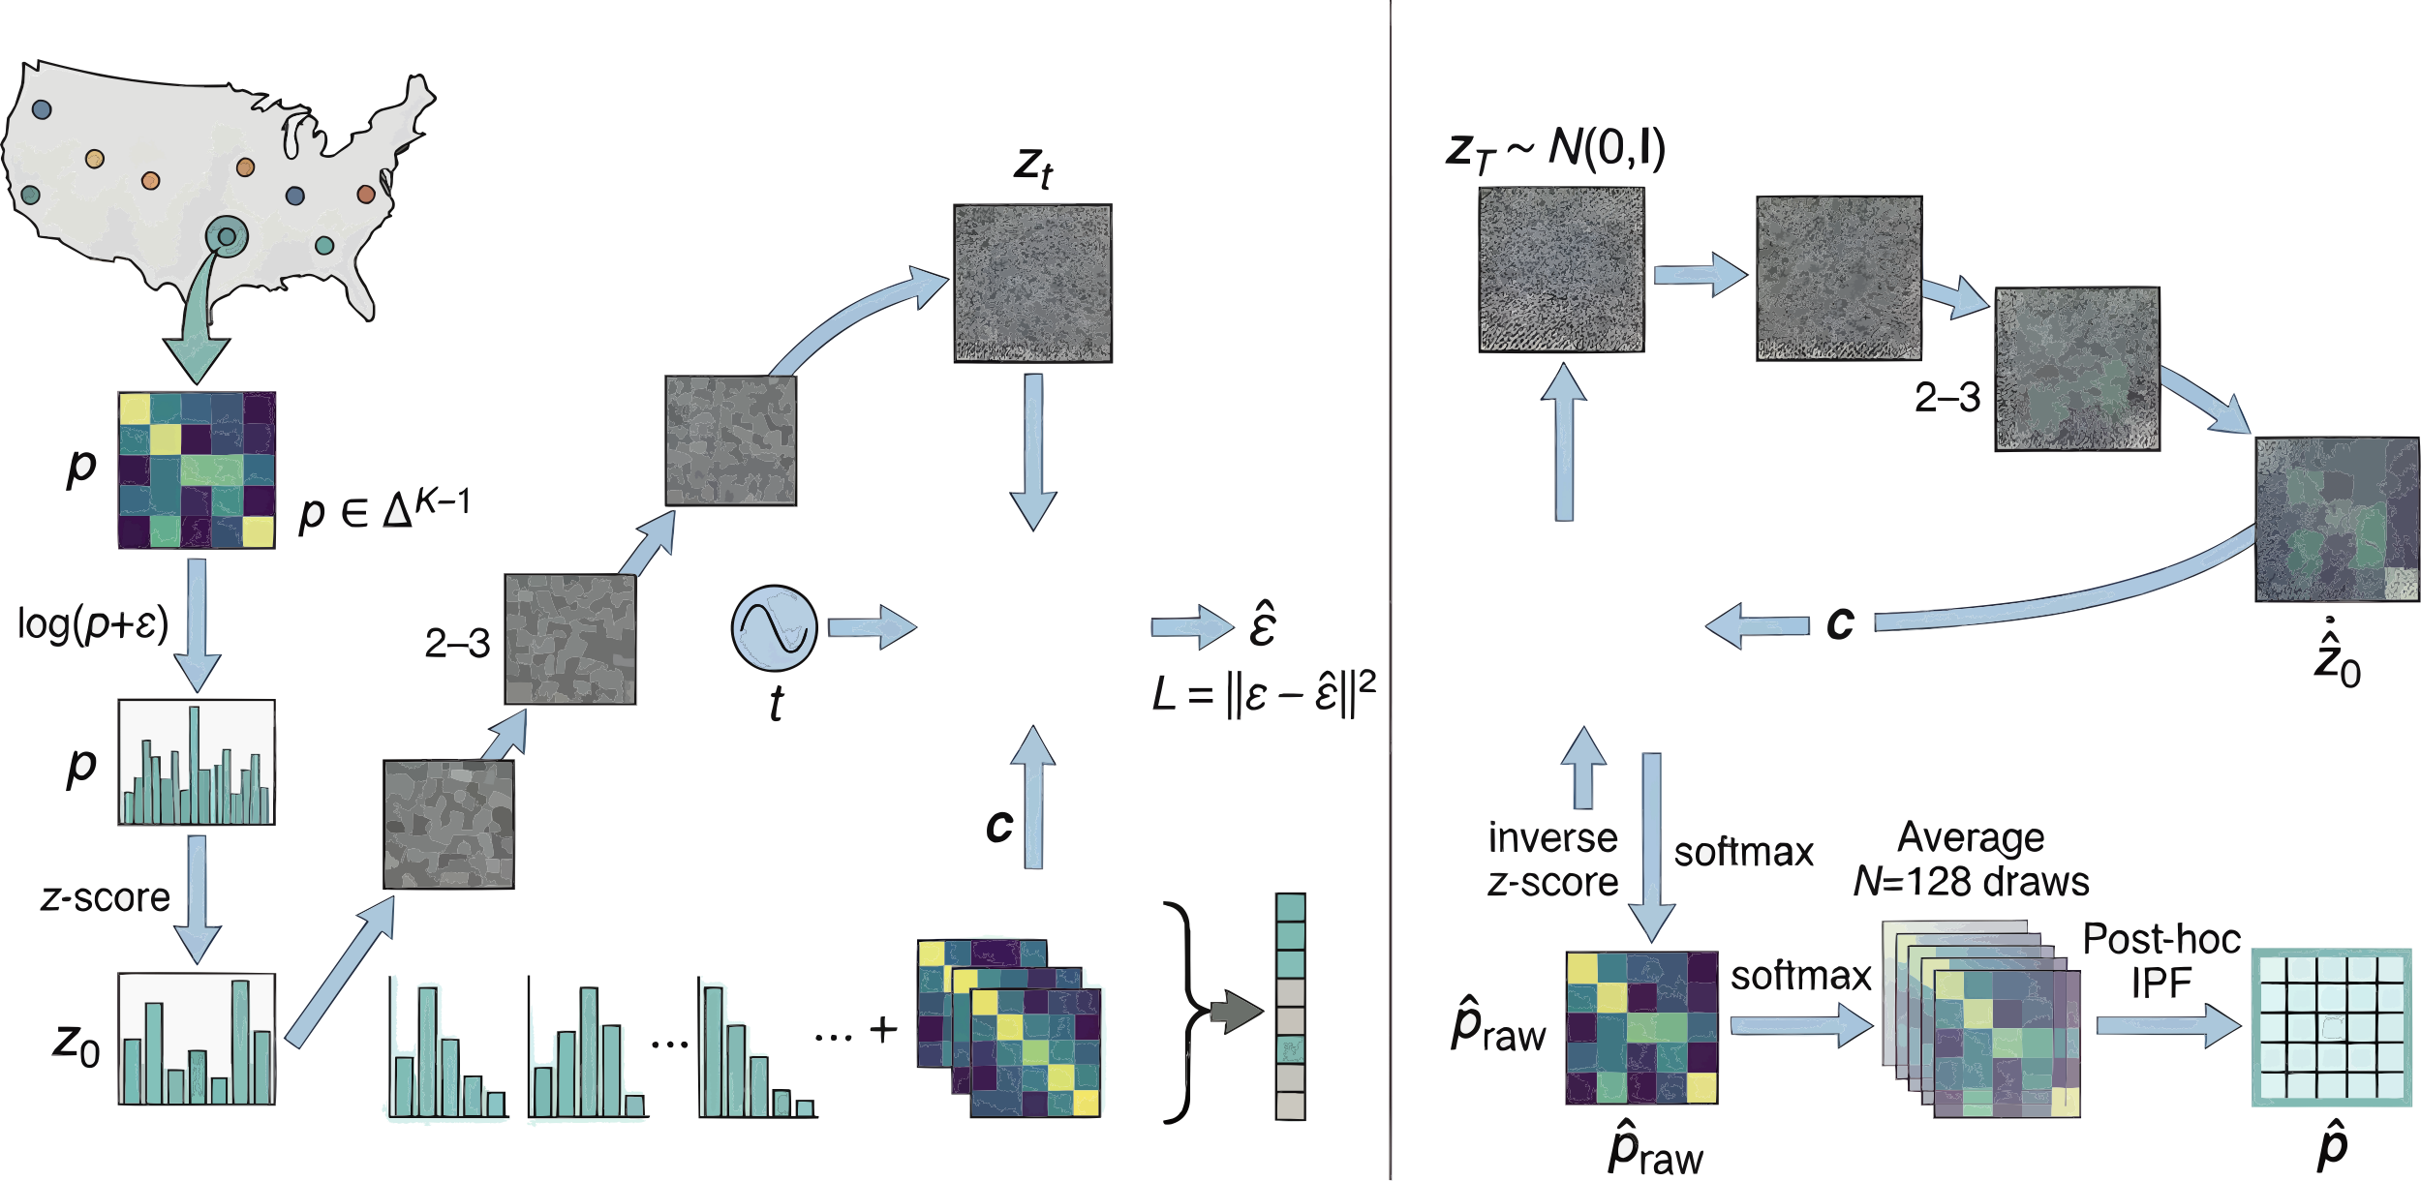


训练
推理
去噪器
去噪器
年龄$×$收入
年龄
收入
教育
收入$×$教育

Slide 3

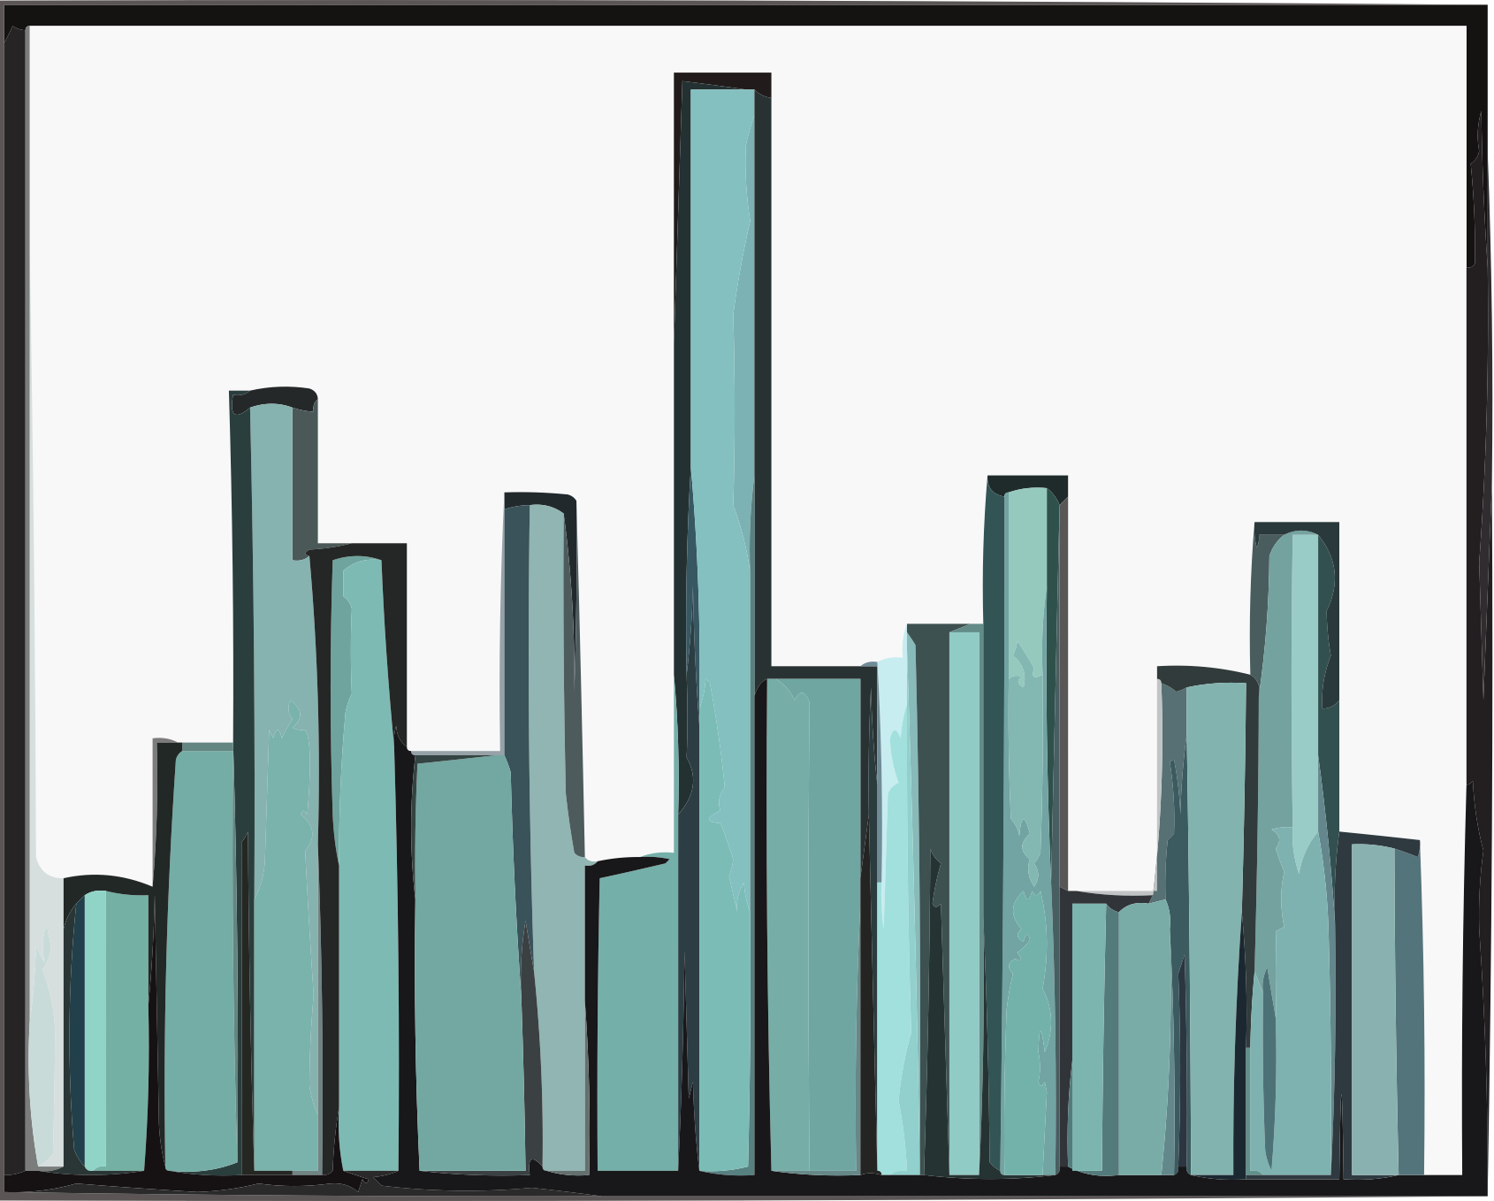

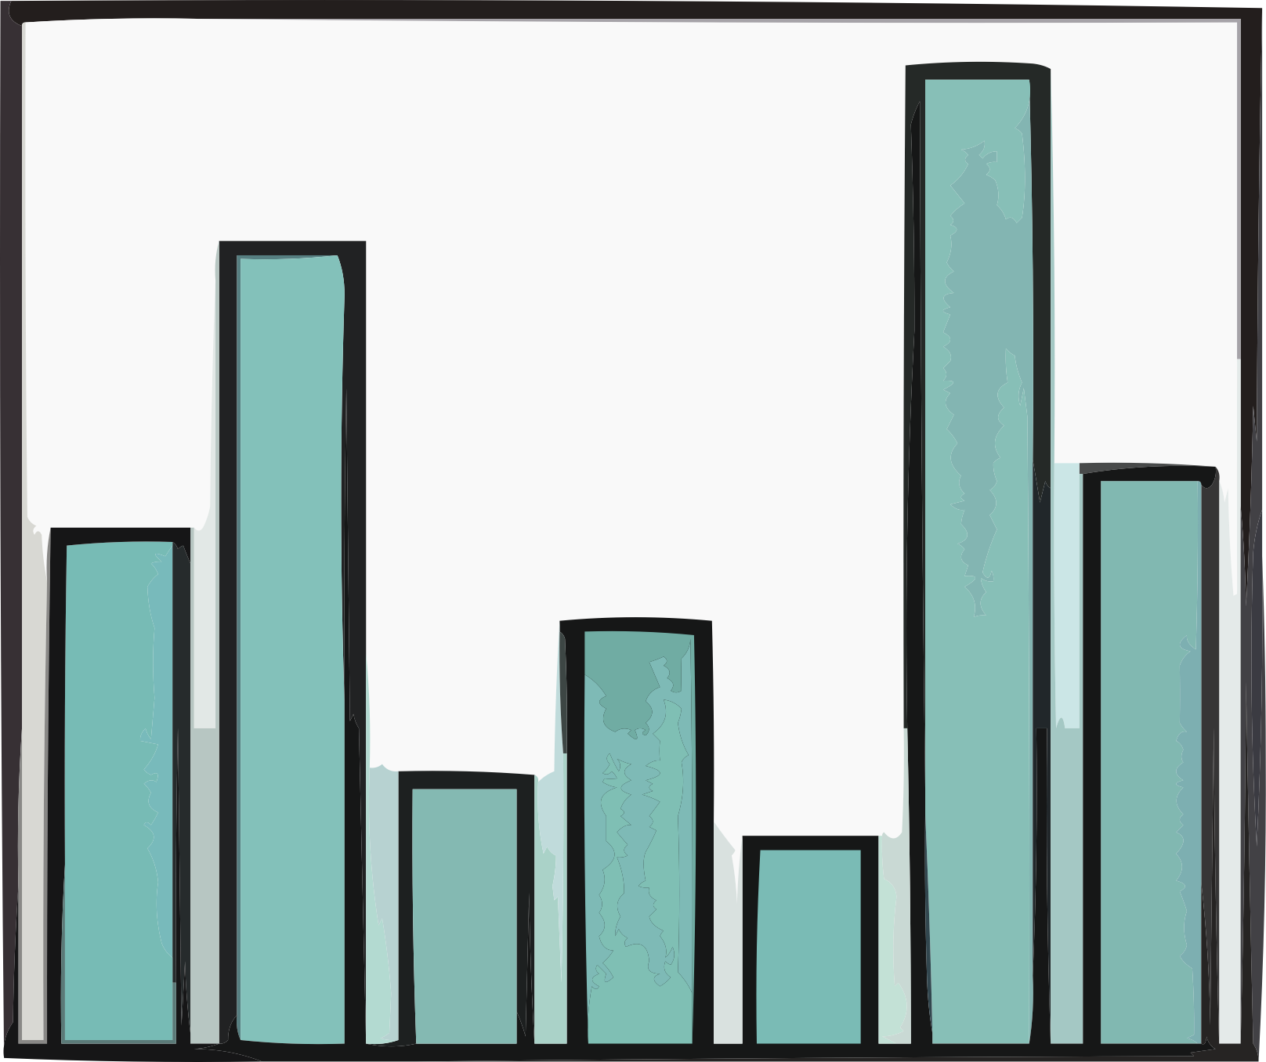





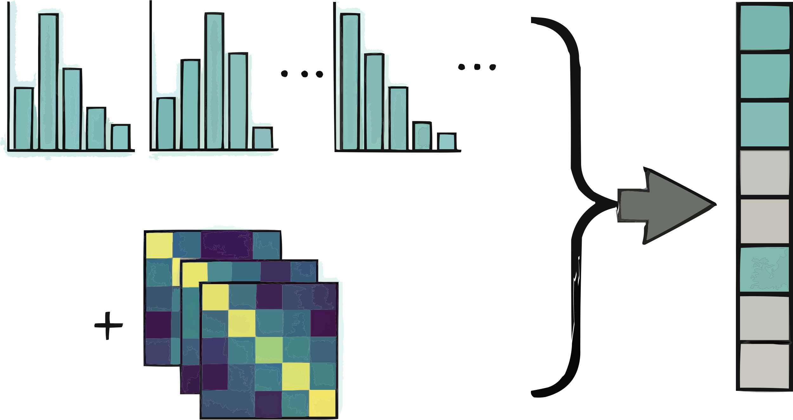



步骤1：人口属性特征提取
PUMS 数据
Z-score
标准化
离散化
$$log (p+φ)$$
步骤3：分布推断
步骤2：扩散模型训练
逆扩散
扩散
逆 Z-score变换 & Softmax
噪声预测网络
条件信息
抽取
平均
采样
t
时间步

Slide 4
PUMS Data
Step1: Demographic Characteristic Extraction
Bin & Aggregate
Log
Transformation
Z-score
Normalization
Step3: Distribution Inference
Step2: Diffusion Model Training
Reverse
Diffusion
Forward
Diffusion
Inverse Z-score & Softmax
Noise Predictor
Condition
Repeated Draws
Average over Draws
Sample
t
Time Steps

Slide 5
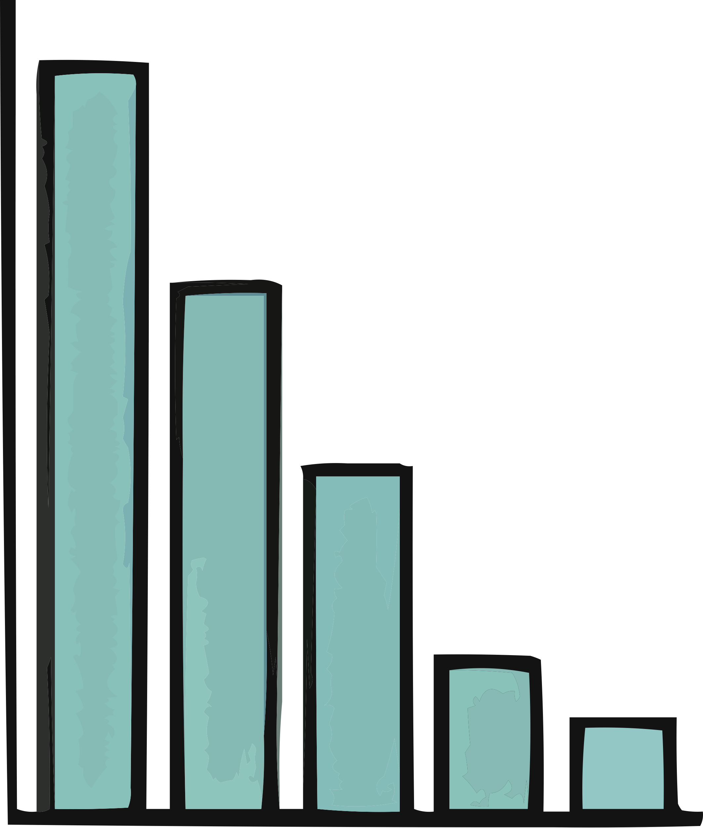
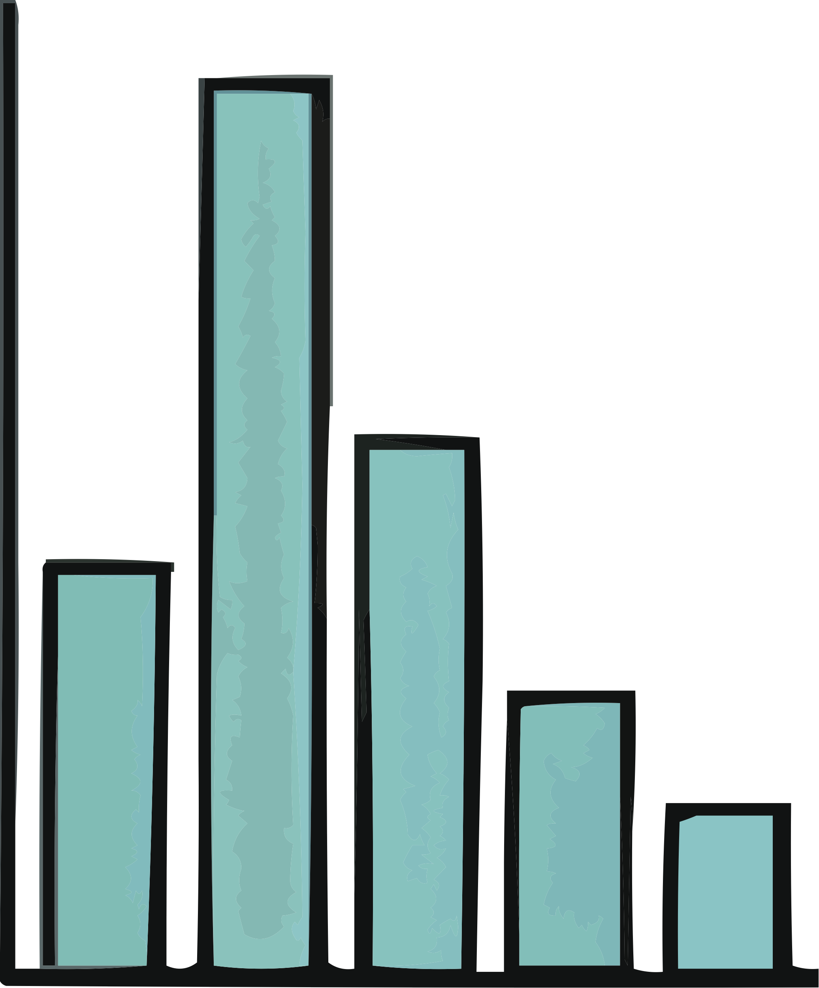






Step1: Regional Targets and External Conditions
Step2: Regional-Context Diffusion Training
Step3: Synthetic Population Generation
External Census Summaries
Predict Noise
4-attribute Regional Joint Distribution
Generate
Age
sex
Encode
Condition Encoder
Joint Diffusion Model
Education
Employment
Sample
Earnings
4-attribute Joint Target
PUMS Microdata
Person-level earnings model
Assign Earnings
Regional Context
Age
Gender
5-attribute Synthetic Population
Age
Sex
Education
Employment
Earnings
Education
Employment
Conditional Earnings Target
Income

