Slide 1

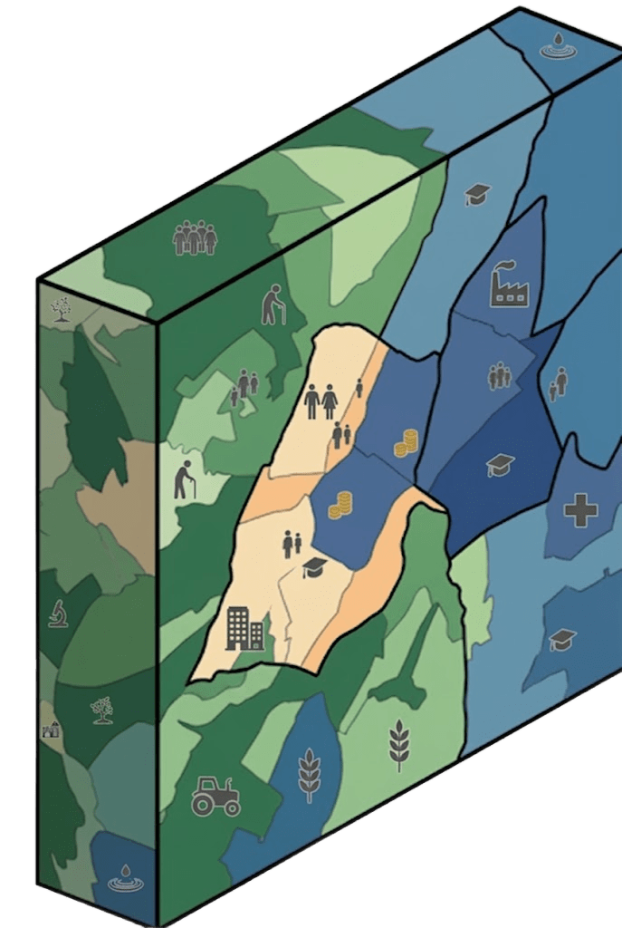
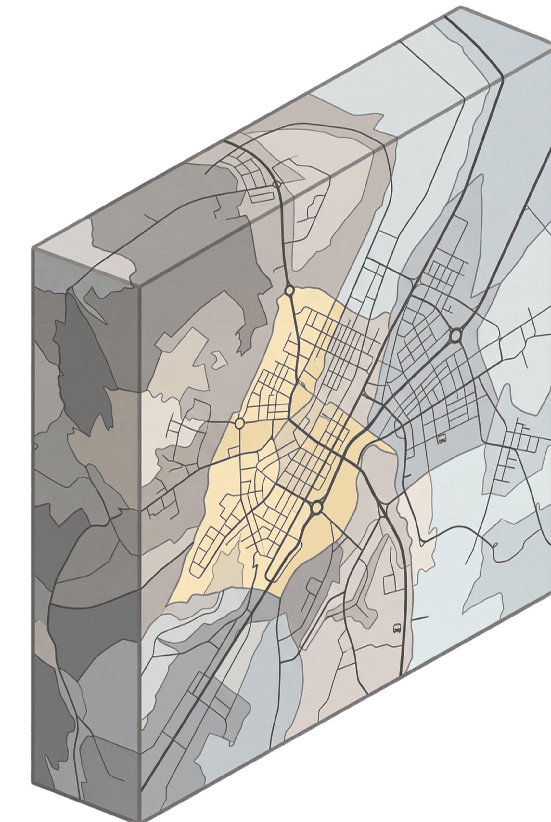
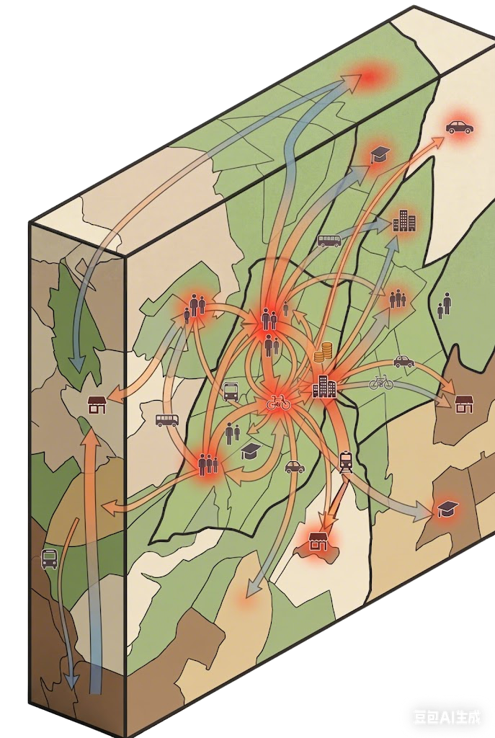
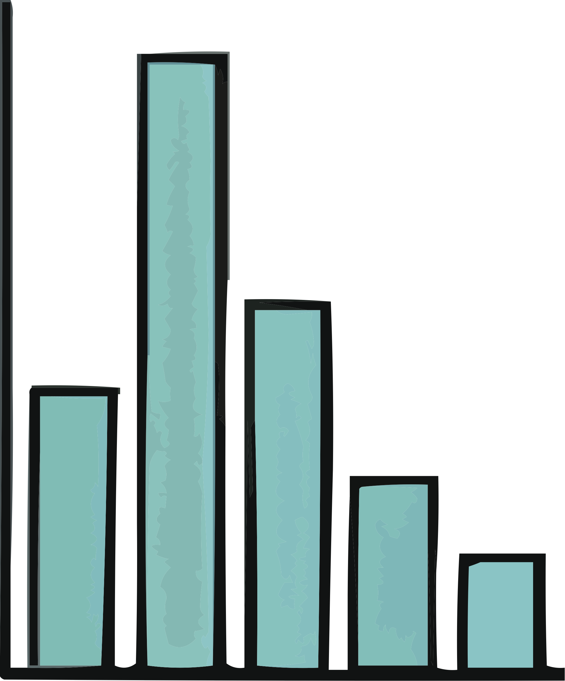
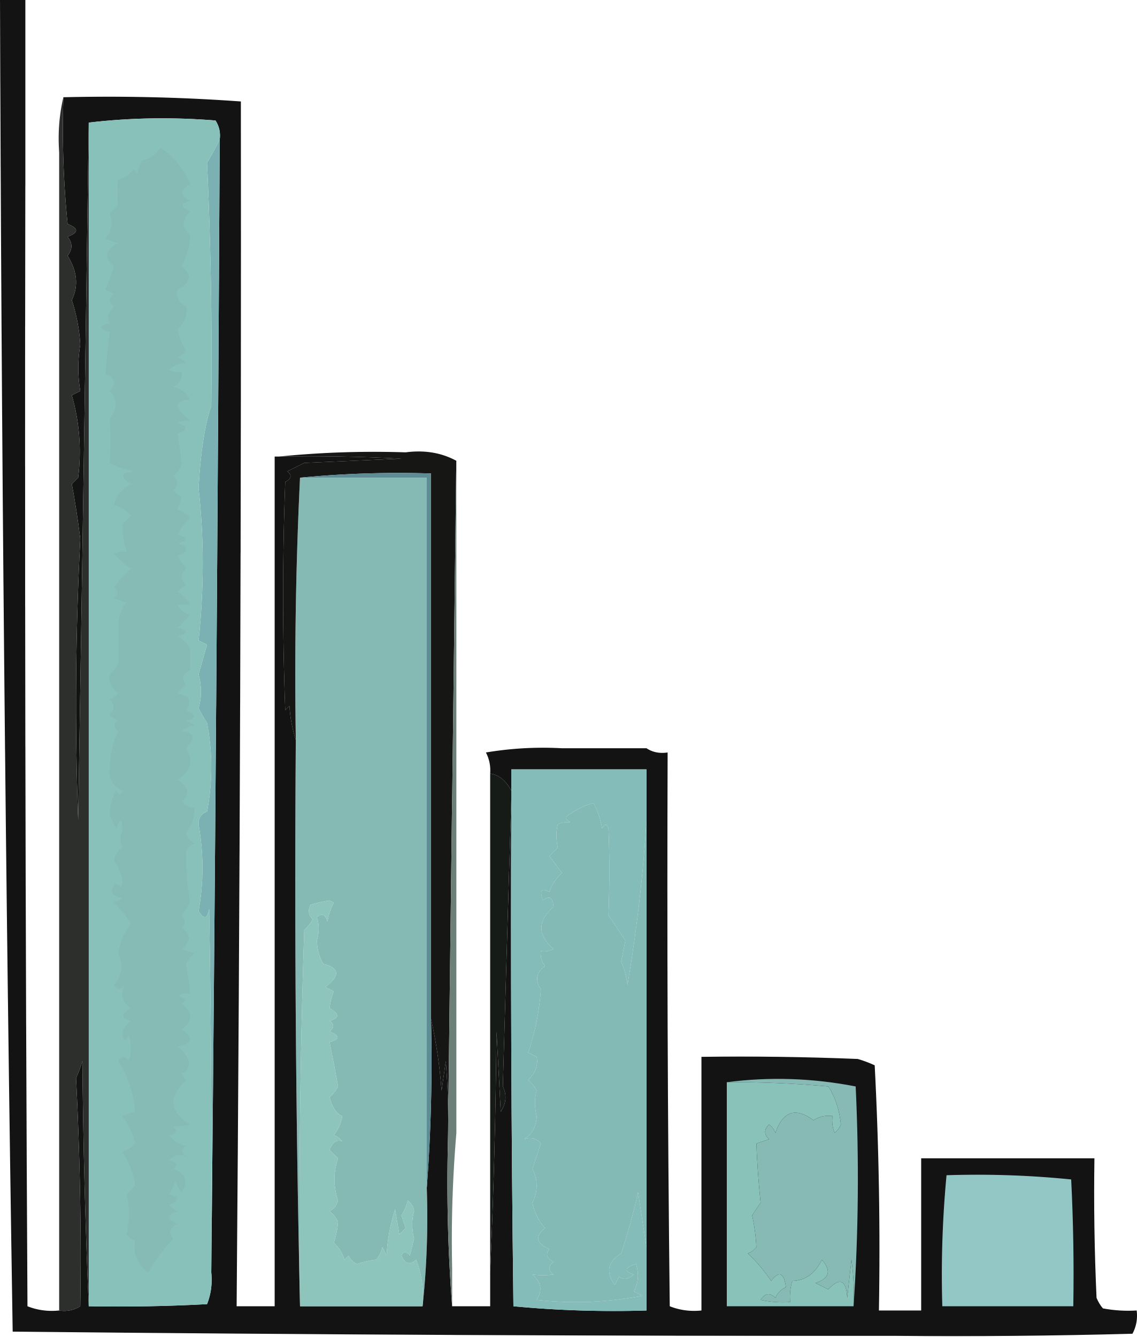





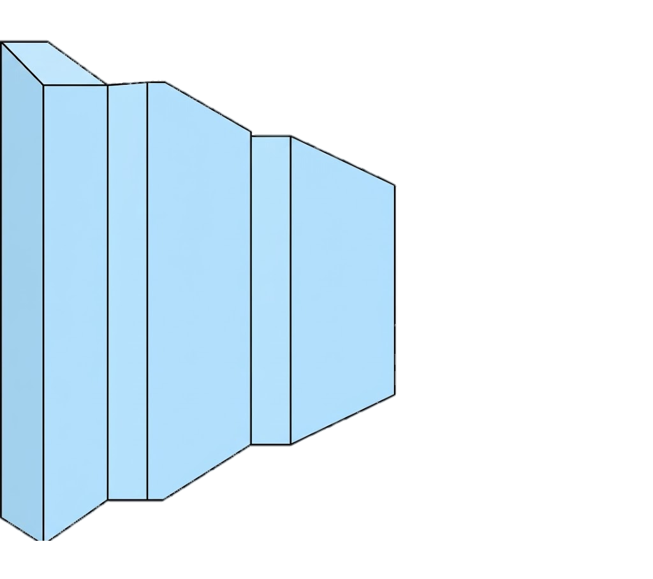
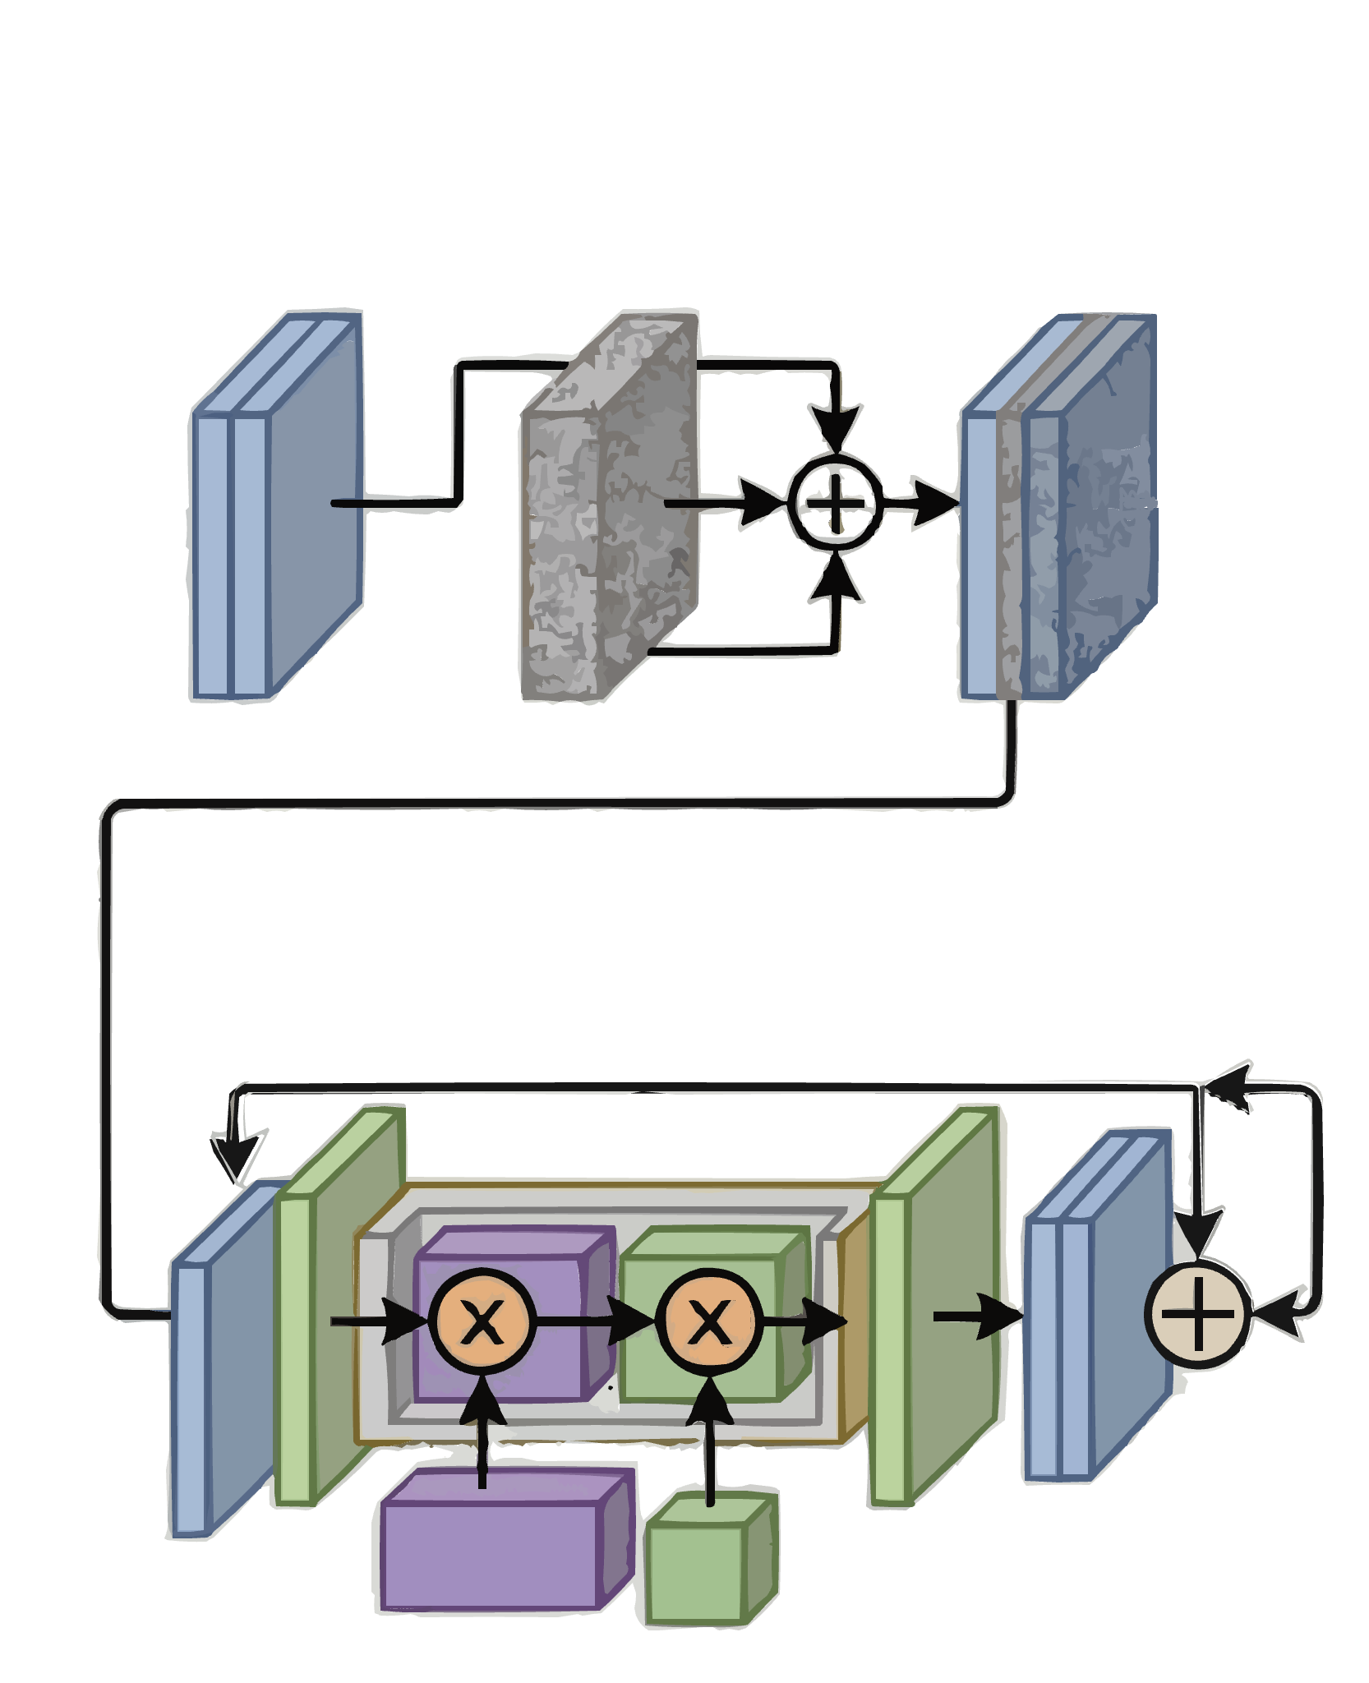
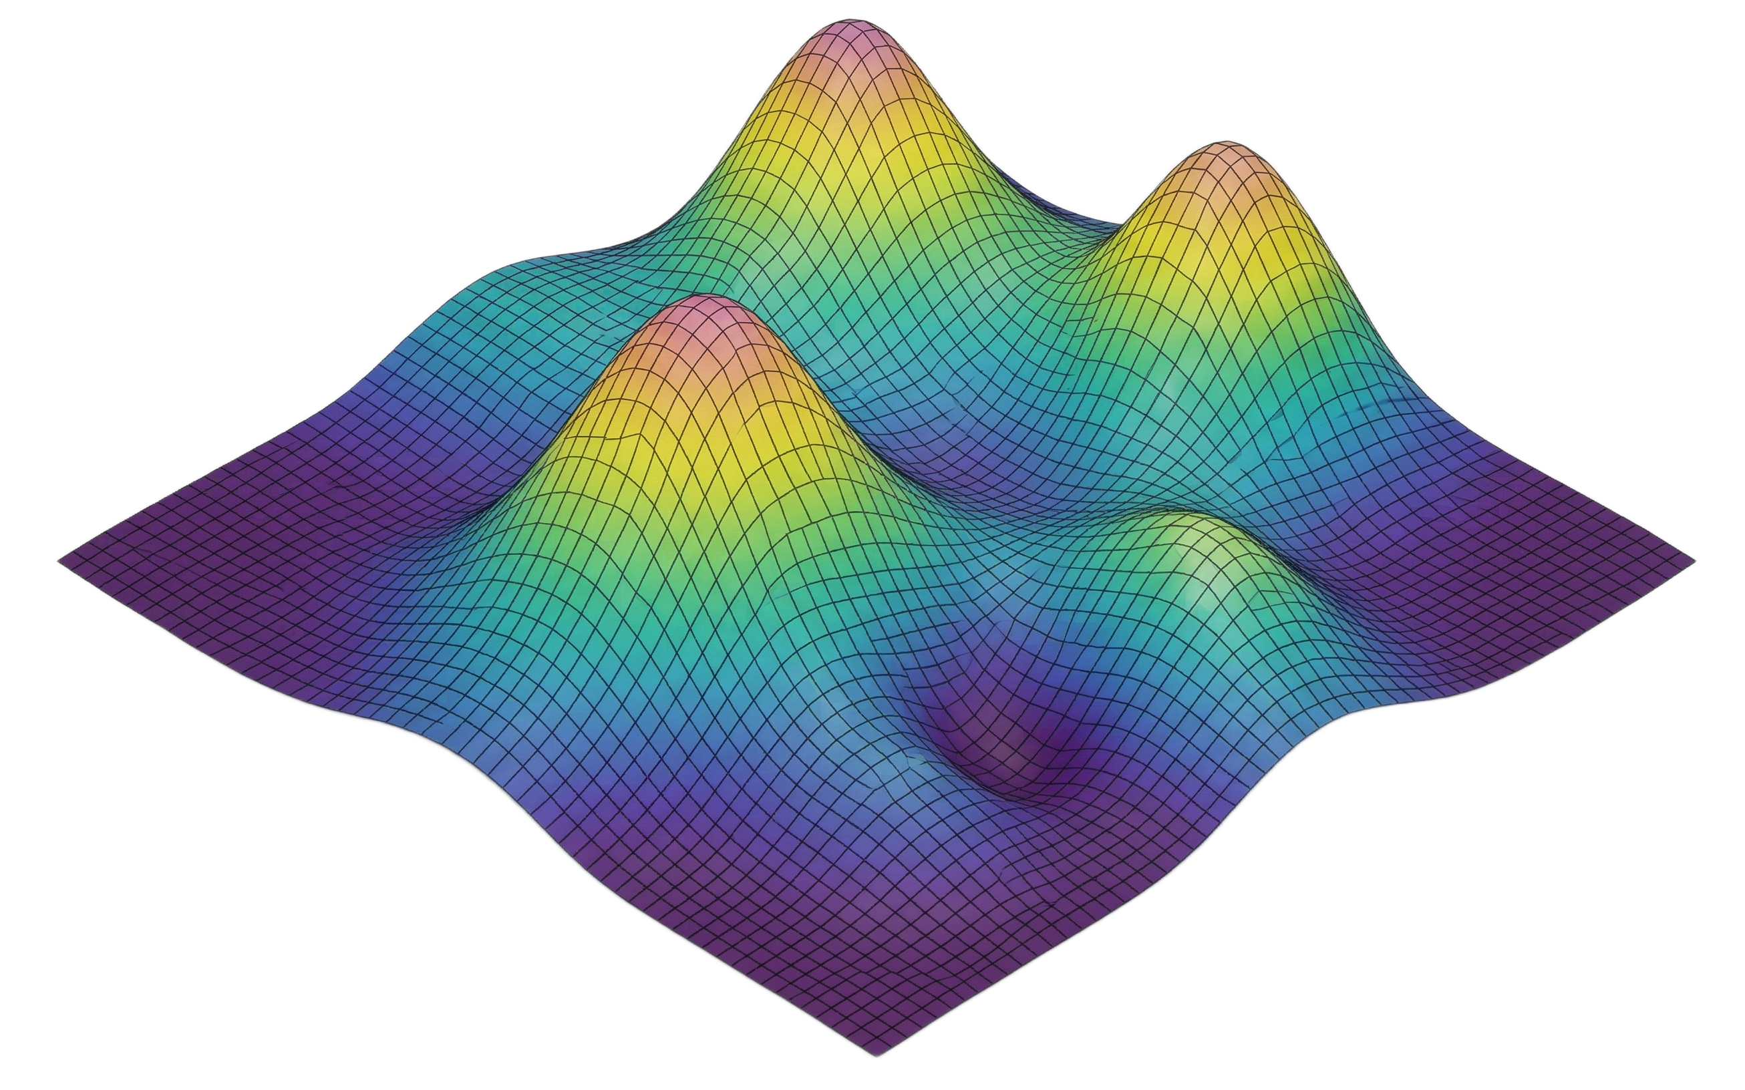

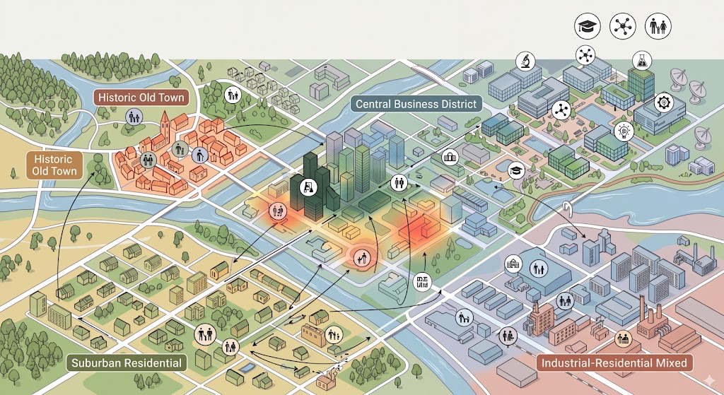

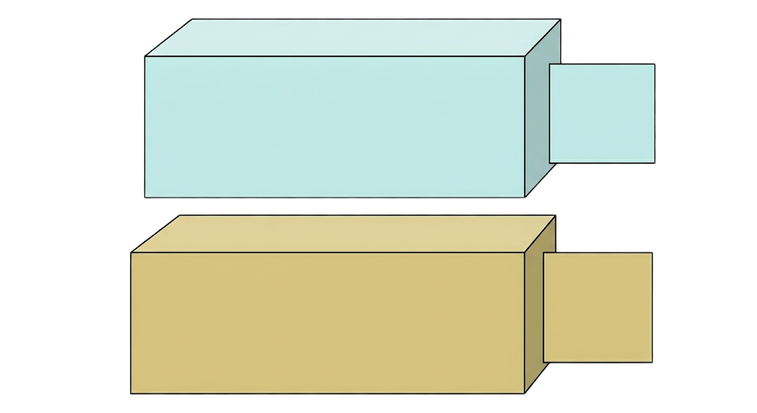
Step1: Regional Targets, Census Summaries and Spatial Data
External Conditions Extracted from Census
Regional Targets Extracted from PUMS Microdata
Spatial Support Data
Age
Sex
Education
Employment
Income
Level
Age
Education
Sex
Employment
Income
Level
Tract-level Census
Road Network
LODES OD Flows
Step2: Hierarchical Joint Distribution Learning
Step3: Synthetic Population Generation and Location Assignment
Training Supervision
PUMA-level 5-attribute Full Joint
Synthetic Population with 5 attributes
1. Age
2. Sex
3. Education
4. Employment
5. Earnings
Stage2: Full-joint Diffusion Model
Stage1: Coarse Structure
Sample
Assign Locations
Coarse Regional Distribution
Point-level Synthetic Population Data
Spatial Location Model

