Slide 1
Hadoop

Slide 2
500G

Slide 3
Google: 20亿
分布式文件系统
A:10
C:67
C:

Slide 4
3:1
7:1
9:1
3:1
3:1
7:1
3:1
3：4
7：2
9：1

Slide 5
30亿，500亿
Map reduce:
  函数式编程API
  运行框架
reduce

Slide 6
1G

Slide 8
20T
Scribe, facebook
flume

Slide 10
JobTracker

Slide 11
Slot:
JobTracker
key1
mapper
reducer1
mapper2
mapper
reducer2
mapper4

Slide 13
Cloud computing
IaaS:
OpenStack
OpenNebular
PaaS
SaaS

Slide 14
海量数据→ 大数据
PageRank
MapReduce: 编程框架
GFS: DFS
20亿条,50TB
Map:
1.1.1.1 1
1.1.1.2 1

Slide 15
Lucene
  Nutch(MapRedue+NDFS)
  Hadoop
    MapReduce
    HDFS

Slide 16
Hadoop
Map
  mapper: map task
Reduce
  reducer: reduce task
JobTracker
TaskTracker
map
map
map
map

Slide 17
shuffle and sort
combiner → partitioner
a
b

Slide 18
100
word 1
a 1
how 1
word 1

Slide 19
20TB
map
key-value
key-value
na 1
na 1
na 0
na 1
na 1234567

Slide 20
A.txt

Slide 21
1GB:64MB

Slide 23
Hadoop
  MapReduce
    编程框架
    运行环境
  HDFS

Slide 24
HDFS
Client
Hive
Pig
Crunch
JobTracker
map
input split1
reduce
part-r-00000
map
input split2
reduce
part-r-00001
map
input split3
Avro (Protocol Buffer, Thrift)
sqoop

Slide 25
namenode
datanode
datanode
datanode
datanode
datanode

Slide 26
flume (ASF)
chukwa (ASF)
scribe (facebook)

Slide 27
Hadoop
  MapReduce
  HDFS
  HBase

Slide 28
RDB
  行式数据库
BigTable, HBase (Data source, Data sink)
  列式数据库

Slide 29
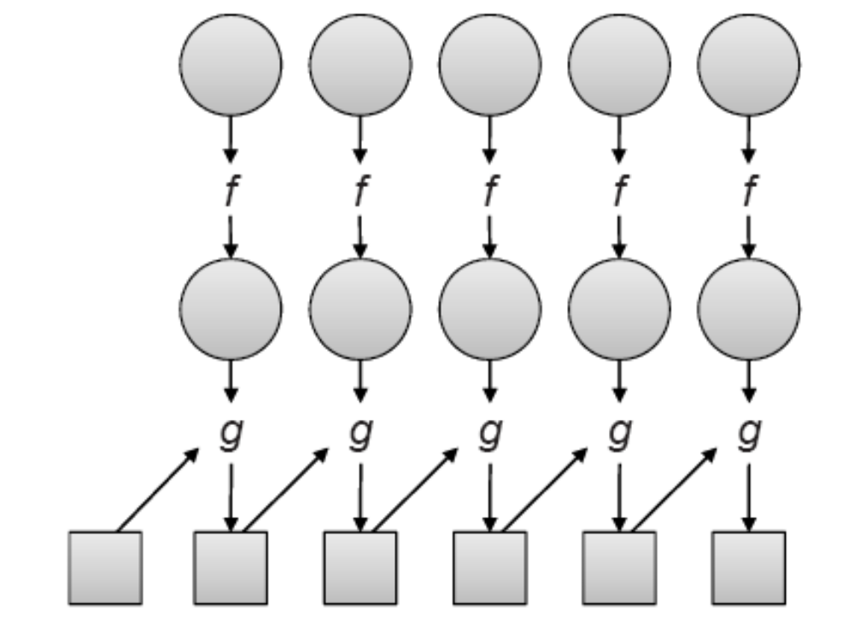
Functional programming

Slide 30
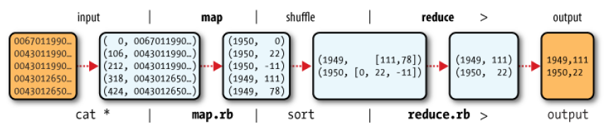

Slide 31
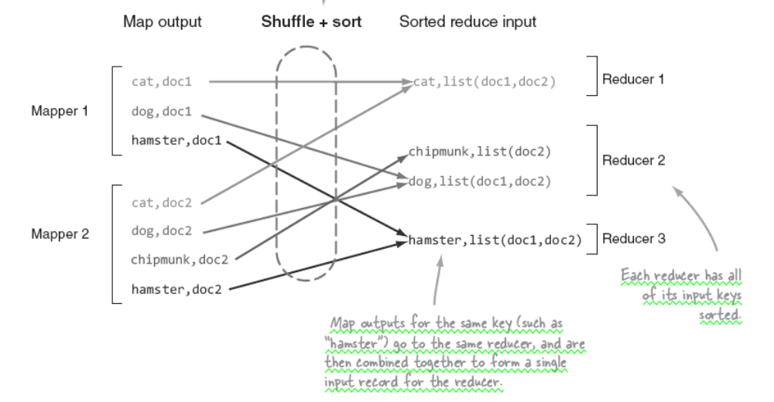

Slide 32
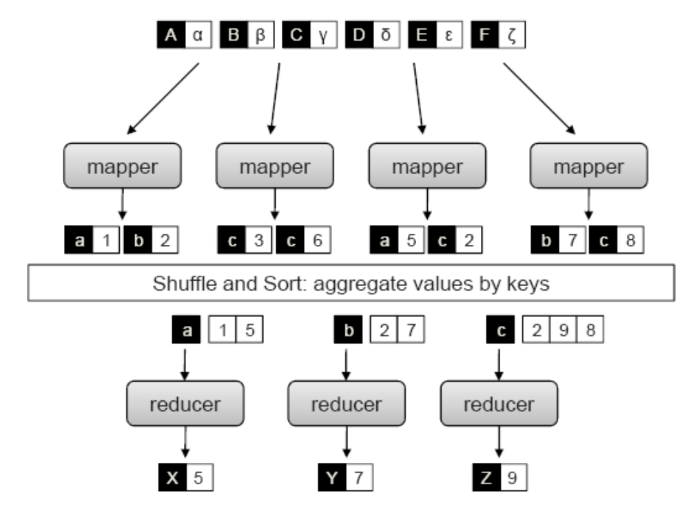
MapReduce

Slide 33
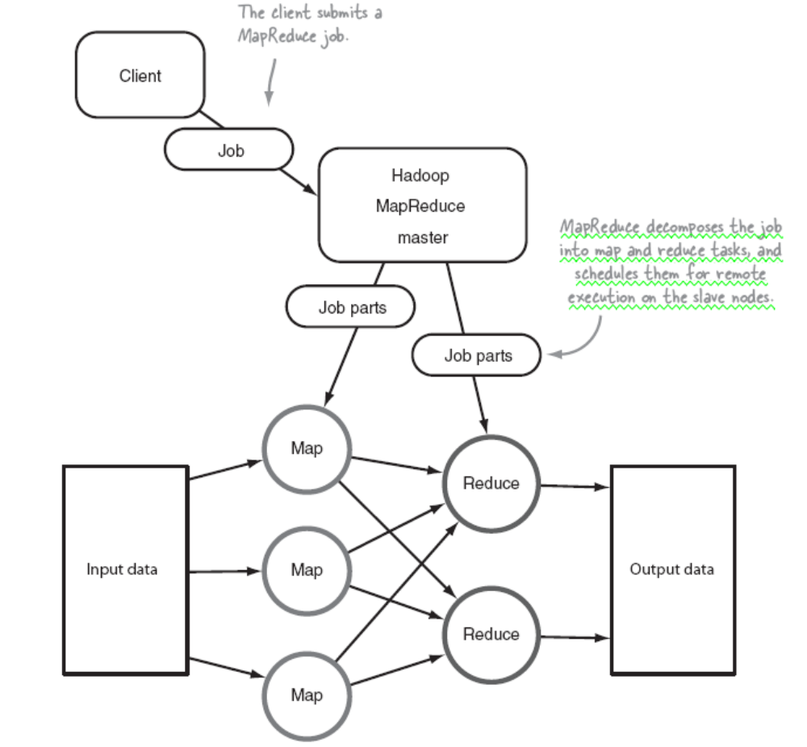

Slide 34
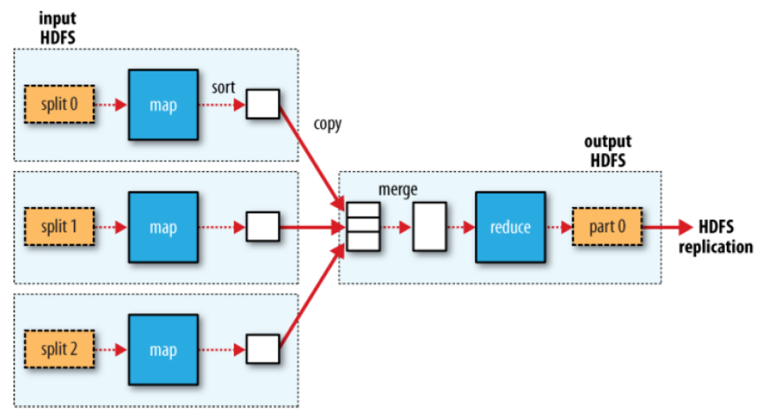

Slide 35
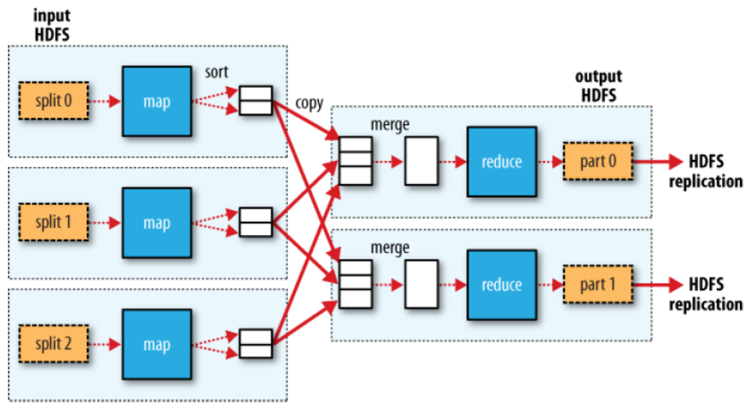

Slide 36
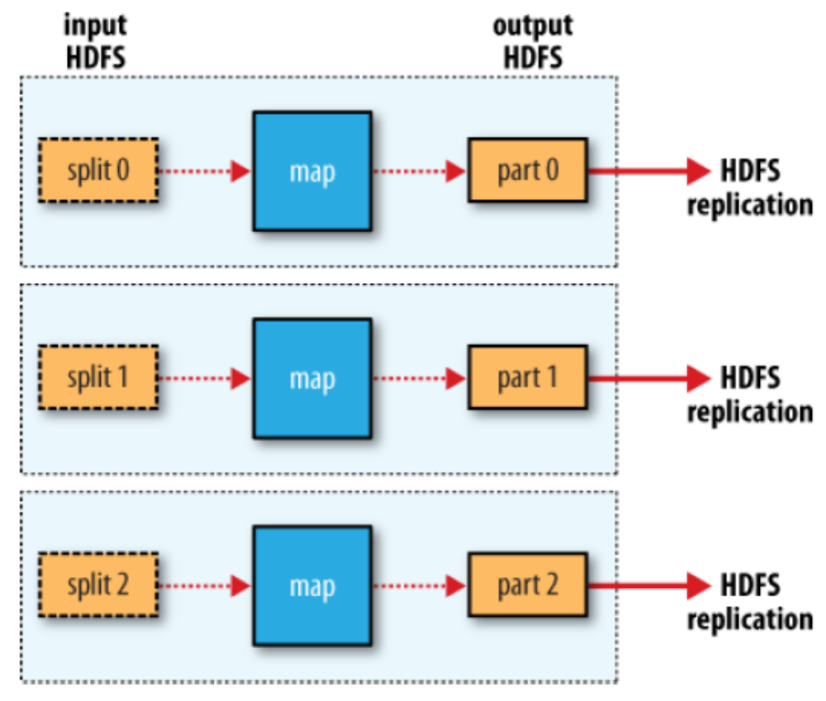

Slide 37
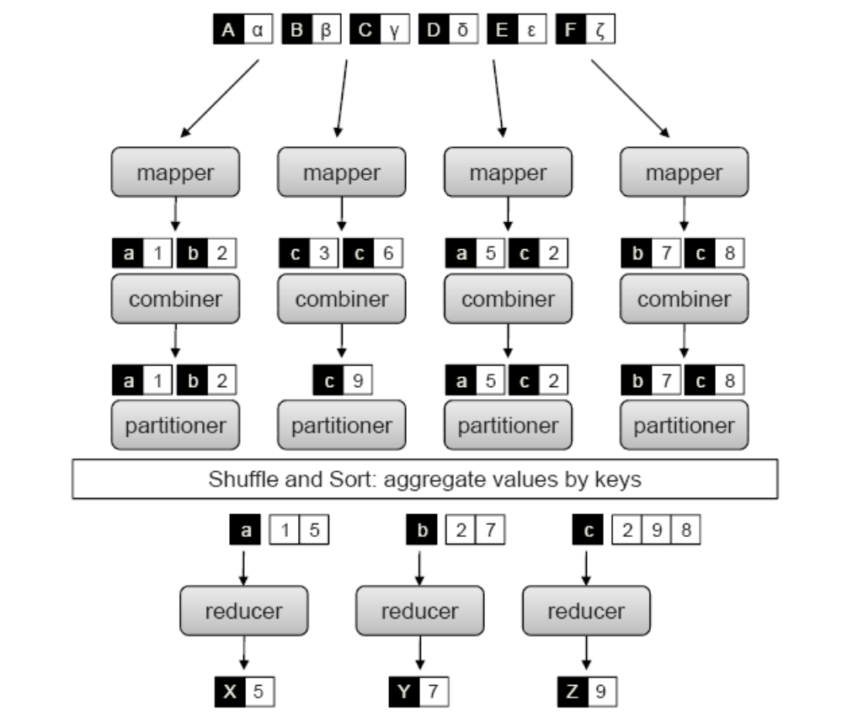
combiner

Slide 38
JobTracker
NameNode
secondaryNameNode
DataNode
TaskTracker
2 map
2 reduce

Slide 39
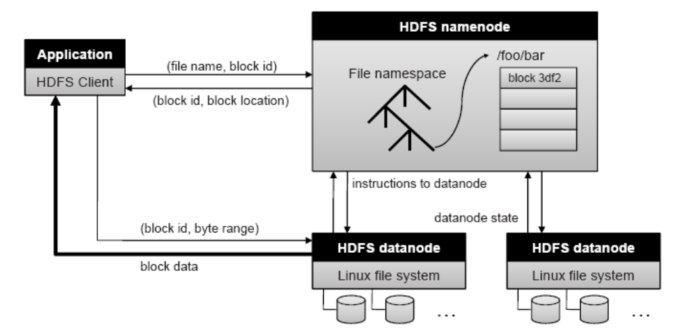
HDFS

Slide 40
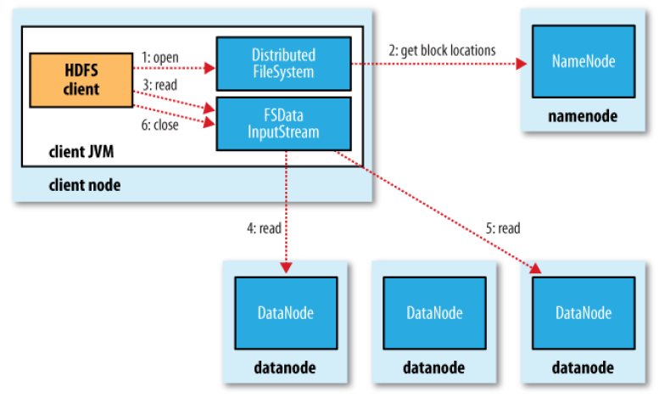
HDFS Read

Slide 41
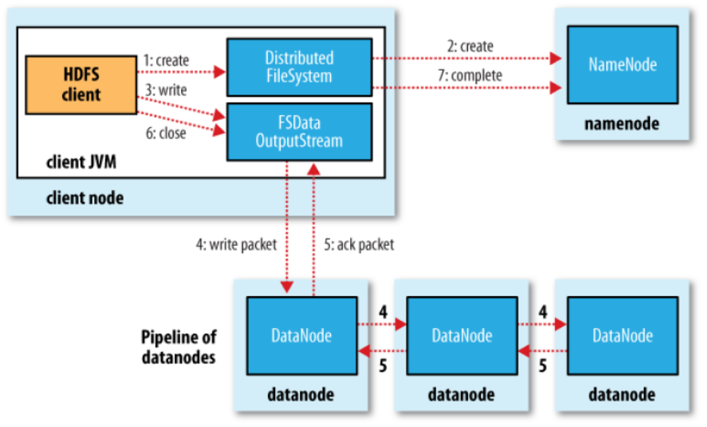
HDFS Write

Slide 42
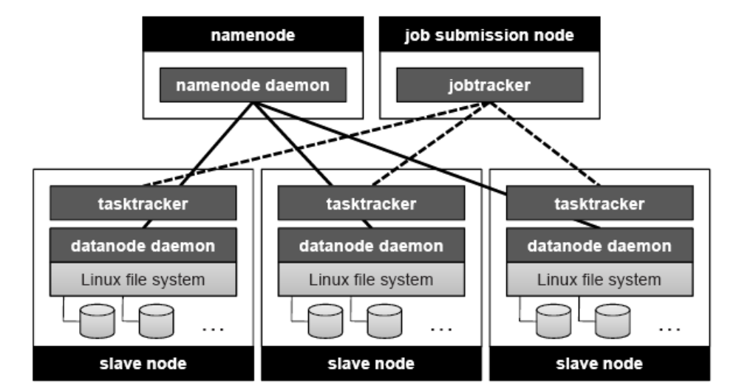
Hadoop

Slide 43
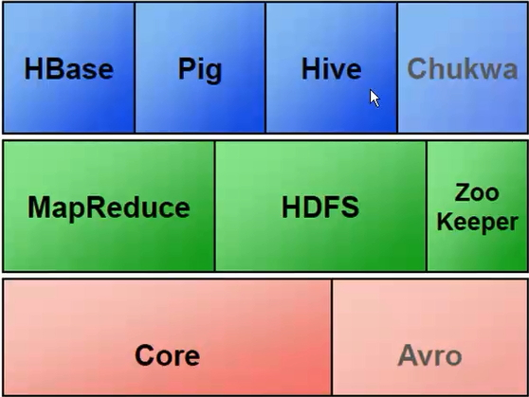

Slide 44
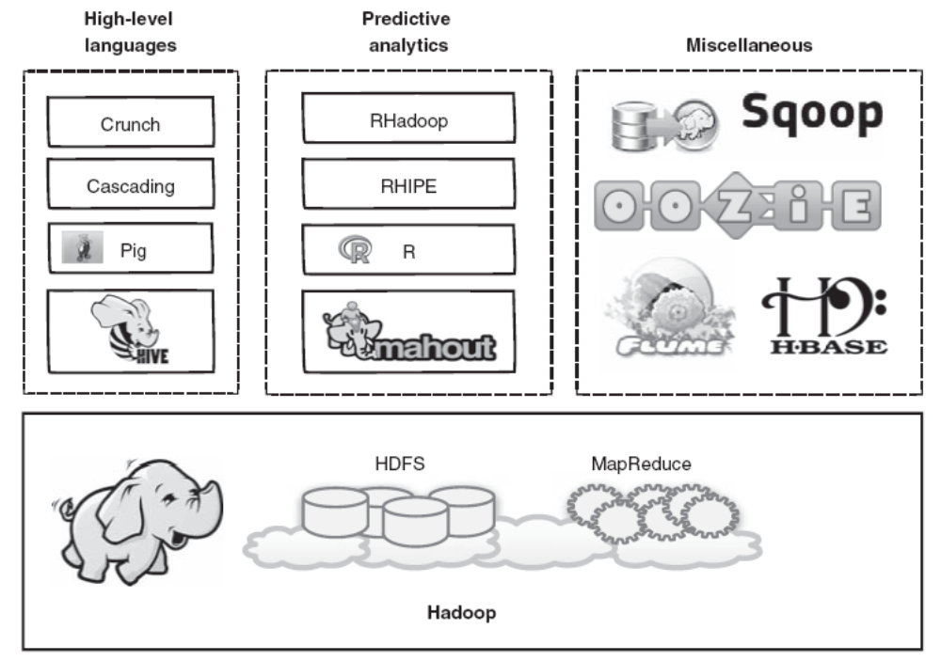

Slide 45
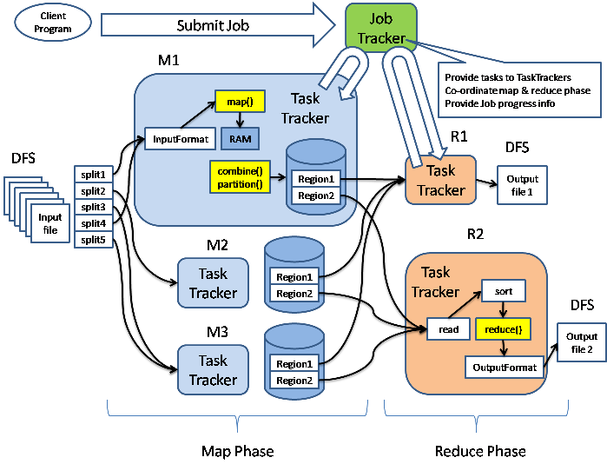

Slide 46
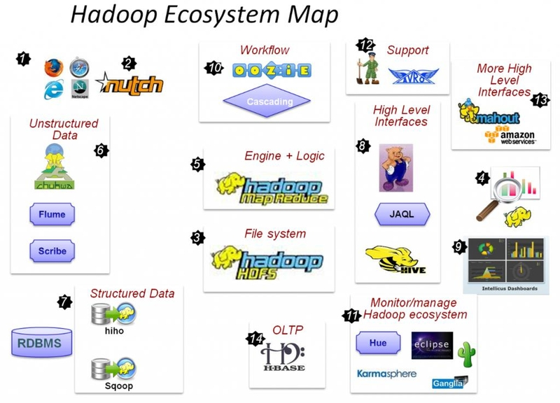
R,RHadoop

Slide 47
Cloudera, CDH
hive

Slide 48
NoSQL: 稀疏格式存储方案
CRUD:
Age: 30
10

Slide 49
0.20.2
  JobTracker
  TaskTracker
  NameNode
  SecondaryNameNode
  DataNode

Slide 51
本地模式
伪分布式模式
完全分布工模式

Slide 52
/hadoop/temp
snn
NameNode
JobTracker
DataNode
TaskTracker

Slide 53
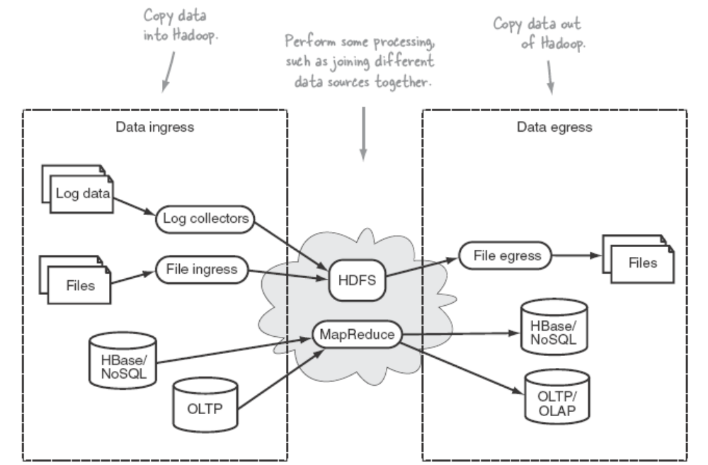
Hadoop data ingress and egress

Slide 54
Key elements of ingress and egress
idempotent
aggregation
data format transformation
recoverability
correctness
resource consumption and performance
monitoring

Slide 55
Moving data into Hadoop
Two primary methods that can be used for moving data into Hadoop
  writing external data at the HDFS level (a data push)
  reading external data at the MapReduce level (more like a pull).

Slide 56
Data sources
Hadoop data ingress across a spectrum of data sources
  log files
  semistructured or binary files
  Databases
  HBase

Slide 57
Pushing log files into Hadoop
Flume, Chukwa, and Scribe are log collecting and distribution frameworks that have the capability to use HDFS as a data sink for that log data

Slide 58
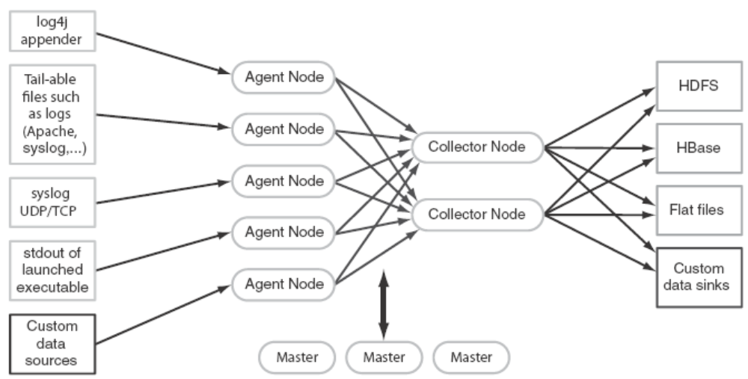
FLUME
A distributed system for collecting streaming data

Slide 59
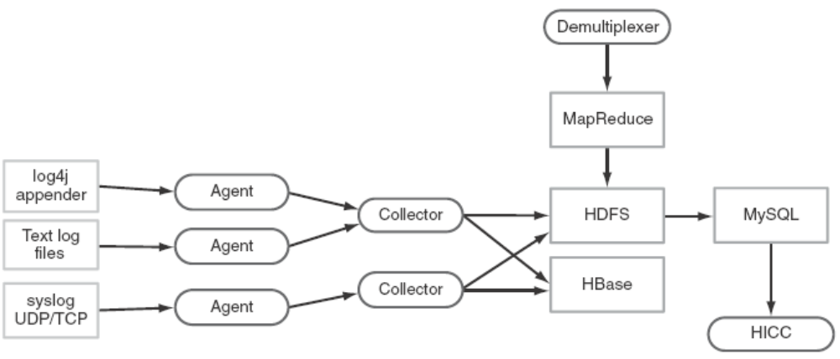
CHUKWA
An Apache subproject of Hadoop that also offers a large-scale mechanism to collect and store data in HDFS

Slide 60
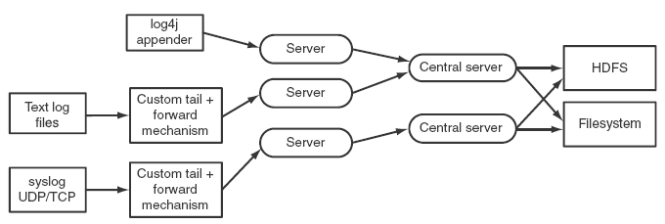
SCRIBE
A rudimentary streaming log distribution service, developed and used heavily by Facebook

Slide 61
Pushing and pulling semistructured and binary files
HDFS File Slurper
  A simple utility that supports copying files from a local directory into HDFS and vice versa

Slide 62
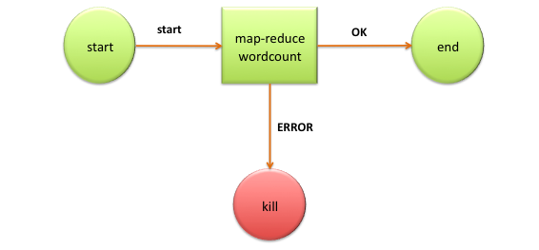
Scheduling regular ingress activities with Oozie
Oozie is a server based Workflow Engine specialized in running workflow jobs with actions that run Hadoop Map/Reduce and Pig jobs

Slide 63

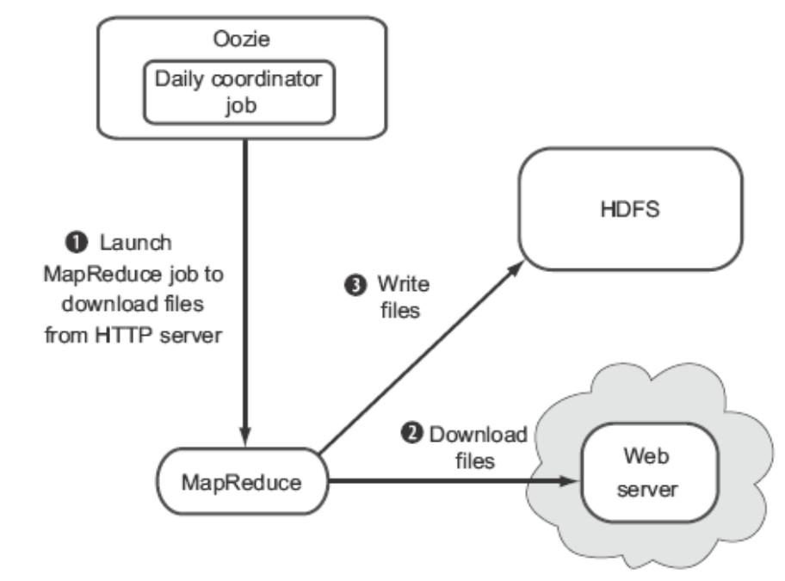
Oozie can be used to ingress data into HDFS, and can also be used to execute postingress activities such as launching a MapReduce job to process the ingressed data

Slide 64
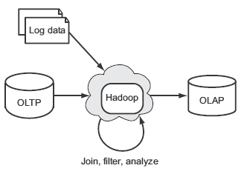
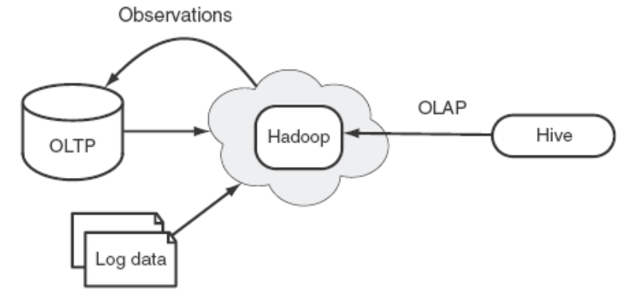
Pulling data from databases
Using Hadoop for data ingress, joining, and egress to OLAP
Using Hadoop for OLAP and feedback to OLTP systems

Slide 65
MapReduce contains DBInputFormat and DBOutputFormat classes, which can be used to read and write data from databases via JDBC
Avro
  A language-neutral data serialization system
  To address the major downside of Hadoop Writables: lack of language portability
  Apache Thrift
  Google’s Protocol Buffers
Notes:
In computer science, in the context of data storage and transmission, serialization, is the process of converting a data structure or object state into a format that can be stored (for example, in a file or memory buffer, or transmitted across a network connection link) and "resurrected" later in the same or another computer environment.[1] When the resulting series of bits is reread according to the serialization format, it can be used to create a semantically identical clone of the original object. For many complex objects, such as those that make extensive use of references, this process is not straightforward. Serialization of object-oriented objects does not include any of their associated methods with which they were previously inextricably linked.
This process of serializing an object is also called deflating or marshalling an object.[2] The opposite operation, extracting a data structure from a series of bytes, is deserialization (which is also called inflating or unmarshalling).

Slide 66
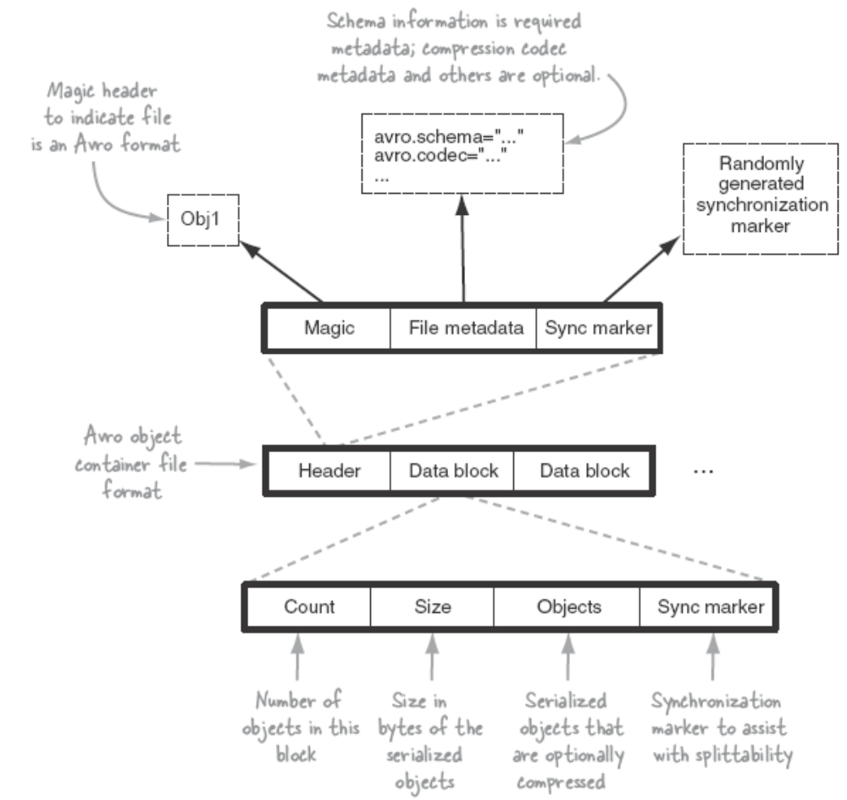
Avro container file format

Slide 67
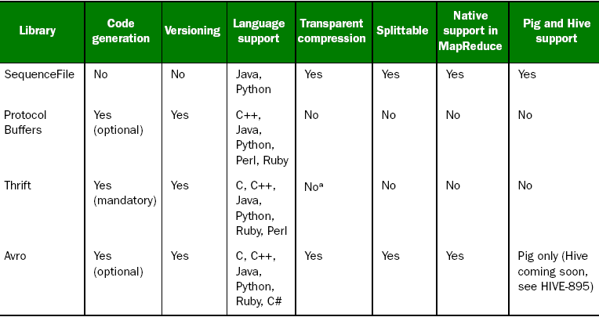
Comparing SequenceFiles, Protocol Buffers, Thrift, and Avro

Slide 68

Using Sqoop to import data from MySQL
A tool designed for efficiently transferring bulk data between Apache Hadoop and structured datastores such as relational databases

Slide 69
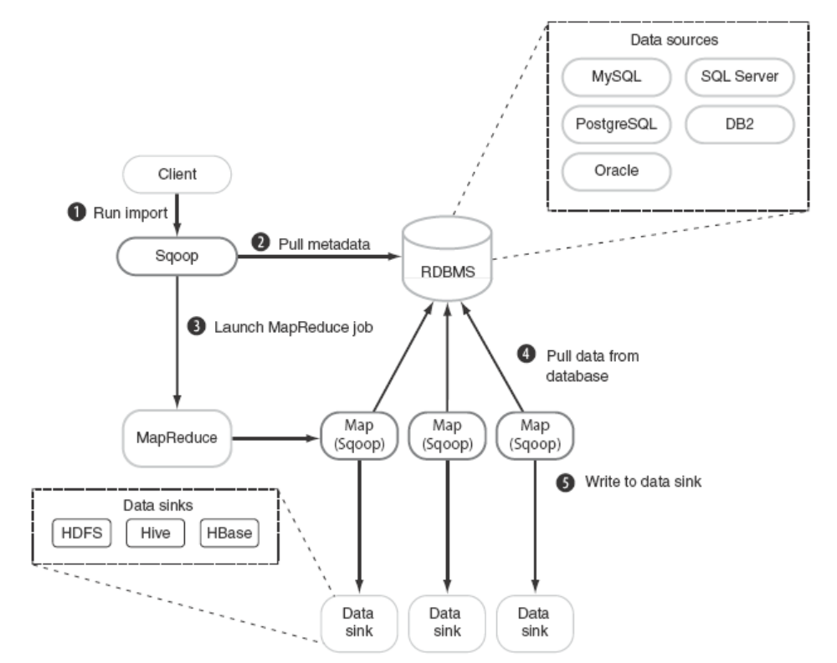
Sqoop import overview

Slide 70
Moving data out of Hadoop
Sqoop
Hbase

Slide 71
