Slide 1
Raid & Mdadm

Slide 2
文件, inode bitmap, block bitmap
super block

Slide 3
4096, 67%, 33%, 10W, 30M
Block
Inode: index node, 128byte: mode, owner, group, timestamp, size, blocks

Slide 4
1000W, 块组
/var/log/a.log
/var/test/ab.log

Slide 5
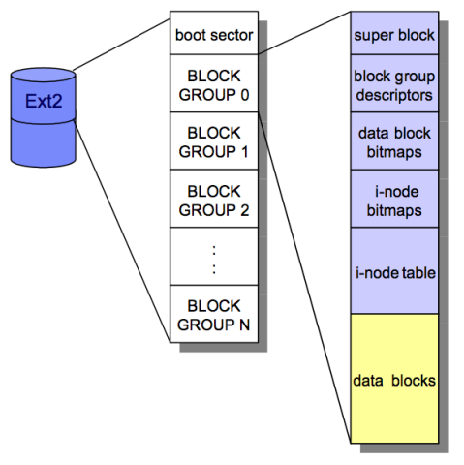
dumpe2fs
MBR:
bootloader
fs table
2

Slide 6
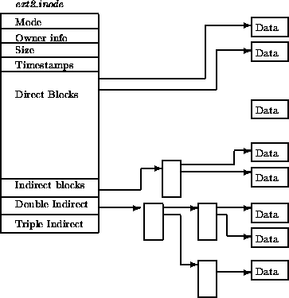

Slide 7
ext2, ext3, ext4
reiserfs, xfs, jfs
GFS2, OCFS2
iso9660
FAT32, NTFS
中间层
VFS

Slide 8
raid: redundant array of independent disks
IDE: 133Mbps
SCSI: 320Mbps
USB: 480Mbps
SATA: 6Gbps
SAS:
  /dev/sd
  /dev/hd
BIOS
冗余

Slide 9
Cat /etc/fstab /etc/inittab
协议
Controller：控制器
Adapter：适配器

Slide 10
MB, Mb
IDE: 133Mbps
SATA: 300Mbps, 600Mbps, 6Gbps
USB 3.0: 480Mbps
SCSI: Small Computer System Interface
  10000, 15000
RAID

Slide 11
Raid Level
IDE(ATA), 133Mbps， 并行
SATA: 6Gbps， 串行
USB: 串行
SCSI: UltraSCSI, 320Mbps, 并行总结
SAS：2.5
RAID：
  IDE
  SCSI

Slide 12
SCSI：8，7target; 16, 15target
SATA
SAS， SCSI
首部
initiator
LUN：Logical Unit Number

Slide 13
硬件RAID
软件RAID

Slide 14
/dev/sda, /dev/sdb
BIOS
  Raid 0
  Raid 1
500G

Slide 15
/dev/sdb, sdc, sdd, sde
md: multi disks
/dev/md0
fd:

Slide 16
RAID的历史
In 1987, Patterson, Gibson and Katz at the University of California Berkeley, published a paper entitled, "A Case for Redundant Arrays of Inexpensive Disks (RAID)."
  This paper described various types of disk arrays, referred to by the acronym RAID. At the time, data was stored largely on large, expensive disk drives (called SLED, or Single Large Expensive Disk). The term inexpensive was used in contrast to that disk implementation. The term RAID has been redefined to refer to independent disks, to reflect the advances in the storage technology.
RAID storage has now grown from an academic concept to an industry standard.
Notes:
Historical Note: In 1987, Patterson, Gibson and Katz at the University of California Berkeley, published a paper entitled, "A Case for Redundant Arrays of Inexpensive Disks (RAID)." This paper described various types of disk arrays, referred to by the acronym RAID. At the time, data was stored largely on large, expensive disk drives (called SLED, or Single Large Expensive Disk). The term inexpensive was used in contrast to that disk implementation. The term RAID has been redefined to refer to independent disks, to reflect the advances in the storage technology.
RAID storage has now grown from an academic concept to an industry standard.

Slide 17
2G
RAID level: 级别
32m

Slide 18
2G, 镜像，mirror RAID 1
RAID 0+1

Slide 19
2G, 镜像，mirror RAID 1
RAID 1+0
1
2
3
1
1

Slide 20
校验码, 2G
1/n
1
2
3
1+2+3
4+5+6
4
5
6
8
7
8

Slide 21
500G, 200G
JBOD
Hadoop
  HDFS

Slide 22

Physical array vs.
Logical array (RAID Set)
Physical Array
Logical Array
RAID
Controller
Logical Array
Host
RAID Array
Notes:
Physical disks inside a RAID array are usually contained in smaller sub-enclosures. These sub-enclosures, or physical arrays, hold a fixed number of physical disks, and may also include other supporting hardware, such as power supplies.
A subset of disks within a RAID array can be grouped to form logical associations called logical arrays, also known as a RAID set. The operating system may see these disk groups as if they were regular disk volumes. Logical arrays facilitate the management of a potentially huge number of disks. For example:
Several physical disks can be concatenated to make large logical volumes (e.g., for databases)
A single physical disk can be divided up to create smaller areas (e.g., for logging)
Note: The number of logical arrays defined depends entirely on the RAID level(s) and the specific vendor implementation. Often, there is a 1:1 ratio of physical arrays to logical arrays. However, you could have a logical array with multiple physical arrays. Or, a physical array with multiple logical arrays.
Generally, the array management software implemented in RAID systems handles:
Management and control of disk aggregations (e.g. volume management)
Translation of I/O requests between the logical and the physical
Error correction if disk failures occur

Slide 23
数据组织：条带技术（Strips and Stripes）
Stripe 1
Stripe 2
Stripe 3
Strips
Strip: 一块磁盘内连续编址的存储块
Strip size (Strip depth): Strip中存储块个数
Stripe: RAID set中所有磁盘里对齐的Strip
Stripe width: RAID set中磁盘数
Stripe size: 磁盘数Stripe width*Strip size
Notes:
RAID sets are made up of disks. Within each disk, there are groups of contiguously addressed blocks, called strips. The set of aligned strips that spans across all the disks within the RAID set is called a stripe.
Strip size (also called stripe depth) describes the number of blocks in a strip, and is the maximum amount of data that will be written to or read from a single disk in the set before the next disk is accessed (assuming that the accessed data starts at the beginning of the strip).
All strips in a stripe have the same number of blocks.
Decreasing strip size means that data is broken into smaller pieces when spread across the disks.
Stripe size describes the number of data blocks in a stripe.
To calculate the stripe size, multiply the strip size by the number of data disks.
Stripe width refers to the number of data strips in a stripe (or, put differently, the number of data disks in a stripe).

Slide 24
RAID性能：分带技术（Striping）
RAID
Controller
LUN
Logical Unit Number
Striping Level:
  Block
  Blocks
  Byte
Host
Logical Array
Notes:
Striping improves performance by distributing data across the disks in the array. This use of multiple independent disks allows multiple reads and writes to take place concurrently.
When a large amount of data is written, the first piece is sent to the first drive, the second piece to the second drive, and so on.
The pieces are put back together again when the data is read.
Striping can occur at the block (or block multiple) level or the byte level. This is determined by the RAID level and the vendor-specific implementation.
Notes on striping:
Increasing the number of drives in the array increases performance because more data can be read or written simultaneously.
A higher stripe width indicates a higher number of drives and therefore better performance.
Striping is generally handled by the controller and is transparent to the host operating system.

Slide 25
RAID冗余：镜像（Mirroring）
RAID
Controller
Mirrored Disk
Host
RAID Array
  优点：快速恢复、改进读性能
  缺点：降低写性能（写到多块盘上）、高费用（镜像盘）
Notes:
A key element in RAID arrays is redundancy to improve fault tolerance. Mirroring uses multiple drives that hold identical copies of the data (usually 2 drives). Every write to a data disk is also a write to the mirror disk(s), meaning that all drives contain the same data. This is transparent to the attached host. If a disk fails, the RAID controller uses the mirror drive for data recovery and continuous operation. Data on a replaced drive is rebuilt from the mirrored drive.
Benefits - fast recovery from a failure and improved read performance
Drawbacks:
Degrades write performance because each block of host data is written to multiple disks
High cost of data protection due to the need for multiple disks

Slide 26
RAID冗余：数据校验（Parity Check）
0
4
8
1
5
9
RAID
Controller
2
6
10
3
Host
7
11
0 1 2 3
4 5 6 7
8 9 10 11
Parity Disk
or Distributed
Notes:
Parity is a redundancy check that ensures that the data is protected without having to have a full set of duplicate drives.
If a single disk in the array fails, the other disks have enough redundant data so that the data from the failed disk can be recovered
Like striping, parity is generally a function of the RAID controller and is transparent to the host .
Parity information can either be:
Stored on a separate, dedicated drive
Distributed with the data across all the drives in the array

Slide 27
数据校验示例
5 + 3 + 4 + 2 = 14
5
Data
3
Data
The middle drive fails:
Data
4
5 + 3 + ? + 2 = 14
? = 14 – 5 – 3 – 2
? = 4
2
Data
14
Parity
RAID Array
Notes:
This example uses arithmetic operations to demonstrate how parity works. It illustrates the concept, but not the actual mechanism.
Think of parity as the sum of the data on the other disks in the RAID set. Each time data is updated, the parity will be updated as well, so that it always reflects the current sum of the data on the other disks.
Note: While parity is calculated on a per stripe basis, the diagram omits this detail for the sake of simplification.
If a disk fails, the value of its data is calculated by using the parity information and the data on the surviving disks.
If the parity disk fails, the value of its data is calculated by using the data disks. Parity will only need to be recalculated, and saved, when the failed disk is replaced with a new disk.
In the event of a disk failure, each request for data from the failed disk requires that the data be recalculated before it can be sent to the host. This recalculation is time-consuming, and will decrease the performance of the RAID set. Hot spare drives, introduced later, provide a way to minimize the disruption caused by a disk failure.

Slide 28
RAID的级别（通常使用的）
RAID 0 ：Striped Array with No Fault Tolerance
RAID 1 ：Disk Mirroring
RAID 3 ：Parallel Access Array with Dedicated Parity Disk
RAID 4 ：Striped Array with Independent Disks and a Dedicated Parity Disk
RAID 5 ：Striped Array with Independent Disks and Distributed Parity
Combinations of levels (i.e., 1 + 0, 0 + 1, etc.)
Notes:
There are some standard RAID configuration levels, each of which has benefits in terms of performance, capacity, data protection, etc.
The discussion will center around the commonly used levels, and commonly used combinations of levels.

Slide 29
RAID 0
– Striped Array with no Fault Tolerance
Block 4
RAID
Controller
Block 3
Block 2
Block 1
Block 0
Block 4
Block 3
Block 2
Block 1
Block 0
Host
vs. JBOD?
Notes:
RAID 0 stripes the data across the drives in the array without generating redundant data.
Performance - better than JBOD because it uses striping. The I/O rate, called throughput, can be very high when I/O sizes are small. Large I/Os will produce high bandwidth (data moved per second) with this RAID type. Performance is further improved when data is striped across multiple controllers with only one drive per controller.
Data Protection – no parity or mirroring means that there is no fault tolerance. Therefore, it is extremely difficult to recover data.
Applications – those that need high bandwidth or high throughput, but where the data is not critical, or can easily be recreated. Temporary storage or spool areas can make use of RAID 0 .

Slide 30
RAID 1 – Disk Mirroring
Block 1
RAID
Controller
Block 0
Block 1
Block 1
Block 0
Block 0
Host
Notes:
RAID 1 uses mirroring to improve fault tolerance. A RAID 1 group consists of 2 (typically) or more disk modules. Every write to a data disk is also a write to the mirror disk(s). This is transparent to the host. If a disk fails, the disk array controller uses the mirror drive for data recovery and continuous operation. Data on the replaced drive is rebuilt from the mirror drive.
Benefits - high data availability and high I/O rate (small block size).
Drawbacks - total number of disks in the array equaling 2 times the data (useable) disks. This means that the overhead cost equals 100%, while usable storage capacity is 50%.
Performance – improves read performance, but degrades write performance
Data Protection - improved fault tolerance over RAID 0
Disks – at least two disks
Cost – expensive due to the extra capacity required to duplicate data
Maintenance - low complexity
Applications - accounting, payroll, finance, and applications requiring high availability

Slide 31
RAID 0+1 – Striping and Mirroring
Block 3
RAID
Controller
Block 2
Block 1
Block 0
Block 3
Block 3
Block 2
Block 2
Block 1
Block 1
Block 0
Block 0
Host
Notes:
RAID 0+1 is one way of combining the speed of RAID 0 with the redundancy of RAID 1. RAID 0+1 is implemented as a mirrored array whose basic elements are RAID 0 stripes.
Benefits - medium data availability, high I/O rate (small block size), and the ability to withstand multiple drive failures as long as they occur on the same stripe.
Drawbacks - total number of disks equal two times the data disks, with overhead cost equaling 100%
Performance - high I/O rates; writes are slower than reads because of mirroring
Data Protection - medium reliability
Disks - even number of disks (4 disk minimum to allow striping)
Cost - very expensive because of the high overhead
Applications – imaging and general file server

Slide 32
RAID 1+0 – Mirroring and Striping
Block 3
RAID
Controller
Block 2
Block 1
Block 0
Block 3
Block 3
Block 2
Block 2
Block 1
Block 1
Block 0
Block 0
Host
Notes:
RAID 1+0 (or RAID 10, RAID 1/0, or RAID A) also combines the speed of RAID 0 with the redundancy of RAID 1, but it is implemented a different manner than RAID 0+1. RAID 1+0 is a striped array whose individual elements are RAID 1 arrays - mirrors.
Benefits - high data availability, high I/O rate (small block size), and the ability to withstand multiple drive failures as long as they occur on different mirrors.
Drawbacks - total number of disks equal two times the data disks, with overhead cost equaling 100%
Data Protection - high reliability.
Disks - even number of disks (4 disk minimum, to allow striping)
Cost - very expensive, because of the high overhead
Performance: High I/O rates achieved using multiple stripe segments. Writes are slower than reads, because they are mirrored
Applications – databases requiring high I/O rates with random data, and applications requiring maximum data availability

Slide 33
RAID 0+1 vs. RAID 1+0
通常情况下，具有相同的优点。
但在恢复（Rebuild ）操作时，存在很大的不同：
  RAID 1+0 uses a mirrored pair – only 1 disk is rebuilt if a disk fails
  RAID 0+1 if a single drive fails, the entire stripe is faulted
    RAID is 0+1 is a poorer solution and is less common
Notes:
Do not confuse RAID 1+0 with RAID 0+1. The benefits offered by theses combinations of RAID level are identical while all the disks are operating normally. If a failure occurs, however, the rebuild operations are very different.
RAID 1+0 has a mirrored pair as its basic element. If a drive fails and is replaced, only the mirror needs to be rebuilt. In other words, the disk array controller uses the surviving drive in the mirrored pair for data recovery and continuous operation. Data from one surviving disk will be copied to the replacement disk.
Note: If there is a hot spare, data is rebuilt onto the hot spare from the surviving drive in the mirrored pair . When the failed disk is replaced, data from the surviving drive in the mirrored pair is used to rebuild the data on the replaced disk.
RAID 0+1 uses a stripe as its basic element. The stripe has no protection (RAID 0). If a single drive fails, the entire stripe is faulted, meaning that only half the disks in the RAID set are available for data access. A rebuild operation rebuilds the entire stripe, copying data from each disk in the healthy stripe to the equivalent disk in the failed stripe. This causes increased, and unneeded, I/O load on the backend, and also makes the RAID set more vulnerable to a second disk failure.
RAID 0+1 is less common than RAID 1+0, and is a poorer solution.

Slide 34
RAID 3
- Parallel Transfer with Dedicated Parity Disk
Block 3
RAID
Controller
Block 2
Block 1
Block 0
Block 0
Block 1
Parity
Generated
Block 2
Host
Block 3
P 0 1 2 3
RAID 3 always reads and writes complete stripes of data across all the disks.
Notes:
RAID Level 3 stripes data for high performance and uses parity for improved fault tolerance. Data is striped across all the disks but one in the array. Parity information is stored on a dedicated drive, so that data can be reconstructed if a drive fails.
RAID 3 always reads and writes complete stripes of data across all the disks. There are no partial writes that update one out of many strips in a stripe.
Benefits - the total number of disks is less than in a mirrored solution (e.g. 1.25 times the data disks for group of 5), good bandwidth on large data transfers
Drawbacks - poor efficiency in handling small data blocks. This makes it not well suited to transaction processing applications. Data is lost if multiple drives fail within the same RAID 3 Group.
Performance - high data read/write transfer rate. Disk failure has a significant impact on throughput. Rebuilds are slow.
Data Protection - uses parity for improved fault tolerance
Striping – byte level to multiple block level, depending on vendor implementation.
Applications - applications where large sequential data accesses are used such as medical and geographic imaging

Slide 35
RAID 4
- Striping with Dedicated Parity Disk
Block 0
Block 0
Block 4
Block 1
Block 5
Parity
Generated
Block 2
Block 0
RAID
Controller
Block 0
Block 6
P 0 1 2 3
Block 3
Host
Block 7
P 0 1 2 3
P 0 1 2 3
P 4 5 6 7
The data disks are independently accessible,
Multiple reads and writes can occur simultaneously.
Notes:
RAID Level 4 stripes data for high performance and uses parity for improved fault tolerance. Data is striped across all the disks but one in the array. Parity information is stored on a dedicated disk so that data can be reconstructed if a drive fails.
The data disks are independently accessible, and multiple reads and writes can occur simultaneously.
Benefits - the total number of disks is less than in a mirrored solution (e.g., 1.25 times the data disks for group of 5), good read throughput, and reasonable write throughput.
Drawbacks – the dedicated parity drive can be a bottleneck when handling small data writes. This RAID level is not well suited to transaction processing applications. Data loss if multiple drives fail within the same RAID 4 Group.
Performance - high data read transfer rate. Poor to medium write transfer rate. Disk failure has a significant impact on throughput
Data Protection - uses parity for improved fault tolerance.
Striping – usually at the block (or block multiple) level
Applications – general purpose file storage
RAID 4 is much less commonly used than RAID 5, discussed next. The dedicated parity drive is a bottleneck, especially when a disk failure has occurred.

Slide 36
RAID 5
- Independent Disks with Distributed Parity
Block 0
Block 0
Block 4
Block 4
Block 1
Block 5
Parity
Generated
Block 2
Parity
Generated
Block 4
RAID
Controller
Block 0
Block 0
Block 4
Block 6
P 0 1 2 3
P 4 5 6 7
Block 3
Host
P 4 5 6 7
P 4 5 6 7
P 0 1 2 3
P 0 1 2 3
Block 7
Notes:
RAID 5 does not read and write data to all disks in parallel like RAID 3. Instead, it performs independent read and write operations. There is no dedicated parity drive; data and parity information is distributed across all drives in the group.
Benefits - the most versatile RAID level. A transfer rate greater than that of a single drive but with a high overall I/O rate. Good for parallel processing (multi-tasking) applications/environments. Cost savings due to the use of parity over mirroring.
Drawbacks - slower transfer rate than RAID 3. Small writes are slow, because they require a read-modify-write (RMW) operation. There is degradation in performance in recovery and reconstruction modes and data loss if multiple drives within the same group are lost.
Performance - high read data transaction rate, medium write data transaction rate. Low ratio of parity disks to data disks. Good aggregate transfer rate
Data Protection - single disk failure puts volume in degraded mode. Difficult to rebuild (as compared to RAID level 1).
Disks - 5-disk and 9-disk groups are popular. Most implementations allow other RAID set sizes.
Striping – block level, or multiple block level
Applications - file and application servers, database servers, WWW, email, and News servers

Slide 37
RAID实现
硬件实现 ( 通常是一块特殊的磁盘控制器卡 )
  Controls all drives that are attached it
  Performs all RAID-related functions including volume management
  Array(s) appear to the host operating system as a regular disk drive
  Dedicated cache to improve performance
  Generally provides some type of administrative software
软件实现
  Generally runs as part of the operating system
  Volume management and performed by the server
  Provides more flexibility for hardware, which can reduce the cost
  Performance is dependent on CPU load & server performance
  Has limited functionality
Notes:
As a broad distinction, hardware RAID is implemented by intelligent storage systems external to the host, or, at minimum, intelligent controllers in the host that offload the RAID management functions from the host.
Software RAID usually describes RAID that is managed by the host CPU. The disadvantage of software RAID is that is uses host CPU cycles that would be better utilized to process application data. In addition, many host CPUs and operating systems do not perform I/O functions very efficiently, so the host is ill-suited for the task. Software RAID often looks attractive initially because it does not require the purchase of additional hardware. The initial cost savings are soon exceeded by the expense of using a costly server to perform I/O operations that it performs inefficiently at best.

Slide 38

热备份（Hot Spares）
RAID
Controller
Parity or Mirror
Automatic or User initiated
Notes:
A hot spare is an idle component (often a drive) in a RAID array that becomes a temporary replacement for a failed component. For example:
The hot spare takes the failed drive’s identity in the array.
Data recovery takes place. How this happens is based on the RAID implementation:
If parity was used, data will be rebuilt onto the hot spare from the parity and data on the surviving drives.
If mirroring was used, data will be rebuilt using the data from the surviving mirrored drive.
The failed drive is replaced with a new drive at some time later.
One of the following occurs:
The hot spare replaces the new drive permanently—meaning that it is no longer a hot spare and a new hot spare must be configured on the system.
When the new drive is added to the system, data from the hot spare is copied to the new drive. The hot spare returns to its idle state, ready to replace the next failed drive.
Note: The hot spare drive needs to be large enough to accommodate the data from the failed drive
Hot spare replacement can be:
Automatic - when a disk’s recoverable error rates exceed a predetermined threshold, the disk subsystem tries to copy data from the failing disk to a spare one. If this task completes before the damaged disk fails, the subsystem switches to the spare and marks the failing disk unusable. (If not it uses parity or the mirrored disk to recover the data, as appropriate).
User initiated - the administrator tells the system when to do the rebuild. This gives the administrator control (e.g., rebuild overnight so as not to degrade system performance), however, the system is vulnerable to another failure because the hot spare is now unavailable. Some systems implement multiple hot spares to improve availability.

Slide 40
raid0, raid1, raid4, raid5, raid6, raid10, raid50
raid0: 条带
10%
读/写性能都线性增加
没有容错能力
N*disk

Slide 41
raid 1 镜像
线上业务不中止
数据不丢失
写入性能没有提升
读取性能提升
1*DISK

Slide 42
raid4
4
3
2
1
n-1
n-1
n-1
(n-1)*disk

Slide 43
raid5
6
5
3
4
1
2
n-1
n-1
n-1
(n-1)*disk

Slide 44
raid10
1
1

Slide 45
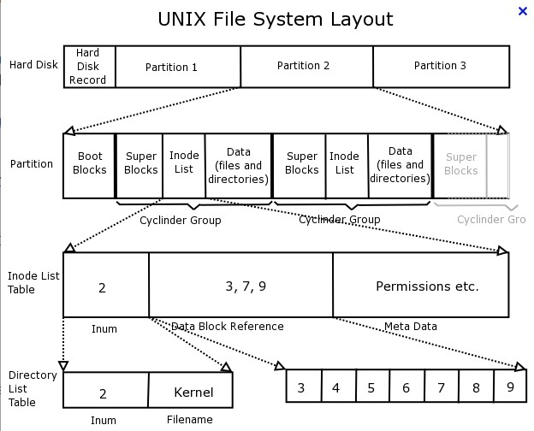

Slide 46
RAID
SCSI: Small Computer System Interface
  Parallel
  UltraSCSI: 320M/s
    10000RPS, 15000
  IDE: 133M/s
    5400, 7200
raid
  Redundant Array Inexpensive Disks

Slide 47
RAID
  Redundant Array Independent Disks
Level
  0,1,2,3,4,5,6,7, 10, 50
  0,1,5,6,10,50

Slide 50
RAID:
/data
  rm mytab.myd

Slide 51
md: 内核，用户

Slide 52
mdadm
  /etc/mdadm.conf
/dev/md0, /dev/md1
App
md

Slide 53
可以是任意块设备
  分区
  /dev/sdb1, /dev/sdb2

Slide 54
md: Multi Disks
软件：RAID
硬件：RAID

Slide 55
IDE
SCSI
  Raid
  Redundant Array of Inexpensive Disks

Slide 56
Level
  Raid0
  …
  Raid7
  Raid10
  raid50

Slide 57
SCSI, → RAID
RAID:
  Independent

Slide 58
Raid1, 4, 5, 6, 10
Raid0, 4, 5, 6, 10
Liner:
  100
  60G-60g = 120G

Slide 59
hard
  /dev/sd
Soft
  /dev/md#

Slide 60
IDE: 133m/s
USB2.0, 13, 4
Usb3.0, 100+, 30
Sata: 300M/S, 600M/S
SCSI: 300+m/s
ftp://

Slide 61
RAID: Redundant Array of Inexpensive Disks
Independent
RAID Adapter

Slide 62
Ide:133M/S, 200m/S

Slide 63
133m/s, >=3, (n-2)/n
10m
A
B
C
D

Slide 64
BIOS
RIAD → 3

Slide 65
Software Adapter
  md: multidisk
  /dev/md0
mdadm

Slide 66
user space
  disk1 + disk2 = raid
kernel space
  disk1 + disk2 = raid
  md
mdadm

Slide 67
RAID
  IDE,ATA PARA 133M/s 7200/m 5400/m
  SCSI<->10%
  I/O ,SCSI,
Redundent Array Inexpensive Disks
RAID卡
Redundent Array Independent Disks

Slide 68
RAID Level
  linear：
  raid0:
  raid1:
  raid4:
  raid5:
  raid6:
  raid7:
  raid10
Software RAID

Slide 69
Level:
  仅是区别磁盘的不同组合方式
  RAID0-7，RAID10，linear,串接

Slide 70
linear:
  20G, 60G, 80G
RAID0→ performance
  2+
RAID1
  2+
RAID4 → RAID5
  3+
RAID6

Slide 71
RAID10
RAID01

Slide 72
内核模块，软件驱动
multi disk, md
/dev/md#
raid0, /dev/md5
mdadm
可以是任意块设备

Slide 73
Linux S RAID Overview
RAID devices are virtual devices created from two or more real block devices.
This allows multiple devices (typically disk drives or partitions thereof) to be combined into a single device to hold (for example) a single filesystem.
Linux Software RAID devices are implemented through the md (Multiple Devices) device driver.
Currently, Linux supports LINEAR md devices, RAID0 (striping), RAID1 (mirroring), RAID4, RAID5, RAID6, RAID10.

Slide 74
120G
80
80

Slide 75
SYNOPSIS
mdadm - manage MD devices aka Linux Software RAID
  Also Known As
mdadm [mode] <raiddevice> [options] <component-devices>
  mdadm

Slide 76
MODES
  Assemble
  Create
  Follow or Monitor
  Grow
  Manage
OPTIONS

Slide 77
MODES
Assemble
  Assemble the components of a previously created array into an active array.
  Components can be explicitly given or can be searched for.
Create
  Create a new array with per-device superblocks.
Follow or Monitor
  Monitor one or more md devices and act on any state changes.
  only meaningful for raid1, 4, 5, 6, 10
    raid0 or linear never have missing, spare, or failed drives, so there is nothing to monitor

Slide 78
STOP

Slide 79
Modes(2)
Grow
  Grow (or shrink) an array, or otherwise reshape it in some way.
  Currently supported growth options include changing the active size of component devices and changing the number of active devices in RAID levels 1/4/5/6.
Manage
  This is for doing things to specific components of an array such as adding new spares and removing faulty devices.

Slide 80
OPTIONS
Options for selecting a mode
  -A, --assemble
    Assemble a pre-existing array.
  -C, --create
    Create a new array.
  -F, --follow, --monitor
    Select Monitor mode.
  -G, --grow
    Change the size or shape of an active array.
If a device is given before any options, or if the first option is --add, --fail, or --remove, then the MANAGE mode is assumed.

Slide 81
Options that are not mode-specific
-v, --verbose
  Be more verbose about what is happening.
  only affects --detail --scan and --examine –scan
-s, --scan
  Scan config file or /proc/mdstat for missing information.

Slide 82
Options for create, or grow
-n, --raid-devices=
  Specify the number of active devices in the array.
  Setting a value of 1 is probably a mistake and so requires that --force be specified first.
  This number can only be changed using --grow for RAID1, RAID5 and RAID6 arrays.
-x, --spare-devices=
  Specify the number of spare (eXtra) devices in the initial array.
  The number of component devices listed on the command line must equal the number of raid devices plus the number of spare devices.

Slide 83
-c, --chunk=
  Specify chunk size in kibibytes. The default is 64.
-l, --level=
  When used with --create, options are: linear, raid0, 0, stripe, raid1, 1, mirror, raid4, 4, raid5, 5, raid6, 6, raid10, 10
-p, --layout=
  configures the fine details of data layout for raid5, and raid10 arrays, and controls the failure modes for faulty.

Slide 84
Options for Manage mode
-a, --add
  add listed devices to a live array.
-r, --remove
  remove listed devices
  must not be active
-f, --fail, --set-faulty
  mark listed devices as faulty.

Slide 87
mdadm

Slide 88
Options for Monitor mode:
-m, --mail
  Give a mail address to send alerts to.
-y, --syslog
  Cause all events to be reported through 'syslog'.

Slide 89
CREATE MODE
mdadm --create md-device --chunk=X --level=Y --raid-devices=Z devices

Slide 90
MANAGE MODE
mdadm device options... devices...
mdadm /dev/md0 -f /dev/hda1 -r /dev/hda1 -a /dev/hda1

Slide 91
EXAMPLES
mdadm --query /dev/name-of-device
  find out if a given device is a raid array, or is part of one
mdadm --stop –scan
  shut down all arrays that can be shut down

Slide 92
/proc/mdstat
  /proc/mdstat lists all active md devices with information about them
/etc/mdadm.conf
  lists which devices may be scanned to see if they contain MD super block, and gives identifying information (e.g. UUID) about known MD arrays

Slide 93
mdadm –C /dev/mdN –n 2 –l 0 /dev/devices
mdadm –C /dev/mdN –n 2 –x 1 –l 1 /dev/devices
mdadm –C /dev/mdN –l 5 –n 3 –x 1 –c 128 /dev/devices
cat /proc/mdstat
mdadm –detail –scan > /etc/mdadm.conf

Slide 94
mdadm --fail /dev/md1 /dev/sdNN
mdadm --remove /dev/md1 /dev/sdNN
mdadm --add /dev/md1 /dev/sdNN
mdadm -S /dev/md1
mdadm -A /dev/md1

Slide 95
要求创建level 5 raid,要求可使用空间为2G,三块初始设备，一个空闲热备设备
文件系统类型为ext3，要求开机可以自动挂载，挂载点为/share，而且要支持acl和磁盘配额
/dev/sda{6,7,8,9}
  mdadm -C /dev/md0 -a yes -n 3 -x 1 -l 5 /dev/sda{6,7,8,9}
  cat /proc/mdstat
  mdadm --detail /dev/md0
  mkfs -t ext3 -L raid5 /dev/md0
  mkdir /share
  vim /etc/fstab
    /dev/md0 /share ext3 defaults,acl,usrquota,grpquota 0 0
  mount -a
  ls /share
    lost+found

Slide 96
RAID->Abstact Layer
RAID->Metadata Device,Block device
LV->Logical Volume
Metadata Device
PD->Abstract ->Metadata device,block
RAID->
PD-PV->VG->LV grow,shrink
LV->
LVM->Logical Volume Manager
lvm->lvm2

Slide 97
cp 2G file /data, ext3: block
mdadm –c
chunk
2048:2k
mke2fs –b 2048 -E stride=32 /dev/md0

Slide 98
RAID
  md: Multi disk
  md
  dm: Device Mapper

Slide 99
Device Mapper
md: Multiple Devices; RAID
dm: Device Mapper; 内核

Slide 100
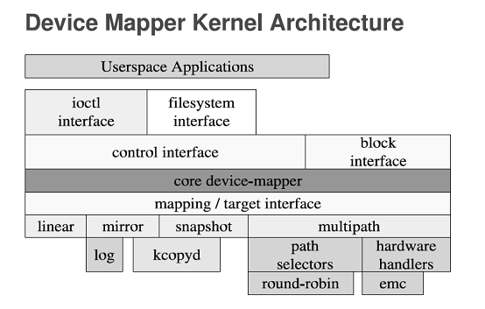

Slide 101
数据备份

Slide 102
dm
逻辑设备
50G

Slide 103
物理边界，逻辑边界
chunk
LE: Logical Extend
Logical Volume
Volume Group
VG
Physical Volume
PV
PE: Physical Extend，盘区

Slide 104
pv
  pvcreate, pvremove, pvscan, pvdisplay, pvmove
vg
  vgcreate, vgremove, vgextend, vgreduce, vgs, vgdisplay, vgscan
lv
  lvcreate, lvremove, lvextend, lvreduce, lvs, lvdisplay

Slide 105
分区：物理边界

Slide 106
LVM:

Slide 107
cp, dd, 10T, 6hours

Slide 110
dmsetup; LVM
dm target:
  strip
  mirror
  raid45
  error
  zero
  snapshot: 快照

Slide 111
LVM, dm
RAID, md
  metadisk
LVM
Multipath

Slide 112
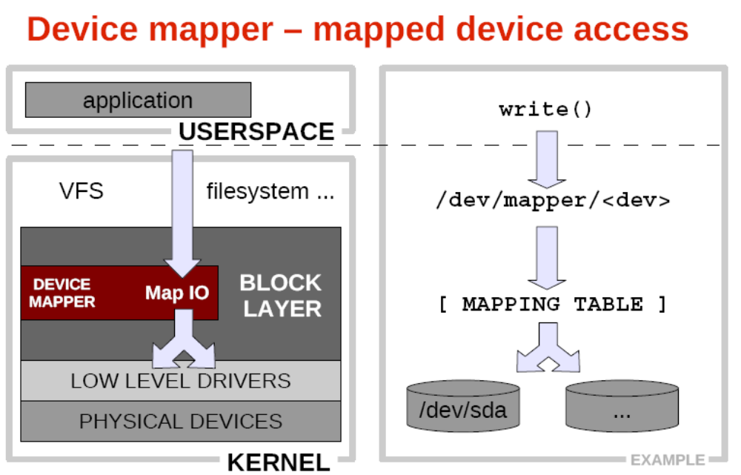

Slide 113
meta device: LVM(Logical Volume Manager)
LVM2
dm:
LV: Logical Volume
LE: Logical Extension
800 LE
VG: Volume Group
PE: 4m
PV
Physical Volume
8e

Slide 114
PV: physical volume
  pvcreate, pvdisplay, pvs, pvmove, pvremove
VG:
  vgcreate, vgdisplay, vgs, vgreduce, vgextend, vgremove
lv
  lvcreate, lvdisplay, lvs, lvreduce, lvextend, lvresize, lvremove

Slide 117
RAID1, RAID10
snapshot
ZFS
200G
500MB
10hours→20hours
almost

Slide 120
LVM: Logical Volume Manager
  dm→LVM
    Logical Volume
  md→mdadm

Slide 121
200G: MySQL
  2
snapshot

Slide 122
15G, 40G
pv
Logical Volume
LE: Logical Extened
30G
Volume Group
8e
8e
8e
pv1:8e
Physical Volume
PE: 16M
Block Device

Slide 123
pv
  pvcreate, pvscan, pvdisplay, pvs, pvmove, pvremove
vg
  vgcreate, vgscan, vgdisplay, vgs, vgextend, vgreduce, vgremove
lv
  lvcreate, lvscan, lvdisplay, lvs, lvextend, lvreduce, lvremove

Slide 124
VG: 10G
  PV:
    1*10G
    2*5G
LV: 2G

Slide 125
PD->PV->VG->LV
LV->
pv
  pvcreate,pvscan,pvdisplay,pvmove,pvremove
vg
  vgcreate,vgdisplay,vgscan,vgextend
lv
  lvcreate,lvdisplay,lvextend,lvreduce,lvscan

Slide 126
PP
pvcreate
vgdisplay
vgcreate
lvcreate
PP->PV->VG->LV

Slide 127
vgcreate
  -l maxlogicalvolumes
  -p maxphysicalvolumes
  -s physicalextentsize
vgextend - add physical volumes to a volume group
  vgextend VolumeGroupName PhysicalDevicePath

Slide 128
vgreduce
  -a, --all
    Removes all empty physical volumes if none are given on command line.
  --removemissing

Slide 129
RAID0,RAID1 lv -i 2
lvcreate
  -i, --stripes Stripes
    Gives the number of stripes. This is equal to the number of physical volumes to scatter the logical volume.
  -I, --stripesize StripeSize
    Gives the number of kilobytes for the granularity of the stripes.
  -p, --permission r|rw
    Set access permissions to read only or read and write.
  -m, --mirrors Mirrors
    Creates a mirrored logical volume with Mirrors copies. For example, specifying "-m 1" would result in a mirror with two-sides; that is, a linear volume plus one copy.

Slide 130
umount /lvm1
fsck -f /dev/vol1/lv1
resize2fs /dev/vol1/lv1 150M
lvreduce -L 150M /dev/vol1/lv1
mount /dev/vol1/lv1 /lvm1

Slide 131
pvmove - move physical extents
backup
data online
  2:45,3:00
  15 minutes
  ->事务性日志,redo log; undo log, commit
  ->历史日志,clean,ro ->
  lvm,snapshot

Slide 132
三种形式：
  源代码
    automake->Makefile.in
    autoconf->Configure
  编译好的二进制形式
  rpm
tar jxvf pack-0.1.1-tar.bz2
cd pack-0.1.1
./Configure --help | less Makefile
make
make install

Slide 133
LVM
  Logic Volume Manager
  逻辑卷管理器
Abstract Layer

Slide 134
LVM → RAID
LVM, 可变化的逻辑边界
  /dev/sda6: 10G+50G
  /mydata
  /dev/sda6: 100G
LVM1
LVM2

Slide 135
PV (Physical Volume)
VG (Volume Group)
LV (Logical Volume)

Slide 136
pvcreate, pvmove, pvremove, pvscan, pvdisplay
vgcreate, vgremove, vgscan, vgdisplay, vgreduce, vgextend
lvcreate, lvmove, lvremove, lvscan, lvdisplay, lvreduce, lvextend, lvresize, lvchk

Slide 139
1G

Slide 140
扩展分区
100G
100G

Slide 141
service bootl
App
shell
lib
Kernel: system call, interrupt

Slide 142
/boot

Slide 143
3: on
3

