Slide 1
Network

Slide 2
A

Slide 4
123.1.1.2
主机密钥
  非对称加密
    Secret key
    Public key
  密钥交换

Slide 5
中间人攻击

Slide 6
root
root
p
s
s/p

Slide 7
login
nsswitch → /etc/nsswitch.conf

Slide 9
OS
  Kernel
  process

Slide 10
10,进程，内核
线性内存
物理内存
用户空间
mkdir
5ms
内核空间

Slide 11
进程
  进程号
  内存空间
  用户
  父进程
  CPU time

Slide 12
Context Switch
  环境

Slide 13
100k*100
内核数据结构
  task structure
    PPID:
    PID: 7
    Name: Jerry
3

Slide 14
恢复现场
9

Slide 15
bug
线性地址，物理地址

Slide 16
Memory Management Unit
32bit
  4G（1G）
  Process
    10K
MMU
TLB
1
2
3

Slide 17
process
  thread

Slide 19
1000

Slide 21
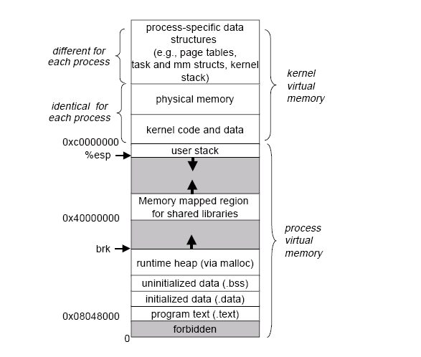

Slide 23
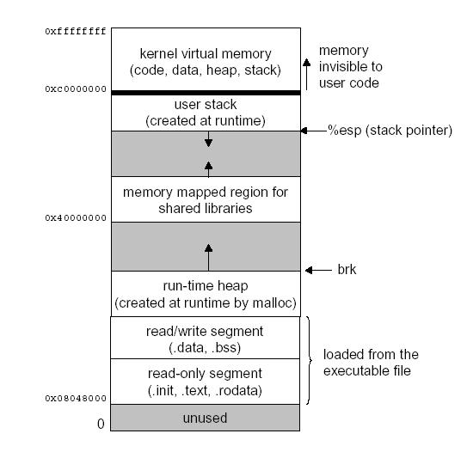

Slide 24
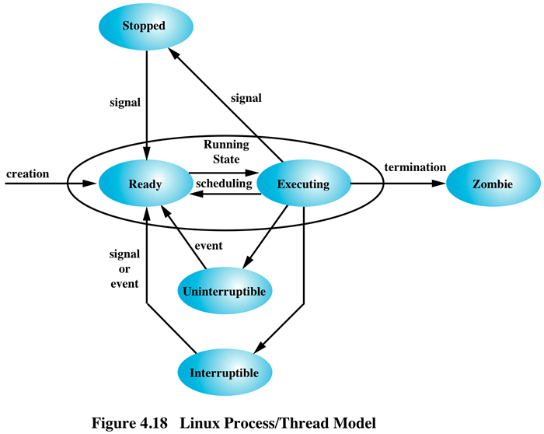

Slide 25
进程：功能

Slide 26
0-139：140
进程状态
父子关系
优先级关系

Slide 29
1、获得更多的CPU运行时间;
2、更优先获得运行的机会；
100-139:
  nice值：优雅的，友好的
  -20——19
  100——139
    普通用户仅能够调大自己的进程的Nice值；

Slide 30
PID：Process ID
init:
semaphore

Slide 31
RAM
ROM

Slide 32
/lib/modules/
/
/usr, /boot, /home
/proc
/sys
/dev

Slide 33
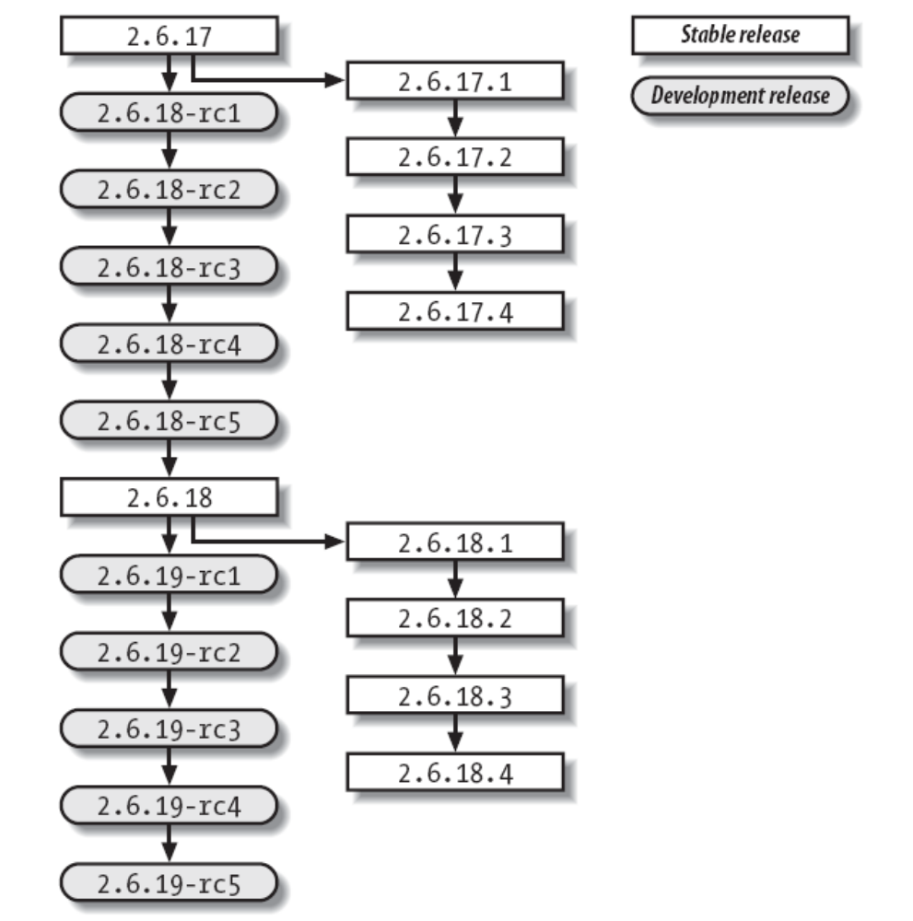
RHEL Clustering & Storage Management
page:<number>

Slide 35
Mingetty tty1
Login

Slide 36

make SUBDIR=arch/
make drivers/net/ethernet/amd/pcnet32.ko

Slide 37
make SUBDIR=arch/

Slide 38
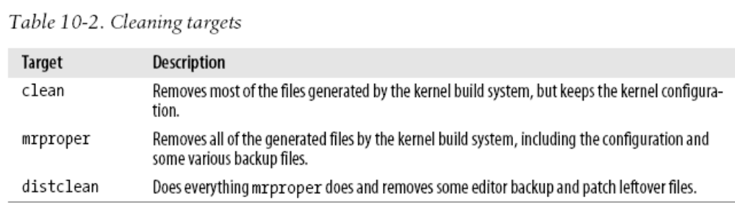

Slide 39
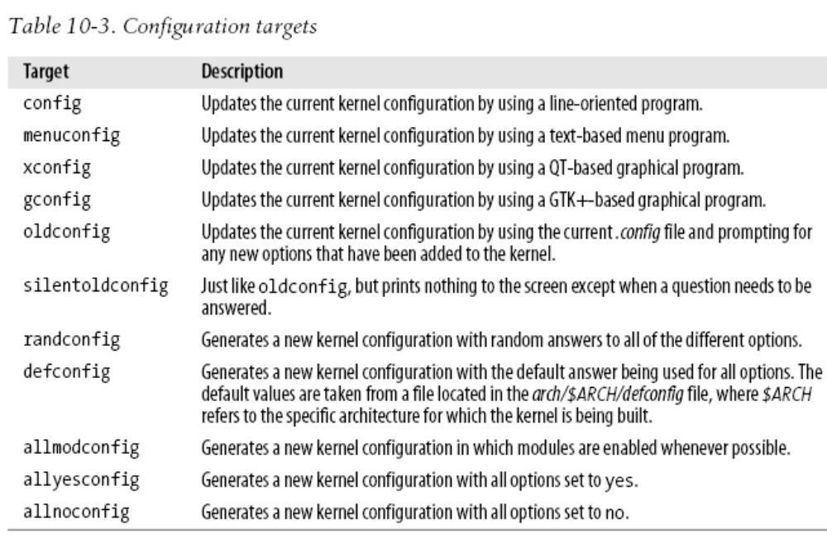

Slide 40
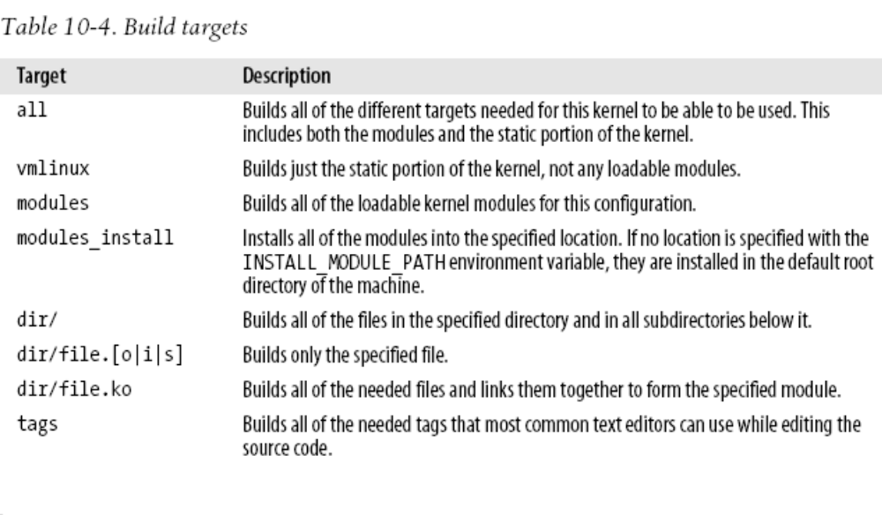
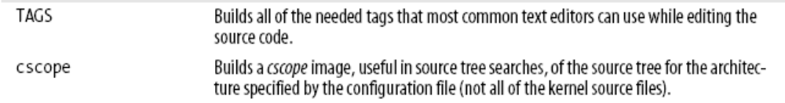

Slide 41
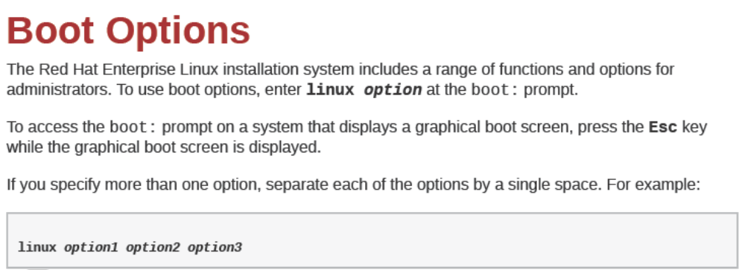

Slide 42
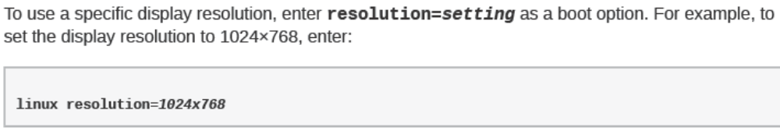
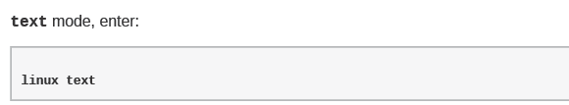

Slide 43
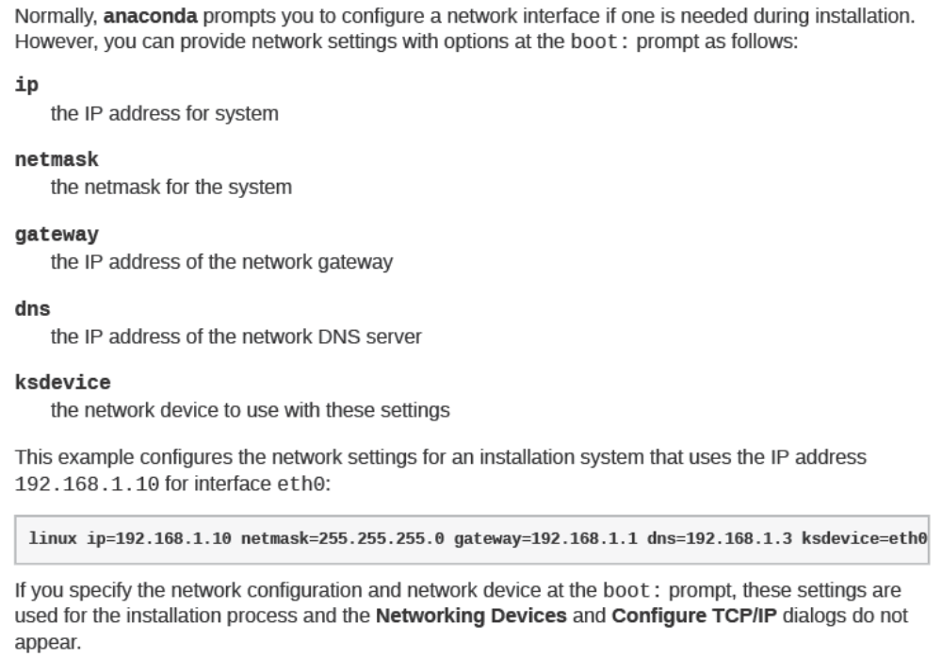

Slide 44
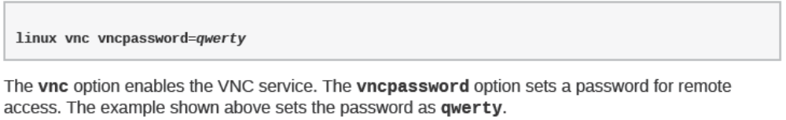
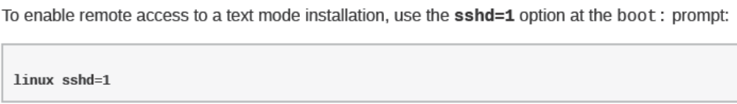

Slide 45
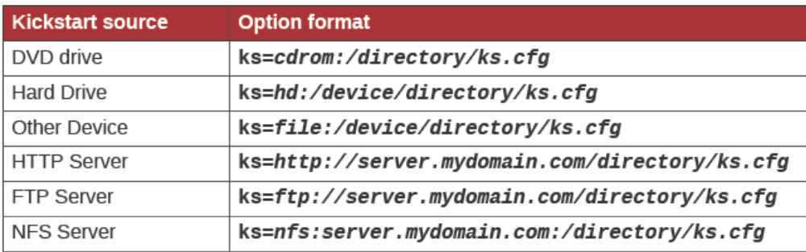

Slide 46
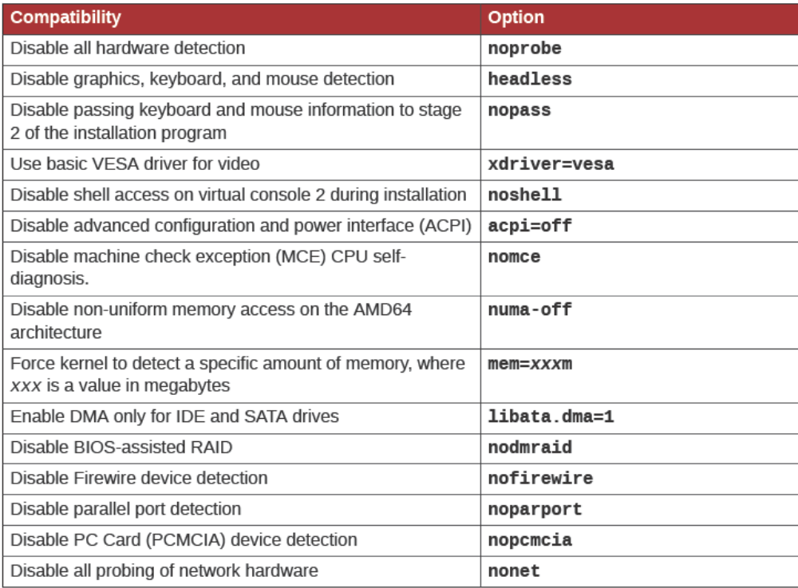
Overriding Automatic Hardware Detection

Slide 47
nash
  switch_root

Slide 48
Network
10Mbps
MByte
电磁
协议：protocol

Slide 49
线路仲裁
A
B
MAC：Media Access Control
C
D
MAC地址
M
首部，报头
Ethernet
CSMA/CD： Carrier Sense Multi Access Collision Detection载波侦听多路访问，冲突检测
冲突域

Slide 50
A
B
网桥
C

Slide 51
平面
A
B
C
交换机
M
K
N

Slide 53
中继器

Slide 55
总线
HUB
B
C
A

Slide 56
A
B
A
C
B
D

Slide 57
A
B
C
S1
D
6
S2
M
N
5
7

Slide 58
Socket, ip:port
套接字

Slide 59
OSI

Slide 60
R2
R1
R4
R3
R5

Slide 61
201.1.2.0/24
  10
  4, 6
8-2=6
  00
  01 00 0001- 01 11 1110:
    201.1.2.64, 201.1.2.127
    65 - 126
  10 00 0001 – 10 11 110
    201.1.2.128, 201.1.2.191
    129 - 190
  11

Slide 62
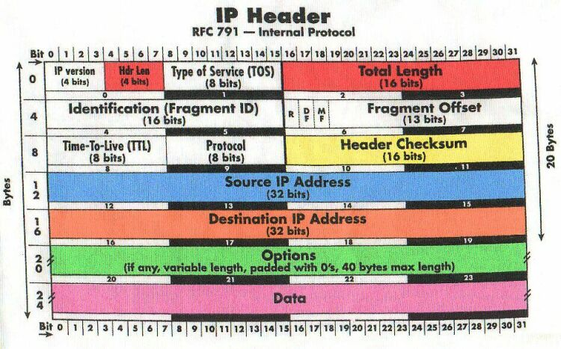

Slide 63
1500BYTE

Slide 64
OSI

Slide 67
TCP: Transmission Control Protocol
UDP: User Datagram Protocol
TCP
UDP
IP
jerry
tom
Ethernet
ppp
ATM

Slide 69
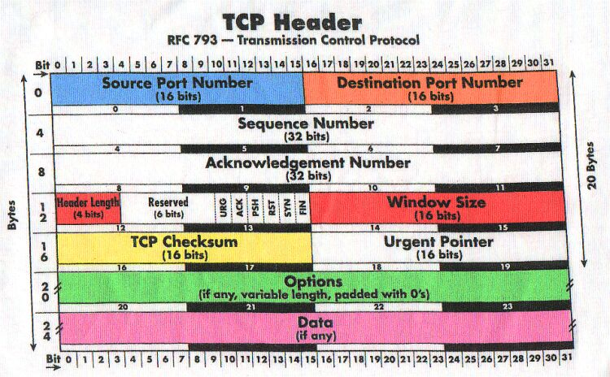

Slide 70
3次握手，4次断开
FIN=1
ACK=1, sn=101, an=301
SYN=1,ACK=1,an=101,sn=300
SYN=1,sn=100

Slide 71
路由
User Space
TCP/IP
Kernel Space

Slide 72
bonding

Slide 73
名称
lo: 本地回环
以太网网卡：ethX
pppX

Slide 74
程序：指令+数据
.so
shared object
text
data+bss
heap: 堆
Stack: 栈

Slide 75
/lib, /usr/lib
apache
glibc

Slide 76
500
软件包管理器
  打包成一文件：二进制程序，库文件，配置文件，帮助文件
  生成数据库，追踪所安装的每一个文件

Slide 77
rpm

Slide 78
BIOS(ROM)→MBR(bootloader)
LVM

Slide 79
rpm: 依赖关系
x→y
C/S:
  Client, Server
yum repository
  文件服务
    ftp
    web
    file

Slide 80
x(10,2)
rpm: 能力
元数据文件
yum: rpm能力
Client
  配置文件
    yum仓库

Slide 81
RedHat
  DVD
    rpm包
    元数据文件
      createrepo

Slide 83
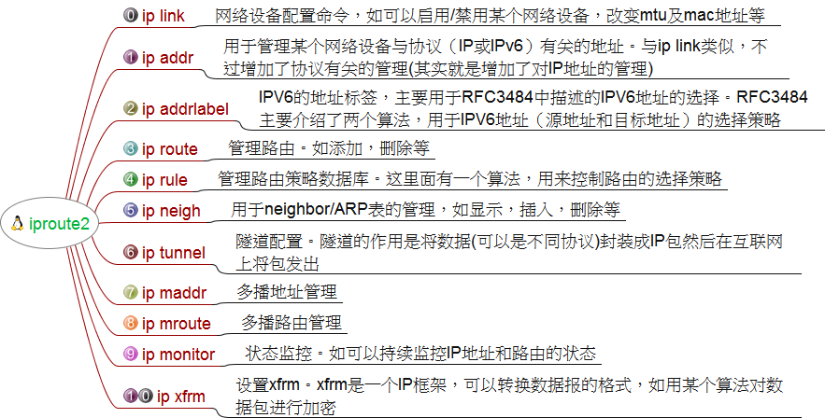
iproute2

Slide 84
link
network device configuration
  ip link set
    change device attributes
  ip link show
    display device attributes

Slide 85
ip link set
Abbreviations: set, s
dev NAME (default)
  NAME specifies network device to operate on
up and down
  change the state of the device to UP or DOWN
multicast on or multicast off
  change the MULTICAST flag on the device
address LLADDRESS
  change the station address of the interface
broadcast LLADDRESS
mtu NUMBER
  change the MTU of the device
name NAME
  change the name of the device

Slide 86
ip link show
Abbreviations: show, list, lst, sh, ls, l
dev NAME (default)
  NAME specifies the network device to show
  If this argument is omitted all devices are listed
up
  only display running interfaces.

Slide 87
ip address
protocol address management
  ip address add
    add new protocol address
  ip address delete
    delete protocol address
  ip address show
    look at protocol addresses
  ip address flush
    flush protocol addresses

Slide 88
ip address add
Abbreviations: add, a
dev NAME
  the name of the device to add the address to
local ADDRESS (default)
  the address of the interface
broadcast ADDRESS
  the broadcast address on the interface
label NAME
  Each address may be tagged with a label string
scope SCOPE_VALUE
  the scope of the area where this address is valid
    global - the address is globally valid
    site - (IPv6 only) the address is site local
    link - the address is link local
    host - the address is valid only inside this host

Slide 89
ip address delete
Abbreviations: delete, del, d
delete protocol address
  Coincide with the arguments of ip addr add
  The device name is a required argument
  The rest are optional
  If no arguments are given, the first address is deleted

Slide 90
ip address show
Abbreviations: show, list, lst, sh, ls, l
dev NAME (default)
  name of device
to PREFIX
  only list addresses matching this prefix
label PATTERN
  only list addresses with labels matching the PATTERN
primary and secondary
  only list primary (or secondary) addresses

Slide 91
ip address flush
This command has the same arguments as show
The difference is that it does not run when no arguments are given
With the -statistics option, the command becomes verbose

Slide 92
ip route
routing table management
ip route add
  add new route
ip route change
  change route
ip route replace
  change or add new one
ip route delete
  delete route
ip route show
  list routes
ip route flush
  flush routing tables
ip route get
  get a single route

Slide 93
Route types
unicast
  the route entry describes real paths to the destinations covered by the route prefix
unreachable
  these destinations are unreachable
  Packets are discarded and the ICMP message host unreachable is generated
blackhole
  these destinations are unreachable
  Packets are discarded silently
prohibit
  these destinations are unreachable
  Packets are discarded and the ICMP message communication administratively prohibited is generated

Slide 94
local
  the destinations are assigned to this host
  The packets are looped back and delivered locally
broadcast
  the destinations are broadcast addresses
  The packets are sent as link broadcasts

Slide 95
ip route add
Abbreviations: add, a
to TYPE PREFIX (default)
  the destination prefix of the route
  If TYPE is omitted, ip assumes type unicast
  PREFIX is an IP or IPv6 address optionally followed by a slash and the prefix length
    If the length of the prefix is missing, ip assumes a full-length host route
    There is also a special PREFIX default - which is equivalent to IP 0/0 or to IPv6 ::/0

Slide 96
ip route add(2)
dev NAME
  the output device name
via ADDRESS
  the address of the nexthop router
  Actually, the sense of this field depends on the route type
src ADDRESS
  the source address to prefer when sending to the destinations covered by the route prefix

Slide 97
ip route show

