Slide 1
Virtualization

Slide 2
Rss, page cache, anon page
Process monitor
VA
OS: system call
PA

Slide 3
Rss, page cache, anon page
VA
Process monitor
Hypervisor call
hypercall
GuestOS
PA
OS: system call
hypervisor

Slide 4
HostOS
普通指令
特权指令

Slide 6
CPU: 全量CPU时间片
内存：连续、全部内存空间 (0x0000, )
I/O: 全部可用IO

Slide 7
CPU虚拟化
基于“二进制翻译(Binary Translation)”技术的完全虚拟化
操作系统辅助的虚拟化，也即半虚拟化(paravirtualization)或准虚拟化
硬件辅助的虚拟化

Slide 8
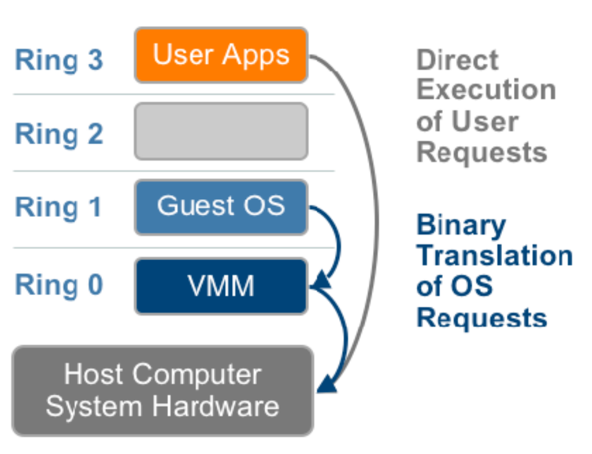
Binary Translation (BT)

Slide 9
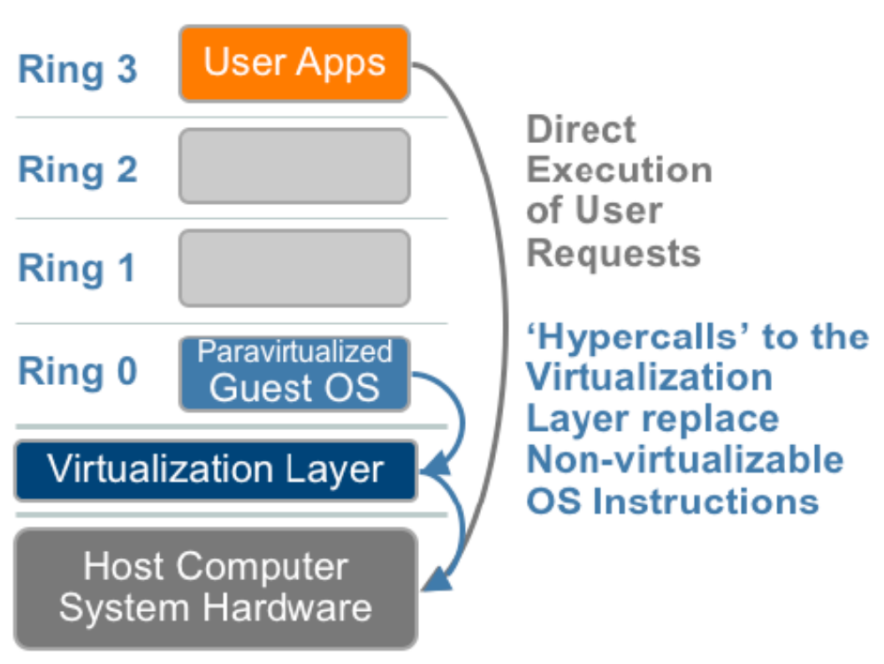
半虚拟化(Paravirtualization)

Slide 10
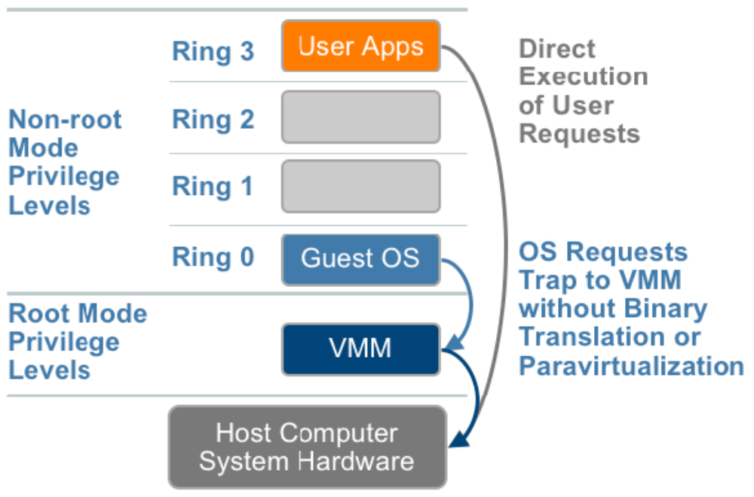
硬件辅助的虚拟化

Slide 11
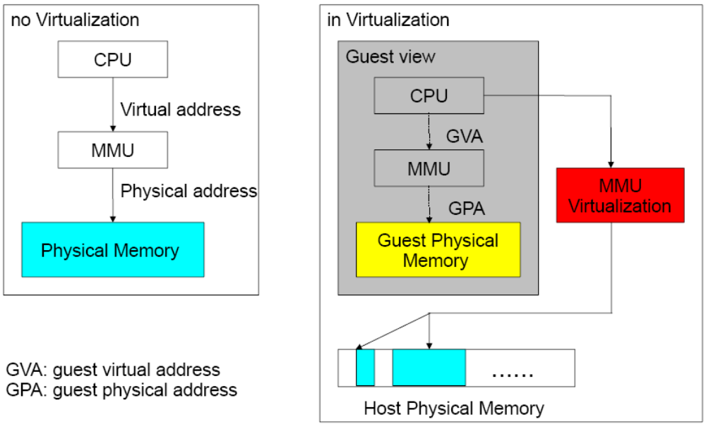
内存虚拟化

Slide 12
Intel和AMD分别通过EPT(Extended Page Tables)和NPT(Nested Page Tables)为虚拟化应用提升影子MMU的性能，并通过标记(tagged)TLB来避免虚拟机切换时频繁清写(flush)TLB以提高TLB缓存的命中率。

Slide 13
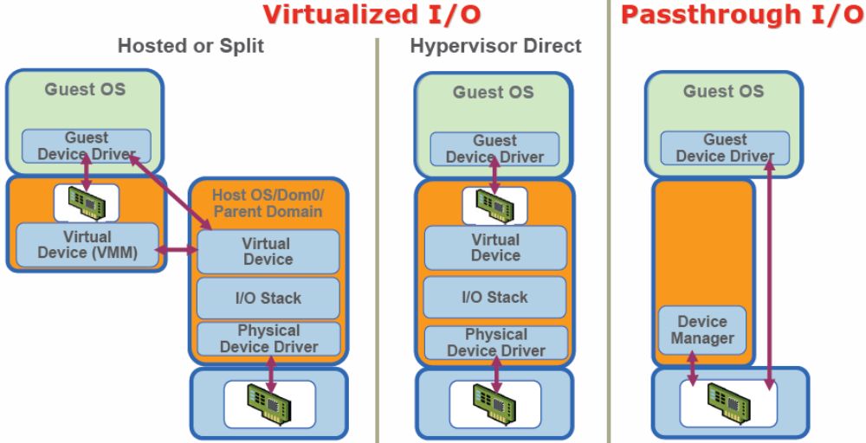
IO虚拟化

Slide 14
Hosted VMM
虚拟化模型
  Vmware workstattion, VMWare Server
  VMWare ESX, VMWare ESXi
Dom0
Xen
cpu, interrupt, memory
VMM
VMM
hypervisor

Slide 15
KVM: Kernel-based Virtual Machine
  基于内核的虚拟机
KVM: 内核模块
Guest Mode
kernel → hypervisor

Slide 16
cywin
Container:
  OpenVZ
wine

Slide 17
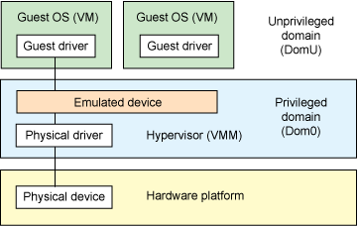
模拟

Slide 18
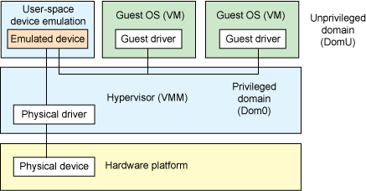
基于用户空间的设备模拟

Slide 19
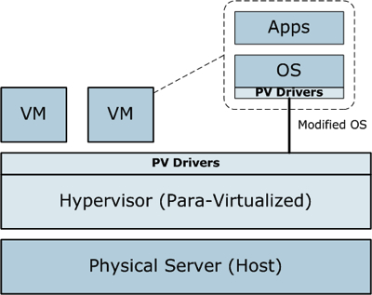
半虚拟化

Slide 20
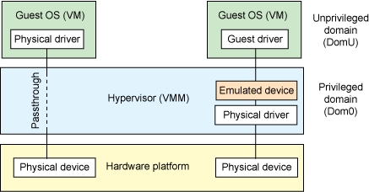
IO透传

Slide 21
Xen

Slide 22
app
Kernel
VMM
hypercall

Slide 23
Emulated Hardware
OS

Slide 24
VMM

Slide 25
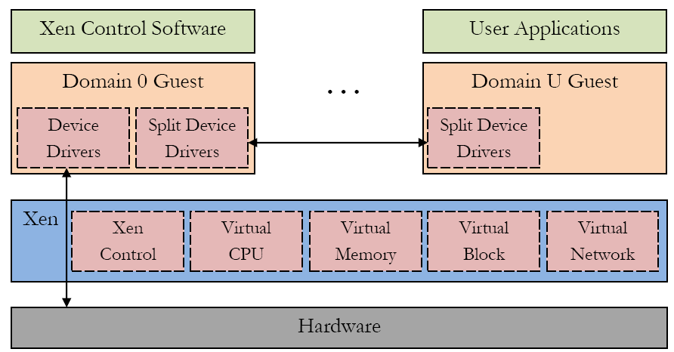
Xen Arch
Qemu
back
front

Slide 26
Xcp
Linux → OS
  Xen
  /etc/grub.conf
    Kernel /xen.gz
    Module /vmlinuz
    Mouule /initrd

Slide 27
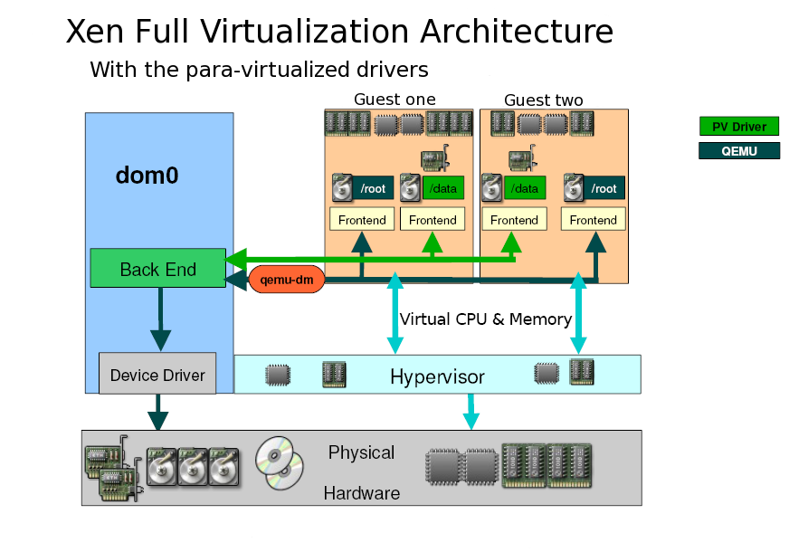
Full Virt

Slide 28
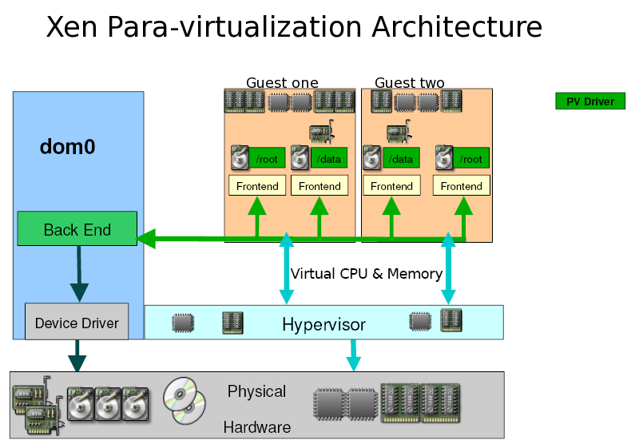
Para Virt

Slide 29
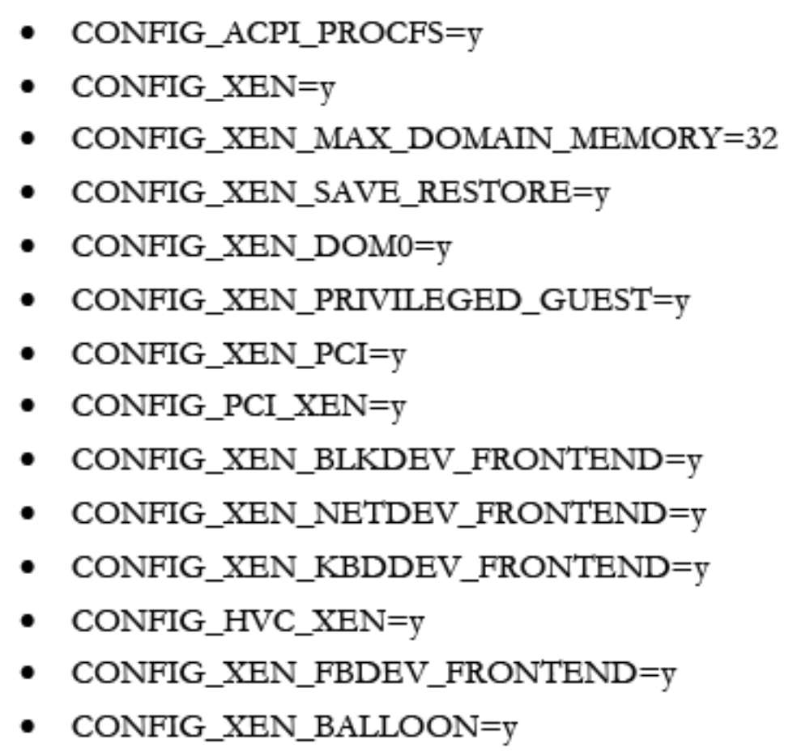
Dom0 Kernel

Slide 30
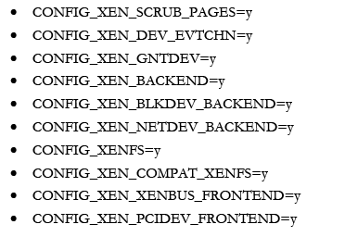
Dom0 Kernel (2)

Slide 31
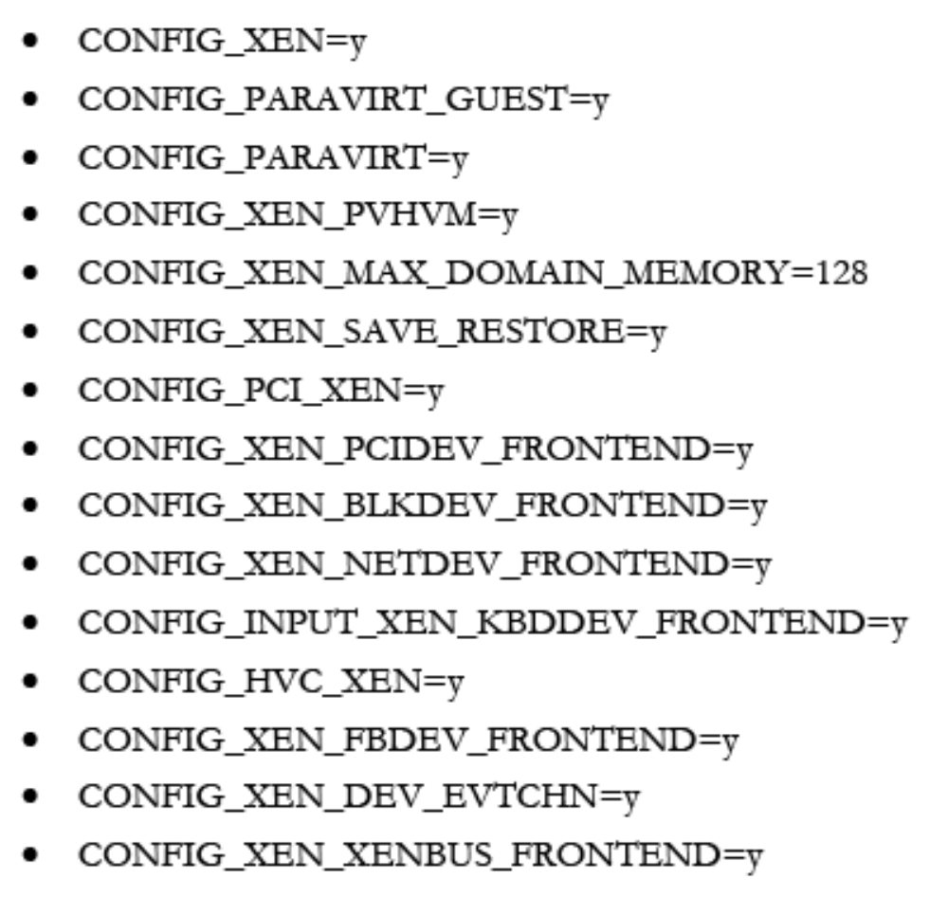
DomU Kernel

Slide 32
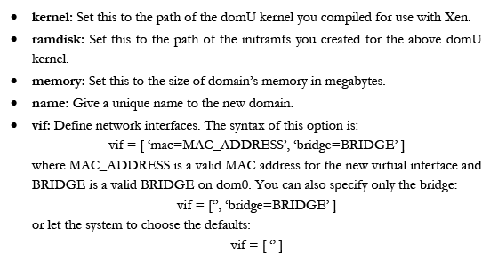
Xen Guest File

Slide 33
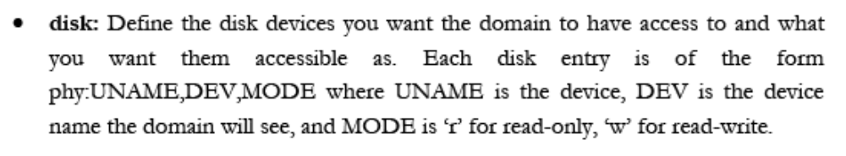
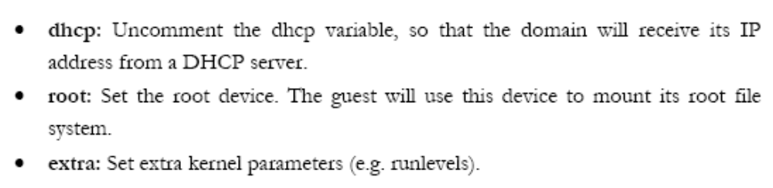

Slide 34
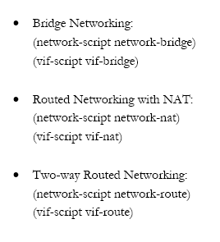
network

Slide 35
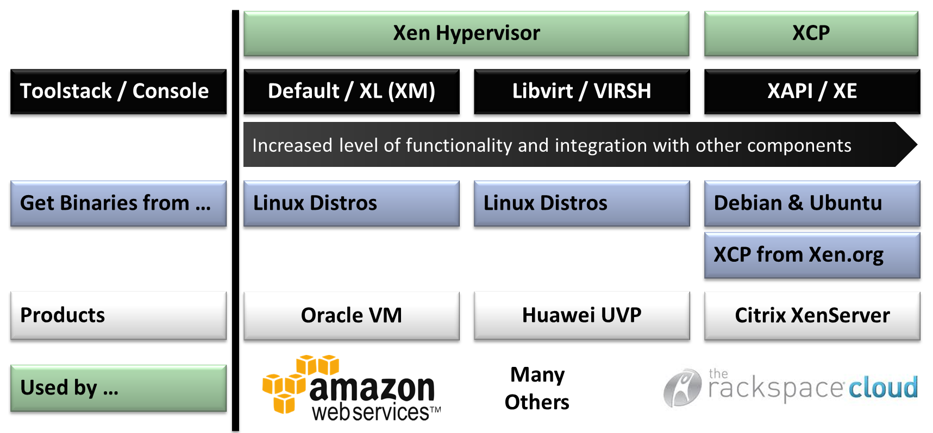

Slide 36
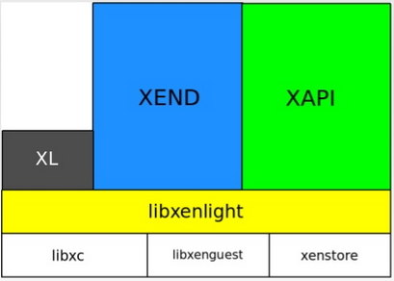
Xen hypervisor
Xen Cloud Platform

Slide 37
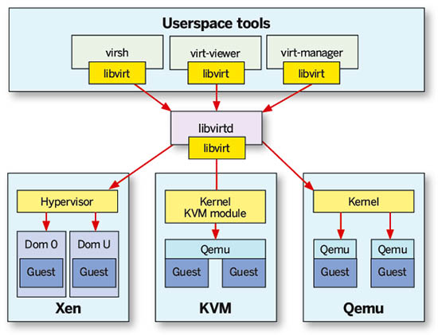

Slide 38
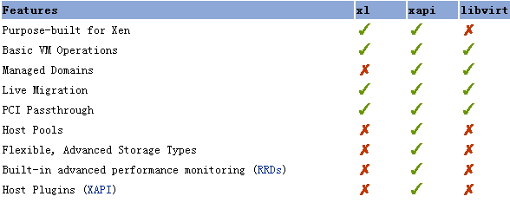

Slide 39
rootfs

Slide 41
Taget, lun

Slide 42
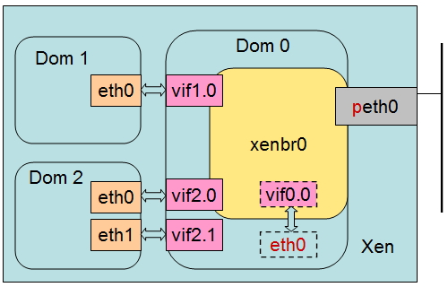
桥接

Slide 43
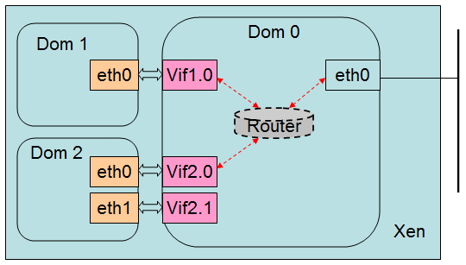
路由模式

Slide 44
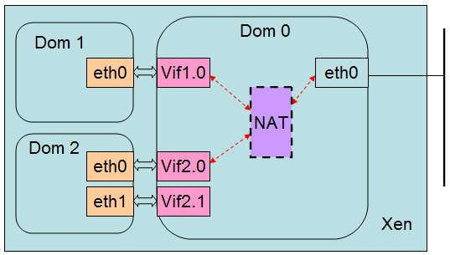
NAT模式

Slide 45
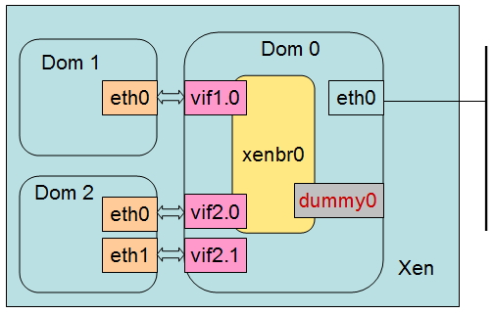
伪网络接口(dummy0)
仅主机

Slide 46
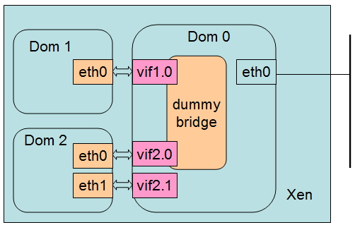
伪网桥

Slide 47
使用brctl命令创建桥接设备
# brctl addbr dumbr0
# brctl setfd dumbr0 0
# ip link set dumbr0 up
vif = [ ‘bridge=dumbr0’, ]

Slide 48
KVM

Slide 49
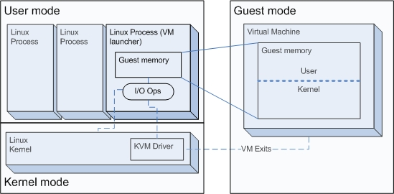
KVM架构

Slide 50
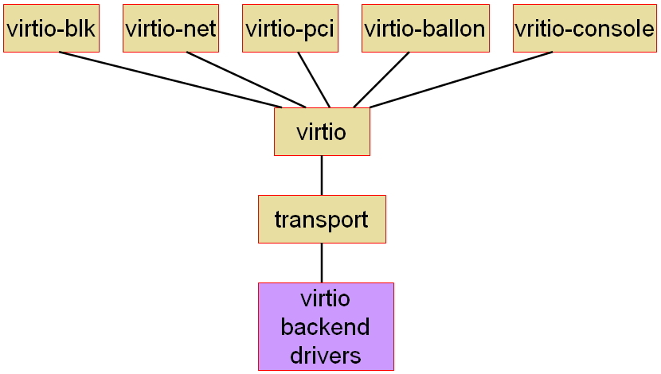
virtio

Slide 51
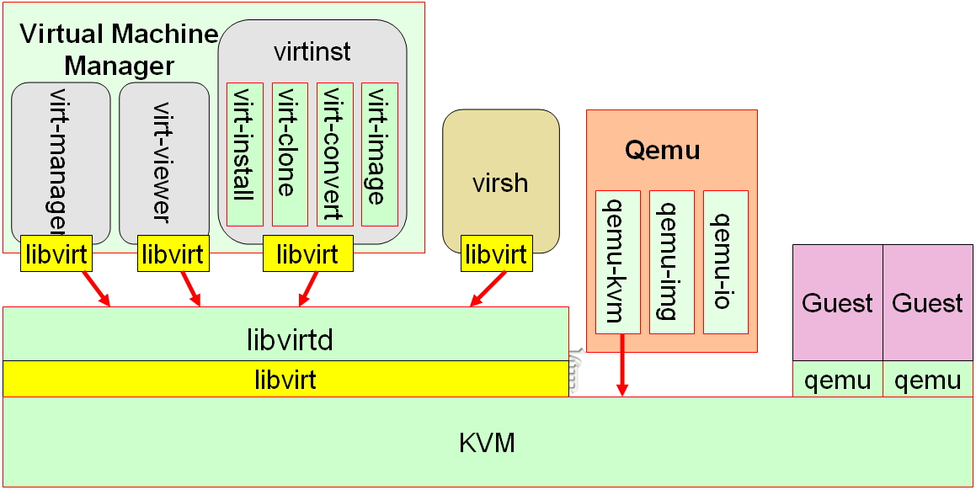
KVM管理工具

Slide 52
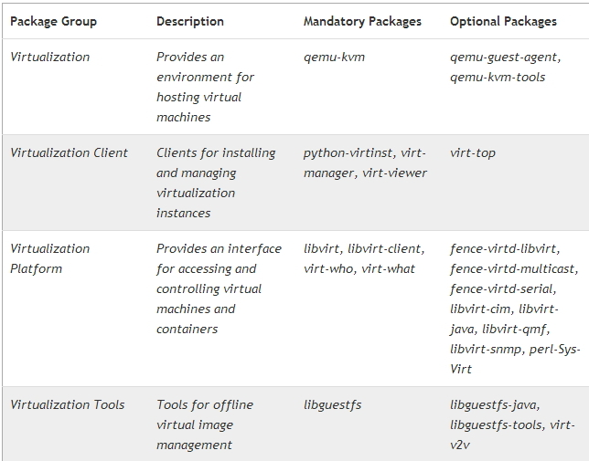

Slide 53
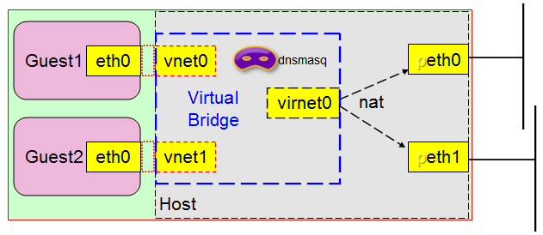
NAT模型（NAT Mode）

Slide 54
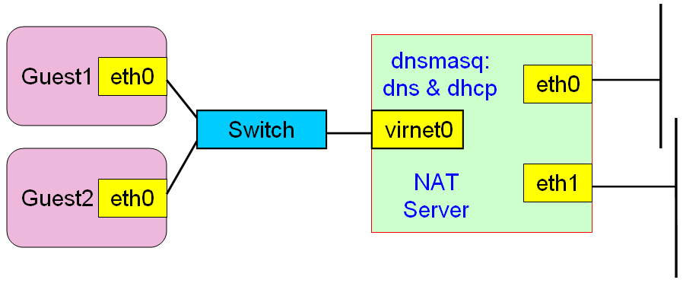
NAT实现的虚拟网络

Slide 55
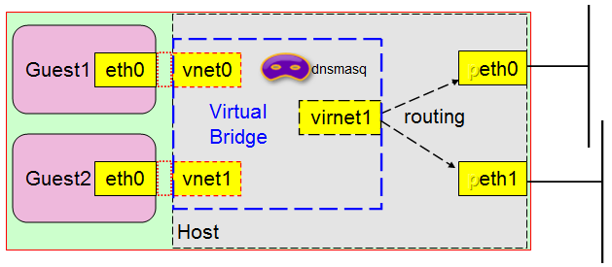
路由模型

Slide 56

上图实现的网络模型

Slide 57
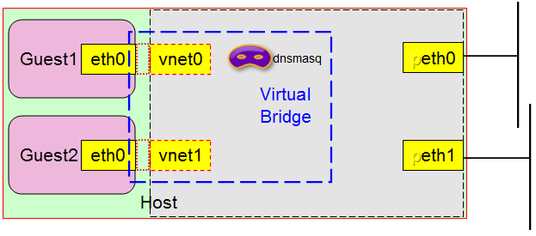
隔离模型

Slide 58
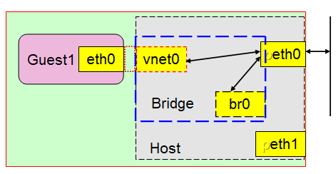
桥接模型

Slide 59
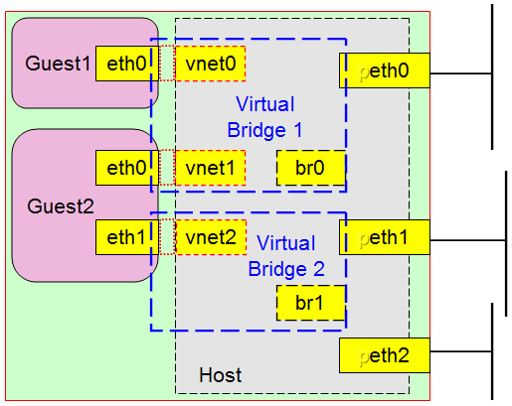
多路桥接

Slide 60
Xen is a virtual machine monitor (hypervisor) that allows you to use one physical computer to run many virtual computers
Virtual machine monitors provide a convenient way to use the same physical computer hardware for many different tasks
The hypervisor controls the underlying hardware, allowing it to be used by many guest systems at once, and gives each guest system the illusion that it is running on its own private hardware

Slide 61
The hypervisor abstracts the physical resources of the host computer into discrete virtual counterparts that can be allocated for use by individual guests
Virtual guests treat their virtual hardware as if it were real, and the hypervisor ensures that this illusion is seamless
Additionally, hypervisors must ensure some level of isolation between guests
In a way, hypervisors act as both magician and traffic cop

Slide 62
Virtual machine monitors also provide a uniform interface to the hardware
This uniform interface shields guest systems from some lower level details of the physical computing resources and provides portability, which is another key benefit of virtualization
In fact, many modern hypervisors allow guest systems to move from one physical machine to another without interruption
Guest system configurations can easily be developed on one machine and then deployed on many systems
This eases the job of managing or deploying software on a collection of machines with different hardware characteristics
Guest systems can even migrate from one physical computer to another while running. Xen calls this live migration. Some benefits of virtualization are as follows

Slide 63
Emulator
Emulator virtual machines provide a virtual computing architecture that is not the same as the actual physical architecture of the host machine
Operating systems intended for the emulated hardware are executed unmodified

Slide 64
x86-32bit
  power

Slide 65
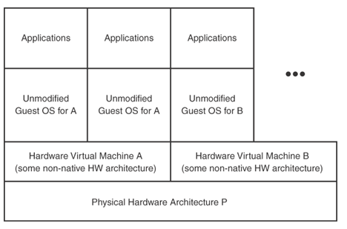

Slide 66
Full Virtualization
The full virtualization hypervisor presents the actual physical hardware to each guest so that operating systems intended for the underlying architecture may run unmodified and unaware that they are being run virtualized

Slide 67
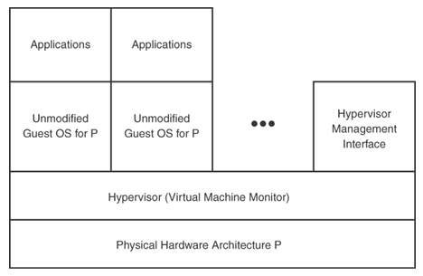

Slide 68
The x86 architecture is notoriously difficult to virtualize
Because of this, virtualization specifics (Intel's VT and AMD's AMD-V) have been added to improve performance and make running an operating system within a Xen virtual machine simpler
Major vendors of full virtualization include VMware Workstation, VMware Server (formerly GSX Server), Parallels Desktop, Win4Lin Pro, and z/VM
Xen supports full virtualization on basic architectures with the previously mentioned hardware support for virtualization

Slide 69
Paravirtualization
In paravirtualization, the hypervisor exports a modified version of the underlying physical hardware
The exported virtual machine is of the same architecture
Targeted modifications are introduced to make it simpler and faster to support multiple guest operating systems
  the guest operating system might be modified to use a special hypercall application binary interface (ABI) instead of using certain architectural features that would normally be used

Slide 70
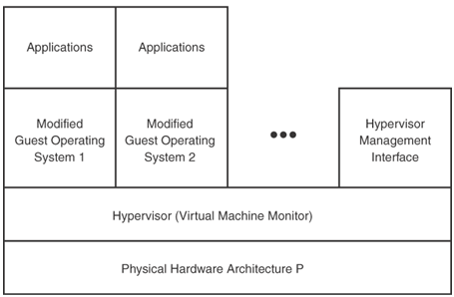

Slide 71
KVM:
  Kernel Virtual Machine

Slide 72
Major advantages include performance, scalability, and manageability
The two most common examples of this strategy are User-mode Linux (UML) and Xen
The choice of paravirtualization for Xen has been shown to achieve high performance and strong isolation even on typical desktop hardware
Xen extends this model to device I/O

Slide 73
Operating System Level Virtualization
No virtual machine monitor
The virtualization is done entirely within a traditional single operating system image
Implementations of operating system level virtualization include Virtuozzo, Linux VServers, OpenVZ, Solaris Containers, FreeBSD jails, and HP UX 11i Secure Resource Partitions

Slide 74
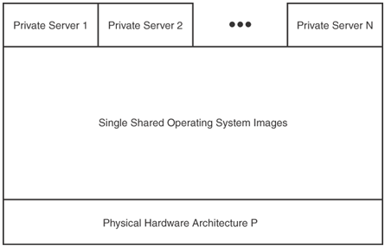

Slide 75
Other Types of Virtualization
Library virtualization
  emulates operating systems or subsystems via a special software library
  An example: Wine
Application virtualization (managed runtime)
  the approach of running applications inside a virtual execution environment
  The virtual execution environment provides a standard API for cross-platform execution and manages the application's consumption of local resources

Slide 76
Linux KVM (Kernel Virtual Machine)
KVM is a full virtualization solution that was merged during the 2.6.20 mainline kernel development period
KVM is a modification to the Linux kernel that actually makes Linux into a hypervisor upon insertion of an additional KVM module
The method of KVM operation is rather interesting
  Each guest running on KVM is actually executed in user space of the host system
  This approach makes each guest instance (a given guest kernel and its associated guest user space) look like a normal process to the underlying host kernel

Slide 77
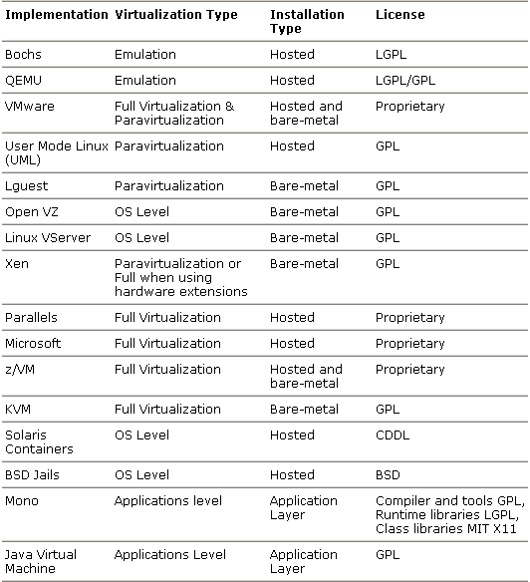
Virtualization Products at a Glance

Slide 79
/etc/xen/, /etc/libvirt/qemu/
N1
N50

Slide 80
C10
vm1
调度器
C20，vm1
实例模板
网络服务
NFS
存储映像
文件模板

Slide 81
Compute (Nova)
  Nova-volume
  Nova-network
  Nova-scheduler
  Nova-compute
Storage (Image, Glance)
  Glance: 映像文件元数据管理服务
Identify (keystone)

Slide 82
swift
分布式文件系统

Slide 86
Horizon
  Swift
  Essex

