Slide 1
dialog

Slide 2
session affinity
In-memory
  Engine上的jvmRoute参数，
  cluster
  web.xml <distributable/>
  时间同步
channel

Slide 3
关闭,session affinity
http://172.16.100.1/sess

Slide 4
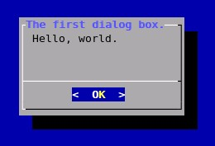
What is dialog?
A program that will let you to present a variety of questions or display messages using dialog boxes from a shell script.
Created by Savio Lam, and currently maintained by Thomas E. Dickey
Use the dialog utility for creating TTY (terminal) dialog boxes.

Slide 5
dialog package
The dialog command uses command line parameters to determine what type of Window widget to produce.
A widget is the dialog package term for a type of Windows element.
Each dialog widget provides output in two forms:
  Using STDERR
  Using the exit code status
    “OK” : 0
    “Cancle” , “No” : 1
$?

Slide 6
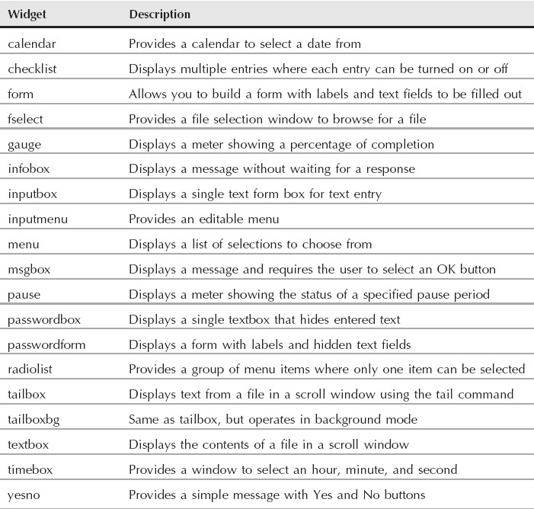
The dialog Widgets

Slide 7
Syntax
dialog --common-options --boxType "Text" Height Width --box-specific-option
  --common-options are used to set dialog boxes background color, title, etc.
  All dialog boxes have at least three parameters:
    "Text" : The caption or contents of the box.
    height : The height of the dialog box.
    width : The width of the dialog box.
dialog --print-maxsize
dialog --create-rc file

Slide 8
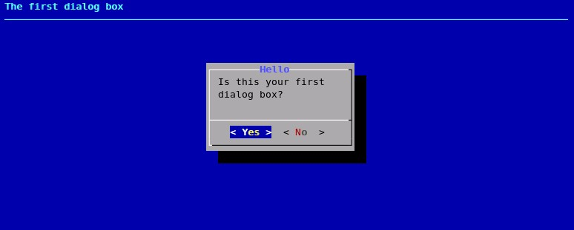
The first dialog box
dialog --backtitle “The first dialog box” --title “Hello” --yesno “Is this your first dialog box?” 7 25

Slide 9
common-options
--backtitle backtitle
  Specifies a backtitle string to be displayed on the backdrop, at the top of the screen.
--begin y x
  Specify the position of the upper left corner of a dialog box on the screen.
--colors
  Interpret embedded "\Z" sequences in the dialog text by the following character, 0-7, b, B, u, U, ect
  Restore normal settings with "\Zn"

Slide 10
common-options(2)
--defaultno
  Make the default value of the yes/no box a No.
--default-item string
  Set the default item in a checklist, form or menu box. Normally the first item in the box is the default.
--insecure
  Makes the password widget friendlier but less secure, by echoing asterisks for each character.

Slide 11
common-options(3)
--nocancel
  Suppress the "Cancel" button in checklist, inputbox and menu box modes.
--nook
  Suppress the "OK" button in checklist, inputbox and menu box modes.
--no-shadow
  Suppress shadows that would be drawn to the right and bottom of each dialog box.
--ok-label string
  Override the label used for "OK" buttons.

Slide 12
common-options(4)
--timeout secs
  Timeout (exit with error code) if no user response within the given number of seconds.
--title title
  Specifies a title string to be displayed at the top of the dialog box.

Slide 13
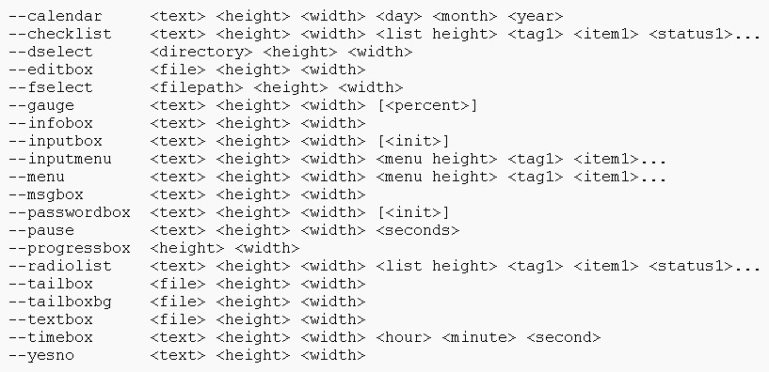
Box options

Slide 14
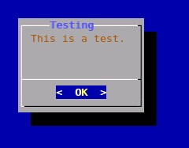
The msgbox widget
dialog --msgbox text height width
  dialog –colors --title Testing --colors --msgbox “﹨Z3This is a test﹨Zn” 10 20 2>dialog.out
  --ok-lable “text”

Slide 15
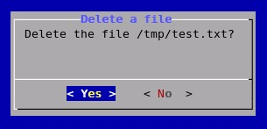
The yesno widget
dialog --yesno text height width
  dialog --title “Delete a file” --no-shadow --yesno “Delete the file /tmp/test.txt?” 7 35

Slide 16
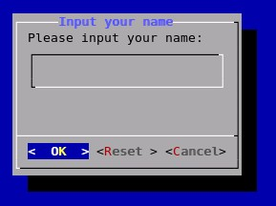
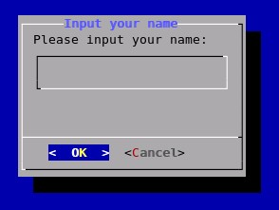
The inputbox widget
dialog --inputbox text height width
  dialog --title “Input your name” --inputbox “Please input your name:” 10 30 2> /tmp/name.txt
--extra-button
--extra-label string

Slide 17
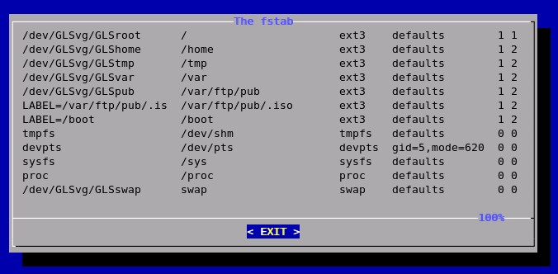
The textbox widget
dialog --textbox file height width
  dialog --title “The fstab” --textbox /etc/fstab 17 80
--exit-label string

Slide 18
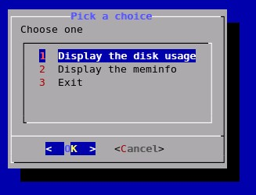
The menu widget
dialog --menu text height width menu-height tag1 item1 tag2 item2 …
  dialog --title “pick a choice” --menu “Choose one” 12 35 5 1 “Display the disk usage” 2 “Display the meminfo” 3 “Exit”

Slide 19
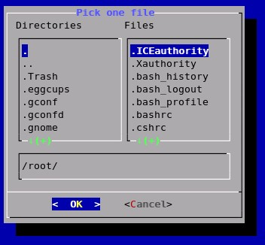
The fselect widget
dialog --fselect filepath height width
  dialog --title “Pick one file” --fselect /root/ 7 40

Slide 20
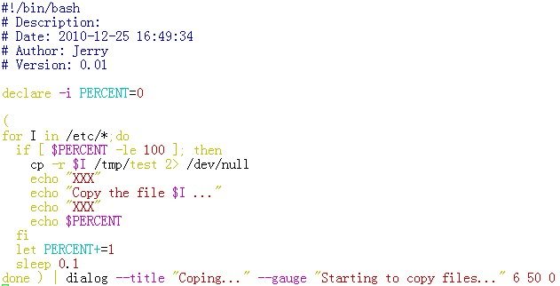

The gauge widget
dialog --gauge text height width [<percent>]

Slide 21
The form widget
dialog --form text height width formheight [ label y x item y x flen ilen ] ...
  flen: field length, defines the length shown for a selected field
  ilen: input-length, defines the permissible length of the data entered in the field
  Use up/down arrows (or control/N, control/P) to move between fields. Use tab to move between windows.

Slide 22
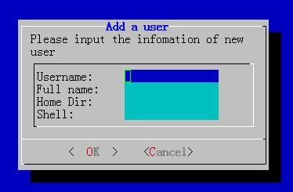
The form widget(2)
# dialog --title "Add a user" --form "Please input the infomation of new user:" 12 40 4 \
"Username:" 1 1 "" 1 15 15 0 \
"Full name:" 2 1 "" 2 15 15 0 \
"Home Dir:" 3 1 "" 3 15 15 0 \
"Shell:" 4 1 "" 4 15 15 0

Slide 23
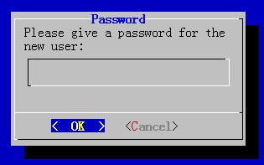
The passwordbox widget
dialog --passwordbox text height width [init]
--insecure
  Echoes asterisks for each character.
# dialog --title "Password" --passwordbox "Please give a password for the new user:" 10 35

