Slide 1
iptables/netfilter

Slide 2
ip_forward

Slide 3
www.magedu.com
宿主
View：视图
C
3
2
SMTP
DNS
web
DMZ

Slide 4
小项目

Slide 5
小项目

Slide 7
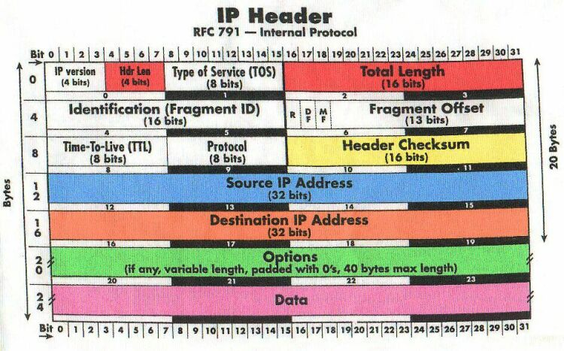
ipv4

Slide 8
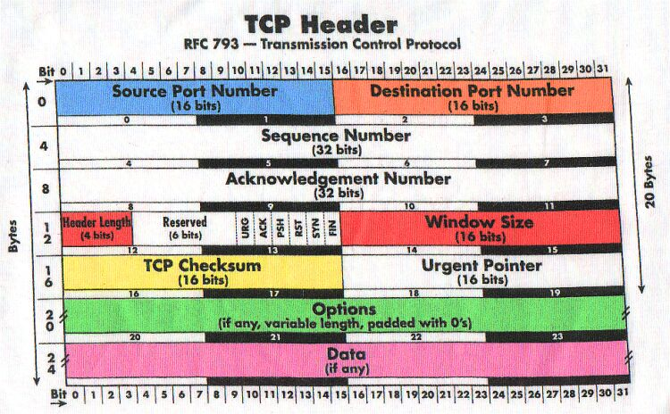

Slide 10
500

Slide 11
ip_forward
192.16.10.0/24
A
172.16.0.0/16
1
2
B
/proc/sys/net/ipv4/ip_forward:1

Slide 12
web
ftp
80
21

Slide 15
http
转换为能够通过网络发送的数据格式
  文本
  二进制

Slide 17
主动关闭， 被动关闭

Slide 18
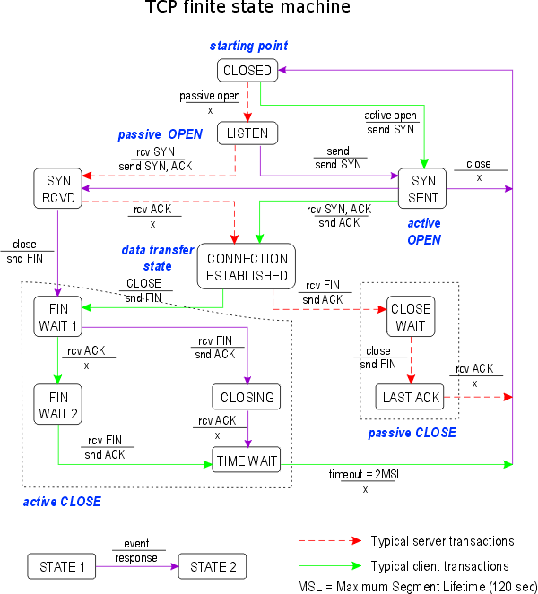

Slide 19
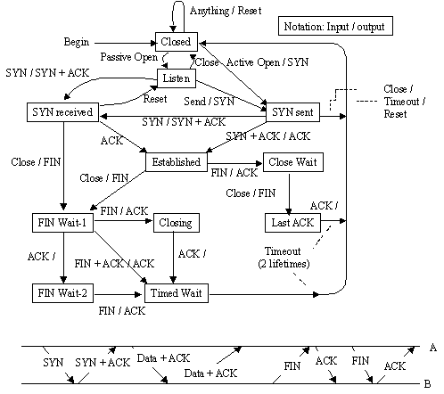
The TCP Finite State Machine (FSM)

Slide 20
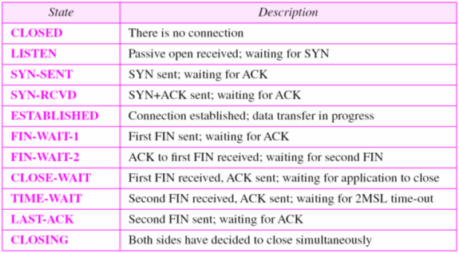
TCP State

Slide 21
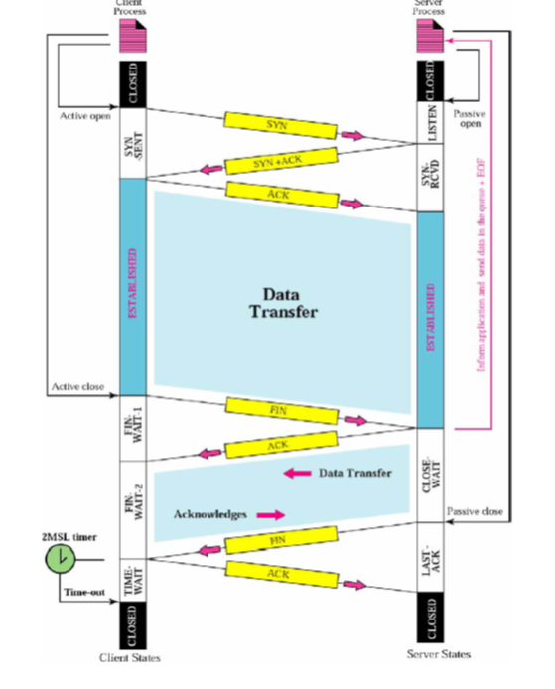

Slide 22
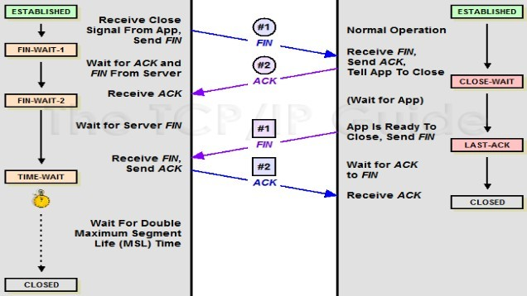

Slide 23
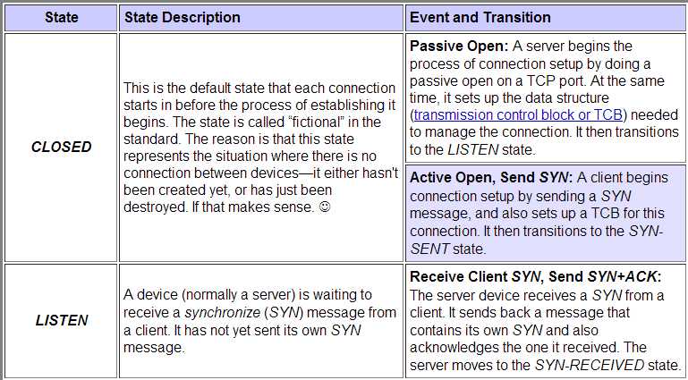

Slide 24
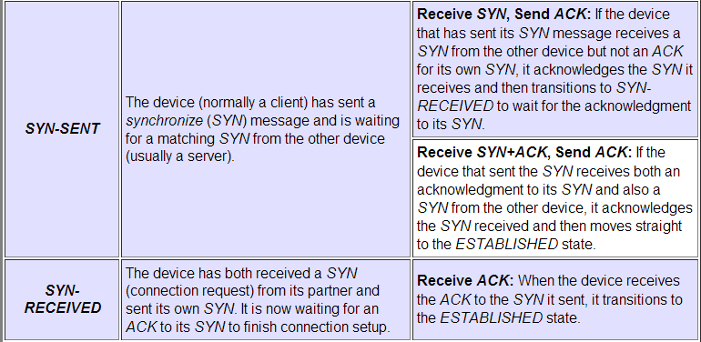

Slide 25
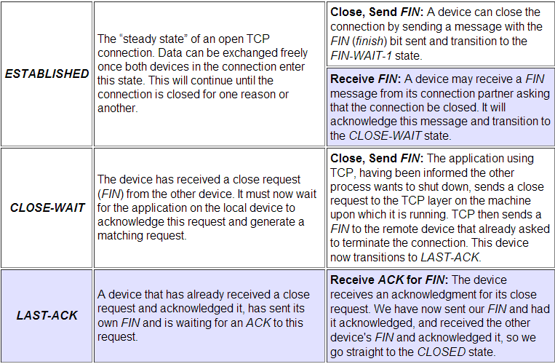

Slide 26
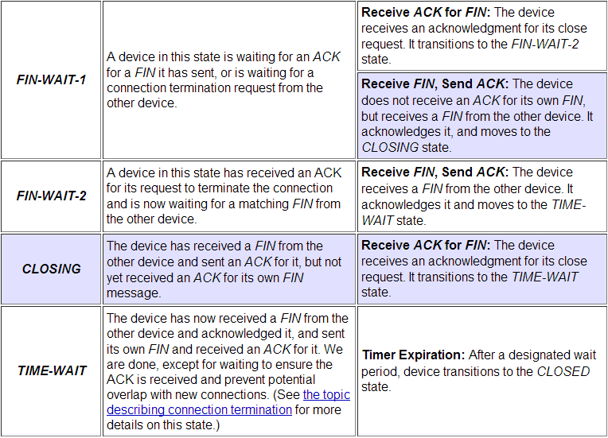

Slide 27
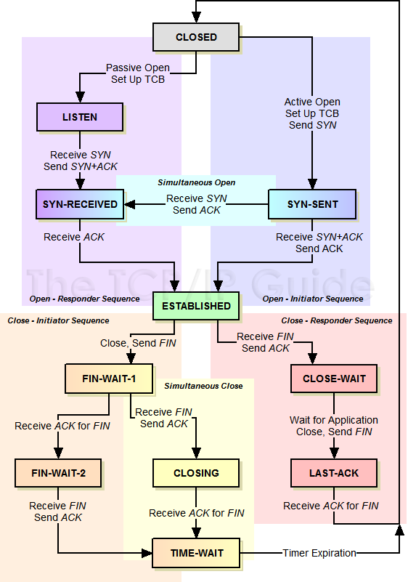
The TCP Finite State Machine (FSM)

Slide 28
规则：标准

Slide 29
app

Slide 30
/proc/sys/net/ipv4/ip_forward
NAT
ip
路由表
路由决策

Slide 32
udp: 53
dport
sport
dport
sport

Slide 33
80
ip_conntrack
  A→B

Slide 34
ESTABLISHED

Slide 35
ip_conntrack
  /proc/net/ip_conntrack

Slide 36
ip_conntrack

Slide 39
www.magedu.com: IP
12.1.1.6
12.1.1.7
12.1.1.7
172.16.100.7
12.1.1.6
12.1.1.6
12.1.1.7
172.16.100.6
12.1.1.7

Slide 40
ASCII
Protocol
报文
编码规则
解码规则

Slide 41
MAC: Media Access Control
MTU:1500（1460），1600
CRC
以太网, CSMA/CD
令牌环网
A
C
B
D
冲突域
广播域

Slide 42
广播风暴
A
B

Slide 43
1:a → 2：b
IP: network+host
mask
B
A
C
2
1
TCP/UDP

Slide 46
/proc/sys/net/ipv4/ip_forward
172.16.0.0/16
172.16.1.1
eth0
eth1

Slide 47
源地址转换， SNAT
目标地址转换， DNAT
端口地址转换， PNAT

Slide 48
ipfw 2.0
ipchains 2.2
iptables 2.4
  iptables: 用户空间工具
    编写规则
  netfilter
    内核中，框架(framework)
    hook function
      规则链
      INPUT, OUTPUT, FORWARD, PREROUTING, POSTROUTING

Slide 49
功能：
  filter
  nat
  mangle
  raw

Slide 50

数据包过滤匹配流程
网络A
路
由
选
择
网络B
本机的应用进程
raw：OUTPUT
mangle：OUTPUT
入站数据流向
mangle：INPUT
nat：OUTPUT
出站数据流向
filter：INPUT
filter：OUTPUT
raw：PREROUTING
路
由
选
择
mangle：FORWARD
mangle：POSTROUTING
mangle：PREROUTING
filter：FORWARD
nat：POSTROUTING
nat：PREROUTING
转发数据流向

Slide 51
172.16.0.0/16

Slide 52
drop
22

Slide 53
流向：
  到本机
    PREROUTING → INPUT
  转发
    PREROUTING → FORWARD → POSTROUTING
  由本机发出
    OUTPUT→ POSTROUTING

Slide 54
table
raw
  PREROUTING, OUTPUT
mangle
  PREROUTING, INPUT, FORWARD, OUTPUT, POSTROUTING
nat
  PREROUTING, OUTPUT, POSTROUTING
filter
  INPUT, FORWARD, OUTPUT

Slide 55
filter
  匹配条件
    netfilter，检查模块
    扩展模块
  处理动作
    ACCEPT
    DROP, REJECT

Slide 56
100条
  自定义链

Slide 57
netfiter的规则表、链结构
iptables 防火墙默认的规则表、链结构
raw 表
mangle 表
nat 表
filter 表
……
……
……
第1条规则
第2条规则
第3条规则
……
PREROUTING链
PREROUTING链
PREROUTING 链
……
……
……
OUTPUT链
POSTROUTING链
POSTROUTING 链
INPUT 链
……
……
……
INPUT 链
OUTPUT 链
FORWARD 链
……
……
OUTPUT 链
OUTPUT 链
……
FORWARD 链

Slide 58
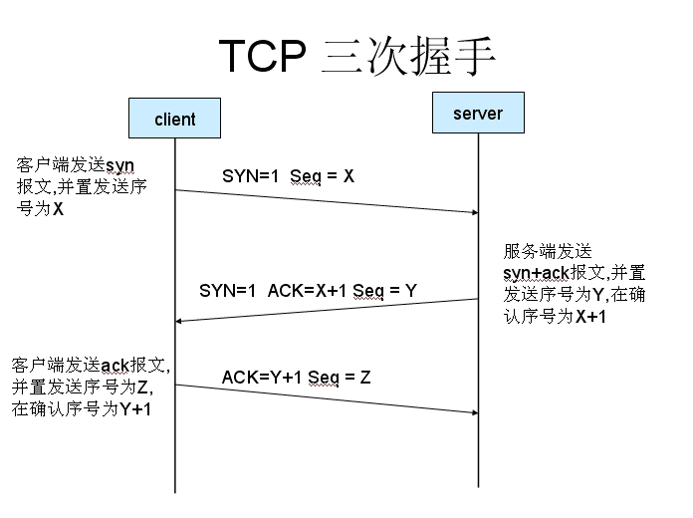

Slide 59
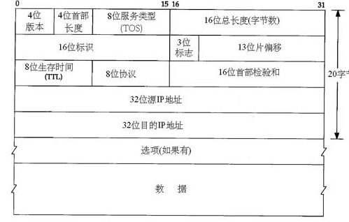
IP首部

Slide 60
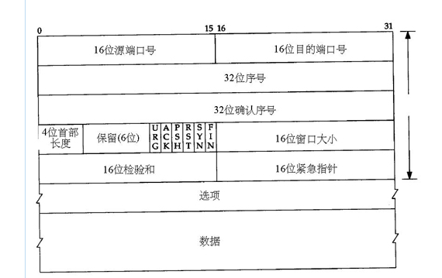
Tcp首部

Slide 61
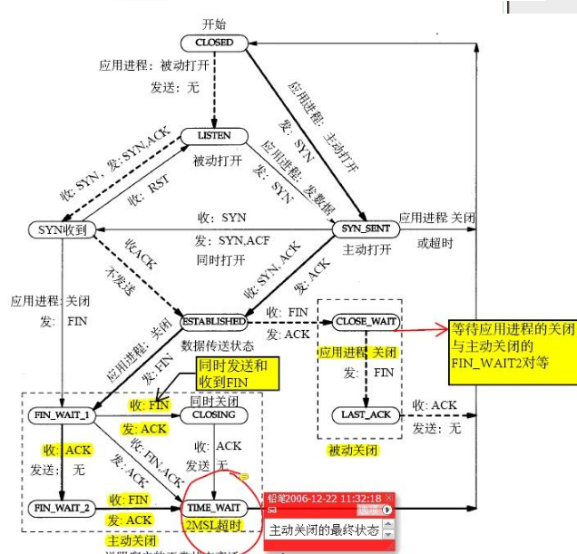

Slide 62
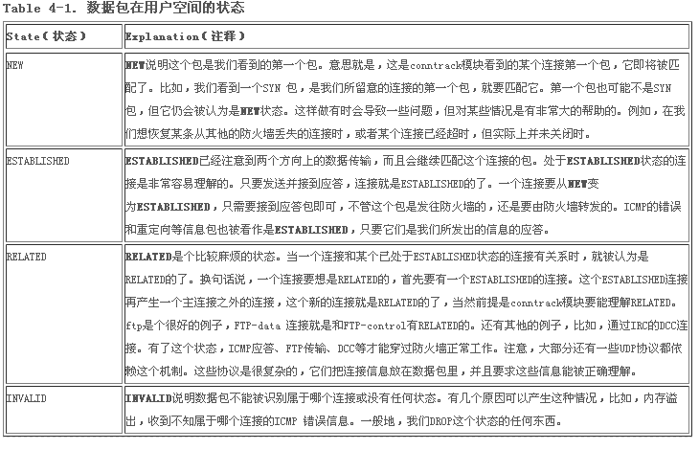

Slide 63
TCP/IP stack , kernel(rules)
iptables/netfilter
允许/不允许, filter
地址转换, nat
修改报文原数据，mangle

Slide 64
filter
  INPUT, FORWARD, OUTPUT
nat
  PREROUTING, OUTPUT, POSTROUTING
mangle
  PREROUTING, INPUT, FORWARD, OUTPUT, POSTROUTING

Slide 65
172.16.0.0/16, 172.16.0.1
  172.16.100.1
httpd
sshd
smb

Slide 66
172.16.0.0/16, 172.16.0.1
  172.16.0.1
192.16.10.19
sshd
httpd
Client
172.16
.100.1
10.18
smb

Slide 67
1、web被dnat出去；
2、仅允许每天08:00-12:00和14:00-22:00访问；
3、使用iptables记录日志，每分钟10个包；
4、拒绝访问URL资源中包含prohibit字符串的web资源；
5、每个IP发起的并发请求数不得超出3个；
web
index.html
prohibit.html
Client
DNAT

Slide 68
172.16.0.0/16, 172.16.0.1
  172.16.100.1
httpd
sshd
smb

Slide 69
SNAT
192.168.10.7
172.16.100.1
192.168.10.18
172.16.100.2
Internet

Slide 70
80
Internet
22

Slide 71




SNAT策略的应用环境
Linux网关服务器
Internet
eth0: 218.29.30.31/30
eth1: 192.168.0.1/24
www.google.com
218.29.30.29
局域网PC机
192.168.0.100/24

Slide 72
SNAT策略的原理
未使用SNAT策略时的情况
Linux网关服务器
eth1：192.168.0.1
eth0：218.29.30.31
局域网客户端
192.168.0.100
Internet中的Web服务器
218.29.30.29
源地址：192.168.0.100
目标地址：218.29.30.29
源地址：192.168.0.100
目标地址：218.29.30.29
路
由
转
发
HTTP请求
HTTP请求
HTTP应答
无法正确路由
源地址：218.29.30.29
目标地址：192.168.0.100

Slide 73
SNAT策略的原理
在网关中使用SNAT策略以后
Linux网关服务器
eth1：192.168.0.1
eth0：218.29.30.31
局域网客户端
192.168.0.100
Internet中的Web服务器
218.29.30.29
源地址：192.168.0.100
目标地址：218.29.30.29
源地址：218.29.30.31
目标地址：218.29.30.29
SNAT
转换
HTTP请求
HTTP请求
HTTP应答
源地址：218.29.30.29
目标地址：192.168.0.100
源地址：218.29.30.29
目标地址：218.29.30.31

Slide 74
DNAT策略的应用环境
Linux网关服务器
Internet
www.benet.com
eth0: 218.29.30.31/30
eth1: 192.168.0.1/24
Internet中的客户机
218.29.30.29
网站服务器192.168.0.6/24
Ssh服务器

Slide 75
DNAT策略的原理
在网关中使用DNAT策略发布内网服务器
Linux网关服务器
eth0：218.29.30.31
eth1：192.168.0.1
局域网内的Web服务器
192.168.0.6
Internet中的客户机
218.29.30.29
源地址：218.29.30.29
目标地址：192.168.0.6
源地址：218.29.30.29
目标地址：218.29.30.31
DNAT
转换
HTTP请求
HTTP请求
HTTP应答
HTTP应答
源地址：192.168.0.6
目标地址：218.29.30.29
源地址：218.29.30.31
目标地址：218.29.30.29

Slide 76
工作网络层的防火墙
工作于应用层的应用层网关

Slide 77
源地址转换
sshd
ftp
sshd
192.168.0.34
192.168.10.20
Web
Client
httpd
192.168.10.10
192.168.0.73

Slide 78
192.168.0.y/24
192.168.0.x/24
172.16.0.1/24
172.16.0.2/24
10.0.0.1/24
10.0.0.2/24
www.a.org
ftp.a.org
ns.a.org
web
ftp
dns

Slide 79
Firewall
  组件，工作网络边缘（主机边缘），对进出本网络数据包基于一定的规则进行检查，并在匹配某规则时由规则定义的处理机制进行处理的

Slide 80
tcp/ip,内核中
选择了5个位置，hook function

Slide 81
PREROUTING
INPUT
OUTPUT
FORWARD
POSTROUTING
filter: INPUT,OUTPUT,FOWARD
nat: PREROUTING, POSTROUTING, OUTPUT
mangle：
raw：PREROUTING,OUTPUT

Slide 82
Objectives
Upon completion of this unit, you should be able to:
  Describe IP and Routing
  Compare IPv4 and IPv6
  Describe IPv6 Features
  Understand Netfilter Architecture
  Learn to use the iptables command
  Understand Network Address Translation(NAT)

Slide 83
What is IPTables?
IPTables are building blocks of a framework within the Linux 2.4.x and 2.6.x kernels.
It is the successor of IPChains (2.2.x) and ipfwadm (2.0.x)
This framework enables packet filtering, network addresss [and port] translation (NA[P]T).
Also allows packet mangling.

Slide 84
Contd.
It works by creating a generic table structure of rulesets.
As in IPChains, each rule in an IPTable consists of a set of classifiers (IPTable matches) and a corresponding action (IPTable target).
IPTables, along with NetFilter, Connection Tracking, and the NAT Subsystem make up the entire framework.

Slide 85
Salient Features
Stateless Packet Filtering (IPv4 and IPv6)
Packet Filtering with states (as in IPv4)
All types of network address and port translation (NAT/NAPT)
Multiple layers of API's for 3rd party extensions
Large number of plugins and modules kept in a repository.

Slide 86
What can be done with IPTables?
Build internet firewalls based on packet filtering, with or without specifying states.
Use NAT and masquerading for sharing internet access if you don't have enough public IP addresses.
Do further packet manipulation (mangling), such as altering the TOS (Type of Service) bits of the IP header

Slide 87
PREROUTING,INPUT,FORWARD,OUTPUT, POSTROUTING
nat, filter, mangle, raw
-R
-A
-N
-D
-X

Slide 88
iptables -t filter INPUT -d 192.168.0.2 -p icmp --icmp-type 8 -j DROP
iptables -t filter OUTPUT -s 192.168.0.2 -p icmp --icmp-type 0 -j DROP
  iptables -F
  iptables -t filter -R DROP
  iptables -A INPUT -s 0.0.0.0/0.0.0.0 -p tcp --dport 22 -j ACCEPT
iptables -t nat -A PREROUTING -s 192.168.0.0/24 -j SNAT --to-source 1.1.1.1
iptables -t filter -A FORWARD -s 192.168.0.10/24 -d 1.1.1.1 -j DROP

Slide 89
iptables -t nat -A POSTROUTING -s 192.168.0.0/24 -d 1.0.0.0/24 -j MASQUERADE
iptables -t filter -A FORWARD -s 192.168.0.0/24 -d 1.0.0.253 -j DROP

Slide 90
-m {state|multiport|limit|mac}
Connection State
  NEW: SYN=1, FIN ACK RST=0
  ESTABLISHED: ACK=1
  RELATED: (ftp)
  INVALID
multiport
  --source-ports
  --destination-ports
  --ports

Slide 91
limit
  --limit /second, /hour, /minute, /day , /month
  --limit-burst
mac
  --mac-source XX:XX:XX:XX:XX:XX

Slide 92
iprange
  [!]--src-range ip-ip
  [!]--dst-range ip-ip
string
  --string pattern
  --algo bm|kmp

Slide 93
connlimit

Slide 94
Local:192.168.0.0 Remote :1.0.0.0/24
Inner:192.168.0.254
Outer:1.1.1.1
Local machine:192.168.0.2, 192.168.0.3
iptables -t nat -A PREROUTING -s 1.0.0.0/24 -d 1.1.1.1 -p tcp --dport 2020 -j DNAT --to-dest 192.168.0.2:22
iptables -A FORWARD -s 1.0.0.253 -d 192.168.0.2 -p tcp --dport 22 -j DROP

Slide 95
service iptables restart
service iptables save
  /etc/sysconfig/iptables
iptables-save > /etc/sysconfig/myrules
iptables-restore < /etc/sysconfig/myrules.2

Slide 96
at now+3min
  iptables-save > /etc/syspconfig/myrules.3
  iptables -t filter -F
iptables -A INPUT -p tcp --dport 22 -j DROP

Slide 97
WEB
  iptables -P INPUT DROPdestination-ports 22,25,80 -j ACCEPT
  iptables -P OUTPUT DROP
  iptables -A INPUT -d 192.168.0.2 -p tcp --dport 80 -m state --state NEW -j ACCEPT
  iptables -A INPUT -d 192.168.0.2 -p tcp --dport 25 -m state --state NEW -j ACCEPT
  iptables -A INPUT -d 192.168.0.2 -p tcp --dport 22 -m state --state NEW -j ACCEPT
  iptables -A INPUT -d 192.168.0.2 -p tcp -m state --state NEW -m multiport --destination-ports 22,25,80 -j ACCEPT
  iptables -A OUTPUT -s 192.168.0.2 -p tcp --sport 80 -m state --state ESTABLISHED -j ACCEPT

Slide 98
-m state
  NEW
  ESTABLISHED
  RELATED
  INVALID
-m multiport
  --source-ports port1,port2,port3,…
  --destination-ports port1,port2,port3,…
  --ports port1,port2,port3,…

Slide 99
/sbin/modprobe ip_conntrack_ftp
iptables -A INPUT -p TCP -i eth0 --dport 21 -m state --state NEW -j ACCEPT
iptables -A INPUT -p ALL -m state --state ESTABLISHED,RELATED -j ACCEPT
iptables -A OUTPUT -p ALL -m state --state ESTABLISHED,RELATED -j ACCEPT

Slide 100
sshd
  iptables -A INPUT -s OTHERs -d LOCAL_IP -p tcp --dport 22 -m state --state NEW,ESTABLISHED -j ACCEPT
  iptables -A OUTPUT -s LOCAL_IP -d OTHERs -p tcp --sport 22 -m state --state ESTABLISHED -j ACCEPT
ftp
  modprobe ip_conntrack_ftp
  iptables -A INPUT -s OTHERs -d LOCAL_IP -p tcp --dport 21 -m state --state NEW,ESTABLISH -j ACCEPT
  iptables -A INPUT -s OTHERs -d LOCAL_IP -m state --state ESTABLISHED,RELATED -j ACCEPT
  iptables -A OUTPUT -s LOCAL_IP -d OTHERs -p tcp --sport 21 -m state --state ESTABLISHED -j ACCEPT
  iptables -A OUTPUT -s LOCAL_IP -d OTHERS -m state --state ESTABLISHED,RELATED -j ACCEPT

Slide 101
SNAT策略概述
SNAT策略的典型应用环境
  局域网主机共享单个公网IP地址接入Internet
SNAT策略的原理
  源地址转换，Source Network Address Translation
  修改数据包的源IP地址

Slide 102
SNAT策略的应用环境
Linux网关服务器
Internet
eth0: 218.29.30.31/30
eth1: 192.168.0.1/24
www.google.com
218.29.30.29
局域网PC机
192.168.0.100/24

Slide 103
SNAT策略的原理
未使用SNAT策略时的情况
Linux网关服务器
eth1：192.168.0.1
eth0：218.29.30.31
局域网客户端
192.168.0.100
Internet中的Web服务器
218.29.30.29
源地址：192.168.0.100
目标地址：218.29.30.29
源地址：192.168.0.100
目标地址：218.29.30.29
路
由
转
发
HTTP请求
HTTP请求
HTTP应答
无法正确路由
源地址：218.29.30.29
目标地址：192.168.0.100

Slide 104
SNAT策略的原理
在网关中使用SNAT策略以后
Linux网关服务器
eth1：192.168.0.1
eth0：218.29.30.31
局域网客户端
192.168.0.100
Internet中的Web服务器
218.29.30.29
源地址：192.168.0.100
目标地址：218.29.30.29
源地址：218.29.30.31
目标地址：218.29.30.29
SNAT
转换
HTTP请求
HTTP请求
HTTP应答
源地址：218.29.30.29
目标地址：192.168.0.100
源地址：218.29.30.29
目标地址：218.29.30.31

Slide 105
SNAT策略的应用
SNAT的应用案例
Linux网关服务器
Internet
eth0: 218.29.30.31/30
eth1: 192.168.0.1/24
www.google.com
218.29.30.29/30
局域网PC机
192.168.0.100/24

Slide 106
SNAT策略的应用
前提条件
  局域网各主机正确设置IP地址/子网掩码
  局域网各主机正确设置默认网关地址
推荐实现步骤
  1. 开启网关主机的路由转发功能
  2. 添加使用SNAT策略的防火墙规则
  规则示例：
  iptables -t nat -A POSTROUTING -s 192.168.0.0/24
  -o eth0 -j SNAT --to-source 218.29.30.31
在路由选择之后再进行处理
来自特定局域网段的数据包
需要从接口eth0外出的数据包
网关主机外网接口的IP地址

Slide 107
SNAT策略的应用
验证SNAT结果
  在局域网主机中（192.168.0.100）应能够访问外网的Web服务器（218.29.30.29）
    命令行执行 “elinks http://218.29.30.29” 进行访问
  查看外网测试主机（218.29.30.29）的Web访问日志，记录的应为网关主机的公网IP地址(218.29.30.31)
[root@localhost ~]# tail -f /var/log/httpd/access_log
218.29.30.31 - - [04/Jun/2009:14:02:02 +0800] "GET / HTTP/1.1" 403 3985 "-" "ELinks/0.11.1 (textmode; Linux; 80x25-2)"

Slide 108
网关使用动态公网IP地址的情况
MASQUERADE（地址伪装）策略
  只需将 “-j SNAT --to-source 218.29.30.31”的形式改为“-j MASQUERADE”即可
  如果是通过ADSL拨号方式连接Internet，则外网接口名称通常为 ppp0、ppp1等
MASQUERADE策略应用示例
[root@localhost ~]# iptables -t nat -A POSTROUTING -s 192.168.0.0/24
-o ppp0 -j MASQUERADE

Slide 109
DNAT策略概述
DNAT策略的典型应用环境
  在Internet中发布位于企业局域网内的服务器
DNAT策略的原理
  目标地址转换，Destination Network Address Translation
  修改数据包的目标IP地址

Slide 110
DNAT策略的应用环境
Linux网关服务器
Internet
www.benet.com
eth0: 218.29.30.31/30
eth1: 192.168.0.1/24
Internet中的客户机
218.29.30.29
网站服务器192.168.0.6/24
Ssh服务器

Slide 111
DNAT策略的原理
在网关中使用DNAT策略发布内网服务器
Linux网关服务器
eth0：218.29.30.31
eth1：192.168.0.1
局域网内的Web服务器
192.168.0.6
Internet中的客户机
218.29.30.29
源地址：218.29.30.29
目标地址：192.168.0.6
源地址：218.29.30.29
目标地址：218.29.30.31
DNAT
转换
HTTP请求
HTTP请求
HTTP应答
HTTP应答
源地址：192.168.0.6
目标地址：218.29.30.29
源地址：218.29.30.31
目标地址：218.29.30.29

Slide 112
DNAT策略的应用
DNAT的应用案例
Linux网关服务器
Internet
www.benet.com
eth0: 218.29.30.31/30
eth1: 192.168.0.1/24
Internet中的客户机
218.29.30.29
网站服务器192.168.0.6/24

Slide 113
DNAT策略的应用
前提条件
  局域网的Web服务器正确设置了IP地址/子网掩码
  局域网的Web服务器正确设置了默认网关地址
推荐实现步骤
  1. 确认已开启网关的路由转发功能
  2. 添加使用DNAT策略的防火墙规则
  规则示例：
  iptables -t nat -A PREROUTING -i eth0 -d 218.29.30.31 -p tcp --dport 80 -j DNAT --to-destination 192.168.0.6
在路由选择之前进行处理
从外网接口eth0进入的数据包
访问网关的公网IP地址的数据包
访问标准Web服务端口的数据包
内网中Web服务器的实际IP地址

Slide 114
DNAT策略的应用
验证DNAT结果
  在外网测试机（218.29.30.29）中，应能够通过浏览器访问网关公网IP地址（218.29.30.31）的80端口
    命令行执行 “elinks http://218.29.30.31”进行访问
    —— 实际网页内容由主机 192.168.0.6 提供
  查看局域网内Web服务器（192.168.0.6）的Web访问日志，应记录了外网测试机的IP地址(218.29.30.29)
[root@localhost ~]# tail -f /var/log/httpd/access_log
218.29.30.29 - - [04/Jun/2009:14:35:53 +0800] "GET / HTTP/1.1" 200 15 "-" "ELinks/0.11.1 (textmode; Linux; 80x25-2)"

Slide 115
通过DNAT策略同时修改目标端口号
使用形式
  只需要在“--to-destination”后的目标IP地址后面增加“:端口号”即可，即：
    -j DNAT --to-destination 目标IP:目标端口
通过DNAT策略修改目标端口号的应用示例
  从Internet中访问网关主机（218.29.30.31）的 80 端口时，实际由运行在局域网主机（192.168.0.5）的 8080 端口的应用程序提供服务
[root@localhost ~]# iptables -t nat -A PREROUTING -i eth0 -d 218.29.30.31 -p tcp --dport 80 -j DNAT --to-destination 192.168.0.5:8080

Slide 116
SNAT
172.16.100.6
192.168.10.6
Remote
Client
Local
Server
192.168.10.128
172.16.100.1

Slide 117
SNAT:
  ipv4

Slide 118
DNAT, PNAT
ip
  web, smtp, dns
80

Slide 119
SNAT
Internet
Local
Client

Slide 120
DNAT
Local
telnet
Server
10.7
Internet
Client
Local
Web
Server

Slide 121
邮件服务
nginx
awk, sudo

Slide 122
10.0.x.1
192.168.10.6
vmnet1
172.16.x.1
192.168.10.128

Slide 123
ACK, SYN, FIN, RST

Slide 124
l7-filter

Slide 125
二进制文件，库文件，配置文件，帮助文件
/usr/local/apache/
source:
  tar zxvf package-1.1.1.tar.gz
  cd package-1.1.1
  ./configure --prefix
  make
  make install

Slide 126
Application Layer Packet Classifier
L7-filter is a classifier for Linux's Netfilter that identifies packets based on application layer data.
  It can classify packets as Kazaa, HTTP, Jabber, Citrix, Bittorrent, FTP, Gnucleus, eDonkey2000, etc., regardless of port.
  It complements existing classifiers that match on IP address, port numbers and so on.
http://l7-filter.sourceforge.net/

Slide 127
userspace-beta

Slide 128
iptables tcp/ip
l7-filter
App data →
netfilter,
iptables

Slide 129
What Need To Get
The 2.4 or 2.6 Linux kernel source (2.6 strongly preferred) from kernel.org
The iptables source from netfilter.org
"l7-filter kernel version" package (netfilter-layer7-vX.Y.tar.gz)
"Protocol definitions" package (l7-protocols-YYYY-MM-DD.tar.gz)

Slide 130
Kernel Patch
Use the appropriate kernel patch from the "Layer 7 patches" package to patch the kernel
  Please read the README in the package to determine which patch to use
  # tar zxvf linux-2.6.28.10.tar.gz -C /usr/src
  # tar zxvf netfilter-layer7-v2.22.tar.gz -C /usr/src
  # ln –s /usr/src/linux-2.6.28.10/ /usr/src/linux
  # cd /usr/src/linux/
  # patch -p1 < ../netfilter-layer7-v2.22/kernel-2.6.25-2.6.28-layer7-2.22.patch

Slide 131
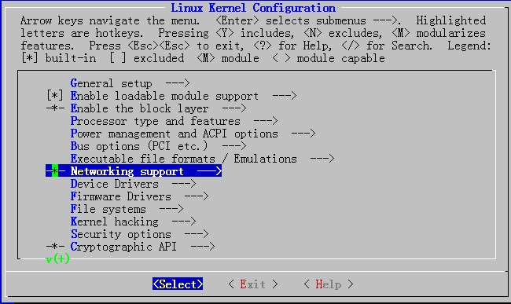
Configuring and Compiling the kernel
Before you configure kernel make sure you have development tools (gcc compilers and related tools) are installed on your system.
  # cp /boot/config-2.6.18-164.el5 /usr/src/linux/.config
  # make menuconfig

Slide 132
Configuring and Compiling the kernel
Networking support → Networking Options →Network packet filtering framework →Core Netfilter Configuration
  <M> Netfilter connection tracking support
  <M> “layer7” match support
  <M> “string” match support
  <M> “time” match support
  <M> “iprange” match support
  <M> “connlimit” match support
  <M> “state” match support
  <M> “conntrack” connection match support
  <M> “mac” address match support
  <M> "multiport" Multiple port match support

Slide 133
Configuring and Compiling the kernel
Networking support → Networking Options →Network packet filtering framework → IP: Netfilter Configuration
  <M> IPv4 connection tracking support (required for NAT)
  <M> Full NAT
    <M> MASQUERADE target support <M> NETMAP target support <M> REDIRECT target support

Slide 134
Compiling and installing the kernel
Start compiling and installing
  make
  make modules_install
  make install
Edit the /boot/grub/grub.conf, set the default booting kernel to the new kernel
Restart

Slide 135
iptables
# cp /etc/init.d/iptables ~/iptables
# cp /etc/sysconfig/iptables-config ~/
# rpm -e iptables-ipv6 iptables iptstate --nodeps
# tar jxvf iptables-1.4.6.tar.bz2 –C /usr/src
# cd /usr/src/iptables-1.4.6
# cp ../netfilter-layer7-v2.22/iptables-1.4.3forward-for-kernel-2.6.20forward/libxt_layer7.* ./extensions/
./configure --prefix=/usr --with-ksource=/usr/src/linux
make
make install

Slide 136
iptables
# tar zxvf l7-protocols-2009-05-28.tar.gz
# cd l7-protocols-2009-05-28
# make install
# mv ~/iptables /etc/rc.d/init.d/
# service iptables start

Slide 137
l7-filter uses the standard iptables extension syntax
  iptables [specify table & chain] -m layer7 --l7proto [protocol name] -j [action]

Slide 138
L7-filter Supported Protocols
bittorrent
  P2P filesharing / publishing tool
edonkey
  eDonkey2000 - P2P filesharing
kugoo
  KuGoo - a Chinese P2P program
msn-filetransfer
  MSN (Micosoft Network) Messenger file transfers
msnmessenger
  Microsoft Network chat client
pplive
  Chinese P2P streaming video
qq
xunlei

Slide 139
connlimit
  [!] --connlimit-above n
  Allows you to restrict the number of parallel connections to a server per client IP address (or client address block).
  Example:
    iptables -A INPUT -p tcp --syn --dport 22 -m connlimit --connlimit-above 2 -j REJECT
    Allow 2 ssh connections per client host

Slide 140
string
  This modules matches a given string by using some pattern matching strategy.
  It requires a linux kernel >= 2.6.14.
  [!] --string pattern
    Matches the given pattern.
  --algo {bm|kmp}
    Select the pattern matching strategy. (bm = Boyer-Moore, kmp = Knuth-Pratt-Morris)
  Examples:
    iptables –A OUTPUT –p udp --dport 53 -m string --string “verycd” --algo bm -j DROP
    iptables -A OUTPUT -p tcp --dport 80 -m string --string “法轮功” --algo kmp -j DROP
Notes:
The Boyer-Moore algorithm is considered as the most efficient string-matching algorithm in usual applications.
The Boyer–Moore string search algorithm is a particularly efficient string searching algorithm, and it has been the standard benchmark for the practical string search literature.[1] It was developed by Bob Boyer and J Strother Moore in 1977. The algorithm preprocesses the target string (key) that is being searched for, but not the string being searched in (unlike some algorithms that preprocess the string to be searched and can then amortize the expense of the preprocessing by searching repeatedly). The execution time of the Boyer-Moore algorithm can be sub-linear: it doesn't need to check every character of the string to be searched, but rather skips over some of them. Generally the algorithm gets faster as the key being searched for becomes longer. Its efficiency derives from the fact that with each unsuccessful attempt to find a match between the search string and the text it's searching, it uses the information gained from that attempt to rule out as many positions of the text as possible where the string cannot match.

Slide 141
time
  This matches if the packet arrival time/date is within a given range.
  --datestart YYYY[-MM[-DD[Thh[:mm[:ss]]]]]
  --datestop YYYY[-MM[-DD[Thh[:mm[:ss]]]]]
    Only match during the given time, The possible time range is 1970-01-01 T00:00:00 to 2038-01-19 T04:17:07
  --timestart hh:mm[:ss]
  --timestop hh:mm[:ss]
    The possible time range is 00:00:00 to 23:59:59.
    Leading zeroes are allowed.
Notes:
The Knuth–Morris–Pratt string searching algorithm (or KMP algorithm) searches for occurrences of a "word" W within a main "text string" S by employing the observation that when a mismatch occurs, the word itself embodies sufficient information to determine where the next match could begin, thus bypassing re-examination of previously matched characters.
The algorithm was conceived by Donald Knuth and Vaughan Pratt and independently by J. H. Morris in 1977, but the three published it jointly.

Slide 142
time
  [!] --monthdays day[,day...]
    Only match on the given days of the month. Possible values are 1 to 31.
  [!] --weekdays day[,day...]
    Only match on the given weekdays. Possible values are Mon, Tue, Wed, Thu, Fri, Sat, Sun, or values from 1 to 7, respectively.
  Examples:
    -m time --weekdays Sa,Su
    -m time --timestart 12:30 --timestop 13:30

Slide 143
-j LOG
  --log-level level
    Level of logging
  --log-prefix prefix
    Prefix log messages with the specified prefix; up to 29 letters long, and useful for distinguishing messages in the logs.
  --log-tcp-options
    Log options from the TCP packet header.
  --log-ip-options
    Log options from the IP packet header.

Slide 144
项目
某公司根据业务规划，需要建立一个DMZ区域，并在其中提供DNS, WWW, FTP, MYSQL, NFS等服务；
公司申请获得了一个公网IP，123.18.1.32/24，并注册申请了域名test.org；
现期望：
  内网用户能够通过这个申请到的公网IP访问互联网；
  通过公网IP将内网中的DNS，WWW, FTP, MYSQL服务输出给互联网和内网用户访问；NFS服务则只允许DMZ区域和内网用户访问；
    WWW为LAMP架构；
    FTP需要开启虚拟帐号的功能，且其访问的目录为了扩展，希望使用逻辑卷(比如，挂载至/var/upload);
  为加强安全，内网主机不允许来自互联网的主机访问；
  内网用户访问DNS, WWW等服务器时使用路由方式直接访问，而外网用户则需要通过外网地址访问；
  DMZ区域中的主机不能主动向别的主机发起连接请求；
  请根据以上要求给出你的设计图；而后模拟实现此应用；

Slide 145
WWW
DNS

