Slide 5
http, smtp
Apache: https

Slide 6
www.taobao.com
Client
Web: https
443
www.taobao.com

Slide 8
www.magedu.com

Slide 9
名称解析，40，5W
gethostname
hosts
2.2.2.2
DNS
IANA

Slide 10
domain:逻辑, zone:物理

Slide 11
主
辅助
辅助

Slide 13
DH
Pub key encryption KE

Slide 15
快照
20G
40G
LV:
Vg:
Pv:8e
20G
20G
20G

Slide 16
pvcreate, pvremove, pvmove, pvscan, pvdisplay, pvs
vgcreate, vgdisplay, vgextend, vgreduce, vgs, vgscan
lvcreate, lvdisplay, lvremove, lvreduce, lvextend, lvs

Slide 17
1G: physical
fs: logical

Slide 20
sudo
什么是sudo？
  Sudo是可以让某个用户不需要拥有管理员的账号密码，可以执行管理员的权限的。
  作为管理员可以指派某些用户可以执行某些特定命令，类似于suid

Slide 21
172.16.100.1
192.168.0.254
172.16.0.1
192.168.0.51

Slide 22
Who which_host=(whom) COMMAND
  Which_host
  Linux NIS域

Slide 23
10
NIS

Slide 24
Sudo的特点
它的特性主要有这样几点：
  Sudo能够限制用户只在某台主机上运行某些命令
  Sudo提供了丰富的日志，详细地记录了每个用户干了什么。它能够将日志传到中心主机或者日志服务器
  Sudo使用时间戳文件来执行类似的“检票”系统。当用户调用sudo并且输入它的密码时，用户获得了一张存活期为5分钟的票(这个值可以在编译的时候改变)
  Sudo的配置文件是sudoers文件，它允许系统管理员集中的管理用户的使用权限和使用的主机。它所存放的位置默认是在/etc/sudoers，属性为0440

Slide 25
如何配置sudo
配置文件：/etc/sudoers （sudo的配置文件定义很严格权限为400）
语法 who which_host=(whom) command
编辑命令visudo

Slide 28
文件系统不一致
20G， 2h

Slide 29
缺页异常
2G, X2
2G,4G
>4G, 2G

Slide 30
角速度

Slide 31
c/s

Slide 33
y

Slide 35
CLI
GUI
System Call

Slide 37
Boot sector

Slide 44
Track, cylinder:柱面

Slide 48
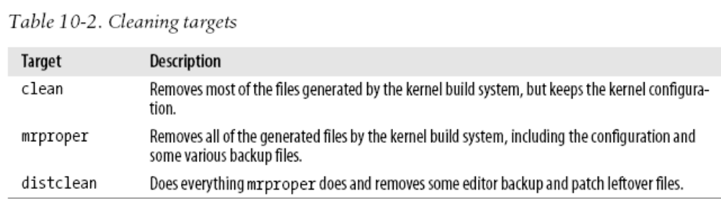

Slide 49
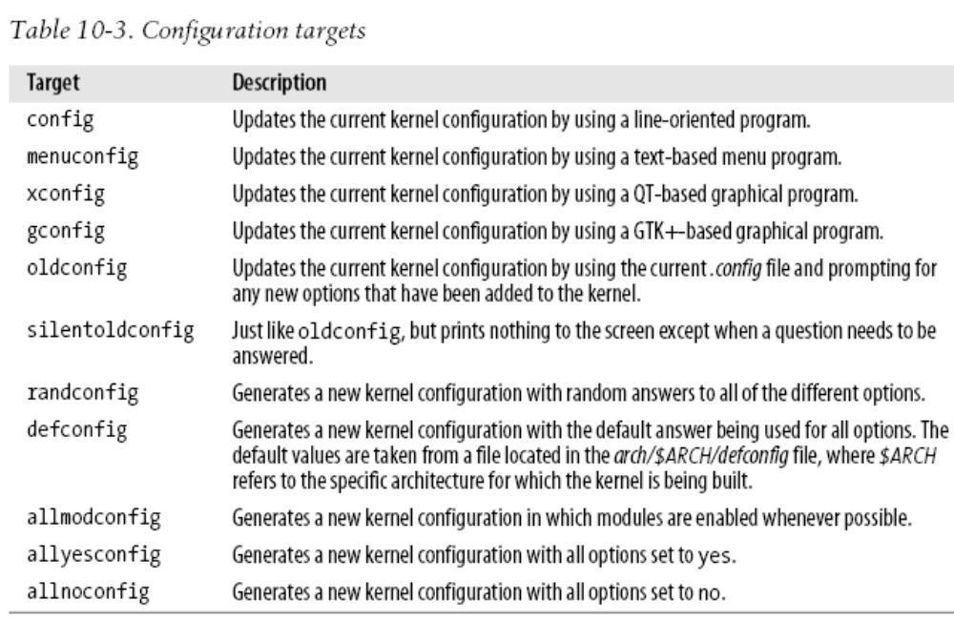

Slide 50
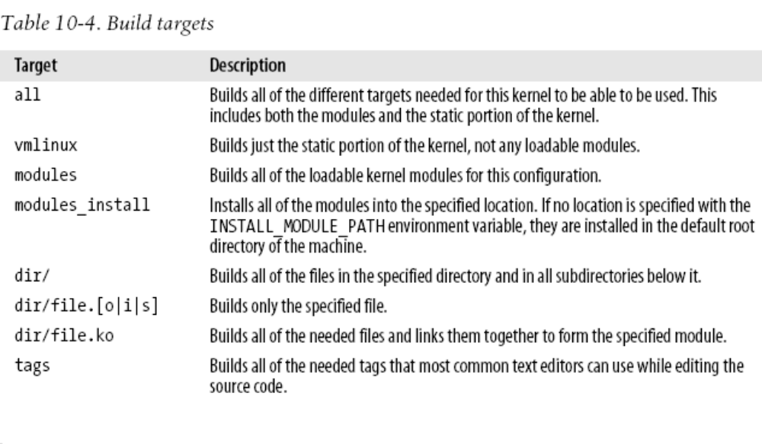
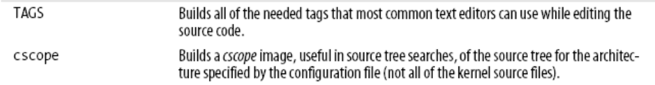

Slide 51
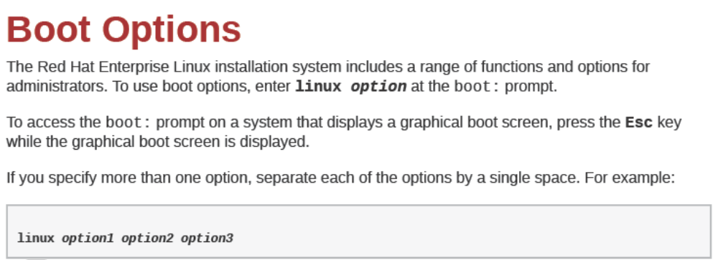

Slide 52
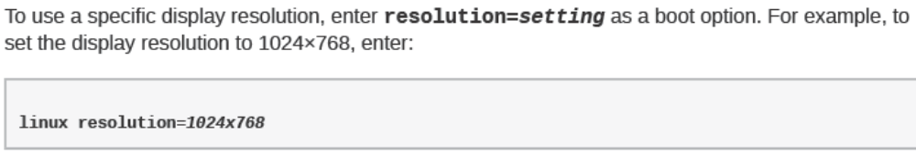
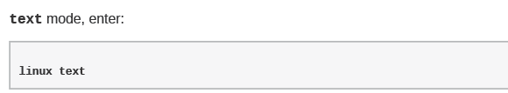

Slide 53
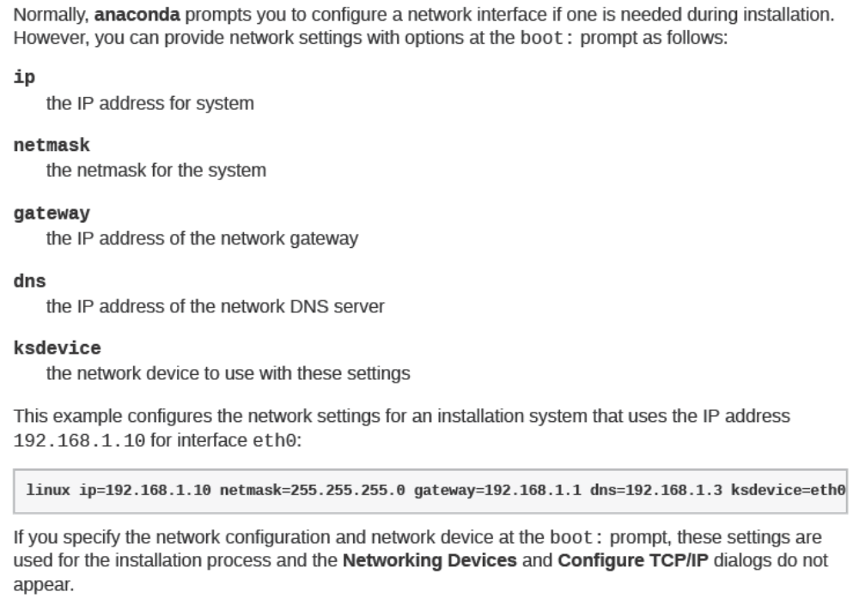

Slide 54
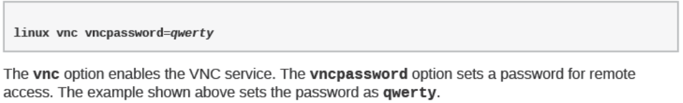
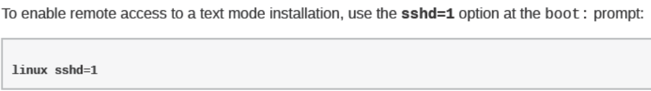

Slide 55
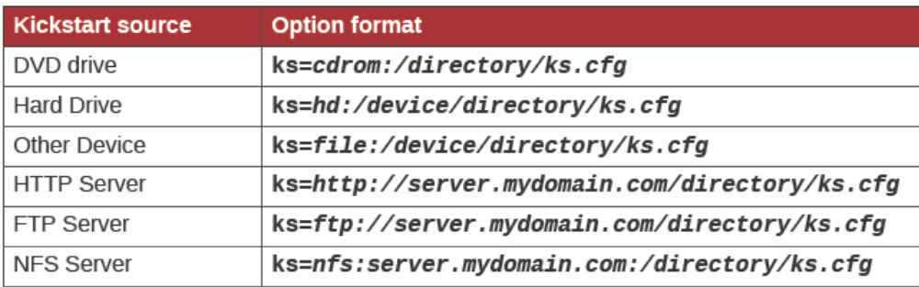

Slide 56
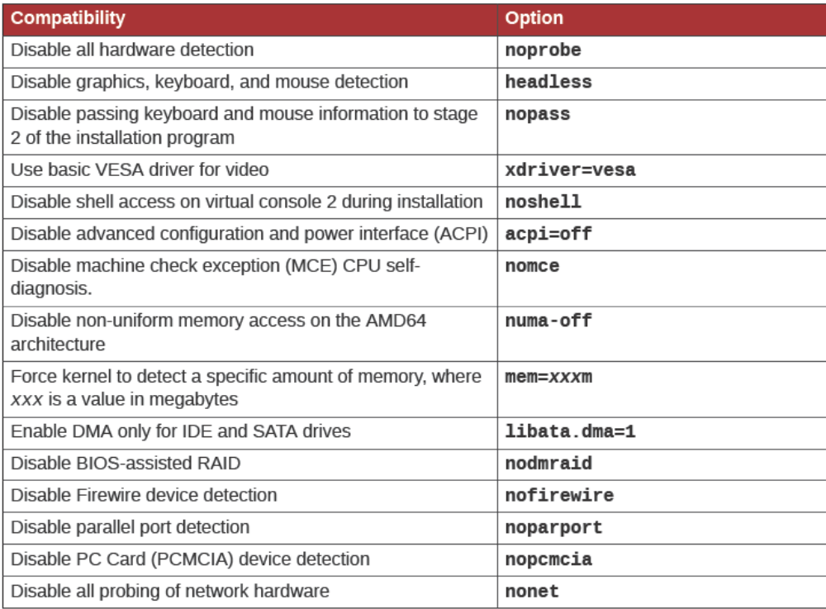
Overriding Automatic Hardware Detection

Slide 57

make SUBDIR=arch/

Slide 58
./a.sh p1 p2 p3 p4 p5 … p20
  $1, $2,…, $5
  echo $1
  shift

Slide 59
rpm
Redhat
  up2date
  Yellow Dog
  yum→ rpm: Yellowdog Updater Modified
  X->x2->y

Slide 60
C/S
  yum
  yum repository
  X
XML:X→X1→X2→Y
all rpms
XML
yum

Slide 62
Protocols
  ftp://
  http://
  file:///
/etc/yum.conf
/etc/yum.repos.d/FILE.repo

Slide 64
root,a, /tmp/a.txt
kernel
  系统初始化
  进程调度:
    0-99
    100-139
  内存管理
  安全管理
    perm, selinux(c2→B1), netfilter
  提供buffer和cache提高系统性能
  文件系统(VFS:ext2, ext3, ext4, vfat, iso9660, xfs, jfs, reiserfs, swap, nfs, smbfs)
hardware

Slide 65
内核设计：
  微内核
  单内核：
    模块化的设计
    Linux内核组成
      kernel
        initrd
      kernel object .ko
内核编译时选用的选项不同，功能也不同
  Standard: 4G
    kernel: 1G
    process: 3G
  PAE: 16G

Slide 66
kernel
  64, 512G
kernel-xen
  126, 512G

Slide 68
ext3, ext4, ext2, xfs, jfs, reiserfs, iso9660, swap, vfat
write(), open(), read()

Slide 69
SCSI
RAID
iSCSI
inode

Slide 70
/var/tmp/a.txt
  Sda5
  /mydata, /dev/sda5

Slide 71
虚拟内存
  在磁盘的一片空间
  pm
  LRU
多大：
  <2G, 2X
  2G<, <4G, 1.5X
  >=4G, 4G

Slide 73
GNU/Linux
  rpm → 依赖关系，up2date
  specs
  rpm, 数据库 → 指纹信息 → 签名
  二进制文件 /bin, /sbin, /usr/bin, /usr/sbin, /usr/local/bin, /usr/local/sbin,
  配置文件 /etc , /usr/local/etc ,
  库文件 /lib, /usr/lib, /usr/local/lib, /usr/X11/lib
  帮助文件 /usr/share/doc, /usr/share/man, /usr/local/share/man

Slide 74
rpm
  -ivh, --nodeps
  -Uvh or –Fvh --force Y-3 → X-2
  -e
  -q
    -qa
    -ql package_name
    -qf
  -V

Slide 75
--nosignature
  Don't verify package or header signatures when reading.
--oldpackage
  Allow an upgrade to replace a newer package with an older one.
--test
  Do not install the package, simply check for and report potential conflicts.

Slide 76
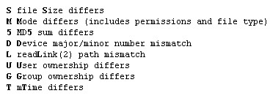

Slide 77
REBUILD DATABASE OPTIONS
rpm {--initdb|--rebuilddb} [-v] [--dbpath DIRECTORY]

Slide 78
DIGITAL SIGNATURE AND DIGEST VERIFICATION
  rpm --import PUBKEY ...
  rpm {--checksig} [--nosignature] [--nodigest] PACKAGE_FILE ...
  rpm -qa gpg-pubkey*
  RPM-GPG-KEY-redhat-release
  cd /etc/pki/rpm-gpg

Slide 79
ftp://, http://, nfs, file:///
mysql-server
mysql

Slide 80
http://192.168.0.254/yum/Server

Slide 81
mkdir /media/cdrom /var/yum
mount /dev/cdrom /media/cdrom
cp -r /media/cdrom/* /var/yum/
chmod –R u+w /var/yum/
createrepo -g /var/yum/Server/repodata/comps-rhel5-server-core.xml /var/yum/Server

Slide 82
rpm, yum
/var/lib/rpm
  rpm -initdb
  rpm -rebuilddb
-ivh
-Uvh -Fvh
-e
-q
  a, f, l, i, p
-V
--test
--nodeps
--force
--oldpackage

Slide 83
/etc/yum.repos.d/
*.repo
[repo_name]
name=
baseurl=
enabled=
gpgcheck=

Slide 84
mkdir /var/yum
cp -r /media/cdrom/* /var/yum/
createrepo -g

Slide 85
yum
  install
  update
  erase, remove
  info
  search
  grouplist
  list
    all, installed, available, extras
  clean
    all
  groupinstall
  groupremove
  repolist
  localinstall
-y
-q
-t
--nogpgcheck

Slide 86
BIOS ← → CMOS (ROM)

Slide 87
removable device
harddisk
cdrom
MBR → Master Boot Record
  512
    446, bootloader,
    64, 16byte, 标识一个主分区
    2 ，magic code

Slide 88
446 → second stage
SCSI ← kernel,initrd

Slide 89
BIOS → Bootloader (MBR),
安装操作系统时提供
GRUB, LILO Linux LOader

Slide 90
/boot/grub/

Slide 91
(hd0,0)
ide, hda,hdb
scsi, sata, usb sd
/boot,/
  /boot/kernel
/boot
  /kernel

Slide 92
Image → Scale image → 640X480
Image → mode → Indexed → 256 改为14
File → Save As → picname.xpm
cp picname.xpm /boot/grub/
gzip /boot/grub/picname.xpm

Slide 93
root (hdn,n)
kernel /vmlinuz- quiet
initrd /initrd-
boot

Slide 94
fdisk /dev/sdb
  p
  n
  d
  w
  q
  l
  t

Slide 95
BIOS → Bootloader (MBR，two stage) → kernel, initrd → init(PID:1, /etc/inittab) → login → bash
  /etc/rc.d/rc.sysinit
  /etc/rc.d/rcN/
  /etc/rc.d/rc.local

Slide 96
GRUB
  /boot/grub/grub.conf
  /etc/grub.conf, /boot/grub/menu.lst
root (hd1,0)
setup (hd1)
grub-install --root-directory=/mnt /dev/sdb

Slide 97
独立守护进程， web
非独立守护进程 ← 超级守护进程 Xinetd

Slide 98
宿主机，
另一块装一个系统，

Slide 99
chroot
BIOS → Bootloader(MBR) → kernel, initrd → init (/etc/inittab) → (默认级别3) /etc/rc.d/rc.sysinit → /etc/rc.d/rcN.d/Snn → /etc/rc.d/rc.local → 6 virtual console (/etc/issue)→ login
shell

Slide 100
0, 1, 2, 3, 4, 5, 6
init 6
init 0
  /etc/rc.d/rcN.d/ → /etc/rc.d/init.d/
  独立守护进程，非独立守护进程（Xinetd）
  chkconfig daemon_name on
  chkconfig --list
  chkconfig --level 35 daemon_name on|off
  chkconfig --add
runlevel

Slide 101
start, stop, restart, status

Slide 102
Bootloader
  LILO → LInux Loader
  Grand Unified bootloader
Grub
  stage 1 (← MBR) → stage 2 (对应操作系统的启动分区，/boot
  kernel, rootfs, initrd
  /boot/grub/grub.conf
    default=0
    timeout=10
    title System
    root ()
    kernel / ro root= quiet
    initrd

Slide 103
sd: sata, scsi, usb /dev/sd[a-z]
hd: IDE,(ata) /dev/hd[a-z]
  /dev/hda, /dev/hdb, /dev/hdc, /dev/hdd
ide, 133M/s
sata, 300m/s, 600m/s
scsi, ultra scsi, 320m/s → SAS

Slide 104
xfs

Slide 106
-t fstype
-a 表示挂载/etc/fstab中的每一个文件系统
-r = -o ro
-w = -o rw
--bind
-o options
  ro
  rw
  loop
  remount
  defaults
  exec
  suid
  acl

Slide 107
umount /dev/device
umount /mount_point

Slide 108
主版号-次版号-发行号-修正号
2.6.34.2

Slide 109
动态模块加载的功能，ko
ntfs,

Slide 110
make menuconfig
make gconfig make xconfig
make config
make oldconfig
make allyesconfig
make allnoconfig
.config
make
make modules_install
make install

Slide 112
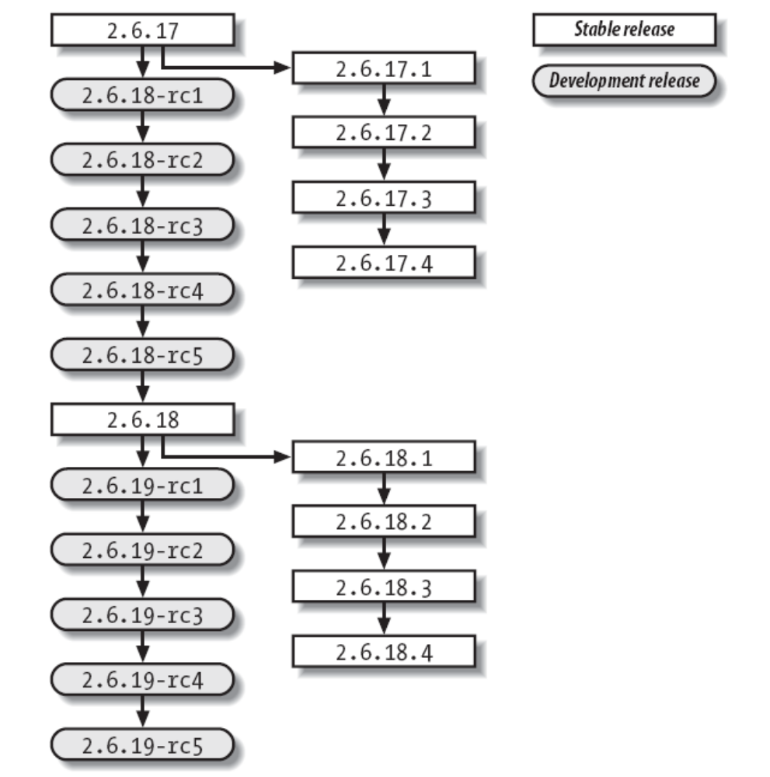

Slide 113
MBR → Bootloader, 64,
Extended, 5 or f
swap, 82
ext2/3 83
lvm 8e
raid, fd

Slide 114
fdisk –l /dev/[sh]d[a-z]
fdisk /dev/sda
n, d, p, t, w, q, l
partprobe
mkfs –t fstype
mkfs.fstype
mke2fs

Slide 115
-j
-b {1024|2048|4096}
-c
-i
-N
-m
-L
e2label
blkid
tune2fs
  -m
  -i
  -c
  -L
  -l

Slide 116
mount [options] -o [options] /dev/device /mount_point
-a /etc/fstab
-r, -w
--bind
-t
-o
  ro, rw, exec, suid, auto, loop, sync, async, nouser, acl, remount, dev, netdev, defaults

Slide 117
.ko

Slide 118
umount /dev/device
umount /mount_point
fuser -v /mount_point
fuser -km /mount_point

Slide 119
/etc/fstab
  device mount_point fstype mount_options dump_freq fsck_order
  /dev/hda3 /share ext3 defaults 0 0
/etc/mtab

Slide 120
Linux 2.6

Slide 121
内核模块，ko
/lib/modules/`uname –r`
/boot/vmlinuz-
uname -r -a

Slide 122
lsmod
modprobe module_name
modprobe -r module_name
modinfo module_name
insmod /path/to/module

Slide 123
initrd, rootfs + s
mkinitrd /boot/initrd-`uname –r`.img `uname -r`

Slide 124
目标主机
  硬盘：IDE
    分区：
      boot
      /
  CPU
  …
宿主机
linux-
busybox-

Slide 125
/mnt/boot
/mnt/sysroot

Slide 126
/mnt/boot
hda1
/mnt/sysroot
hda2
/mnt/temp
initrd

Slide 127
init → /etc/inittab → /etc/init.d/rcS →
mount –a
initrd
/etc/issue

Slide 128
宿主机：
  RedHat → bash → gcc (glibc) → gcc (glibc) → chroot {gcc(glibc) (bash,binutils)}
  gcc(glibc),binutils

Slide 129
/proc → 虚拟文件系统，伪，procfs
sys

Slide 130
/dev/console
/dev/null
/dev/zero
/dev/sda
/dev/cdrom
/dev/random 熵池
/dev/hd
/dev/sda, sdb,sdc,
Udev → 用户空间

Slide 131
usbs
/sys, sysfs

Slide 132
/dev/tty0, /dev/fb0
/dev/tty[1-6]
  chvt
  mingetty /etc/inittab
/dev/ttySn
/dev/console
  dmesg
  kernel parameter: console=ttyS0
/dev/pts/n
  GUI terminal
  SSH

Slide 133
X Window
X protocol ,
http, apache
c/s, X, → X window
Xorg
  x386
  XFree86
Xorg

Slide 134
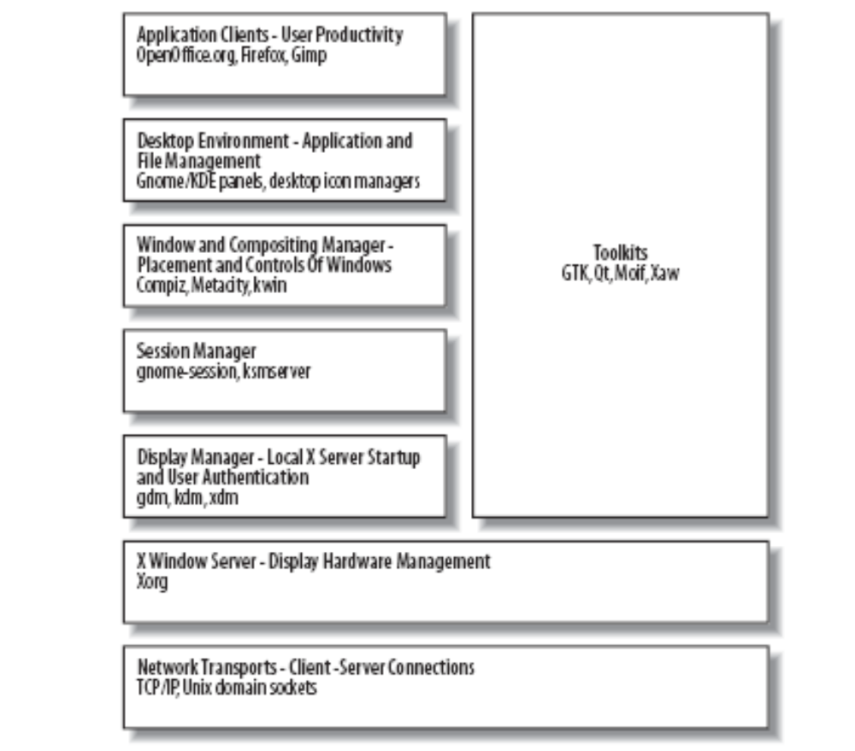

Slide 135
Gnome → twm→ gnome-session → X server → Xorg

Slide 136
Display Hardware
Zero or more pointing devices (mice, trackballs, touchscreens).
  Relative pointing devices
  Absolute pointing devices
Zero or more keyboards.
  The keyboard sends a scancode corresponding to a button location when that button is pressed, and sends another code when that button is released. This permits the system to detect how long buttons are held down and in what combination.
One or more video cards, each connected to one or more monitors.

Slide 137
In order to convert these scancodes into characters, the system needs to know which symbol is associated with which key. This is done through a keyboard map.

Slide 138
Display Specifications
host:display[.screen]
localhost:0.0

Slide 139
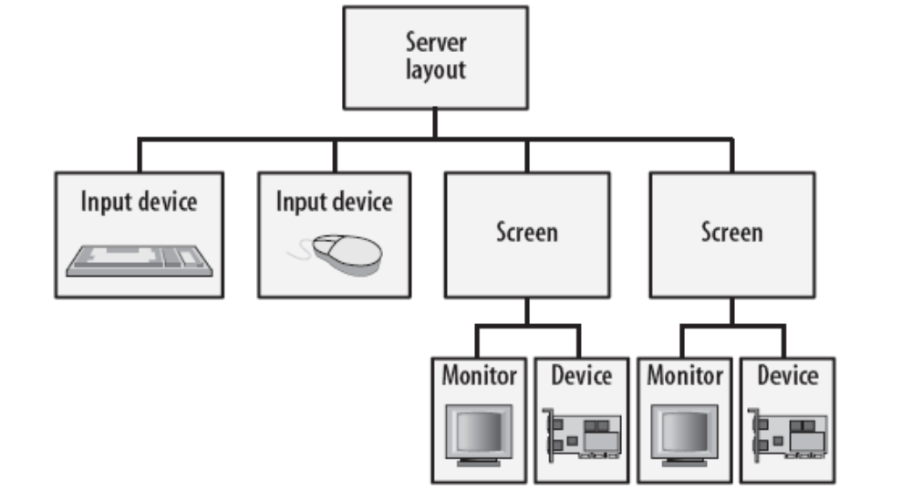
Hierarchy of sections in the X server configuration file

Slide 140
syslogd, klogd, auditd
  selinux
/etc/syslog.conf
facility.priority
16:30
16:

Slide 141
1.log
1.2.log
1.3.log
.
.
.1.6.log

Slide 142
/var/ftp/pub
/mnt/ftp
  /mnt /etc/auto.server
ftp -ro,intr,hard 192.168.0.254:/var/ftp/pub

Slide 143
20
/home/guests/&
/home/*

Slide 144
startx :0
startx -- :1
startx -- :2

Slide 145
/dev (character, block) (major, minor)
  mknod
  udev /etc/udev/rules.d/*.rules /sys
/proc
  sys
  kernel/hostname
  net/ipv4/ip_forward
  echo 1 > /proc/sys/net/ipv4/ip_forward
  sysctl –w net.ipv4.ip_forward=1
  vim /etc/sysctl.conf

Slide 146
tload, vmstat, pmap
  tload /proc/loadavg
  vmstat
  pmap

Slide 147
physical console
  /dev/tty0
virtual console
  /dev/tty[1-6]
serial console
  /dev/ttyS*
system console
  /dev/console → /dev/tty0
    kernel console=ttyS0
  /dev/pts/#

Slide 148
X Xfree86 Xorg
  X server
  session manager
  window manager
  desktop
X & → xterm & → twm & → gnome-session &

Slide 149
vnc
  c/s
Redhat Linux VNC
  vnc-server
  vncpasswd
  vncserver &
  vim ~.vnc/xstartup
    twm & → gnome-session &
  vncserver –kill :n
  vncserver &
  vim /etc/sysconfig/vncserver
    VNCSERVER=“user :n”

Slide 150
vnc
vncviewer host:n
vncviewer –via user@host localhost:n

Slide 151
X server (基于IP的认证方式)
  xhost +
  xhost –
export DISPLAY=Xserver:0.0
system-config-printer

Slide 152
syslogd, klogd, auditd
  service syslog start
/etc/syslog.conf
  facility.priority /var/log/messages
  @host
  syslogd –h
NTP
  /etc/ntp.conf
    server
  system-config-date &

Slide 153
cups,
  /etc/cups/cupsd.conf
  /etc/cups/printers.conf
  system-config-printer &

Slide 154
Automounter
  /etc/auto.master
    /mntpointer /etc/auto.files
  /etc/auto.files
    indirect_path mount_options host:/share/folder
  service autofs restart

Slide 155
sudo
  /etc/sudoers
  visudo
  user, runas, host, command
  userAlias hostAlias=(RunAs)Tag:CmndAlias

Slide 156
IP, HOSTNAME, DNS, ROUTE
  /etc/sysconfig/network
  hostname
  echo “hostname” > /proc/sys/kernel/hostname
  /etc/resolv.conf
    ifcfg-ethX PEERDNS=no
  route add –net|-host DEST netmask MASK gw GW
  /etc/sysconfig/network-scripts/route-ethX
    DEST via GATEWAY

Slide 157
dhclient

Slide 158
SAM
/etc/shadow, /etc/passwd, /etc/group
UID, GID,
login_name/password

Slide 160
nss → Name Service Switch
nis域
2
网络服务器
guest2001
1
RPC: 远程过程调用， Portmap

Slide 161
localfiles
NIS → Network Information System
LDAP → Lightweight Directory Access Protocol
Winbind

Slide 162
NSS, kerberos, LDAP, SmartCard, SMB, winbind

Slide 163
yellow page 黄页
  NIS

Slide 164
ypserv
ypbind
yp-tools

Slide 165
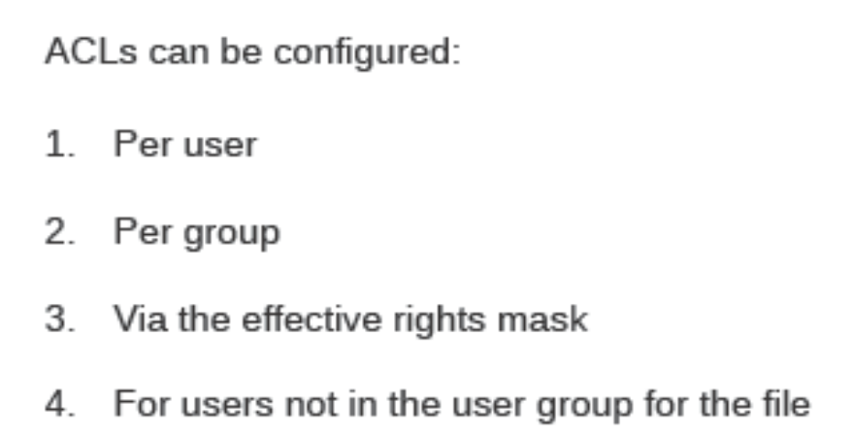


Slide 166
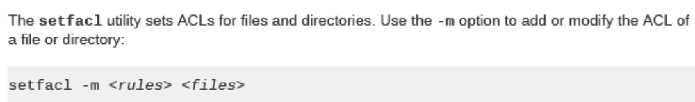
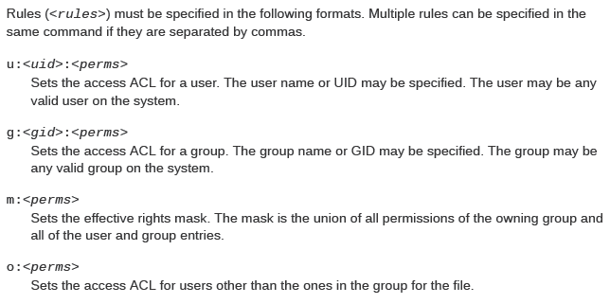

Slide 167
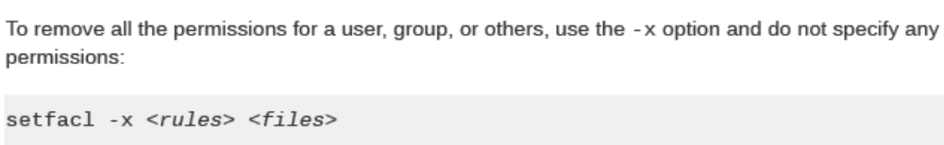
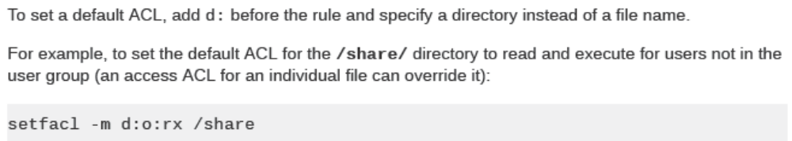


Slide 168
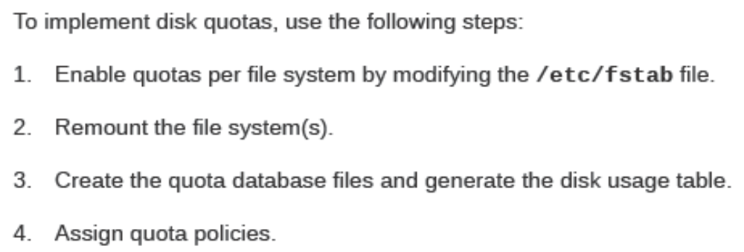
Configuring Disk Quotas

Slide 169
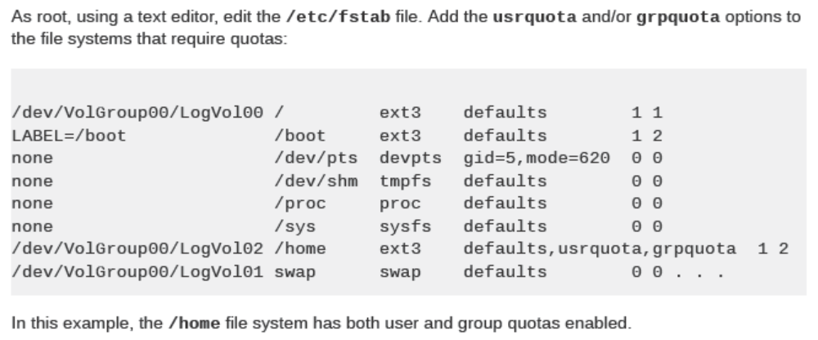
Enabling Quotas

Slide 170
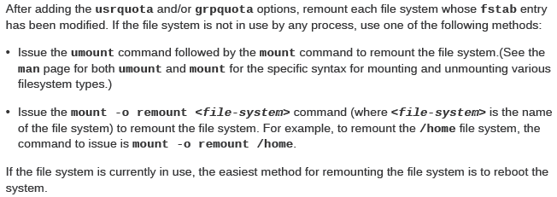
Remounting the File Systems

Slide 171
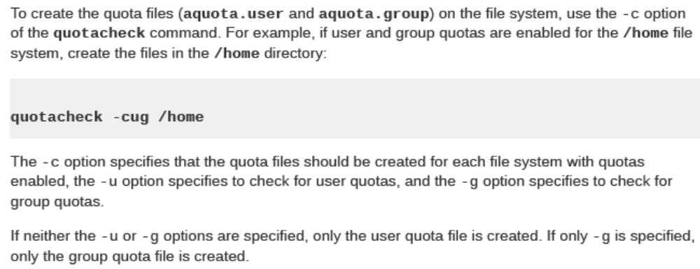
Creating the Quota Database Files

Slide 172
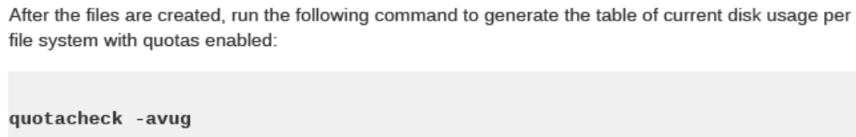
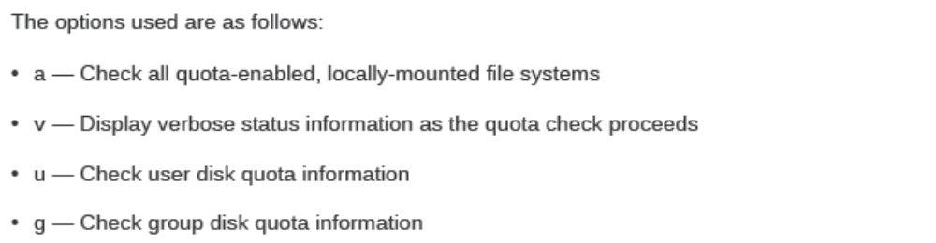

Slide 173
Assigning Quotas per User
edquota –g group_name
edquota user_name

Slide 174
NIS:
  ypserv
  ypbind
  yp-tools
nisdomainname
  /etc/sysconfig/network
    NISDOMAIN=
portmap, RPC
  service portmap status
  rpcinfo –p localhost
  rcpinfo –p ypServer

Slide 175
/etc/yp.conf
  domain NISDOMAIN server HOSTNAME
/etc/nsswitch.conf
  passwd: files nis
  group:
  shadow:
  hosts: files nis dns
autofs
  /etc/auto.master
    /home/guests /etc/auto.home
  /etc/auto.home
    * -rw,intr,hard 192.168.0.254:/home/guests/&

Slide 176
ACL
  setfacl
    -m
      u:uid:perm
      g:gid:perm
      o:perm
      d:u:uid:perm, d:g:gid:perm, d:o:perm
      m:mask
    -x
      u:uid
      g:uid
      o
    -b
  getfacl

Slide 177
Quota
  blocks, inodes
    soft (grace time)
    hard
/etc/fstab
  usrquota,grpquota
remounting this filesystem
  mount -o remount /filesystem
Creating the database
  quotacheck –cug
Editing user’s quota
  quotaon /home
  setquota
  edquota
    -u
    -g

Slide 178
quota
repquota /filesystem
warnquota

Slide 179
dump/restore
tar,cpio
rsync

Slide 180
RAID
  level
    LINER
    0
    1
    4
    5
    6
    10
mdadm
  mode
    create
    assemble
    follow minitor
    manager
    grow

Slide 181
mdadm -C /dev/md0 –a yes –l 0 –n 2 /dev/two_devices
1G, 2, 1G, 1 space_device
mdadm –C /dev/md1 –a yes –l 1 –n 2 –x 1 /dev/three_devices
cat /proc/mdstat
mdadm --detail /dev/md0
mdadm -S /dev/md0
mdadm /dev/md0 -f
  -r
  -a
mdadm -A -s

Slide 182
Volumn
  pv → vg → lv
lvm
  pv
    pvcreate
  vg
    vgcreate, vgextend
  lv
    lvcreate

Slide 183
lvcreate -L 512M -n ftp myvol

Slide 184
extend
  lvextend -L [+]n /dev/vg/lv
  resize2fs -p /dev/vg/lv
reduce
  umount /filesystem
  fsck -f /dev/vg/lv
  resize2fs /dev/vg/lv size
  lvreduce -L size /dev/vg/lv
  mount
  df -lh

Slide 185
snapshot
  7X24

Slide 186
lv
snapshot → backup

Slide 187
lv,
lvcreate -L size -p r -s -n backup /dev/vg/lv
mount snapshot, verify the data
umount snapshot, dump
remove snapshot
umount lv
mkfs lv
mount lv
cd lv
restore

Slide 188
dialog
  menu
    1 disk usage()
    2 memory usage()
    3 exit

Slide 189
ks=cdrom:/ks.cfg
linux ks=http://192.168.0.254/workstation.cfg

Slide 190
1G
  iso/
  linux ks=floppy:/ks.cfg

