Slide 1
Tomcat

Slide 2
Java程序语言
Java API
1.java
2.java
Java
complier
Class loader
1.class
2.class
公共类
Linux
JVM

Slide 3
html:
  mime, a.cgi

Slide 4
Servlet

Slide 5
JSP
连接器
jvm instance

Slide 6
运行时数据区域
E-R
类加载器
类：操作
对象：方法
方法区
溢出：
本地方法栈
java虚拟机栈
引用计数器
堆
程序计数器
执行引擎

Slide 7
类的生命周期
Loading
Verification
Preparation
Resolution
Initialization
Using
Unloading

Slide 9
Web Container
Servlet Container

Slide 10
jsp, http,
Server
Service
Engine 1
realm
Servlet Container
Connector
Connector
Host
realm
context
realm

Slide 11
Tomcat的部署方式

Slide 12
ajp: apache jserv protocol

Slide 13
nginx+tomcat

Slide 15
web
a.java
a.class

Slide 16
连接器
Jsper
.jsp→.java
.java→.class

Slide 17
JVM
log4j
Server
service
Engine
Realm
Connector
Host
Connector
HOST
Realm
Connector
Context
Realm
log
log

Slide 18
Web container, JVM
http
https
ajp

Slide 19
J2SE → Java SE
J2EE → Java EE

Slide 20
Tomcat

Slide 21
Java
  Applet
  Servlet: 请求-响应
  JSP
    Jasper
HTTP
HTTPS
AJP

Slide 22
并发能力
http

Slide 23
standalone
线程
ajp
http

Slide 24
mod_proxy
  mod_http_proxy
  mod_ajp_proxy
mod_jk

Slide 27
mod_proxy

Slide 28
www.magedu.com /
动静分离
  .jsp, .do

Slide 29
Web app

Slide 31
standalone

Slide 33
http连接器，禁用
mod_proxy
mod_proxy_http
mod_proxy_ajp
mod_proxy_banlancer
mod_jk
mod_jk2
ajp: 效率高

Slide 35
Jvm: Java VM
bootstrap

Slide 36
<Directory “”>
</Directory>
<Location “/bbs”>
</Location>
<LocationMatch “\.(jsp|do)”>
  ProxyPass http:
</LocationMatch>

Slide 37
.jsp
test.html
index.html

Slide 39
Nginx
Varnish
Squid
Apache ()

Slide 40
JVM
  JAVA_OPTS=

Slide 41
conf/web.xml
Webapps
  /
  /WEB-INF/
    web.xml
    lib/
    class/

Slide 42
JDK
JRE
Hotspot JDK
OpenJDK

Slide 43
xml, json
1.7update9
1.6update35
Tomcat
  ASF

Slide 45
序列化
/usr/java/

Slide 47
Nginx
  Web
  Web reverse proxy
    Varnish
    Squid, Apache
  Mail reverse proxy
event-based
AIO

Slide 48
Upstream()
URL hash: /path/to/cache_object

Slide 49
Nginx
Reverse proxy
Nginx
Reverse proxy
varnish
LAMP
LAMP
LAMP
LAMP
nginx
nginx
LAMP

Slide 50
a.so
x
y
500
400
hmtl格式页面
php(opcode): xcache
perl,

Slide 51
Tomcat Arch
Server
Service
Connector
Engine
Connector
Host
Connector
Context
AJP: Apache Jserv Protocol

Slide 53
http connection:
  http, cotyo
  NIO

Slide 54
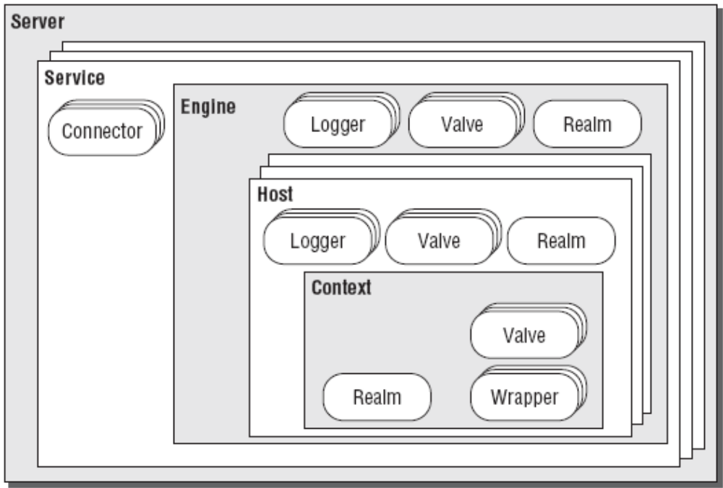
JNDI: Resource, 用户认证

Slide 56
/www/htdocs/webapps
  bbs/
    index.jsp
    logo.jpg
    WEB-INF/
      web.xml
      classes
      lib
  WAR

Slide 57
session
URL， http://server/manager/
Web GUI
  manager
    程序部署操作
    会话管理
    status
  host manager
    虚拟主机
  Realm → 用户

Slide 58
Session Manager
  StandardManager
    Tomcat服务要正常关闭
    kill -9
    保存至文件SESSIONS.ser
  PersistentManager
    session id.session
    FileStore
      abd78fd9afhdagy89ewqtrjg.session
    JDBCStore
      RDMBS

Slide 60
mod_jk → AJP → tomcat
mod_proxy:
  mod_proxy_http
  mod_proxy_ajp
  mod_proxy_balancer
mod_proxy
mod_jk

Slide 62
www
mail
www
mail

Slide 63
worker
worker
worker

Slide 64
session affinity
DeltaManager
BackupManager
A
B

Slide 65
upstream

Slide 66
ajp13
LVS

Slide 67
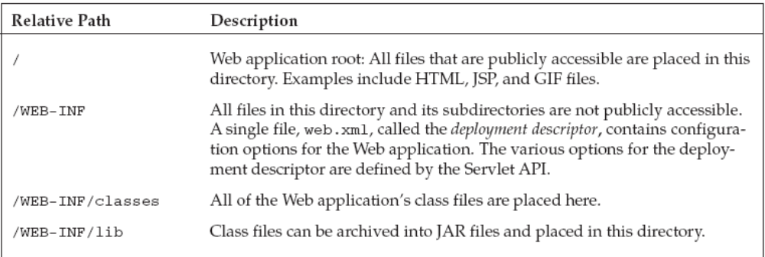

Slide 68
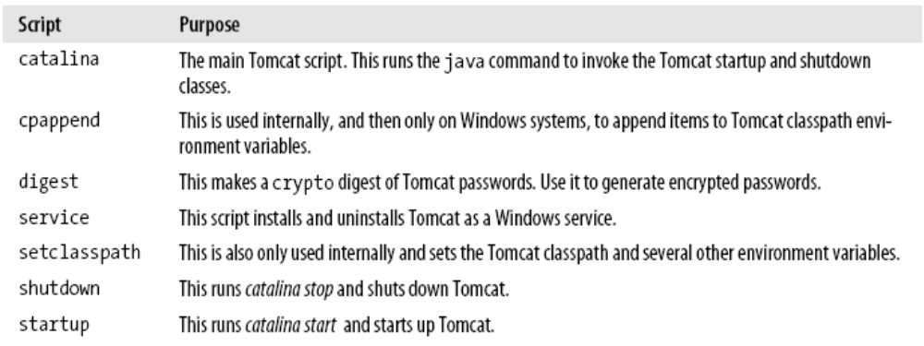


Slide 69
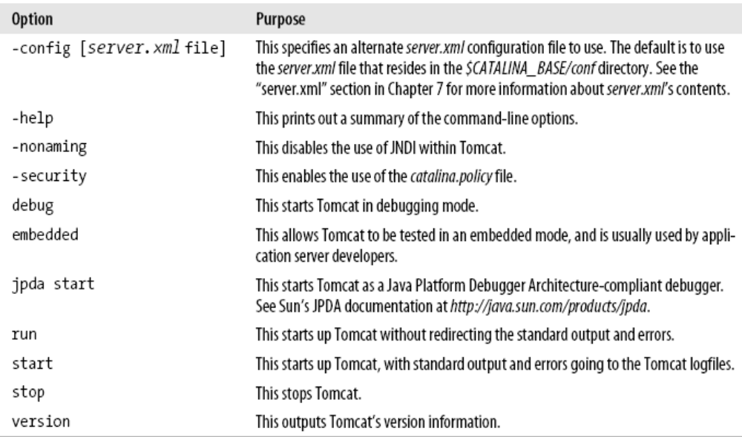
startup options

Slide 70
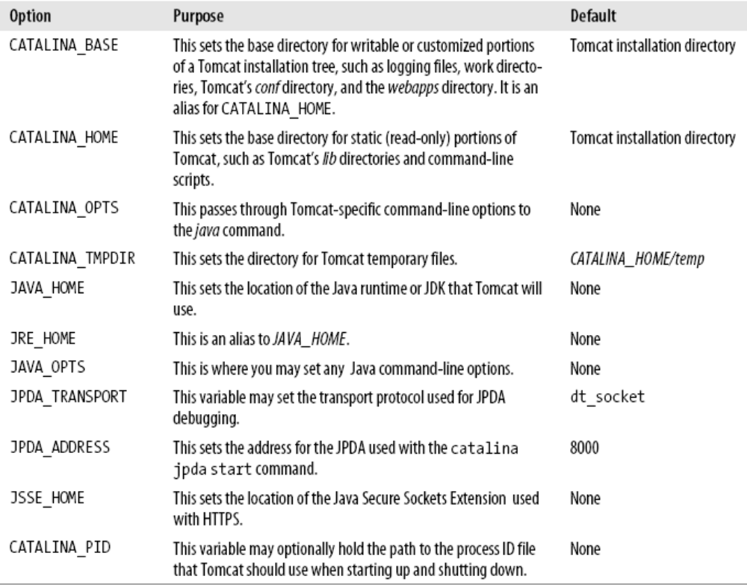
Tomcat Environment Variables

Slide 71
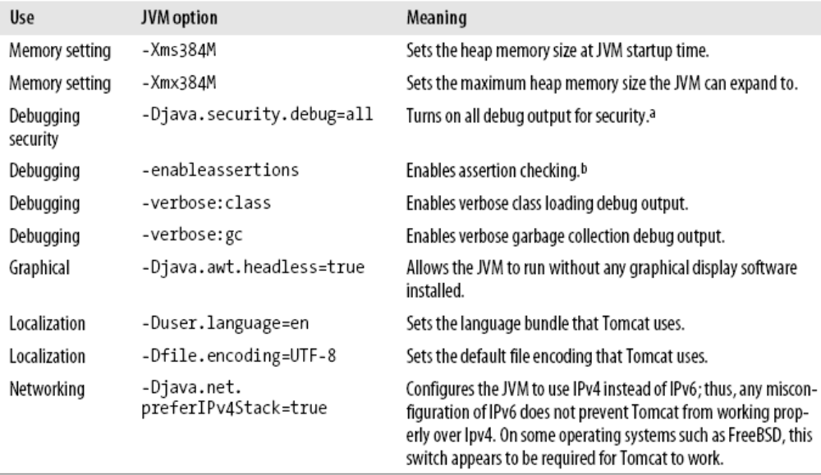
Java VM configuration options

Slide 72
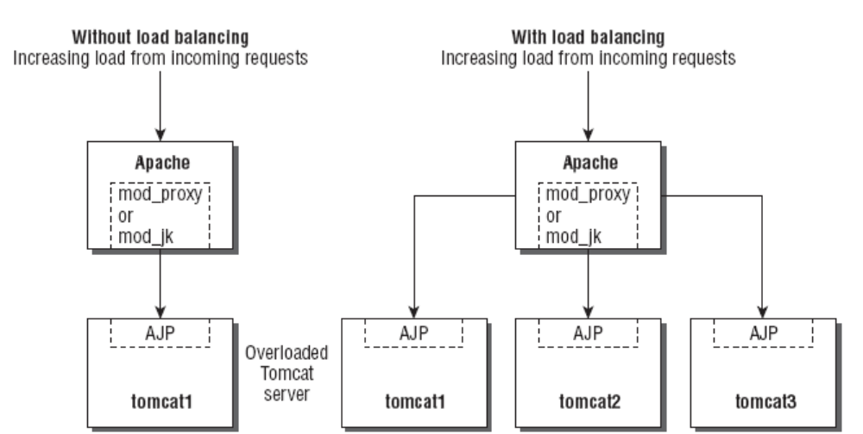

Slide 73
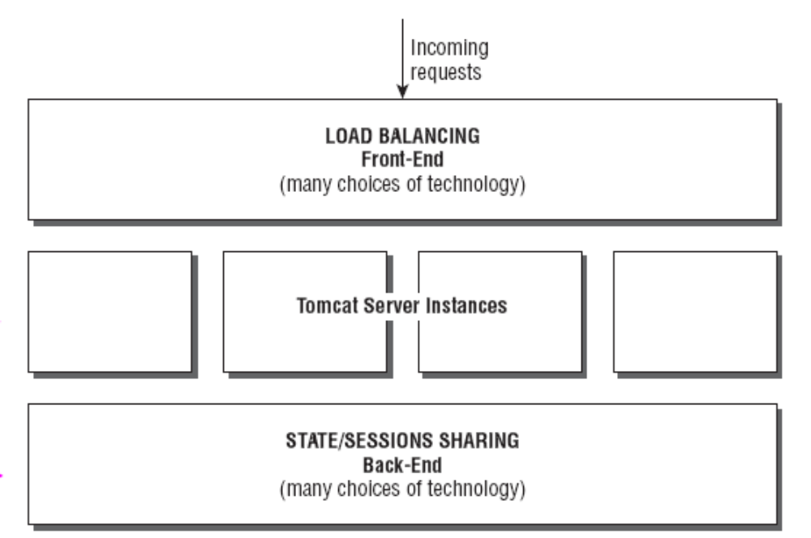

Slide 74
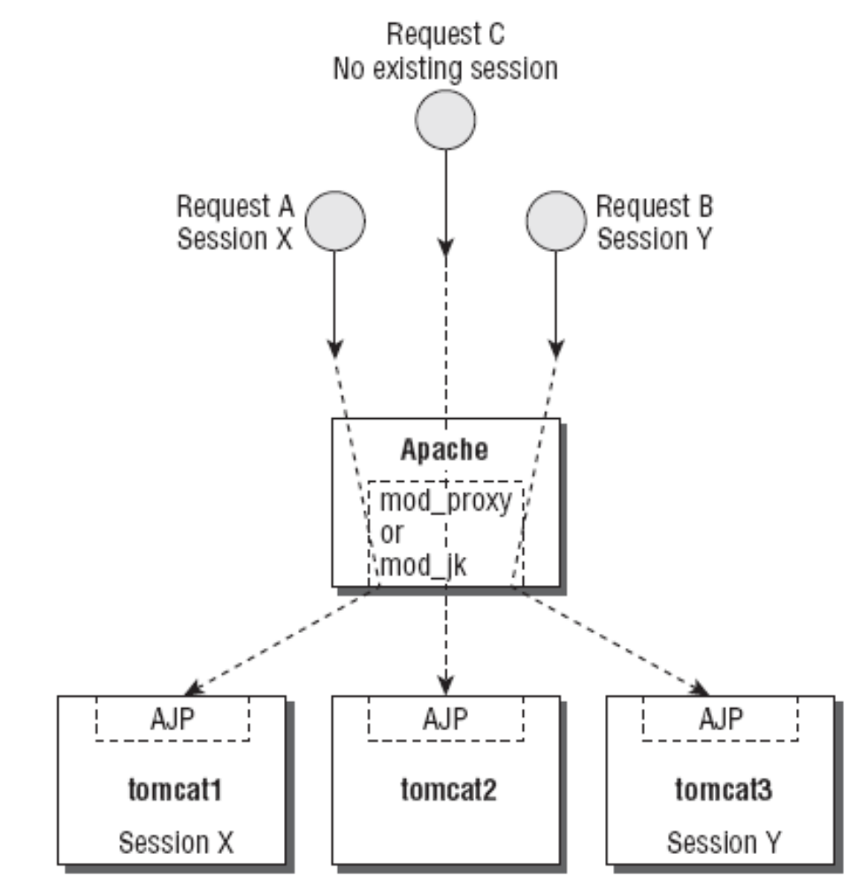

Slide 75
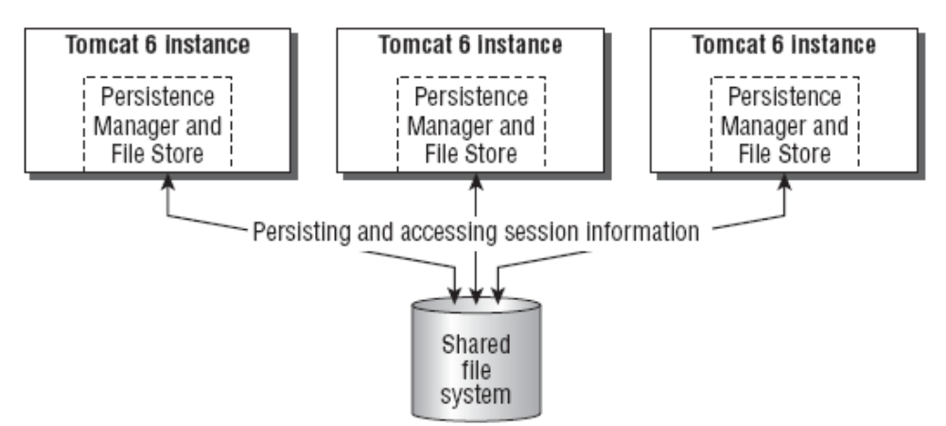

Slide 76
