Slide 1
TENSORRT（二）---环境配置与编程实例
October 2017

Slide 2
TensoRT回顾
TensorRT环境配置与安装
TensorRT编程模型
TensoRT实例展示
概述

Slide 3
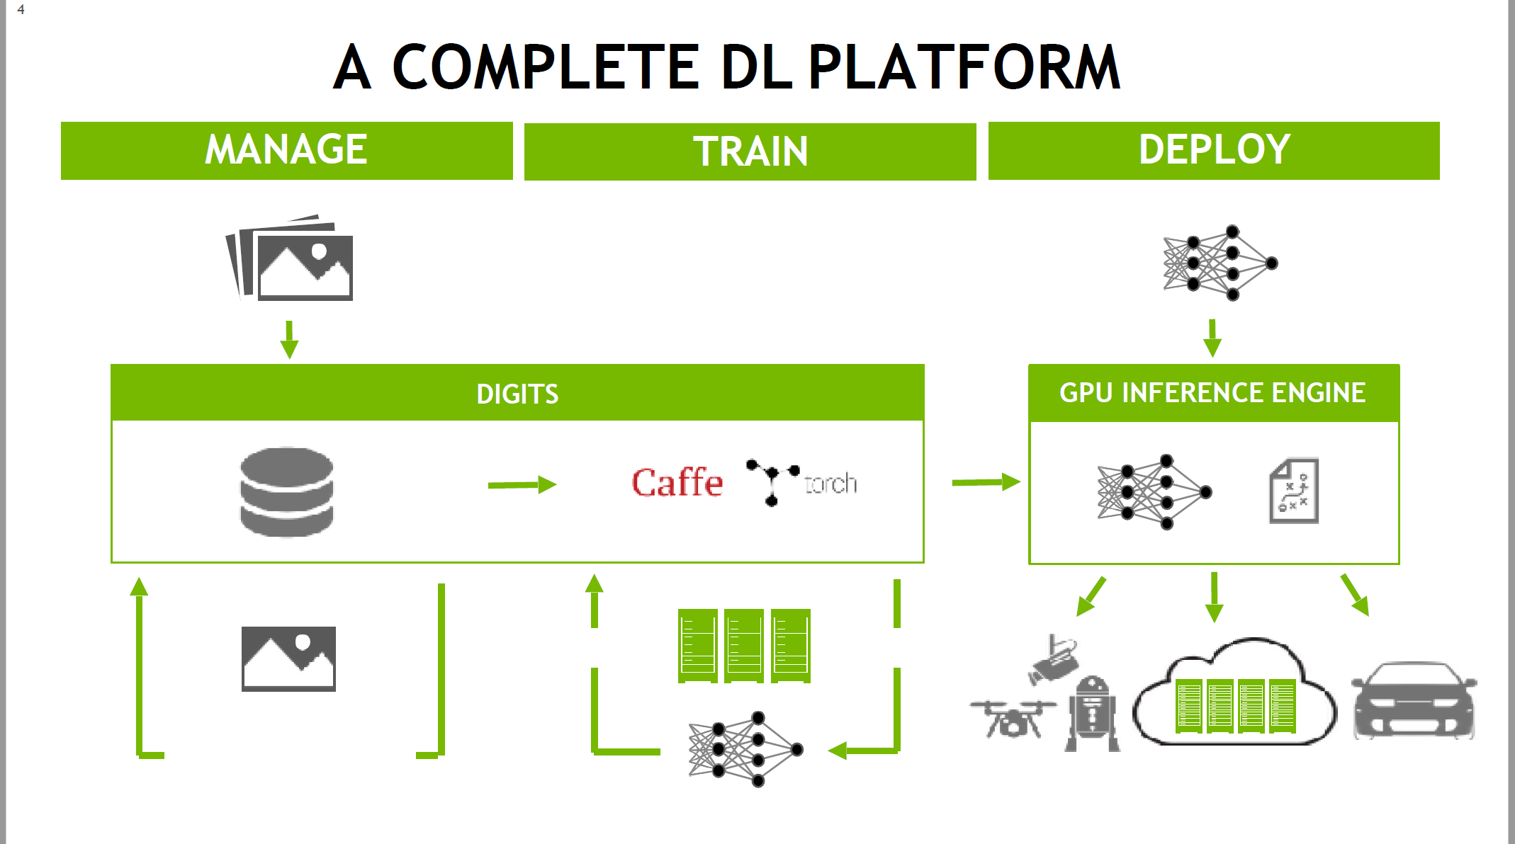
TensoRT回顾

Slide 4
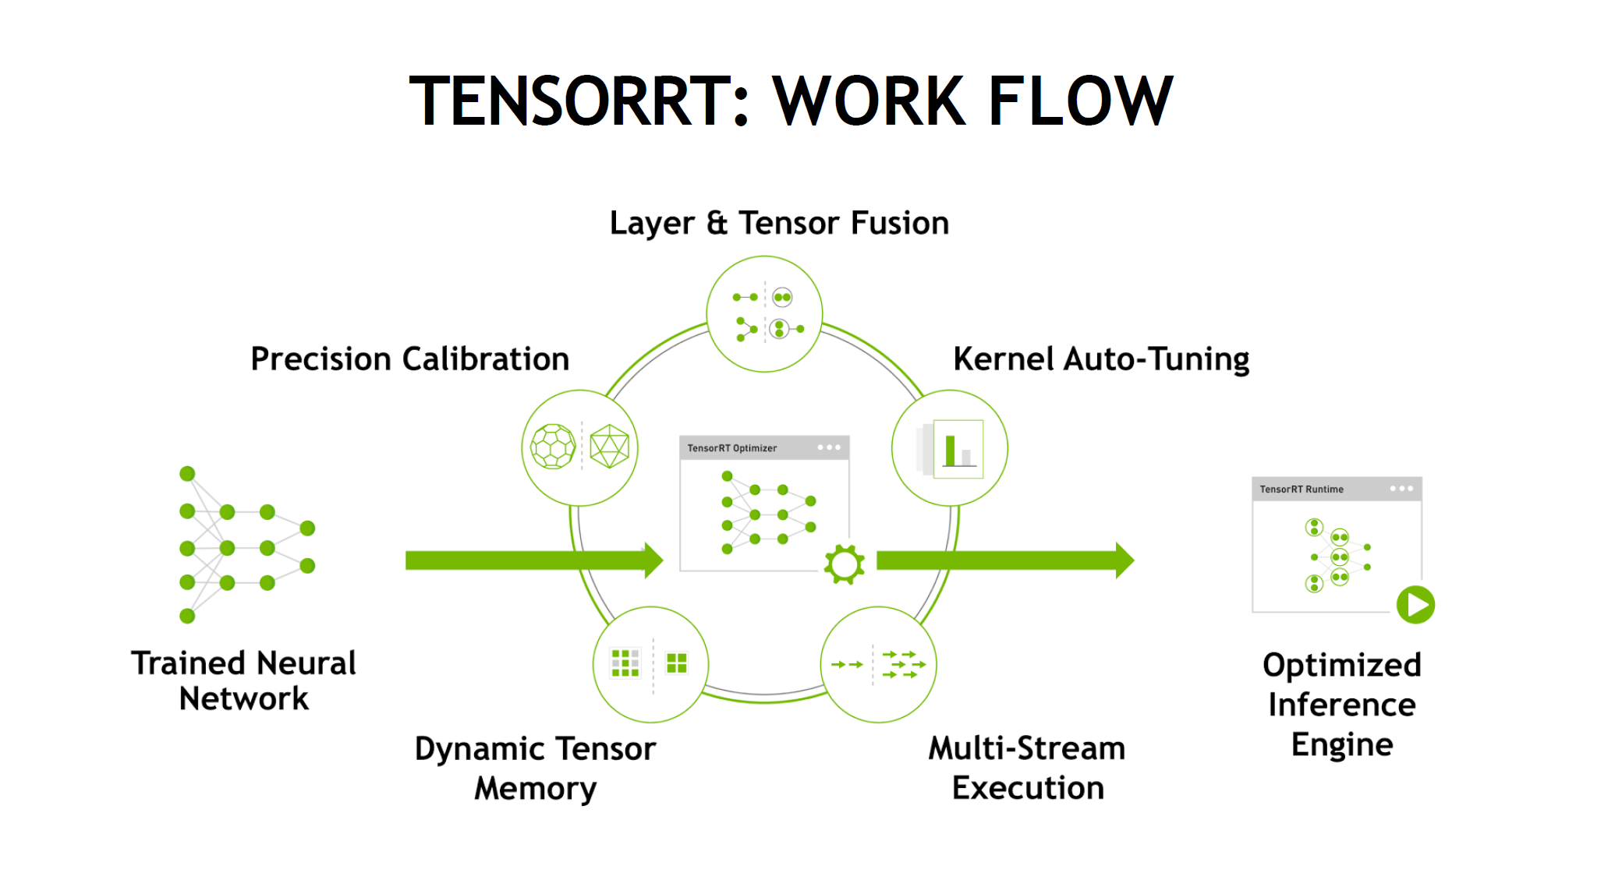
TensoRT回顾

Slide 5
1.CUDA
去官网下载cuda，此处使用的是cuda9.0版本的deb安装方式：
~$ mkdir Downloads
~$ cd Downloads
~$ wget http://developer.download.nvidia.com/compute/cuda/repos/ubuntu1604/x86_64/cuda-repo-ubuntu1604_9.0.176-1_amd64.deb
~$ sudo dpkg -i cuda-repo-ubuntu1604_9.0.176-1_amd64.deb
~$ sudo apt-key adv --fetch-keys http://developer.download.nvidia.com/compute/cuda/repos/ubuntu1604/x86_64/7fa2af80.pub
~$ sudo apt-get update
~$ sudo apt-get install cuda
TensorRT环境配置与安装

Slide 6
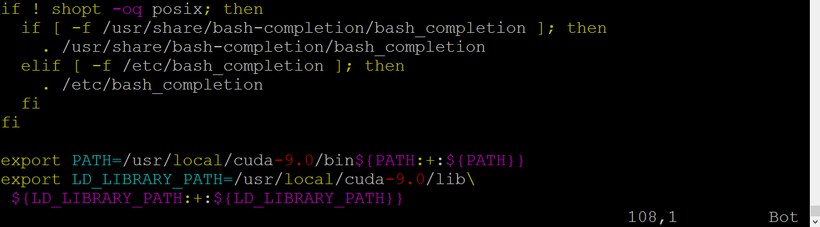
接下来，在环境变量中添加CUDA：
~$ sudo vim ~/.bashrc
在最后一行添加cuda的安装路径：
export PATH=/usr/local/cuda-9.0/bin${PATH:+:${PATH}}
export LD_LIBRARY_PATH=/usr/local/cuda-9.0/lib64\ ${LD_LIBRARY_PATH:+:${LD_LIBRARY_PATH}}
TensorRT环境配置与安装

Slide 7
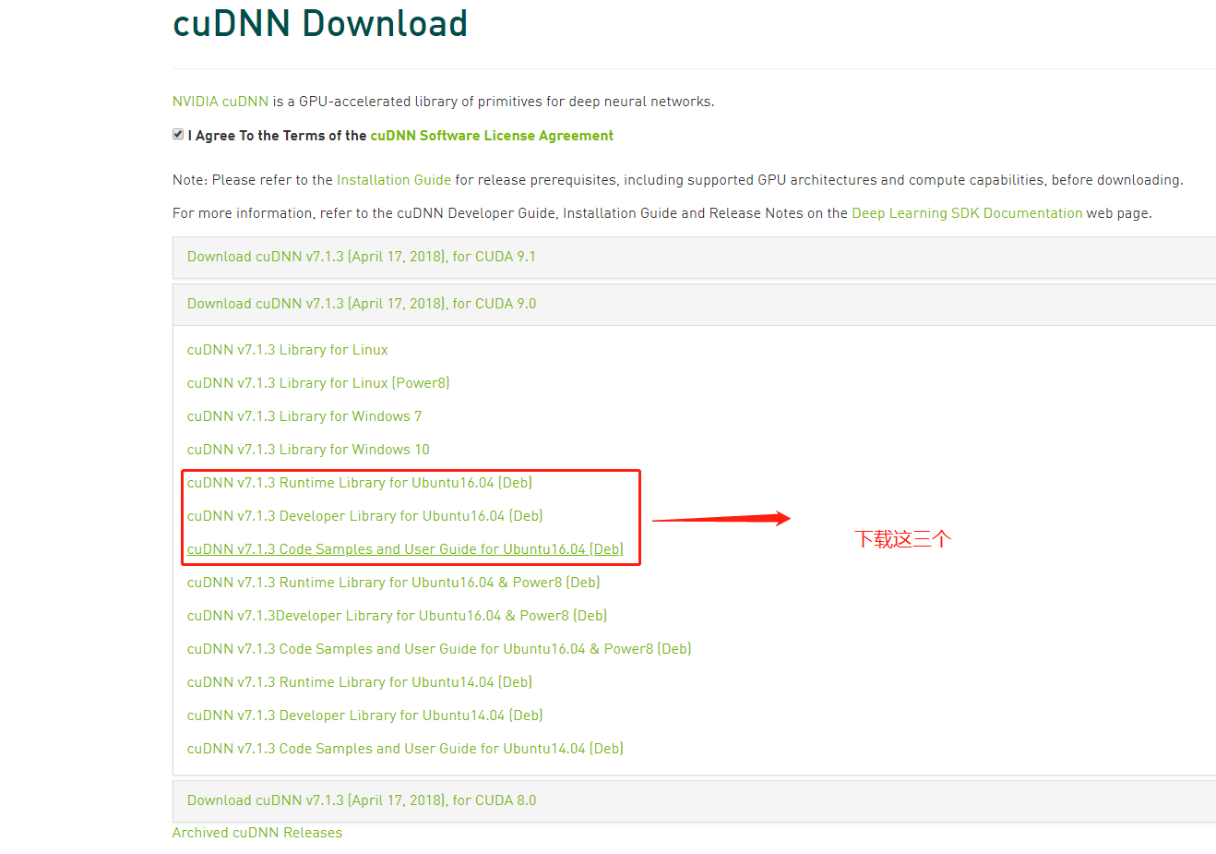
2.安装cudnn：
下载cudnn （本系统是ubuntu 16.04+cuda 9.0）:
下载地址：https://developer.nvidia.com/rdp/cudnn-download
TensorRT环境配置与安装

Slide 8
安装并测试：
$ sudo dpkg -i libcudnn7_7.1.3.16-1%2Bcuda9.0_amd64.deb
$ sudo dpkg -i libcudnn7-dev_7.1.3.16-1%2Bcuda9.0_amd64.deb
$ sudo dpkg -i libcudnn7-doc_7.1.3.16-1+cuda9.0_amd64.deb
然后我们测试一下安装的结果：
$ cp -r /usr/src/cudnn_samples_v7/ $HOME
$ cd ~/cudnn_samples_v7/mnistCUDNN
$ make
$ ./mnistCUDNN
TensorRT环境配置与安装

Slide 9
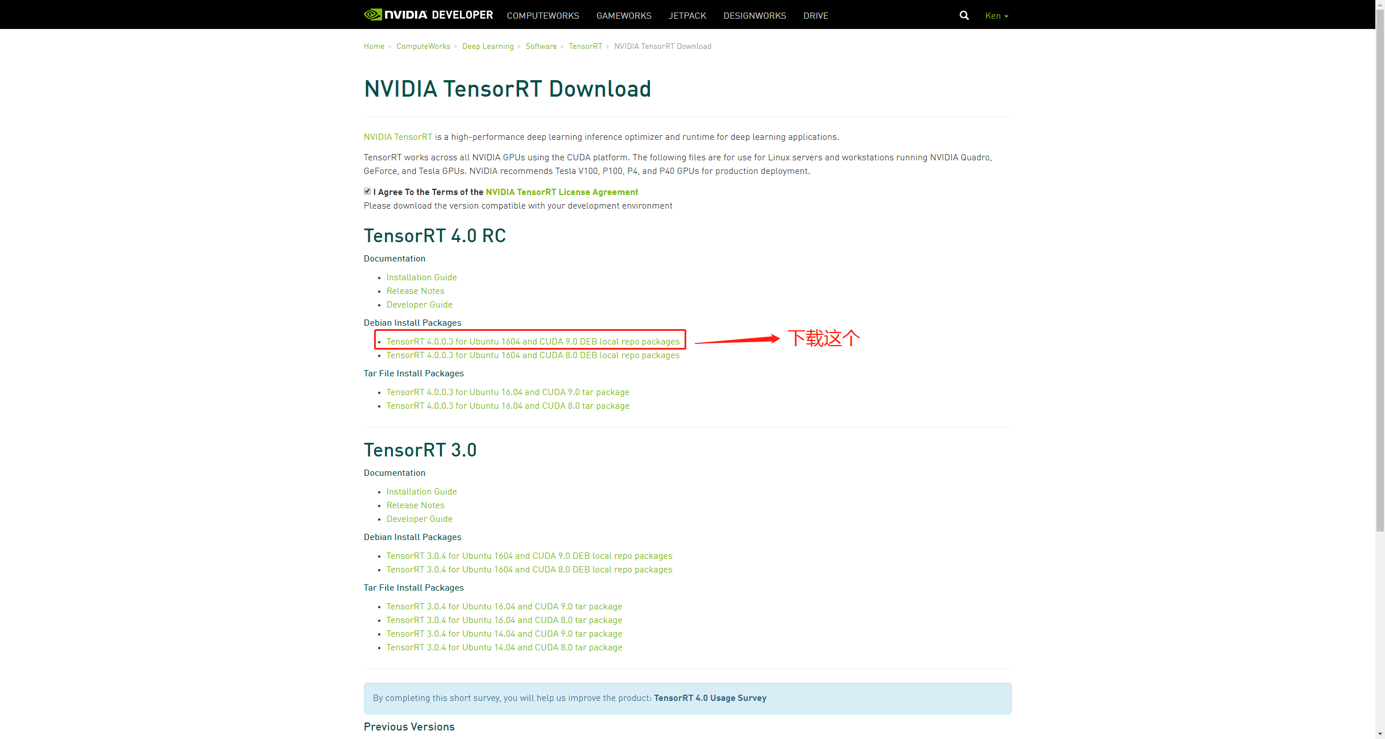
3.TensorRT的下载与安装
首先，我们下载TensorRT：
https://developer.nvidia.com/nvidia-tensorrt-download
TensorRT环境配置与安装

Slide 10
$ sudo dpkg -i nv-tensorrt-repo-ubuntu1604-cuda9.0-rc-trt4.0.0.3-20180329_1-1_amd64.deb
$ sudo apt-get update
$ sudo apt-get install tensorrt
如果你是python 2.7
$ sudo apt-get install python-libnvinfer-doc swig
如果是3.5
sudo apt-get install python3-libnvinfer-doc
这样就安装好了，我们测试一下：
$ cp -r /usr/src/tensorrt/ ~/
$ cd ~/tensorrt/samples
$ make
$ cd ../bin
$ ./sample_int8 mnist
TensorRT环境配置与安装

Slide 11
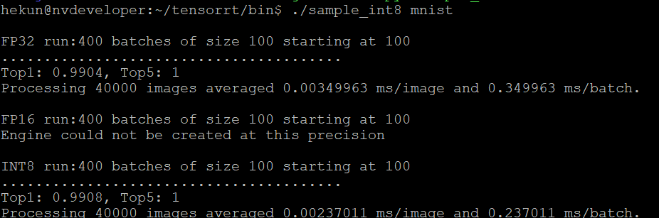
TensorRT环境配置与安装

Slide 12
1. caffeToGIEModel － 将 caffe model 转换到 TensorRT 格式
// 1.创建builder
IBuilder* builder = createInferBuilder(gLogger);
// 2.解析caffe模型，保存到 Network
INetworkDefinition* network = builder->createNetwork();
ICaffeParser* parser = createCaffeParser();
const IBlobNameToTensor* blobNameToTensor = parser->parse(locateFile(deployFile, directories).c_str(), locateFile(modelFile, directories).c_str(),*network, DataType::kFLOAT);
// 3.指定输出Tensor
for (auto& s : outputs)
network->markOutput(*blobNameToTensor->find(s.c_str()));
// 4.构建engine
builder->setMaxBatchSize(maxBatchSize);
builder->setMaxWorkspaceSize(1 << 20);
ICudaEngine* engine = builder->buildCudaEngine(*network);
assert(engine);
// 5.销毁parser
network->destroy();
parser->destroy();
// 6.将engine序列化到GIE，退出
gieModelStream = engine->serialize();
engine->destroy();
builder->destroy();
TensorRT编程模型

Slide 13
2. 执行过程 main
// 1.从caffe模型创建GIE模型，序列化到流
IHostMemory *gieModelStream{nullptr};
caffeToGIEModel("mnist.prototxt", "mnist.caffemodel", std::vector < std::string > { OUTPUT_BLOB_NAME }, 1, gieModelStream);
// x.数据获取（略）
// x.解析mean文件(略)
// 2.反序列化，得到Runtime engine
IRuntime* runtime = createInferRuntime(gLogger);
ICudaEngine* engine = runtime->deserializeCudaEngine(gieModelStream->data(), gieModelStream->size(), nullptr);
if (gieModelStream) gieModelStream->destroy();
// 3.创建上下文
IExecutionContext *context = engine->createExecutionContext();
// 4.运行inference
float prob[OUTPUT_SIZE];
doInference(*context, data, prob, 1);
// 5.销毁engine
context->destroy();
engine->destroy();
runtime->destroy();
TensorRT编程模型

Slide 14
TensoRT实例展示

