Slide 1

企鹅电竞PWA实践
腾讯增值平台部 渠宏伟

Slide 2
什么是PWA

Slide 3
Why not Web?
13%
.vs.
87%
Mobile web
Apps
Source: comScore Mobile Metrix, U.S., Age 18+, June 2015

Slide 4
What was missing?
可靠的性能
推送消息
桌面图标访问
离线缓存
硬件权限

Slide 5
What is a Progressive Web App?
Progressive Web Apps are experiences that combine the best of the web and the best of apps. They are useful to users from the very first visit in a browser tab, no install required. As the user progressively builds a relationship with the app over time, it becomes more and more powerful. It loads quickly, even on flaky networks, sends relevant push notifications, has an icon on the home screen, and loads as a top-level, full screen experience.

Slide 6
Key features of PWA
Progressive - Work for every user
Responsive - Fit any form
Connectivity independent - Work offline or on low quality
App-like - Feel like an app
Fresh - Always up-to-date
Safe - Served via HTTPS
Discoverable - Are identifiable as “applications”
Re-engageable - push notifications.
Installable - Allow users to “keep” apps on their home screen
Linkable - Easily share via URL

Slide 7
PWA核心技术

Slide 8
PWA核心技术
Web App Manifest
Service Worker
App Shell
Push Notification
Fetch API

Slide 9
Web App Manifest
/manifest.json
{
"name": ”My WPA",
"short_name": ”MyWPA",
"icons": [{
"src": "/images/curex-256.png",
"sizes": "256x256",
"type": "image/png"
}],
"start_url": "/index.html",
"display": "standalone",
"background_color": "#003300",
"theme_color": "#003300"
}
link in your HTML <head>
<link rel="manifest" href="/manifest.json">

Slide 10
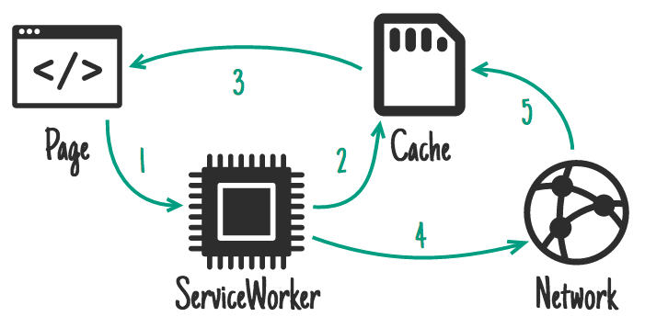
Service Worker

Slide 11
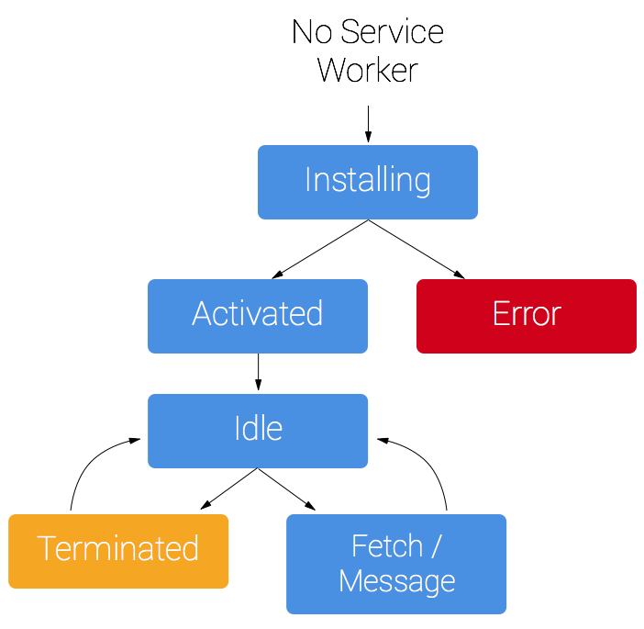
Service Worker Lifecycle

Slide 12
Register Service Workers
// Registering service worker in js file if ('serviceWorker' in navigator) {
window.addEventListener('load', function() {
navigator.serviceWorker.register('/sw.js').then(function(registration) {
// Registration was successful
console.log('ServiceWorker registration successful with scope: ', registration.scope);
}).catch(function(err) {
// registration failed :(
console.log('ServiceWorker registration failed: ', err);
});
});
}

Slide 13
Install Service workers and caching resources
// code in service worker file
var CACHE_NAME = 'pwa-cache-v1';
var urlsToCache = [
'/',
'/styles/main.css',
'/script/main.js'
]; self.addEventListener('install', function(event) {
// Perform install steps
event.waitUntil(
caches.open(CACHE_NAME)
.then(function(cache) {
console.log('Opened cache');
return cache.addAll(urlsToCache);
})
); });

Slide 14
Push Notification
1. Works If Browser Closed
2. Needs Permission

Slide 15
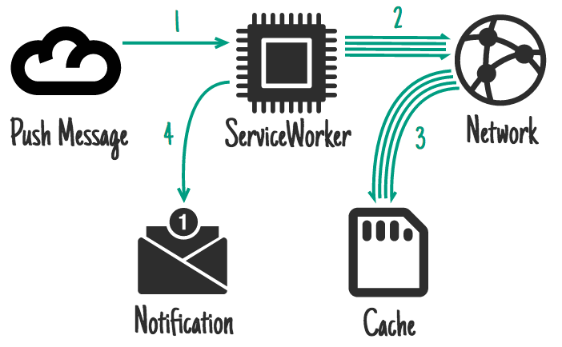
Push Notification

Slide 16
Push Notification
// sw.js
self.addEventListener('push', event => {
event.waitUntil(
// Process the event and display a notification.
self.registration.showNotification("Hey!")
);
});
self.addEventListener('notificationclick', event => {
// Do something with the event
event.notification.close();
});
self.addEventListener('notificationclose', event => {
// Do something with the event
});

Slide 17
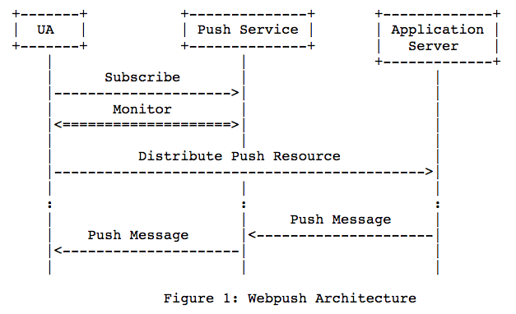
Web Push Protocol

Slide 18
App Shell

Slide 19
App Shell
var CACHE_NAME = 'dependencies-cache';
// Files required to make this app work offline
var REQUIRED_FILES = [
'random-1.png',
'random-2.png',
'random-3.png',
'style.css',
'index.html',
'/', // Separate URL than index.html!
'index.js',
'app.js'
];
self.addEventListener('install', (event) => {
// Perform install step:
// loading each required file into cache
event.waitUntil(
caches.open(CACHE_NAME)
// Add all offline dependencies to the cache
.then((cache) => {
return cache.addAll(REQUIRED_FILES));
})
// At this point everything has been cached
.then(() => self.skipWaiting())
);
});

Slide 20
Fetch API
Fetch API 设计为比 XMLHttpRequest 更低层的 API， 意在统一页面中的各种 Fetch（包括 img、script、lint、importScripts(), cursor 等）， 使它们的表现（比如重定向和跨域发生的时候）更为一致。 Fetch API 标准中还定义了 Response 和 Request 对象的接口，借此我们可以更方便地操作 HTTP 请求和响应。
Fetch 标准：https://fetch.spec.whatwg.org/
标准状态：Living Standard
兼容性：Android Browser 53+，Opera Mobile 37+，Chrome for Android 56+，QQ Browser 1.2+

Slide 21
PWA实践经验

Slide 22



快速创建PWA应用

Slide 23
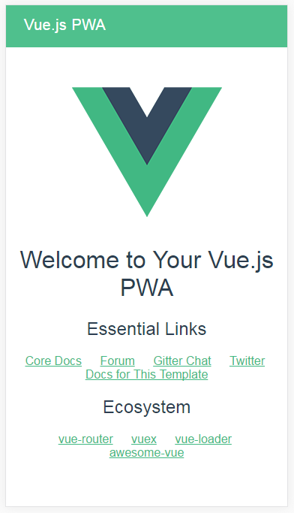
使用vue-cli创建PWA
# once and you're good:
$ npm install -g vue-cli
# create a new project:
$ vue init pwa my-project
$ cd my-project
$ npm install
# start a dev server:
$ npm run dev
https://github.com/vuejs-templates/pwa

Slide 24
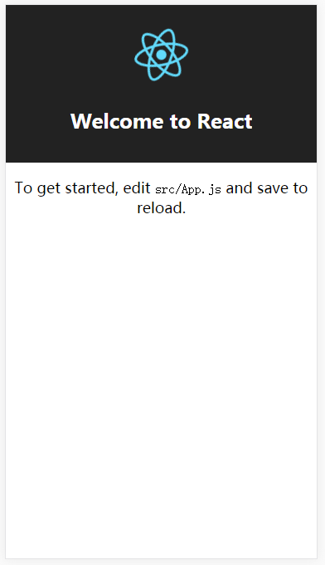
使用create-react-app创建PWA
# once and you're good:
npm install -g create-react-app
# create a new project:
create-react-app my-app
cd my-app/
# start a dev server:
npm start
https://github.com/facebookincubator/create-react-app

Slide 25
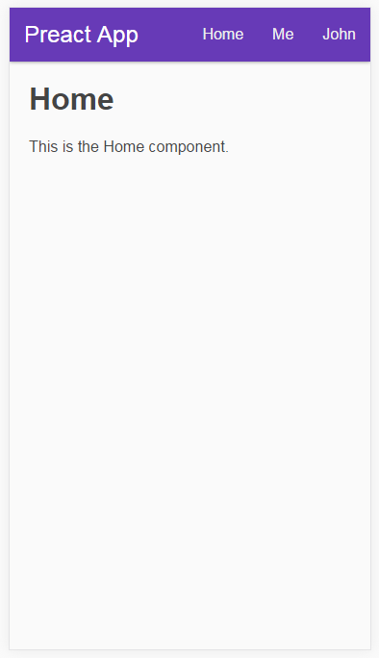
使用preact-cli创建PWA
# once and you're good:
npm i -g preact-cli
# create a new project:
preact create my-great-app
cd my-great-app
# start a live-reload/HMR dev server:
npm start
# go to production:
npm run build
https://github.com/developit/preact-cli

Slide 26
Tips

Slide 27
统计添加到桌面用户数
window.addEventListener('beforeinstallprompt', function(e) {
// beforeinstallprompt Event fired
// e.userChoice will return a Promise.
e.userChoice.then(function(choiceResult) {
console.log(choiceResult.outcome);
if(choiceResult.outcome == 'dismissed') {
console.log('User cancelled home screen install');
}
else {
console.log('User added to home screen');
}
});
});

Slide 28
不显示添加到桌面提示条
window.addEventListener('beforeinstallprompt', function(e) {
console.log('beforeinstallprompt Event fired');
e.preventDefault();
return false;
});

Slide 29
延迟提示桌面提示条
console.log('beforeinstallprompt Event fired');
e.preventDefault();
// Stash the event so it can be triggered later.
deferredPrompt = e;
return false;
});
btnSave.addEventListener('click', function() {
if(deferredPrompt !== undefined) {
// let's show the prompt.
deferredPrompt.prompt();
// Follow what the user has done with the prompt.
deferredPrompt.userChoice.then(function(choiceResult) {
console.log(choiceResult.outcome);
if(choiceResult.outcome == 'dismissed') {
console.log('User cancelled home screen install');
}else {
console.log('User added to home screen');
}
// We no longer need the prompt. Clear it up.
deferredPrompt = null;
});
}
});

Slide 30
忽略参数缓存
self.addEventListener('fetch', function(event) {
event.respondWith(
caches.match(event.request, {
ignoreSearch: true
}).then(function(response) {
return response || fetch(event.request);
})
);
});

Slide 31
查询缓存容量信息
navigator.storageQuota.queryInfo("temporary").then(function(info) {
console.log(info.quota);
// Result: <quota in bytes>
console.log(info.usage);
// Result: <used data in bytes>
});

Slide 32
缓存持久化
if (navigator.storage && navigator.storage.persist) {
navigator.storage.persist().then(function (persistent) {
if (persistent)
console.log("Storage will not be cleared except
by explicit user action");
else
console.log("Storage may be cleared by the UA
under storage pressure.");
});
}

Slide 33
Service Worker代码调试

Slide 34
Service Worker无缓存调试

Slide 35
Web PUSH调试

Slide 36
More
1、依赖https，建议开启http2/spdy 降低https带来的延时。
2、目前适用于android 5 以上版本，IOS不支持。
3、国内GCM不可用，还没有实现Web Push Protocol的推送服务。
4、android webview环境复杂。
5、Service Worker fetch请求UA为系统UA，无法获取应用标示。
6、Fetch API存在不同统一问题，使用polyfill兼容。
7、X5支持Service Worker 、Fetch。

Slide 37
PWA的未来

Slide 38
More
network availability
audio/video capture
augmented reality
speech recognition
Bluetooth
USB
NFC
proximity
ambient light
geo-location
orientation
vibration
battery status
file access
contacts access
更多接口：https://whatwebcando.today
更多接口：https://whatwebcando.today
更多接口：https://whatwebcando.today
更多接口：https://whatwebcando.today

Slide 39
Q & A

