Slide 1

Jingwei Wu, PhD
Chapter 16
Selecting the Right Statistical Tests
A courtesy of “USING AND INTERPRETING STATISTICS” by ERIC W. CORTY | THIRD EDITION (Macmillan Education)

Slide 2

Objectives
Review of Statistical Tasks
Descriptive Statistics
Hypothesis Tests I: Difference Tests
Hypothesis Tests II: Relationship Tests

Slide 3
Selecting the Right Statistical Test
Picking the right statistical tool depends on the task; there are three types of tasks:
Summarizing a set of data
Descriptive tasks
Deciding if a group of cases differs from another group on some underlying parameter
Difference tests
Determining if two variables vary together systematically
Relationship tests

Slide 4
Selecting the Right Statistical Test
Chapter 1 covered three different types of studies:
Descriptive studies
Experimental designs
Correlational designs
Important because different types of studies call for different statistics

Slide 5
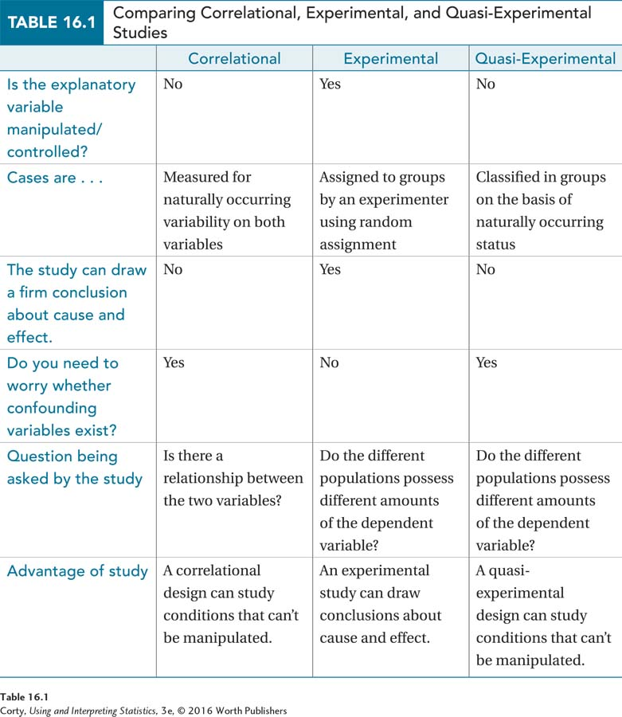
Comparing Different Study Types

Slide 6
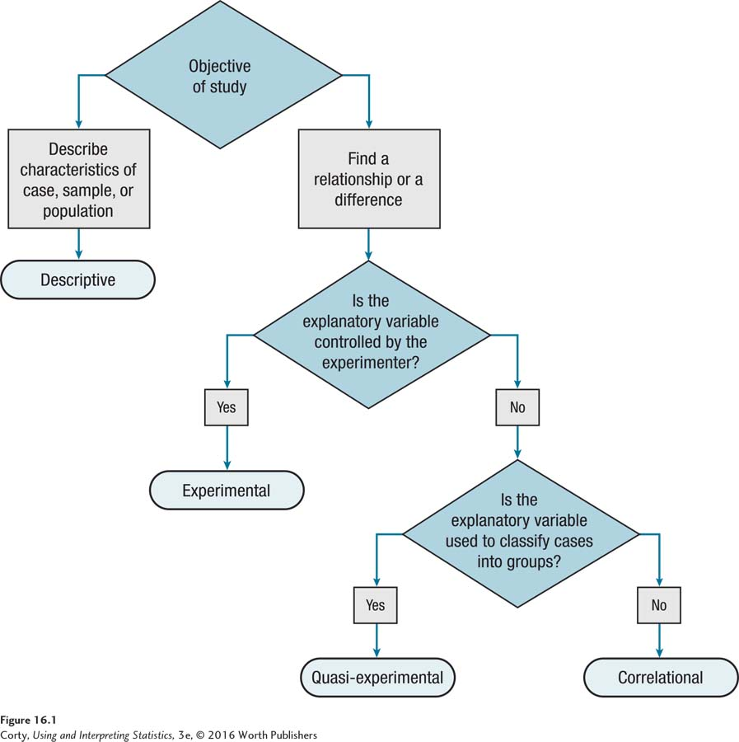
How to Choose: Type of Study
Flowchart used to determine study type
Descriptive
Correlational
Experimental
Quasi-experimental
Study type depends on whether
independent variable is manipulated by the experimenter, and
if independent variable is not manipulated, whether cases are classified into groups.

Slide 7
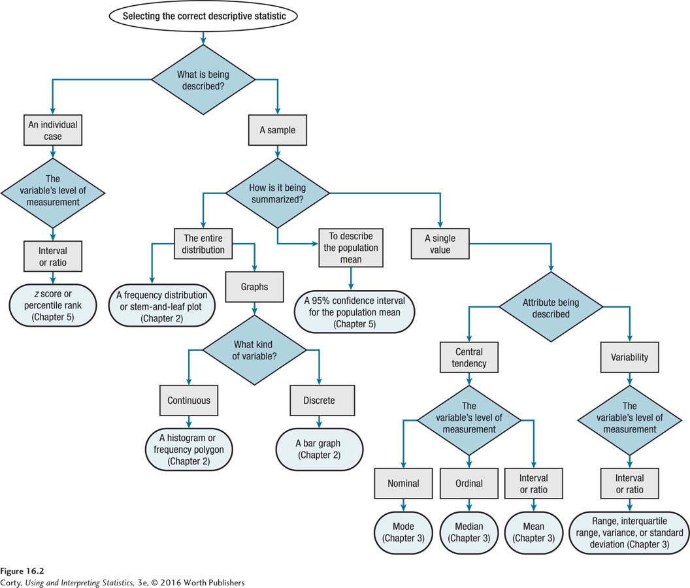
How to Choose: Selecting a Descriptive Statistic
Figure 16.2 How to Choose: Selecting a Descriptive Statistic

Slide 8
Level of Measurement: Information Contained in Numbers
 | Same/Different | Direction of Difference (more/less) | Amount of Distance (equality of units) | Proportion (absolute zero point)
Nominal | ✔
Ordinal | ✔ | ✔
Interval | ✔ | ✔ | ✔
Ratio | ✔ | ✔ | ✔ | ✔

Slide 9
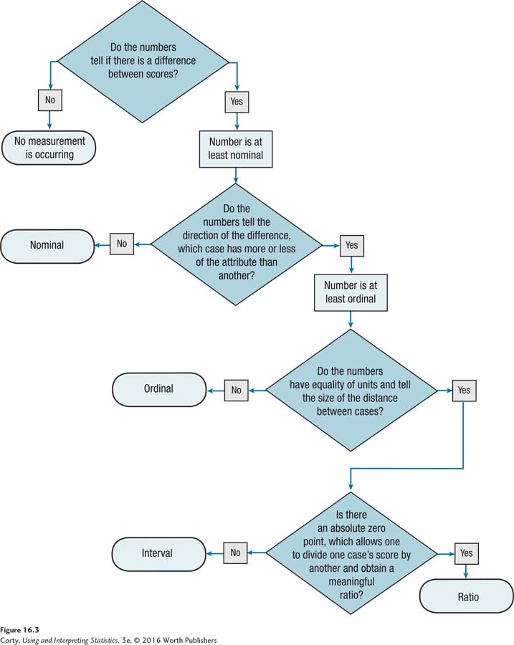
How to Choose: Level of Measurement
Asking the four questions in this flowchart will lead to a decision regarding the level of measurement of a variable

Slide 10
Describing Individual Cases
Describing a single case
If characteristic being measured for an individual case is measured at the interval or ratio level, it can be left as a raw score or transformed
Transformed scores have an advantage because they put scores into context
Two types of transformed scores discussed in Chapter 4
z scores reveal whether a score falls above or below the mean and how far away from the mean it falls
Percentile ranks tell the percentage of scores in the distribution that fall at or below a score

Slide 11
Describing a Sample of Cases
Describing a sample from a population summarized by
Presenting the entire distribution
Table (i.e., a frequency distribution)
Graph (histogram, frequency polygon, or bar graph)
Which graph used depends on whether variable is continuous or discrete
Single value that describes some aspect of the sample
Central tendency or variability

Slide 12
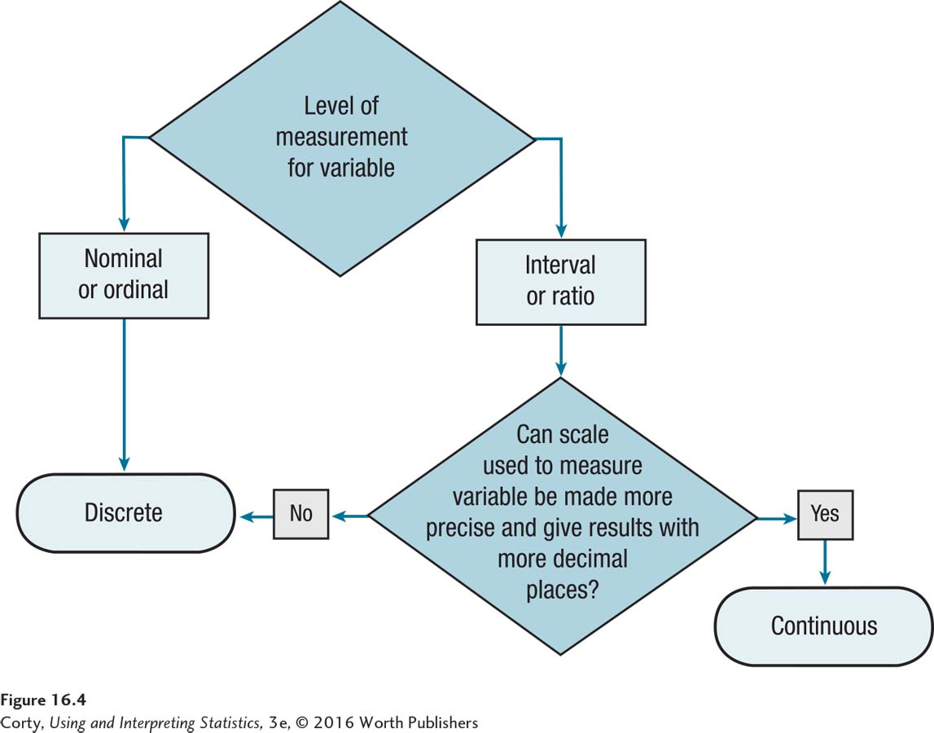
How to Choose: Continuous Numbers vs. Discrete Numbers
To determine if the variable is continuous or discrete, decide whether the variable is nominal or ordinal or interval or ratio. Then follow the flowchart.

Slide 13
Describing a Sample of Cases
Describing a sample from a population summarized by
Presenting the entire distribution
Table (i.e., a frequency distribution)
Graph (histogram, frequency polygon, or bar graph)
Which graph used depends on whether variable is continuous or discrete
Single value that describes some aspect of the sample
Central tendency or variability

Slide 14
Which Measure of Central Tendency for Which Level of Measurement
 | Measure of Central Tendency
Level of Measurement | Mode | Median | Mean
Nominal | ✔
Ordinal | ✔ | ✔
Interval or ratio | ✔ | ✔ | ✔
Not all measures of central tendency can be used with all levels of measurement. When more than one measure of central tendency may be used, choose the one that utilizes more of the information available in the numbers. If considering a mean, be sure to check the shape of the data set for skewness and modality.

Slide 15
Describing a Sample of Cases
Descriptive statistics for variability (interval or ratio)
Range
Interquartile range (IQR)
Variance
Population (σ²)
Sample (s²)
Standard Deviation
Population (σ)
Sample (s)

Slide 16
Describing a Sample of Cases
Multiple descriptive statistics provide better sense of data set
Example: teacher reporting test results
Frequency distribution
Grouping scores provides overview of class performance
Mean
Summarizes the class’s performance
Standard deviation
Indicates how much variability existed in the scores
Range
Reveals best and worst student performance
Reveals how much distance separated the best and the worst students
Percentile rank
Teacher might transform a student’s score into a percentile rank to compare that student’s performance to the rest of the class

Slide 17
Hypothesis Tests I: Difference Tests
Difference Tests
Statistical tests that look for differences among groups of cases
Choosing difference test depends on
Number of groups of cases
Number of independent variables
Type of samples
Dependent variable’s level of measurement
Example
Are people with depression or people with anxiety more impaired by their disorder?
Answered by a difference test

Slide 18
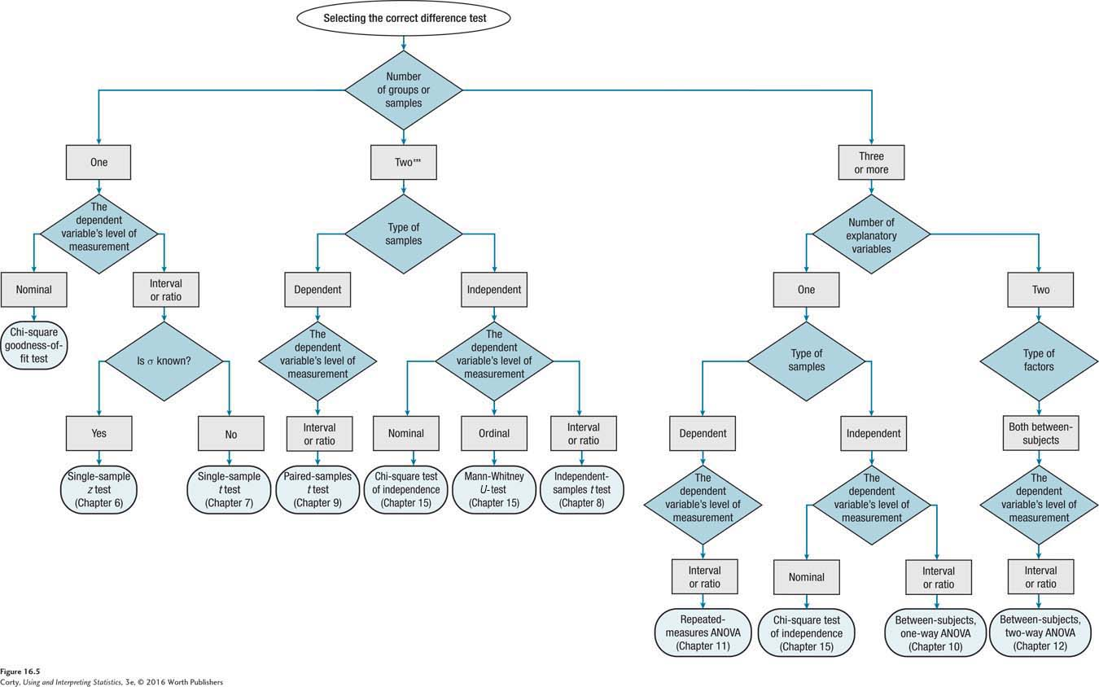
How to Choose: Selecting the Correct Difference Test
**See next slide
for 3 or more

Slide 19
How to Choose: Selecting the Correct Difference Test (continued)
Number
of groups or
samples
Selecting the correct difference test
**Chapter 11 and 12 are not covered in this course

Slide 20
How to Choose: Guidelines for Determining If Samples Are Independent Samples or Dependent Samples
Is each sample a random sample from its respective population?
Yes
No
Is the size of each sample different? (That is, does n₁ ≠ n₂?)
Yes
No
Do the samples consist of the same cases measured at more than one point in time or more than one condition?
Yes
No
Does the selection of cases for one sample determine the selection of cases for the other sample? Are cases paired together in some way?
Yes
No

Slide 21
Hypothesis Tests II: Relationship Tests
Relationship Tests
Statistical tests that examine whether a correlation exists between two variables
Example
Is there a relationship between college students’ attractiveness and number of dates in college?
Answered by a relationship test

Slide 22
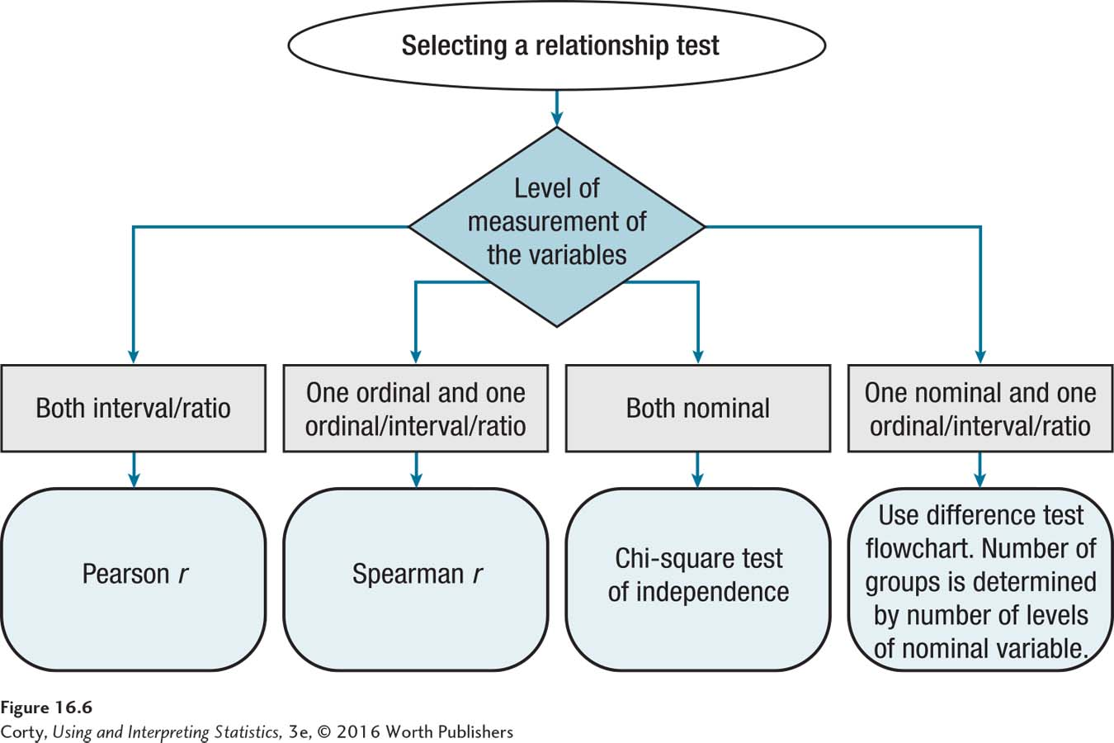
How to Choose: Selecting the Correct Relationship Test

Slide 23
How to Choose: Selecting the Correct Relationship Test (continued)
The decision about which relationship test to use in a given situation is determined by the level of measurement for each of the two variables:
If both variables are measured at the interval or ratio level, then the Pearson r is used (see Chapter 13).
If one variable is ordinal and the other is ordinal or interval or ratio, use a Spearman r (see Chapter 15).
If both variables are nominal-level, then the chi-square test of independence is used (see Chapter 15).

Slide 24
How to Choose: Selecting the Correct Relationship Test (continued)
When one of the variables is nominal and the other is not, the relationship question can be conceptualized as a difference question.
To do so, treat the nominal variable as the explanatory variable and use it to classify cases into groups.
Then, the difference test flowchart (Figure 16.5) can be used to determine the appropriate test.

Slide 25
Application Demonstration: Descriptive Statistic
Milgram (1963), Obedience to Authority
Would normal people behave in inhumane ways just because they were following orders?
Descriptive statistics used
26 of 40 normal men, 65%, were willing to shock a man to death because a researcher asked them to

Slide 26
Application Demonstration: Relationship Test
Eron (1972), Television and Aggression
Is there a relationship between watching TV violence and aggression?
Relationship tests used
Statistically significant correlation of +.21 between violent TV watching at age 9 and rating of aggressiveness by peers at age 9
Correlation 10 years later was a stronger one: r = .31
Correlation between violent TV watching at age 19 and aggression at age 19, not statistically different from zero
Correlations suggest that early viewing of violent TV is more strongly related to aggression 10 years later than it is to aggression as a child

Slide 27
Application Demonstration: Difference Test
Loftus & Palmer (1974), Language and Memory
Asked how fast cars were traveling when a crash occurred
Description of speed varied by utilizing different descriptive words
“smashed,” “collided,” ”bumped,” ”hit,” or “contacted”
Difference test used
Perceptions of speed increased by about 2 mph for each word that suggested more speed
Analysis of variance showed that perceptions can be manipulated by a person asking about them

