Slide 1

Jingwei Wu, PhD
Chapter 5
Sampling and Confidence Intervals
A courtesy of “USING AND INTERPRETING STATISTICS” by ERIC W. CORTY | THIRD EDITION (Macmillan Education)

Slide 2

Objectives
Sampling and Sampling Error
Sampling Distributions and the Central Limit Theorem
The 95% Confidence Interval for a Population Mean

Slide 3
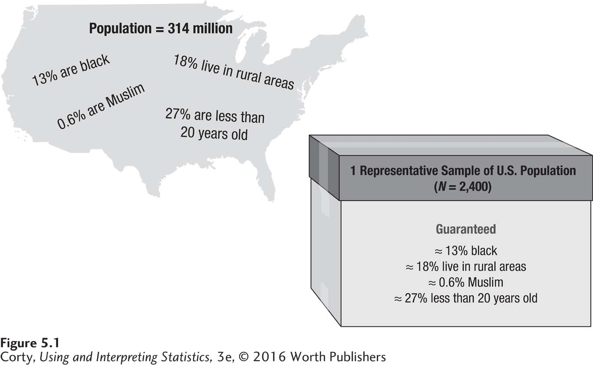
Types of Samples
Representative:
Means all the attributes of the population are present in the sample in the same proportion as in the population
Results from representative samples can be generalized to the population.
A sample is smaller than the population
Here, a sample of 2,400 people is used to represent a population of 314,000,000. If the sample is representative, it has all the attributes that are present in the population in roughly the same degree.

Slide 4
Types of Samples
Convenience Sample
Sampling strategy in which cases are selected for study based on the ease with which they can be obtained
Easy to obtain, but not representative
Example
Social psychologist studying students’ sexual attitudes and behaviors goes to student union at lunchtime and asks students to complete his survey

Slide 5
Types of Samples
Random Sample
Sampling strategy in which each case in the population has an equal chance of being selected
Example: Names drawn from barrel
Social psychologist studying students’ sexual attitudes and behaviors goes to registrar and gets a list of names of all registered students, places names on slips of paper, places slips in barrel, mixes it up, draws a name.

Slide 6
Types of Samples
Random number table
The random digits in this table can be used to select a random sample from a population.
Example: 4,703 students and you want a random sample of 50
Assign sequential numbers to pool of participants
Use random number table and move across it, looking for values of 4,703 or lower
Each time value is encountered, that person goes into the sample
 | A | B | C | D | E | F
1 | 8607 | 1887 | 52 | 2039 | 5502 | 3174
2 | 5574 | 4576 | 5273 | 8582 | 1424 | 9439
3 | 5515 | 8367 | 6317 | 6974 | 3452 | 2639
4 | 0296 | 8870 | 3197 | 4853 | 4434 | 1571
5 | 0149 | 1919 | 8684 | 9082 | 0335 | 6276

Slide 7
Problems with Sampling
Two Potential Problems with Random Samples
Self-selection bias
Nonrepresentative sample that may occur when the subjects who agree to participate in a research study differ from those who choose not to participate
Sampling Error
Discrepancies, due to random factors, between sample values and a population value
Consent Rate
Percentage of targeted subjects who agree to participate in a study
Self-selection bias not a problem if consent rate is above 70%

Slide 8
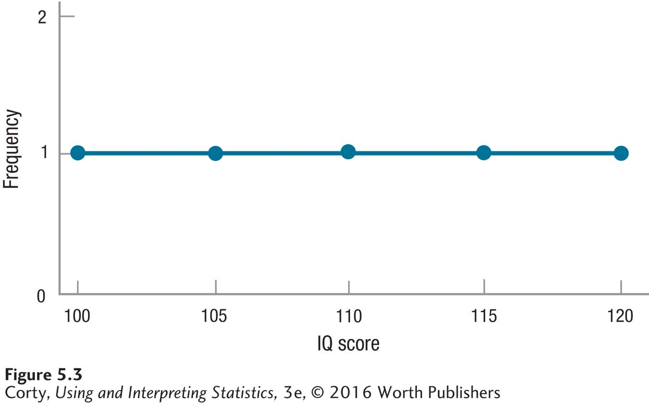
Sampling Distributions
Frequency distribution generated by taking repeated, random samples from a population and generating some value, like a mean, for each sample
Example: IQ of 5 people in a small town in Texas
Distribution of IQ scores in this population is flat

Slide 9

Sampling Distributions
Calculations: IQ of 5 people in a small town in Texas
Calculate population mean
Make a sampling distribution
Take repeated random samples from this population (sample size N = 2). Note: sampling with replacement.
For each sample, calculate a mean.
Make a frequency distribution of the sample means.
$$μ=\frac{ΣX}{N} \\ =\frac{100+105+110+115+120}{5} \\ =\frac{550.0000}{5} \\ =110.0000 \\ =110.00$$

Slide 10
Sampling Distributions
Samples (N = 2) from Population of Five Cases
The letters in the first panel represent all possible samples, of size N = 2 and sampling with replacement, from a population of 5.
The second panel replaces the letters with the IQs of the participants.
The third panel reports the mean IQ for each pair of participants.
All Possible Unique Samples
A, A | A, B | A, C | A, D | A, E
B, B | B, C | B, D | B, E
C, C | C, D | C, E
D, D | D, E
E, E
IQs for Samples
100, 100 | 100, 105 | 100, 110 | 100, 115 | 100, 120
105, 105 | 105, 110 | 105, 115 | 105, 120
110, 110 | 110, 115 | 110, 120
115, 115 | 115, 120
120, 120
Mean IQs for Samples
100.00 | 102.50 | 105.00 | 107.50 | 110.00
105.00 | 107.50 | 110.00 | 112.50
110.00 | 112.50 | 115.00
115.00 | 117.50
120.00

Slide 11
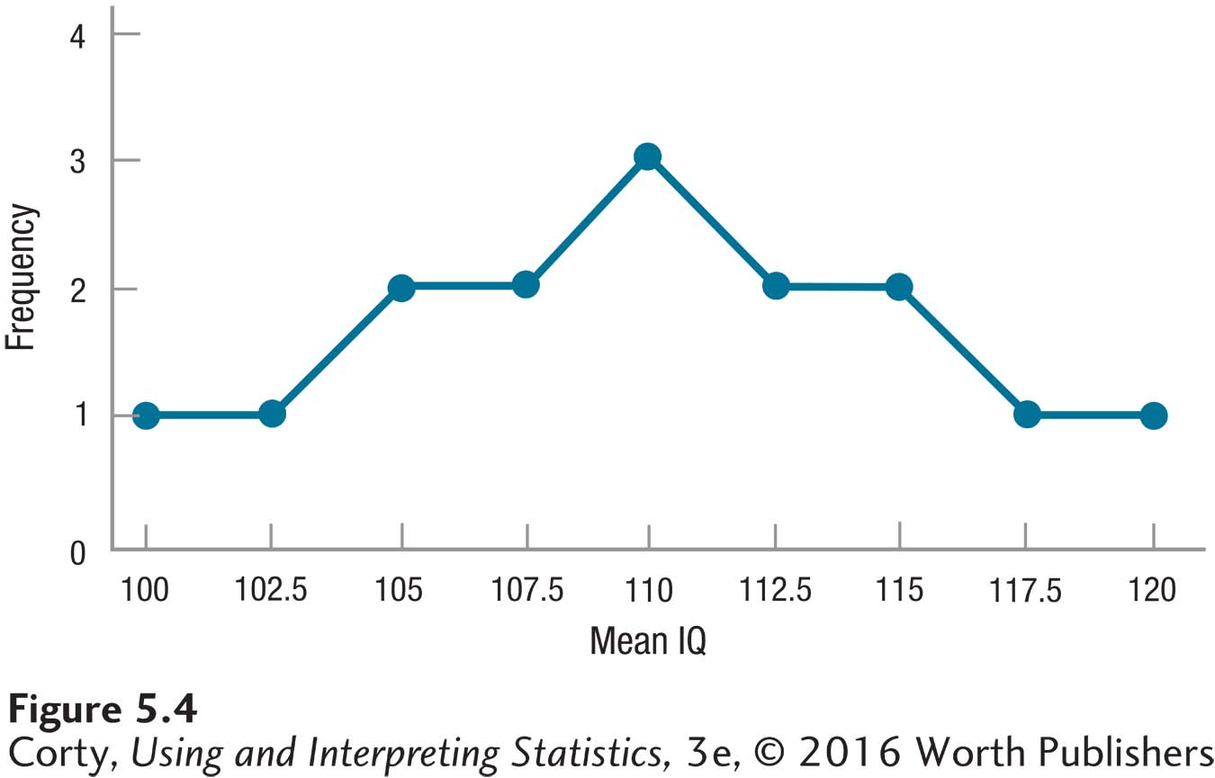
Sampling Distributions
Standard Error of the Mean (σ_{M})
Standard deviation of a sampling distribution of the mean
Sampling distribution is starting to assume normal shape
Mean of sampling distribution is same as population mean
µ_{M}=110.00
Sampling Distribution of Means for Repeated, Random Samples of Size N = 2 from Small Texas Town

Slide 12
Central Limit Theorem
Statement about the shape that a sampling distribution of the mean takes if the size of the samples is large and every possible sample is obtained
Reveals 3 things
If N is large, the sampling distribution of the mean will be normally distributed, no matter what the shape of the population is.
If N is large, the mean of the sampling distribution is the same as the mean of the population from which the samples were selected.
If N is large, a statistician can compute the standard error of the mean (the standard deviation of the sampling distribution) using Equation provided in the next two slides

Slide 13


Calculating Standard Error of the Mean (σ_{M})
Example: 100 Americans given IQ test, σ = 15
$$σ_{M}=\frac{σ}{\sqrt{N}} \\ where σ_{M}=the standard error of the mean \\ σ=the standard deviation of the population \\ N=number of cases in the sample$$
$$σ_{M}=\frac{σ}{\sqrt{N}} \\ =\frac{15}{\sqrt{100}} \\ =\frac{15}{10.0000} \\ =1.50$$

Slide 14

When σ Is Not Known
Calculating estimated standard error of the mean
$$s_{M}=\frac{s}{\sqrt{N}} \\ where s_{M}=the estimated standard error of the mean \\ s=the sample standard deviation \\ N=number of cases in the sample$$

Slide 15

Estimated Standard Error of the Mean (s_{M})
Example: Nurse practitioner measuring diastolic blood pressure
N = 83, s = 11
$$s_{M}=\frac{s}{\sqrt{N}} \\ =\frac{11}{\sqrt{83}} \\ =\frac{11}{9.1104} \\ =1.2074 \\ =1.21$$

Slide 16
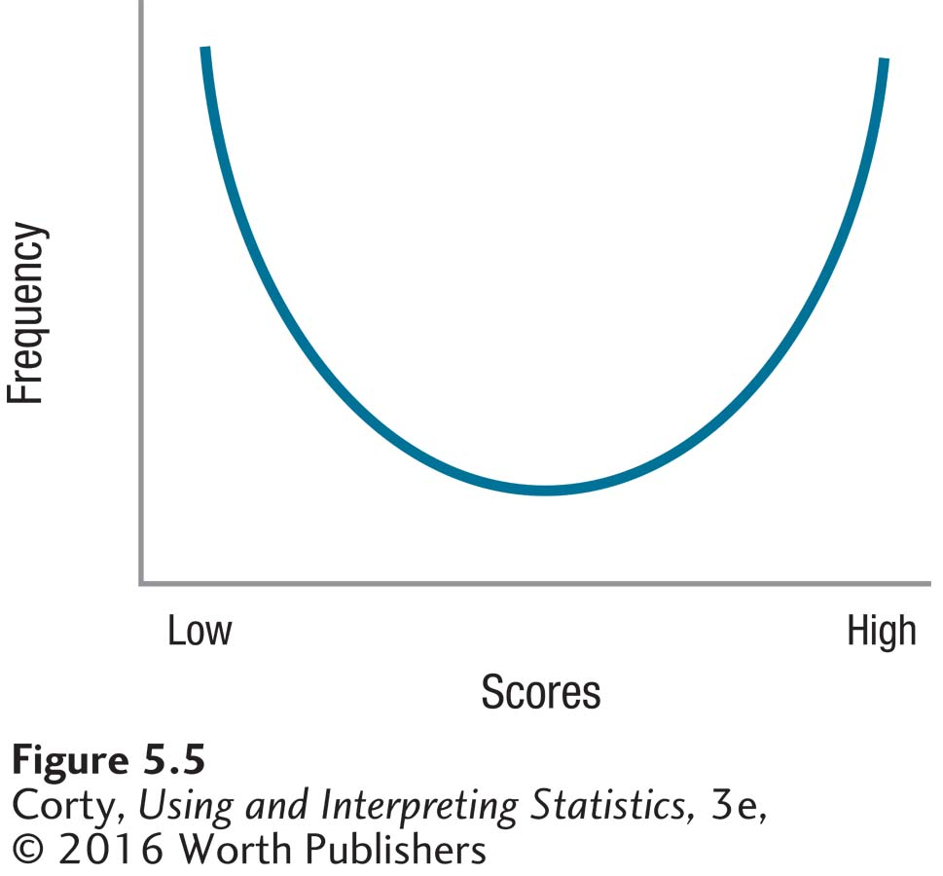
Usefulness of Central Limit Theorem
This graph shows a population with a non-normal shape.
According to the central limit theorem, as long as the size of the samples drawn from this population is large enough, a sampling distribution of the mean for this non-normally shaped population will have a normal distribution.
A Population That Is Not Normally Distributed

Slide 17
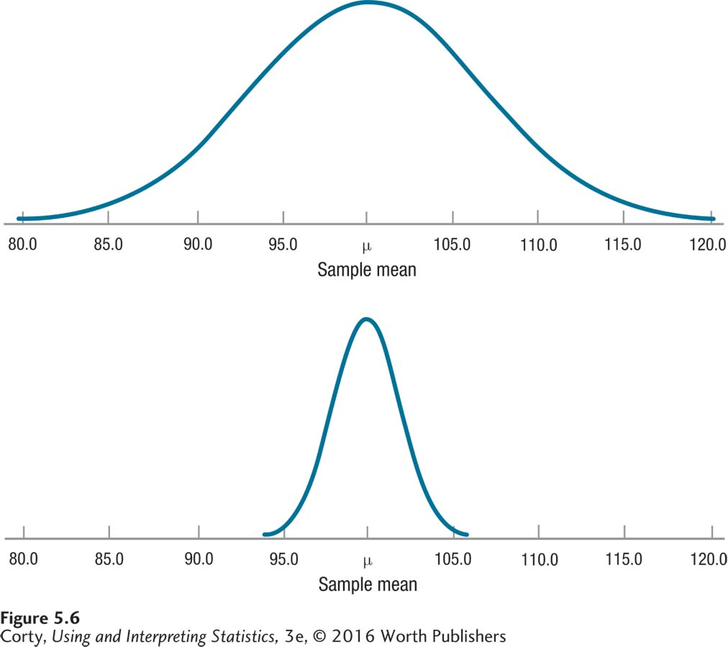
Usefulness of Central Limit Theorem
Used to calculate standard error of the mean (s_{M})
Effect of size of standard error of the mean on sampling:
Both sampling distributions are from populations where μ = 100 and σ = 15.
Top panel, small sample N = 9, s_{M} = 5.00
Bottom panel, larger sample N = 100, s_{M} = 1.50
When s_{M} is smaller, sampling distribution clustered more tightly around population mean of 100.

Slide 18

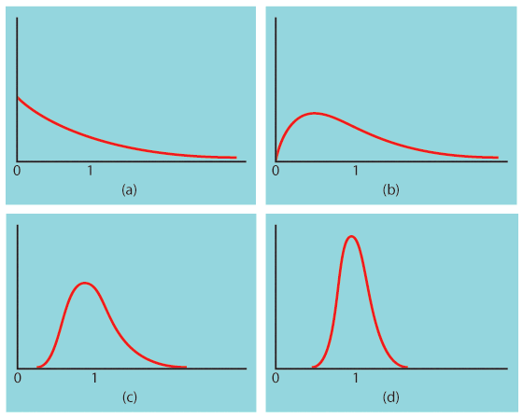
An Illustration
When randomly sampling from any population with mean µ and standard deviation σ, when n is large enough, then sampling distribution of is approximately Normal.
Sampling distribution of for n = 2 observations
Population with strongly skewed distribution
Sampling distribution of ddfor n = 25
observations
Sampling distribution of for n = 10 observations

Slide 19
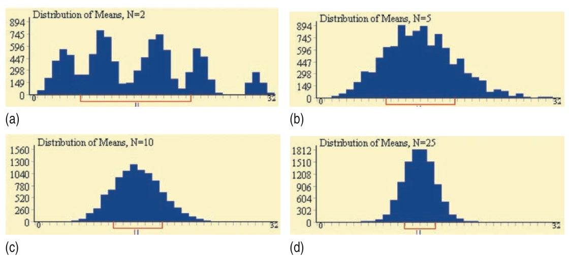
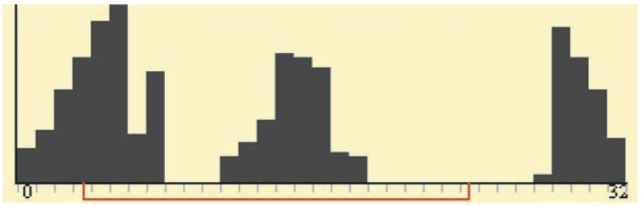

The Central Limit Theorem Statement
Draw an SRS of size n from any population with mean µ and finite standard deviation σ. The Central Limit Theorem (CLT) says that when n is large enough, the sampling distribution of the sample mean is approximately Normal:
is approximately
$$N\left(μ,\frac{σ}{\sqrt{n}}\right)$$

Slide 20
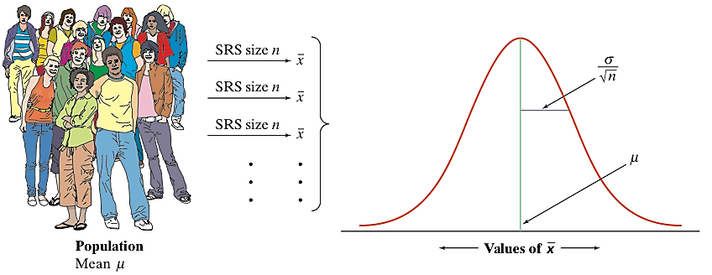
Sampling Distribution of a Sample Mean
When we choose many SRSs with same sample size n from a population, the sampling distribution of is centered at the population mean µ and is less spread out than the population distribution.

Slide 21
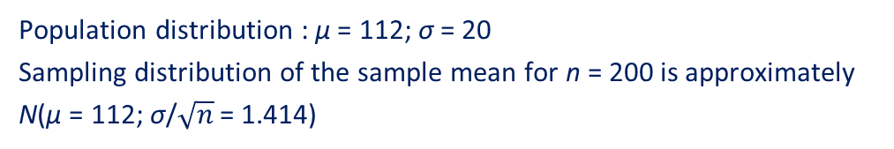
Example 1
In a large population of adults, the mean IQ is 112 with standard deviation 20. Suppose 200 adults are randomly selected for a market research campaign.
The distribution of the sample mean IQ is:
Exactly normal, mean 112, standard deviation 20
Approximately normal, mean 112, standard deviation 20
Approximately normal, mean 112 , standard deviation 1.414
Approximately normal, mean 112, standard deviation 0.1
Answer: C) Approximately normal, mean 112 , standard deviation 1.414
Population distribution : µ = 112; σ = 20
Sampling distribution of the sample mean for n = 200 is approximately N(µ = 112; σ/$\sqrt{n}$ = 1.414)

Slide 22

Example 2
Hypokalemia is diagnosed when blood potassium levels are below 3.5mEq/dl. Let’s assume that we know a patient whose measured potassium levels vary daily according to a normal distribution N(μ = 3.8, σ = 0.2).
1. If only one measurement is made, what is the probability that this patient will be misdiagnosed with Hypokalemia?
z = −1.5, P(z < −1.5) = 0.0668 ≈ 7%
2. If measurements are taken on 4 separate days and averaged, what is the probability of a misdiagnosis with Hypokalemia?
z = −3, P(z < - 3.0) = 0.0013 ≈ 0.1%

Slide 23
The 95% Confidence Interval for a Population Mean
Confidence interval:
is the range, based on sample value, within which a researcher estimates a population value falls.
is an interval estimate for a population value, not a point estimate.
uses statistics to estimate parameters.
Point estimate:
is a single value as an estimate of a population value.

Slide 24
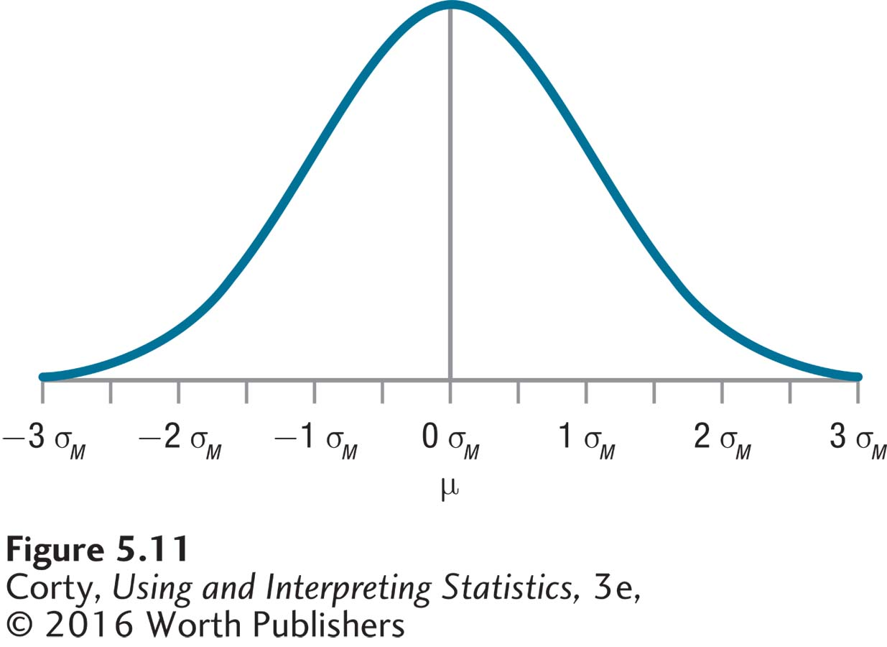
A Sampling Distribution of the Mean
By the central limit theorem:
the sampling distribution of the mean is normally distributed.
the midpoint of a sampling distribution of the mean is the mean of the population from which the samples are drawn.
the standard deviation of the sampling distribution of the mean is the standard error of the mean (σ_{M}).

Slide 25
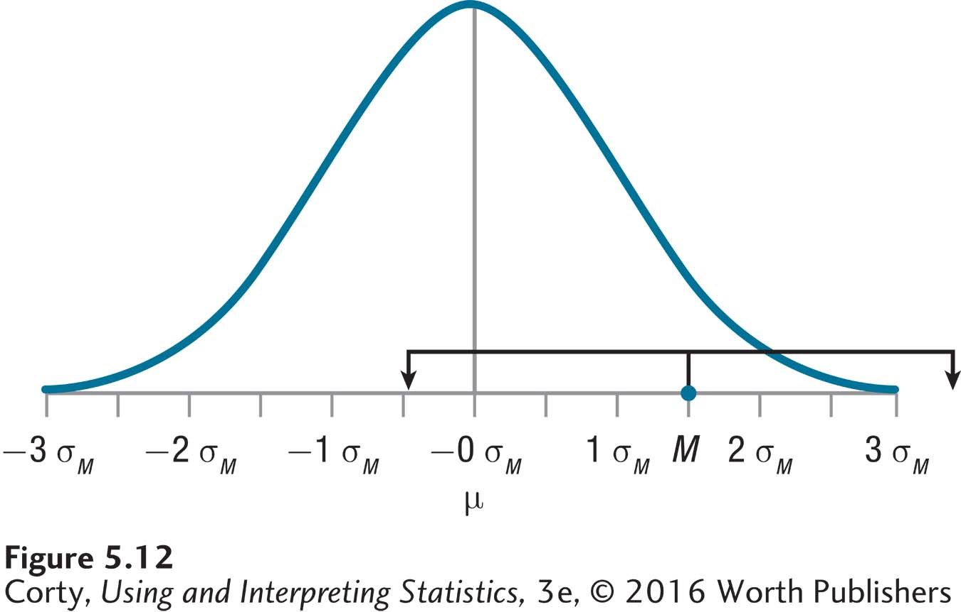
±1.96 σ_{M} Brackets Built Around a Sample Mean
The 95% confidence interval extends from 1.96 σ_{M} below M to 1.96 σ_{M} above.
Notice that this interval captures μ, the population mean.

Slide 26
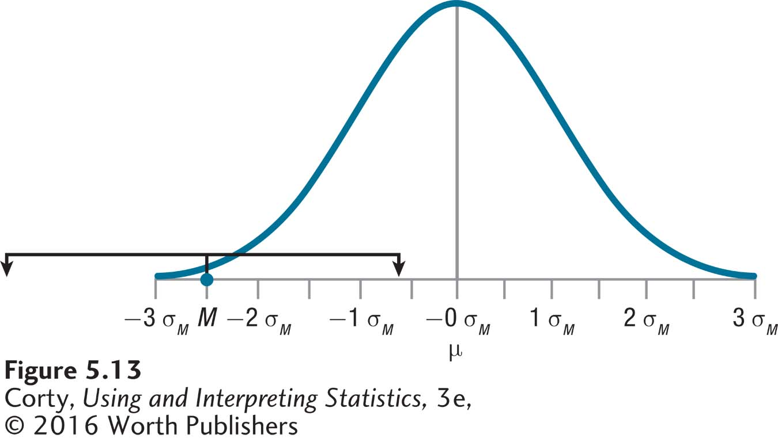
±1.96 σ_{M} Brackets Built Around a Sample Mean
The 95% confidence interval extends from 1.96 σ_{M} below M to 1.96 σ_{M} above.
Notice that this interval fails to captures μ, the population mean.

Slide 27
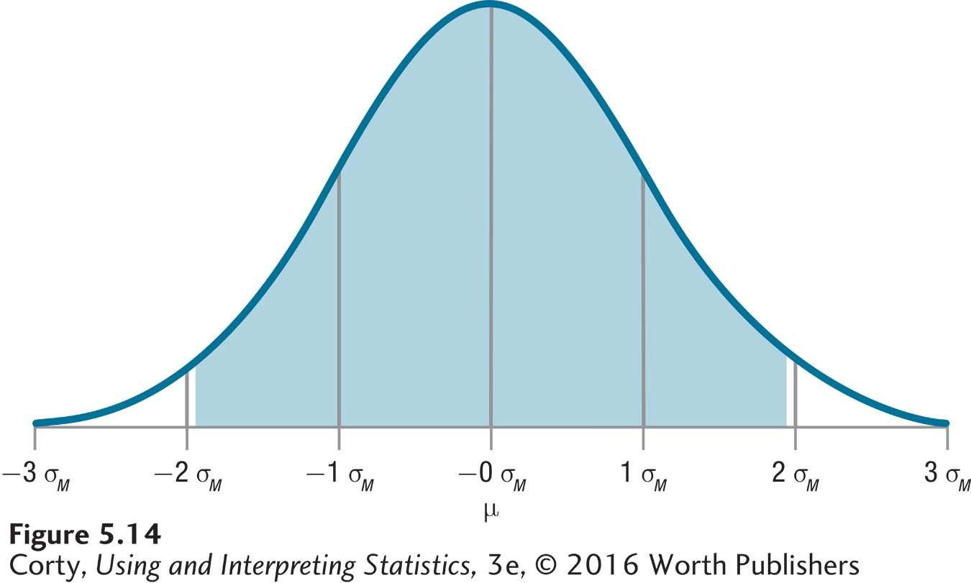
Putting It All Together: Defining the 95% Confidence Interval for the Population Mean

Slide 28
Putting It All Together: Defining the 95% Confidence Interval for the Population Mean
If a sample mean is picked at random from a sampling distribution of the mean, there’s a 95% chance that the sample mean falls in the shaded region, as shown in Figure 5.14.
Brackets that extend ±1.96 σ_{M} capture μ for every sample mean in the shaded region.
For any mean picked at random from the sampling distribution, there’s a 95% chance that 1.96 σ_{M} brackets extended symmetrically around it will capture μ.

Slide 29
Area Within Which 95% of the Sample Means Fall in a Sampling Distribution of the Mean
95% of sample means in a sampling distribution of the mean fall in the area from 1.96 σ_{M} below the midpoint to 1.96 σ_{M} above the midpoint.
95% confidence intervals that are built around means in the shaded area will successfully capture the population mean, μ.

Slide 30
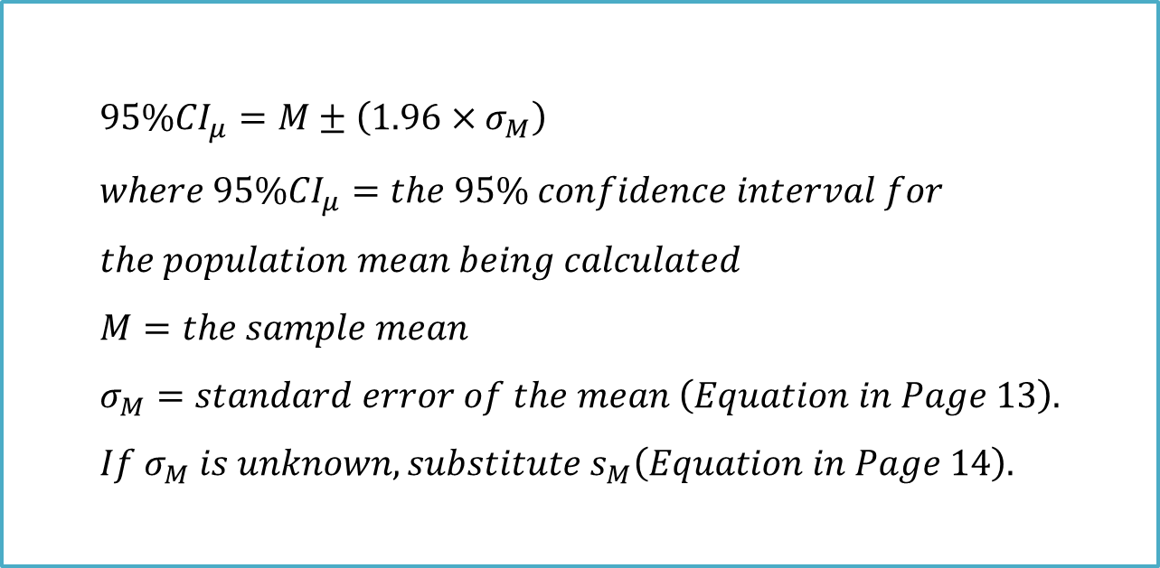
Formula for 95% Confidence Interval for the Population Mean
$$95\%{CI}_{μ}=M±\left(1.96×σ_{M}\right) \\ where 95\%{CI}_{μ}=the 95\% confidence interval for \\ the population mean being calculated \\ M=the sample mean \\ σ_{M}=standard error of the mean \left(Equation in Page 13\right). \\ If σ_{M} is unknown, substitute s_{M}\left(Equation in Page 14\right).$$

Slide 31
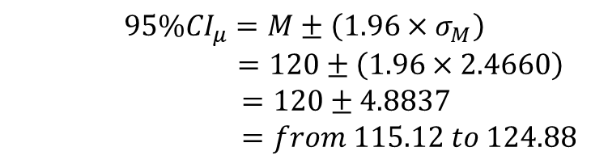

Calculating 95% Confidence Interval
Calculation for a confidence interval: M, σ, and N. σ and N are needed to calculate σ_{M} using Equation in page 13.
Equation in previous page can be used to calculate the 95% confidence interval.
$$σ_{M}=\frac{σ}{\sqrt{N}} \\ =\frac{15}{\sqrt{37}} \\ =\frac{15}{6.0828} \\ =2.4660 \\ =2.47$$
$$95\%{CI}_{μ}=M±\left(1.96×σ_{M}\right)$$
$=120±\left(1.96×2.4660\right)$
$=120±4.8837$
$=from 115.12 to 124.88$

Slide 32
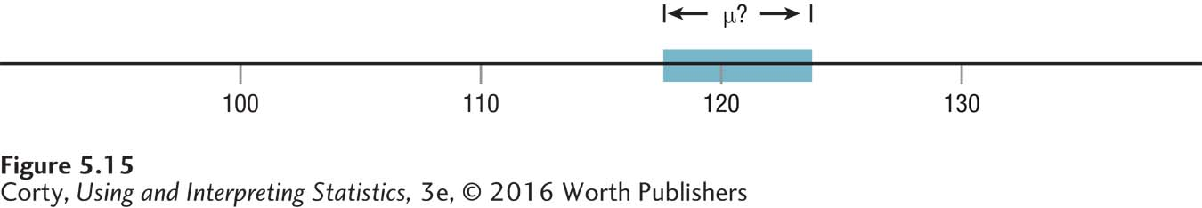
Using a Confidence Interval to Indicate the Range Within Which a Population Value Falls
The shaded area indicates the range within which the mean IQ of all students at the elite college probably falls.

Slide 33
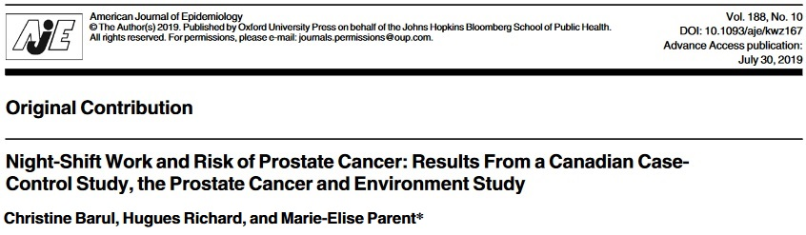
Example
Prostate cancer patients’ age in Montreal, Quebec, Canada has a known population standard deviation σ =6.9.
1. They collected 1,904 prostate cancer cases, and the average age is 63.6. Calculate a 95% confidence interval.
Since z* = 1.960 for 95% confidence level, thus 95% CI for age in prostate cancer cases is
63.6 ± 1.96 (6.9/$\sqrt{1904}$) = 63.6 ± 0.31 = (63.29, 63.91)
2. They also collected 1,965 controls, and the average age is 64.9. Calculate a 95% confidence interval.
Since z* = 1.960 for 95% confidence level, thus 95% CI for age in controls is
64.9 ± 1.96 (6.9/$\sqrt{1965}$) = 64.9 ± 0.31 = (64.59, 65.21)

