Slide 1

Jingwei Wu, PhD
Special Topic I Therapy and Diagnostic Tests
A courtesy of “USING AND INTERPRETING STATISTICS” by ERIC W. CORTY | THIRD EDITION (Macmillan Education)

Slide 2

Objectives
Introduction
Therapy math – 3 metrics
Diagnostic test math – level 1
Diagnostic test math – level 2

Slide 3
Objectives
Introduction
Therapy math – 3 metrics
Diagnostic test math – level 1
Diagnostic test math – level 2

Slide 4
Diagnosis
Cause
DISEASE
Prognosis
Therapy

Slide 5
Diagnosis
Risk Factor
Prognostic Factor
Cause
DISEASE
Prognosis
Therapy

Slide 6
Diagnosis
Cause
DISEASE
Prognosis
Prevention
Treatment
Therapy

Slide 7
Diagnosis
Risk Factor
Prognostic Factor
Cause
DISEASE
Prognosis
Prevention
Treatment
Therapy

Slide 8
Objectives
Introduction
Therapy math – 3 metrics
Diagnostic test math – level 1
Diagnostic test math – level 2

Slide 9
“Therapy Math” ARR, RRR, NNT
IF → 5-yr mortality from AIDS is 70%, and antiretroviral therapy ↓ it to 35%
Absolute risk reduction = 35%
Relative risk reduction = ARR/Untreated = 35%/70% = 50%
Number needed to treat =
1/ARR = 1/.35 = 3

Slide 10
Adverse Outcome Rate
Untreated = 1% Treated = 0.5%

Slide 11
Adverse Outcome Rate
Untreated = 1% Treated = 0.5%
ARR = 0.5% NNT = 1/.005 = 200

Slide 12
Adverse Outcome Rate
Untreated = 10% Treated = 5%

Slide 13
Adverse Outcome Rate
Untreated = 10% Treated = 5%
ARR = 5% NNT = 1/.05 = 20

Slide 14
Adverse Outcome Rate
Untreated = 100% Treated = 50%

Slide 15
Adverse Outcome Rate
Untreated = 100% Treated = 50%
ARR = 50% NNT = 1/.5 = 2

Slide 16
Adverse Outcome Rate
Untreated = 1% Treated = 0.5%
ARR = 0.5% NNT = 1/.005 = 200
Untreated = 10% Treated = 5%
ARR = 5% NNT = 1/.05 = 20
Untreated = 100% Treated = 50%
ARR = 50% NNT = 1/.5 = 2
RRR in all 3 cases is same → 50%
0.5% / 1% or 5% / 10% or 50% / 100%

Slide 17
Lipid Research Clinics Coronary Primary Prevention Trial
3806 asymptomatic middle-aged men with hypercholesterolemia
Randomized to cholestyramine (bile acid sequestrant) vs. placebo
Followed for average of 7.4 years
Primary endpoint: coronary heart disease death or nonfatal myocardial infarction
Placebo 9.8%
Cholestyramine 8.1%
JAMA 1984;251:351-364

Slide 18
Disease | Lipids
Outcome | CHD Death or Nonfatal MI
-- Cont.% | 9.8%
-- Exp. % | 8.1%
ARR | 1.7%
NNT | 59
RRR | 17%
1/.017
1.7/ 9.8

Slide 19
NNT for 45 y/o woman (to prevent 1 death by 75)

Slide 20
Ipratropium plus Albuterol vs. Albuterol Alone in Acute Asthma
55 adults with severe asthma attack presenting to emergency department
Randomized to nebulized combined treatment vs. nebulized albuterol alone.
Primary endpoint: peak flow improvement
Secondary endpoint: hospital admission
Albuterol alone 36% (10 of 28 patients)
Combined therapy 11% ( 3 of 27 patients)
Lin et al, Ann Emerg Med 1998;31:208-212.

Slide 21
THERAPY – In-Class Exercise Answers
Disease | Asthma
Outcome | Hospital Admission
-- Cont.% | 36%
-- Exp. % | 11%
ARR | 25%
NNT | 4
RRR | 69%
1/.25
25/36

Slide 22
THERAPY – In-Class Exercise Answers
Disease | Lipids | Asthma
Outcome | CHD Death or Nonfatal MI | Hospital Admission
-- Cont.% | 9.8% | 36%
-- Exp. % | 8.1% | 11%
ARR | 1.7% | 25%
NNT | 59 | 4
RRR | 17% | 69%

Slide 23
B-blockers Post-MI Mortality
High Risk
Placebo | 20 %
B-blocker | 14 %
ARR | 6%
RRR | 30 %
NNT | 17
6/20
1/.06

Slide 24
B-blockers Post-MI Mortality
Low Risk
Placebo |  | 2.0 %
B-blocker |  | 1.4 %
ARR |  | 0.6%
RRR |  | 30 %
NNT |  | 170
0.6/2
1/.006

Slide 25
B-blockers Post-MI Mortality
High Risk
Low Risk
Placebo | 20 % | 2.0%
B-blocker | 14 % | 1.4 %
ARR | 6% | 0.6%
RRR | 30 % | 30 %
NNT | 17 | 170

Slide 26
U.S. Physicians Health Study (22,000 subjects in RCT for 5 years)
Took aspirin or placebo
RRR for heart attack (MI) = 44%
Absolute risk of MI only 0.26%
NNT for MI was 385
NNH (melena) was about 100
NNH (stroke) was 1000
Sackett, Clinical Epidemiology, p. 206

Slide 27
Limitations of the 3 Metrics
The 3 metrics can only be used when the outcome is binary. They cannot be calculated for a continuous outcome.
For continuous outcomes, the effect of treatment is typically expressed as a mean which cannot be converted into ARR or NNT.
However, one can select a clinically meaningful cutpoint on a continuous variable and then calculate the metrics. For example
% of hypertensive patients achieving a diastolic BP < 90 mm Hg
% of diabetic patients reaching a target A1C < 7.0

Slide 28
Objectives
Introduction
Therapy math – 3 metrics
Diagnostic test math – level 1
Diagnostic test math – level 2

Slide 29
Diagnosis
Prog-nosis
Cause
DISEASE
Therapy

Slide 30
Diagnostic Tests -- Examples
Laboratory (blood, urine, sputum, spinal fluid, pus, ...)
Imaging (X-rays, ultrasound, CT, MRI)
Procedures (endoscopy, angiograpy, electrophysiology, spirometry, …)
Pathology (tissue specimens, …)
Patient-report (scales, interviews, …)
Physical exam (most parts of exam)

Slide 31
Reasons for Diagnostic Testing
Establish a diagnosis in symptomatic patients → an ECG to diagnose ST-elevation myocardial infarction (STEMI) in patients with chest pain.
Screen for disease in asymptomatic patients → a mammogram in women older than 50 years.
Prognostic information in patients with known disease → CD4 count in patients with HIV.
Monitor therapy for either benefits or side effects → an international normalized ratio (INR) in patients taking warfarin.
Rule out a disease → a pregnancy test to exclude ectopic pregnancy.
Elizabeth Abram, Medscape

Slide 32
Independent
(predictor / exposure)
_
+
+
Dependent (outcome)
_

Slide 33
Disease
_
+
+
Test
_

Slide 34
Disease
_
+
+
Test
_
100
400
Prevalence = Pre-Test Probability = 20%

Slide 35
Disease
_
+
+
100
0
Test
_
0
400
100
400
500
The “perfect” test = 100% accurate

Slide 36
Disease
_
+
+
80
Test
_
20
100
Sensitivity = “Positive in Disease” (PID) = 80%

Slide 37
Disease
_
+
+
80
Test
_
320
400
Specificity = “Negative in Health” (NIH) = 80%

Slide 38
Disease
_
+
PPV = 80/160 = 50%
+
80
80
Test
NPV = 320/340 = 94%
_
20
320
Se = 80% “PID”
Sp = 80% “NIH”

Slide 39
Disease
Instead of 50%
_
+
+
PPV = 86%
240
40
Test
NPV = 73%
_
60
160
Instead of 94%
300
200
Prevalence = Pre-Test Probability = 60%

Slide 40
Predictive Value Varies with Disease Prevalence
Sensitivity and specificity are mainly intrinsic characteristics of the test and generally do not vary much with disease prevalence
Predictive value depends on BOTH test operating characteristics AND disease prevalence, and can vary considerably as disease prevalence varies
When ordering a test, you are faced with a positive or negative result, and thus need to estimate pre-test probability (prevalence) in order to determine the post-test result probability (predictive value)

Slide 41
Left ventricular dysfunction by echo
_
+
PPV = 26/37 = 72%
+
26
11
BNP > 75
NPV = 75/89 = 84%
_
14
75
Se = 26/40 = 65%
Sp = 75/86 = 87%
Landray BMJ 2000

Slide 42
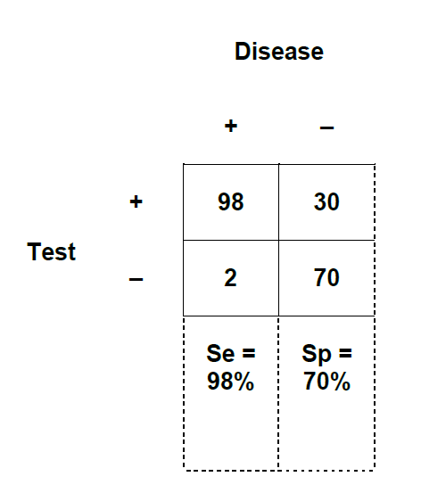
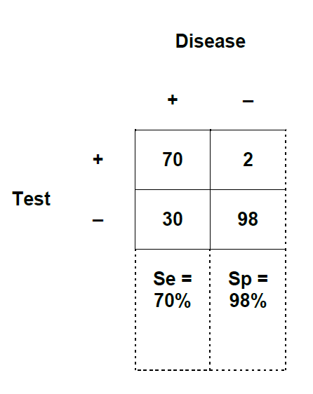
Highly sensitive test good at ruling out disease (SnOUT)
Very few false negatives
Highly specific test good at ruling in disease (SpIN)
Very few false positives

Slide 43
SnOUT and SpIN
SnOut
S ensitive test with a n egative result is good at ruling- OUT the disease.
SpIN
S pecific test with a p ositive result is good at ruling- IN the disease.
Examples: 2-stage serologic tests for infections (HIV disease; syphilis; …)

Slide 44
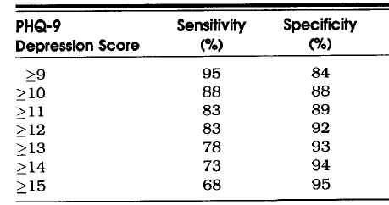
Sensitivity vs. Specificity Trade-off
Operating Characteristics of Varying PHQ-9 Cutpoints for Diagnosing Major Depression
Kroenke, J Gen Intern Med, 2001

Slide 45
Objectives
Introduction
Therapy math – 3 metrics
Diagnostic test math – level 1
Diagnostic test math – level 2

Slide 46
Disease
_
+
+ LR = probability of positive test in pts with disease ÷ probability of positive test in pts without disease
+
80
80
Test
_
20
320
100
400
+LR = TPR/FPR = Se/(1-Sp) .8/.2 = 4

Slide 47
Disease
_
+
- LR = probability of negative test in pts with disease ÷ probability of negative test in pts without disease
+
80
80
Test
_
20
320
100
400
−LR = FNR/TNR = (1-Se)/Sp = .2/.8 = 0.25

Slide 48
Left ventricular dysfunction by echo
_
+
+
26
11
BNP > 75
_
14
75
+ LR = .65/.13 = 5
Se = 26/40 = 65%
Sp = 75/86 = 87%
Landray BMJ 2000

Slide 49
Likelihood Ratios for Ferritin
Ferritin level | Iron-deficent | Not iron-deficient | Likelihood ratio
< 19 | 47 | 2 | 41.5
19-45 | 23 | 13 | 3.1
46-100 | 7 | 27 | 0.5
> 100 | 8 | 108 | 0.1
TOTAL | 85 | 150
Goat et al, J Gen Intern Med 1992

Slide 50
Calculating LR for a Test Range
Ferritin level | Iron-deficent | Not iron-deficient | Likelihood ratio
< 19
19-45 | 23 | 13 | 3.1
46-100
> 100
TOTAL | 85 | 150
[23/85] ÷ [13/150] = .271/.087 = 3.1

Slide 51
LR for Test Ranges– Another Example
PSA Level | Likelihood Ratio
< 2 | 0.3
2 to 4 | 0.7
> 4 to 10 | 1.0
> 10 to 20 | 1.5
> 20 | 6.3
> 4 | 1.3
Hoffman et al, BMC Fam Practice, 2002

Slide 52
Strength of a Diagnostic Test
Strength | LR + | LR −
Excellent | 10 | 0.1
Very good | 5 | 0.25
Fair | 2 | 0.5
Useless | 1 | 1

Slide 53
Comparing Diagnostic Tests

Slide 54
Comparing Diagnostic Tests
Perfect test AUC=1.0
Worthless test AUC=0.5

Slide 55
Rules of Thumb about Area under the Curve (AUC) for Diagnostic Tests
AUC | Diagnostic “Strength”
≥ 0.90 | Excellent
≥ 0.80 | Good
≥ 0.70 | Fair
≥ 0.60 | Poor
0.50 | No better than chance

Slide 56
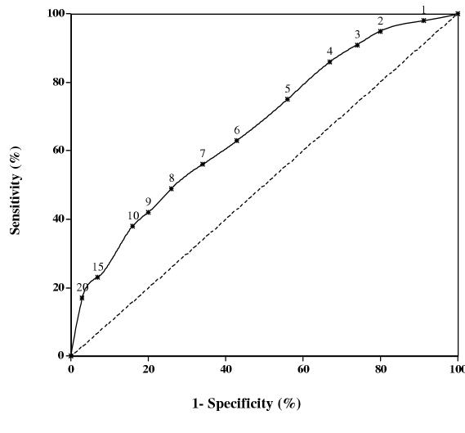
ROC Curve for PSA Test
2,162 men
Age = 61 (median)
Mean PSA
7.8 in cancer
5.4 in those without cancer
AUC = 0.67
Hoffman et al, BMC Fam Practice, 2002

Slide 57
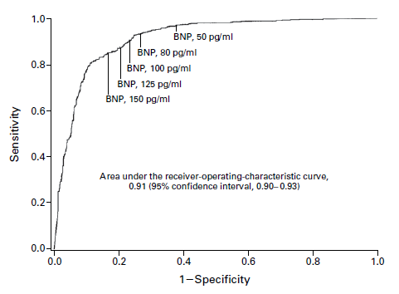
Receiver Operating Curve (ROC) Analysis

Slide 58
Odds ←→ Probability
3 to 1 Odds
75% Probability

Slide 59
Odds ←→ Probability
1 to 4 Odds (i.e.,, 0.25 to 1)
20% Probability

Slide 60
Odds = Probability / (1 − Probability)
75% probability
Odds = .75 / .25 = 3 (i.e., 3 to 1 odds)
20% probability
Odds = .20 / .80 = 0.25 (i.e., 0.25 to 1)
Probability = Odds / (1 + Odds)
3 to 1 Odds
Probability = 3/ 4 = .75 (or, 75%)
0.25 to 1 Odds
Odds = .25 /1.25 = 0.20 (i.e. 20%)

Slide 61
Using Odds with Likelihood Ratios
20 y/o man with dypsnea & chest pain
Pre-test probability of PE = 20%
Pre-test odds = 0.2/(1-0.2) = .2/.8 = 0.25
He has a high-probability lung scan for which the LR = 18.
Post-test odds = pretest odds X LR = 18 x 0.25 = 4.5
Post-test probability = odds/(1 + odds) = 4.5 / 5.5 = 82%

Slide 62
20 y/o man with dypsnea & chest pain
20% pretest probability of pulm embolus
Scan Result Probability | LR | Post-test probability
High | 18.3 | 82%
Intermediate | 1.2 | 23%
Low | 0.36 | 8%
Normal | 0.1 | 2%
Guyatt et al, User’s Guide, JAMA book, 2002

Slide 63
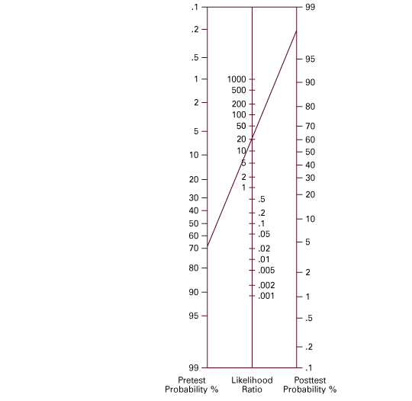
Likelihood Ratio Nomogram

Slide 64
“Rule of Thumb” for Likelihood Ratios
LR | Change in Prob.
10 | + 45
9 | + 40
6 | + 35
5 | + 30
4 | + 25
3 | + 20
2 | + 15
LR | Change in Prob.
1 | None
0.5 | − 15
0.4 | − 20
0.3 | − 25
0.2 | − 30
0.1 | − 45
McGee, JGIM 2002

Slide 65
If pretest probability of disease = 50%
LR | Change in Prob.
10 | + 45
9 | + 40
6 | + 35
5 | + 30
4 | + 25
3 | + 20
2 | + 15
Post-test probability
95%
80%
65%

