Slide 1

Jingwei Wu, PhD
Chapter 2
Frequency Distributions
A courtesy of “USING AND INTERPRETING STATISTICS” by ERIC W. CORTY | THIRD EDITION (Macmillan Education)

Slide 2

Objectives
Frequency Distributions
Discrete Numbers and Continuous Numbers
Graphing Frequency Distributions
Shapes of Frequency Distributions

Slide 3
Frequency Distributions
Frequency distribution
Tally of how often different values of a variable occur in a set of data
Intuitive way to organize and reduce data
Utilized for nominal-, ordinal-, interval-, and ratio-level data
Types of frequency distribution tables
Ungrouped frequency distribution
Grouped frequency distribution

Slide 4
Types of Frequency Distributions
Ungrouped frequency distribution
Is a count of how often each individual value of a variable occurs in a set of data
Is used when the values a variable can take are limited

Slide 5
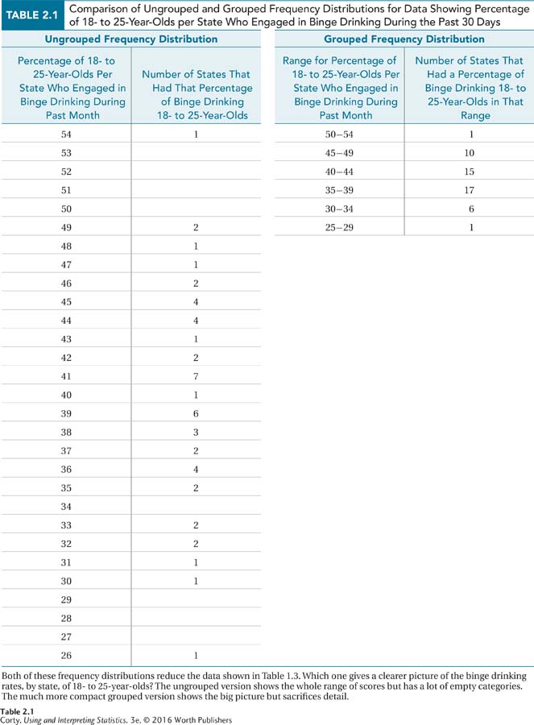
Ungrouped Frequency Distributions Data Percentage of 18- to 25-Year-Olds per State Who Engaged in Binge Drinking During the Past Month

Slide 6
Grouped Frequency Distributions Percentage of 18- to 25-Year-Olds per State Who Engaged in Binge Drinking During the Past Month

Slide 7
Ungrouped Frequency Distributions
Number of Children in Families of 31 Students in a Class
Basic frequency distribution
Table has title describing the contents
Columns are labeled
Abbreviation for frequency is f
Table is “upside-down”: largest value of variable at the top
No value in table that indicates sample size, so that info is placed in the title
One value (5 children per family) did not exist, but was included
Number of Children in a Family | Frequency (f)
6 | 1
5 | 0
4 | 2
3 | 5
2 | 14
1 | 9
Note: This is the simplest version of a frequency distribution. The only information it contains is the frequency with which each value occurs.

Slide 8
Ungrouped Frequency Distributions
Additional information included in table:
Cumulative frequency (f_{c})
Percentage (%)
Cumulative Percentage (%_{c})
Number of Children in a Family | Frequency (f) | Cumulative Frequency (f_{c}) | Percentage (%) | Cumulative Percentage (%_{c})
6 | 1 | 31 | 3.23 | 100.00
5 | 0 | 30 | 0.00 | 96.77
4 | 2 | 30 | 6.45 | 96.77
3 | 5 | 28 | 16.13 | 90.32
2 | 14 | 23 | 45.16 | 74.19
1 | 9 | 9 | 29.03 | 29.03

Slide 9
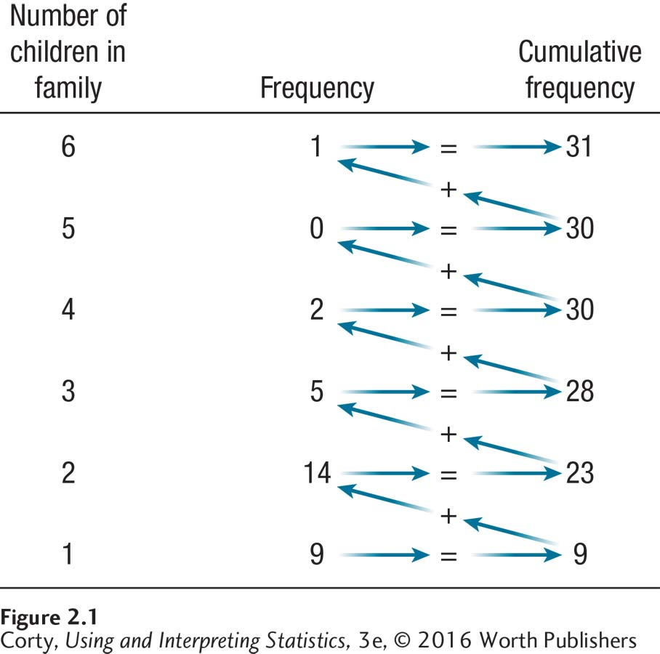
Ungrouped Frequency Distributions
Cumulative Frequency
Count of how often a given value, or a lower value, occurs in a set of data
Abbreviated f_{c}
Calculated by adding up all the frequencies at or below a given row
See figure on the right

Slide 10
Ungrouped Frequency Distributions
Cumulative Frequency (f_{c})
Organized upside down, biggest value in top row
Top row should be the same as the total number of cases, N, in the data set
Only calculated for data that have an order, where numbers tell direction
Ordinal-, interval-, ratio-level data

Slide 11
Ungrouped Frequency Distributions
Additional information included in table:
Cumulative frequency (f_{c})
Percentage (%)
Cumulative Percentage (%_{c})
Number of Children in a Family | Frequency (f) | Cumulative Frequency (f_{c}) | Percentage (%) | Cumulative Percentage (%_{c})
6 | 1 | 31 | 3.23 | 100.00
5 | 0 | 30 | 0.00 | 96.77
4 | 2 | 30 | 6.45 | 96.77
3 | 5 | 28 | 16.13 | 90.32
2 | 14 | 23 | 45.16 | 74.19
1 | 9 | 9 | 29.03 | 29.03

Slide 12

Ungrouped Frequency Distributions
Percentage (%)
Takes information in frequency column and turns it into percentages
$$\%=\frac{f}{N}×100$$
where % = frequency percentage
$f=$ frequency
$N=$ total number of cases

Slide 13
Ungrouped Frequency Distributions
Additional information included in table:
Cumulative frequency (f_{c})
Percentage (%)
Cumulative Percentage (%_{c})
Number of Children in a Family | Frequency (f) | Cumulative Frequency (f_{c}) | Percentage (%) | Cumulative Percentage (%_{c})
6 | 1 | 31 | 3.23 | 100.00
5 | 0 | 30 | 0.00 | 96.77
4 | 2 | 30 | 6.45 | 96.77
3 | 5 | 28 | 16.13 | 90.32
2 | 14 | 23 | 45.16 | 74.19
1 | 9 | 9 | 29.03 | 29.03

Slide 14

Ungrouped Frequency Distributions
Cumulative percentage (%_{c})
Cumulative frequency expressed as a percentage of the number of cases in the data set
$$\%_{c}=\frac{f_{c}}{N}×100$$
where $\%_{c}$ = frequency percentage
$f_{c}=$ frequency
$N=$ total number of cases

Slide 15
Grouped Frequency Distributions
Grouped frequency distribution
Count how often the values of a variable, grouped into intervals, occur in a set of data
For variables measured at the ordinal-level or higher
Decide how many intervals to include
Balance between amount of detail presented and number of intervals
Rule of thumb 7 ± 2
Make intervals that are 5, 10, 20, 25, or 100 units wide
All intervals are the same width
Intervals do not overlap

Slide 16
Grouped Frequency Distributions: Property Crime Rates for the 50 States
State | Rate | State | Rate | State | Rate
South Dakota | 17 | Wisconsin | 28 | Kansas | 37
North Dakota | 19 | Wyoming | 29 | New Mexico | 37
New Hampshire | 19 | Illinois | 29 | Missouri | 37
New York | 20 | Colorado | 30 | Nevada | 38
New Jersey | 22 | California | 30 | Georgia | 39
Idaho | 22 | Minnesota | 30 | Arkansas | 40
Vermont | 23 | Michigan | 31 | Alabama | 40
Pennsylvania | 24 | Nebraska | 32 | Washington | 40
Massachusetts | 24 | Mississippi | 32 | Louisiana | 41
Connecticut | 24 | Delaware | 34 | North Carolina | 41
Maine | 24 | Alaska | 34 | Tennessee | 41
Virginia | 25 | Indiana | 34 | Florida | 41
Kentucky | 25 | Maryland | 34 | Texas | 41
West Virginia | 25 | Ohio | 35 | Hawaii | 42
Iowa | 26 | Utah | 35 | South Carolina | 43
Rhode Island | 26 | Oregon | 35 | Arizona | 44
Montana | 28 | Oklahoma | 35

Slide 17
Grouped Frequency Distribution for State Property Crime Rates per 1,000 Population Interval Width = 5)
Crime Rate Interval | Midpoint (m) | Frequency (f) | Cumulative Frequency (f_{c}) | Percentage (%) | Cumulative Percentage (%_{c})
40-44 | 42.00 | 11 | 50 | 22.00 | 100.00
35-39 | 37.00 | 9 | 39 | 18.00 | 78.00
30-34 | 32.00 | 10 | 30 | 20.00 | 60.00
25-29 | 27.00 | 9 | 20 | 18.00 | 40.00
20-24 | 22.00 | 8 | 11 | 16.00 | 22.00
15-19 | 17.00 | 3 | 3 | 6.00 | 6.00

Slide 18
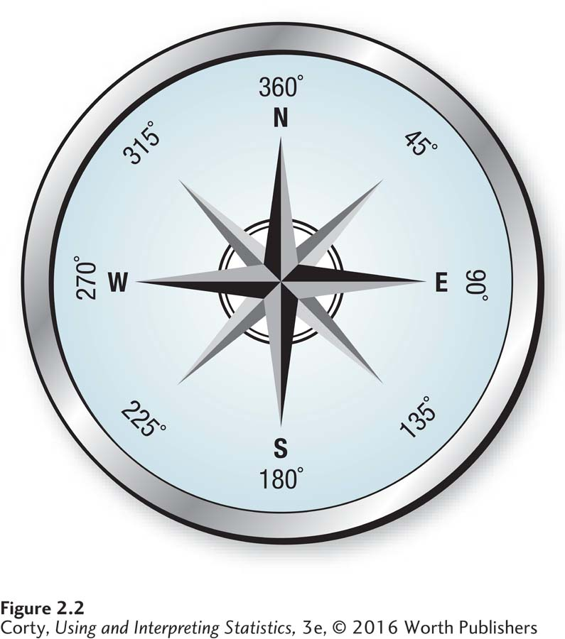
Grouped Frequency Distributions
New column, m
Midpoint (m)
Middle of an interval in a grouped frequency distribution
2 reasons for having midpoint
Summary of the interval
Convention to assign value of midpoint as a reference
Four Cardinal Compass Headings

Slide 19
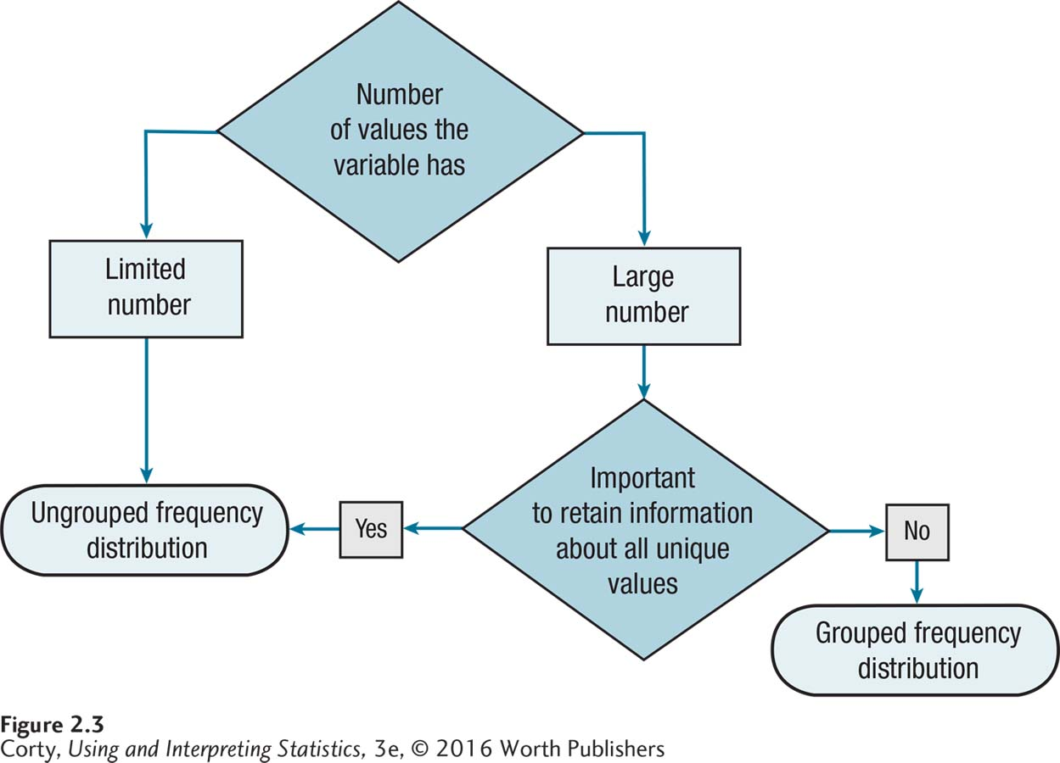
How to Choose: Deciding Whether to Make an Ungrouped Frequency Distribution or a Grouped Frequency Distribution for an Ordinal-, Interval-, or Ratio-Level Variable

Slide 20
How to Choose: Making a Frequency Distribution Table
Step 1: Decide whether to make a grouped or ungrouped frequency distribution.
Step 2: If grouped, decide the width and number of intervals.
Step 3: Organize the data.
Step 4: Decide what information to include in the table.
Step 5: Communicate clearly.

Slide 21
Discrete Numbers and Continuous Numbers
Discrete numbers
Answer the question “how many,” take whole number values, and have no “in-between” value
Continuous numbers
Answer the question “how much” and can have “in-between” values; the specificity of the number, the number of decimal places reported, depends on the precision of the measuring instrument

Slide 22
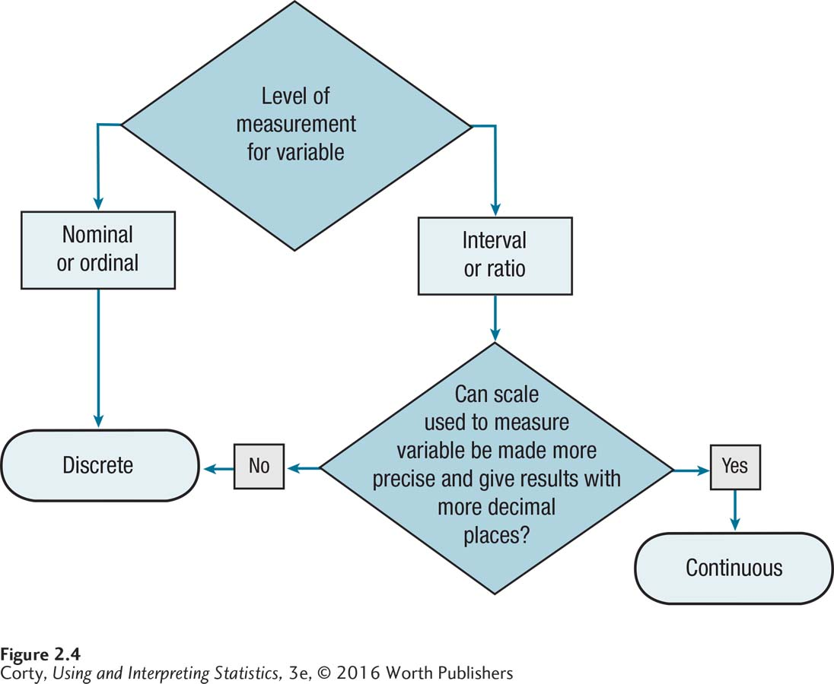
How to Choose: Continuous Numbers vs. Discrete Numbers

Slide 23
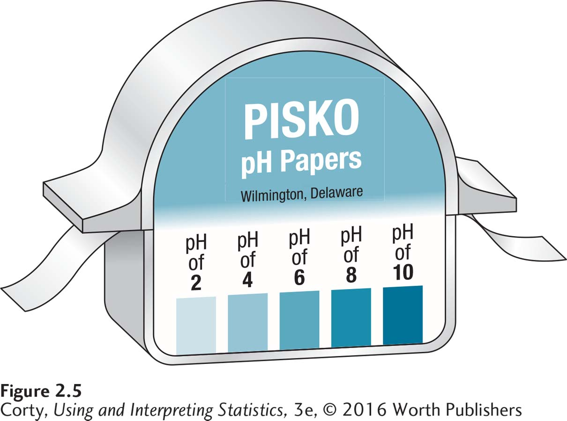
Discrete Numbers and Continuous Numbers
A single continuous number represents a range of values
Real limits are the upper and lower bounds of a single continuous number or of an interval in a grouped frequency distribution
Apparent limits represents the upper and lower bounds of an interval in a grouped frequency distribution
What does it mean if the pH of the solution is 6?

Slide 24
Graphing Frequency Distributions
3 graphs showing frequency information
Bar graphs
Graph of a frequency distribution for discrete data (nominal- or ordinal-level data) that use the heights of bars to indicate frequency; the bars do not touch
Histograms
Frequency distribution for continuous data (interval- or ratio-level data), displayed in graph form, using the heights of bars to indicate frequency; the bars touch each other
Frequency polygons
Frequency distribution for continuous data (interval- or ratio-level data), displayed in graphic format, using a line connecting dots above interval midpoints, that indicate frequency

Slide 25
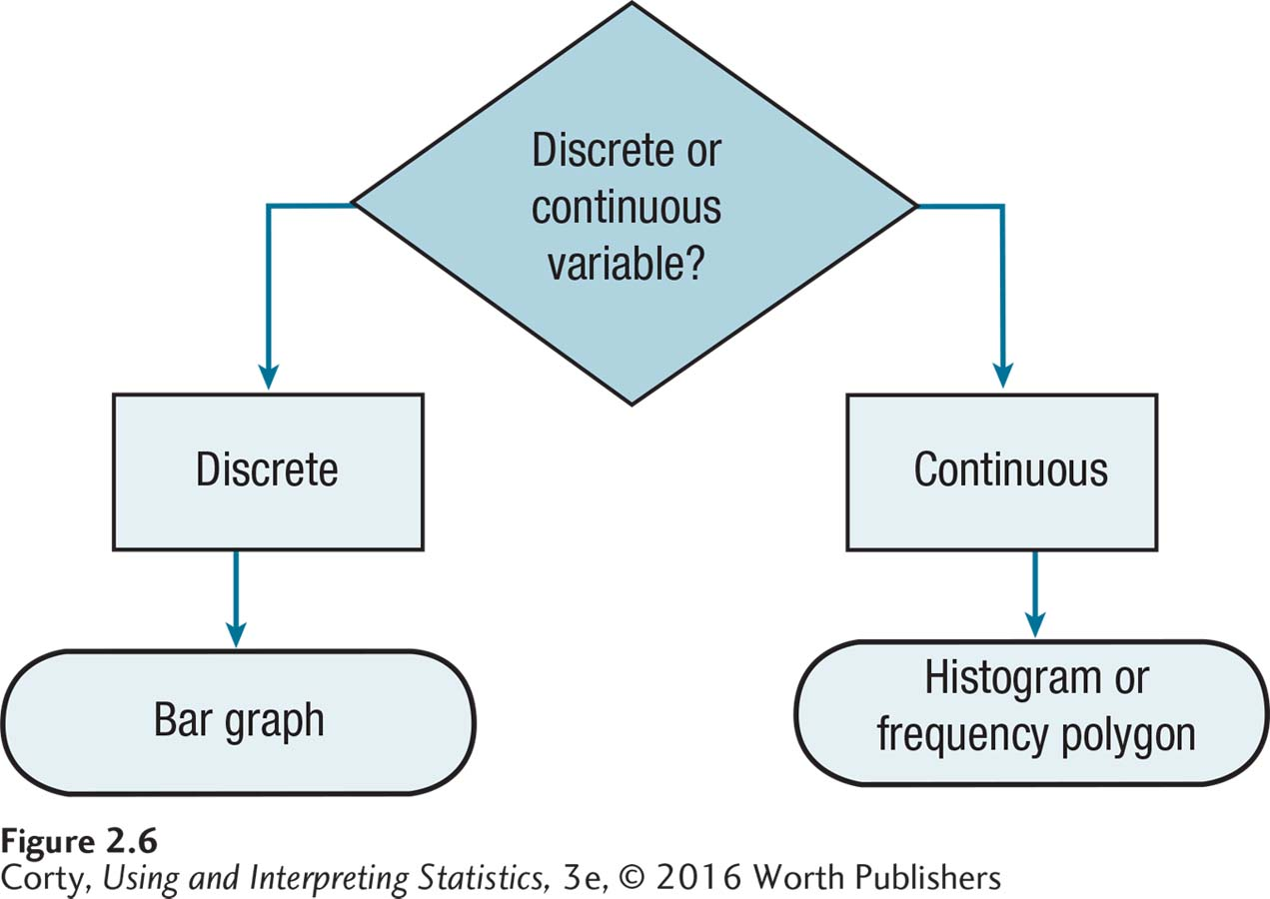
How to Choose: What Graph for a Frequency Distribution?

Slide 26
About Bar Graphs
Graphs are wider than they are tall
Different categories of the variable go on X-axis
Frequency is on Y-axis
Detailed title is necessary
A bar as high as the frequency should be drawn above each category
All bars should have same width and should not touch each other

Slide 27
Frequency Distribution of the Sex of 65 Students in an Upper-Level Psychology Class
Sex | Frequency (f) | Percentage (%)
Male | 19 | 29.33
Female | 46 | 70.77
Note: A frequency distribution for a nominal variable only provides frequency information and the percentage in each category. Because order is arbitrary for nominal variables, do not calculate cumulative frequencies or cumulative percentages.

Slide 28
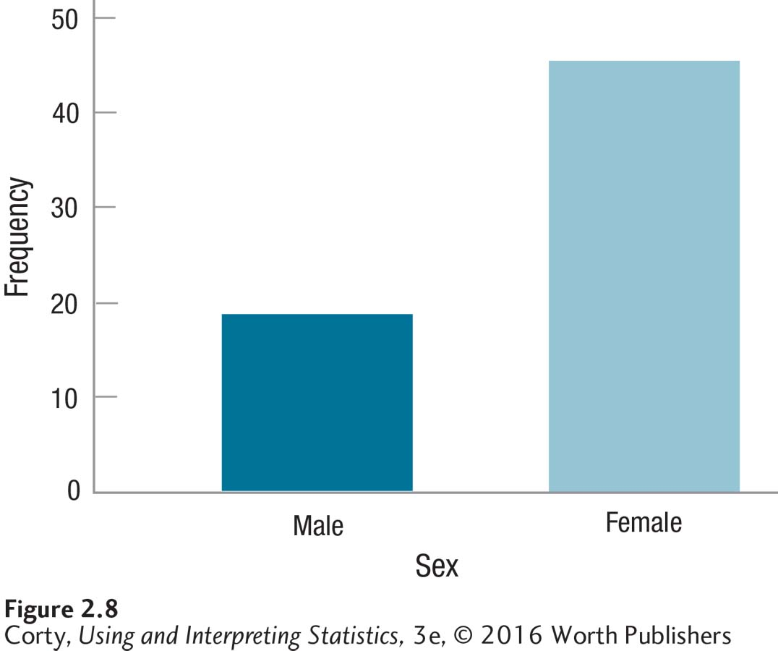
Bar Graph Showing the Sex of Students (N = 65) in Upper-Level Psychology Class
Note that the bars don’t touch each other in bar graphs because the variable on the X-axis is discrete.

Slide 29
About Histograms
Frequency on Y-axis, starts at zero
Values of variable on X-axis
Detailed title
Bars go up as high as the frequency in the interval
Bars touch each other
Discontinuity mark on X-axis alerts people that the graph does not start at zero

Slide 30
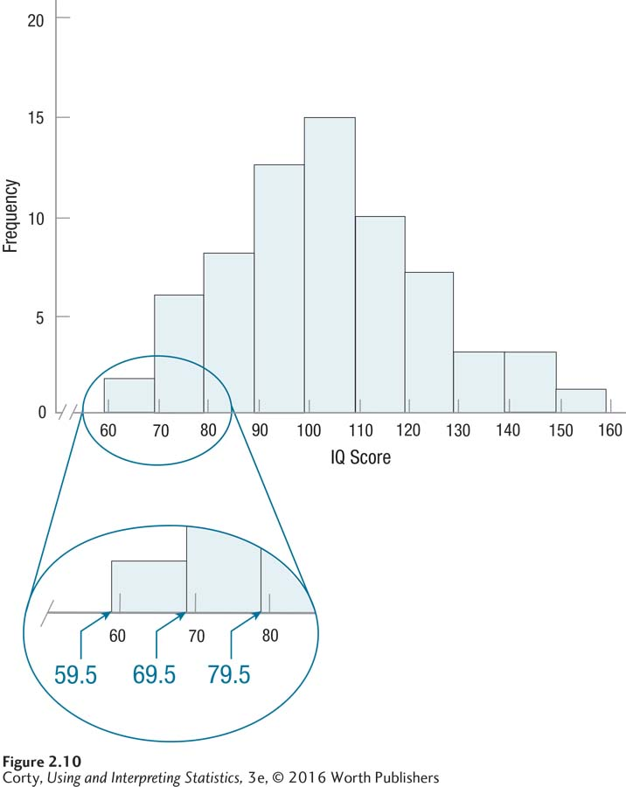
Histogram Showing Grouped Frequency Distribution of IQ Scores for 68 Sixth Graders (Interval Width = 10)

Slide 31
About Frequency Polygons
Frequency on Y-axis starts at zero and goes up, in equal intervals, to the first interval above the largest possible frequency
X-axis shows midpoints of the intervals being graphed
Detailed title
Frequencies marked by dots at the appropriate height at the midpoints of the intervals
Dots are connected by lines
Graph starts and ends at intervals with a frequency of zero
Discontinuity mark on X-axis, graph does not start at zero

Slide 32
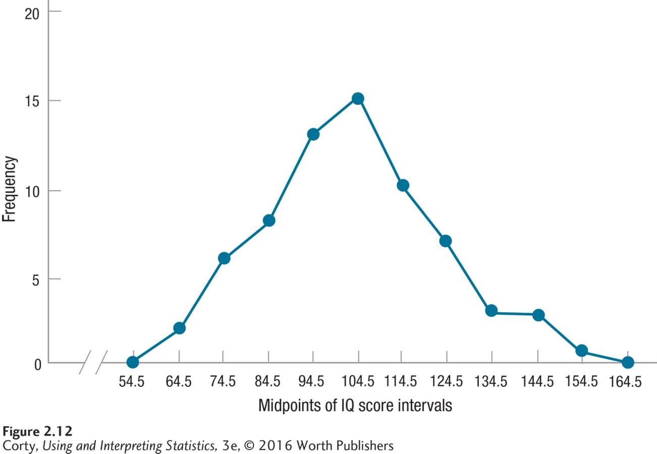
Frequency Polygon Showing Grouped Frequency Distribution of IQ Scores for 68 Sixth Graders (Interval Width = 10)

Slide 33
Key Differences Among Graphs
 | Bar Graphs | Histograms | Frequency Polygons
Type of data | Discrete | Continuous | Continuous
Physical characteristics of the graph | Bars don’t touch each other. | Bars touch each other. Bars go up and down at the real limits of the interval | Frequencies are marked with dots at the midpoints of the intervals. Dots are connected by lines Frequencies “go to zero” at the far left and far right of the graph

Slide 34
Shapes of Frequency Distributions
There are three aspects of the shape of frequency distributions
Modality
Skewness
Kurtosis

Slide 35
Three Aspects of Shape of Frequency Distribution Curves to Describe
Modality | Skewness | Kurtosis
How many high points there are in a data set | Whether the data set is symmetric | Whether a data set is peaked or flat

Slide 36
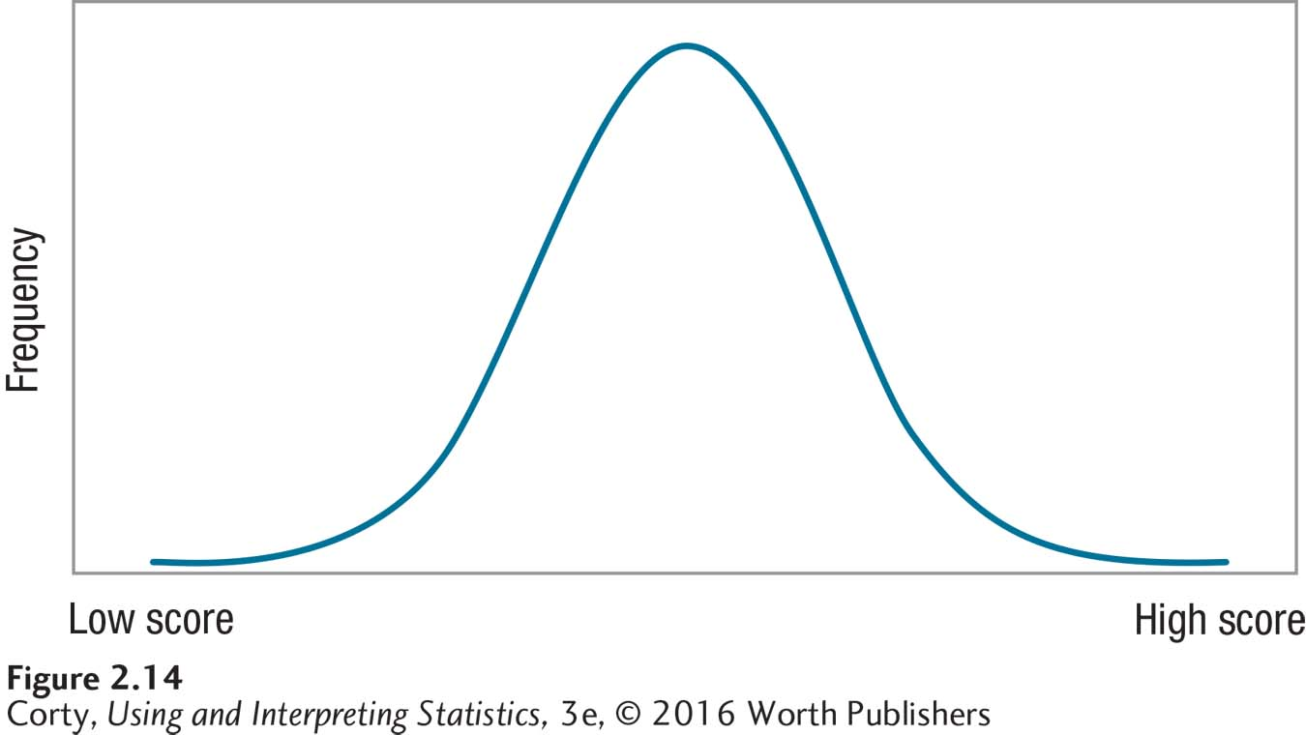
The Normal Distribution

Slide 37
Frequency Polygon Showing Grouped Frequency Distribution of IQ Scores for 68 Sixth Graders (Interval Width = 10)

Slide 38
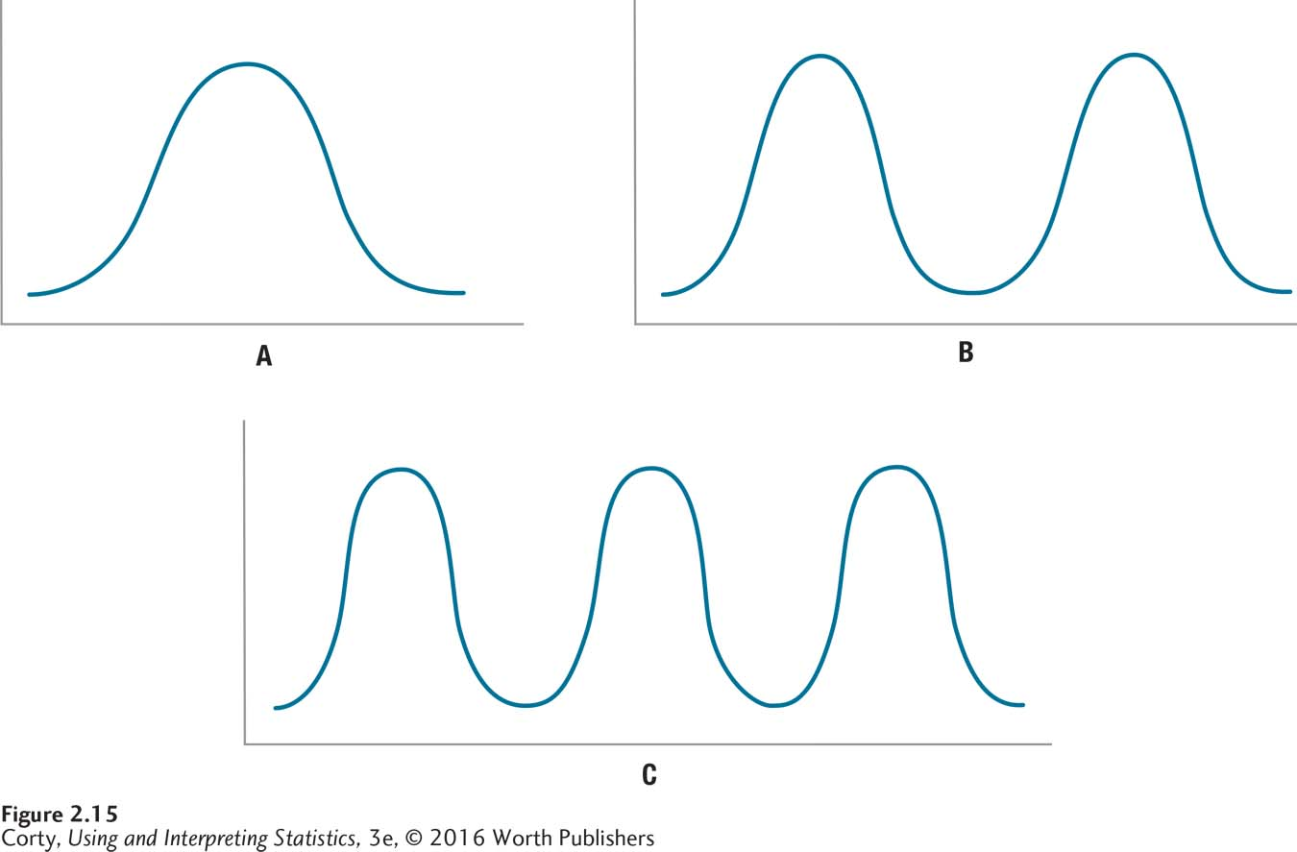
Examples of Modality
Panel A shows a unimodal data set, panel B a bimodal data set, and panel C a multimodal data set

Slide 39
Shapes of Frequency Distributions
Skewness
Deviation from symmetry in a frequency distribution, which means the left and right sides of the distribution are not mirror images of each other
Positive skew
Asymmetrical frequency distribution in which the tail extends to the right, in the direction of higher scores
Negative skew
Asymmetrical frequency distribution in which the tail extends to the left, in the direction of lower scores

Slide 40
Examining Distributions
Symmetric if the right and left sides of the graph are approximately mirror images of each other.
Skewed to the right (right-skewed) if the right side of the graph (containing the half of the observations with larger values) is much longer than the left side.
Skewed to the left (left-skewed) if the left side of the graph is much longer than the right side.
Symmetric
Right-skewed
Left-skewed

Slide 41
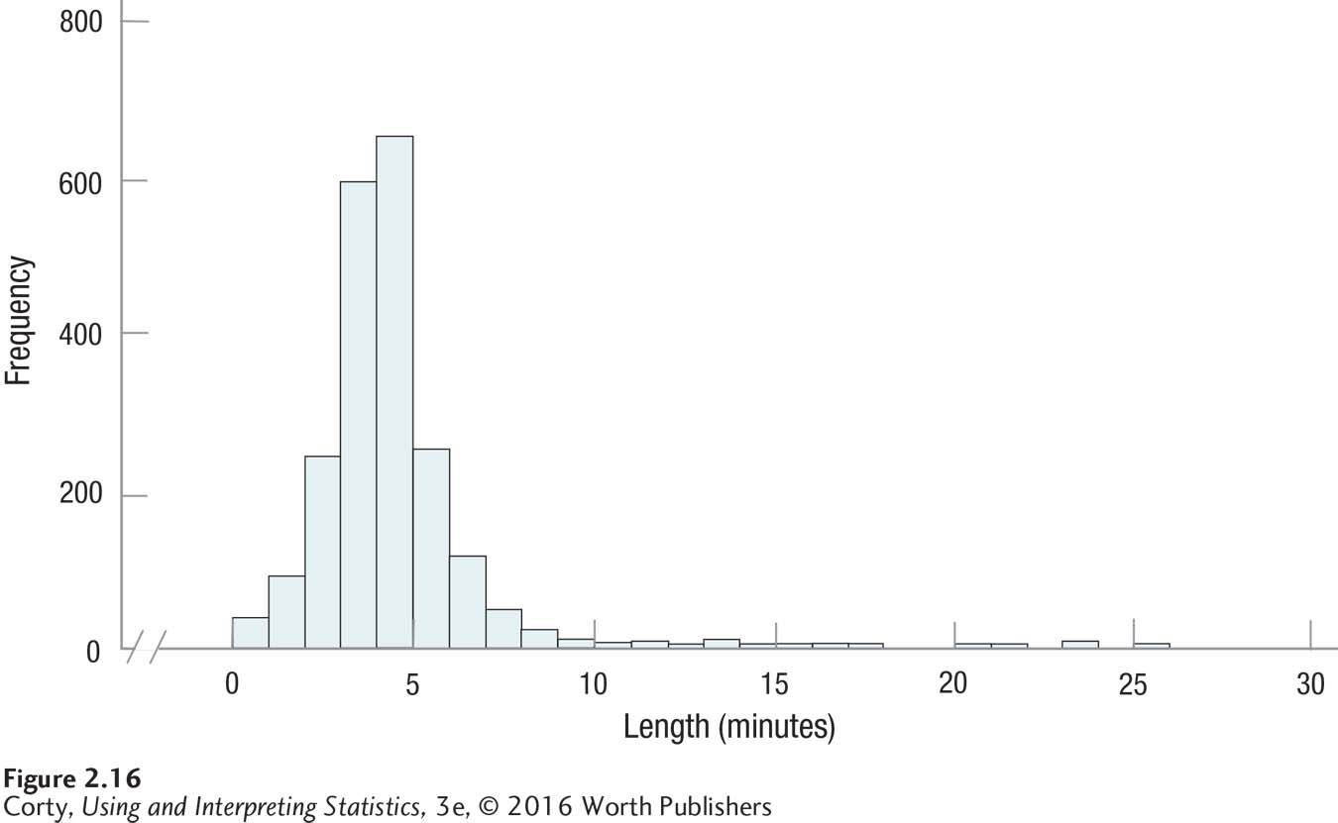
Shapes of Frequency Distributions
Example of Positive Skew
Length of Songs in an iTunes Library

Slide 42
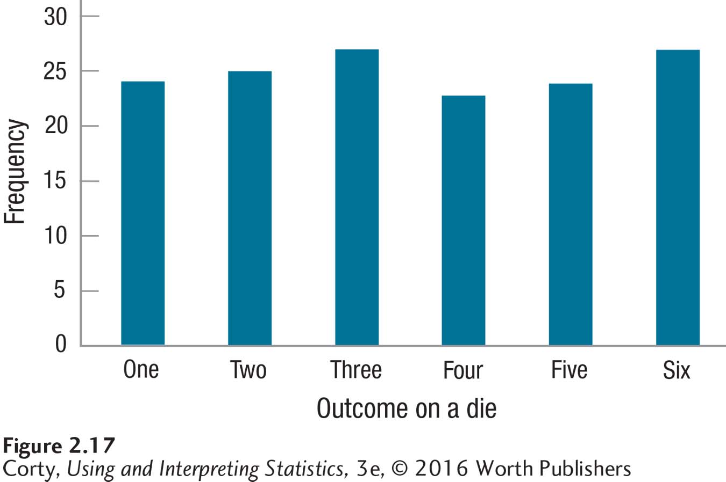
Frequency Distribution of Outcomes on a Die Rolled 150 Times
Kurtosis refers to how peaked or flat a data set is. This data set is flat.

Slide 43
Stem-and-Leaf Displays
Characteristics
Help to summarize a set of data
Present the data compactly, like a grouped frequency distribution
Keep all the details like an ungrouped frequency distribution
Show the shape like a graph

Slide 44
Construct Stem-and-Leaf Graph
Separate each observation into a stem (first part of the number) and a leaf (the remaining part of the number). Stems may have as many digits as needed, but each leaf contains only a single digit.
Write the stems in a vertical column with the smallest value at the top; draw a vertical line to the right of the stems.
Write each leaf in the row to the right of its stem; order leaves if desired.

Slide 45
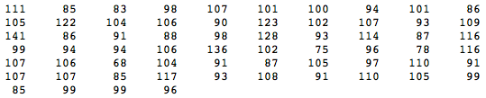
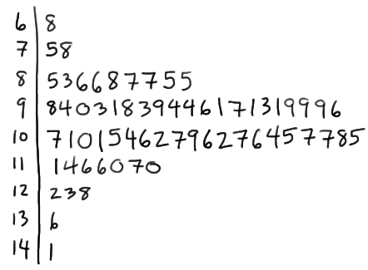
Stem-and-Leaf Example
64 students’ IQs are as follows
Stemplots

