Slide 1

Jingwei Wu, PhD
Chapter 3
Measures of Central Tendency and Variability
A courtesy of “USING AND INTERPRETING STATISTICS” by ERIC W. CORTY | THIRD EDITION (Macmillan Education)

Slide 2

Objectives
Central Tendency
Variability

Slide 3
Central Tendency and Variability
Central tendency
Single value used to represent the typical score in a set of scores
Variability
Summary of level of variety exists in a set of scores
Two Students with the Same Central Tendency and Different Variability
 | Marcie | Darren
English | 3.00 | 4.00
Math | 3.00 | 2.00
Spanish | 3.00 | 4.00
Art | 3.00 | 2.00
Speech | 3.00 | 4.00
Political Science | 3.00 | 2.00
History | 3.00 | 4.00
Psychology | 3.00 | 2.00
GPA | 3.00 | 3.00
Two students with the same GPA achieved it with very different patterns of scores. Darren shows more variability in performance than Marcie.

Slide 4
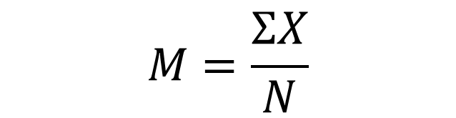
Mean
Mean
Average calculated for interval- or ratio-level data by summing all the values in a data set and dividing by the number of cases; abbreviated M
Formula for Sample Mean (M)
M = the mean of a sample
∑ = summation sign
X = the values of X for the cases in the sample
N = the number of cases in the sample
$$M=\frac{ΣX}{N}$$

Slide 5

Mean
Example
Demographer selects 5 adults from the United States
Height measured in inches
Mean for the sample calculated.
62, 65, 66, 69, 73
$$M=\frac{ΣX}{N}$$
$$=\frac{62+65+66+69+73}{5}$$
$$=\frac{335.00}{5}$$
$$=67.00$$

Slide 6
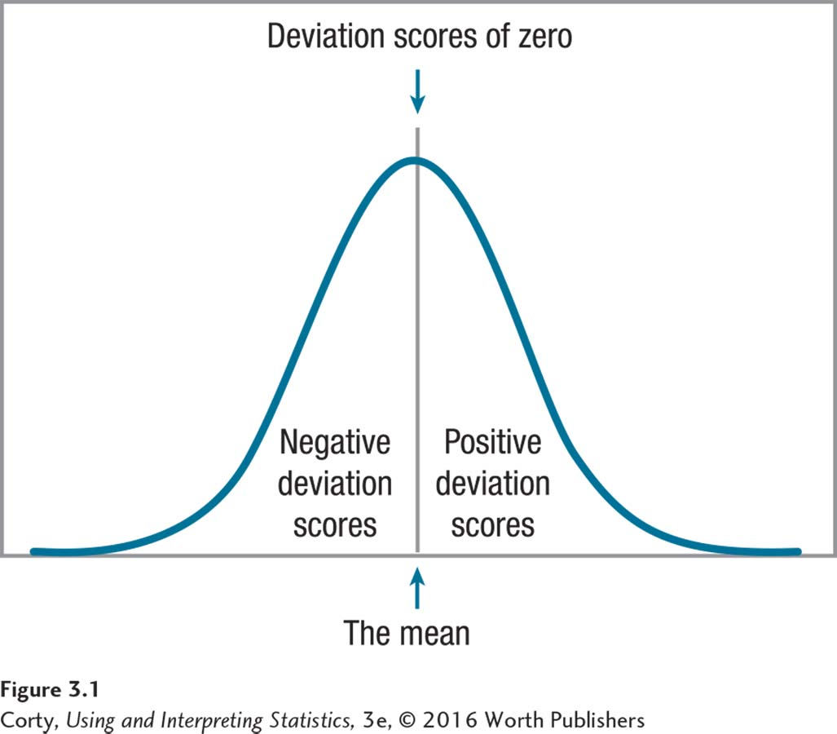
Deviation Scores
Characteristics
Deviation scores are a measure of how far a score falls from the mean, calculated by subtracting the mean from the score.
Raw scores above the mean have positive deviation scores.
Raw scores below the mean have negative deviation scores.
Scores exactly at the mean have deviation scores of zero.
The further the raw score is from the mean, the bigger the deviation score.

Slide 7
Deviation Scores for Heights of Five Americans
Height in Inches | Deviation Score (X-M)
62 | −5.00
65 | −2.00
66 | −1.00
69 | 2.00
73 | 6.00
 | 0.00
These are the deviation scores, calculated as the raw score minus the mean of 67.00 for the height data. For example, the deviation score for the person 62″ tall is 62 − 67.00 = − 5.00. When all the deviation scores for a set of scores are added together, they sum to zero.

Slide 8
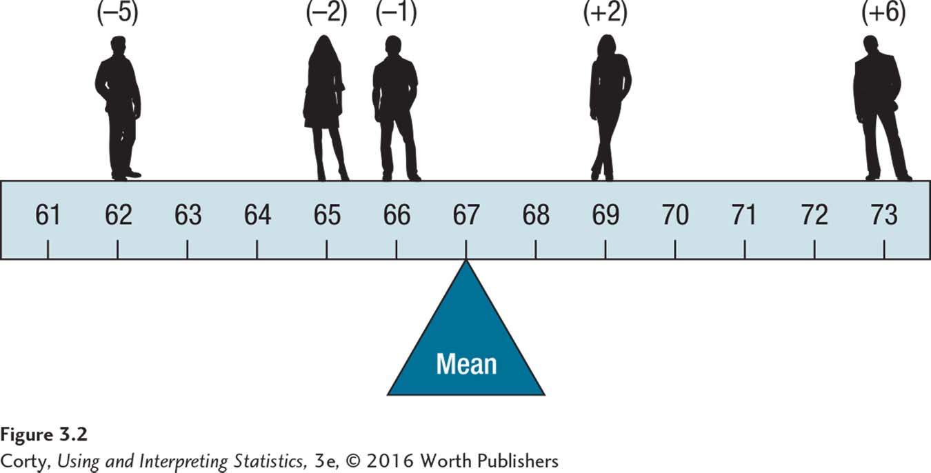
Mean as a Balancing Point

Slide 9
Outlier
One problem with the mean is that it can be influenced by an outlier:
Extreme (unusual) score that falls far away from the rest of the scores in a set of data

Slide 10
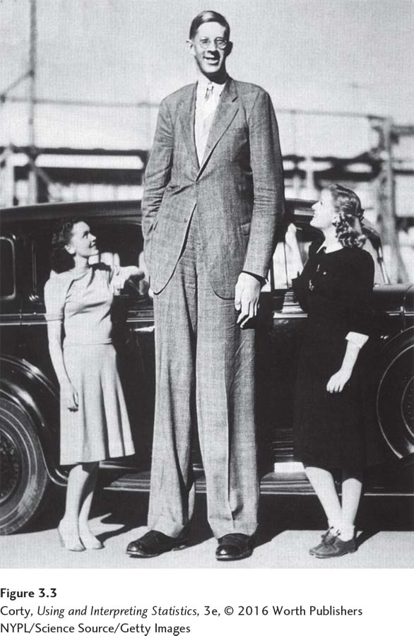
Outlier – How It Affects the Mean
Example
Robert Wadlow, world’s tallest man
Add his height to demographer’s sample
Causes average height to jump almost 7 inches

Slide 11
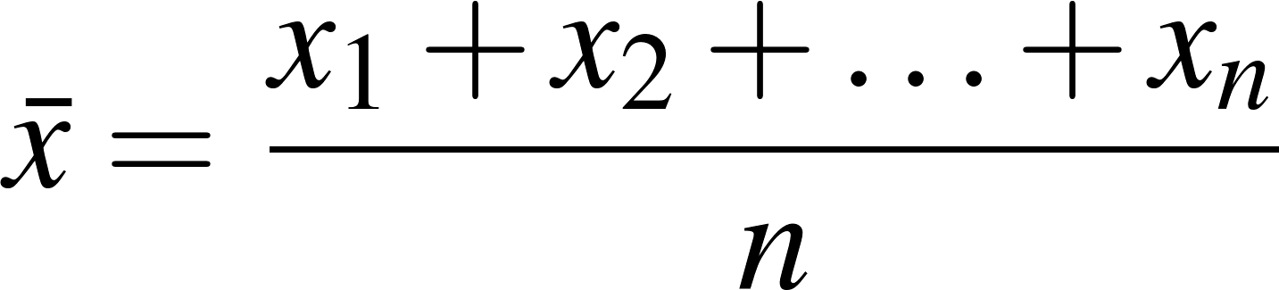
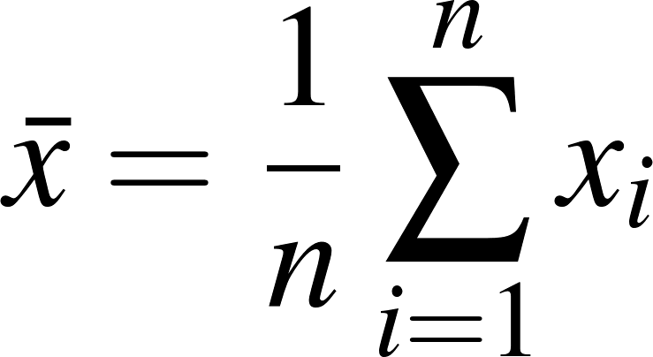
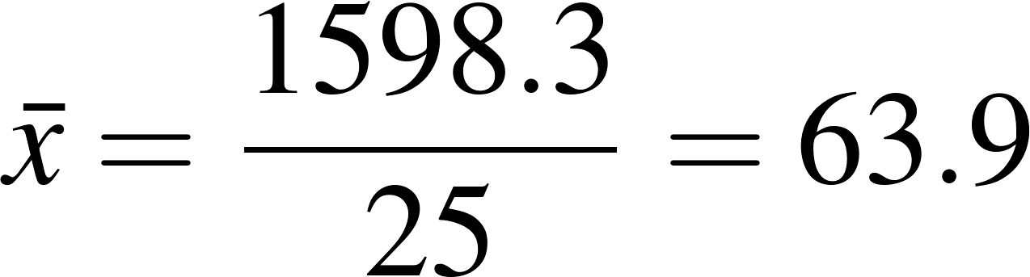

Example
A subsample of n=25 participants attending the seventh examination of the Framingham offspring
Woman (i) | Height (x) |  | Women (i) | Height (x)
i = 1 | X₁= 58.2 |  | i = 14 | X₁₄= 64.0
i = 2 | X₂= 59.5 |  | i = 15 | X₁₅= 64.5
i = 3 | X₃= 60.7 |  | i = 16 | X₁₆= 64.1
i = 4 | X₄= 60.9 |  | i = 17 | X₁₇= 64.8
i = 5 | X₅= 61.9 |  | i = 18 | X₁₈= 65.2
i = 6 | X₆= 61.9 |  | i = 19 | X₁₉= 65.7
i = 7 | X₇= 62.2 |  | i = 20 | X₂₀= 66.2
i = 8 | X₈= 62.2 |  | i = 21 | X₂₁= 66.7
i = 9 | X₉= 62.4 |  | i = 22 | X₂₂= 67.1
i = 10 | X₁₀= 62.9 |  | i = 23 | X₂₃= 67.8
i = 11 | X₁₁= 63.9 |  | i = 24 | X₂₄= 68.9
i = 12 | X₁₂= 63.1 |  | i = 25 | X₂₅= 69.6
i = 13 | X₁₃= 63.9 |  | n = 25 | = 1598.3
Mathematical notation:

Slide 12
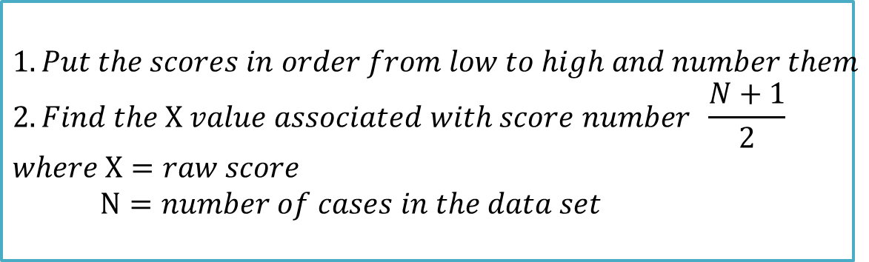
Median
Characteristics
Average calculated by finding the score associated with the middle case, the case that separates the top half of scores from the bottom half
Abbreviated Mdn
Can be calculated for ordinal-, interval-, or ratio-level data
$$1. Put the scores in order from low to high and number them \\ 2. Find the X value associated with score number \frac{N+1}{2} \\ where X=raw score \\ N=number of cases in the data set$$

Slide 13
Calculating the Median for the Height Data, N = 5
Example
Demographer selects 5 adults from the United States
Calculate the median for the sample
Median is the score associated with the third case, 66
Score Number | Height in Inches
1 | 62
2 | 65
3 | 66
4 | 69
5 | 73

Slide 14
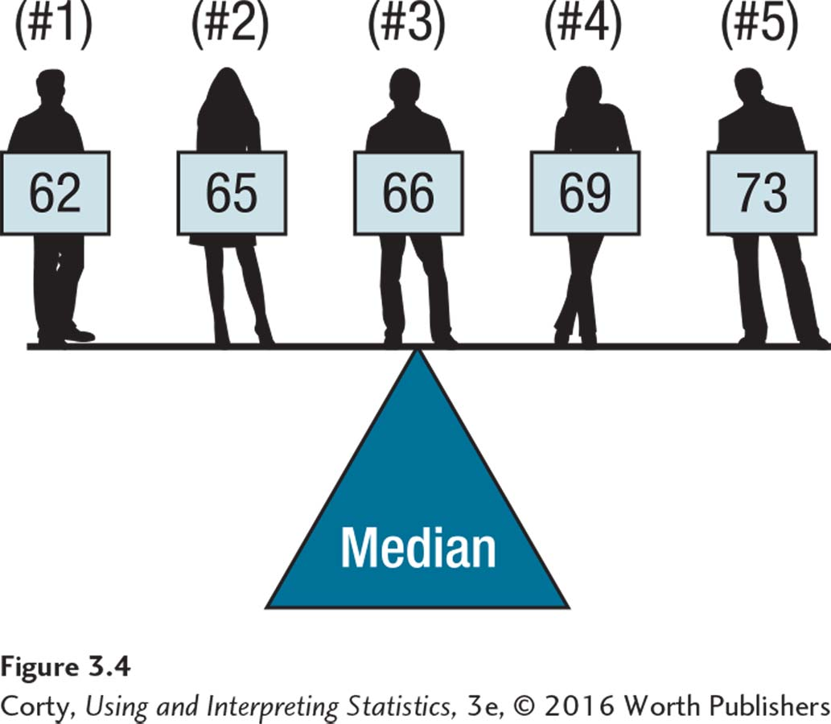
Median as Balancing Point
The numbers in parentheses above the scores are their ranks. The median is the balancing point, the center, for the number of scores.

Slide 15

Calculating the Median for the Height Data with Outlier Added
Example
Robert Wadlow, world’s tallest man
Add his height to demographer’s sample
Median for the six cases is 67.50
Outlier changed the median only 1.5” higher
Score Number | Height in inches
1 | 62
2 | 65
3 | 66
• | X(67.50)
4 | 69
5 | 73
6 | 107
$$\frac{N+1}{2}=\frac{6+1}{2}=3.5$$
$$\frac{66+69}{2}=67.50$$

Slide 16
Example
A subsample of n=25 (left) or n=24 (right) participants’ weights in the Framingham study
1 | 1 | 58.2
2 | 2 | 59.5
3 | 3 | 60.7
4 | 4 | 60.9
5 | 5 | 61.9
6 | 6 | 62.0
7 | 7 | 62.2
8 | 8 | 62.2
9 | 9 | 62.4
10 | 10 | 62.9
11 | 11 | 63.1
12 | 12 | 63.7
13 |  | 63.9
14 | 1 | 64.0
15 | 2 | 64.1
16 | 3 | 64.7
17 | 4 | 64.8
18 | 5 | 65.2
19 | 6 | 65.7
20 | 7 | 66.3
21 | 8 | 66.7
22 | 9 | 67.1
23 | 10 | 67.8
24 | 11 | 68.9
25 | 12 | 69.6
1 | 1 | 58.2
2 | 2 | 59.5
3 | 3 | 60.7
4 | 4 | 60.9
5 | 5 | 61.9
6 | 6 | 62.0
7 | 7 | 62.2
8 | 8 | 62.2
9 | 9 | 62.4
10 | 10 | 62.9
11 | 11 | 63.1
12 |  | 63.7
13 |  | 63.9
14 | 1 | 64.0
15 | 2 | 64.1
16 | 3 | 64.7
17 | 4 | 64.8
18 | 5 | 65.2
19 | 6 | 65.7
20 | 7 | 66.3
21 | 8 | 66.7
22 | 9 | 67.1
23 | 10 | 67.8
24 | 11 | 68.9
1. Sort observations by size.
n = number of observations
______________________________
2.a. If n is odd, the median is observation (n+1)/2 down the list
2.b. If n is even, the median is the mean of the two middle observations.
⬅ n = 25
(n+1)/2 = 26/2 = 13
Median = 63.9
n = 24 ➔
n/2 = 12
Median = (63.7+63.9) /2 = 63.8

Slide 17
Mode
Mode
Is score that occurs with the greatest frequency
Can be used for nominal data
Example
Sex of students in psychology class
Most common value (in Table 2.11, female) is the mode
Sex | Frequency (f) | Percentage (%)
Male | 19 | 29.23
Female | 46 | 70.77

Slide 18
Example
A subsample of n=26 participants attending the seventh examination of the Framingham offspring
Woman (i) | Height (x) |  | Women (i) | Height (x)
i = 1 | X₁= 58.2 |  | i = 14 | X₁₄= 64.0
i = 2 | X₂= 59.5 |  | i = 15 | X₁₅= 64.1
i = 3 | X₃= 60.7 |  | i = 16 | X₁₆= 64.5
i = 4 | X₄= 60.9 |  | i = 17 | X₁₇= 64.8
i = 5 | X₅= 61.9 |  | i = 18 | X₁₈= 65.2
i = 6 | X₆= 61.9 |  | i = 19 | X₁₉= 65.7
i = 7 | X₇= 62.2 |  | i = 20 | X₂₀= 66.2
i = 8 | X₈= 62.2 |  | i = 21 | X₂₁= 66.7
i = 9 | X₉= 62.4 |  | i = 22 | X₂₂= 67.1
i = 10 | X₁₀= 62.9 |  | i = 23 | X₂₃= 67.8
i = 11 | X₁₁= 63.9 |  | i = 24 | X₂₄= 68.9
i = 12 | X₁₂= 63.9 |  | i = 25 | X₂₅= 69.6
i = 13 | X₁₃= 63.9 |  | i = 26 | X₂₆= 69.9
Sort the data firstly
Mode=63.9, since it appeared 3 times!

Slide 19
How to Choose: Which Measure of Central Tendency for Which Level of Measurement
 | Measure of Central Tendency
Level of Measurement | Mode | Median | Mean
Nominal | ✓
Ordinal | ✓ | ✓
Interval or Ratio | ✓ | ✓ | ✓
Not all measures of central tendency can be used with all levels of measurement. When more than one measure of central tendency may be used, choose the measure that uses more of the Information available in the numbers. If planning to calculate a mean, be sure to check the shape of the data set for skewness and modality.

Slide 20
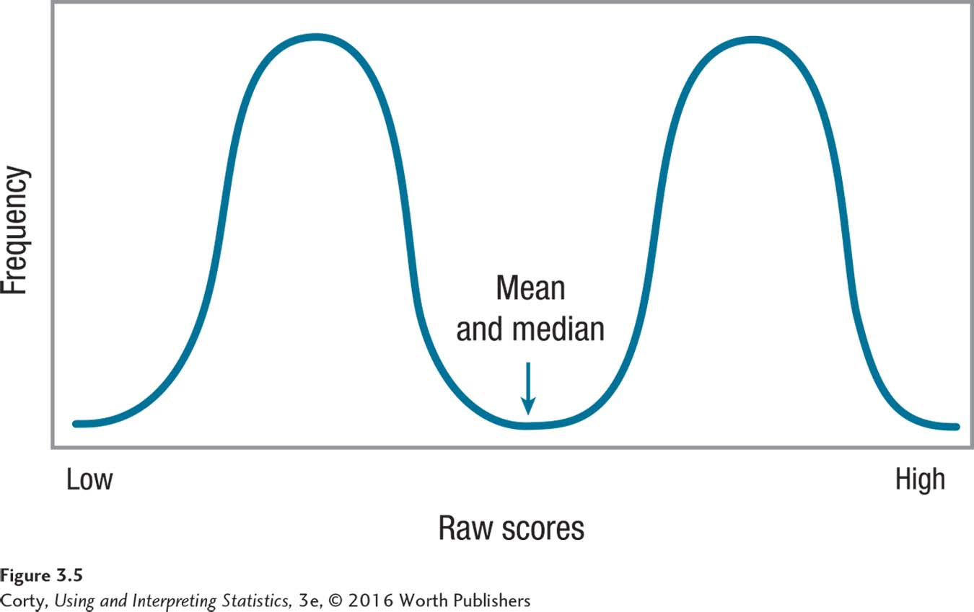
Central Tendency for a Bimodal Distribution
It is not appropriate to calculate a mean or a median for bimodal data. In this case, central tendency should be reported as two modes.

Slide 21
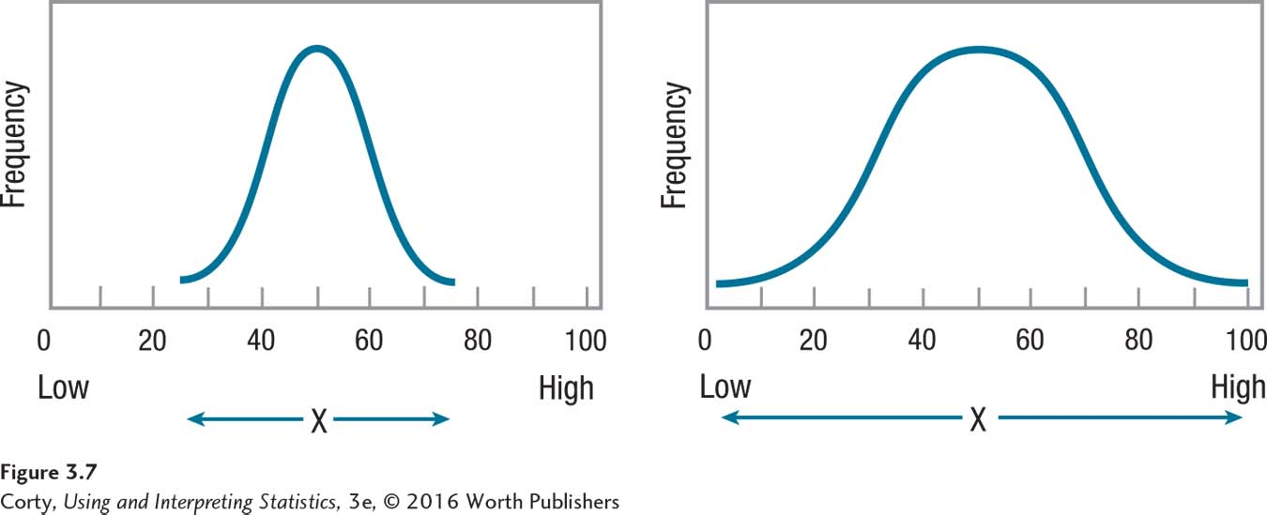
Differing Amounts of Variability
Variability
Defined as how much spread there is in a set of scores
Spread
Refers to how much the scores cluster together or how much they stretch out over a wider range

Slide 22
Variability
Four Measures of Variability
Range
Interquartile range
Variance
Standard deviation

Slide 23
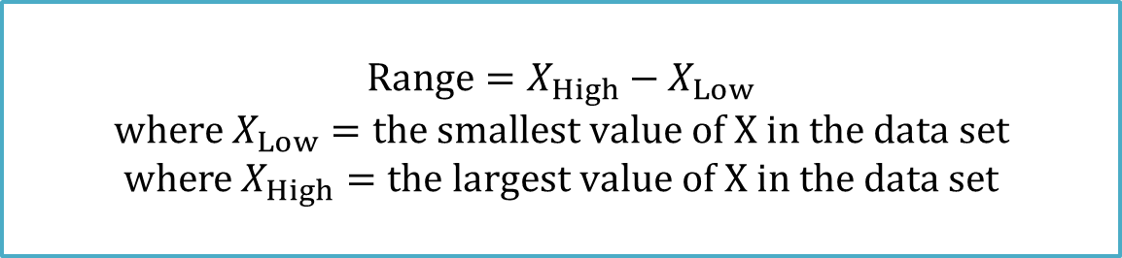
Range
Range
Measure of variability for interval- or ratio-level data
Distance from the lowest score to the highest score
Example – height data
Range = 73 – 62 = 11.00
Problems with using the range
Depends on only 2 scores in the data set; influenced by outliers
$$Range=X_{High}−X_{Low}$$
$$where X_{Low}=the smallest value of X in the data set$$
$$where X_{High}=the largest value of X in the data set$$

Slide 24
Example
A subsample of n=10 participants attending the seventh examination of the Framingham offspring
Woman (i) | BMI (x)
i = 1 | X₁= 24.4
i = 2 | X₂= 26.4
i = 3 | X₃= 24.9
i = 4 | X₄= 25.5
i = 5 | X₅= 22.8
i = 6 | X₆= 29.0
i = 7 | X₇= 31.9
i = 8 | X₈= 28.8
i = 9 | X₉= 31.5
i = 10 | X₁₀= 26.8
Smallest BMI=22.8
Largest BMI=31.9
Range = 31.9-22.8 = 9.1

Slide 25
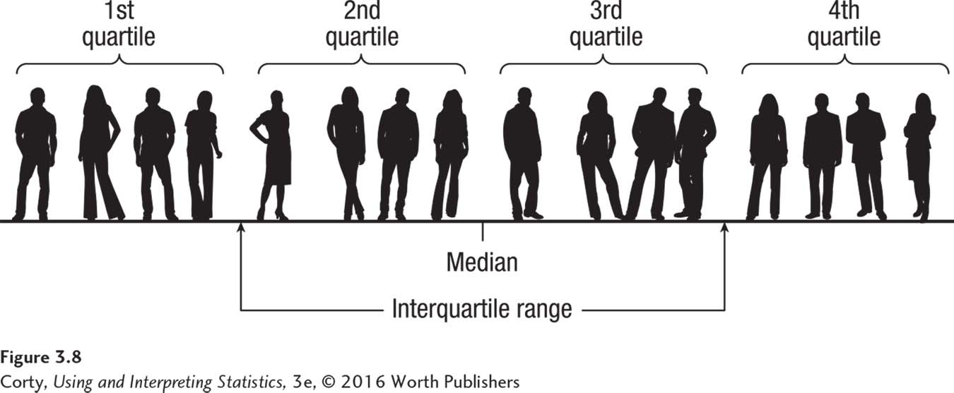
Four Quartiles of a Data Set
Interquartile Range
Measure of variability for interval- or ratio-level data
Distance covered by the middle 50% of scores
Abbreviated IQR

Slide 26
Example
A subsample of n=25 participants’ weights in the Framingham study
1 | 1 | 69.6
2 | 2 | 68.9
3 | 3 | 67.8
4 | 4 | 67.1
5 | 5 | 66.7
6 | 6 | 66.3
7 | 7 | 65.7
8 | 8 | 65.2
9 | 9 | 64.8
10 | 10 | 64.7
11 | 11 | 64.1
12 | 12 | 64.0
13 |  | 63.9
14 | 1 | 63.7
15 | 2 | 63.1
16 | 3 | 62.9
17 | 4 | 62.4
18 | 5 | 62.3
19 | 6 | 62.2
20 | 7 | 62.0
21 | 8 | 61.9
22 | 9 | 60.9
23 | 10 | 60.7
24 | 11 | 59.5
25 | 12 | 58.2
The third quartile, Q₃, is the value in the sample that has 75% of the data at or below it (it is the median of the upper half of the sorted data, excluding median).
⬅ Q₃ = third quartile = 66.0
⬅ Median = 63.9
The first quartile, Q₁, is the value in the sample that has 25% of the data at or below it (it is the median of the lower half of the sorted data, excluding median).
⬅ Q₁ = first quartile = 62.1
IQR = Q₃-Q₁ = 66.0-62.1 = 3.9

Slide 27
Population Variance
Variance
Is mean squared deviation score
Abbreviated as σ²
Pronounced “sigma squared”
Standard deviation
Is square root of the variance
The variance and the standard deviation use information from all the cases in the data set. As a result, they are better measures of variability in the whole data set.

Slide 28
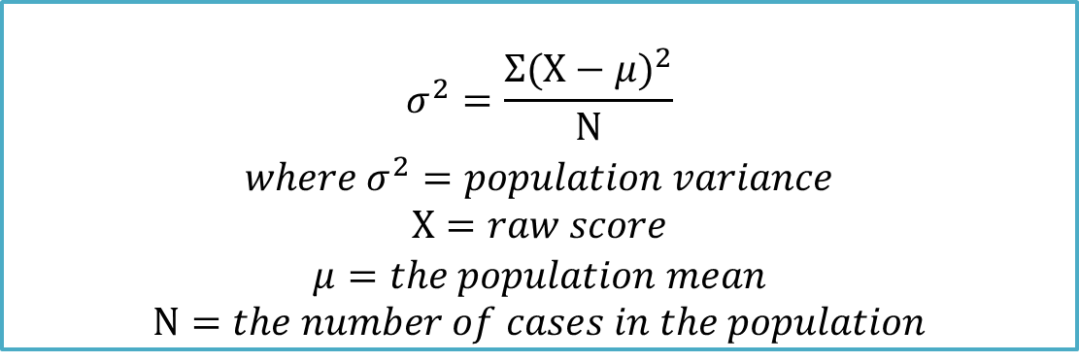
Formula for Population Variance (σ²)
Four steps
Create deviation scores for each case in the population by subtracting the population mean from each raw score
Square each of these deviation scores
Add up all the squared deviation scores
Divide this sum by the number of cases in the population
$$σ^{2}=\frac{Σ{(X−μ)}^{2}}{N}$$
$$where σ^{2}=population variance$$
$$X=raw score$$
$$μ=the population mean$$
$$N=the number of cases in the population$$

Slide 29
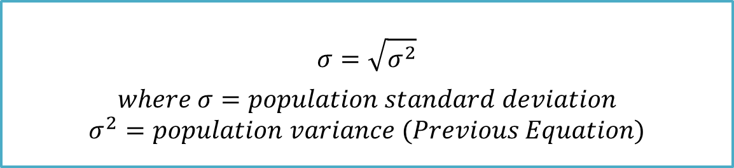
Formula for Population Standard Deviation (σ)
Standard Deviation (σ)
Square root of the variance
Measure of the average distance that scores fall from the mean
Abbreviated as σ
Pronounced “sigma”
$$σ=\sqrt{σ^{2}}$$
$$where σ=population standard deviation$$
$$σ^{2}=population variance (Previous Equation)$$

Slide 30

Formula for Sample Variance (s²)
Sample Variance
Abbreviated as s²
Pronounced “s squared”
$$s^{2}=\frac{Σ{(X−M)}^{2}}{N−1}$$
$$where s^{2}=sample variance$$
$$X=raw score$$
$$M=the sample mean$$
$$N=the number of cases in the sample$$

Slide 31
Deviation Scores and Squared Deviation Scores for Height Data with a Mean of 67.00
Start by making a table
See demographer’s example below
Height (X) | Score (X−M) | Squared Deviation Score (X−M)²
62 | −5.00 | 25.00
65 | −2.00 | 4.00
66 | −1.00 | 1.00
69 | 2.00 | 4.00
73 | 6.00 | 36.00
 |  | = 70.00
Whether a deviation score is positive or negative, the squared deviation score is always positive.

Slide 32
Calculate Sample Variance (s²)
Four Steps
Subtract the mean from each score in order to calculate deviation scores.
Take each deviation score and square it.
Add up all the squared deviation scores.
Called sum of squares
Abbreviated SS
Take the sum of the squared deviation scores and divide it by the number of cases minus 1 to find sample variance.
The demographer would report the sample variance for the five Americans as s² = 17.50.

Slide 33
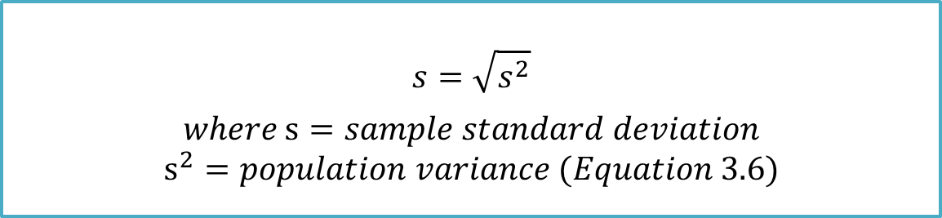
Sample Standard Deviation (s)
Sample Standard Deviation
Abbreviated as s
See previous demographer’s example
The demographer would report the standard deviation of the sample as s = 4.18.
$$s=\sqrt{s^{2}}$$
$$where s=sample standard deviation$$
$$s^{2}=population variance (Equation 3.6)$$

Slide 34
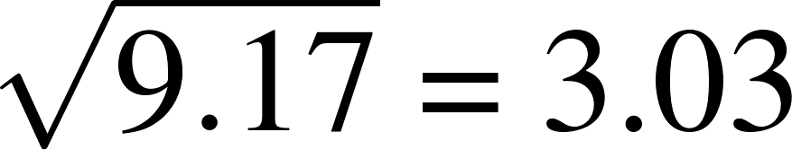
Example
A subsample of n=10 participants attending the seventh examination of the Framingham offspring
Woman (i) | BMI (x) | (x_{i}-mean) | (x_{i}-mean)²
i = 1 | X₁= 24.4 | 24.4-27.2 = -2.8 | (-2.8)² = 7.84
i = 2 | X₂= 26.4 | 26.4-27.2 = -0.8 | (-0.8)² = 0.64
i = 3 | X₃= 24.9 | 24.9-27.2 = -2.3 | (-2.3)² = 5.29
i = 4 | X₄= 25.5 | 25.5-27.2 = -1.7 | (-1.7)² = 2.89
i = 5 | X₅= 22.8 | 22.8-27.2 = -4.4 | (-4.4)² = 19.36
i = 6 | X₆= 29.0 | 29.0-27.2 = 1.8 | (1.8)² = 3.24
i = 7 | X₇= 31.9 | 31.9-27.2 = 4.7 | (4.7)² = 22.09
i = 8 | X₈= 28.8 | 28.8-27.2 = 1.6 | (1.6)² = 2.56
i = 9 | X₉= 31.5 | 31.5-27.2 = 4.3 | (4.3)² = 18.49
i = 10 | X₁₀= 26.8 | 26.8-27.2 = -0.4 | (-0.4)² = 0.16
 | mean=27.2 | sum = 0 | sum = 82.56
1. Calculate the mean.
2. Calculate each deviation.
deviation = observation – mean
Square each deviation.
Find the “average” squared deviation. Calculate the sum of the squared deviations divided by (n – 1). This is called the variance.
Calculate the square root of the variance. This is the standard deviation.
“Average” squared deviation = 82.56/(10 – 1) = 9.17. This is the variance.
Standard deviation = square root of variance =

