Slide 1

Jingwei Wu, PhD
Chapter 9
The Paired-Samples t Test
A courtesy of “USING AND INTERPRETING STATISTICS” by ERIC W. CORTY | THIRD EDITION (Macmillan Education)

Slide 2

Objectives
Paired Samples
Calculating the Paired-Samples t Test
Interpreting the Paired-Samples t Test

Slide 3
Paired Samples
Paired-Samples t test
Hypothesis test used to compare the means of two dependent samples.
When samples are dependent, each case consists of a pair of data points, one data point from each of the two samples.
In dependent samples, also called paired samples, the data points may be paired in a variety of ways.

Slide 4
Paired Samples: Designs
Data points may be paired in a variety of ways
Repeated-measures design
Same participants are measured at two or more points in time; also called longitudinal research.
Longitudinal research (or repeated-measures design)
Study in which the same participants are measured at two or more points in time
Pre-post design
Participants are measured on the dependent variable before and after an intervention
Within-subjects design
Same participants are measured in two different situations or under two different conditions.

Slide 5
Paired Samples
Advantages of repeated-measures and within-subjects designs
Able to control for individual differences
More powerful; probability of rejecting the H₀ is higher
Smaller sample sizes needed
Other paired-samples techniques
Matched pairs
Participants are grouped into sets of two based on their being similar on potential confounding variables

Slide 6
Paired Samples
Commonly used paired-samples t test
Dependent-samples t test
Correlated-samples t test
Related-samples t test
Matched-pairs t test
Within-subjects t test
Repeated-measures t test

Slide 7
Calculating the Paired-Samples t Test
Example: Dr. Keim’s humidity study
What is the effect of humidity on perceived temperature?
6 volunteers tested in a temperature- and humidity-controlled chamber
Participants tested twice separated by 24 hours
Temperature set at 76°F; participants tested in both low- and high-humidity conditions
Spent 15 minutes in the chamber
Participants were asked what the temperature was inside the chamber

Slide 8
Calculating the Paired-Samples t Test
The Effect of Humidity Level on Perceived Temperature
Participant | Low-Humidity Test (control condition) | High-Humidity Test (experimental condition) | Difference Score
1 | 76 | 81 | 5.00
2 | 80 | 90 | 10.00
3 | 78 | 85 | 7.00
4 | 72 | 82 | 10.00
5 | 76 | 82 | 6.00
6 | 68 | 75 | 7.00
M= | 75.00 | 82.50 | 7.50
s= | 4.34 | 4.93 | 2.07

Slide 9
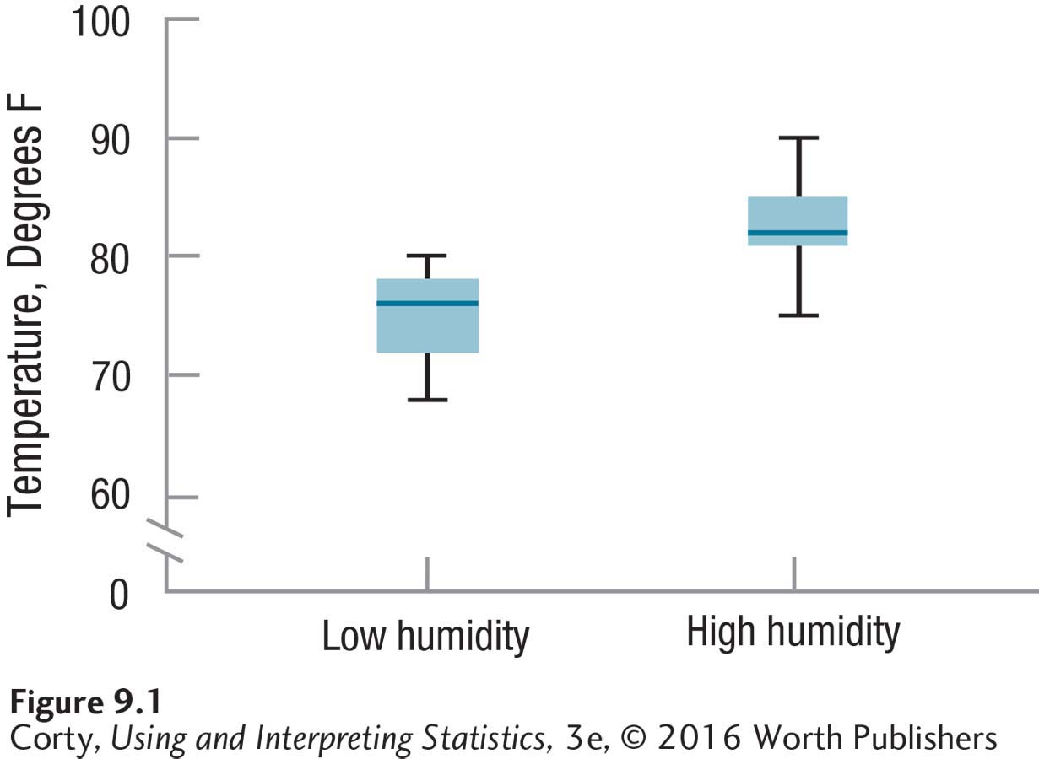
Calculating the Paired-Samples t Test
Humidity study
Perceived temperature (dependent variable) on Y-axis
2 conditions, low humidity and high humidity (independent variable), on X-axis
Graphic appears to show that temperature is perceived as hotter when the humidity is higher
Hypothesis testing necessary to determine whether difference is statistically significant
Box-and-Whisker Plots Showing Perceived Temperature in Low- and High-Humidity Conditions
Low Humidity (M = 75.00, s = 4.34)
High Humidity (M = 82.50, s = 4.93)

Slide 10
Hypothesis Testing in Action - Example
Dr. Keim’s humidity study
6 Steps of Hypothesis Testing
STEP 1 - Pick a Test
STEP 2 - Check the Assumptions
STEP 3 - List the Hypotheses
STEP 4 - Set the Decision Rule
STEP 5 - Calculate the Test Statistic
STEP 6 - Interpret the Results

Slide 11
Humidity Study – Step 1
STEP 1: Pick a test
Dr. Keim is using a within-subjects design comparing the means for a sample of people measured in two different conditions, low humidity and high humidity
She will use a paired-samples t test
2 dependent samples

Slide 12
Humidity Study – Step 2
STEP 2: Check the Assumptions
Three Assumptions for the Paired-Samples t Test
Random sample: The sample is a random sample from the population. | Robust to violation
Independence of observations: Each case within a group or condition is independent of the other cases in that group or condition. | Not robust to violation
Normality: The population of difference scores is normally distributed. | Robust to violation

Slide 13

Humidity Study – Step 2
STEP 2: Check the Assumptions
Third assumption, normality assumption, says that in the larger population, the difference scores are normally distributed.
Difference scores are needed to calculate a paired-samples t test.
$$D=X_{1}−X_{2} \\ where D=the difference score being calculated \\ X_{1}=a case^{′}s score in Condition 1 \\ X_{2}=a case^{′}s score in Condition 2$$
Example:
First case, person perceived low-humidity as 76° and high-humidity as 81°

Slide 14
Humidity Study – Step 3
STEP 3: List the Hypotheses
Two-tailed, nondirectional, paired-samples t test
Low humidity is perceived as hotter than high humidity, or
High humidity is perceived as hotter than low humidity
H₀: μ_{LowHumidity}= μ_{HighHumidity}
H₁: μ_{LowHumidity}≠ μ_{HighHumidity}
One-tailed, directional, paired-samples t test
Dr. Keim predicted that high humidity leads to a higher perceived temperature
H₀: μ_{LowHumidity} ≥ μ_{HighHumidity}
H₁: μ_{LowHumidity} < μ_{HighHumidity}

Slide 15
Humidity Study – Step 4
STEP 4: Set the Decision Rule
Critical Value of t , t_{cv}
Value of t used to determine whether null hypothesis is rejected or not
Use Appendix Table 3 to find t_{cv}
3 pieces of information are needed to find the t_{cv}
Is the test one-tailed or two-tailed?
Willingness to make a Type I error, determined by alpha level
Degrees of freedom, based on sample size
Most common form of the paired-samples t test
Two-tailed with alpha set at .05

Slide 16

Humidity Study – Step 4
Degrees of Freedom (df )
Number of values in a sample that are free to vary
Humidity example
df = 6 – 1 = 5
Use Appendix Table 3 to find t_{cv}
Find the intersection of the column for a two-tailed hypothesis test, α = .05 and the row where df = 5
t_{cv} = ±2.571
$$df=N−1 \\ where df=degrees of freedom \\ N=the number of pairs of cases$$

Slide 17
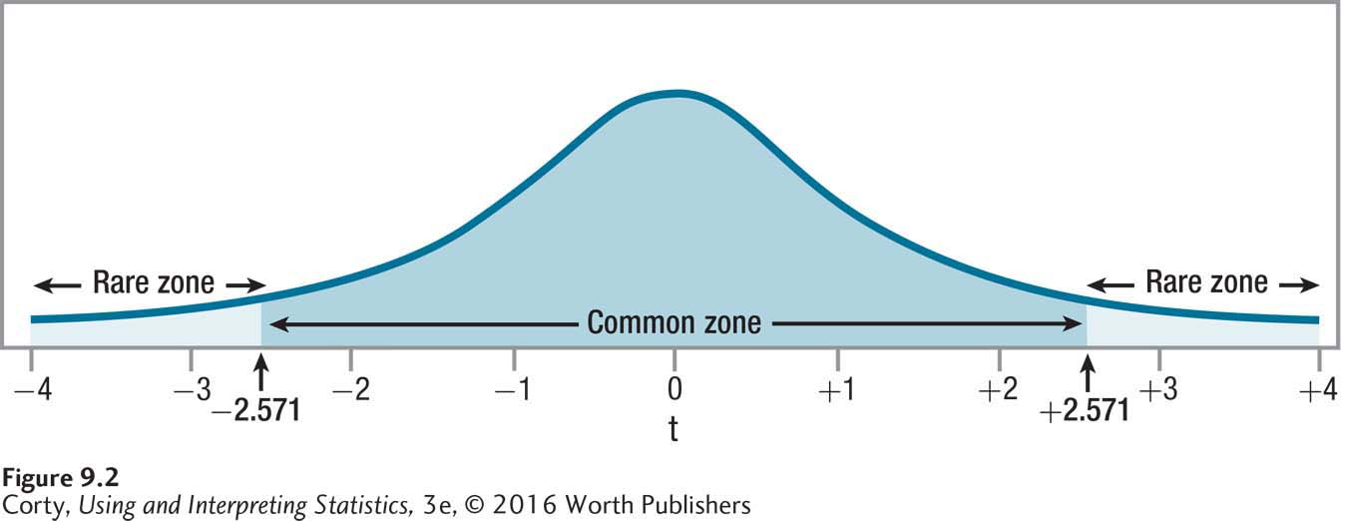
Humidity Study – Step 4
STEP 4: Set the Decision Rule
Two-tailed, Alpha level, α = .05, df = 5, t_{cv} = ±2.571
If t ≤ -2.571 or t ≥ 2.571, reject the null hypothesis
If -2.571 < t < 2.571, fail to reject null hypothesis
Critical Value of t, Two-Tailed, α = .05, df = 5

Slide 18
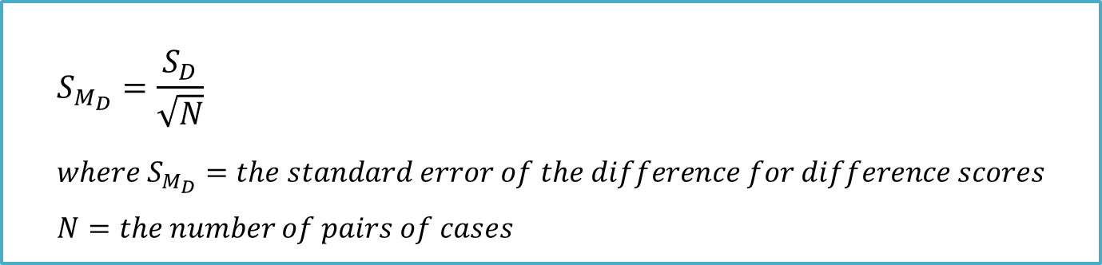
Humidity Study – Step 5
STEP 5: Calculate the Test Statistic
2 steps
Calculate the standard error of the difference (Equation 9.3)
Use standard error of the difference to calculate t (Equation 9.4)
$$S_{M_{D}}=\frac{S_{D}}{\sqrt{N}} \\ where S_{M_{D}}=the standard error of the difference for difference scores \\ N=the number of pairs of cases$$

Slide 19

Humidity Study – Step 5
STEP 5: Calculate Test Statistic
Standard Error of the Difference for Difference Scores
Standard deviation of the sampling distribution of difference scores
Abbreviated s_{MD}
Used as the denominator in the paired-samples t test equation
Calculate standard error of the difference s_{MD} (Equation 9.3)
$$S_{M_{D}}=\frac{S_{D}}{\sqrt{N}} \\ =\frac{2.07}{\sqrt{6}} \\ =\frac{2.07}{2.4495} \\ =0.8451 \\ =0.85$$

Slide 20

Humidity Study – Step 5
STEP 5: Calculate the Test Statistic
Use standard error of the difference to calculate t
$$t=\frac{M_{1}−M_{2}}{S_{M_{D}}} \\ where t=the the value of the test statistic foa paired−samples t test \\ M_{1}=the mean of one sample \\ M_{2}=the mean of the other sample \\ S_{M_{D}}=standard error of the difference for difference scores \\ (Equation 9.3)$$

Slide 21
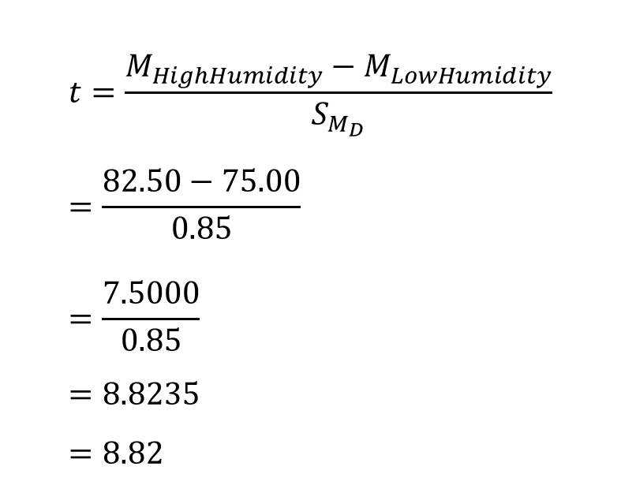
Humidity Study – Step 5
STEP 5: Calculate the Test Statistic
Calculate t value
Divide the numerator, the difference between the 2 sample means, by the denominator, the standard error of the difference (s_{MD})
$$t=\frac{M_{HighHumidity}−M_{LowHumidity}}{S_{M_{D}}} \\ =\frac{82.50−75.00}{0.85} \\ =\frac{7.5000}{0.85} \\ =8.8235 \\ =8.82$$

Slide 22
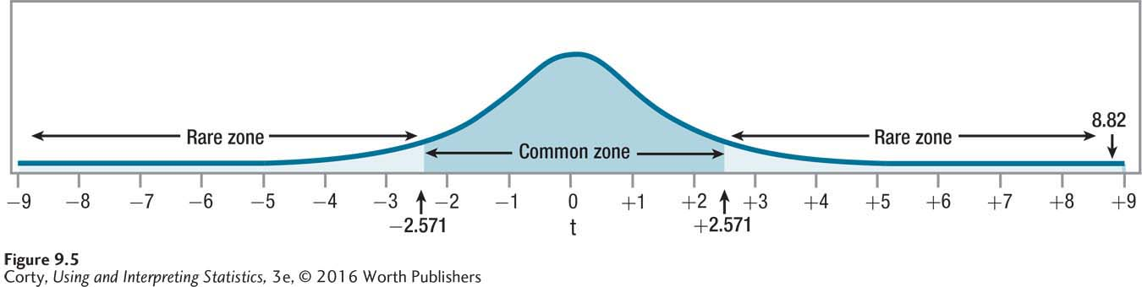
Humidity Study – Step 6
STEP 6: Interpret the Results
Need to answer 3 questions
Was the null hypothesis rejected?
How big is the effect?
How wide is the confidence interval?
Observed Value of t from Humidity Study

Slide 23
Humidity Study – Step 6
STEP 6: Interpret the Results
What is the effect of humidity on perceived temperature?
Low Humidity: M = 75.00, s = 4.34
High Humidity: M = 82.50, s = 4.93
Mean difference score was 7.50 (S_{D} = 2.07)
Two-tailed, alpha level, α = .05, df = 5, t_{cv} = ±2.571

Slide 24
Humidity Study – Step 6 (APA Style)
STEP 6: Interpret the Results
APA format, t(5) = 8.82, p < .05
The initial t says that the statistical test was a t test
5, degrees of freedom For a paired-samples t test, df = N − 1
Observed t value, 8.82, is reported This number is the value of t calculated APA format requires value to be reported to two decimal places
.05 tells us that alpha was set at .05, 5% chance of making a Type 1 error
p < .05 reveals that the null hypothesis was rejected Observed result (8.82) is a rare result - probability of occurring is less than .05, when the null hypothesis is true

Slide 25

Humidity Example – Step 6 – Cohen’s d
STEP 6: Interpret the Results
Cohen’s d is inappropriate for a paired-samples t test
It measures the impact of the independent variable on the dependent variable
Also includes the effect of individual differences
Result
Overestimates the size of the effect
Instead: Calculate the confidence interval for the difference between population means and then use professional expertise to translate it into an effect size

Slide 26
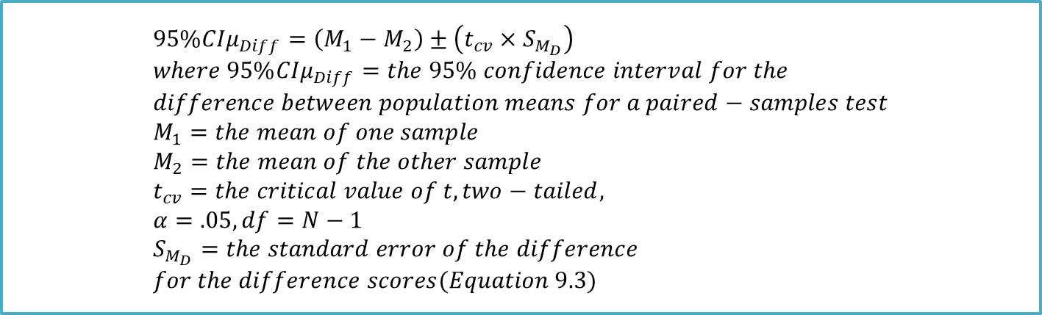
Humidity Study – Step 6 – Confidence Interval
How wide is the confidence interval and how big is the effect? The confidence interval for the difference between population means reveals how small or how large the difference between the population means might be.
$$95\%{CIμ}_{Diff}=\left(M_{1}−M_{2}\right)±\left(t_{cv}×S_{M_{D}}\right) \\ where 95\%{CIμ}_{Diff}=the 95\% confidence interval for the \\ difference between population means for a paired−samples test \\ M_{1}=the mean of one sample \\ M_{2}=the mean of the other sample \\ t_{cv}=the critical value of t, two−tailed, \\ α=.05, df=N−1 \\ S_{M_{D}}=the standard error of the difference \\ for the difference scores(Equation 9.3)$$

Slide 27
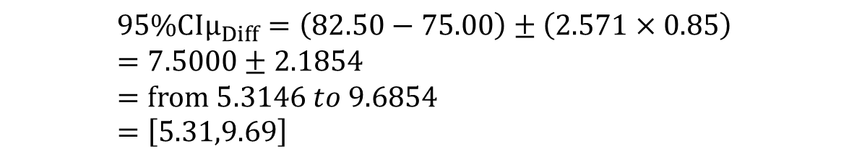
Humidity Study – Step 6 – Confidence Interval
STEP 6: Interpret the Results
High Humidity: M₁ = 82.50
Low Humidity: M₂= 75.00
t_{cv} = 2.571 (two-tailed, with α = .05, df = 5)
s_{MD} = 0.85
Dr. Keim’s confidence interval ranges from 5.31° to 9.69°, which means that 5 to 10 degrees is perceived as a noticeable difference in comfort level
$$95\%{CIμ}_{Diff}=\left(82.50−75.00\right)±\left(2.571×0.85\right) \\ =7.5000±2.1854 \\ =from 5.3146 to 9.6854 \\ =\left[5.31,9.69\right]$$

Slide 28
Humidity Study – Step 6 – Confidence Interval
STEP 6: Interpret the Results
Width of the confidence interval
CI_{W} = CI_{UL} – CI_{LL} = 9.69 – 5.31 = 4.38
Confidence interval is 4.38° wide
Dr. Keim is inclined to focus on the observed difference of 7.50 degrees in her interpretation since the perceived temperature difference is meaningful and the confidence interval is sufficiently narrow.

Slide 29
Putting It All Together – Humidity Example
Four points addressed in Dr. Keim’s interpretation
What was the study about?
What were its main results?
What do these results mean?
Are there specific suggestions for future research?

Slide 30
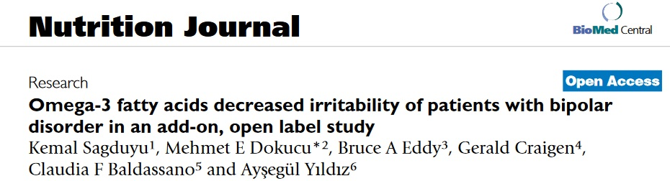
Example
Omega-3 fatty acids (O-3FA) may have a beneficial effect on irritable mood.
This is a report on a 34 patients with bipolar disorder in the open ended, Omega-3 Fatty Acid add-on study.
The irritability component of Young Mania Rating Scale (YMRS) is used to assess manic symptoms, which are graded on a 0 to 8 scale. A higher scale indicates a severe irritable mood. The YMRS irritability sub-score is recorded at the beginning of the study and at the end of study.
The initial mean score was 3.18 (SD = 1.09). The mean for the last recorded event was 1.68 (SD = 1.89). As with the above means there was a sizable decrease.
Question: Is there a statistically significant decrease in mean YMRS irritability sub-score in patients with bipolar disorder?

Slide 31



Example
Step 1: State the null and alternative hypotheses.
If we define the mean YMRS irritability sub-score at the beginning of the study as , define the mean YMRS irritability sub-score at the end of the study as , then
H₀: ≤
H_{a}: >
If we define the parameter of interest is the mean change of YMRS irritability sub-score from the beginning to the end of the study, , then equivalently
H₀: ≤ 0
H_{a}: > 0

Slide 32
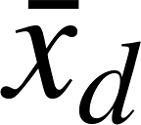

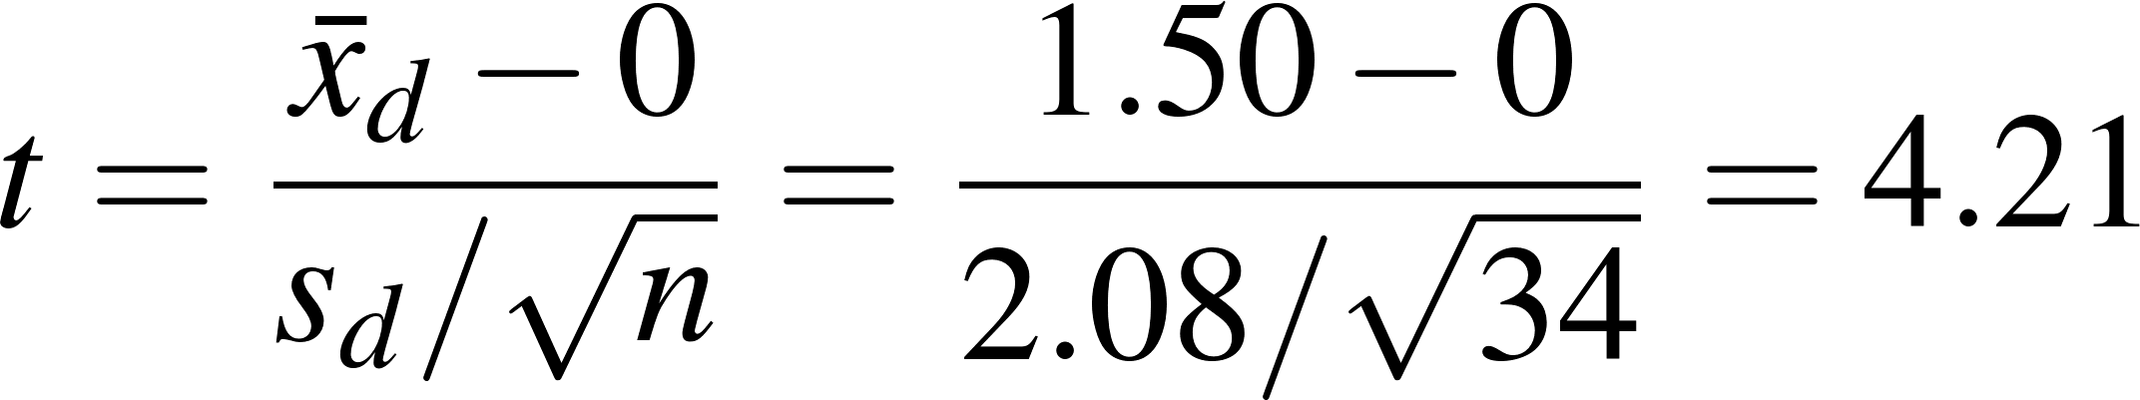
Example
Step 2: Calculate the value of the test statistic t.
Base on the raw data, we can calculate a new variable: x_{d} = x_{initial} – x_{end} for each patient and summarize the statistics for this new variable, = 1.50, = 2.08, thus
Step 3: Find the P-value for the observed data.
For the test statistic t = 4.21 and alternative hypothesis H_{a}: > 0, the P-value is the area to the right of t = 4.21 under the t distribution curve with df = 34 – 1 = 33. Thus, based on Appendix Table 3, the P-value is < .005.
Step 4: State a conclusion.
The decrease was found to be statistically significant using a paired sample t-test (t = 4.21, 33 df, p < .005). Omega-3 Fatty Acid intake helped with the irritability component of patients suffering from bipolar disorder with a significant decreased irritability.

Slide 33
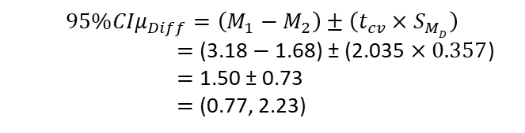

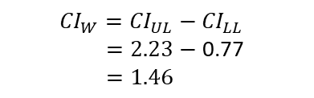
Example
Step 5: Calculate 95% CIµ_{Diff}, CI_{W}.
$$S_{M_{D}}=\frac{S_{D}}{\sqrt{N}} \\ =\frac{2.08}{\sqrt{34}} \\ =\frac{2.08}{5.8309} \\ =0.3567$$
$$95\%{CIμ}_{Diff}=\left(M_{1}−M_{2}\right)±\left(t_{cv}×S_{MD}\right)$$
$=$ (3.18 $−$1.68) ± (2.035 $×0.357$)
$=$ 1.50 ± 0.73
$=$ (0.77, 2.23)
${CI}_{W}={CI}_{UL}−{CI}_{LL}$
$=2.23−$ 0.77
$=1.46$

