Slide 1

Jingwei Wu, PhD
Chapter 10
Between-Subjects, One-Way Analysis of Variance
A courtesy of “USING AND INTERPRETING STATISTICS” by ERIC W. CORTY | THIRD EDITION (Macmillan Education)

Slide 2

Objectives
Introduction to Analysis of Variance
Calculating Between-Subjects, One-Way ANOVA
Interpreting Between-Subjects, One-Way ANOVA

Slide 3
Introduction to Analysis of Variance
Analysis of Variance (ANOVA)
Family of statistical tests for comparing the means of 2 or more groups
Focus for this chapter
Between-Subjects, One-Way ANOVA
Statistical test used to compare the means of 2 or more independent samples when there is just one independent variable
Between Subjects
ANOVA terminology for independent samples
Way
Term for an independent variable in ANOVA
Factor
Term for an independent variable in ANOVA
Level
ANOVA terminology for a category of an independent variable

Slide 4
Introduction to Analysis of Variance: Handedness Example
Is there a difference in artistic ability among right-handed, left-handed, and ambidextrous people?
Sample of people classified into 3 groups
Right-handed, left-handed, ambidextrous
Artistic ability measured
Comparing Artistic Ability in Three Independent Samples
Level 1 | Level 2 | Level 3
Right-handed | Left-handed | Ambidextrous
A one-way ANOVA has one factor with multiple levels. Here, the factor (explanatory variable) is handedness, and the three levels are right-handed, left-handed, and ambidextrous.

Slide 5
Why ANOVA Is Needed
Needed to keep the risk of Type I error at a reasonable level when comparing multiple samples
Example: 5 experimental groups
4 medications and a placebo tested to treat a disease
10 separate t tests would be needed to make all comparisons
Each t test has 5% Type I error rate
Results in almost a 50% chance of Type I error
All Possible Pairs of Five Experimental Groups
1 vs. 2 | 1 vs. 3 | 1 vs. 4 | 1 vs. 5
2 vs. 3 | 2 vs. 4 | 2 vs. 5
3 vs. 4 | 3 vs. 5
4 vs. 5

Slide 6
Why ANOVA Is Needed
With ANOVA, one test is completed
Alpha level is set at .05
ANOVA compares all means at once
If any two means are significant, perform a post-hoc test
Post-Hoc Test
Follow-up test to a statistically significant ANOVA, engineered to find out which pairs of means differ while keeping the overall alpha level at the chosen level

Slide 7
What ANOVA Does
ANOVA works by analyzing a set of scores and separating out the different sources of variability
Within-Group Variability
Variability within a sample of cases, all of which have received the same treatment
Primarily caused by individual differences
Between-Group Variability
Variability in scores that is primarily due to the different treatments that different groups receive

Slide 8
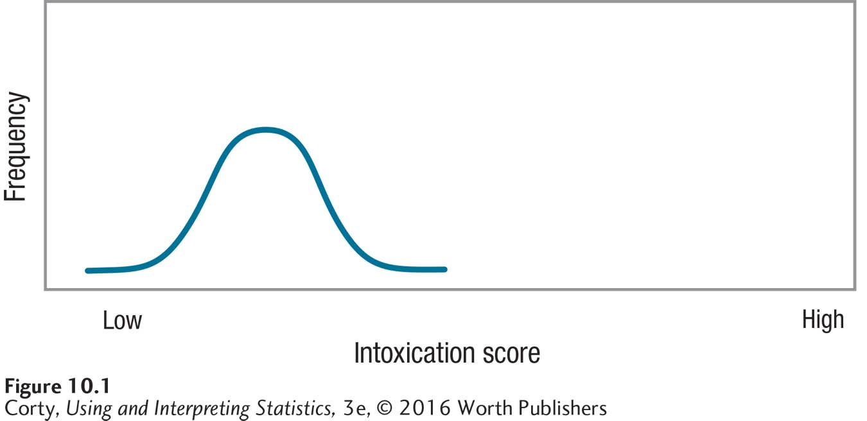
What ANOVA Does
Example: Alcohol Intoxication
All participants received exactly the same dose of alcohol; however there was variability in how it affected them:
Some exhibited very little intoxication and others showed more.
Variability within the group is accounted for by individual differences such as sex, weight, time since last meal, and prior experience with alcohol.
Distribution of Intoxication Scores for Participants Who Consumed One Beer
Demonstrates within-group variability

Slide 9
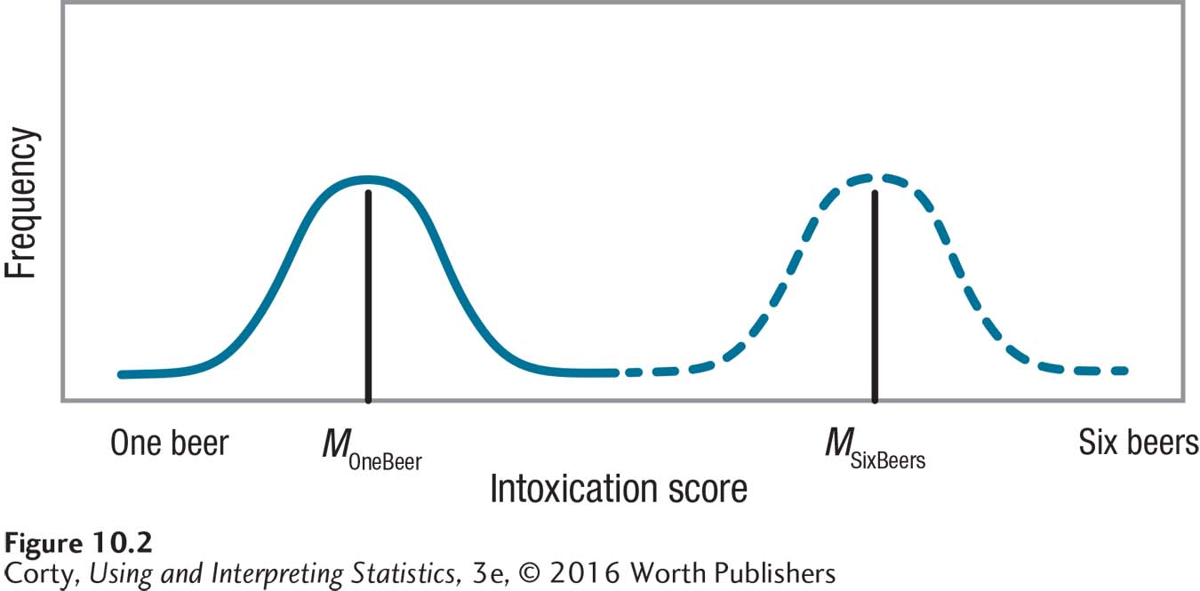
What ANOVA Does
Example: Alcohol Intoxication
Left curve is the distribution of intoxication scores for participants who consumed one beer.
Right curve is the distribution of scores for participants who consumed six beers.
Within each group there is variability in the intoxication level, variability due to individual differences.
There is also variability between the two groups.
Easiest way to see this is to observe that the two curves have different midpoints.
Distributions of Intoxication Scores for Participants Who Consumed Different Amounts of Alcohol

Slide 10
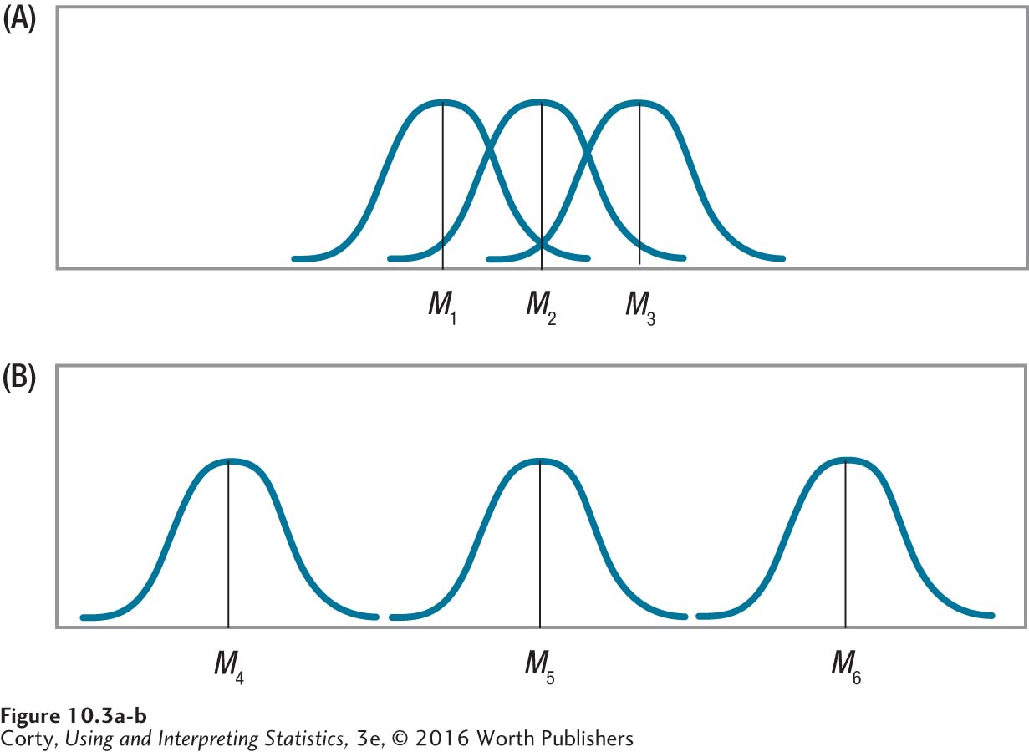
How ANOVA Uses Variability
Top panel (A)
3 different treatments have about the same average effect on outcome.
3 means (M1 to M3) are very close to each other and there is a lot of overlap.
Bottom panel (B)
3 treatments have very different effects on outcome.
3 means (M4 to M6) are further apart from each other and there is no overlap in outcome from group to group.
Examples of Little Impact of Treatment on Outcome and a Lot of Impact of Treatment on Outcome

Slide 11
How ANOVA Uses Variability
ANOVA language
More between-group variability when the effect of treatment is large (bottom panel) than when the effect of treatment is small (top panel)
ANOVA would show results in Panel A as not significant and results in Panel B as significant
Examples of Little Impact of Treatment on Outcome and a Lot of Impact of Treatment on Outcome

Slide 12
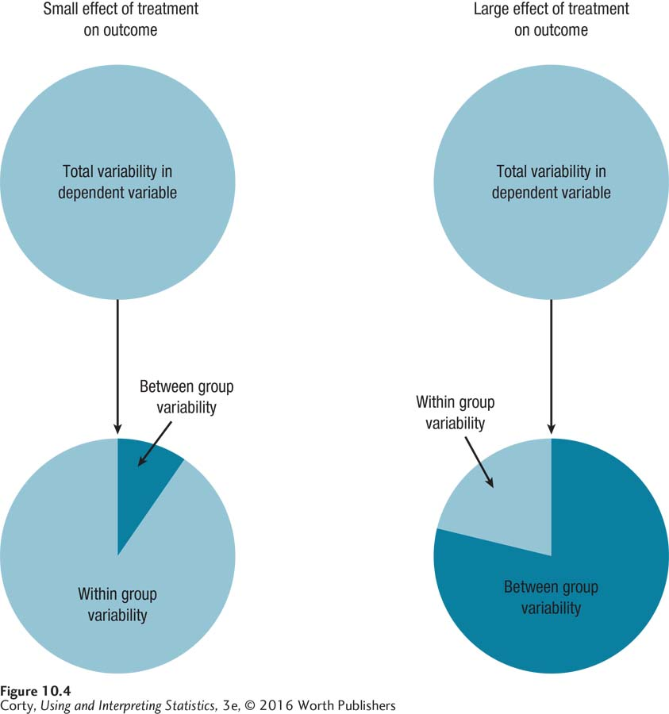
Partitioning Variability into Between-Group and Within-Group Variability

Slide 13
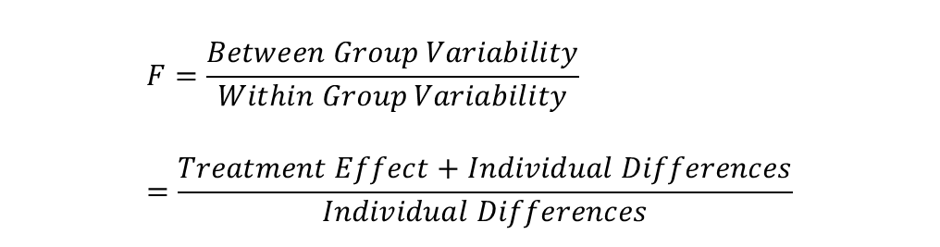
How ANOVA Uses Variability
F ratio
Calculates ratio of between-group variability to within-group variability
To decide if the amount of between-group variability is large or small, ANOVA compares it to within-group variability
F ratio means
If no treatment effect, F ratio has the same numerator (individual differences) and denominator (individual differences); it will equal 1.
As treatment effect grows, numerator becomes larger than denominator; F ratio climbs above 1.
As F ratio increases, climbs above 1, results are more likely to be statistically significant.
$$F=\frac{Between Group Variability}{Within Group Variability} \\ =\frac{Treatment Effect+Individual Differences}{Individual Differences}$$

Slide 14
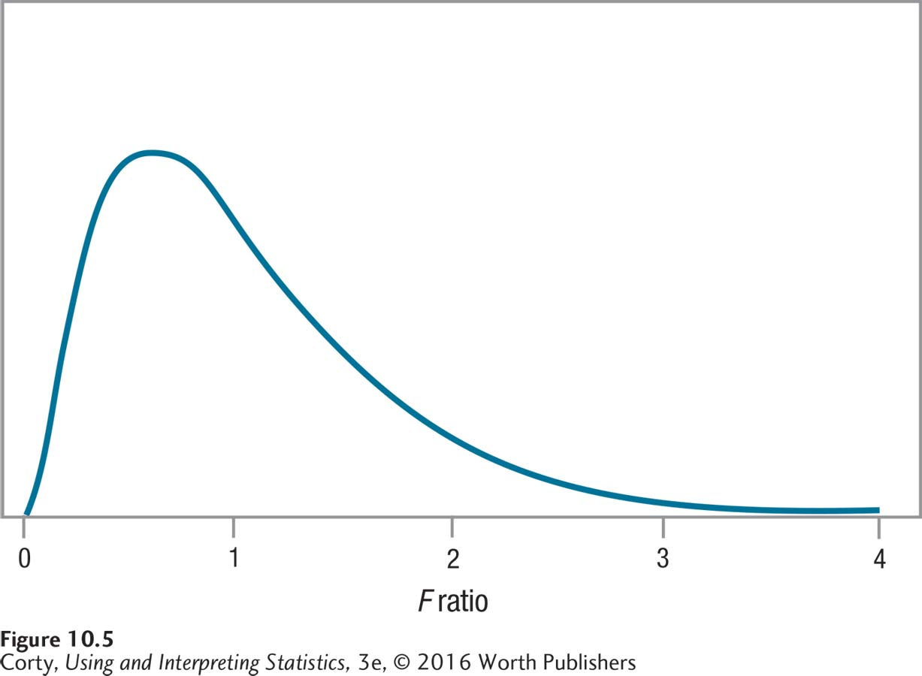
How ANOVA Uses Variability
Example of a sampling distribution for the F ratio
Ratio of between-group variability to within-group variability
F can’t be lower than zero; the high point of the curve is close to a value of 1 on the X-axis
Distribution is positively skewed
Probability decreases as F gets larger than 1
An Example of a Sampling Distribution for the F Ratio

Slide 15
Hypothesis Testing in Action - Example
Dr. Chung’s Food/Maze Study
6 Steps of Hypothesis Testing
STEP 1 - Pick a Test
STEP 2 - Check the Assumptions
STEP 3 - List the Hypotheses
STEP 4 - Set the Decision Rule
STEP 5 - Calculate the Test Statistic
STEP 6 - Interpret the Results

Slide 16
Calculating Between-Subjects, One-Way ANOVA
Example: Dr. Chung’s Food/Maze Study
Can rats discriminate among different types of food and does this discrimination influence their behavior?
Trained 10 rats to run in large, complex maze.
Rat placed in start box and had to find its way to goal box.
Trained with 3 different types of food:
low-calorie
normal-calorie
high-calorie
Placed rats on diet until they lost 10% of their body weight.
Randomly assigned rats to 3 groups based upon type of food they would find in the goal box.
Timed in seconds how long it took the rat to get to goal box.

Slide 17
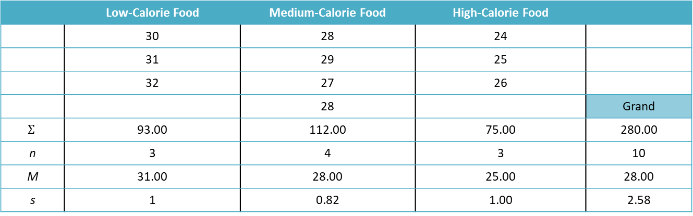
Calculating Between-Subjects, One-Way ANOVA
Data from food/maze study shown in Table 10.3 Time to Run Maze (in seconds)
 | Low-Calorie Food | Medium-Calorie Food | High-Calorie Food
 | 30 | 28 | 24
 | 31 | 29 | 25
 | 32 | 27 | 26
 |  | 28 |  | Grand
$$Σ$$ | 93.00 | 112.00 | 75.00 | 280.00
n | 3 | 4 | 3 | 10
M | 31.00 | 28.00 | 25.00 | 28.00
s | 1 | 0.82 | 1.00 | 2.58

Slide 18
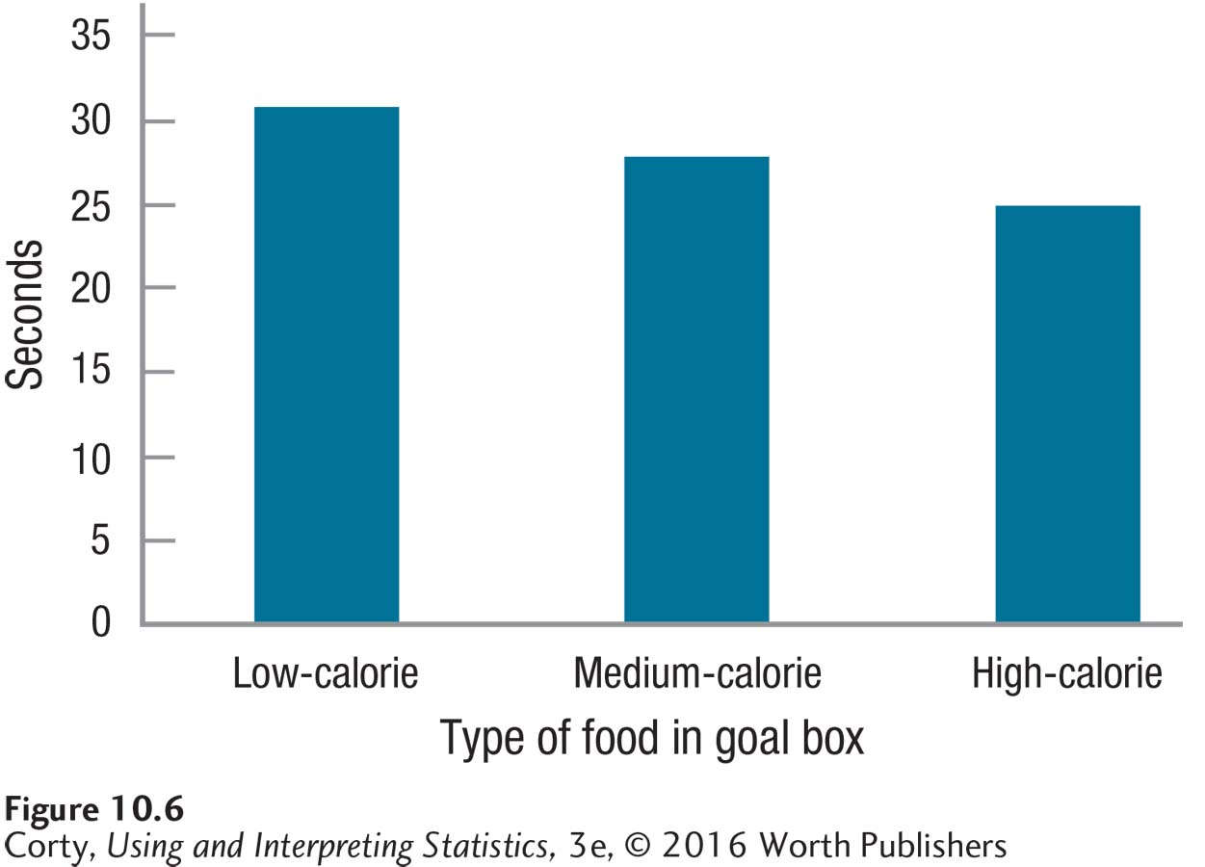
Calculating Between-Subjects, One-Way ANOVA
Example: Food/Maze
Some decrease in the time it takes a rat to run the maze (i.e., an increase in speed) as the calorie content of the food in the goal box increases
Effect looks modest
Between-subjects, one-way ANOVA can be used to see if the effect is statistically significant
The Effect of Calorie Content on Maze Travel Time
Low calorie (M = 31.00)
Medium calorie (M = 28.00)
High calorie (M = 25.00)

Slide 19
Hypothesis Testing in Action: Food/Maze Example
STEP 1: Pick a Test
Dr. Chung is comparing the means of 3 independent samples
One independent variable (calorie content)
3 levels (low-, medium-, and high-calorie food)
Dependent variable, seconds, measured at the ratio level
Dr. Chung will use a between-subjects, one-way ANOVA

Slide 20
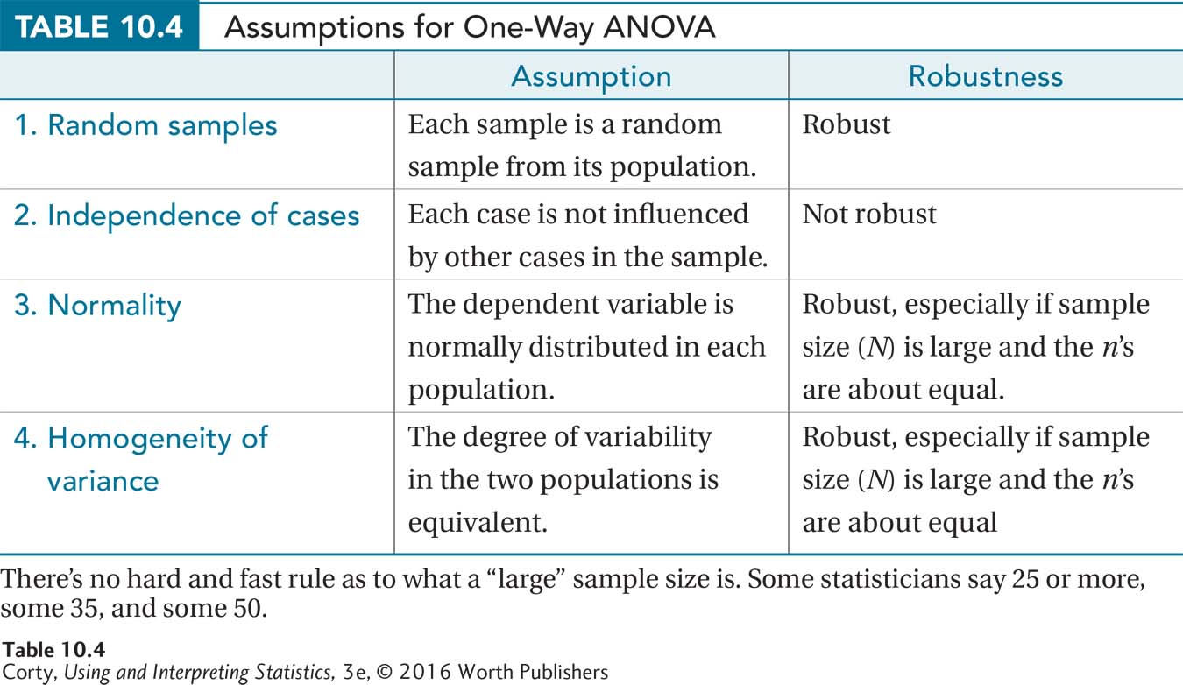
Food/Maze Example (continued)
STEP 2: Check the Assumptions
Random samples
Independence of cases
Normality
Homogeneity of variance
Can you list the assumption and robustness of each assumption?

Slide 21
Food/Maze Example (continued)
STEP 3: List the Hypotheses
ANOVA always has nondirectional hypotheses
Nondirectional, between-subjects, one-way ANOVA
H₀: μ₁ = μ₂ = μ₃
H₁: At least one population mean is different from the others.

Slide 22
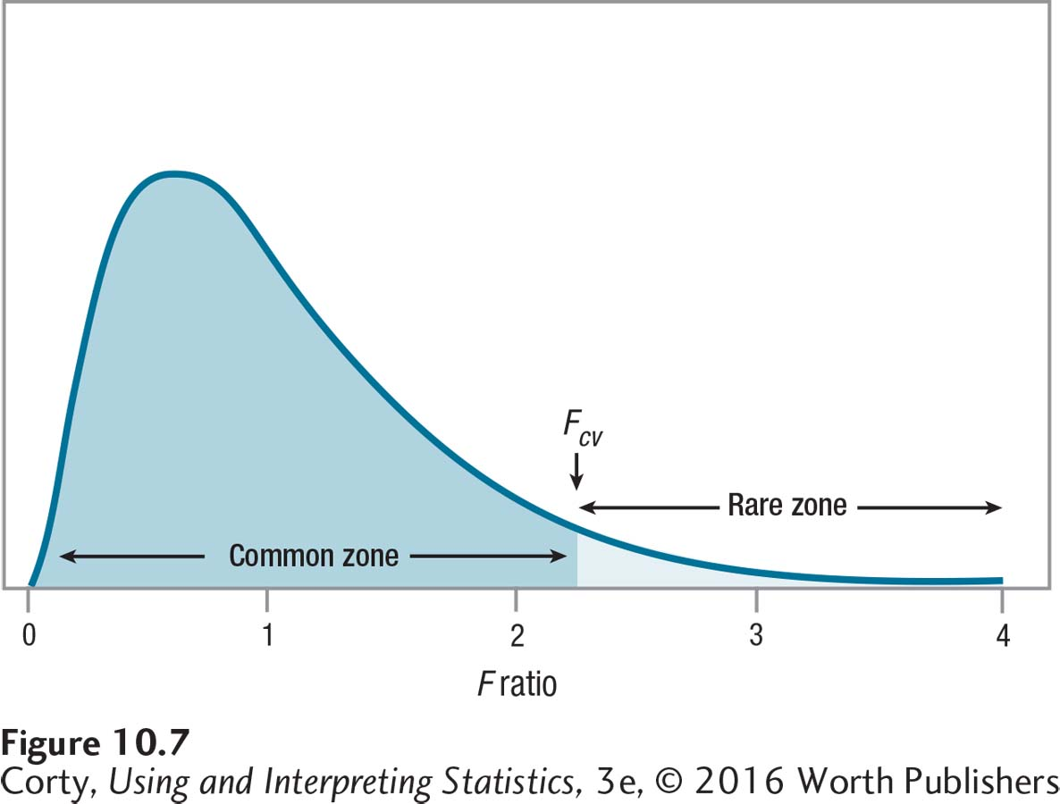
Food/Maze Example (continued)
STEP 4: Set the Decision Rule
If F ≥ F_{cv} , reject H₀
If F < F_{cv} , fail to reject H₀
Using the Critical Value of F to Mark the Common Zone

Slide 23



Food/Maze Example (continued)
STEP 4: Set the Decision Rule (continued)
3 groups (low-, medium-, high-calorie food), k = 3
10 participants in study, N = 10
Use Appendix Table 4 to find F_{cv}
Find the intersection of df_{between} = 2 (numerator) and df_{within} = 7 (denominator)
$${df}_{Between}=k−1 \\ =3−1 \\ =2$$
$${df}_{Within}=N−k \\ =10−3 \\ =7$$
$${df}_{Total}=N−1 \\ =10−1 \\ =9$$

Slide 24

Food/Maze Example (continued)
Degrees of Freedom (df )
$${df}_{Between}=k−1 \\ {df}_{Within}=N−k \\ {df}_{Total}=N−1 \\ where {df}_{Between}=between−groups degrees of freedom \\ \left(degrees of freedom for the numerator\right) \\ where {df}_{Within}=within−groups degrees of freedom \\ \left(degrees of freedom for the denominator\right) \\ k=the number of groups \\ N=thetotal number of cases$$

Slide 25
Food/Maze Example (continued)
STEP 4: Set the Decision Rule (continued)
3 groups (low-, medium-, high-calorie food), k = 3
10 participants in study, N = 10
Use Appendix Table 4 to find F_{cv}
Find the intersection of df_{between} = 2 (numerator) and df_{within} = 7 (denominator)
$${df}_{Between}=k−1 \\ =3−1 \\ =2$$
$${df}_{Within}=N−k \\ =10−3 \\ =7$$
$${df}_{Total}=N−1 \\ =10−1 \\ =9$$

Slide 26
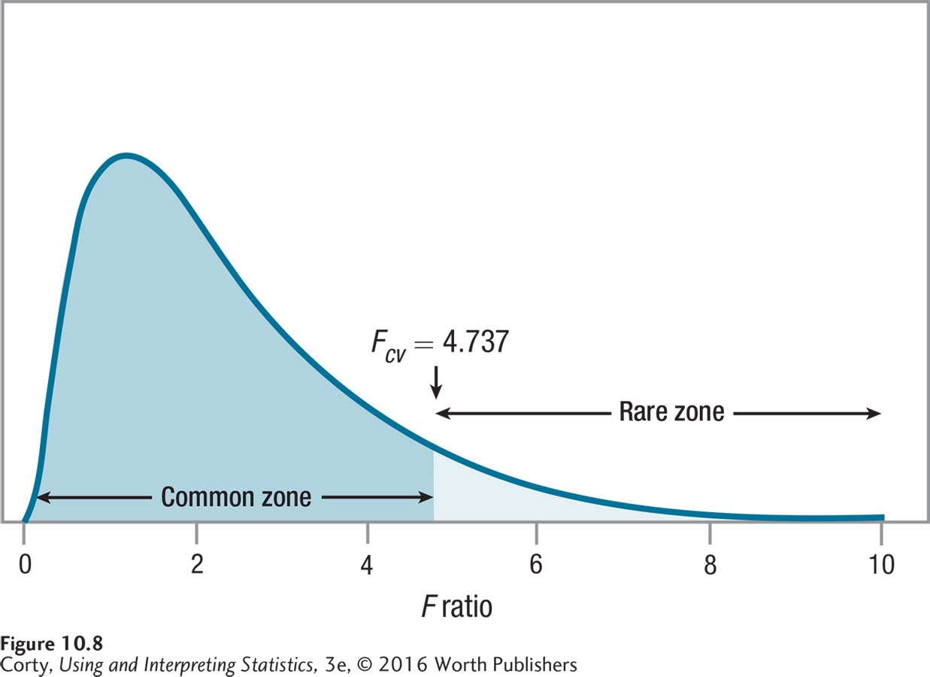
Food/Maze Example (continued)
STEP 4: Set the Decision Rule (continued)
F_{cv} = 4.737
If F ≥ 4.737 reject the null hypothesis
If F < 4.737 fail to reject the null hypothesis
The Critical Value of F for 2 and 7 Degrees of Freedom

Slide 27

Food/Maze Example (continued)
STEP 5: Calculate the Test Statistic
$${SS}_{Total}=ΣX^{2}−\frac{{\left(ΣX\right)}^{2}}{N} \\ where {SS}_{Total}=total sum of squares \\ X=raw score \\ N=the total number of cases$$

Slide 28
Food/Maze Example (continued)
Maze Running Time Data from Table 10.3, Squared and Summed, in Preparation for Computing Sums of Squares
 | Low-Calorie |  | Medium-Calorie |  | High-Calorie
 | X | X² | X | X² | X | X²
 | 30 | 900 | 28 | 784 | 24 | 576
 | 31 | 961 | 29 | 841 | 25 | 625
 | 32 | 1024 | 27 | 729 | 26 | 676 | Grand
 |  |  | 28 | 784 |  |  | X | X²
Sum | 93 | 2885 | 112 | 3138 | 75 | 1877 | 280 | 7900
n | 3 |  | 4 |  | 3 |  | 10

Slide 29

Food/Maze Example (continued)
STEP 5: Calculate the Test Statistic (continued)
The sum of squared scores for Step 1 is 7,900.00. Step 2 is next.
Calculating between-subjects, one-way ANOVA
$$\frac{{\left(ΣX\right)}^{2}}{N}=\frac{{280}^{2}}{10} \\ =\frac{78,400.00}{10} \\ =7,840.00$$
$${SS}_{Total}=ΣX^{2}−\frac{{\left(ΣX\right)}^{2}}{N} \\ =7,900.00−7,840.00 \\ =60.00$$

Slide 30

Food/Maze Example (continued)
STEP 5: Calculate the Test Statistic (continued)
$${SS}_{Between}=Σ\left(\frac{{\left({ΣX}_{Group}\right)}^{2}}{n_{Group}}\right)−\frac{{\left(ΣX\right)}^{2}}{N} \\ where {SS}_{Between}=between−groups sum of squares \\ X_{Group}=raw scores for cases in a group \\ n_{Group}=number of cases in a group \\ X=raw scores \\ N=total number of cases$$

Slide 31
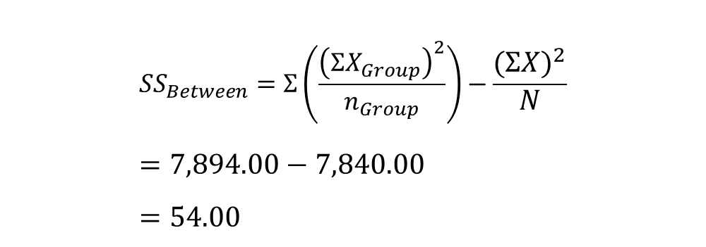
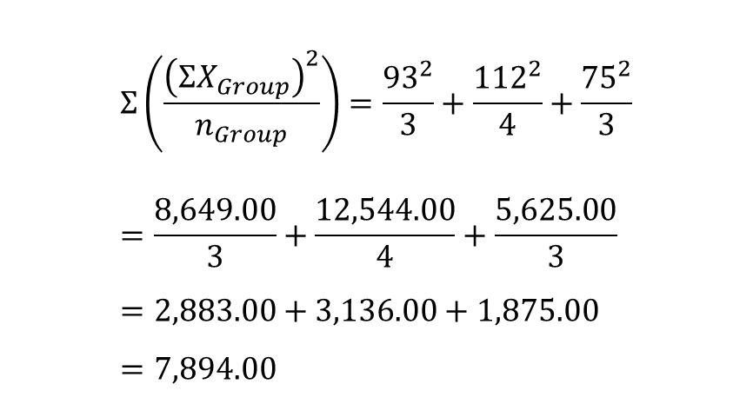
Food/Maze Example (continued)
$$Σ\left(\frac{{\left({ΣX}_{Group}\right)}^{2}}{n_{Group}}\right)=\frac{{93}^{2}}{3}+\frac{{112}^{2}}{4}+\frac{{75}^{2}}{3} \\ =\frac{8,649.00}{3}+\frac{12,544.00}{4}+\frac{5,625.00}{3} \\ =2,883.00+3,136.00+1,875.00 \\ =7,894.00$$
STEP 5: Calculate the Test Statistic (continued)
$${SS}_{Between}=Σ\left(\frac{{\left({ΣX}_{Group}\right)}^{2}}{n_{Group}}\right)−\frac{{\left(ΣX\right)}^{2}}{N} \\ =7,894.00−7,840.00 \\ =54.00$$

Slide 32
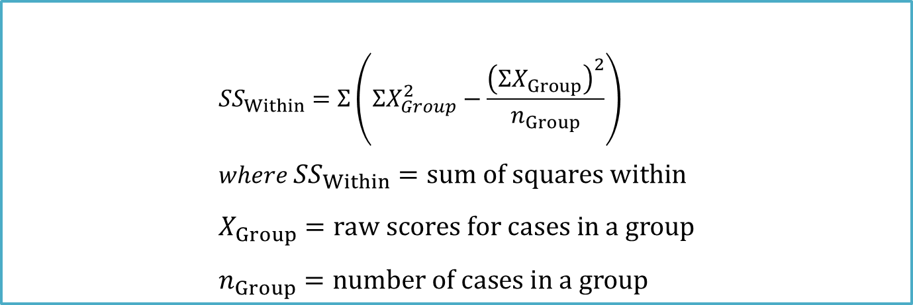
Food/Maze Example (continued)
STEP 5: Calculate the Test Statistic (continued)
The final sum of squares to calculate is the sum of squares within. Equation 10.4 covers this.
$${SS}_{Within}=Σ\left(ΣX_{Group}^{2}−\frac{{\left({ΣX}_{Group}\right)}^{2}}{n_{Group}}\right) \\ where {SS}_{Within}=sum of squares within \\ X_{Group}=raw scores for cases in a group \\ n_{Group}=number of cases in a group$$

Slide 33

Food/Maze Example (continued)
STEP 5: Calculate the Test Statistic (continued)
Sum of Squares Total for Between-Subjects
$${SS}_{Within}=Σ\left(ΣX_{Group}^{2}−\frac{{\left({ΣX}_{Group}\right)}^{2}}{n_{Group}}\right) \\ =\left(2,885−\frac{{93}^{2}}{3}\right)+\left(3,138−\frac{{112}^{2}}{4}\right)+\left(1,887−\frac{{75}^{2}}{3}\right) \\ =\left(2,885−\frac{8,649.00}{3}\right)+\left(3,138−\frac{12,544.00}{4}\right)+\left(1,887−\frac{5,625.00}{3}\right) \\ =\left(2,885−2,883.00\right)+\left(3,138−3,136.00\right)+\left(1,887−1,875.00\right) \\ =2.00+2.00+2.00 \\ =6.00$$

Slide 34
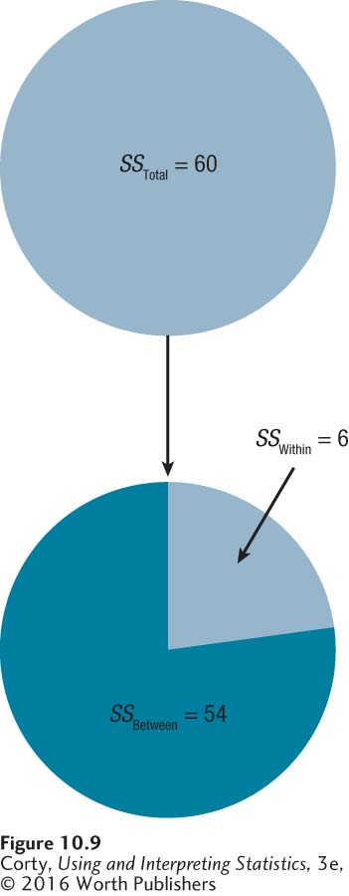
Food/Maze Example (continued)
Partitioning Total Sum of Squares for Maze Running Time Data
SS_{Total} can be broken down into its component parts, SS_{Between} and SS_{Within}.
Note that the largest chunk of SS_{Total} is accounted for by SS_{Between}.

Slide 35
Summary Table for One-Way ANOVA
Template for ANOVA Summary Table for One-Way ANOVA
1 row for each source of variability:
- Between-groups variability on the top row
- Within-groups variability on the middle row
- Total variability on the bottom row
5 columns, in order, tell:
- Source of variability
- Sum of squares
- Degrees of freedom
- “Mean square”
- F ratio

Slide 36

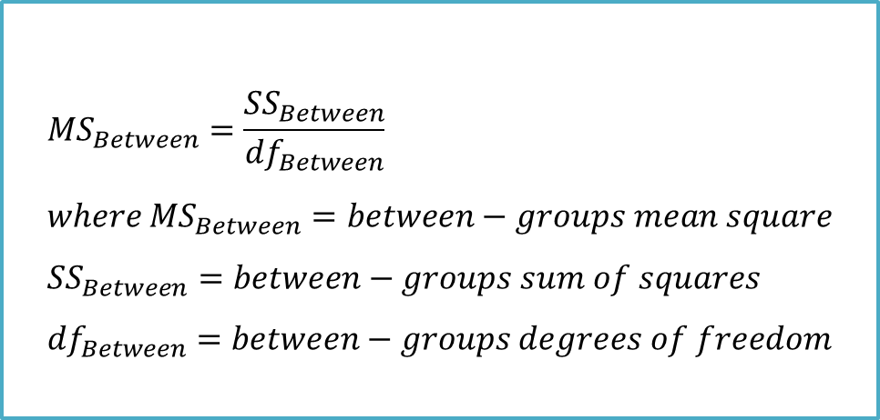
Food/Maze Example (continued)
STEP 5: Calculate the Test Statistic (continued)
$${MS}_{Between}=\frac{{SS}_{Between}}{{df}_{Between}} \\ where {MS}_{Between}=between−groups mean square \\ {SS}_{Between}=between−groups sum of squares \\ {df}_{Between}=between−groups degrees of freedom$$
$${MS}_{Between}=\frac{{SS}_{Between}}{{df}_{Between}} \\ =\frac{54.00}{2} \\ =27.00$$

Slide 37

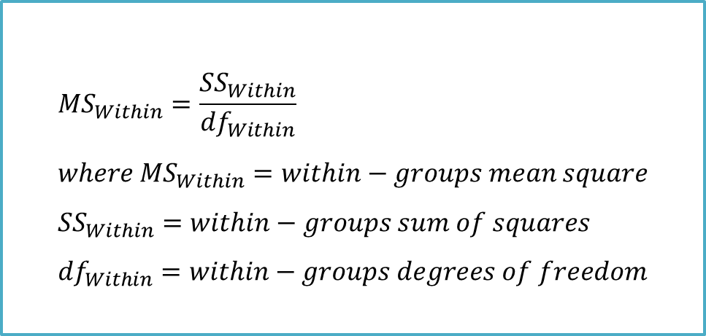
Food/Maze Example (continued)
STEP 5: Calculate the Test Statistic (continued)
$${MS}_{Within}=\frac{{SS}_{Within}}{{df}_{Within}} \\ =\frac{6.00}{7} \\ =0.8571 \\ =0.86$$
$${MS}_{Within}=\frac{{SS}_{Within}}{{df}_{Within}} \\ where {MS}_{Within}=within−groups mean square \\ {SS}_{Within}=within−groups sum of squares \\ {df}_{Within}=within−groups degrees of freedom$$

Slide 38

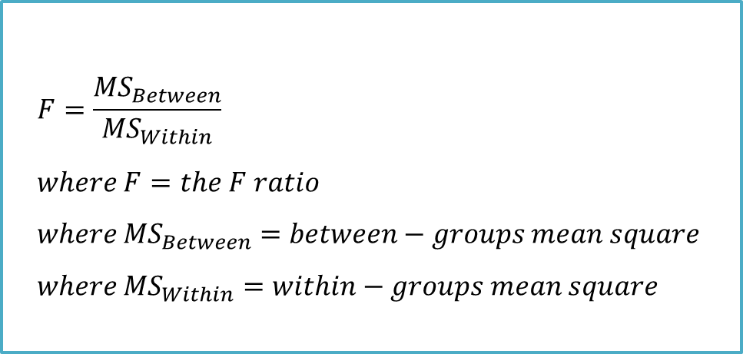
Food/Maze Example (continued)
STEP 5: Calculate the Test Statistic (continued)
$$F=\frac{{MS}_{Between}}{{MS}_{Within}} \\ where F=the F ratio \\ where {MS}_{Between}=between−groups mean square \\ where {MS}_{Within}=within−groups mean square$$
$$F=\frac{{MS}_{Between}}{{MS}_{Within}} \\ =\frac{27.00}{0.86} \\ =31.3953 \\ =31.40$$

Slide 39
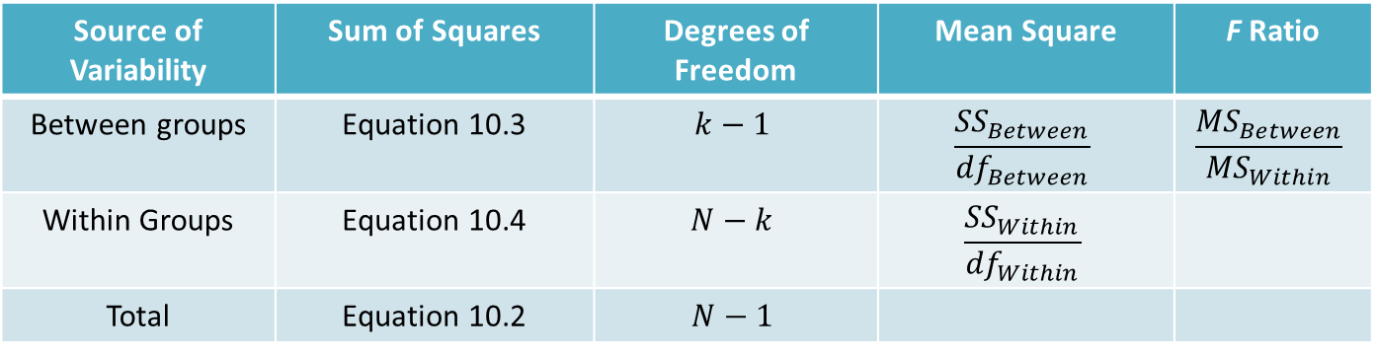
Food/Maze Example (continued)
STEP 5: Calculate the Test Statistic (continued)
How to Complete an ANOVA Summary Table for a Between-Subjects, One-Way ANOVA
Source of Variability | Sum of Squares | Degrees of Freedom | Mean Square | F Ratio
Between groups | Equation 10.3 | $$k−1$$ | $$\frac{{SS}_{Between}}{{df}_{Between}}$$ | $$\frac{{MS}_{Between}}{{MS}_{Within}}$$
Within Groups | Equation 10.4 | $$N−k$$ | $$\frac{{SS}_{Within}}{{df}_{Within}}$$
Total | Equation 10.2 | $$N−1$$
This table summarizes all the steps necessary to complete an ANOVA summary table for a between-subjects, one-way ANOVA.

Slide 40
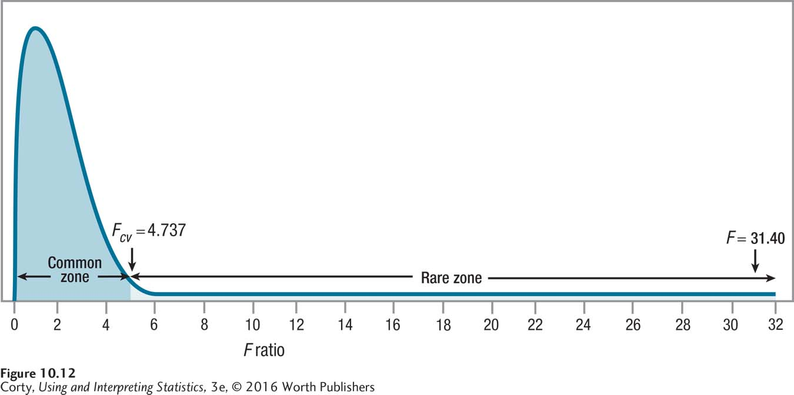
Food/Maze Example (continued)
STEP 6: Interpret the Results (continued)
Can rats discriminate among different types of food?
Low calorie (M = 31.00), Medium calorie (M = 28.00), High calorie (M = 25.00)
F_{cv} = 4.737, F = 31.40
Reject the null hypothesis; see Figure 10.9

Slide 41
Food/Maze Example – Step 6: APA Style
STEP 6: Interpret the Results
APA format, F(2, 7) = 31.40, p < .05
F indicates that an F test, an analysis of variance, was used
2, degrees of freedom for SS_{Between} 7, degrees of freedom for SS_{Within} N = 2 + 7 + 1 = 10
31.40 is the observed (calculated) value of test statistic.
.05 says that alpha was set at .05; 5% chance of making a Type 1 error.
p < .05, which reveals that the null hypothesis was rejected. Observed result (31.40) is a rare result - probability of less than .05 of occurring when the null hypothesis is true.

Slide 42
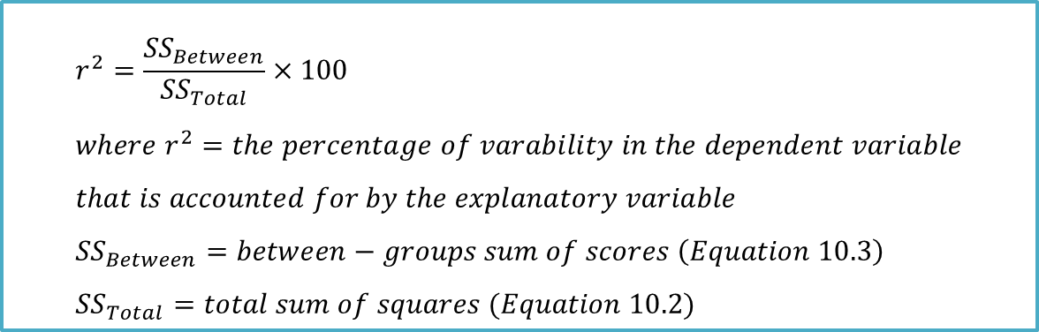
Food/Maze Example – Step 6: Effect Size
STEP 6: Interpret the Results
How big is the effect?
r², pronounced “r squared”
Tells the percentage of variability in the dependent variable that is accounted for (or predicted) by the independent variable
$$r^{2}=\frac{{SS}_{Between}}{{SS}_{Total}}×100 \\ where r^{2}=the percentage of varability in the dependent variable \\ that is accounted for by the explanatory variable \\ {SS}_{Between}=between−groups sum of scores \left(Equation 10.3\right) \\ {SS}_{Total}=total sum of squares (Equation 10.2)$$

Slide 43
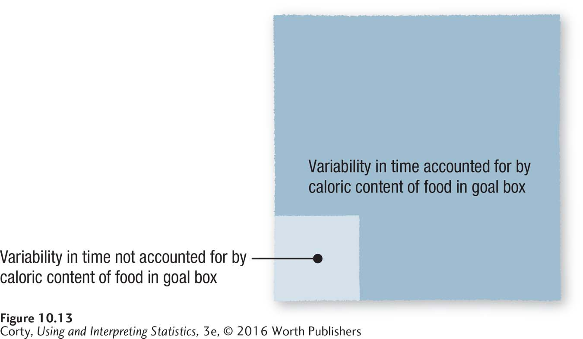

Food/Maze Example – Step 6: Effect Size
Calculate effect size
Interpretation of r²
r² ≈ small effect
r² ≈ 9% (medium effect)
r² ≈ 25% (large effect)
$$r^{2}=\frac{{SS}_{Between}}{{SS}_{Total}}×100 \\ =\frac{54.00}{60.00}×100 \\ =.9000×100 \\ =90\%$$
Percentage of Variability in Time to Run the Maze Scores That Is Accounted for by Type of Food in Goal Box

Slide 44
Food/Maze Example – Step 6: Tukey HSD
Where is the effect?
Post-hoc test needed
Tukey HSD
Calculates an HSD value
If the observed difference between a pair of means is greater than or equal to the HSD value, then the researcher can conclude that there is a statistically significant difference between the two groups.
df = 7, within-groups df
k= 3, number of groups
q = 4.17

Slide 45
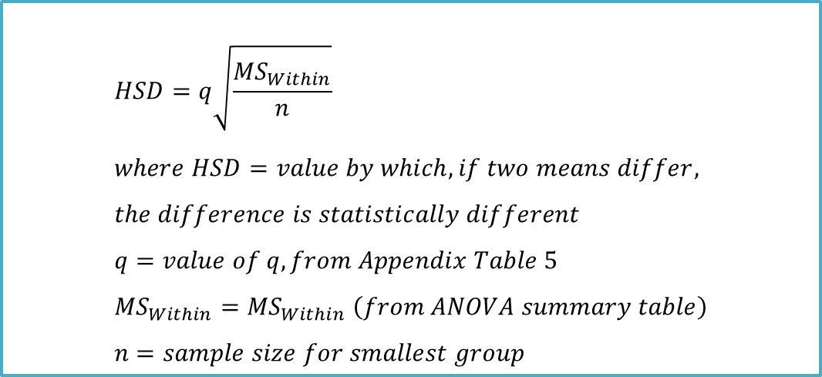
Food/Maze Example – Step 6: Tukey HSD
STEP 6: Interpret the Results
Where is the effect?
Tukey HSD
$$HSD=q\sqrt{\frac{{MS}_{Within}}{n}} \\ where HSD=value by which, if two means differ, \\ the difference is statistically different \\ q=value of q, from Appendix Table 5 \\ {MS}_{Within}={MS}_{Within} \left(from ANOVA summary table\right) \\ n=sample size for smallest group$$

Slide 46
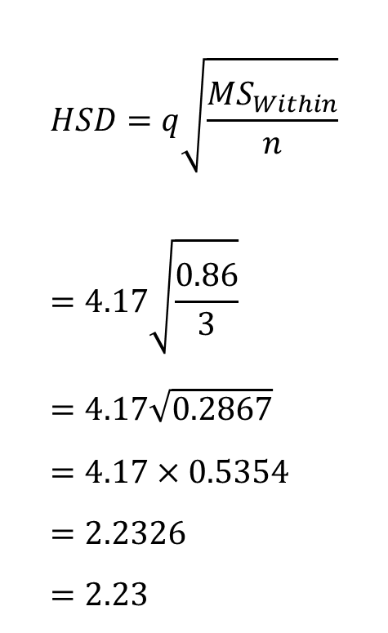
Food/Maze Example – Step 6: Tukey HSD
$$HSD=q\sqrt{\frac{{MS}_{Within}}{n}} \\ =4.17\sqrt{\frac{0.86}{3}} \\ =4.17\sqrt{0.2867} \\ =4.17×0.5354 \\ =2.2326 \\ =2.23$$
Tukey HSD
q = 4.17, MS_{Within} = 0.86, n = 3 (sample size for smallest group)
Any two means that differ by at least 2.23 seconds are honestly significantly different (HSD)
All comparisons were significant

Slide 47
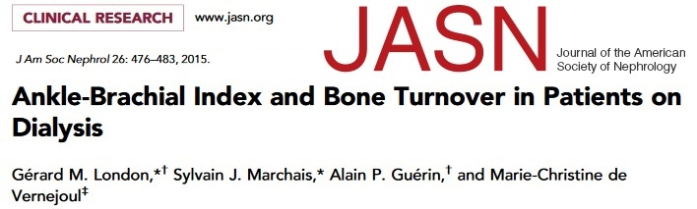
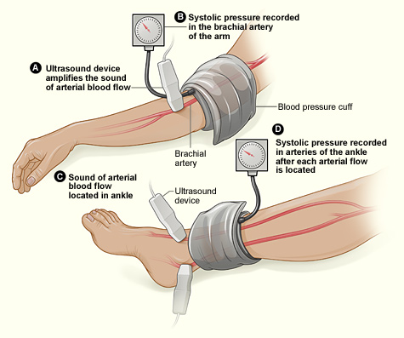
Example
The ankle-brachial pressure index (ABix) is the ratio of the blood pressure at the ankle to the blood pressure in the upper arm (brachium). A low ABI suggests blocked arteries due to peripheral artery disease (PAD).
For 65 prevalent nondiabetic patients on hemodialysis, they measured ABix and evaluated mineral and bone disorders with bone histomorphometry. Patients were divided in three groups according to their ABix values: normal ABix, 0.9 - 1.3; low ABix, <0.9; high Abix, >1.4 (i.e., incompressible). One primary blood chemistry outcome is serum high-sensitivity C-reactive protein (hsCRP). It is used to evaluate individuals for risk of CVD.
30 patients with Normal ABix had mean hsCPR of 2.91 (SD = 1.93), 11 patients with LOW ABix had mean hsCPR of 8.13 (SD = 3.28), and 24 patients with HIGH ABix had mean hsCPR of 7.09 (SD = 3.57).
Question: Are there any mean differences of hsCRP according to ABix (among three groups)?

Slide 48
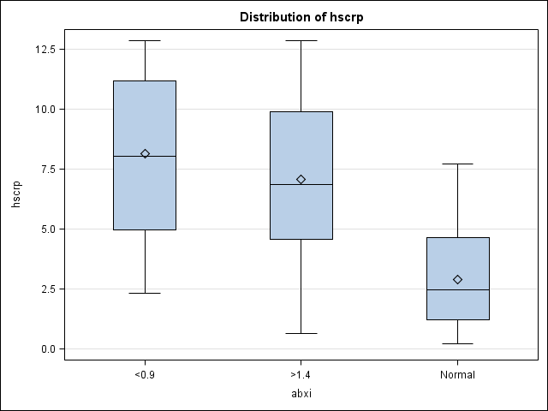
Example
Means:
Normal: 2.91
ABix < 0.9: 8.13
ABix > 1.4: 7.09
Mean hsCRP in patients with either ABix < 0.9 or ABix > 1.4 appears higher than normal patients.
Are these differences statistically significant?
We need to run one-way ANOVA analysis for it. However, do not forget to check for the conditions for ANOVA.

Slide 49
Example
Null hypothesis: The true means (for hsCRP) are the same for all groups (the three ABix classifications).
Alternative hypothesis: The true means (for hsCRP) are NOT the same for all groups (the three ABix classifications).
Put in another way,
Null hypothesis: H₀ : µ₁ = µ₂ = µ₃
Alternative hypothesis: H_{a} : not all three µ’s are the same
Where µ₁, µ₂, µ₃ are the true hsCRP means in normal patients, in patients with ABix < 0.9 and in patients with ABix > 1.4 , respectively.

Slide 50
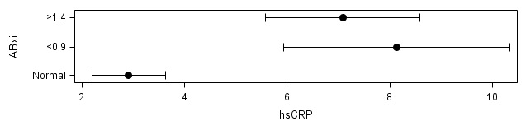
Example
P-value < .05 significant differences
The ANOVA Procedure: Dependent Variable: hscrp
Sum of
Source DF Squares Mean Square F Value Pr > F
Model 2 336.0503666 168.0251833 20.46 <.0001
Error 62 509.0787656 8.2109478
Corrected Total 64 845.1291322
R-Square Root MSE
0.397632 2.865475
N
ABix Obs Mean Std Dev
ƒƒƒƒƒƒƒƒƒƒƒƒƒƒƒƒƒƒƒƒƒƒƒƒƒƒƒƒƒƒƒƒƒƒƒƒ
<0.9 11 8.1326852 3.2839532
>1.4 24 7.0874720 3.5693072
Normal 30 2.9111922 1.9317345
ƒƒƒƒƒƒƒƒƒƒƒƒƒƒƒƒƒƒƒƒƒƒƒƒƒƒƒƒƒƒƒƒƒƒƒƒ
Follow-up analysis
Pr > |t| for H0: LSMean(i)=LSMean(j)
i/j 1 2 3
1 0.5785 <.0001
2 0.5785 <.0001
3 <.0001 <.0001
There is significant evidence that the three ABix ranges do not all have the same means of hsCRP.
From the confidence intervals (and looking at Tukey-HSD follow-up procedure), we see that patients with abnormal ABix (<0.9 or >1.4, i.e., with PAD) have similar mean hsCRP and both are distinctly higher than patients with normal ABix.

