Slide 1

Jingwei Wu, PhD
Chapter 7
The Single-Sample t Test
A courtesy of “USING AND INTERPRETING STATISTICS” by ERIC W. CORTY | THIRD EDITION (Macmillan Education)

Slide 2

Objectives
Calculating the Single-Sample t Test
Interpreting the Single-Sample t Test

Slide 3
Calculating the Single-Sample t Test
Single-Sample t test
Statistical test that compares a sample mean to a population mean when the population standard deviation is not known
Example: Dr. Farshad’s reaction time study
Do adults with attention deficit hyperactivity disorder (ADHD) differ in reaction time from the general population?
Reaction time test normed on adults in the United States μ = 200 milliseconds (msec)
Obtained a random sample of 141 adults diagnosed with ADHD from ADHD treatment centers in Illinois
Reaction time for the sample (M = 220, s = 27)

Slide 4
Quick Review: Six Steps of Hypothesis Testing
STEP 1 - Pick a Test
STEP 2 - Check the Assumptions
STEP 3 - List the Hypotheses
STEP 4 - Set the Decision Rule
STEP 5 - Calculate the Test Statistic
STEP 6 - Interpret the Results

Slide 5
Reaction Time Example – Step 1
STEP 1 - Pick a Test
Dr. Farshad is comparing mean of a sample to the mean of a population.
She does not know population standard deviation, so she must choose the single-sample t test.

Slide 6
Reaction Time Example – Step 2
STEP 2 – Check the Assumptions
All 3 assumptions have been met
Assumption | Explanation | Robustness
Random sample | The sample is a random sample from the population. | Robust if violated.
Independence of observations | Cases within the sample don’t influence each other. | Not robust to violations
Normality | The dependent variable is normally distributed in the population. | Robust to violations if the sample size is large.
Assumptions for the Single-Sample t Test

Slide 7
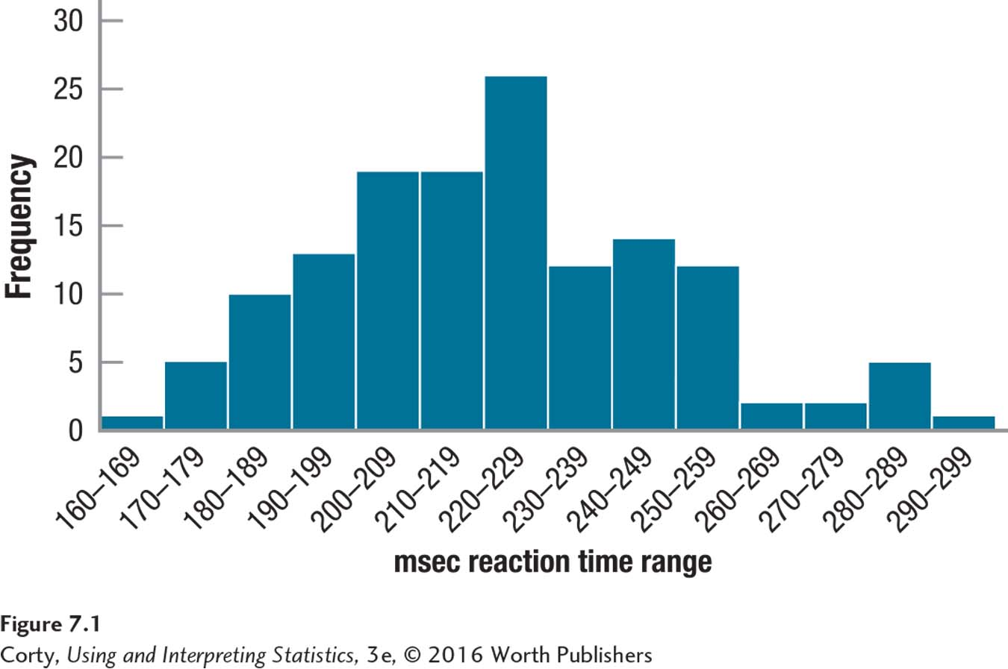
Reaction Time Example – Step 2
Histogram Showing Reaction Time for 141 Adults with Diagnosis of ADHD

Slide 8
Reaction Time Example – Step 3
STEP 3 – List the Hypotheses
Two-tailed, nondirectional, single-sample t test
Dr. Farshad doesn’t know whether adults with ADHD had faster or slower reaction times.
H₀: μ_{ADHD-Adults} = 200
H₁: μ_{ADHD-Adults} ≠ 200
One-tailed, directional, single-sample t test
Dr. Farshad believes adults with ADHD have slower reaction times.
H₀: μ_{ADHD-Adults} ≤ 200
H₁: μ_{ADHD-Adults} > 200

Slide 9
Reaction Time Example – Step 4
STEP 4 – Set the Decision Rule
Critical Value of t
Value of t used to determine whether null hypothesis is rejected or not
Abbreviated t_{cv}
Three pieces of information are needed to find the t_{cv}
Is the test one-tailed or two-tailed?
How willing is one to make a Type I error?
How large is the sample size?

Slide 10
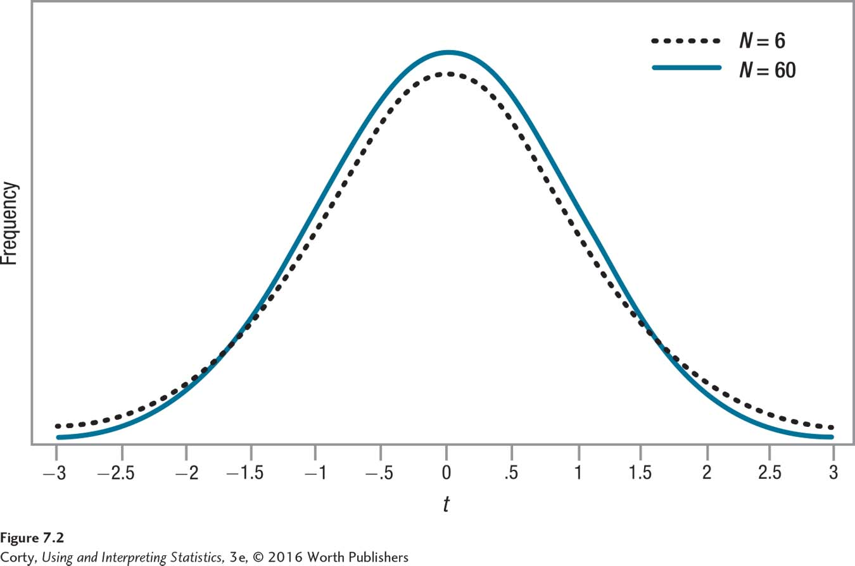
Shape of the Sampling Distribution of t
Figure shows how the shape of the sampling distribution of t changes with the sample size.
When the sample size is small, there is more variability and more samples have means that fall farther out in a tail
Result is that the t_{cv} falls farther away from the midpoint when the sample size is small, making it more difficult to reject null hypothesis.
Sample size affects t_{cv} ; critical value determines the rare and common zones.
Shape of Sampling Distribution of t as a Function of Sample Size

Slide 11
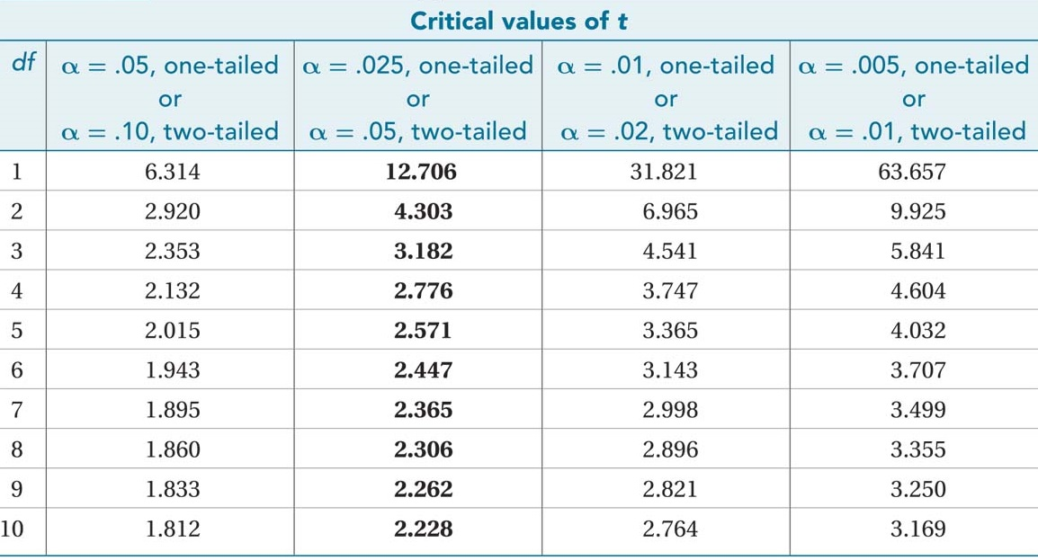
Critical Values of t (Appendix Table 3)

Slide 12

Degrees of Freedom (df)
Degrees of Freedom (df )
Number of values in a sample that are free to vary
$$df=N−1 \\ where df=degrees of freedom \\ N=sample size$$
For the reaction-time study, there are 141 participants in the sample, so degrees of freedom are calculated like this:
df = 141 − 1
= 140

Slide 13
Critical Values of t (Appendix Table 3)

Slide 14
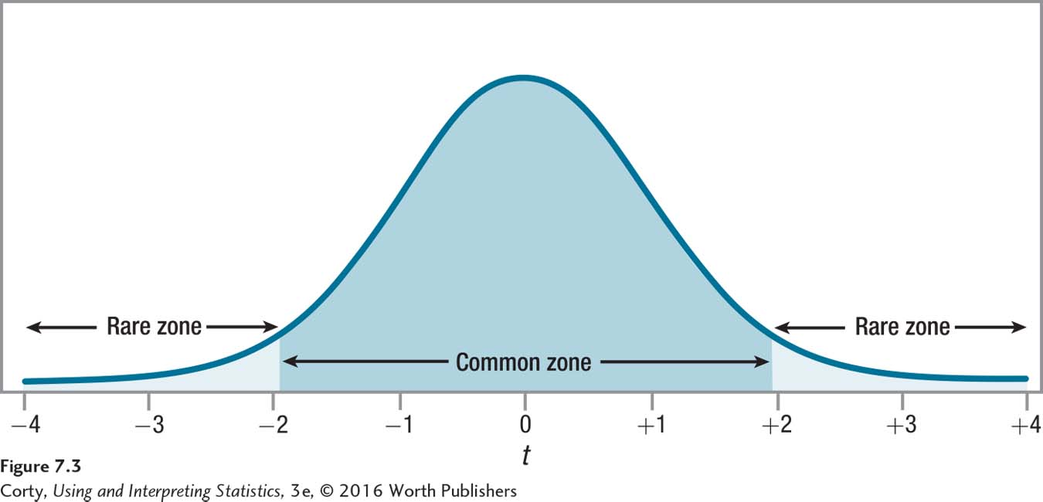
Reaction Time Example – Step 4
STEP 4 – Set Decision Rule
Reaction-Time Example
Two-tailed
Alpha level, α = .05
N = 141, df = 140
With df = 140, α = .05, two-tailed, border between the rare and common zones is ± 1.977
If observed value of t falls in the rare zone, null hypothesis is rejected; one fails to reject it if the observed value falls in the common zone.
Setting the Decision Rule: Two-Tailed, Single-Sample t Test

Slide 15
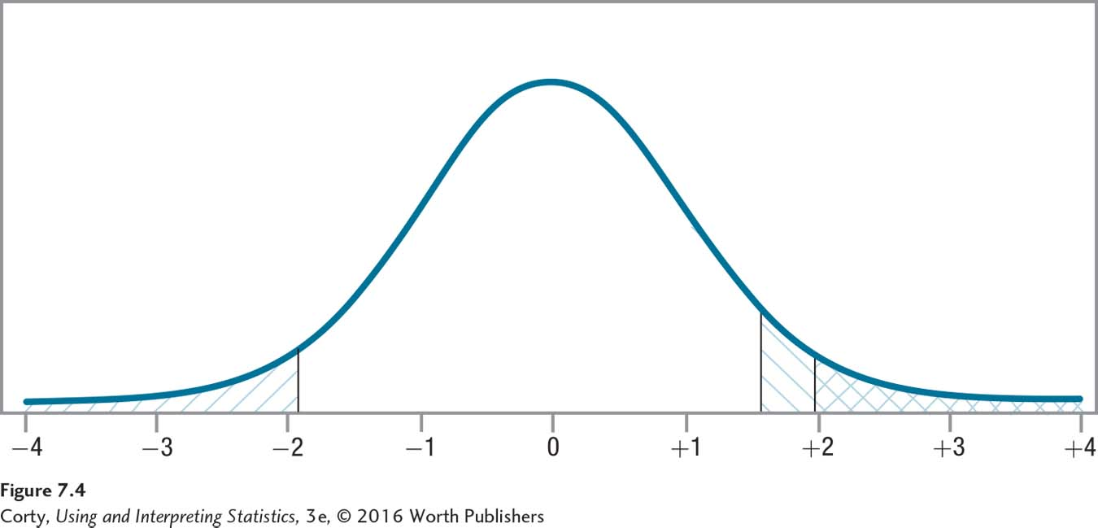
Comparing Rare Zones
Rare zone of the sampling distribution of t with df = 140 and α = .05 for a one-tailed test is the section marked \\\ to the right of t = 1.656.
For a two-tailed test, the rare zone is marked /// to the right of t = 1.977.
Notice how much larger the rare zone is for the one-tailed test, making it easier to reject the null hypothesis for a one-tailed test.
Comparing Rare Zones for One-Tailed and Two-Tailed Tests

Slide 16

Reaction Time Example – Step 5
STEP 5 – Calculate the Test Statistic
$$t=\frac{M−μ}{S_{M}} \\ where t=t value \\ M=sample mean \\ μ=population mean \left(or a specified value\right) \\ S_{M}=estimated standard error of the mean (Equation 5.2)$$

Slide 17
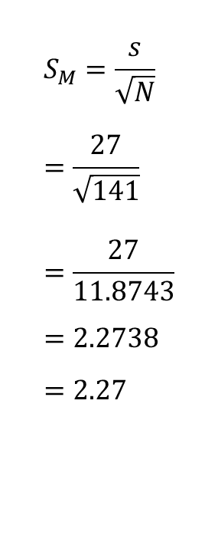
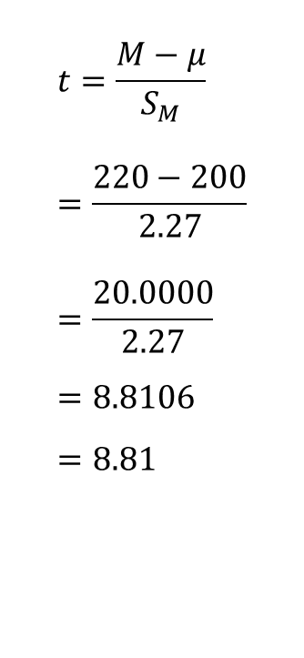
Reaction Time Example – Step 5
STEP 5 – Calculate the Test Statistic
Calculate estimated standard error of the mean (s_{M})
Calculate t value
N = 141, s = 27, M = 220, μ = 200
s_{M} = 2.27, t =8.81
$$t=\frac{M−μ}{S_{M}} \\ =\frac{220−200}{2.27} \\ =\frac{20.0000}{2.27} \\ =8.8106 \\ =8.81$$
$$S_{M}=\frac{s}{\sqrt{N}} \\ =\frac{27}{\sqrt{141}} \\ =\frac{27}{11.8743} \\ =2.2738 \\ =2.27$$

Slide 18
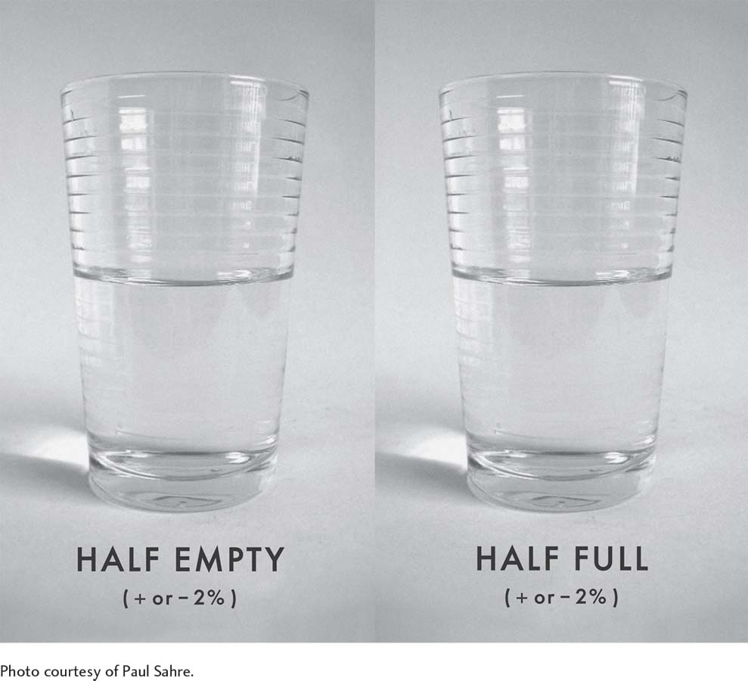
Interpretation
Interpretation is subjective but should be based on facts. Confidence intervals, introduced later in the chapter, provide a little wiggle room.

Slide 19
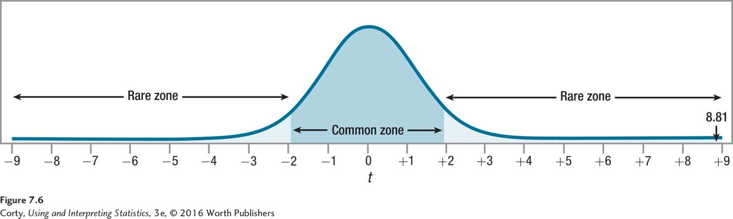
Reaction Time Example – Step 6
STEP 6 – Interpret the Results
Need to answer three questions
Was the null hypothesis rejected?
How big is the effect?
How wide is the confidence interval?
Single-Sample t Test: Results from ADHD Reaction-Time Study

Slide 20

Reaction Time Example – Step 6 – Effect Size
STEP 6 – Interpret the Results
Effect Size (d)
Measure of the degree of impact of the independent variable on the dependent variable
$$d=\frac{M−μ}{s} \\ where d=the effect size \\ M=sample mean \\ μ=hypothesized sample mean \\ s=sample standard deviation$$

Slide 21

Reaction Time Example – Step 6 – Effect Size
STEP 6 – Interpret the Results
Reaction time study
M = 220, μ = 200, s = 27
d = 0.74, medium effect, interpretation continued
The effect of ADHD status on reaction time falls in the medium range, suggesting that the slower reaction time associated with having ADHD may impair performance.
$$d=\frac{M−μ}{s} \\ =\frac{220−200}{27} \\ =\frac{20.0000}{27} \\ =0.7407 \\ =0.74$$

Slide 22
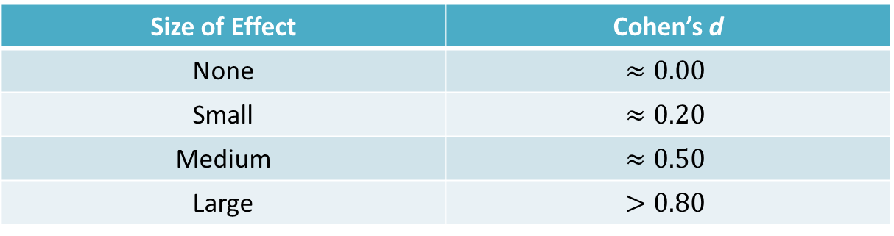
Reaction Time Example – Step 6 – Effect Size
Effect Sizes in the Social and Behavioral Sciences
Size of Effect | Cohen’s d
None | $$≈0.00$$
Small | $$≈0.20$$
Medium | $$≈0.50$$
Large | $$>0.80$$

Slide 23
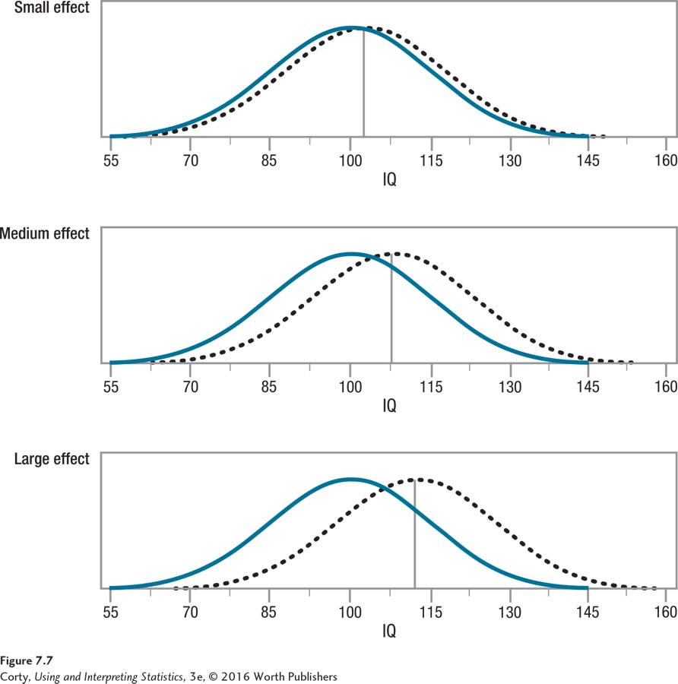
Examples of Small, Medium, and Large Effect Sizes

Slide 24
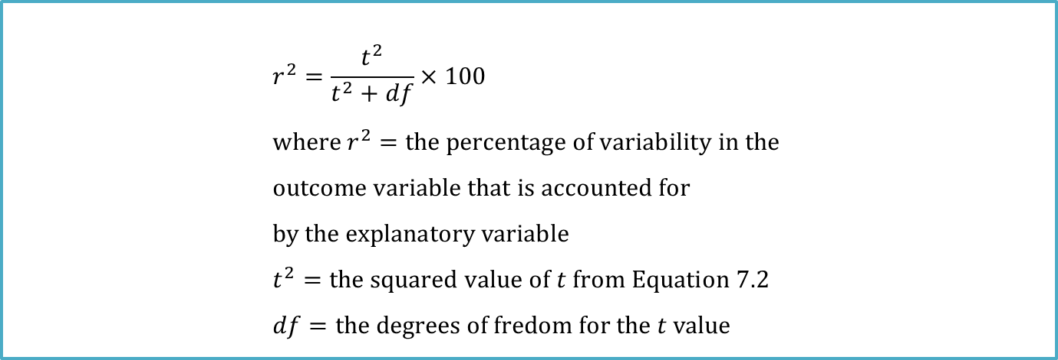
r Squared
Also called coefficient of determination (r squared. r²)
Tells how much impact the explanatory variable has on the outcome variable
$$r^{2}=\frac{t^{2}}{t^{2}+df}×100 \\ where r^{2}=the percentage of variability in the \\ outcome variable that is accounted for \\ by the explanatory variable \\ t^{2}=the squared value of t from Equation 7.2 \\ df=the degrees of fredom for the t value$$

Slide 25
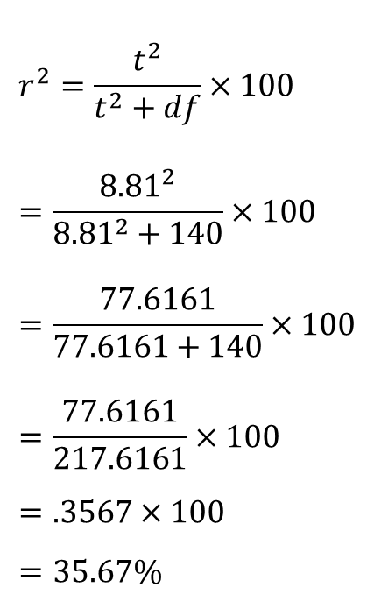
r Squared
$$r^{2}=\frac{t^{2}}{t^{2}+df}×100 \\ =\frac{{8.81}^{2}}{{8.81}^{2}+140}×100 \\ =\frac{77.6161}{77.6161+140}×100 \\ =\frac{77.6161}{217.6161}×100 \\ =.3567×100 \\ =35.67\%$$
For the ADHD data, these calculations would lead to the conclusion that r² = 36%:

Slide 26
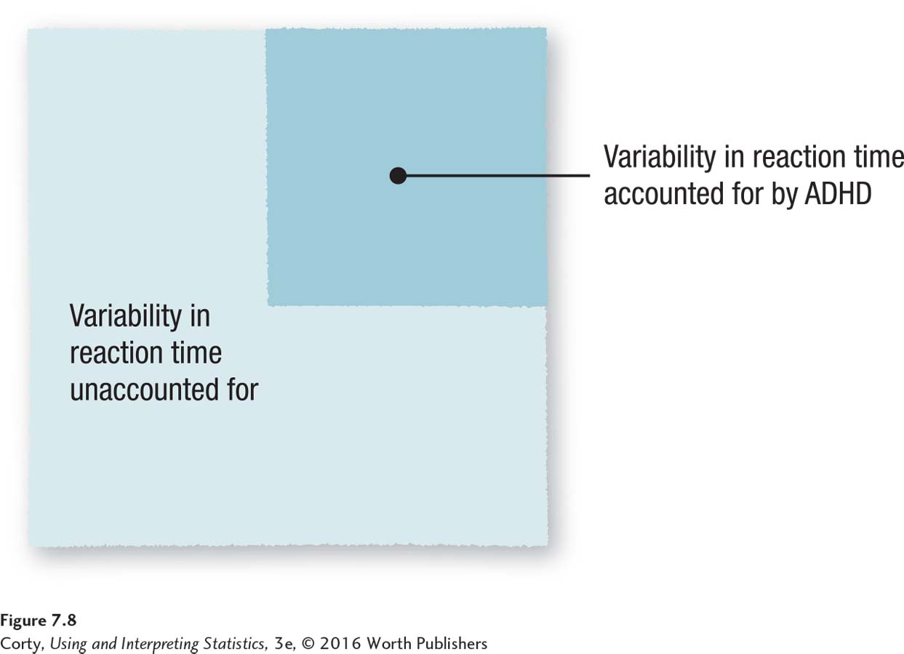
Percentage of Variability in Reaction Time Accounted for by ADHD Status

Slide 27
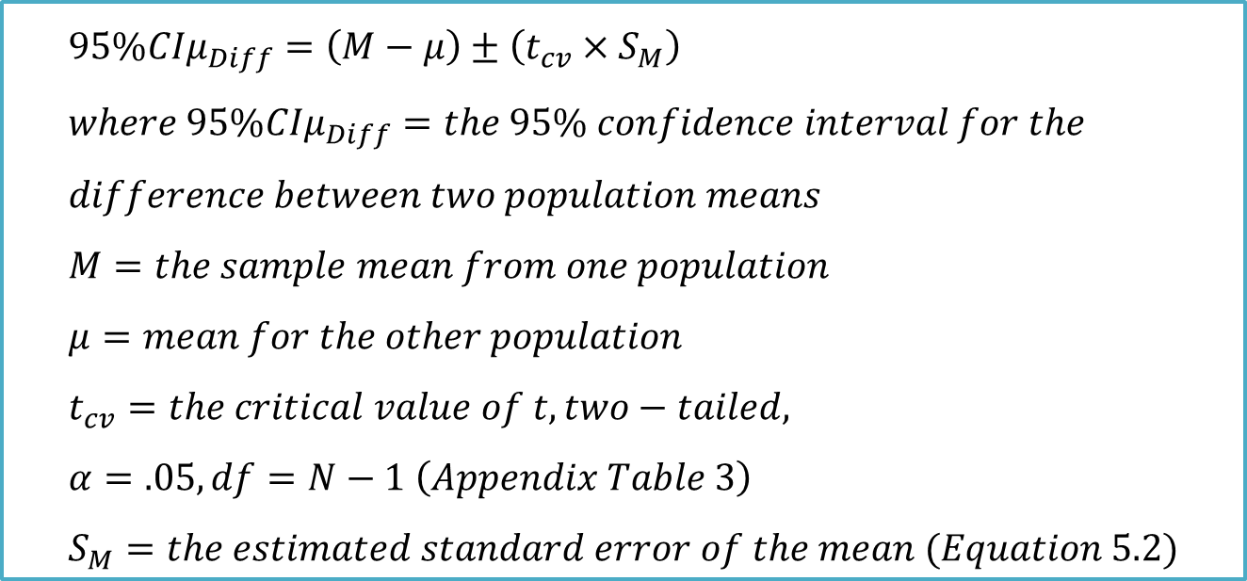
Reaction Time Example – Step 6 – Confidence Interval
$$95\%{CIμ}_{Diff}=\left(M−μ\right)±\left(t_{cv}×S_{M}\right) \\ where 95\%{CIμ}_{Diff}=the 95\% confidence interval for the \\ difference between two population means \\ M=the sample mean from one population \\ μ=mean for the other population \\ t_{cv}=the critical value of t, two−tailed, \\ α=.05, df=N−1 \left(Appendix Table 3\right) \\ S_{M}=the estimated standard error of the mean (Equation 5.2)$$

Slide 28

Reaction Time Example – Step 6 – Confidence Interval
STEP 6 – Interpret the Results
μ = 200, M = 220, s_{M} = 2.27, t_{cv} = 1.977
$95\%{CIμ}_{Diff}$ = (15.51, 24.49)

Slide 29
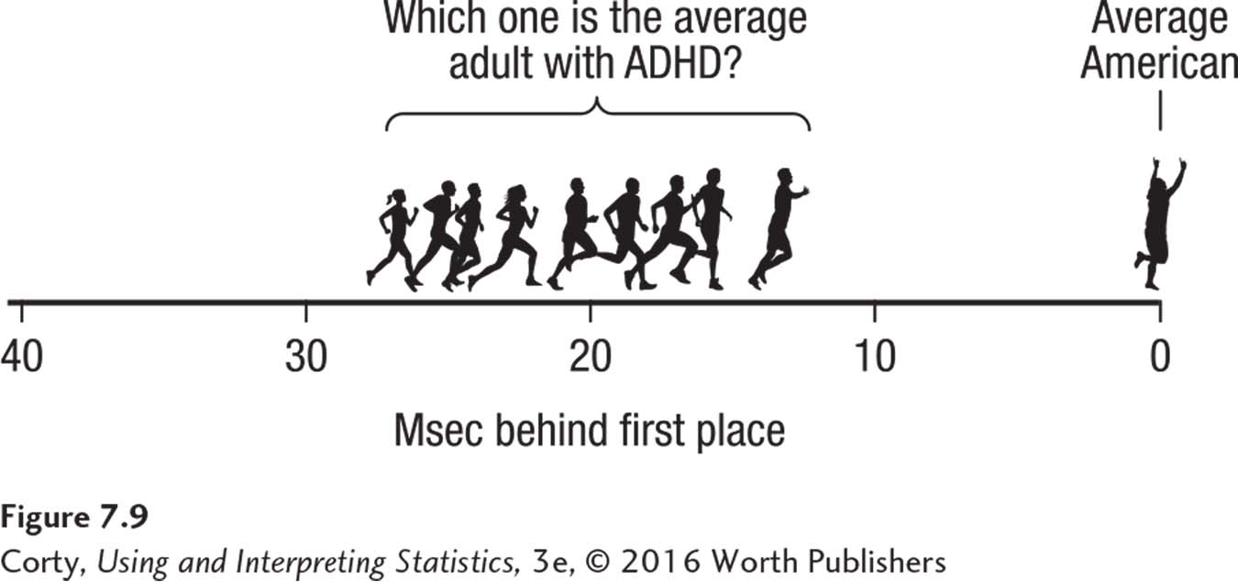
Reaction Time Example – Step 6 – Confidence Interval
Imagine a race: a person representing the average American crosses the finish line first, followed by a person representing the average adult with ADHD.
How much slower is the average adult with ADHD?
Confidence interval says the average adult with ADHD probably trails the average American by anywhere from 15.51 msec to 24.49 msec.
Confidence Interval for the Difference Between Population Means for the Reaction-Time Study

Slide 30

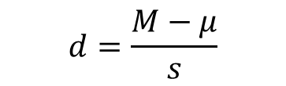
Reaction Time Example – Step 6 – Confidence Interval
$$d=\frac{M−μ}{s}$$
STEP 6 – Interpret the Results
Width of the Confidence Interval for Reaction Time Study
CI_{W} = 24.49 – 15.51 = 8.98
Confidence Interval is almost 9 msec wide
Calculate Cohen’s d for the two ends of the confidence interval
Effect could be from d = 0.57, medium effect, to d = 0.91 large effect
$${CI}_{W}={CI}_{UL}−{CI}_{LL} \\ where {CI}_{W}=the width of the confidence interval \\ {CI}_{UL}=the upper limit of the confidence interval \\ {CI}_{LL}=the lower limit of the confidence interval$$

Slide 31
Putting It All Together – Reaction Time Example
Four points addressed in Dr. Farshad’s interpretation
Brief explanation of the study
Present some facts, means of the sample and the population. Be selective and only report what is most relevant
Explain the meaning of the results
Offer some suggestions for future research, “replicate”
Replicate
To repeat a study, usually introducing some change in procedure to make it better

Slide 32
How Much Do You Remember?
Three questions for interpreting a single-sample t test
Was the null hypothesis rejected?
How big is the effect?
How wide is the confidence interval?

Slide 33
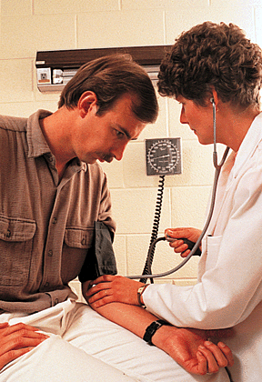

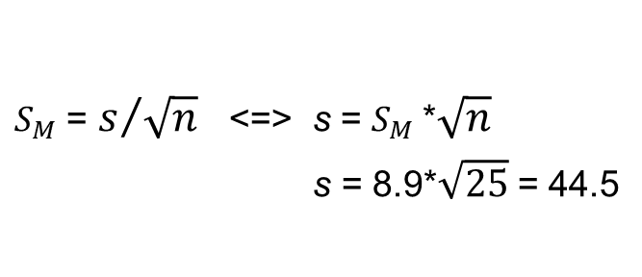
Example 1
A study examined the effect of a new medication on the seated systolic blood pressure. The results, presented as mean ± SEM( ) for 25 patients, are 113.5 ± 8.9.
What is the standard deviation s of the sample data?
$$S_{M}$$
$S_{M}$ = $s/{\sqrt{n}}$ <=> s = $S_{M}$*$\sqrt{n}$
s = 8.9*$\sqrt{25}$ = 44.5

Slide 34


Example 2
The national Center for Health Statistics (NCHS) published a report in 2018 entitled “Health, United States,” and it contains extensive information on major treads in the health of Americans. The NSCH reported that the mean total cholesterol level in 2016 for all adults were 191.
Suppose a new drug is proposed to lower total cholesterol, and a study is designed to evaluate the efficacy of the drug in lowering cholesterol. Fifteen patients are enrolled in the study and asked to take the new drug for 6 weeks. At the end of 6 weeks, each patient’s total cholesterol level is measured and the sample statistics are as follows: n = 15, = 184.1, and s = 28.3.
Raw data is provided as:
{196.3, 217.1, 196.3, 196.7, 132.6, 215.3, 152.1, 198.3, 169.9, 163.0, 218.1, 172.0, 134.9, 199.3, 199.5}
Question: Is there statistical evidence of a reduction in mean total cholesterol in patients after using the new drug for 6 weeks?

Slide 35
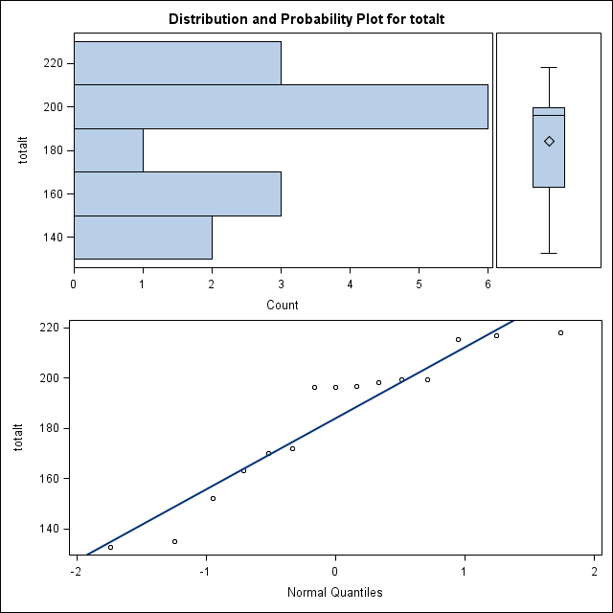
Example 2
If the following conditions are met (which we will discuss more in robust t procedure), we can use a one-sample t test.
Random: We are told that the data come from a random sample of 15 patients from those who took the new drug for 6 weeks.
Normal: Since the sample size is small (n < 30), we must check whether it is reasonable to believe that the population distribution is Normal. Examine the distribution of the sample data.
Independent: Given in the question.

Slide 36
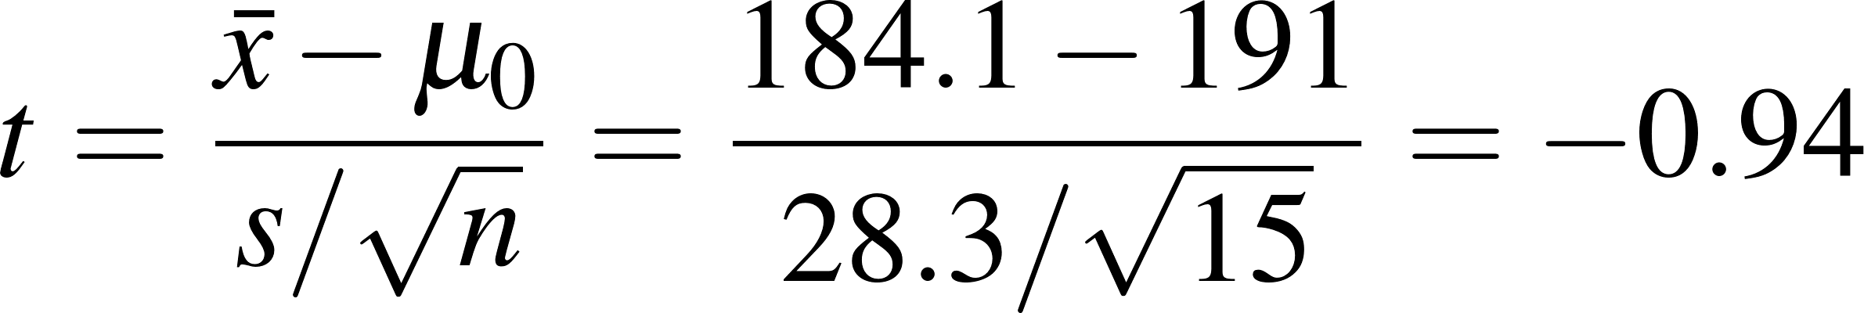
Example 2
Step 1: State the null and alternative hypotheses.
The parameter of interest is the mean total cholesterol level µ in patients after using the new drug for 6 weeks..
Because the research question asked whether the sample mean of 184.1 is statistically significantly lower than population mean of 191, the alternative hypothesis is one-sided;
that is:
H₀: µ ≥ 191
H_{a}: µ < 191
Step 2: Calculate the value of the test statistic t.

Slide 37
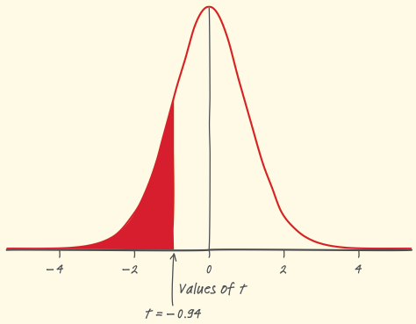
Example 2
Step 3: Set Decision Rule.
For alternative hypothesis H_{a}: μ < 191, a) one-tailed test, b) Alpha level, α = .05, c) N = 15, df = 14.
With df = 14, α = .05, one-tailed, border between the rare and common zones is - 1.761.
If observed value of t falls in the rare zone, null hypothesis is rejected; one fails to reject it if the observed value falls in the common zone.
Step 4: State a conclusion.
Since the test statistic t = -0.94, it falls in the common zone, thus, we fail to reject H₀. We don’t have enough evidence to conclude that the mean total cholesterol level in patients taking the new drug for 6 weeks is lower than the national mean.

Slide 38
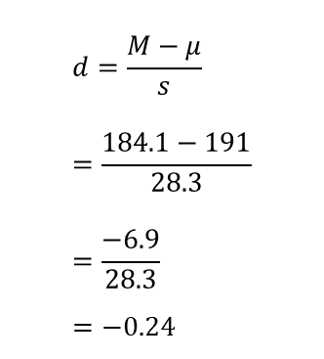
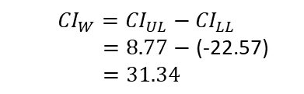
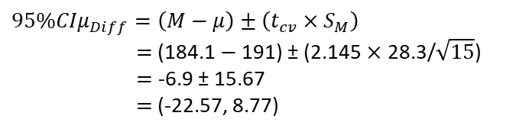
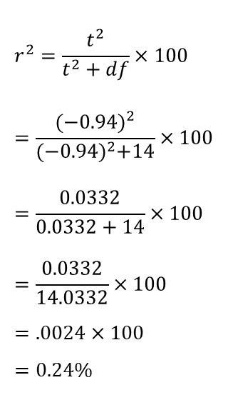
Example 2
Step 5: Calculate d, r², 95% CIµ_{Diff}, CI_{W}.
$$r^{2}=\frac{t^{2}}{t^{2}+df}×100 \\ =\frac{{(−0.94)}^{2}}{{(−0.94)}^{2}+14}×100 \\ =\frac{0.0332}{0.0332+14}×100 \\ =\frac{0.0332}{14.0332}×100 \\ =.0024×100 \\ =0.24\%$$
$$d=\frac{M−μ}{s} \\ =\frac{184.1−191}{28.3} \\ =\frac{−6.9}{28.3} \\ =−0.24$$
$95\%{CIμ}_{Diff}=\left(M−μ\right)±\left(t_{cv}×S_{M}\right)$
$=$ (184.1 $−$191) ± (2.145 $×$ 28.3/$\sqrt{15}$)
$=$ -6.9 ± 15.67
$=$ (-22.57, 8.77)
${CI}_{W}={CI}_{UL}−{CI}_{LL}$
$=8.77−$ (-22.57)
$=31.34$

