Slide 1

Jingwei Wu, PhD
Chapter 8
Independent-Sample t Test
A courtesy of “USING AND INTERPRETING STATISTICS” by ERIC W. CORTY | THIRD EDITION (Macmillan Education)

Slide 2

Objectives
Types of Two-Sample t Tests
Calculating the Independent-Samples t Test
Interpreting the Independent-Samples t Test

Slide 3
Two-Sample t Test
Two-sample t test
Inferential statistical test used to compare the mean of one population to the mean of another population
Among the most commonly used statistical tests
Classic experiments involve two groups
An experimental and a control group to see if the independent variable had an effect on the dependent variable

Slide 4
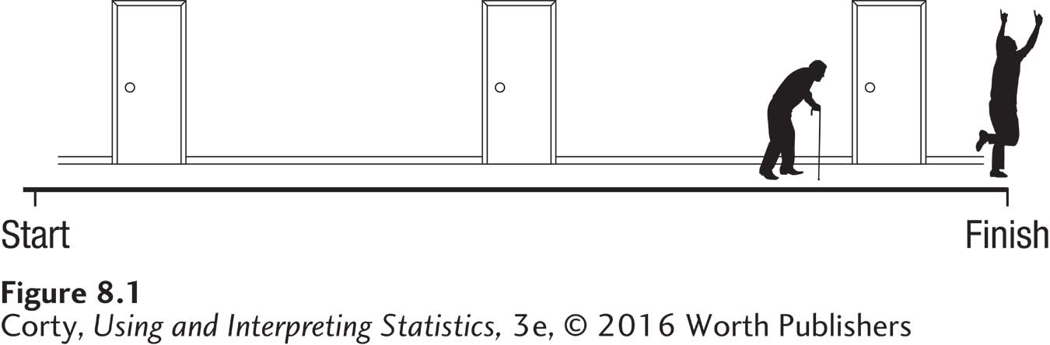
Two-Sample t Test – Elderly Stereotypes Example
How do elderly stereotypes affect behavior?
Control group received neutral words.
Experimental group received words to prime elderly stereotype.
Both groups put the words into sentences, and when finished they were secretly timed walking down the hall.
Results showed that control group walked, on average, 1 second faster down the hall.
Being primed with words that activated a stereotype of elderly people led participants to walk more slowly.

Slide 5
Types of Two-Sample t Tests
Independent samples (Chapter 8)
Selection of cases for one sample has no impact on the selection of cases for another sample
Example: Which sex is smarter?
Dr. Smith obtains a random sample of men and a random sample of women. Each person takes an IQ test and Dr. Smith compares the mean of the men to the mean of the women.
Paired samples (Chapter 9)
Case selection for one sample is influenced by, depends on, the cases selected for another sample
Example: Which sex is smarter?
Dr. Jones gets a random sample of men and has each of them bring a female friend. Each man and each woman takes an IQ test, and Dr. Jones compares the mean of the men to the mean of the women.

Slide 6
Guidelines for Determining if Samples Are Independent or Paired
Independent Samples
Paired Samples
If each sample is a random sample from its respective population
or
If n₁ ≠ n₂, that is, each sample has a different number of cases.*
If samples consist of the same cases measured at more than one point in time or in more than one condition
or
If the selection of cases for one sample determines the selection of cases for another
sample
or
If the cases in the samples are matched, yoked, or paired together in some way.

Slide 7
Calculating the Independent-Samples t Test
Independent-samples t test
Inferential statistical test used to compare two independent samples on an interval- or ratio-level dependent variable
Lowercase n is abbreviation to indicate sample size for a specific group
Subscripts distinguish the 2 groups
Uppercase N will still be used to indicate total sample size

Slide 8
Calculating the Independent-Samples t Test
Example: Dr. Villanova’s depth of processing study
Does deeper processing lead to better memory?
38 psychology students randomly assigned to 2 groups
n₁ = 18 (control group), n₂ = 20 (experimental group)
Participants shown 20 words (e.g., giraffe, DOG, mirror), one at a time, and asked a question about each word
Shallow processing group (control group)
Asked whether word appeared in capital letters or not
Deep processing group (experimental group)
Asked whether the word would make sense in this sentence “The passenger carried a _______ onto the bus.”
Participants wrote down as many words as they could recall

Slide 9
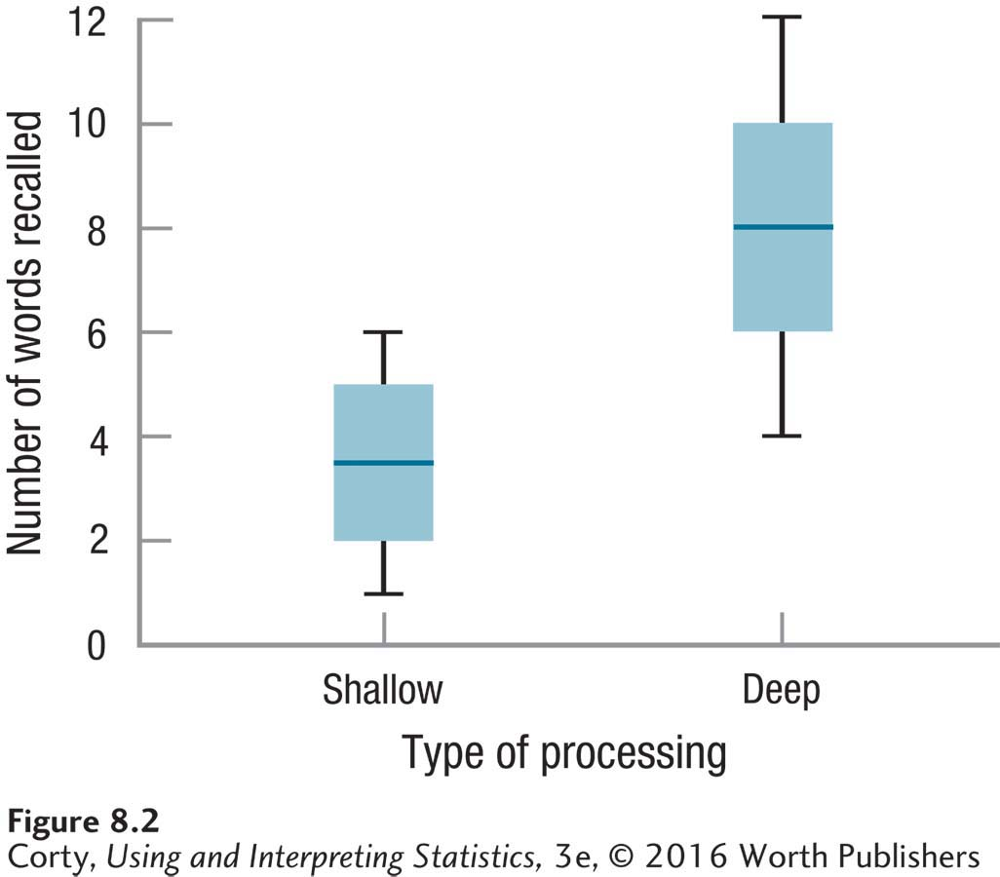
Calculating the Independent-Samples t Test
Example: Depth of processing study
Number of words recalled (dependent variable) on Y-axis
2 groups, shallow and deep (independent variable), on X-axis
Line in the middle of the box is the median
Box that surrounds the line for the median represents the interquartile range, range within which middle 50% of scores fall
Whiskers that extend from the box represent the range of scores
Box-and-Whisker Plots Showing the Results of the Depth of Processing Study
Shallow (M = 3.50, s = 1.54)
Deep (M = 8.30, s = 2.74)

Slide 10
Hypothesis Testing in Action
Example: Dr. Villanova’s depth of processing study
6 Steps of Hypothesis Testing
STEP 1 - Pick a Test
STEP 2 - Check the Assumptions
STEP 3 - List the Hypotheses
STEP 4 - Set the Decision Rule
STEP 5 - Calculate the Test Statistic
STEP 6 - Interpret the Results

Slide 11
Depth of Processing Example – Step 1
STEP 1: Pick a Test
Dr. Villanova is comparing the mean of one population to the mean of another population
He will use an independent-samples t test
2 sample sizes are different, which means they are independent
n_{Shallow} = 18
n_{Deep} = 20

Slide 12
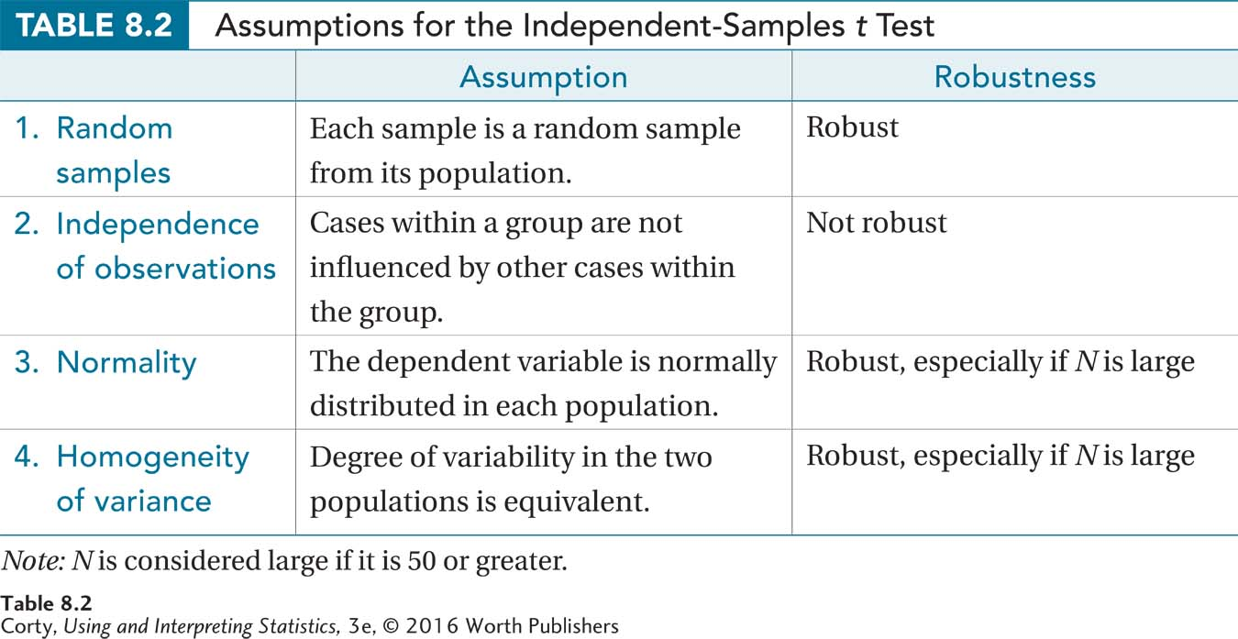
Depth of Processing Example – Step 2
STEP 2: Check the Assumptions
Four assumptions
Random samples
Independence of observations
Normality
Homogeneity of variance Can you identify the assumption and robustness of each of the above terms?

Slide 13
Depth of Processing Example – Step 3
STEP 3: List the Hypotheses
Two-tailed, nondirectional, independent-samples t test
Nondirectional hypotheses are more common than directional
H₀: μ_{Shallow} = μ_{Deep}
H₁: μ_{Shallow} ≠ μ_{Deep}
One-tailed, directional, independent-samples t test
Dr. Villanova believes that deep processing works better than shallow processing based upon original study by Craik and Tulving (1975)
H₀: μ_{Deep} ≤ μ_{Shallow}
H₁: μ_{Deep} > μ_{Shallow}

Slide 14
Depth of Processing Example – Step 4
STEP 4: Set the Decision Rule
Critical value of t , t_{cv}
Value of t used to determine whether null hypothesis is rejected or not
3 pieces of information are needed to find the t_{cv}
Is the test one-tailed or two-tailed?
Willingness to make a Type I error, determined by alpha level
How many degrees of freedom the test has, based on sample size

Slide 15

Depth of Processing Example – Step 4
Degrees of Freedom (df )
Number of values in a sample that are free to vary
Depth of Processing
df = 38 – 2 = 36
$$df=N−2 \\ where df=degrees of freedom \\ N=total number of cases in the two groups$$

Slide 16
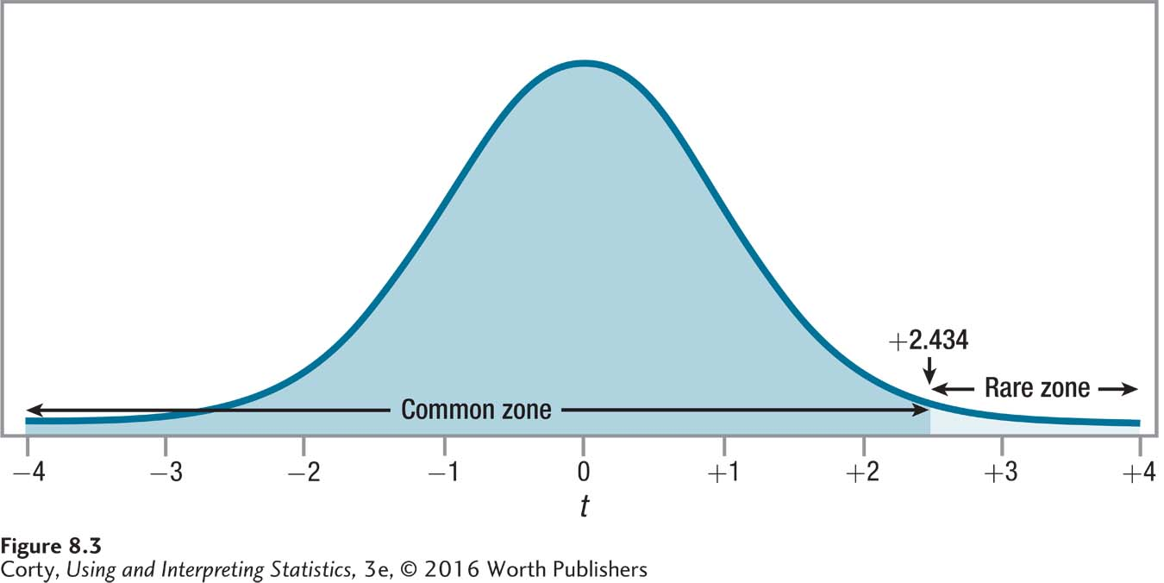
Depth of Processing Example – Step 4
STEP 4: Set the Decision Rule
One-tailed, alpha level: α = .01, df = 36, t_{cv} = 2.434
If t ≥ 2.434, reject the null hypothesis
If t < 2.434, fail to reject null hypothesis

Slide 17
Decision Rules for Independent-Samples t Tests
Two-Tailed Test | One-Tailed Test
If t ≤ −t_{cv} or if t ≥ t_{cv} , reject H₀. If −t_{cv} < t < t_{cv} , fail to reject H₀. | If t ≥ t_{cv} , reject H₀. If t < t_{cv} , fail to reject H₀. or If t ≤ − t_{cv} , reject H₀. If t > − t_{cv} , fail to reject H₀.
Note: t is the value of the test statistic, which is calculated in Step 5. t_{cv} is the critical value, which is found in Appendix Table 3.
For a one-tailed test, the researcher needs to decide in advance whether
the t value should be negative or positive in order to reject the null hypothesis.

Slide 18

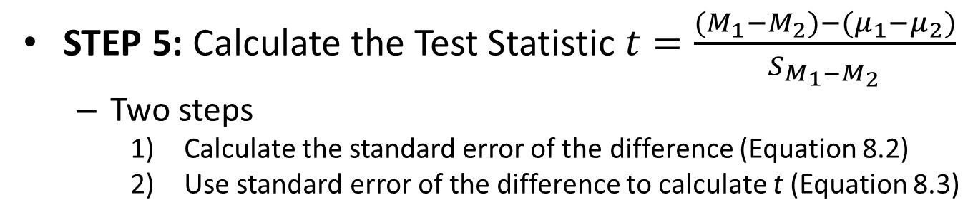
Depth of Processing Example – Step 5
STEP 5: Calculate the Test Statistic $t=\frac{{(M}_{1}−M_{2})−(μ_{1}−μ_{2})}{S_{M_{1}−M_{2}}}$
Two steps
Calculate the standard error of the difference (Equation 8.2)
Use standard error of the difference to calculate t (Equation 8.3)
$$s_{pooled}^{2}=\frac{s_{1}^{2}\left(n_{1}−1\right)+s_{2}^{2}(n_{2}−1)}{df} \\ where s_{pooled}^{2}=the pooled variance \\ n_{1}=the sample size for Group \left(sample\right)1 \\ s_{1}^{2}=the variance for Group 1 \\ n_{2}=the sample size for Group \left(sample\right)2 \\ s_{2}^{2}=the variance for Group 2 \\ df=the degrees of freedom (N−2)$$

Slide 19

Depth of Processing Example – Step 5
STEP 5: Calculate the Test Statistic
The equation calls for the degrees of freedom, which was calculated in the previous step as N – 2 = 38 – 2 = 36
$$s_{pooled}^{2}=\frac{s_{1}^{2}\left(n_{1}−1\right)+s_{2}^{2}(n_{2}−1)}{df} \\ =\frac{{1.54}^{2}\left(18−1\right)+{2.74}^{2}(20−1)}{36} \\ =2.3716\left(17\right)+7.5076\left(19\right) \\ =\frac{40.3172+142.6444}{36} \\ =\frac{182.9616}{36} \\ =5.0823 \\ =5.08$$

Slide 20
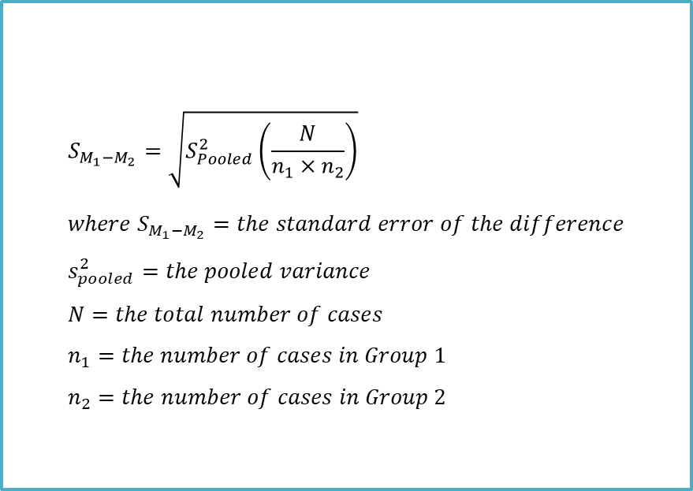
Depth of Processing Example – Step 5
STEP 5: Calculate the Test Statistic
Step 2
Use standard error of the difference to calculate t (Equation 8.3)
$$S_{M_{1}−M_{2}}=\sqrt{S_{Pooled}^{2}\left(\frac{N}{n_{1}×n_{2}}\right)} \\ where S_{M_{1}−M_{2}}=the standard error of the difference \\ s_{pooled}^{2}=the pooled variance \\ N=the total number of cases \\ n_{1}=the number of cases in Group 1 \\ n_{2}=the number of cases in Group 2$$

Slide 21
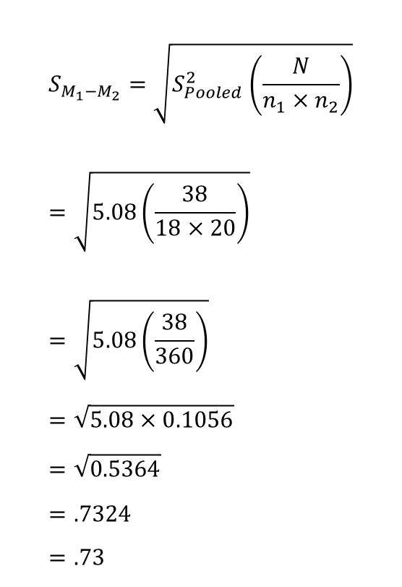
Depth of Processing Example – Step 5
$$S_{M_{1}−M_{2}}=\sqrt{S_{Pooled}^{2}\left(\frac{N}{n_{1}×n_{2}}\right)} \\ =\sqrt{5.08\left(\frac{38}{18×20}\right)} \\ =\sqrt{5.08\left(\frac{38}{360}\right)} \\ =\sqrt{5.08×0.1056} \\ =\sqrt{0.5364} \\ =.7324 \\ =.73$$
STEP 5: Calculate the Test Statistic
Calculating the shallow vs. deep processing study
The standard error of the mean is 0.73. The formula in Equation 8.4 is used to find t. Let’s look at the next slide.

Slide 22
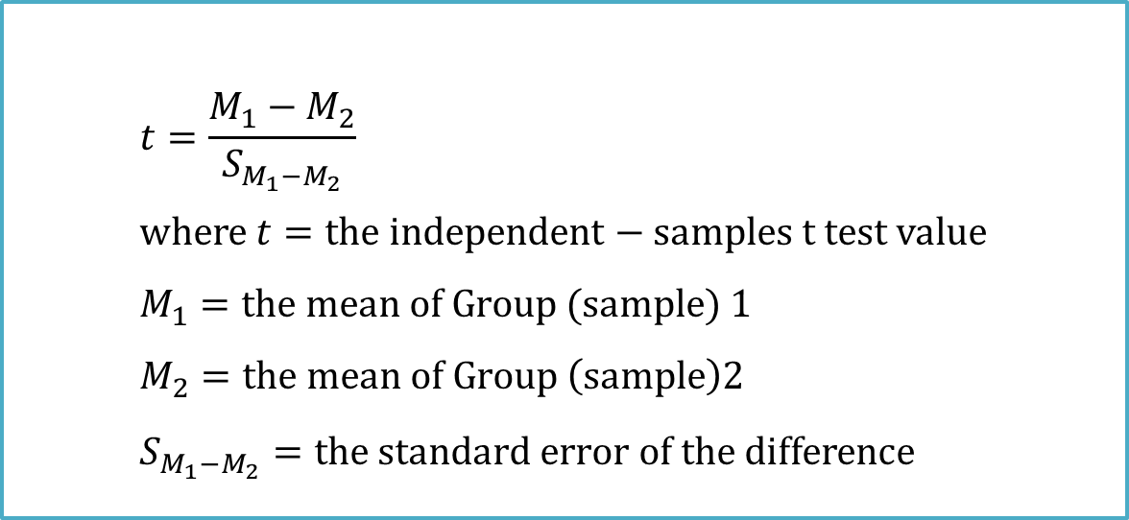
Depth of Processing Example – Step 5
$$t=\frac{M_{1}−M_{2}}{S_{M_{1}−M_{2}}} \\ where t=the independent−samples t test value \\ M_{1}=the mean of Group (sample) 1 \\ M_{2}=the mean of Group \left(sample\right)2 \\ S_{M_{1}−M_{2}}=the standard error of the difference$$
Equation 8.4 says that an independent-samples t value is calculated by dividing
the numerator, the difference between the two sample means, by the denominator, the standard error of the difference.

Slide 23

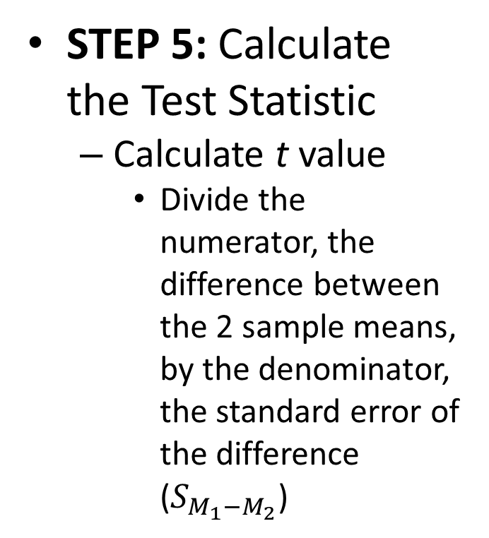
Depth of Processing Example – Step 5
STEP 5: Calculate the Test Statistic
Calculate t value
Divide the numerator, the difference between the 2 sample means, by the denominator, the standard error of the difference ($S_{M_{1}−M_{2}}$)
$$t=\frac{M_{1}−M_{2}}{S_{M_{1}−M_{2}}} \\ =\frac{8.30−3.50}{0.73} \\ =\frac{4.8000}{0.73} \\ =6.5753 \\ =6.58 \\ t=6.58$$

Slide 24
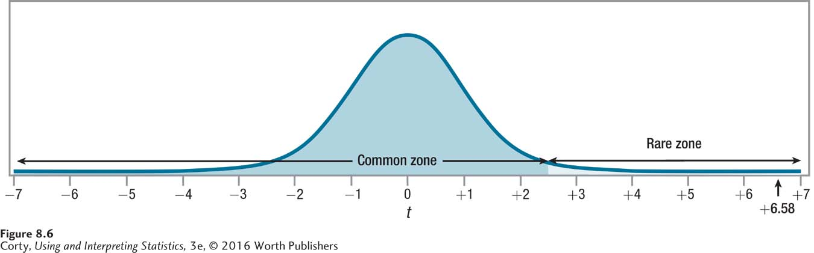
Depth of Processing Example – Step 6
STEP 6: Interpret the Results
Need to answer 3 questions
Was the null hypothesis rejected?
How big is the effect?
How wide is the confidence interval?
Test Statistic for an Independent-Samples t Test for the Depth of Processing Data

Slide 25
Depth of Processing Example – Step 6
STEP 6: Interpret the Results
Does deeper processing lead to better memory?
Shallow processing: M = 3.50, s = 1.54, n₁ = 18
Deep processing: M = 8.30, s = 2.74, n₂ = 20
Calculated t = 6.58, greater than the critical value t of 2.434
Reject the null hypothesis
Test Statistic for an Independent-Samples t Test for the Depth of Processing Data

Slide 26
Depth of Processing Example – Step 6
STEP 6: Interpret the Results
APA format, t(36) = 6.58, p < .01 (one-tailed)
The initial t says that the statistical test was a t test
36, degrees of freedom For an independent samples t test, df = N − 2
Observed t value, 6.58, is reported This number is the value of t calculated APA format requires value to be reported to two decimal places
.01 tells alpha was set at .01
p < .01, reveals that the null hypothesis was rejected Observed result (6.58) is a rare result - probability of less than .01 of occurring when the null hypothesis is true
(one-tailed), tells the reader that a one-tailed test was conducted

Slide 27
Depth of Processing Example – Step 6 – APA Style
STEP 6: Interpret the Results
At this point the first interpretation question can be answered:
Was the null hypothesis rejected?
In a study comparing deep processing to shallow processing, a statistically significant effect was found: [t (36) = 6.58, p < .01 (one-tailed)]. People who were randomly assigned to use deep processing recalled more words (M = 8.30, s = 2.74) than did people who used shallow processing (M = 3.50, s = 1.54).

Slide 28

Depth of Processing Example – Step 6 – Effect Size
STEP 6: Interpret the Results
Effect Size, Cohen’s d
$$d=\frac{M_{1}−M_{2}}{\sqrt{s_{Pooled}^{2}}} \\ where d=Cohen^{′}s d value \\ M_{1}=the mean for Group \left(sample\right)1 \\ M_{2}=the mean for Group \left(sample\right)2 \\ s_{Pooled}^{2}=the pooled variance (from Equation 8.2)$$
Equation 8.5 shows how to calculate Cohen’s d for the independent-samples t test. Note that it makes use of the pooled variance, s²_{Pooled}, which was 5.08.

Slide 29

Depth of Processing Example – Step 6 – Effect Size
STEP 6: Interpret the Results
Calculate Cohen’s d
Deep processing: M₁ = 8.30
Shallow processing: M₂ = 3.50
S²_{Pooled} = 5.0823
d = 2.13, large effect, interpretation continued
Effect size is large, and how people process information does matter in how well they recall information
$$d=\frac{M_{1}−M_{2}}{\sqrt{s_{Pooled}^{2}}} \\ =\frac{8.30−3.50}{\sqrt{5.0823}} \\ =\frac{4.800}{2.2544} \\ =2.1292 \\ =2.13$$

Slide 30
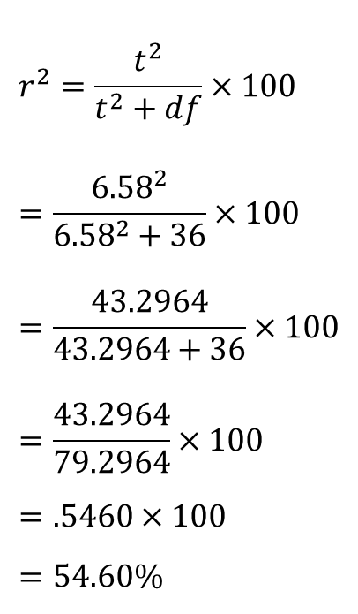
Depth of Processing Example – Step 6 – Effect Size
STEP 6: Interpret the Results
Calculate r²
Same formula for the single-samples t test
t = 6.58, df = 36
r² = 54.60%, large effect, interpretation continued
Effect size is large, with over 50% of the variability explained by group status.
$$r^{2}=\frac{t^{2}}{t^{2}+df}×100 \\ =\frac{{6.58}^{2}}{{6.58}^{2}+36}×100 \\ =\frac{43.2964}{43.2964+36}×100 \\ =\frac{43.2964}{79.2964}×100 \\ =.5460×100 \\ =54.60\%$$

Slide 31
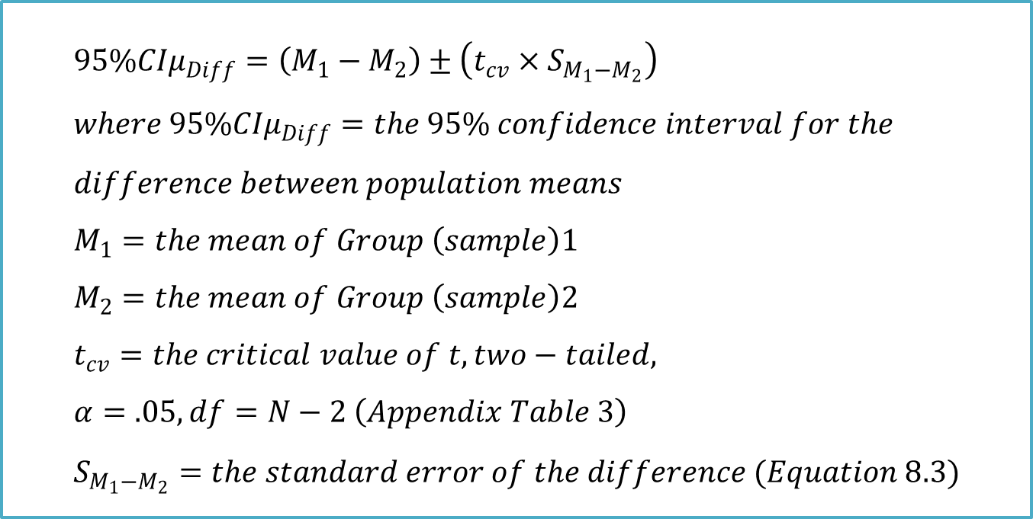
Depth of Processing Example – Step 6 – Confidence Interval
$$95\%{CIμ}_{Diff}=\left(M_{1}−M_{2}\right)±\left(t_{cv}×S_{M_{1}−M_{2}}\right) \\ where 95\%{CIμ}_{Diff}=the 95\% confidence interval for the \\ difference between population means \\ M_{1}=the mean of Group \left(sample\right)1 \\ M_{2}=the mean of Group \left(sample\right)2 \\ t_{cv}=the critical value of t, two−tailed, \\ α=.05, df=N−2 \left(Appendix Table 3\right) \\ S_{M_{1}−M_{2}}=the standard error of the difference (Equation 8.3)$$

Slide 32
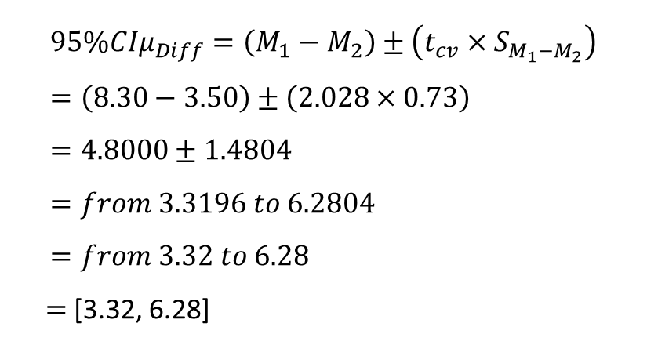
Depth of Processing Example – Step 6 – Confidence Interval
STEP 6: Interpret the Results
Deep processing: M₁ = 8.30
Shallow processing: M₂ = 3.50
S_{M1 – M2}= 0.73
t_{cv} = 2.028 (two-tailed, with α = .05, df = 36)
Dr. Villanova’s confidence interval ranges from 3.32 to 6.28
Deep processing leads to an average of about 3.32 to 6.28 more words being recalled than shallow processing does.
$$95\%{CIμ}_{Diff}=\left(M_{1}−M_{2}\right)±\left(t_{cv}×S_{M_{1}−M_{2}}\right) \\ =\left(8.30−3.50\right)±\left(2.028×0.73\right) \\ =4.8000±1.4804 \\ =from 3.3196 to 6.2804 \\ =from 3.32 to 6.28$$
$=$[3.32, 6.28]

Slide 33

Depth of Processing Example – Step 6 – Confidence Interval
STEP 6: Interpret the Results
Width of the Confidence Interval
CI_{W} = 6.28 – 3.32 = 2.96
Confidence interval is almost 3 words wide
Calculate Cohen’s d
Low end of CI = 3.32, S²_{Pooled} = 5.0823
$$d=\frac{Low end of the confidence interval}{\sqrt{s_{Pooled}^{2}}} \\ =\frac{3.32}{\sqrt{5.0823}} \\ =\frac{3.32}{2.2544} \\ =1.4727 \\ =1.47$$

Slide 34
Putting It All Together – Depth of Processing Example
Four points addressed in Dr. Villanova’s interpretation
Brief explanation of the study
States the main results Be selective and only report what is most relevant
Explains the meaning of the results
Suggestions for future research

Slide 35
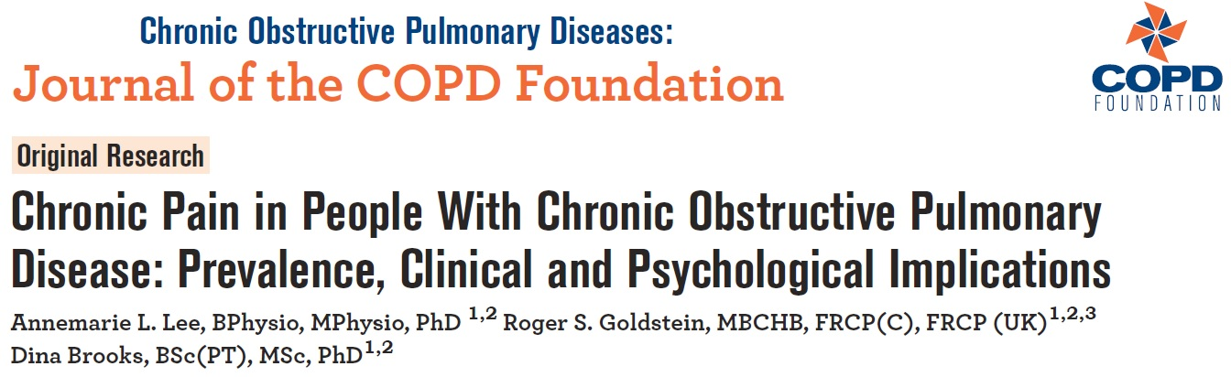
Example 1
Although pain is a common symptom in chronic obstructive pulmonary disease (COPD), pain characteristics such as frequency, duration and severity are unclear.
The primary study aim was to identify these pain characteristics in individuals with COPD versus healthy control participants. Participants with COPD and age and gender-matched, healthy controls completed questionnaires to elicit pain characteristics. Severity of pain is measured by Extended Aberdeen Back Pain Scale (EABPS): a reliable and valid measure of neck, upper
and lower back pain from 35 questions with an overall total score.
29 COPD participants reported mean EABPS score of 26.3 (SD = 22.6), while 19 Control participants reported mean EABPS score of 12.8 (SD = 10.6).
Question: Construct and interpret a 90% confidence interval for the difference in the mean EABPS scores between COPD and Control participants.

Slide 36
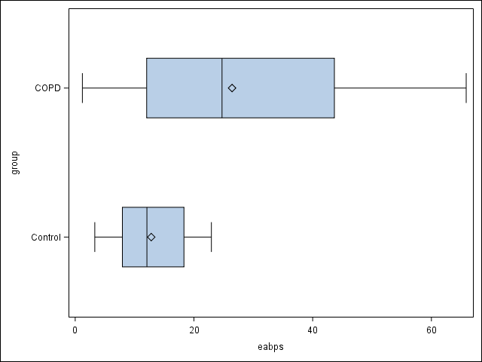
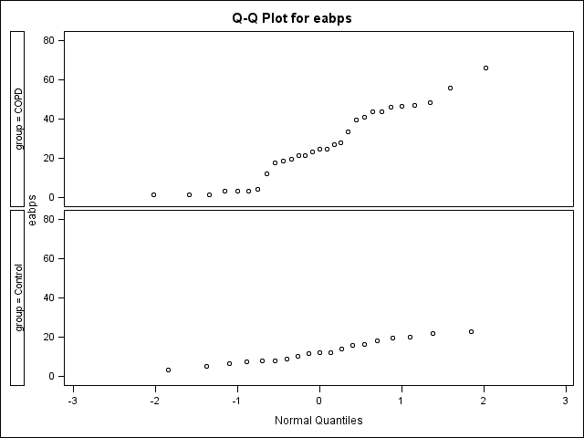
Example 1
Our parameters of interest are µ₁ = the true mean of EABPS in the COPD participants and µ₂ = the true mean of EABPS in the Control participants. We want to estimate the difference µ₁ – µ₂ at a 90% confidence level.
We should use a two-sample t interval for µ₁ – µ₂ if the conditions are satisfied.
Random: The data come from random samples of 48 participants.
Normal: Since the sample size in each group is small (n < 30), we must check whether it is reasonable to believe that the population distribution is Normal. Examine the distribution of the sample data.
Independent: Given in the question.

Slide 37
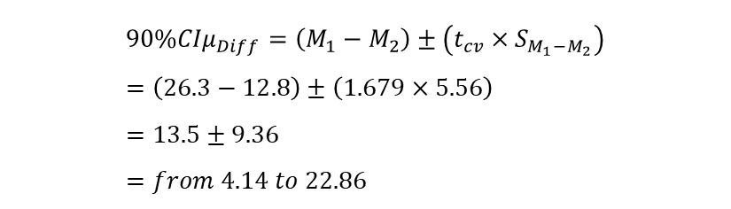

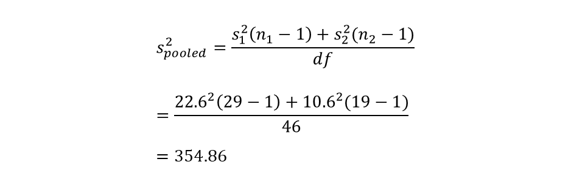
Example 1
Since the conditions are satisfied, we can construct a two-sample t interval for the difference µ₁ – µ₂. We’ll use the df = 29 + 19 – 2 = 46. Based on Table 3, $t_{cv}$ = 1.679 ($α=.10$ two tailed)
$$S_{M_{1}−M_{2}}=\sqrt{S_{Pooled}^{2}\left(\frac{N}{n_{1}×n_{2}}\right)} \\ =\sqrt{354.86\left(\frac{48}{29×19}\right)} \\ =5.56$$
$$s_{pooled}^{2}=\frac{s_{1}^{2}\left(n_{1}−1\right)+s_{2}^{2}(n_{2}−1)}{df} \\ =\frac{{22.6}^{2}\left(29−1\right)+{10.6}^{2}(19−1)}{46} \\ =354.86$$
$$90\%{CIμ}_{Diff}=\left(M_{1}−M_{2}\right)±\left(t_{cv}×S_{M_{1}−M_{2}}\right) \\ =\left(26.3−12.8\right)±\left(1.679×5.56\right) \\ =13.5±9.36 \\ =from 4.14 to 22.86$$
We are 90% confident that the interval from 4.14 to 22.86 captures the difference in the actual mean EABPS of the COPD participants and the actual mean EABPS of the Control participants. This interval suggests that the mean EABPS of the COPD participants is between 4.14 and 22.86 larger than the mean EABPS of the Control participants.

Slide 38

Example 2
To determine whether adjunctive raloxifene therapy reduces illness severity in women with refractory schizophrenia, a 12-week, double-blind, placebo-controlled,
randomized clinical trial was performed at an urban tertiary referral center and a regional center from January 1, 2006, to December 31, 2014.
The primary outcome was the change in the Positive and Negative Syndrome Scale (PANSS) total score. PANSS is a medical scale used for measuring symptom severity of patients with schizophrenia, with higher scores indicating severe illness.
Enrolled participants were randomized to receive either adjunctive raloxifene or placebo. At baseline, 26 participants treated with adjunct raloxifene had mean PANSS score of 79.96 (SD = 15.91), while 30 participants treated with placebo had mean PANSS score of 77.03 (SD = 14.85). The investigators wish to make sure randomization successfully by comparing the mean PANSS score between two randomized groups.
Question: Are there difference in the mean PANSS scores between participants treated with adjunct raloxifene and placebo?

Slide 39
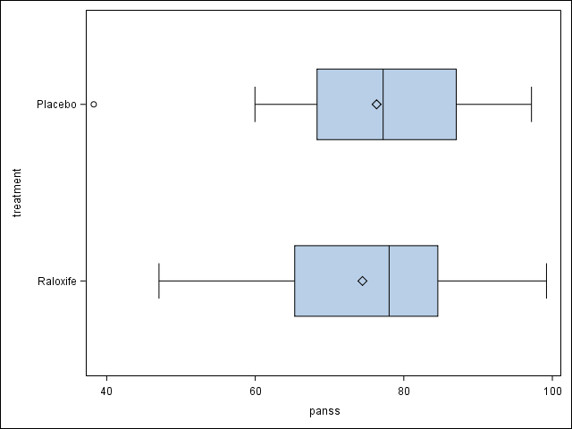
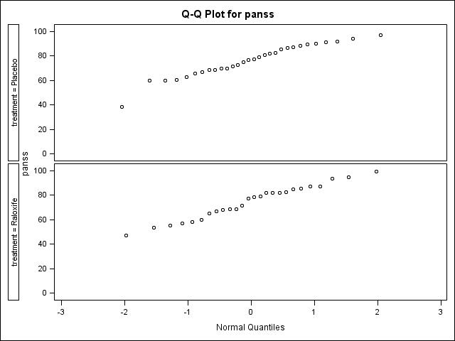
Example 2
Step 1: State the null and alternative hypotheses.
If we define the baseline mean PANSS score in participants treated with adjunctive raloxifene as µ_{T} , define the baseline mean PANSS score in participants treated with placebo as µ_{C} , then
H₀: µ_{T} = µ_{C}
H_{a}: µ_{T} ≠ µ_{C}
If conditions are met, we will carry out an independent two-sample t-test for µ_{T} – µ_{C}.
Random: The 56 participants were randomly assigned to the two groups.
Normal: Boxplots and Normal probability plots for these data are below:
Independent: Due to the random assignment, the two samples may be regarded as independent of each other.

Slide 40


Example 2
Step 2: Calculate the value of the test statistic t.
$$t=\frac{M_{1}−M_{2}}{S_{M_{1}−M_{2}}} \\ =\frac{79.96−77.03}{4.04} \\ =0.725$$
Base on the raw data, M₁ = 79.96, S₁ = 15.91, M₂ = 77.03, S₂ = 14.85, n₁ = 26, n₂ = 30, thus
$s_{pooled}^{2}=$ 227.203
$$S_{M_{1}−M_{2}}=4.04$$
Step 3: Find the P-value for the observed data.
Since this is a two-sided test, using the df = 26 + 30 – 2 = 54, we can use Table 3 to conclude that the P-value is larger than 0.10.
Step 4: State a conclusion.
Because the P-value is greater (than α = 0.05), we fail to reject H₀. The mean PANSS scores at baseline are not statistically significant different between participants randomized to either adjunctive raloxifene group or placebo group. In other words, the severity of illness are similar between two groups, i.e., randomization is successful.

Slide 41
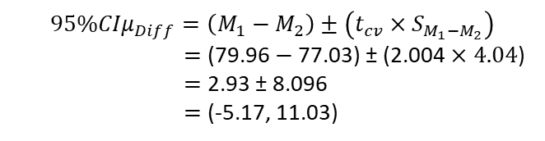


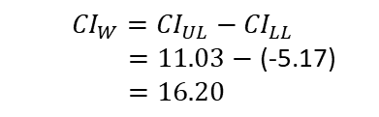
Example 2
Step 5: Calculate d, r², 95% CIµ_{Diff}, CI_{W}.
$$d=\frac{M_{1}−M_{2}}{\sqrt{s_{Pooled}^{2}}} \\ =\frac{79.96−77.03}{\sqrt{227.203}} \\ =\frac{2.93}{15.073} \\ =0.1944 \\ =0.19$$
$$r^{2}=\frac{t^{2}}{t^{2}+df}×100 \\ =\frac{{(0.725)}^{2}}{{(0.725)}^{2}+54}×100 \\ =\frac{0.5256}{0.5256+54}×100 \\ =\frac{0.5256}{54.5256}×100 \\ =.0096×100 \\ =0.96\%$$
$$95\%{CIμ}_{Diff}=\left(M_{1}−M_{2}\right)±\left(t_{cv}×S_{M_{1}−M_{2}}\right)$$
$=$ (79.96 $−$77.03) ± (2.004 $×4.04$)
$=$ 2.93 ± 8.096
$=$ (-5.17, 11.03)
${CI}_{W}={CI}_{UL}−{CI}_{LL}$
$=11.03−$ (-5.17)
$=16.20$

