Slide 1

Jingwei Wu, PhD
Chapter 14
Simple and Multiple Linear Regression
A courtesy of “USING AND INTERPRETING STATISTICS” by ERIC W. CORTY | THIRD EDITION (Macmillan Education)

Slide 2

Objectives
Simple Linear Regression
Errors in Regression
Multiple Regression

Slide 3
Simple Linear Regression
Linear Regression
Predictor variable is used to predict a case’s score on another variable, and the prediction equation takes the form of a straight line.
Regression equation helps one arrive at better decisions overall.
Simple linear regression should be used only with a statistically significant Pearson r.

Slide 4
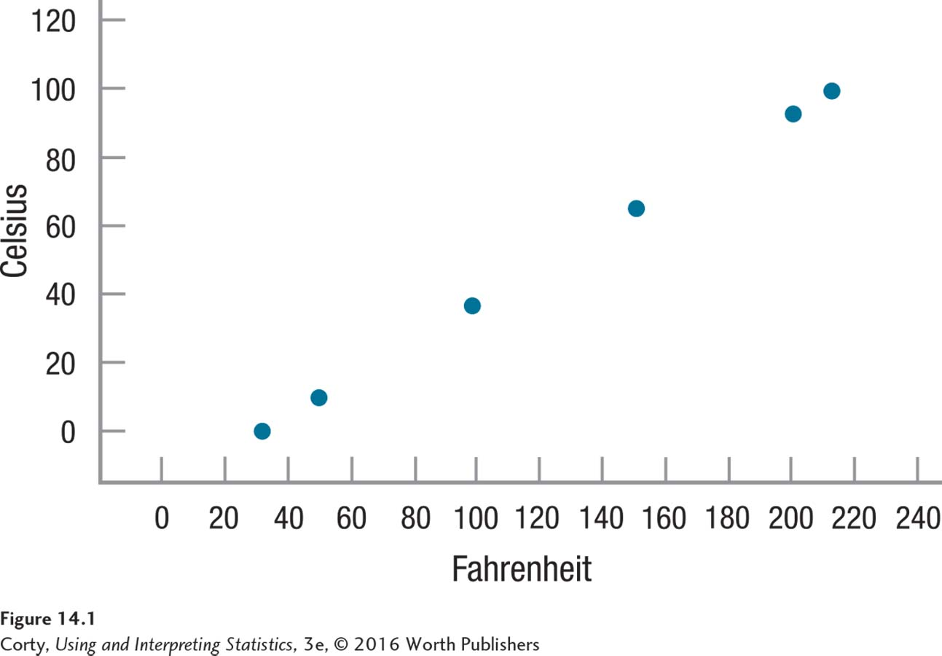
Using a Regression Line for Prediction
Relationship between Fahrenheit and Celsius
Perfect correlation, r = 1.00.
All points in the scatterplot fall on a straight line.
Six data points are known.
What about all the other possible Fahrenheit values?
If an object’s temperature is measured and found to be 86° Fahrenheit, what would it be in Celsius?
Temperature Measured in Fahrenheit and Celsius

Slide 5
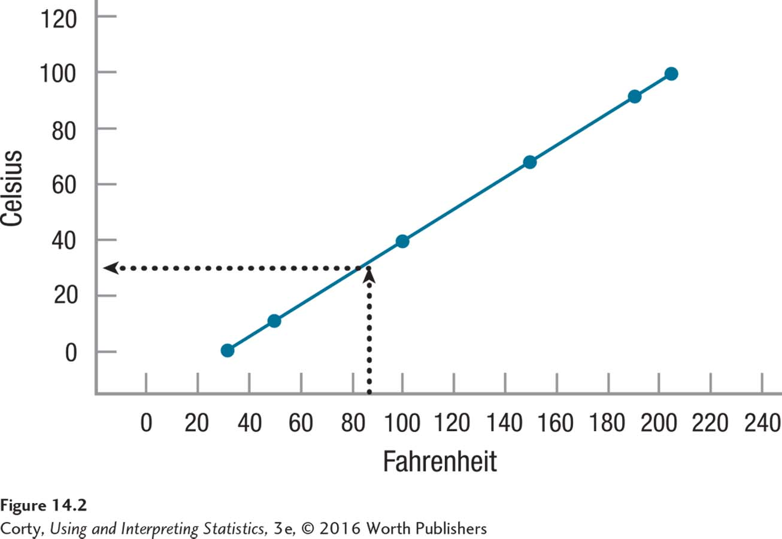
Using a Regression Line for Prediction (continued)
Regression Line
Best-fitting straight line for predicting Y from X
Regression Line for Temperature
Regression line inserted in this scatterplot makes it easy to predict an object’s temperature in Celsius if we know its temperature in Fahrenheit
An object that is 86°F would be about 30°C
Regression Line for Predicting Celsius from Fahrenheit
Draw a vertical line from 86° on the X-axis up to the diagonal line
Draw a horizontal line over to Y-axis
Predicted value of Y is 30°

Slide 6
Using a Regression Line for Prediction (continued)
Y prime
Value of Y predicted from X by a regression equation
Abbreviated Y′
Example: Temperature
6 data points have X scores and Y scores
The case for which a Y score was being found had an X score (86°F), but no Y score
Y score found for it was 30°C, Y′
Regression Line for Predicting Celsius from Fahrenheit

Slide 7
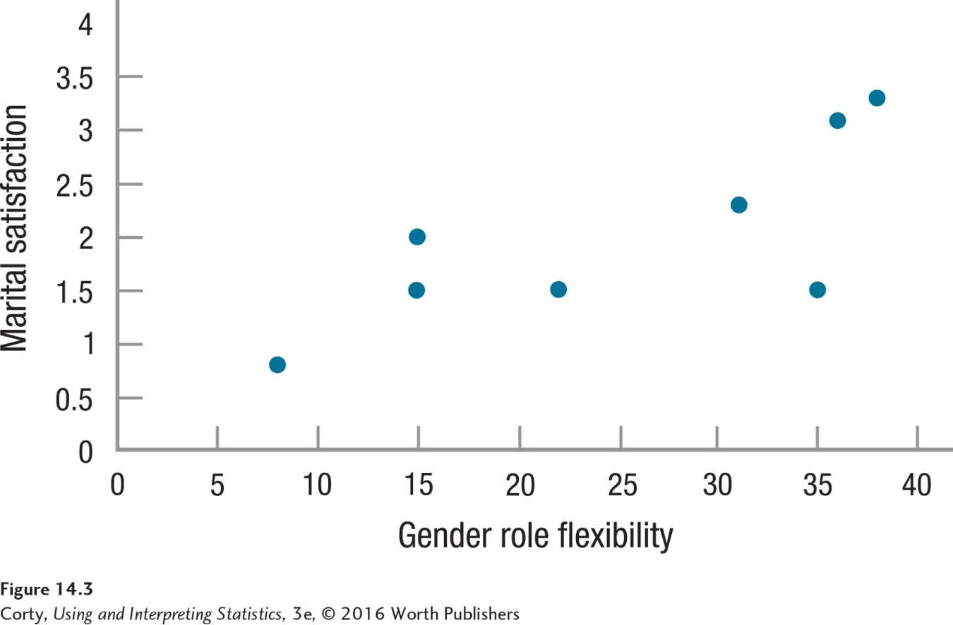
Using a Regression Line for Prediction (continued)
Marital Satisfaction Study
Dr. Paik’s data from Ch. 13
Strong relationship between the two variables in this scatterplot (r = .76)
Not clear where the best place is to draw a regression line for predicting Y from X
Relationship Between Gender Role Flexibility and Marital Satisfaction

Slide 8
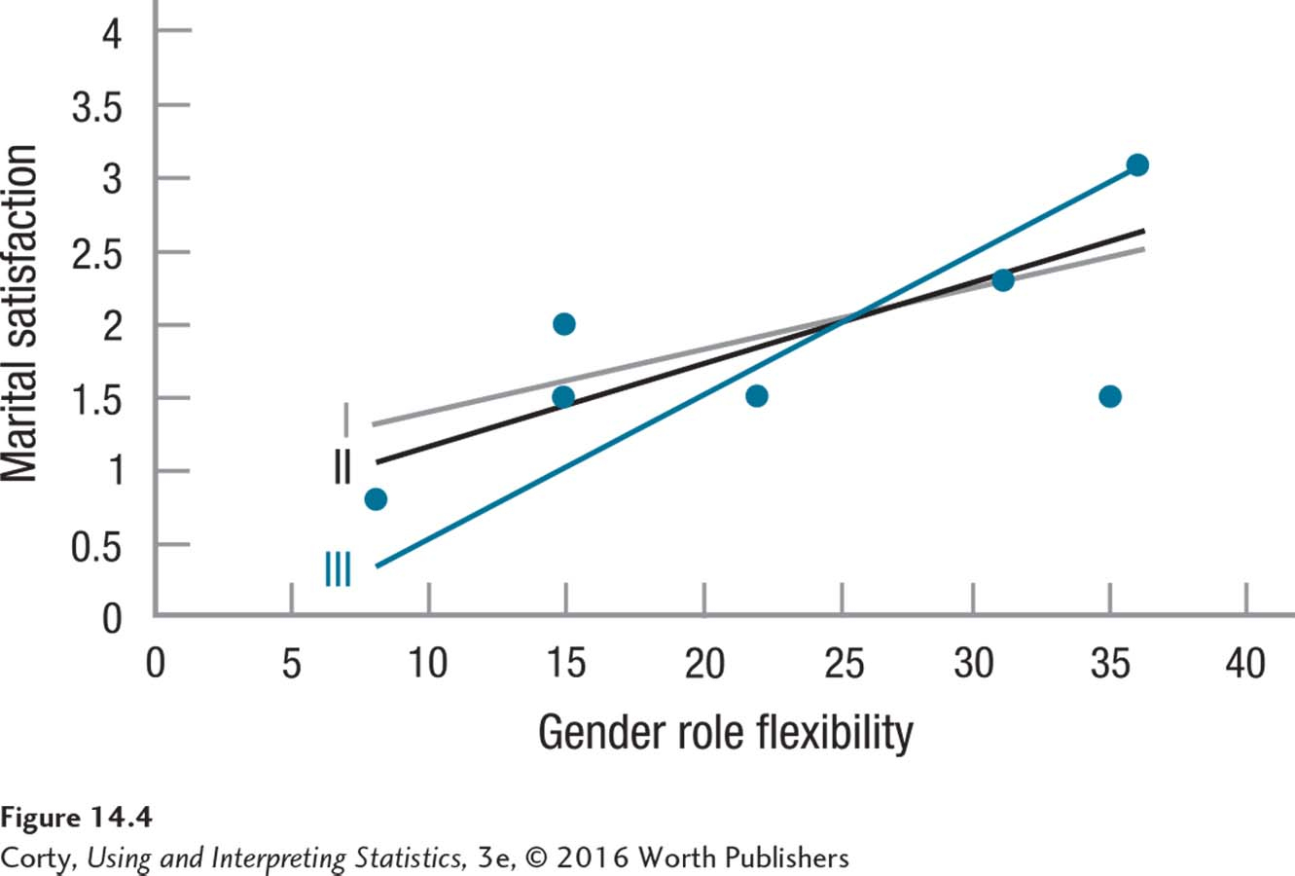
Using a Regression Line for Prediction (continued)
Marital Satisfaction Study
Which of these three lines best “fits” the data in this scatterplot?
By what criterion should one decide?
Statisticians use the “least squares” criterion: the best-fitting line is the one that minimizes the discrepancies between actual Y scores and predicted Y scores
Three Potential Regression Lines for Predicting Marital Satisfaction

Slide 9
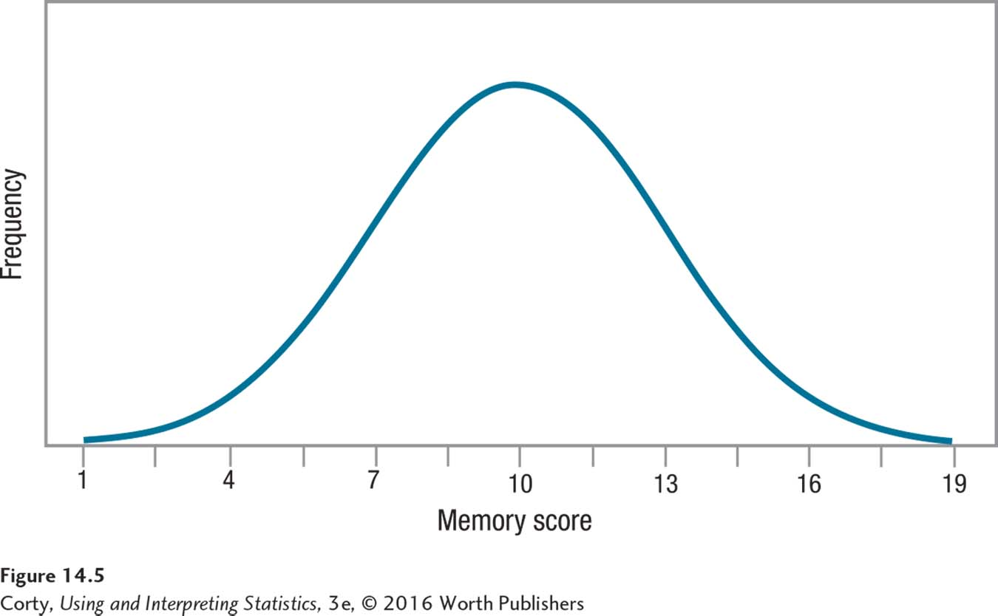
How to Judge Whether a Prediction Is Good
Memory Example
Imagine 12 students randomly selected from a college
Contest to guess their memory test scores
Guess the mean for each one
Best strategy for two reasons:
Mean occurs with the greatest frequency
Errors will be smaller
Frequency Distribution of Memory Scores
Scores range from 1.00 to 19.00
Memory scores are normally distributed with a mean of 10
Notes:
.

Slide 10
How to Judge Whether a Prediction Is Good (continued)
Best prediction is the one that yields the smallest errors between predicted outcomes and actual outcomes.
Least Squares Criterion
Prediction errors are squared and the best-fitting regression line is the one that has the smallest sum of squared errors
Standard Error of the Estimate
Standard deviation of the residual scores, a measure of error in regression

Slide 11
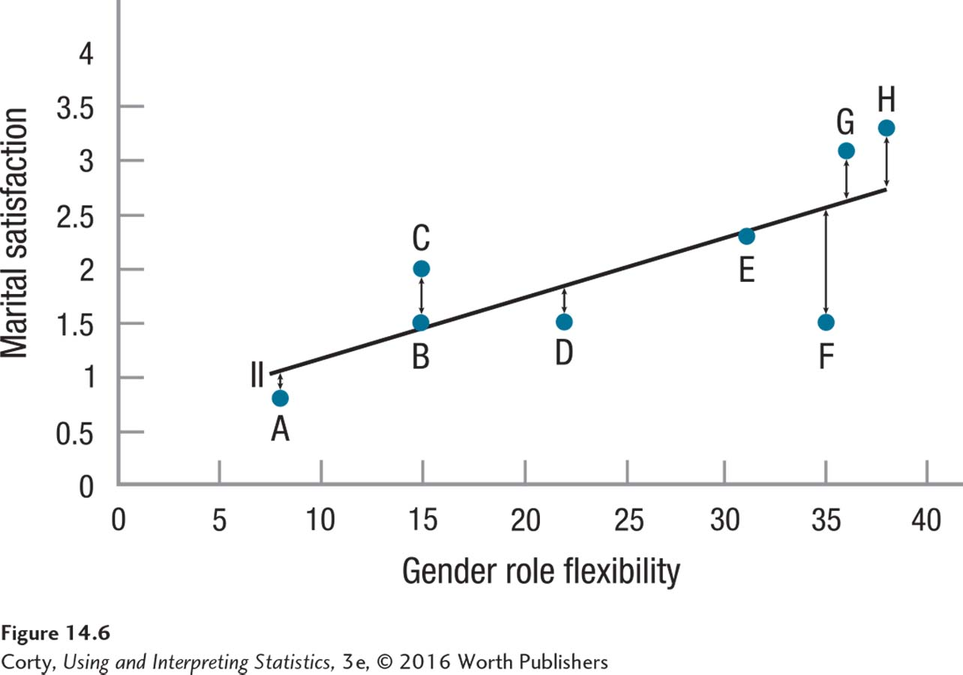
How to Judge Whether a Prediction Is Good (continued)
Marital Satisfaction Study
Figure compares the case’s actual marital satisfaction scores to their predicted scores for line II from Figure 14.4
Double-headed arrows from the actual cases to the line show the sizes of the errors
Cases A, B, and E errors are small: predicted values are close to the actual values
In other cases, like F, error is large and predicted value far from the actual value
Errors in Prediction

Slide 12
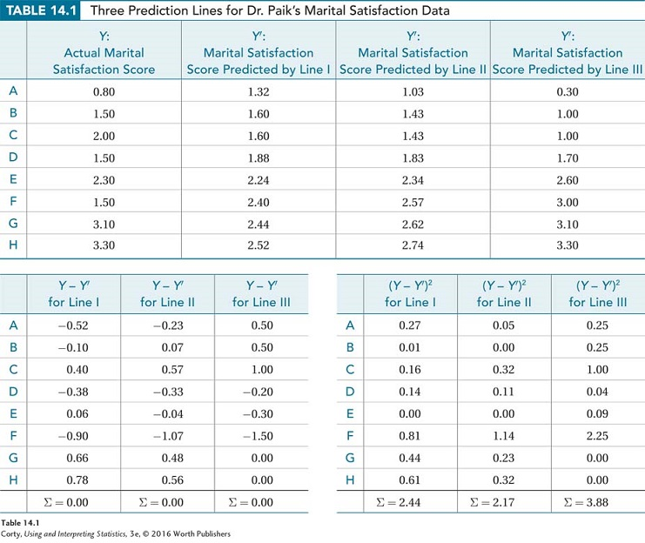
How to Judge Whether a Prediction Is Good (continued)
See Table 14.1 in your text
The tables examine three different prediction lines for Dr. Paik’s marital satisfaction data
Panel A: Each row shows the actual marital satisfaction scores for the eight cases discussed in Ch. 13 and the scores predicted by each of the linear equations
Panel B: Shows residual scores, Y – Y′, for each linear equation For each line, the residual scores sum to zero
Panel C: Displays the squared residual scores

Slide 13
How to Judge Whether a Prediction Is Good (continued)
Residual
Difference between an actual score and a predicted score; size of the error in prediction

Slide 14
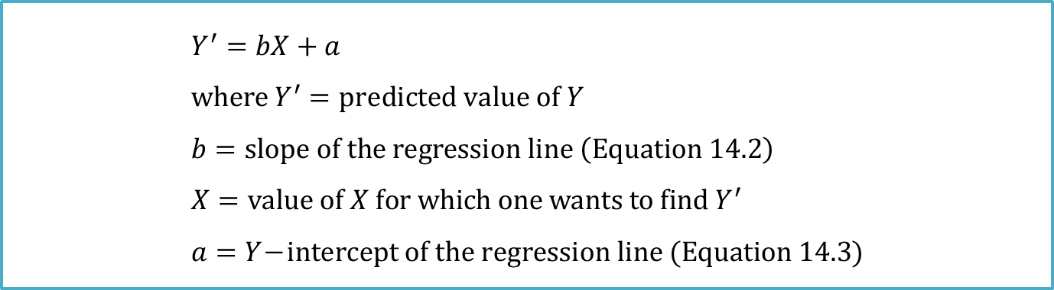
The Linear Regression Equation
Three factors need to be known to apply regression line formula
X value for which one wants to predict a Y value
slope, b
Y-intercept, a
$$Y^{′}=bX+a \\ where Y^{′}=predicted value of Y \\ b=slope of the regression line \left(Equation 14.2\right) \\ X=value of X for which one wants to find Y^{′} \\ a=Y\text{−}intercept of the regression line (Equation 14.3)$$

Slide 15
The Linear Regression Equation (continued)
Understanding Slope
Slope
Tilt of the line; rise over run; how much up or down change in Y is predicted for each 1-unit change in X:
If the slope is positive, the line is moving up and to the right.
If the slope is negative, the line is moving down and to the right.
If the slope is zero, the line is horizontal.

Slide 16

The Linear Regression Equation (continued)
Formula for Calculating Slope
$$b=r\left(\frac{S_{Y}}{S_{X}}\right) \\ where b=slope of the regression line \\ r=observed correlation between X and Y \\ S_{Y}=standard deviation of the Y scores \\ S_{X}=standard deviation of the X scores$$

Slide 17

The Linear Regression Equation (continued)
Dr. Paik’s Marital Satisfaction Study
r = .76, S_{Y} = 0.86, S_{X} = 11.49
Value of the slope, 0.06
For every 1-point increase in a husband’s level of gender role flexibility, there is a predicted increase of 0.06 points in the wife’s level of marital satisfaction
$$b=r\left(\frac{S_{Y}}{S_{X}}\right) \\ =.76\left(\frac{0.86}{11.49}\right) \\ =.76×0.0748 \\ =0.0568 \\ =0.06$$

Slide 18
The Linear Regression Equation (continued)
Understanding the Y-Intercept
Y-intercept
Indicates where the regression line would pass through the Y-axis, when X=0
If Y-intercept is positive, line passes through the Y-axis above zero.
If Y-intercept is negative, line passes through the Y-axis below zero.
The bigger the absolute value of the Y-intercept, the further away from zero the regression line passes through the Y-axis.

Slide 19
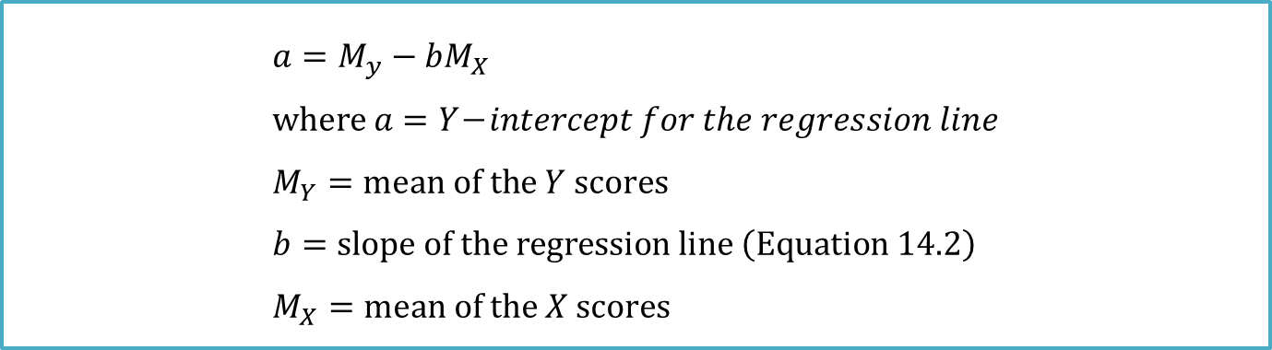
The Linear Regression Equation (continued)
Formula for the Y-Intercept
$$a=M_{y}−bM_{X} \\ where a=Y\text{−}intercept for the regression line \\ M_{Y}=mean of the Y scores \\ b=slope of the regression line \left(Equation 14.2\right) \\ M_{X}=mean of the X scores$$

Slide 20


The Linear Regression Equation (continued)
Dr. Paik’s Marital Satisfaction Study
b = 0.0568, M_{Y} = 2.00, M_{X} = 25.00
Regression formula, Equation 14.1
$$a=M_{y}−bM_{X} \\ =2.00−\left(0.0568×25.00\right) \\ =2.00−\left(1.4200\right) \\ =0.5800 \\ =0.58$$
$$Y^{′}=bX+a \\ =0.06X+0.58$$

Slide 21
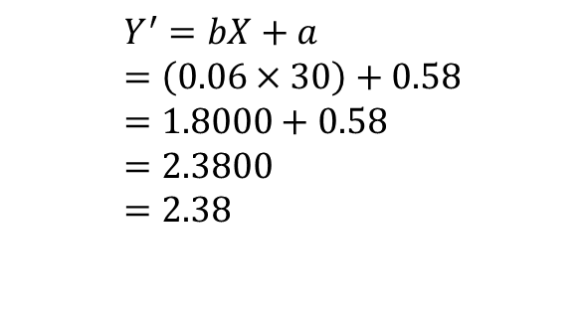
The Linear Regression Equation (continued)
Predicting Y
Dr. Paik needs to select an X value for which to predict Y score
Selects gender role flexibility score of 30 and substitutes that for X
A man with a gender role flexibility score of 30 will have a partner who rates her level of marital satisfaction as 2.38
Marital satisfaction rated on a 4-point scale like GPA
She would rate her marriage at the C+ level
$$Y^{′}=bX+a \\ =\left(0.06×30\right)+0.58 \\ =1.8000+0.58 \\ =2.3800 \\ =2.38$$

Slide 22


The Linear Regression Equation (continued)
Drawing the Regression Line
Helps to highlight the relationship between the two variables
Can be drawn once two points are known
Dr. Paik’s Marital Satisfaction Study
Dr. Paik will find Y′ for lowest X value (8) and Y′ for largest (38)
$$Y^{′}=bX+a \\ =\left(0.0568×8\right)+0.58 \\ =0.4544+0.58 \\ =1.0344 \\ =1.03$$
$$Y^{′}=bX+a \\ =\left(0.0568×38\right)+0.58 \\ =2.1584+0.58 \\ =2.7384 \\ =2.74$$

Slide 23
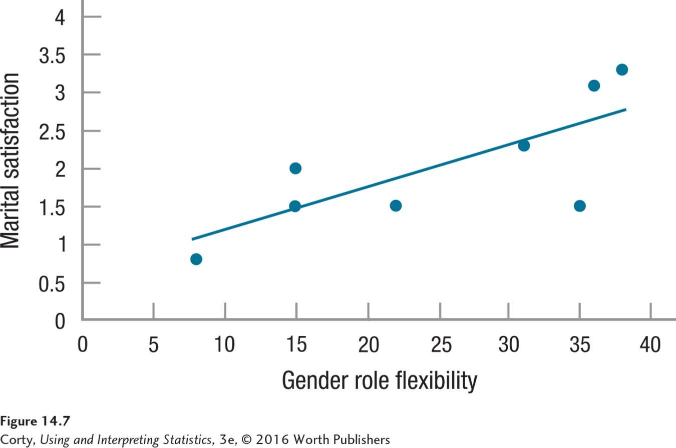
Regression Line
Regression Line for Marital Satisfaction
Finding Y′ for the points at two ends of the range of X scores allows a researcher to draw a regression line.
Any two points can be connected with a straight line.
Regression line should only be used to predict Y′ for the range of X scores used to derive the regression equation.
Regression Line for Predicting Marital Satisfaction

Slide 24
Extrapolation Problem
Sarah’s height was plotted against her age.
Can you guess (predict) her height at age 42 months?
Can you predict her height at age 30 years (360 months)?

Slide 25
Extrapolation Problem
Regression line: y-hat = 71.95 + .383 x
Height at age 42 months?
y-hat = 88
Height at age 30 years?
y-hat = 209.8
She is predicted to be 6’10.5” at age 30! What’s wrong?
This is an example of extrapolation problem

Slide 26
Errors in Regression
Marital Satisfaction Study
Table 14.2: Actual, Predicted, and Residual Scores
 | X: Gender Role Flexibility Score | Y: Marital Satisfaction Score | Y’: Predicted Marital Satisfaction Score | Y–Y’: Residual Score
A | 8 | 0.8 | 1.03 | −0.23
B | 15 | 1.5 | 1.43 | 0.07
C | 15 | 2 | 1.43 | 0.57
D | 22 | 1.5 | 1.83 | −0.33
E | 31 | 2.3 | 2.34 | −0.04
F | 35 | 1.5 | 2.57 | −1.07
G | 36 | 3.1 | 2.62 | 0.48
H | 38 | 3.3 | 2.74 | 0.56
 | M=25.00 s=11.49 | M=2.00 s=0.86 |  | s=0.56

Slide 27
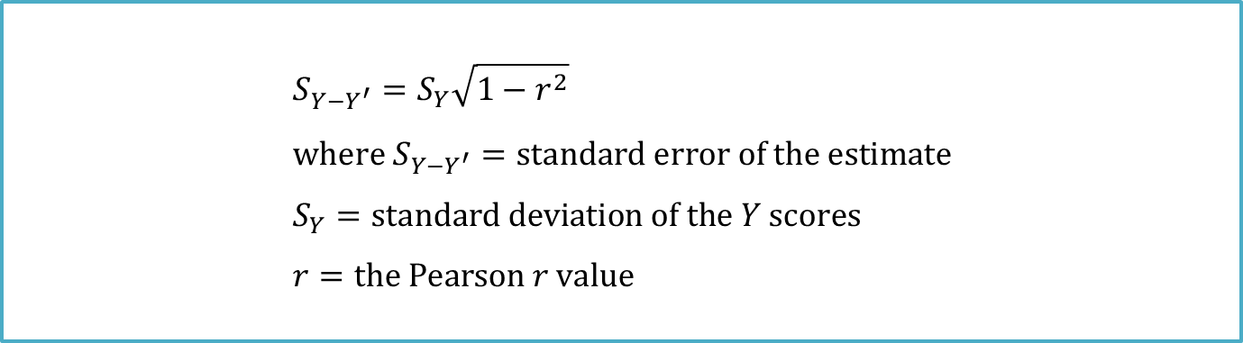
Errors in Regression (continued)
Standard Error of the Estimate
Standard deviation of the residual scores, a measure of error in regression
Formula for the Standard Error of the Estimate
$$S_{Y−Y^{′}}=S_{Y}\sqrt{1−r^{2}} \\ where S_{Y−Y^{′}}=standard error of the estimate \\ S_{Y}=standard deviation of the Y scores \\ r=the Pearson r value$$

Slide 28
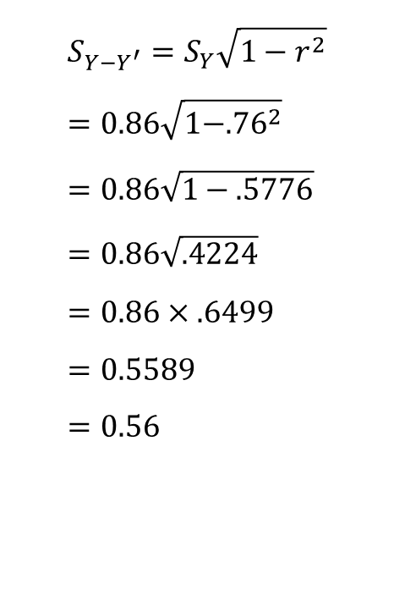
Errors in Regression (continued)
Formula for the Standard Error of the Estimate
Marital Satisfaction Study
Square the correlation coefficient
Subtract the square from 1
Take the square root of the difference
Multiply square root by the standard deviation of the Y scores
s_{Y–Y′} = 0.56, same value found in Table 14.2
$$S_{Y−Y^{′}}=S_{Y}\sqrt{1−r^{2}} \\ =0.86\sqrt{1−{.76}^{2}} \\ =0.86\sqrt{1−.5776} \\ =0.86\sqrt{.4224} \\ =0.86×.6499 \\ =0.5589 \\ =0.56$$

Slide 29
Errors in Regression (continued)
Standard Error of the Estimate
What does a standard error of the estimate of 0.56 mean?
Think of standard error of the estimate as the average residual score, the average difference between the actual Y scores and the predicted Y scores
Is 0.56 a lot of error?
Depends on the possible range of scores
Marital satisfaction, measured on a scale ranging from 0 to 4
Being off by 0.56 points on a 4-point scale, means being off by 14%

Slide 30
Errors in Regression (continued)
Standard Error of the Estimate
Example: “Guess Your Weight” booth
Carny guesses Neil’s weight as 150 pounds
If the carny is off by 14%
Neil could weigh 171 pounds or 129 pounds
Range, from 129 pounds to 171 pounds, gives the general idea of what a prediction interval is

Slide 31
Errors in Regression (continued)
Prediction Interval
Range around Y′ within which there is some certainty that a case’s real value of Y falls
Calculation of the interval is based on the estimated Y score and the standard error of the estimate
The smaller the standard error of the estimate is, the narrower the prediction interval will be, and therefore the better the prediction will be

Slide 32
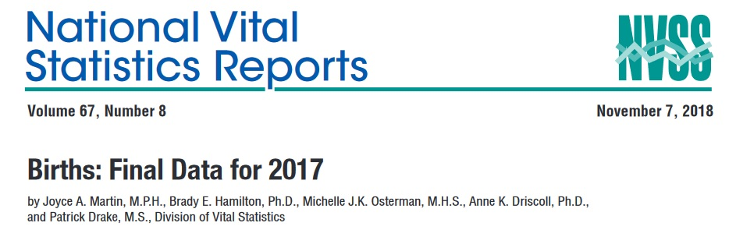
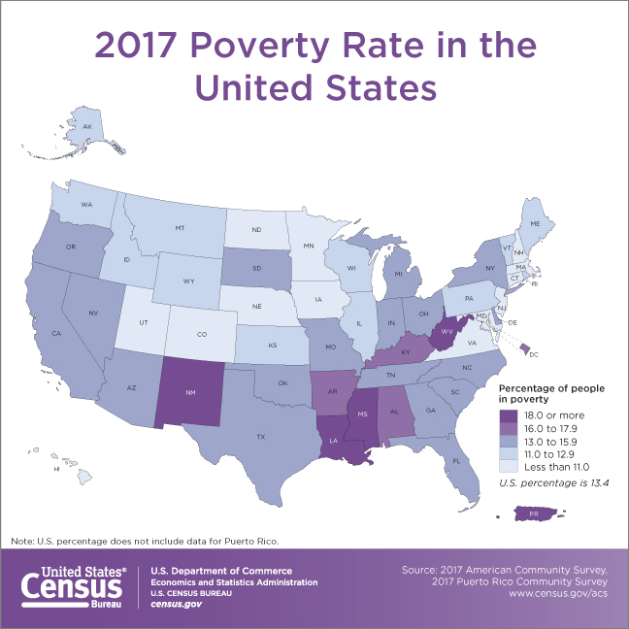
Example 1
Academics and policy-makers have concerned for decades that girls living in lower socio-economic circumstances are more likely than their wealthier peers to become pregnant.
This dataset of size n = 51 contains 50 states and the District of Columbia in the United States. The variables are y = year 2017 birth rate per 1000 females 15 to 17 years old, and x = poverty rate, which is the percent of the state’s population living in households with incomes below the federally defined poverty level.
2017 birth rate data are extracted from 2018 National Vital Statistics Reports, and 2017 poverty rate data are extracted from 2017 American Community Survey.
Question: does poverty level impact teen birth rate?

Slide 33
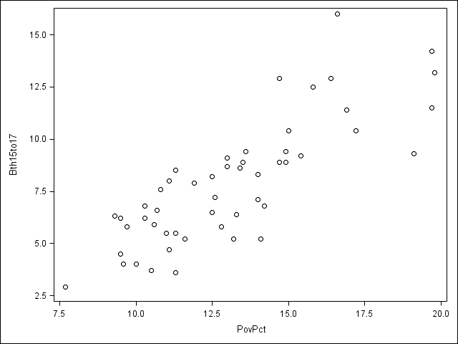
Example 1
The plot of the data below (birth rate on the vertical) shows a generally linear relationship, on average, with a positive slope. As the poverty level increases, the birth rate for 15 to 17 year old females tends to increase as well.

Slide 34
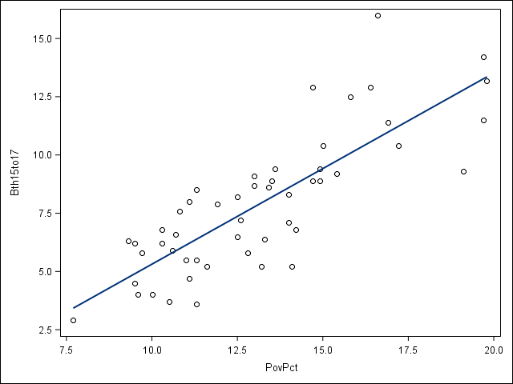
Example 1
The following plot shows a regression line superimposed on the data..

Slide 35
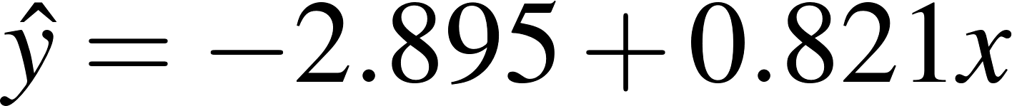
Example 1
The equation parameter of the fitted regression line is given in a statistical software output. In statistical notation, the equation could be written
The equation should really state that it is for the “average” birth rate (or “predicted” birth rate would be okay too) because a regression equation describes the average value of y as a function of one or more x-variables.
The interpretation of the slope (value = 0.821) is that the 15 to 17 year old birth rate increases 0.821 units, on average, for each one unit (one percent) increase in the poverty rate.
The interpretation of the intercept (value=-2.895) is that if there were states with poverty rate = 0, the predicted average for the 15 to 17 year old birth rate would be -2.895 for those states. Since there are no states with poverty rate = 0 this interpretation of the intercept is not practically meaningful for this example.

Slide 36
Example 1
The equation of the regression line is
The regression equation can be used to estimate a 15 to 17 year old birth rate as a function of poverty rate.
For example, suppose a poverty rate is 14% (x = 14). We would estimate that 15 to 17 year old birth rate to be -2.895 + 0.821(14) = 8.599. The equation can also be used to estimate 15 to 17 year old birth rate for other values of poverty rate.
However, the equation should only be used to estimate 15 to 17 year old birth rate for which poverty rates are in the range of the data used to generate the regression equation. In our data, poverty rate ranges from 7.5% to 20%.
For example, we can not estimate 15 to 17 year old birth rate for which the poverty rate is 35% (this is an issue of extrapolation).

Slide 37
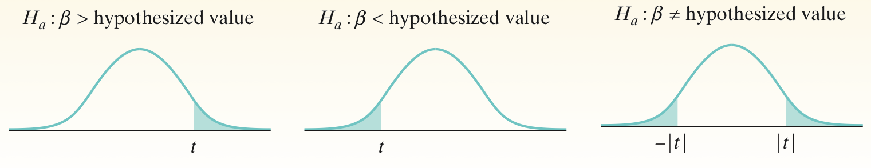
Significance Test for Regression Slope
Significance Test for Regression Slope
To test the hypothesis H₀: β₁ = hypothesized value, compute the test statistic:
Find the P-value by calculating the probability of getting a t statistic this large or larger in the direction specified by the alternative hypothesis H_{a}. Use the t distribution with df = n – 2.

Slide 38
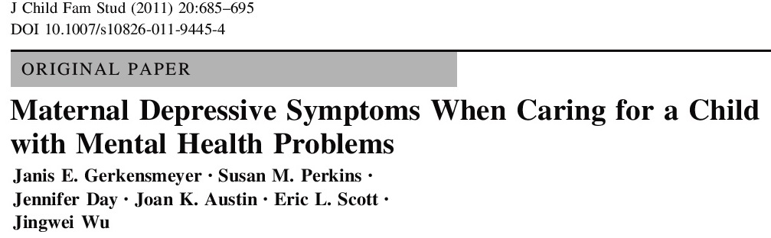

Example 2
As primary caregivers of children with mental health problems, mothers face challenges that put them at risk for depression. This study explored the relationship between the children behavior problems and maternal depression.
Mother’s symptoms of depression were measured by the 20-item Center for Epidemiological Studies Depression Scale (CESD), with a higher score indicating a higher level of depressive symptoms. Child behavior problems were rated by parents on the Child Behavior Checklist (CBCL), with a higher score indicating more problems.
Question: Do the data provide convincing evidence that there is a positive linear relationship between total child behavior problems and maternal depressive symptoms?

Slide 39
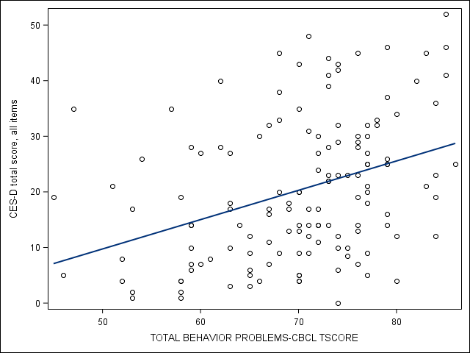
Example 2
Data were collected from a convenience sample of parents identified as the primary caregivers of a child between 2 and 19 years of age who were receiving community health services in one Midwestern state and who had been living at home with the caregiver for at least 20 of
the past 24 months. Only mothers (N = 139) who were the primary caregiver of a child with mental health problems were in this study
We want to perform a test of
H₀ : β₁ = 0
H_{a} : β₁ > 0
where β₁ is the true slope of the population regression line relating child behavior problem to maternal depressive symptom.
The scatterplot suggests a moderately positive linear relationship between total child behavior problem and maternal depressive symptom.

Slide 40
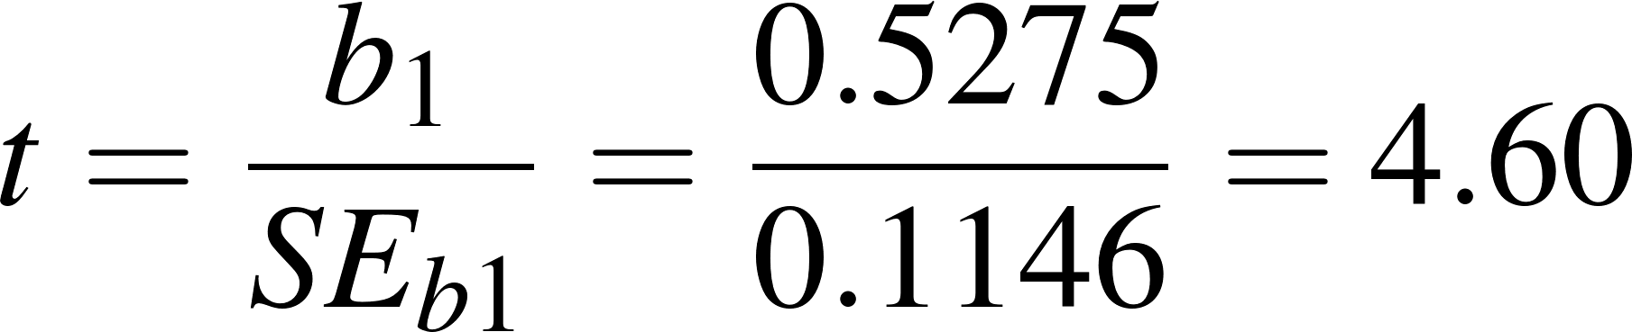
Example 2
The test statistic and P-value can be found in the software output.
Dependent Variable: cesdtot CES-D total score, all items
R-Square Coeff Var Root MSE cesdtot Mean
0.133860 58.48213 11.87070 20.29799
Standard
Parameter Estimate Error t Value Pr > |t|
Intercept -16.63749668 8.08986636 -2.06 0.0416
ttotprb 0.52748722 0.11463559 4.60 <.0001
The output gives P < 0.001 as the P-value for a two-sided test. The P-value for the one-sided test is half of this, thus, still P < 0.001.
The P-value, < 0.001, is less than our α = 0.05 significance level, so we have enough evidence to reject H₀ and conclude that there is a positive linear relationship between total child behavior problem and maternal depressive symptom in the population of mothers.
Interpretation: for each one unit increase in total behavior problem (CBCL score), on average, mother’s depressive symptom (CESD score) increases 0.527 units.

Slide 41
Categorical Explanatory Variables in Regression
Categorical independent variables can be incorporated into a regression model by converting them into 0/1 (“dummy”) variables
For binary variables, code dummies “0” for “one level” and 1 for “another level”
example: “0” for “no” and “1” for “yes”; or “0” for “male” and “1” for “female”
For categorical variables with k categories, use k–1 dummy variables
example: SMOKE2 has three levels, then use k – 1 = 3 – 1 = 2 dummy variables to code this information like this:
SMOKE2 | DUMMY1 | DUMMY2
0 = non-smoker | 0 | 0
1 = former smoker | 1 | 0
2 = current smoker | 0 | 1

Slide 42
Example 3
One binary explanatory variable (INCOME_LOW) is coded 1 for low-income household (below mean income per capita of $48,150) and 0 for not low-income household. Again, mother’s symptoms of depression were measured by the 20-item Center for Epidemiological Studies Depression Scale (CESD), with a higher score indicating a higher level of depressive symptoms.
The mean CESD in low-income household is 21.806 (SD = 12.87), and the mean CESD in not low-income household is 12.696 (SD = 8.67).
Question: Do the data household income impact maternal depressive symptoms?

Slide 43
Example 3
Regress CESD on INCOME_LOW, based on output,
Standard
Parameter Estimate Error t Value Pr > |t|
Intercept 12.69565217 B 2.56281681 4.95 <.0001
income_low 1 9.10970173 B 2.80540760 3.25 0.0015
income_low 0 0.00000000 B . . .
ŷ = 12.696 + 9.110 x
Least squares regression line is:
Intercept (12.696) = the mean CESD of group 0 (not low-income household)
Intercept + b₁ (12.696 + 9.110*1=21.806) = the mean CESD of group 1 (low-income household)
Slope = the mean difference in CESD by low-income status = 21.806 − 12.696 = 9.110
Interpretation: Comparing low-income household vs not low-income household, on average, mother’s depressive symptom (CESD score) is higher by 9.110 units.
t_{stat} = 3.25 with 137 df, P ≈ 0.0015

Slide 44
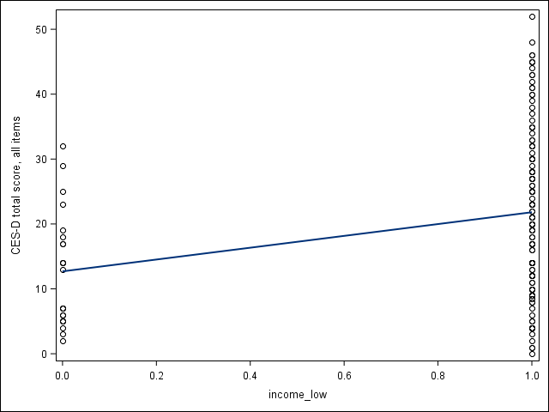
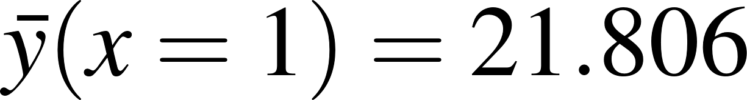
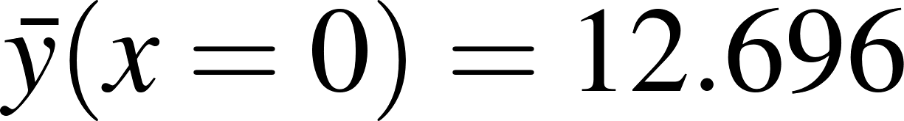
Example 3
b₁ = 21.806 − 12.696 = 9.110
Regression line
Regression line passes through group means
Mother in low-income household had higher mean CESD

Slide 45
Multiple Regression
Example: Student GPA
In which scenario could one more accurately predict a student’s GPA?
Knowing how many hours the student spends on schoolwork each week, OR
Knowing how many hours the student spends on schoolwork each week plus high school GPA, IQ, and how much alcohol the student consumes each week
Most people believe the additional information in Scenario B is relevant to predicting academic performance and they are correct. In Scenario B, the prediction should be more accurate because more factors are taken into account.

Slide 46
Multiple Regression (continued)
The difference between Scenario A and Scenario B is the difference between simple regression and multiple regression.
Simple Linear Regression
Prediction in which Y′ is predicted from a single independent variable
Scenario A
Multiple Linear Regression
Prediction in which multiple independent variables are combined to predict a dependent variable
Adds together the unique predictive power of each variable
Scenario B, better at predicting

Slide 47
Multiple Regression (continued)
R² in Multiple Regression
r², the percentage of variability in the dependent variable that is accounted for by the independent variable(s), is called R² in multiple regression
Better prediction means a higher percentage of variability is accounted for with multiple regression than with simple regression
More powerful technique than simple regression
The square root of R², called the multiple correlation coefficient, is the correlation between the observed response values and the predicted values.

Slide 48
Multiple Regression (continued)
Example: Admitted Class Evaluation Service (ACES)
Predicting first-year GPA
Equation is developed from a first-year class to predict first-year GPA
College Board examines four variables; the Pearson r correlation coefficients for each of these variables predicting GPA by itself are:
SAT reading test, r = .42
SAT writing test, r = .42
SAT math test, r = .39
High school class rank, r = .52
When the four College Board variables are combined to predict GPA, correlation climbs to R = .57
Percentage of variance explained changes from 27.04% to 32.49%

Slide 49
Multiple Regression (continued)
Example: Admitted Class Evaluation Service (continued)
Equation has “weights” for each of the predictor variables
Weights are like the slope in the linear regression equation
A constant that is like the Y-intercept
Here is how estimated GPA, GPA′, would be calculated:
$$GPA^{′}=\left({SAT}_{ReadingScore}×{Weight}_{ReadingScore}\right)+\left({SAT}_{WritingScore}×{Weight}_{WritingScore}\right) \\ +\left({SAT}_{MathScore}×{Weight}_{MathScore}\right)+\left(HSRank×{Weight}_{HSRank}\right)+Constant$$

Slide 50
Multiple Regression (continued)
Example: Admitted Class Evaluation Service (continued)
Here are the four weights and the constant:
Reading weight = 0.0012
Writing weight = 0.0013
Math weight = 0.0006
HS rank weight = 0.0029
Constant = 0.7821

Slide 51
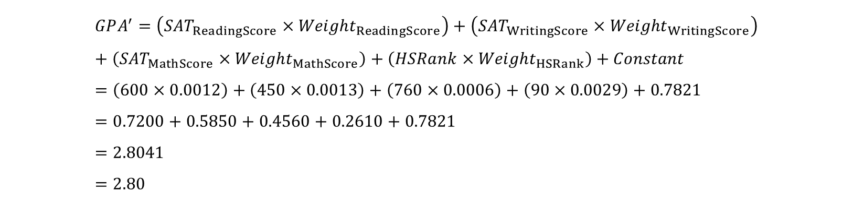
Multiple Regression (continued)
Example: Admitted Class Evaluation Service (continued)
If an applicant were good at reading (SAT score = 600), not so good at writing (SAT score = 450), very good at math (SAT score = 760), and had a very good class rank (90), then her predicted GPA would be
A person with those SAT scores and class rank would be predicted to end up with a GPA of 2.80 at the end of her first year
$$GPA^{′}=\left({SAT}_{ReadingScore}×{Weight}_{ReadingScore}\right)+\left({SAT}_{WritingScore}×{Weight}_{WritingScore}\right) \\ + \left({SAT}_{MathScore}×{Weight}_{MathScore}\right)+\left(HSRank×{Weight}_{HSRank}\right)+Constant \\ =\left(600×0.0012\right)+\left(450×0.0013\right)+\left(760×0.0006\right)+\left(90×0.0029\right)+0.7821 \\ =0.7200+0.5850+0.4560+0.2610+0.7821 \\ =2.8041 \\ =2.80$$

Slide 52
Example 3
Let’s revisit the example by looking at the association of total child behavior problems and low-income household status with maternal depressive symptoms.

Slide 53
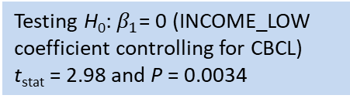
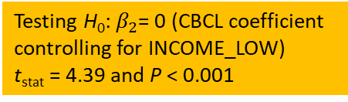
Example
Let’s look at the output.
Testing H₀: $β_{1}$= 0 (INCOME_LOW coefficient controlling for CBCL)
t_{stat} = 2.98 and P = 0.0034
Standard
Parameter Estimate Error t Value Pr > |t|
Intercept -20.77531434 B 7.98877911 -2.60 0.0103
income_low 1 7.89091755 B 2.64944170 2.98 0.0034
income_low 0 0.00000000 B . . .
ttotprb 0.49253502 0.11209417 4.39 <.0001
The multiple linear regression model is:
CESD = -20.775 + 7.891 (INCOME_LOW) + 0.493 (CBCL)
Testing H₀: $β_{2}$= 0 (CBCL coefficient controlling for INCOME_LOW)
t_{stat} = 4.39 and P < 0.001
The slope coefficient associated for INCOME_LOW is 7.891, suggesting that mothers from low-income household have 7.891 more CESD on average compared to not low-income household (after adjusting for CBCL).
The slope coefficient for CBCL is .0.493, suggesting that each unit increase in CBCL associated with an increase of .0.493 mean CESD units on average (after adjusting for INCOME_LOW).
R² is fairly small (0.205, not shown, but will get it from SPSS): only about 20.5% of the variation in maternal depressive symptom can be explained by total child behavior problems and low-income household status.

Slide 54
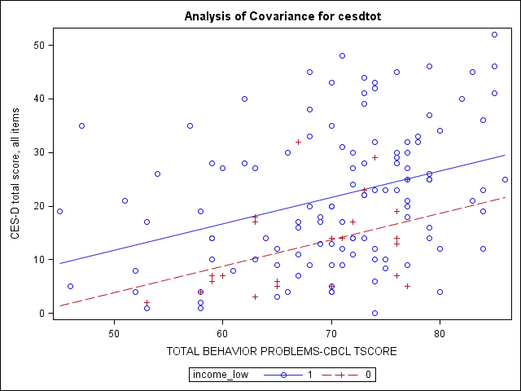
Example
Low-income household: LOW_INCOME = 1
CESD = (-20.775 + 7.891) + 0.493 (CBCL)
Not low-income household: LOW_INCOME = 0
CESD = -20.775 + 0.493 (CBCL)
Different Intercepts, same slope

Slide 55
Interaction Regression Model
In statistics, an interaction may arise when considering the relationship among two or more variables, and describes a situation in which the effect of one independent variable on an outcome depends on the state of a second independent variable.
In multiple regression, an interaction regression model contains two-way cross product terms
Y = b₀ + b₁x₁ + b₂x₂ + b₃x₁x₂ + ε
Without interaction term, effect of X₁ on Y is measured by b₁
With interaction term, effect of X₁ on Y is measured by b₁ + b₃X₂
Effect of X₁ increases as X₂ increases (if b₃>0), or decreases as X₂
increases (if b₃<0)

Slide 56
An Illustration
Y
Y = 1 + 2X₁ + 3X₂ + 4X₁X₂, X₂ = 0 or 1 (dummy variable)
Y = 1 + 2X₁ + 3(1) + 4X₁(1) = 4 + 6X₁
12
8
Y = 1 + 2X₁ + 3(0) + 4X₁(0) = 1 + 2X₁
4
0
X₁
0
0.5
1
1.5
Effect (slope) of X₁ on Y does depend on X₂ value

