Slide 1

Jingwei Wu, PhD
Chapter 15
Nonparametric Statistical Tests: Chi-Square
A courtesy of “USING AND INTERPRETING STATISTICS” by ERIC W. CORTY | THIRD EDITION (Macmillan Education)

Slide 2

Objectives
Introduction to Nonparametric Tests
The Chi-Square Goodness-of-Fit Test
Calculating the Chi-Square Test of Independence
Interpreting the Chi-Square Test of Independence
Other Nonparametric Tests

Slide 3
Introduction to Nonparametric Tests
Parametric test
Statistical test for use with interval- or ratio-level dependent variables, and for which assumptions about the shape of the population must be met
Examples
z, t, F, and r
Nonparametric Test
Statistical test for use with nominal- or ordinal-level dependent variables, and for which assumptions about the shape of the population do not have to be met
Less powerful than parametric tests
Examples
Chi-square goodness-of-fit test
Chi-square test of independence
Spearman rank-order correlation coefficient
Mann–Whitney U Test

Slide 4
The Chi-Square Goodness-of-Fit Test
Nonparametric, single-sample test used to compare the distribution of a categorical (nominal- or ordinal-level) dependent variable in a sample to a known population value
Abbreviations
Chi-square abbreviated χ²
χ is the Greek letter chi, pronounced “kai”
Goodness-of-fit is abbreviated GOF
Called a single-sample test
Single-sample test
Statistical test used to compare the results in a sample to a known population value

Slide 5
The Chi-Square Goodness-of-Fit Test (continued)
Example: Dr. Koenig’s Traffic Tickets Study
Do local police ticket teenagers more often than they ticket adult drivers?
Randomly selected 6 traffic tickets each month for a year (72 tickets total)
11 of the tickets were teen drivers and 61 went to adults
Ages of 72 Ticketed Drivers
Teenagers | Adults
11 | 61

Slide 6
The Chi-Square Goodness-of-Fit Test (continued)
Example: Dr. Koenig’s Traffic Tickets Study
Department of Motor Vehicles
8% of licensed drivers in town are teenagers.
Do teens get more than their fair share of traffic tickets?
Teens are receiving more than 15% of the tickets. or
Can the difference between what is expected (8%) and what is observed (15.28%) be explained by sampling error?

Slide 7
Hypothesis Testing in Action: Example
Example: Dr. Koenig’s Traffic Tickets Study
6 Steps of Hypothesis Testing
STEP 1: Pick a Test
STEP 2: Check the Assumptions
STEP 3: List the Hypotheses
STEP 4: Set the Decision Rule
STEP 5: Calculate the Test Statistic
STEP 6” Interpret the Results

Slide 8
Traffic Tickets Example: Step 1
STEP 1: Pick a Test
Single-sample test needed because a sample value, 15.28%, is compared to a specific value, 8%
Dependent variable (who gets a ticket, teen or adult) is a nominal-level variable
Chi-square goodness-of-fit test

Slide 9
Traffic Tickets Example: Step 2
STEP 2: Check the Assumptions
The chi-square goodness-of-fit test has three assumptions:
Random sample
Independence of observations
Expected frequencies
No assumptions are violated

Slide 10
Traffic Tickets Example: Step 3
STEP 3: List the Hypotheses
H₀: The distribution of tickets to adults and teens in the sample is exactly the same as the distribution of adult and teen drivers in the population.
H₁: The distribution of tickets to adults and teens in the sample differs from the distribution of adult and teen drivers in the population.

Slide 11
Traffic Tickets Example: Step 4
STEP 4: Set the Decision Rule
Critical value of chi-square, χ²_{cv}
χ²_{cv} used to determine whether null hypothesis is rejected or not
Use Appendix Table 9 to find χ²_{cv}
Two pieces of information are needed to find the χ²_{cv}
Willingness to make a Type I error, determined by alpha level
How many degrees of freedom the test has, based on categories

Slide 12
Critical Values of Chi-Square (Appendix Table 10)
Critical value of χ² is found at the intersection of the row with the correct number of degrees of freedom and the column with the desired alpha level
Most commonly used alpha level is α = .05, values in bold
α = .05, df = 1
χ²_{cv} = 3.841
df | Alpha Level
 | .10 | .05 | .01
1 | 2.706 | 3.841 | 10.828
2 | 4.605 | 5.991 | 13.816
3 | 6.251 | 7.815 | 16.266
4 | 7.779 | 9.488 | 18.467
5 | 9.236 | 11.070 | 20.515
6 | 10.645 | 12.592 | 22.458
7 | 12.017 | 14.067 | 24.322
Critical Values of Chi-Square (Appendix Table 9)

Slide 13
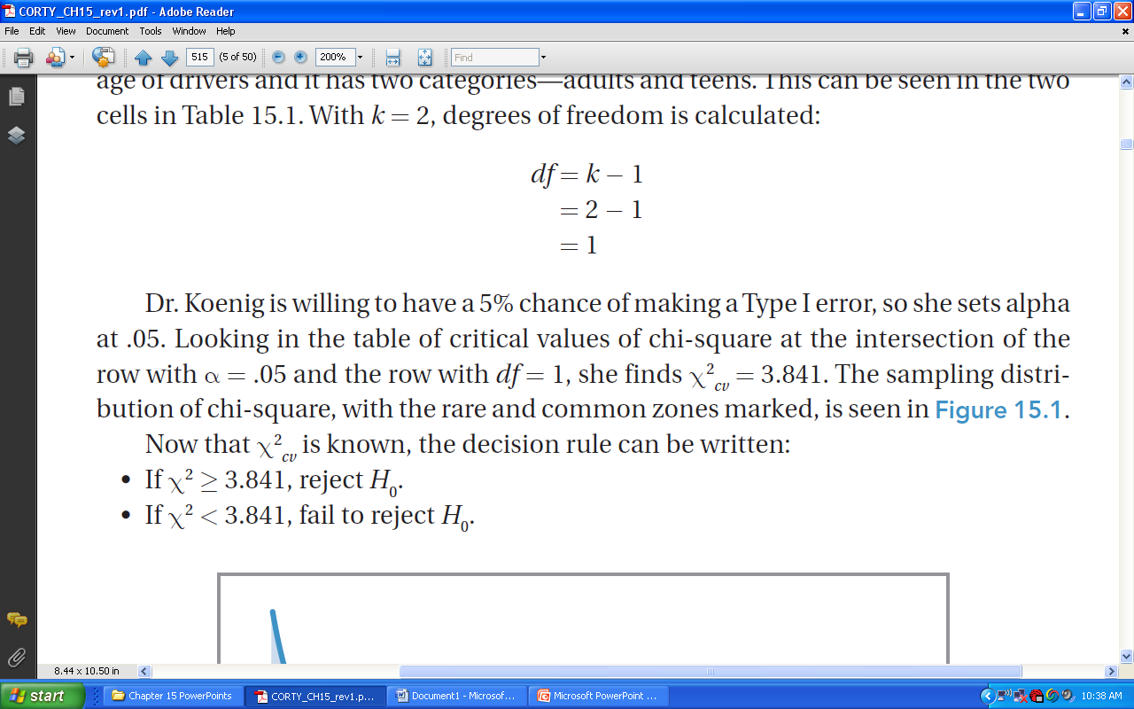

Traffic Tickets Example: Step 4 (continued)
Degrees of Freedom (df )
Traffic Tickets example
Use Appendix Table 9 to find χ²_{cv}
$$df=k−1 \\ where df=degrees of freedom \\ k=number of categories$$

Slide 14
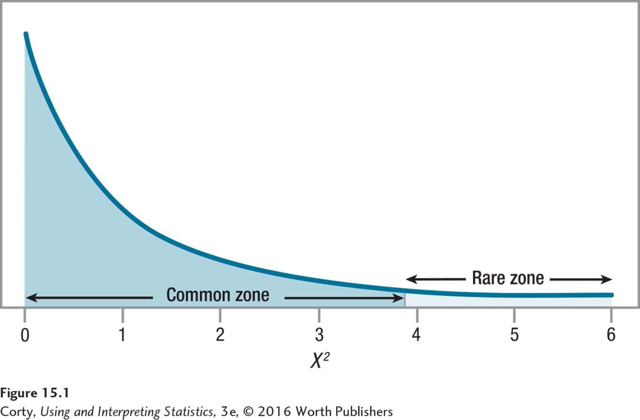
Traffic Tickets Example: Step 4 (continued)
STEP 4: Set the Decision Rule
α = .05, df = 1, χ²_{cv} = 3.841
If χ² ≥ 3.841, reject H₀
If χ² < 3.841, fail to reject H₀
df | Alpha Level
 | .10 | .05 | .01
1 | 2.706 | 3.841 | 10.828
2 | 4.605 | 5.991 | 13.816
3 | 6.251 | 7.815 | 16.266
4 | 7.779 | 9.488 | 18.467
5 | 9.236 | 11.070 | 20.515
6 | 10.645 | 12.592 | 22.458
7 | 12.017 | 14.067 | 24.322
Sampling Distribution of Chi-Square with 1 Degree of Freedom

Slide 15
Traffic Tickets Example: Step 5
STEP 5: Calculate the Test Statistic
Involves comparing the observed frequency (f_{Observed}) of each category of the dependent variable in the sample to the frequency that would be expected (f_{Expected}) if the H₀ were true
 | Teenagers | Adults
Observed Frequency | 11 | 61

Slide 16
Traffic Tickets Example: Step 5 (continued)
STEP 5: Calculate the Test Statistic
Calculate the expected frequency (Equation 15.2)
Observed Frequencies for the Ages of Ticketed Drivers (N = 72)
 | Teenagers | Adults
Observed Frequency | 11 | 61

Slide 17
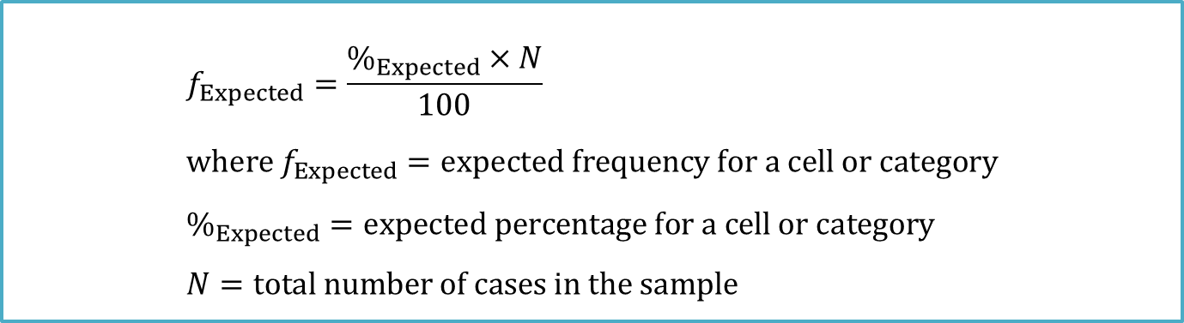
Traffic Tickets Example: Step 5 (continued)
Expected Frequencies (f_{Expected})
$$f_{Expected}=\frac{\%_{Expected}×N}{100} \\ where f_{Expected}=expected frequency for a cell or category \\ \%_{Expected}=expected percentage for a cell or category \\ N=total number of cases in the sample$$

Slide 18
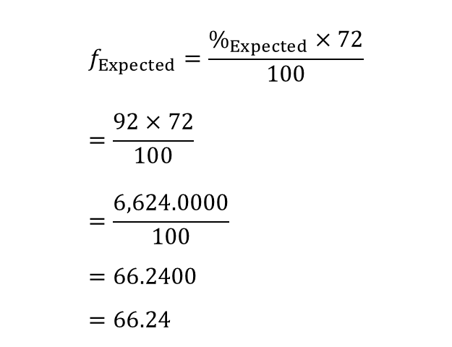

Traffic Tickets Example: Step 5 (continued)
STEP 5: Calculate the Test Statistic
Calculate the expected frequency (Equation 15.2)
Traffic tickets for teenagers %_{Expected} = 8%, N = 72
Traffic tickets for adults %_{Expected} = 92%, N = 72
$$f_{Expected}=\frac{\%_{Expected}×72}{100} \\ =\frac{8×72}{100} \\ =\frac{576.0000}{100} \\ =5.7600 \\ =5.76$$
$$f_{Expected}=\frac{\%_{Expected}×72}{100} \\ =\frac{92×72}{100} \\ =\frac{6,624.0000}{100} \\ =66.2400 \\ =66.24$$

Slide 19
Traffic Tickets Example: Step 5 (continued)
STEP 5: Calculate the Test Statistic Observed Frequencies and Expected Frequencies for the Ages of Ticketed Drivers
 | Teenagers | Adults
Observed Frequency | 11 | 61 | N = 72
Expected Frequency | 5.76 | 66.24 | Ʃ = 72.00

Slide 20

Traffic Tickets Example: Step 5 (continued)
STEP 5: Calculate the Test Statistic
Calculate Chi-Square (χ²) (Equation 15.3)
$$χ^{2}=Σ\frac{{\left(f_{Observed}−f_{Expected}\right)}^{2}}{f_{Expected}} \\ where χ^{2}=chi\text{−}square value \\ f_{Observed}=observed frequency for a cell or category \\ f_{Expected}=expected frequency for a cell or category$$

Slide 21
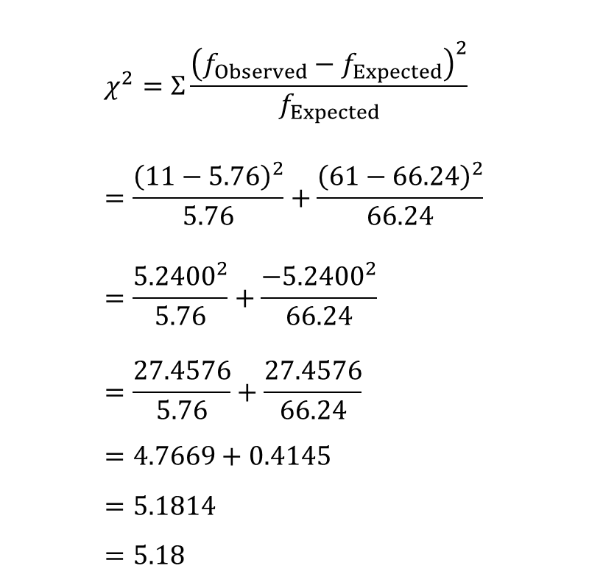
Traffic Tickets Example: Step 5 (continued)
$$χ^{2}=Σ\frac{{\left(f_{Observed}−f_{Expected}\right)}^{2}}{f_{Expected}} \\ =\frac{{\left(11−5.76\right)}^{2}}{5.76}+\frac{{\left(61−66.24\right)}^{2}}{66.24} \\ =\frac{{5.2400}^{2}}{5.76}+\frac{{−5.2400}^{2}}{66.24} \\ =\frac{27.4576}{5.76}+\frac{27.4576}{66.24} \\ =4.7669+0.4145 \\ =5.1814 \\ =5.18$$
STEP 5: Calculate the Test Statistic, χ² (Equation 15.3)
Four Steps
For each cell/category, subtract expected frequency from observed frequency
Square each difference
Divide each squared difference by respective expected frequency, yields quotient
Sum all the quotients to obtain the chi-square value

Slide 22
Traffic Tickets Example: Step 6
STEP 6: Interpret the Results
Need to answer two questions
Was the null hypothesis rejected?
If so, what is the direction of the results?
Recall:
If χ² ≥ 3.841, reject H₀
If χ² < 3.841, fail to reject H₀

Slide 23
Traffic Tickets Example: Step 6 (continued)
STEP 6: Interpret the Results
APA format, χ²(1, N = 72) = 5.18, p < .05
χ² reveals test statistic is a chi-square value.
The 1 in the parentheses is the degrees of freedom.
N = 72 gives the sample size.
5.18 is the value of the test statistic that was calculated (APA format requires value to be reported to two decimal places).
.05 indicates that alpha was set at .05; in other words, a 5% chance of making a Type 1 error.
p < .05 reveals that the null hypothesis was rejected. Value of the test statistic (5.18) is a rare result: the probability of its occurring is less than .05 when the null hypothesis is true.

Slide 24
Traffic Tickets Example: Step 6 (continued)
STEP 6: Interpret the Results
What is the direction of the results?
Compare what was observed to what was expected:
Teenagers account for 8% of the drivers, but they received 15.28% of the tickets.
Researcher can say that 15.28% is statistically higher than 8%.
Dr. Koenig concludes that teens in this town get statistically significantly more tickets than expected for the number of teens who are drivers.

Slide 25
Putting It All Together
A four-point interpretation
What was done?
What was found?
What does it mean?
What suggestions are there for future research?

Slide 26
Calculating the Chi-Square Test of Independence
Chi-Square Test of Independence
Nonparametric test used to determine whether two or more samples of cases differ on a categorical (nominal- or ordinal-level) dependent variable
Answers the question of whether two variables are related or independent
Functions like a relationship test
Example: Is there a relationship between sex and the presence of an eating disorder?
Functions like a difference test
Example: Do the sexes differ in the prevalence of eating disorders?
Also known as
Chi-square test of association
Chi-square test for contingency tables

Slide 27
Calculating the Chi-Square Test of Independence (continued)
Example: Dr. Pradesh’s Reading and Grades Study
Does reading a textbook before or after class have an impact on how well a student does in class?
Random sample of 50 students from introductory psychology classes
26 read the textbook chapters before class
24 read them after the lectures
Students’ grades classified as high (A or B) or low (C, D, or F)

Slide 28
Calculating the Chi-Square Test of Independence (continued)
Results of Example: Dr. Pradesh’s Reading and Grades Study Observed Frequencies for Read the Text Before Lecture vs. Read the Text After Lecture Study
 | High Grade | Low Grade
Read text before lecture | A 20 | B 6 | 26
Read text after lecture | C 12 | D 12 | 24
 | 32 | 18 | N = 50

Slide 29
Calculating the Chi-Square Test of Independence (continued)
Contingency Table
Table showing the degree to which a case’s value on the dependent variable depends on the category of the independent variable
Also called a cross-tabulation table
Indicates how the levels of one variable intersect with the levels of the other variable
This table illustrates the degree to which students’ grades are contingent on when they read the text

Slide 30
Calculating the Chi-Square Test of Independence (continued)
Results of Example: Dr. Pradesh’s Reading and Grades Study Observed Frequencies for Read the Text Before Lecture vs. Read the Text After Lecture Study
 | High Grade | Low Grade
Read text before lecture | A 20 | B 6 | 26
Read text after lecture | C 12 | D 12 | 24
 | 32 | 18 | N = 50

Slide 31
Hypothesis Testing in Action: Example
Example: Dr. Pradesh’s Reading Study
6 Steps of Hypothesis Testing
STEP 1: Pick a Test
STEP 2: Check the Assumptions
STEP 3: List the Hypotheses
STEP 4: Set the Decision Rule
STEP 5: Calculate the Test Statistic
STEP 6” Interpret the Results

Slide 32
Reading and Grades Example: Step 1
STEP 1: Pick a Test
Involves comparing 2 groups (read text before class vs. read text after class) to see if a difference exists for a variable used to categorize people as good performers vs. poor performers
Chi-square test of independence

Slide 33
Reading and Grades Example: Step 2
STEP 2: Check the Assumptions
The three assumptions for the chi-square test of independence are the same as for the chi-square goodness-of-fit test:
Random samples
Independence of observations
Expected frequencies
No assumptions are violated.

Slide 34
Reading and Grades Example: Step 3
STEP 3: List the Hypotheses
Null and alternative hypotheses are statements about populations, not samples
Expressed the same way as the Pearson r
Greek letter rho, ρ, will be used as the abbreviation
H₀: ρ = 0
H₁: ρ ≠ 0

Slide 35
Reading and Grades Example: Step 4
STEP 4: Set the Decision Rule
Critical value of chi-square (χ²_{cv})
χ²_{cv} used to determine whether null hypothesis is rejected or not
Use Appendix Table 9 to find χ²_{cv}
Two pieces of information are needed to find the χ²_{cv}
Willingness to make a Type I error, determined by alpha level
How many degrees of freedom the test has, based on categories

Slide 36

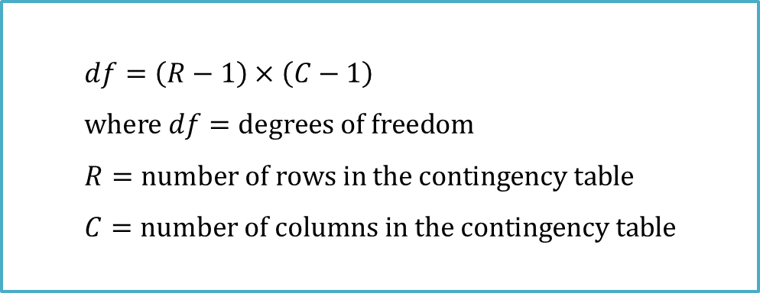
Reading and Grades Example: Step 4 (continued)
Degrees of Freedom (df )
Reading and Grades example
Use Appendix Table 9 to find χ²_{cv}
$$df=\left(R−1\right)×\left(C−1\right) \\ where df=degrees of freedom \\ R=number of rows in the contingency table \\ C=number of columns in the contingency table$$
$$df=\left(R−1\right)×\left(C−1\right) \\ =\left(2−1\right)×\left(2−1\right) \\ =1×1 \\ =1$$

Slide 37
Critical Values of Chi-Square
Critical Value of Chi-Square (See Appendix Table 10)
Critical value of χ² is found at the intersection of the row with the correct number of degrees of freedom and the column with the desired alpha level
Most commonly used alpha level is α = .05, values in bold
α = .05, df = 1
χ²_{cv} = 3.841

Slide 38

Reading and Grades Example: Step 5
STEP 5: Calculate the Test Statistic
Calculate Chi-Square (χ² )
$$χ^{2}=Σ\frac{{\left(f_{Observed}−f_{Expected}\right)}^{2}}{f_{Expected}} \\ where χ^{2}=chi\text{−}square value \\ f_{Observed}=observed frequency for a cell or category \\ f_{Expected}=expected frequency for a cell or category$$

Slide 39
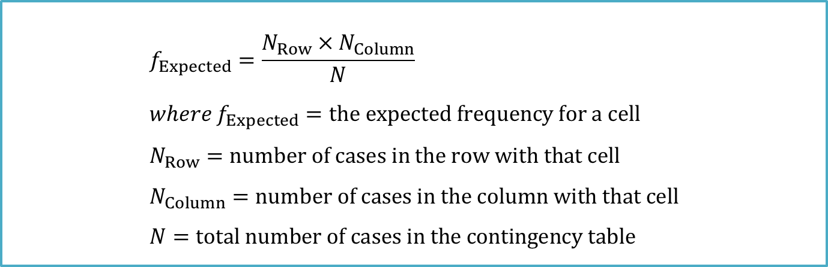
Reading and Grades Example: Step 5 (continued)
STEP 5: Calculate the Test Statistic
To apply chi-square formula, two values are needed for each cell:
Observed frequency (f_{Observed})
Expected frequency (f_{Expected})
$$f_{Expected}=\frac{N_{Row}×N_{Column}}{N} \\ where f_{Expected}=the expected frequency for a cell \\ N_{Row}=number of cases in the row with that cell \\ N_{Column}=number of cases in the column with that cell \\ N=total number of cases in the contingency table$$

Slide 40


Reading and Grades Example: Step 5 (continued)
 | High Grade | Low Grade
Read text before lecture | A 20 | B 6 | 26
Read text after lecture | C 12 | D 12 | 24
 | 32 | 18 | N = 50
$$=\frac{N_{Row1}×N_{Column1}}{N} \\ =\frac{26×32}{50} \\ =\frac{832}{50} \\ =16.64$$
$$=\frac{N_{Row1}×N_{Column2}}{N} \\ =\frac{26×18}{50} \\ =\frac{468}{50} \\ =9.36$$
f_{ExpectedA}
f_{ExpectedB}

Slide 41


Reading and Grades Example: Step 5 (continued)
 | High Grade | Low Grade
Read text before lecture | A 20 | B 6 | 26
Read text after lecture | C 12 | D 12 | 24
 | 32 | 18 | N = 50
$$=\frac{N_{Row2}×N_{Column1}}{N} \\ =\frac{24×32}{50} \\ =\frac{768}{50} \\ =15.36$$
$$=\frac{N_{Row2}×N_{Column2}}{N} \\ =\frac{24×18}{50} \\ =\frac{432}{50} \\ =8.64$$
f_{ExpectedC}
f_{ExpectedD}

Slide 42
Reading and Grades Example: Step 5
Expected Frequencies for the Read Text Before Lecture vs. Read Text After Lecture Study
 | High Grade | Low Grade
Read text before lecture | A 16.64 | B 9.36 | 26
Read text after lecture | C 15.36 | D 8.64 | 24
 | 32 | 18 | N = 50
Equation 15.16 is used to calculate the expected frequencies for a contingency table.
Note that the row frequencies and column frequencies found in this table are the same as those in Table 15.7, the contingency table showing observed frequencies for these data.

Slide 43
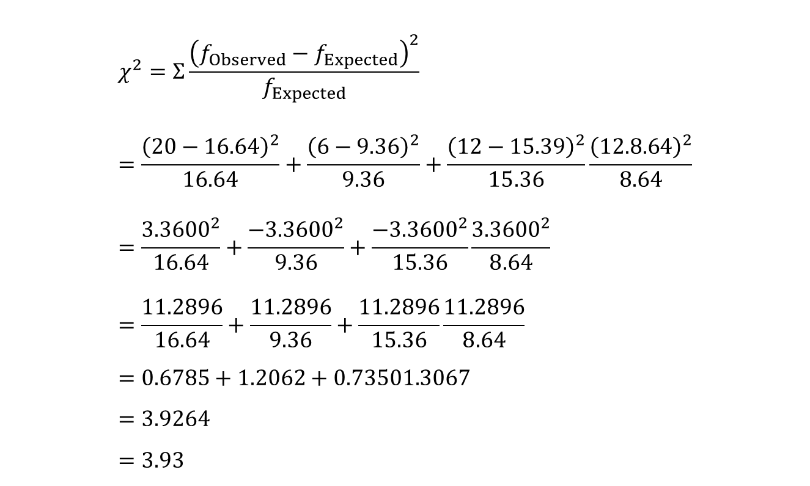
Reading and Grades Example: Step 5
$$χ^{2}=Σ\frac{{\left(f_{Observed}−f_{Expected}\right)}^{2}}{f_{Expected}} \\ =\frac{{\left(20−16.64\right)}^{2}}{16.64}+\frac{{\left(6−9.36\right)}^{2}}{9.36}+\frac{{\left(12−15.39\right)}^{2}}{15.36}\frac{{\left(12.8.64\right)}^{2}}{8.64} \\ =\frac{{3.3600}^{2}}{16.64}+\frac{{−3.3600}^{2}}{9.36}+\frac{{−3.3600}^{2}}{15.36}\frac{{3.3600}^{2}}{8.64} \\ =\frac{11.2896}{16.64}+\frac{11.2896}{9.36}+\frac{11.2896}{15.36}\frac{11.2896}{8.64} \\ =0.6785+1.2062+0.73501.3067 \\ =3.9264 \\ =3.93$$
STEP 5: Calculate the Test Statistic
Calculate Chi-Square χ² (Equation 15.3)

Slide 44
Reading and Grades Example: Step 6
STEP 6: Interpret the Results of Chi-Square Test of Independence
Need to answer 3 questions
Was the null hypothesis rejected?
If so, what is the direction of the difference?
How big is the effect?

Slide 45
Reading and Grades Example: Step 6
STEP 6: Interpret the Results
Was the null hypothesis rejected?
α =.05, df = 1, χ²_{cv} = 3.841 calculated χ²= 3.93
Decision rule 3.93 ≥ 3.841; null hypothesis is rejected
Results can be phrased two ways:
There is a relationship between when a student reads the text and what grade he or she receives in the class.
Among those students who get high grades, a statistically significant difference exists between the students who read the text before class vs. those who read the text after class.

Slide 46
Reading and Grades Example: Step 6
STEP 6: Interpret the Results
What is the direction of the difference?
Twenty of the 26 students in the read-before-class group (76.92%) received high grades compared to 12 of the 24 students (50.00%) of the read-after-class group.
For the larger population of introductory psychology students at this university, completing the textbook readings before class leads to a better grade outcome than completing the reading after class.

Slide 47
Reading and Grades Example: Step 6
STEP 6: Interpret the Results
APA format, χ²(1, N = 50) = 3.93, p < .05
χ² reveals that test statistic was a chi-square.
1, in parentheses, is the degrees of freedom.
N = 50 tells how many cases there were.
3.93 is the value of the test statistic that was calculated.
.05 indicates that alpha was set at .05, in other words, a 5% chance of making a Type 1 error.
p < .05 means that the null hypothesis was rejected.

Slide 48
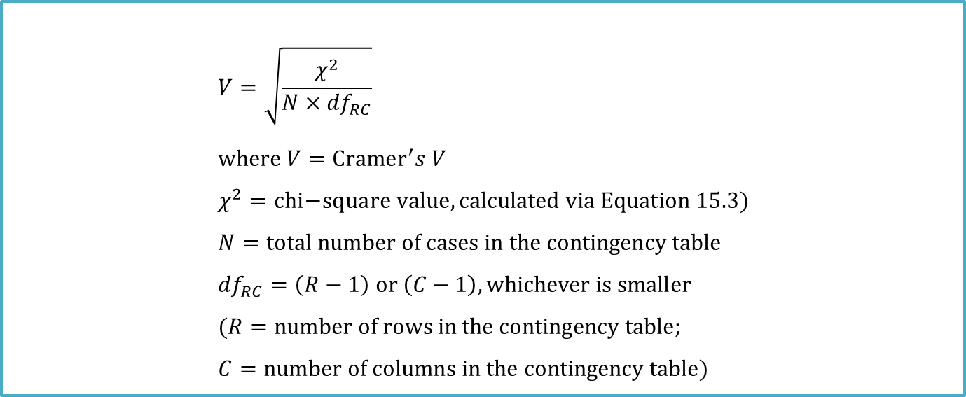
Reading and Grades Example: Step 6
STEP 6: Interpret the Results
How big is the effect?
Transform χ² value into Cramer’s V
$$V=\sqrt{\frac{χ^{2}}{N×{df}_{RC}}} \\ where V=Cramer^{′}s V \\ χ^{2}=chi\text{−}square value, calculated via Equation 15.3) \\ N=total number of cases in the contingency table \\ {df}_{RC}=\left(R−1\right) or \left(C−1\right), whichever is smaller \\ (R=number of rows in the contingency table; \\ C=number of columns in the contingency table)$$

Slide 49

Reading and Grades Example: Step 6
$$V=\sqrt{\frac{χ^{2}}{N×{df}_{RC}}} \\ =\sqrt{\frac{3.93}{50×1}} \\ =\sqrt{\frac{3.93}{50}} \\ =\sqrt{0.0786} \\ =.2804 \\ =.28$$
STEP 6: Interpret the Results
Apply formula for Cramer’s V
χ²= 3.93, N = 50 df_{RC} = 1

Slide 50
Guidelines for Interpreting Cramer’s V
 | Small Effect Size | Medium Effect Size | Large Effect Size
df_{RC}=1 | .10 | .30 | .50
df_{RC}=2 | .07 | .21 | .35
df_{RC}=3 | .06 | .17 | .29
df_{RC}=4 | .05 | .15 | .25
df_{RC}=5 | .05 | .13 | .22
These effect sizes are from Cohen (1988). Note that when df_{RC} = 1, the effect size for Cramer’s V is the same as it is for a Pearson r. As degrees of freedom increase, a smaller V is interpreted as a larger effect.

Slide 51
Putting It All Together: Reading and Grades Example
Four points addressed in Dr. Pradesh’s interpretation
Briefly tells what the study was about
States the results
Explains the meaning of the results
Makes suggestions for future research

Slide 52
Other Nonparametric Tests
Spearman Rank-Order Correlation Coefficient
Nonparametric version of the Pearson correlation coefficient
Examines the relationship between
Two ordinal-level variables
One ordinal-level variable and one interval-/ratio-level variable
As a fallback option with two interval-/ratio-level variables when assumptions for Pearson r have been violated
Abbreviated Spearman r or r_{s}
Can directly apply the hypothesis-testing steps about hypotheses, decision rules, calculation, and interpretation from the Pearson r to the Spearman r

Slide 53
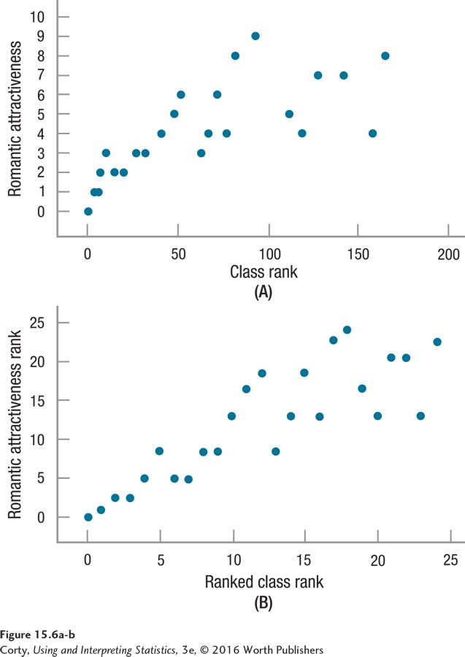
Other Nonparametric Tests
Spearman Rank-Order Correlation Coefficient
Both scatterplots show the relationship between a student’s class rank and his or her desirability as a romantic partner.
In the top graph (A), the naturally occurring range is used for each variable.
In the bottom graph (B), the variables have been converted to ranks.

Slide 54
Other Nonparametric Tests
Mann–Whitney U Test
Nonparametric test used to compare two independent samples on an ordinal-level dependent variable that utilizes ranking
Nonparametric equivalent of the independent-samples t test
Fallback test when nonrobust assumptions have been violated
How Mann–Whitney U Test works
Combines two samples into one group
Assigns ranks to the whole group
Puts the cases back into their original samples
Compares the ranks

Slide 55
Other Nonparametric Tests: Mann–Whitney U Test
Men | Women
163 | 129
156 | 128
155 | 126
155 | 126
153 | 125
Speed | Sex | Rank
163 | Male | 1
156 | Male | 2
155 | Male | 3.5
155 | Male | 3.5
153 | Male | 5
129 | Female | 6
128 | Female | 7
126 | Female | 8.5
126 | Female | 8.5
125 | Female | 10
These are the speeds, in miles per hour, of the five fastest tennis serves by men and the five fastest tennis serves by women.
The data from the two samples in Table 15.13 are combined here in order. It is clear that the five men have faster serves than the five women. And the sum of the ranks for the two sexes, 15 vs. 40, reflects this.

Slide 56
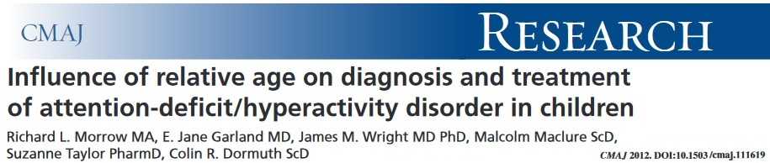
Example 1
Attention-deficit/hyperactivity disorder (ADHD) is the most commonly diagnosed neuro-behavioral disorder in children.
Several studies have investigated the potential association between season of birth and incidence of ADHD, since season of birth has been studied for a number of mental and behavioral disorders, including schizophrenia, for which an association is well-established. However, among studies hypothesizing a causal relation between season of birth and ADHD, a consistent seasonal pattern has not been found.
The annual cut-off date of birth for entry to school in British Columbia, Canada, is Dec. 31. Thus, children born in December are typically the youngest in their grade. The authors conduct a cohort study to determine the influence of relative age within a grade on the diagnosis ADHD in children.
Question: Are children born late in the year (younger than their peers) more likely to be diagnosed with ADHD?

Slide 57
Example 1
A total of 937,943 children were included in their study. There were 32,968 boys were diagnosed with ADHD. They placed all boys in categories based on their month of birth, then calculated the proportion of births based on three-month intervals (Jan-Mar, Apr-Jun, Jul-Sep, Oct-Dec). They also obtained numbers of boys who were diagnosed with ADHD for each interval.
The data is provided in the following table.
Birth Date | Proportion of Births | ADHD Diagnoses
Jan-Mar | 0.244 | 6880
Apr-Jun | 0.258 | 7982
Jul-Sep | 0.257 | 9161
Oct-Dec | 0.241 | 8945
Total |  | 32968
Thus, we can write the hypotheses as:
H₀: p_{J-M} = 0.244, p_{A-J} = 0.258, p_{J-S} = 0.257,
p_{O-D} = 0.241,
H_{a}: At least one of the proportions is
different than claimed
where p_{a-b} = the true population proportion of boys diagnosed with ADHD on that three-month’s interval.

Slide 58
Example 1
Assuming that the distribution of boys diagnosed with ADHD based on overall proportion of birth is true, we can calculate the expected counts for all three-month intervals.
Birth Date | Proportion of Births | ADHD Diagnoses | Expected Counts
Jan-Mar | 0.244 | 6880 | 8044.2
Apr-Jun | 0.258 | 7982 | 8505.7
Jul-Sep | 0.257 | 9161 | 8472.8
Oct-Dec | 0.241 | 8945 | 7945.3
Total |  | 32968 | 32968
Jan-Mar: (32968)(0.244) = 8044.2
Apr-Jun: (32968)(0.258) = 8505.7
Jul-Sep: (32968)(0.257) = 8472.8
Oct-Dec: (32968)(0.241) = 7945.3

Slide 59

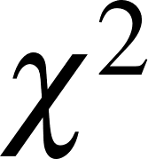
Example 1
To calculate the chi-square statistics,
This statistics will follow a chi-square distribution with df = 4 ̶ 1 = 3 when H₀ is true. Using software, we calculated the P-value is <0.001.
Thus, we reject the null hypothesis (approximately equal likely to be diagnosed with ADHD in either three-month interval). Based on the observed data, we have very strong evidence that boys who are born later in the year, and so are younger than their classmates, are more likely to be diagnosed with ADHD.

Slide 60

Example 2
Increased research attention is being paid to the negative impact of anger on coronary heart disease (CHD).
This study examined prospectively the association between trait anger and the risk of combined CHD (acute myocardial infarction [MI]/fatal CHD, silent MI, or cardiac revascularization procedures). Participants were 12,986 black and white men and women enrolled in the Atherosclerosis Risk In Communities study. Assessment of trait anger was evaluated by the 10-item Spielberger Trait Anger Scale. The overall anger score (a numeric score of 10 to 40) was coded as a 3-level categoric variable in which scores of 22 to 40 defined high trait anger, 15 to 21 moderate anger, and 10 to 14 low anger.
Question : Whether there was a dose-response relation between level of anger
and CHD risk?

Slide 61
Example 2
Spielberger Trait Anger Scores
 | Low, 10-14 | Moderate, 15-21 | High, 22-40
Participants, n (%) | 4821 (37.1) | 7165 (55.2) | 1000 (7.7)
CHD events combined
Yes, n (%) | 142 (2.9) | 226 (3.2) | 48 (4.8)
No, n (%) | 4679 (97.1) | 6939 (96.8) | 952 (95.2)
Is this Two-Way Table to address “relationship” or “difference”?
Answer: test for “Relationship”.

Slide 62
Example 2
We write the appropriate hypothesis:
H₀: There is no association between trait anger level and risk of CHD events.
H_{a}: There is an association between trait anger level and risk of CHD events.
Statistics for Table of chd by anger
Statistic DF Value Prob
ƒƒƒƒƒƒƒƒƒƒƒƒƒƒƒƒƒƒƒƒƒƒƒƒƒƒƒƒƒƒƒƒƒƒƒƒƒƒƒƒƒƒƒƒƒƒƒƒƒƒƒƒƒƒ
Chi-Square 2 9.3112 0.0095
Likelihood Ratio Chi-Square 2 8.2742 0.0160
Mantel-Haenszel Chi-Square 1 2.3391 0.1262
Phi Coefficient 0.0268
Contingency Coefficient 0.0268
Cramer's V 0.0268
After checking for chi-square test conditions, all are met. Thus we conducted chi-square test, calculated = 9.3112, with df = 2, and P-value = 0.0095 (based on output).
Because the P-value is less than α = 0.05, we reject H₀ and conclude that trait anger level and risk of CHD events are associated. Further look at the descriptive statistics, we can conclude that in the entire cohort, high trait anger was associated with an increased risk of combined CHD events.

Slide 63

Example 3
In Europe, lung cancer remains the first cause of cancer-related death in man and the fourth most common among women. Approximately 85% of lung cancer are non-small-cell lung cancer (NSCLCs). In phase III trials, combinations of Cisplatin and other new active agents might produce superior therapeutic results.
The European Organization for Research and Treatment of Cancer (EORTC) Lung Cancer Group conducted a randomized, phase III study to compare the best arms, i.e., Cisplatin plus Paclitaxel (Arm A), with Cisplatin plus Gemcitabine (Arm B) and Paclitaxel plus Gemcitabine (Arm C) in chemotherapy-naïve patients with advanced NSCLC.
One of the end point is response rate (the proportion of patients with tumor size reduction of a predefined amount and for a minimum time period).
Question : To compare the therapeutic efficacy of three arms on response rate in chemotherapy-naïve patients with advanced NSCLC.

Slide 64
Example 3
Treatment Arms
 | Arm A (n = 151) | Arm B (n = 152) | Arm C (n = 155)
Responses (CR + PR)
Yes, n (%) | 48 (31.8) | 56 (36.8) | 43 (27.7)
No, n (%) | 103 (68.2) | 96 (63.2) | 112 (72.3)
Is this Two-Way Table to address “Relationship” or “Difference”?
Answer: test for “Difference”.

Slide 65
Example 3
We write the appropriate hypothesis:
H₀: There is no difference in the distribution of response rate among three arms.
H_{a}: There is a difference in the distribution of response rate among three arms.
Statistics for Table of chd by anger
Statistic DF Value Prob
ƒƒƒƒƒƒƒƒƒƒƒƒƒƒƒƒƒƒƒƒƒƒƒƒƒƒƒƒƒƒƒƒƒƒƒƒƒƒƒƒƒƒƒƒƒƒƒƒƒƒƒƒƒƒ
Chi-Square 2 2.9258 0.2316
Likelihood Ratio Chi-Square 2 2.9245 0.2317
Mantel-Haenszel Chi-Square 1 0.5909 0.4421
Phi Coefficient 0.0799
Contingency Coefficient 0.0797
Cramer's V 0.0799
After checking for chi-square test conditions, all are met. Thus we conducted chi-square test, calculated = 2.9258, with df = 2, and P-value = 0.2316 (based on output).
Because the P-value is larger than α = 0.05, we fail to reject H₀ and conclude that neither Cisplatin plus Gemcitabine nor Paclitaxel plus Gemcitabine chemotherapy is superior to the Cisplatin plus Paclitaxel combination for patients with advanced NSCLC in regard to response rate.

