Slide 1



MemSR: Training Memory-efficient Lightweight Model for Image Super-Resolution
Kailu Wu, Chung-Kuei Lee, and Kaisheng Ma
International Conference on Machine Learning (ICML)
Spotlight Presentation
27 June 2022
Notes:
Hello everyone, I’m Wukailu, today I’ll introduce our recent work “MemSR: Training Memory-efficient Lightweight Model for Image Super-Resolution”

Slide 2
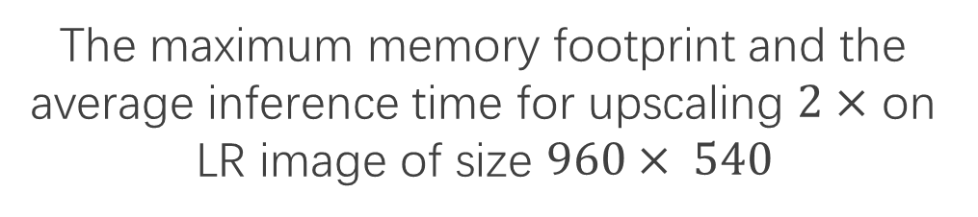
Memory Problem
20ms
100ms
500ms
The maximum memory footprint and the average inference time for upscaling $2×$ on LR image of size $960× 540$
Notes:
With the rapid growth of smart phone camera resolution,

Slide 3

Memory Problem
Typical resolution on smart phone camera: $96MP$
20ms
100ms
500ms
The maximum memory footprint and the average inference time for upscaling $2×$ on LR image of size $960× 540$
Notes:
With the rapid growth of smart phone camera resolution,

Slide 4
Memory Problem
Typical resolution on smart phone camera: $96MP$
The memory limitation for super-resolution algorithms becomes non-negligible on edge devices.
20ms
100ms
500ms
The maximum memory footprint and the average inference time for upscaling $2×$ on LR image of size $960× 540$
Notes:
With the rapid growth of smart phone camera resolution, the memory limitation for super-resolution algorithms becomes non-negligible on edge devices.

Slide 5
Solution?
Plain model?
Notes:
The VGG-like plain model without any branches is the most memory-efficient one.

Slide 6
Solution?
Plain model?
How to train a strong plain model in super-resolution?
Notes:
The VGG-like plain model without any branches is the most memory-efficient one. However, how to train a plain model with high performance in SR becomes a problem.

Slide 7
Solution?
Plain model?
How to train a strong plain model in super-resolution?
Direct Training 25.30dB
Knowledge Distillation 25.67dB (+0.37dB)
RepVGG 24.52dB (-0.78dB)
RepVGG-bn-free 25.35dB (+0.05dB)
Notes:
The performance of the student models obtained from the common methods is not satisfactory.

Slide 8
Solution?
Plain model?
How to train a strong plain model in super-resolution?
Direct Training 25.30dB
Knowledge Distillation 25.67dB (+0.37dB)
RepVGG 24.52dB (-0.78dB)
RepVGG-bn-free 25.35dB (+0.05dB)
Our Initialization + Direct Training 25.97dB (+0.67dB)
+ Knowledge Distillation 25.99dB (+0.69dB)
Notes:
In this regard, we propose a novel algorithm to train a plain model with low memory requirement and comparable accuracy and speed with SOTA's lightweight SR model.

Slide 9
Solution
CONV
ACT
CONV
ACT
CONV
ACT
CONV
ACT
Transform a trained multi-branch teacher model into an equivalent large-size plain model.
Notes:
Our algorithm first transforms a trained multi-branch teacher model into an equivalent large-size plain model,

Slide 10
Solution
CONV
ACT
CONV
ACT
CONV
ACT
CONV
ACT
CONV
ACT
CONV
ACT
Use large-size plain model to compute an initialization of the small-size plain model.
Notes:
Our algorithm first transforms a trained multi-branch teacher model into an equivalent large-size plain model, and then uses this large-size plain model to compute an initialization of the small-size plain model. Using this initialization, the student model only needs to be trained directly to have excellent performance.

Slide 11
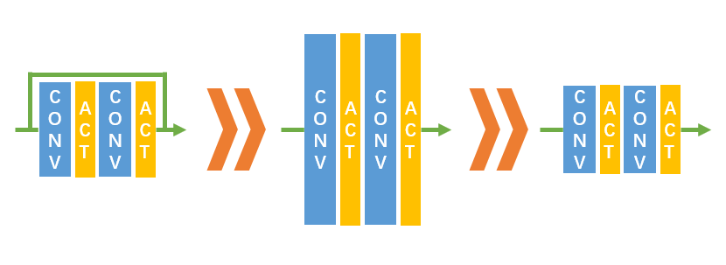
Stage1
Conv
Conv
Conv
Conv
Step1
+C
Id.
Id.
-C
+C
Id.
Id.
-C
Conv
Conv
1x1
Conv
Conv
1x1
Step2
Conv
Conv
1x1
Conv
Conv
1x1
Step3
Conv
Conv
Conv
Conv
1x1
ReLU
Element-wise addition
Conv
Convolution
Id.
Identity Convolution
Transforms a trained multi-branch teacher model into an equivalent large-size plain model.
Notes:
In the first stage we make all values on the skip-connection positive by adding a large constant C, thus it can merge with the convolution kernel in the parallel branch.

Slide 12

Stage2
Conv
Conv
T
$$≈$$
M
*
S
T
T
T
M
M
M
S
S
S
Student
Conv
Conv
M
Convolution
T
Sampled Teacher Feature Map
ReLU
Take Sample
Conv
Convolution
S
Pseudo Student
Feature Map
Decompose
Close to
Use large-size plain model to compute an initialization of the small-size plain model.
Notes:
In the second stage, we create Pseudo Student Feature Map by decomposing Sampled Teacher Feature Map. The Pseudo Student Feature Map is the ideal Student Feature Map after initialization. We can compute the student kernel by corresponding teacher kernel and neighboring mapping M.

Slide 13
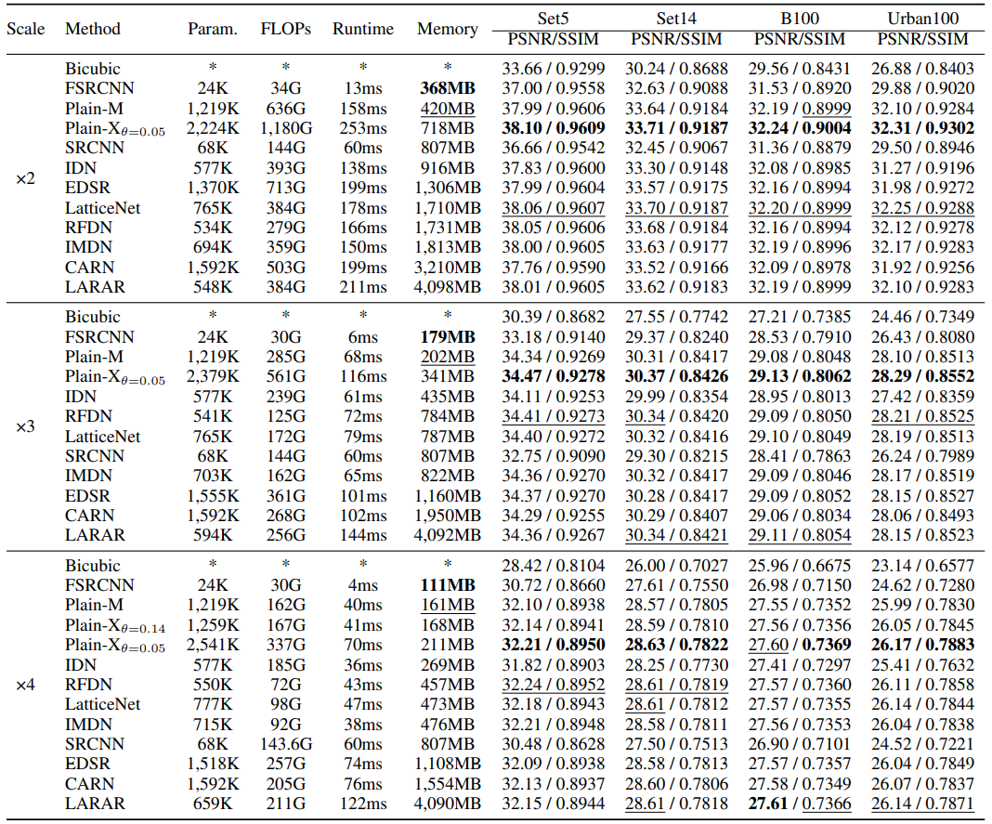
Results
Performance on standard benchmarks.
Notes:
We show with experiments that the plain network trained with MemSR requires less than half the memory footprint while having comparable performance and inference speed compared to the state-of-arts in lightweight models.

Slide 14
Results
Performance on standard benchmarks.
Notes:
We show with experiments that the plain network trained with MemSR requires less than half the memory footprint while having comparable performance and inference speed compared to the state-of-arts in lightweight models.

Slide 15
Results
Performance on standard benchmarks.
Notes:
We show with experiments that the plain network trained with MemSR requires less than half the memory footprint while having comparable performance and inference speed compared to the state-of-arts in lightweight models.

Slide 16
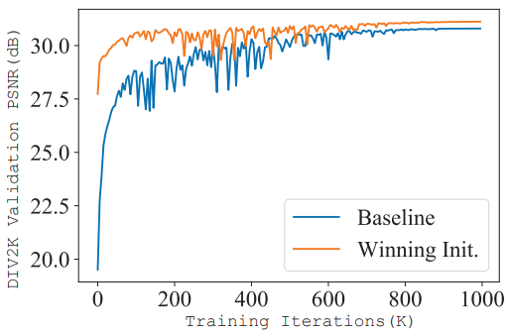
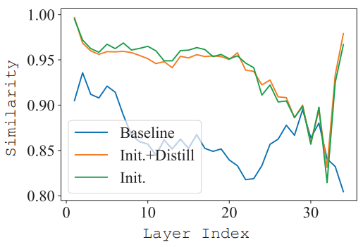
Results
Training Curve
Similarity
converges faster and achieves higher accuracy
knowledge is successfully transferred to the student
Notes:
The training curve of direct training shows that the plain model converges faster and achieves higher accuracy with the computed initialization.
The similarity index shows that the knowledge is successfully transferred to the student from the teacher by the initialization.

Slide 17
Thank you!
Notes:
Thank you for listening!

