Slide 1






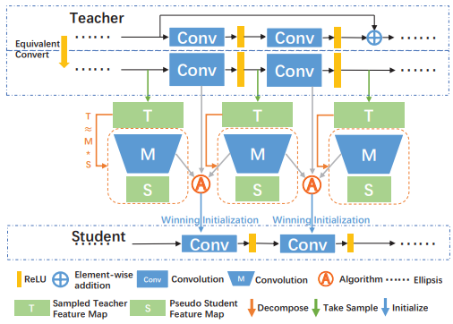

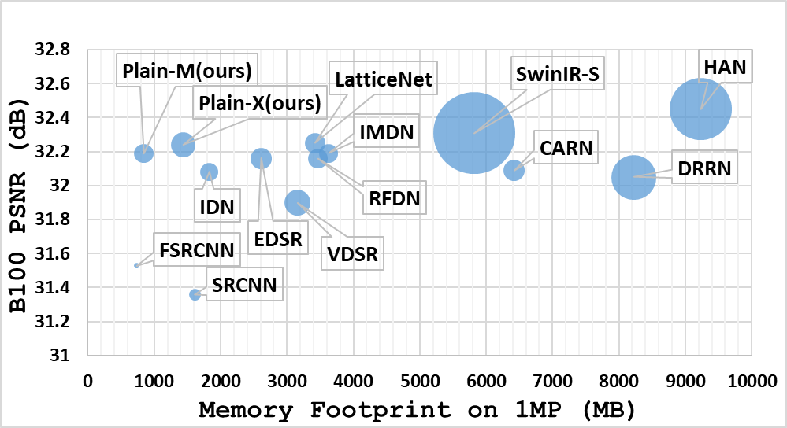
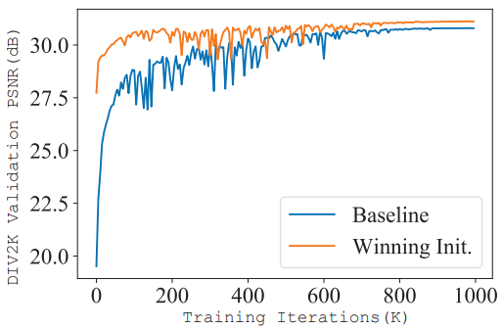
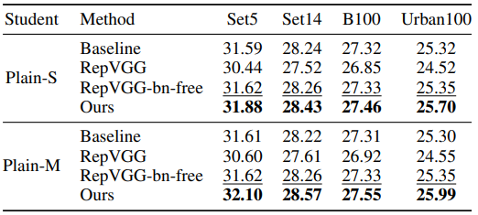
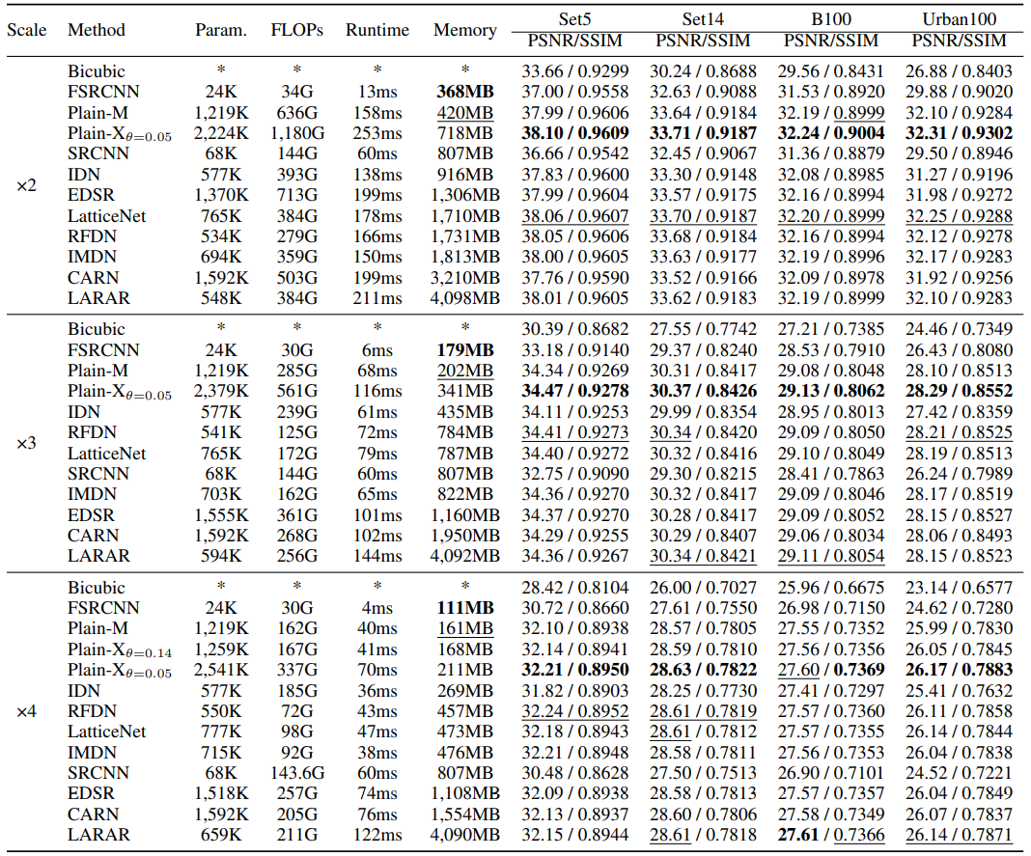
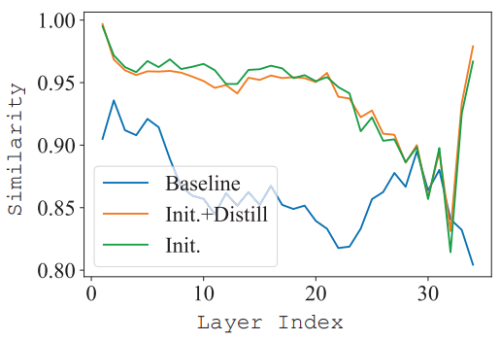
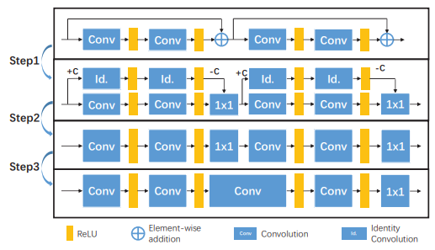
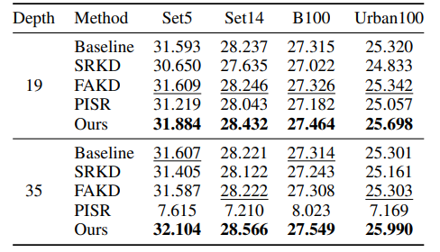
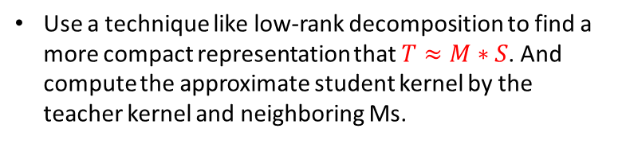
MemSR: Training Memory-efficient Lightweight Model for
Image Super-Resolution
Kailu Wu, Chung-Kuei Lee, Kaisheng Ma
Archip Lab, IIIS, Tsinghua University
Background: Memory Limitation in Super-Resolution
Method: Calculate Winning Initialization From the Teacher
13MP
20MP
48MP
64MP
Create Pseudo Student Feature and Derive the Student’s Kernel
Use a technique like low-rank decomposition to find a more compact representation that $T≈M∗S$. And compute the approximate student kernel by the teacher kernel and neighboring Ms.
Is there a neural network that can run 2x super-resolution on a 16MP image without OOM?
Current lightweight super-resolution methods have high accuracy and fast inference speed but a large memory footprint.
These memory footprints mostly come from skip connections.
Methods without skip connections like FSRCNN and SRCNN have poor performance.
Using this initialization, the results of direct training are substantially improved.
Experiments Results: Accuracy, Speed, and Memory Footprint
Method: Remove Skip-Connections
Step1: Convert the skip connection into 1×1 convolutions by adding a large constant C.
Step2: Merge the convolutions with different kernel sizes.
Step3: Merge neighboring 1×1 convolution and following convolution.
Now, we get an equivalent plain model.
RepVGG failed.
Layer similarity calculated by CKA
Our methods successfully transfer the knowledge from the plain teacher to the plain student through winning initialization.
And achieve comparable accuracy and speed with a much lower memory footprint.
But the memory footprint is still the same as before.
KD performs poorly.

