Slide 1
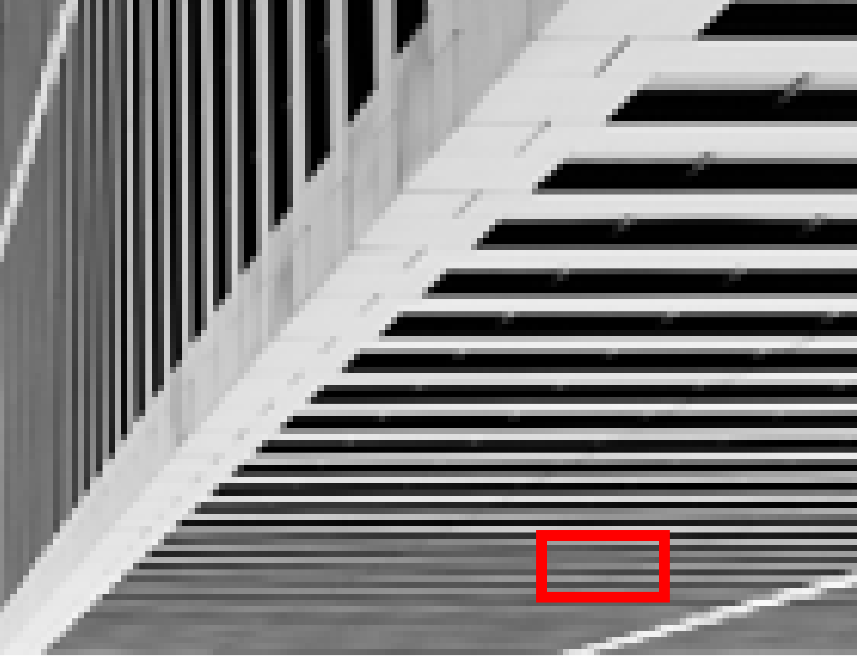










Ground Truth
Bicubic
FSRCNN
SRCNN
VDSR
Urban100:img011x4
CARN
EDSR
IMDN
Plain-M(ours)
Plain-X(ours)

